Slide 1
CPE201 Digital Design
By Benjamin Haas
Class 4: Floats, Text, Errors

Slide 2
Clarification
Thursday Lab
Makeups
Drop-in

Slide 3
Floating Point
For numbers that are not whole
230,879,521 = 2.30879521 x 10⁹ in decimal
Sign = positive, Exponent = 9, mantissa = 2.30879521
-152.49536 = -1.5249536 x 10² in decimal
.00034789 = 3.4789 x 10⁻⁴ in decimal

Slide 4
Floating Point
Sign, exponent, mantissa
1 bit, 8 bits , 23 bits = 32 bits (4 bytes)
Sign (0 = positive, 1 = negative)
Exponent (subtract 127)
Makes the range -126 to +128
Mantissa always starts with non-zero number (1) so leave it out (subtract the first 1 bit)

Slide 5
Example
Number = (-1)^{S}(1+F)(2^{E-127})
Convert 56,231 to floating point
56,231 = 1101 1011 1010 0111₂
S = positive = 0
F = 1.101 1011 1010 0111 x 2¹⁵
1+F (E-127)
E - 127 = 15 → E = 15 + 127 = 142 = 1000 1110
Number = 0 1000 1110 101 1011 1010 0111 0000 0000
Rearrange: 0100 0111 0101 1011 1010 0111 0000 0000
Convert: 0x 4 7 5 B A 7 0 0
In hex: 0x47 5B A7 00

Slide 6
Floating Point
Pros:
Ability to represent non-while numbers
Large range of values
Cons:
Math is a pain (and slow without an FPU)
Precision can be lost

Slide 7
ASCII
7 bit code for characters and symbols
Usually represent w/8bits and MSB=0
For ‘simple’ data transfer

Slide 8
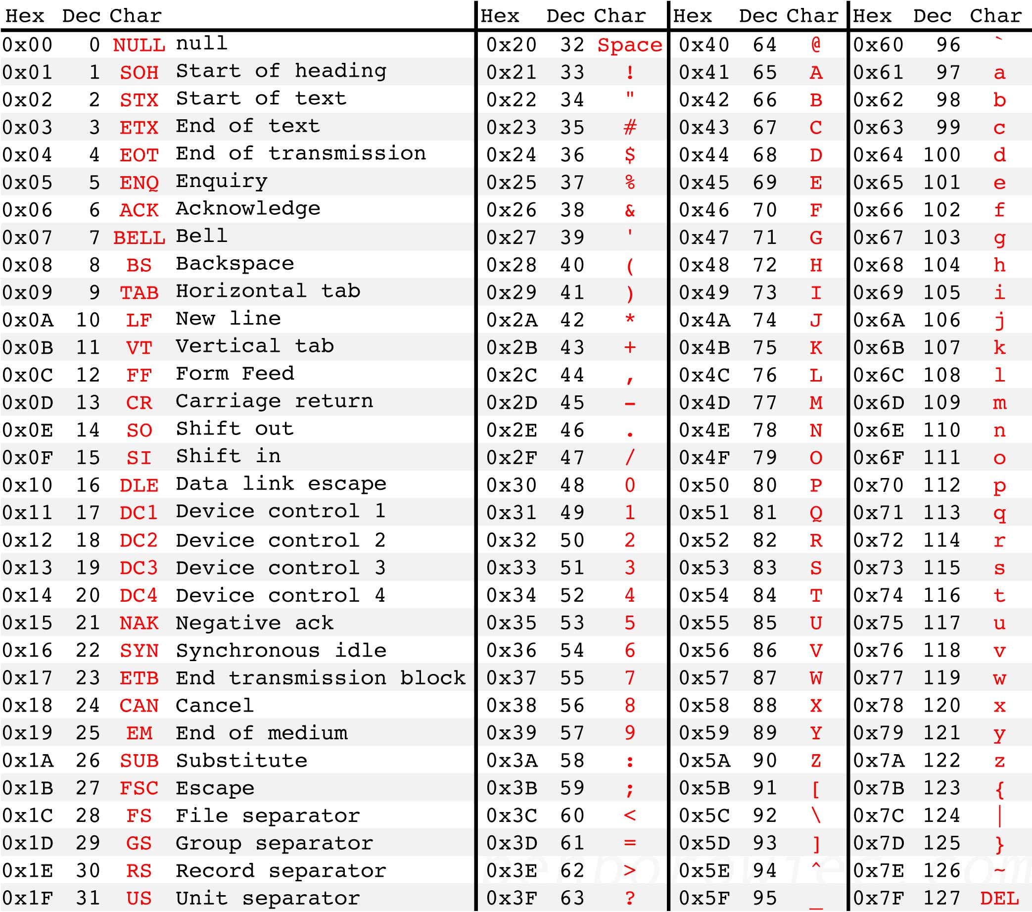

Slide 9
Unicode
Able to represent 2³² characters (4 Gchars)
144,697 chars used in Unicode 14.0
Typically encoded in UTF-8
Sends 1 to 4 bytes per character

Slide 10
Errors
Verify that what you sent is what is received
Creates data overhead
Ensures data integrity
Errors can happen over any transmission

Slide 11
Checksums
Simple way to detect if there is an error
Usually add a byte to make the message total equal zero

Slide 12
Example
ASCII Encoded string “Hi There!”
0x48 0x69 0x20 0x54 0x68 0x65 0x72 0x65 0x21
Add these together to get 0x2EA (truncated to 0xEA)
Number to add to 0xEA to get 0x00 is 0x16)
Or take 2’s complement of 0xEA (also get 0x16)
Send original 9 bytes with 0x16 at the end
Add together all 10 bytes, if you don’t get 0x00, there is an error in the message (usually throw it away and retry)

Slide 13
CRCs
Like a checksum, but more complicated
Better able to identify errors because the order of the data matters
More computationally intensive
More CRC bytes = better error detection capability at the cost of more transmission overhead

Slide 14
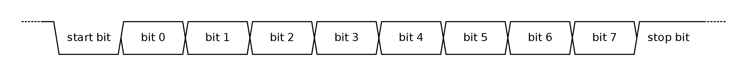
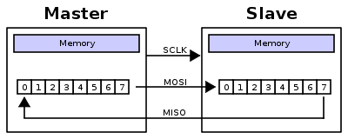
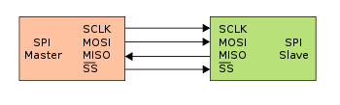
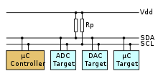
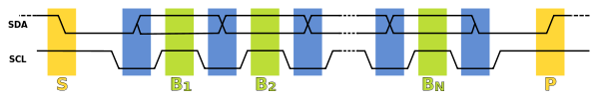
Transmission
UART (USART)
SPI
I2C

Slide 15
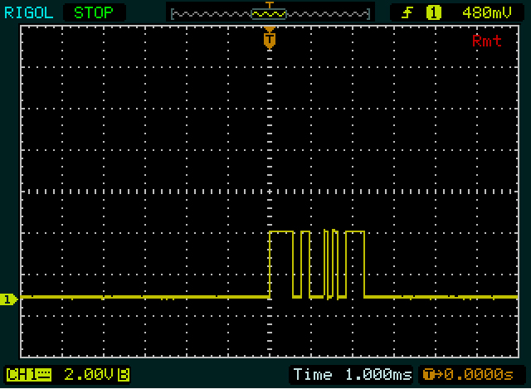
Example

Slide 16
Explanation
It is active low UART (3.3V transmission)
2 bytes transmitted
Values “1010011110” and “1111100110”
Removing START and STOP bits leaves
“01001111” and “11110011”
Reversing the bits (UART send LSB first)
“11110010” and “11001111”
Convert to hex 0xF2 and 0xCF
Reversing byte order to make reading left to right (first byte of meesage sent first) makes the message 0xCF 0xF2
ASCII encoding, message reads as 0 [CR]

Slide 17
Reading
This lecture
Sections 2.6, 2.10-2.11
Next lecture
Sections 3.1-3.3

