Slide 1
CPE201 Digital Design
By Benjamin Haas
Class 5: Logic Gates and Boolean

Slide 2
Binary Storage
Binary cell
Stores 1 bit
Register
A group of n cells, stores a value from 0 to 2^{n} – 1
Encoding scheme matters

Slide 3
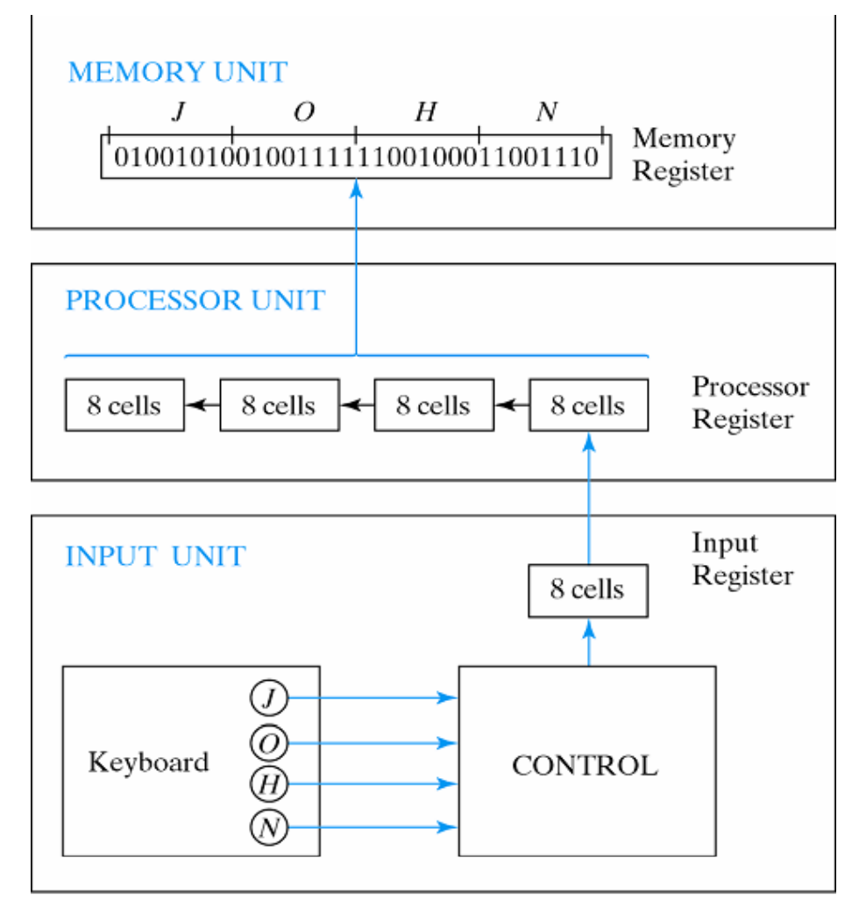
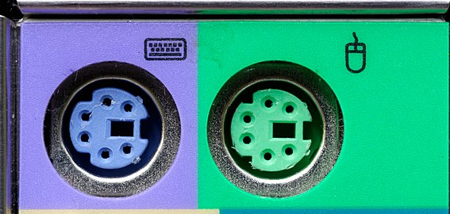
Example
Keyboard to Memory
Not USB here
Probably PS/2 using ACSII

Slide 4
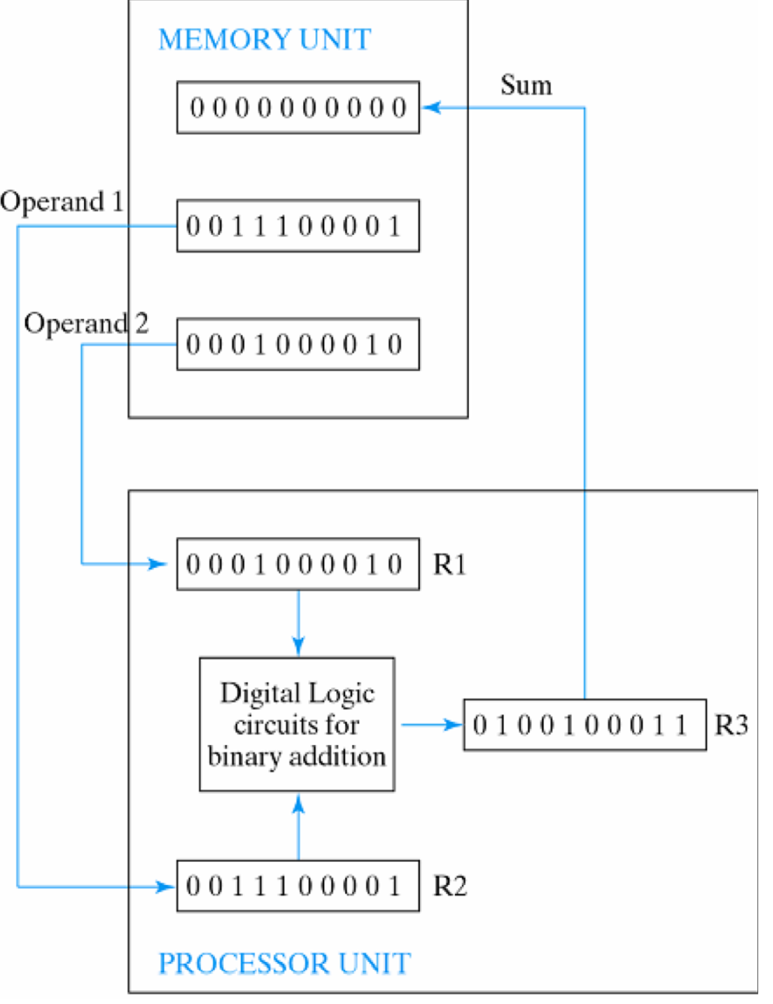
Binary Processing
There are large blocks in a uC
Specialized functions
10 bit adder here
Need to go deeper

Slide 5
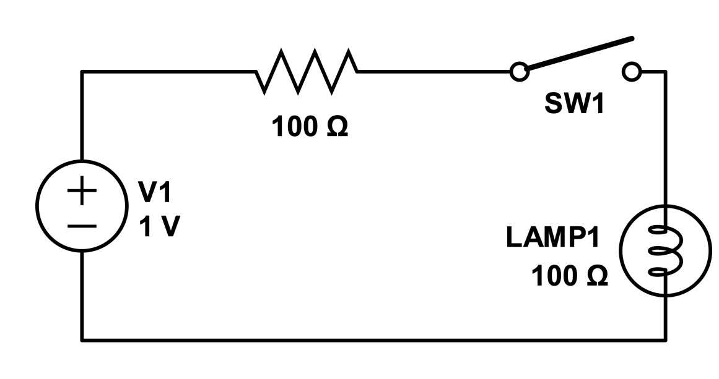
Electrical Review
Voltage: Difference in electric potential between two points
Analogous to water pressure
Current: Flow of charge
Analogous to water flow
Resistance: Tendency of wire to resist current flow
Analogous to water pipe diameter
V = I x R (Ohm’s Law)

Slide 6
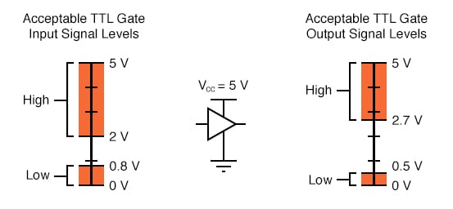
Representing Binary with Voltage
Logic Levels

Slide 7
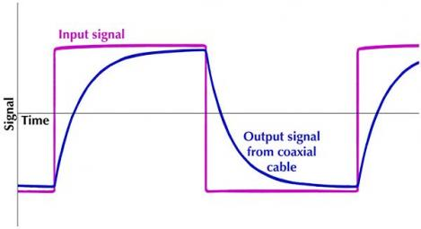
Why the Voltage Ranges?
Resistance
Capacitance
Transmission
Noise
Floating Ground
Speed

Slide 8
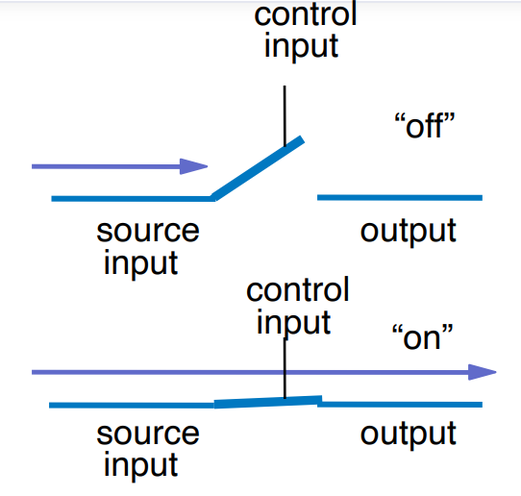
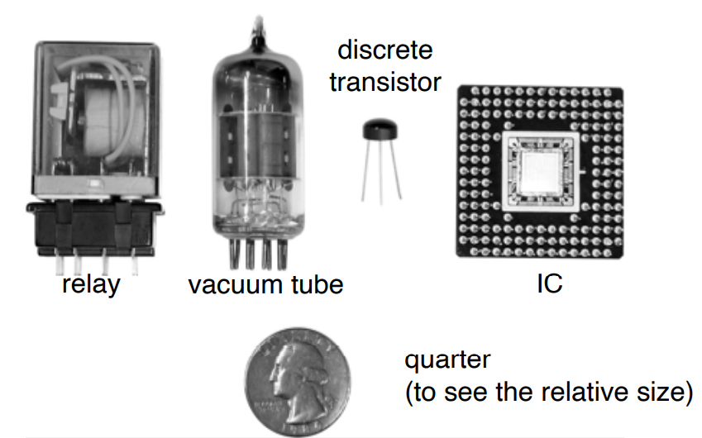
Switches
3 parts
Source input
Output
Control input
Manual switches?! No!
Timeline:
1930s – Relays
1940s – Vacuum Tubes
1950s – Discrete transistors
1960s Integrated Circuits (ICs)
From a few, to tens, to hundreds, to billions today

Slide 9
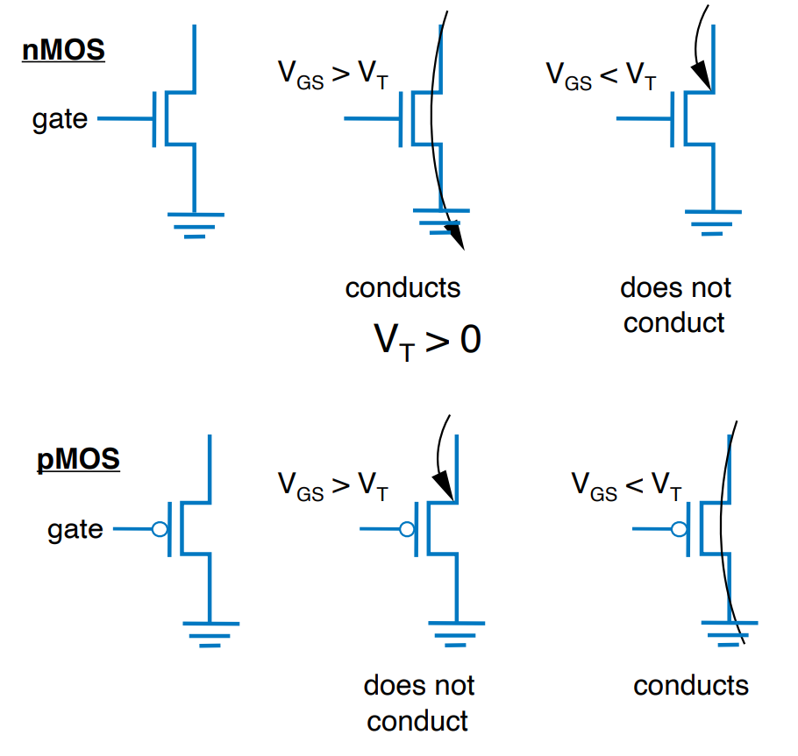
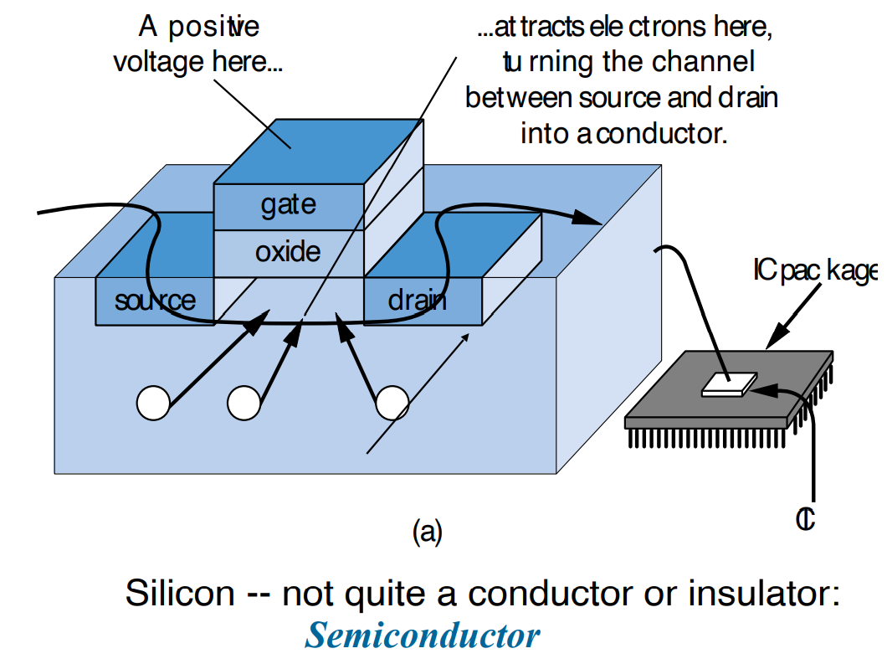
Transistors
Two Types – BJT and MOSFET
Bipolar Junction Transistor
Metal-Oxide-Semiconductor Field-Effect Transistor

Slide 10
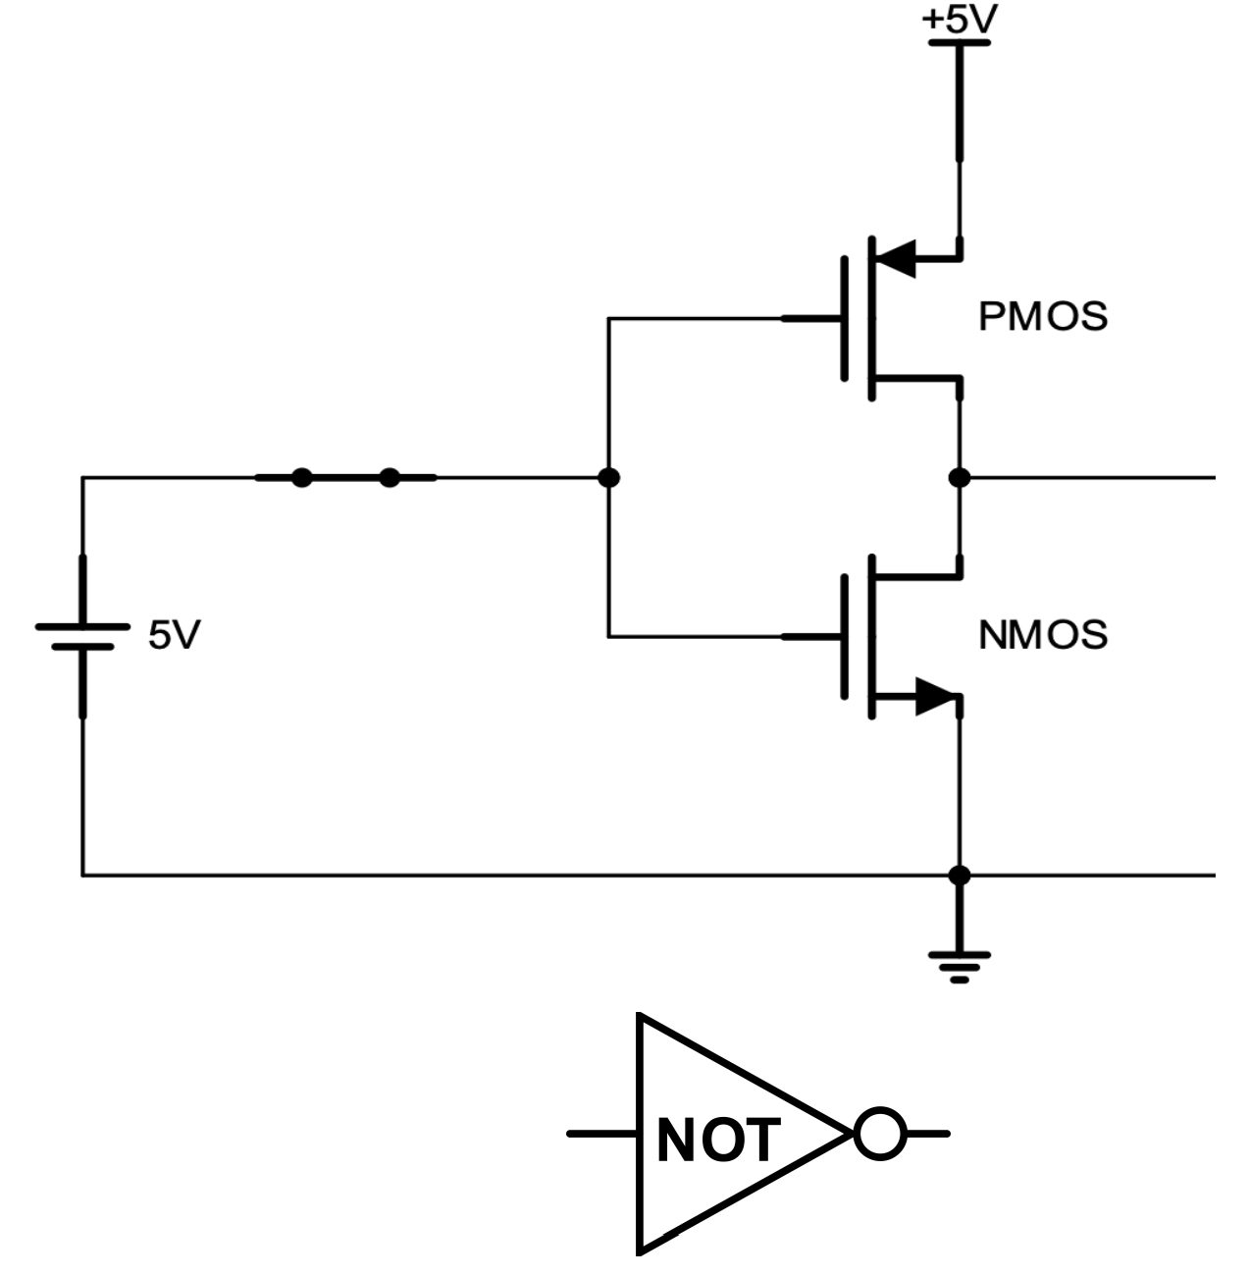
Example
CMOS Inverter
Inverts the input
Input 1 makes output 0
Input 0 makes output 1

Slide 11
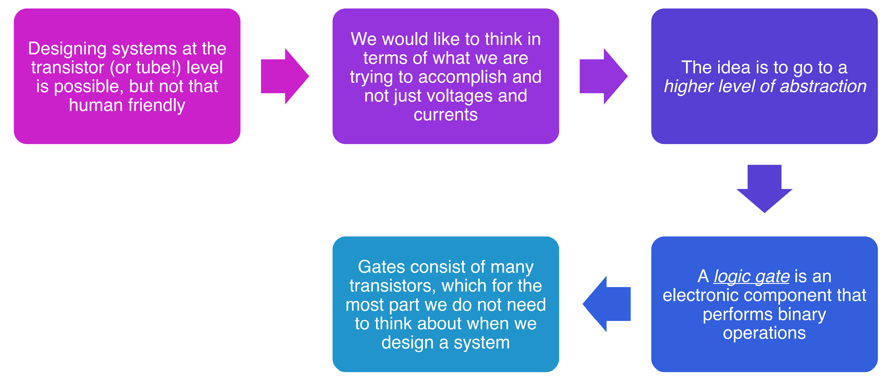
Boolean Logic Gates

Slide 12
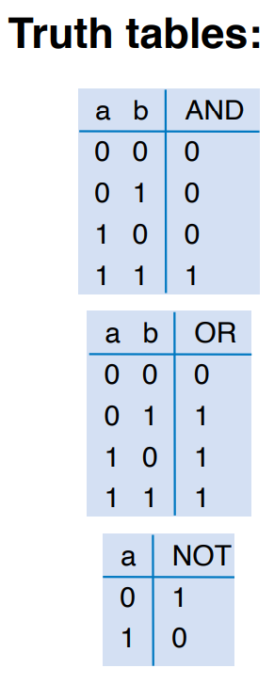
Boolean Algebra
Variable – symbol to represent action, condition, or data
Complement – inverse of a variable
Literal – variable or complement
Basic Operators – AND, OR, NOT

Slide 13
Boolean in History
Developed mid-1800’s by George Boole to formalize human thought and logic (also in PHIL114)
“I’ll go to lunch if Mary goes or John goes, and Sally does not go”
Let F represent my going to lunch (1 means I go, 0 I don’t go)
Likewise, m for Mary going, j for John, and s for Sally
Then F = (m OR j) AND NOT(s)
You can formally evaluate the statement
m=1, j=0, s=1 then F = (1 OR 0) AND NOT(1) = 1 AND 0 = 0
You can formally transform the statement (covered later)
F = (m AND NOT(s)) OR (j AND NOT(s))
Same outputs

Slide 14
Evaluation
F = (a AND b) OR (c AND d)
a=1, b=1, c=1, d=0
F = (1 AND 1) OR (1 AND 0) = 1 OR 0 = 1
a=0, b=1, c=0, d=1
F = (0 AND 1) OR (0 AND 1) = 0 OR 0 = 0
a=1, b=1, c=1, d=1
F = (1 AND 1) OR (1 AND 1) = 1 OR 1 = 1

Slide 15
English to Boolean
Pick variables (things that can be represented in 2 different states
Look at the logic words – both, either, and, etc
Construct a Boolean statement

Slide 16
Examples
F is true if
a is 1 and b is 1
F = a AND b
Either a or b is 1
F = a OR b
a is 1 and b is 0
F = a AND NOT(b)

Slide 17
Example
A fire sprinkler should spray water is high heat is sensed and the system is set to enabled
Let h represent “high heat is sensed”
Let e represent “enabled”
Let F represent “spraying water”
Then F = h AND e

Slide 18
Example
A car alarm should sound if the alarm is enabled, and either the car is shaken or the door is opened
Let a represent alarm is enabled, s represent car is shaken, d represent door is opened, and F represent alarm sounds
Then F= a AND (s OR d)
Alternatively, let d represent that the door is closed (so 1=closed, 0=open)
Then F = a AND (s OR NOT(d))

Slide 19
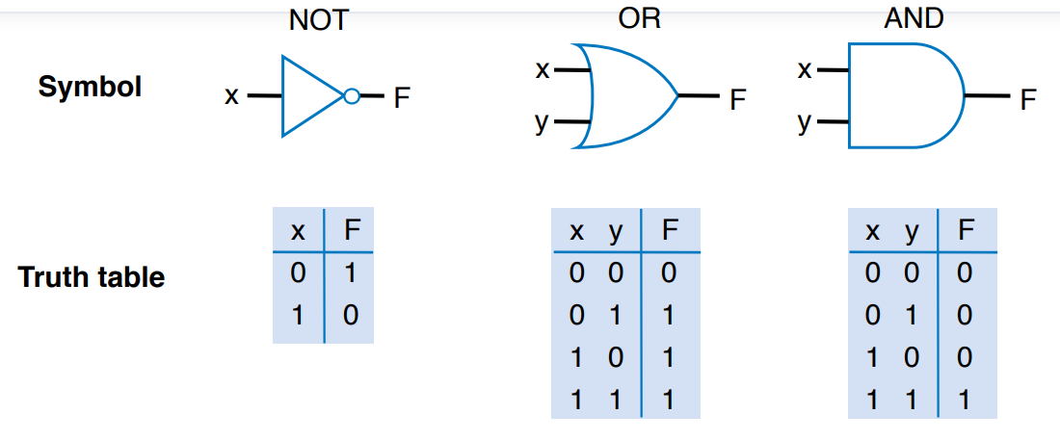
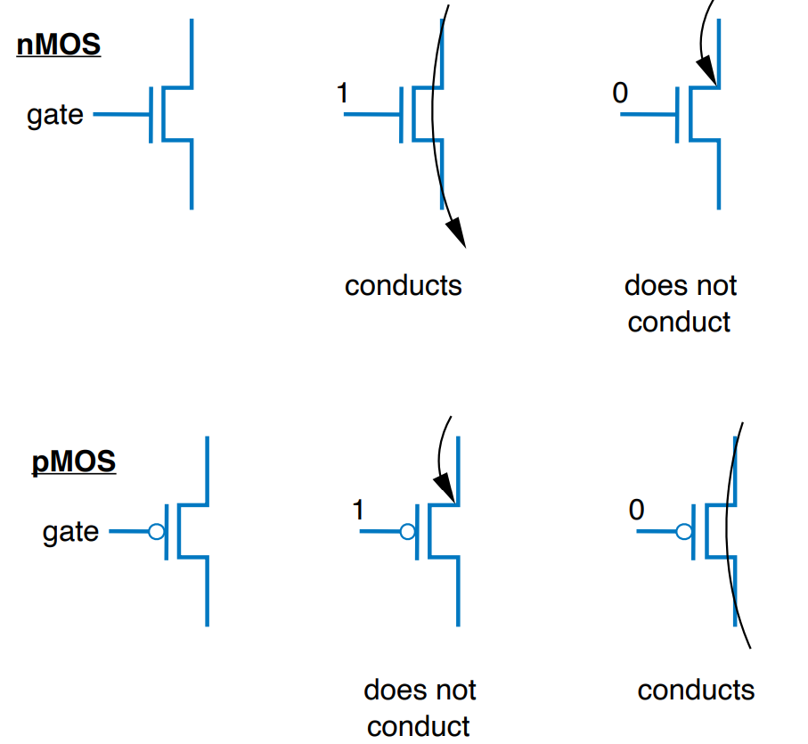
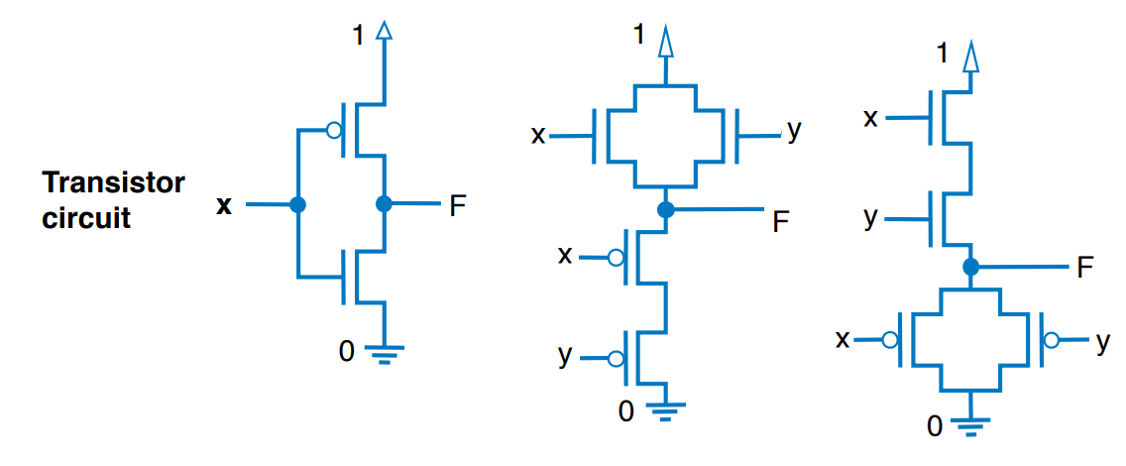
AND/OR/NOT Logic Gates

Slide 20
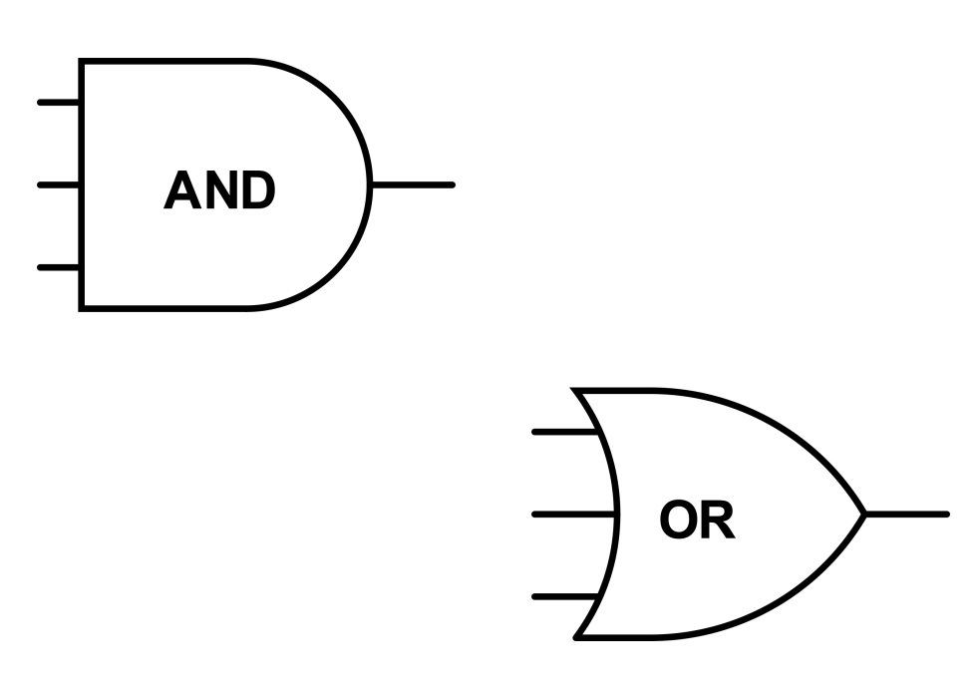
Multiple Inputs
Multiple input AND
Returns 1 when all the inputs are 1
Returns 0 when at least one input is 0
Multiple input OR
Returns 1 when at least one input is 1
Returns 0 when all the inputs are 0

Slide 21
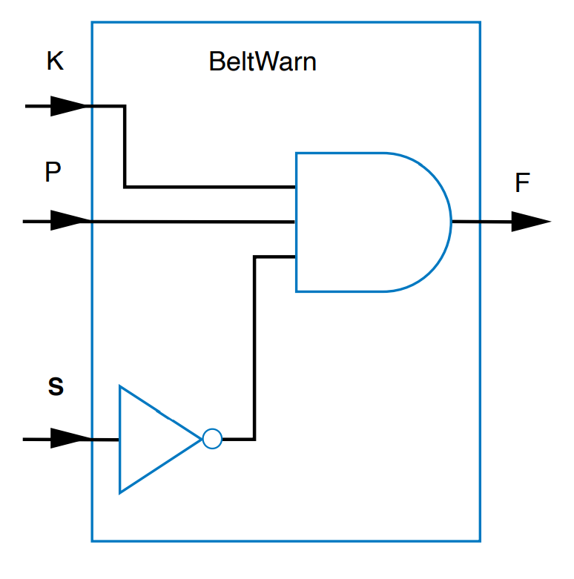
Example
Problem: The seatbelt light should turn on if the key is in the ignition, the person is in the seat, and the seat belt has not been fastened
Variables:
S = 1: seatbelt is fastened
K = 1: key is in the ignition
P = 1: person is in the seat
Equation
F = K AND P AND NOT(S)
Circuit

Slide 22
Boolean Notation (Shorthand)
To not write AND, OR, NOT all the time
AND becomes multiplication
OR becomes addition
NOT becomes apostrophe (X’)or bar (X)
F = (A AND B) OR C → F = AB + C
F = (A AND NOT(B) OR C → F = AB’ + C
F = NOT(A) AND NOT(B) → F = A’B’

Slide 23
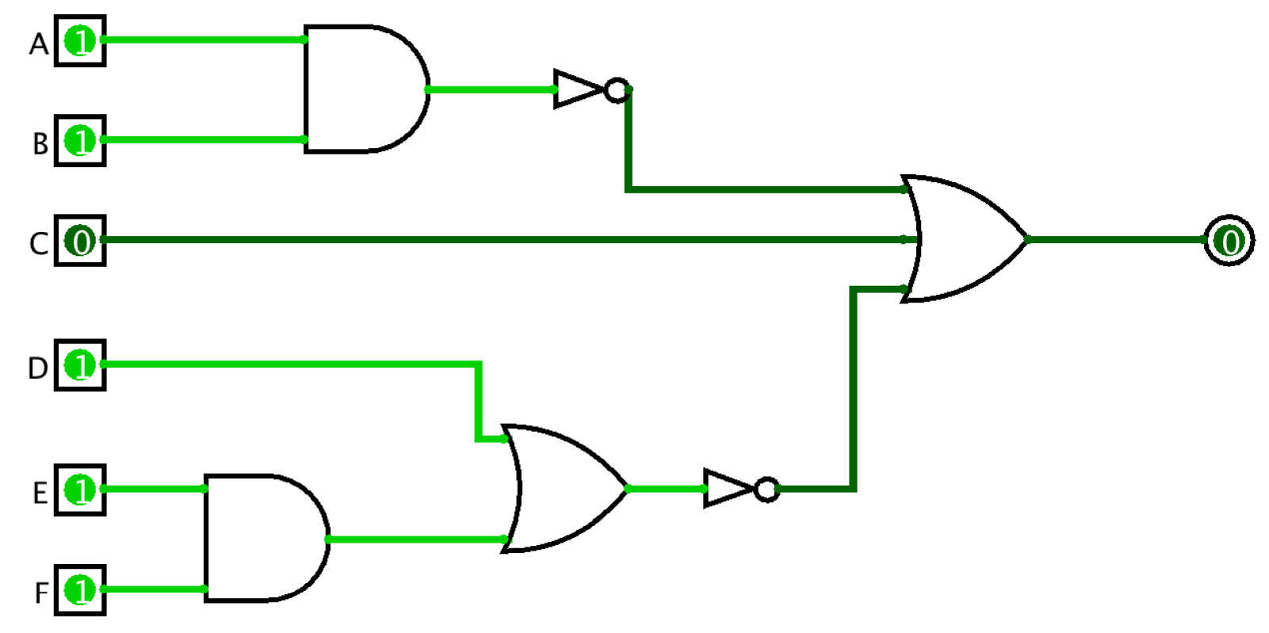
Boolean Equation to Circuit
F = (AB)’ + C + (D + EF)’

Slide 24
Reading
This lecture
Sections 3.1-3.3
Next lecture
Sections 3.4-3.6, 1.6

