Slide 1
CPE201 Digital Design
By Benjamin Haas
Class 8: DeMorgan’s and Boolean Simplification

Slide 2
Mastery
First submission
You can get between 0% and 100% for HW total
Correct problems – full credit, no change on resubmission
Incorrect problems – no credit, can be corrected in resubmission
Second submission
Submit corrected work
Must include a reflection to change a 0% to 100%
Why did you get it wrong the first time and what did you learn to correct the error
Full sentences

Slide 3
Test
Next Wednesday – 02/23
In class
Turn in paper submissions
All material through this week is fair game
1 handwritten cheat sheet, both sides
Calculator

Slide 4
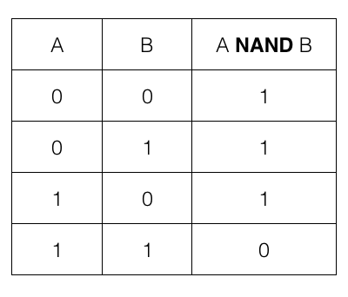
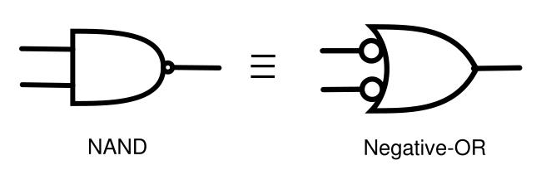
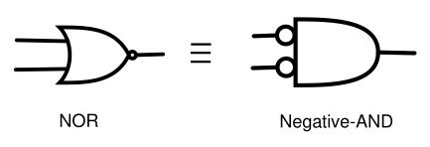
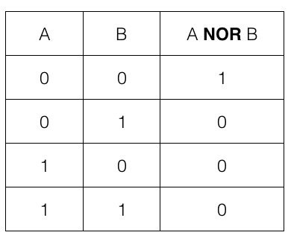
NAND and NOR Equivalents
Foreshadowing…

Slide 5
DeMorgan’s Theorem
The mathematical equivalent
(XY)’ = X’ + Y’
(X + Y)’ = X’Y’

Slide 6
Examples
(XYZ)’
(X’ + Y’ + Z’)’
(W’X + Y’Z’)’
((A’ + B’) + C’)’
(A’B(C + D’) + E)’

Slide 7
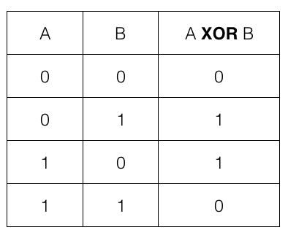
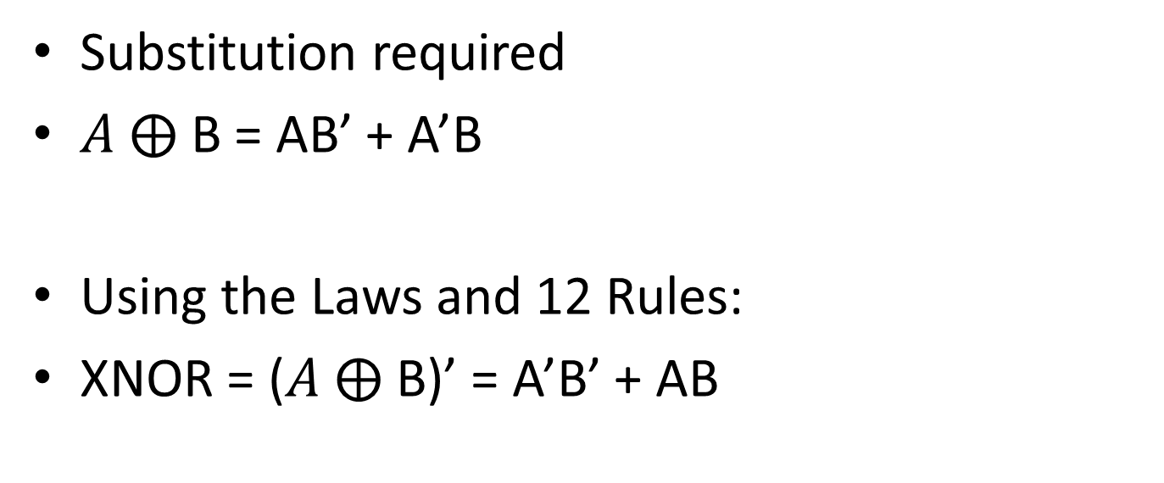
DeMorgan’s and XOR
Substitution required
$A ⨁$ B = AB’ + A’B
Using the Laws and 12 Rules:
XNOR = ($A ⨁$ B)’ = A’B’ + AB

Slide 8
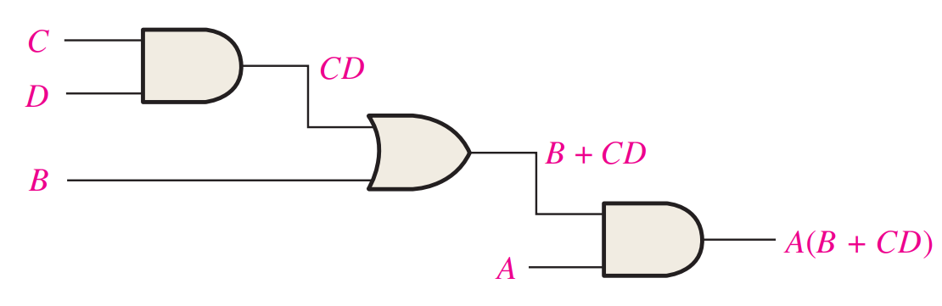
Analysis of Circuits
Start at the left and work right
(Beginning to end of circuit)
Carry a logical output forward as an input

Slide 9
Analysis of Circuits
Make a truth table
2 ^ #inputs is how many rows there are
A | B | C | D | CD | B+CD | A(B+CD)
0 | 0 | 0 | 0 | 0 | 0 | 0
0 | 0 | 0 | 1 | 0 | 0 | 0
0 | 0 | 1 | 0 | 0 | 0 | 0
0 | 0 | 1 | 1 | 1 | 1 | 0
0 | 1 | 0 | 0 | 0 | 1 | 0
0 | 1 | 0 | 1 | 0 | 1 | 0
0 | 1 | 1 | 0 | 0 | 1 | 0
0 | 1 | 1 | 1 | 1 | 1 | 0
A | B | C | D | CD | B+CD | A(B+CD)
1 | 0 | 0 | 0 | 0 | 0 | 0
1 | 0 | 0 | 1 | 0 | 0 | 0
1 | 0 | 1 | 0 | 0 | 0 | 0
1 | 0 | 1 | 1 | 1 | 1 | 1
1 | 1 | 0 | 0 | 0 | 1 | 1
1 | 1 | 0 | 1 | 0 | 1 | 1
1 | 1 | 1 | 0 | 0 | 1 | 1
1 | 1 | 1 | 1 | 1 | 1 | 1

Slide 10
Simplification
Boolean Algebra
Karnaugh Maps

Slide 11
Boolean Algebra
Simplify expressions using the laws and 12 rules
Group terms together that have common terms
Simplify negations using DeMorgan’s
Remove un-needed terms using the rules
A + 0 = A, A ∙ 1 = A, etc.

Slide 12
Examples
A’BC + AB’C’ + A’B’C’ + AB’C + ABC
(AB)’ + (AC)’ + A’B’C’
A + AB + AB’C

Slide 13
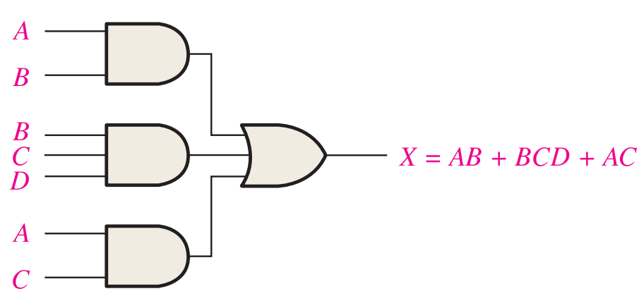
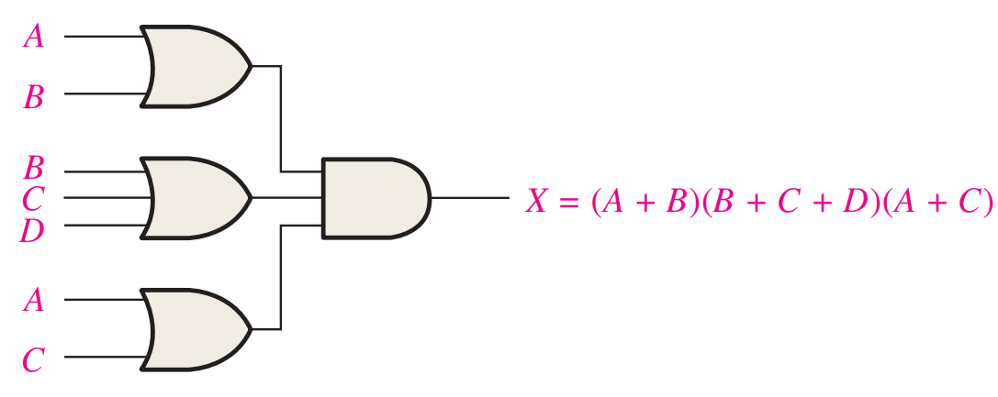
Standard Forms
Sum-of-products (SOP)
Product-of-sums (POS)
Standard forms makes things easier

Slide 14


SOP
All terms have + or ∙ between them and no ()
AB + AC + ABC
A’B + AC + A’B’C’
A(B + C) + AB
(AB)’ + AC

Slide 15
Making SOP
Distribute and DeMorgan’s
A(B + C) + AB = AB + AC
(AB)’ + AC = A’ + B’ + AC

Slide 16
Standard SOP
All inputs need to be in each product term
A’BC + AB’C + A’B’C
ABC + AB + A’BC’

Slide 17
Expanding SOP to Standard SOP
Use Rule 6: A + A’ = 1
Multiply terms by the missing variable using Rule 6 and expand
A’BC + AB + A’BC’
AB(C + C’) = ABC + ABC’
A’BC + ABC + ABC’ + A’BC’

Slide 18
Why?
Each term in the final expression is a line in the truth table for a 1
You could read the truth table from the expression
A’BC + ABC + ABC’ + A’BC’ = 0’11 + 111 + 110’ + 0’10’

Slide 19
Example
AB + AB’CD
Expand twice

Slide 20
POS
All terms are groupings of +, multiplied together
Not can only apply to one input term at a time
(A’ + B)(A + B + C’)(A)
(A + B)’(AB + C)

Slide 21
Making POS
Use DeMorgan’s and Rule 12: (A + B)(A + C) = A + BC
(A + B)’ = A’B’ = (A’)(B’)
(AB + C) = (A + C)(B + C)

Slide 22
Standard POS
All inputs need to be in each sum term
(A’ + B + C)(A + B’ + C)(A’ + B’ + C)
(A + B + C)(A + B)(A’ + B + C’)

Slide 23
Expanding POS to Standard POS
Use Rule 8: A ∙ A’ = 0 to add terms
Expand using Rule 12
(A’ + B + C)(A + B)(A’ + B + C’)
(A + B + CC’) = (A + B + C)(A + B + C’)
(A’ + B + C) (A + B + C)(A + B + C’)(A’ + B + C’)

Slide 24
Why?
Each term in the final expression is a line in the truth table for a 0
You could read the truth table from the expression
(A’ + B + C) (A + B + C)(A + B + C’)(A’ + B + C’) = (1’+0+0)(0+0+0)(0+0+1’)(1’+0+1’)

Slide 25
Example
(A + B)(A + B’ + C + D)
Expand twice

Slide 26
Reading
This lecture
Sections 4.3-4.6
Next lecture
Sections 4.7-4.10

