Slide 1
CPE201 Digital Design
By Benjamin Haas
Class 9: Truth Tables and Karnaugh Maps

Slide 2
Truth Table from SOP
A’BC + ABC + ABC’ + A’BC’ = 0’11 + 111 + 110’ + 0’10’
The only truth table lines that give 1
A | B | C | Output
0 | 0 | 0 | 0
0 | 0 | 1 | 0
0 | 1 | 0 | 1
0 | 1 | 1 | 1
1 | 0 | 0 | 0
1 | 0 | 1 | 0
1 | 1 | 0 | 1
1 | 1 | 1 | 1

Slide 3
Truth Table from POS
(A’ + B + C) (A + B + C)(A + B + C’)(A’ + B + C’) = (1’+0+0)(0+0+0)(0+0+1’)(1’+0+1’)
The only truth table lines that give 0
A | B | C | Output
0 | 0 | 0 | 0
0 | 0 | 1 | 0
0 | 1 | 0 | 1
0 | 1 | 1 | 1
1 | 0 | 0 | 0
1 | 0 | 1 | 0
1 | 1 | 0 | 1
1 | 1 | 1 | 1

Slide 4
Converting Standard Form to the Other
Convert the one you have to a truth table
Find the opposite logic terms
Write the terms out

Slide 5
Example
(A + B + C’)(A’ + B’ + C’)(A + B’ + C)
A’B’C’ + A’BC + AB’C’ + AB’C + ABC’
A | B | C | Output
0 | 0 | 0
0 | 0 | 1 | 0
0 | 1 | 0 | 0
0 | 1 | 1
1 | 0 | 0
1 | 0 | 1
1 | 1 | 0
1 | 1 | 1 | 0

Slide 6
Example
A | B | C | Output
0 | 0 | 0 | 1
0 | 0 | 1
0 | 1 | 0
0 | 1 | 1
1 | 0 | 0
1 | 0 | 1 | 1
1 | 1 | 0 | 1
1 | 1 | 1
ABC’ + A’B’C’ + AB’C
(A+B+C’)(A+B’+C)(A+B’+C’)(A’+B+C)(A’+B’+C’)

Slide 7
Simplification
Boolean Algebra
Karnaugh Maps

Slide 8
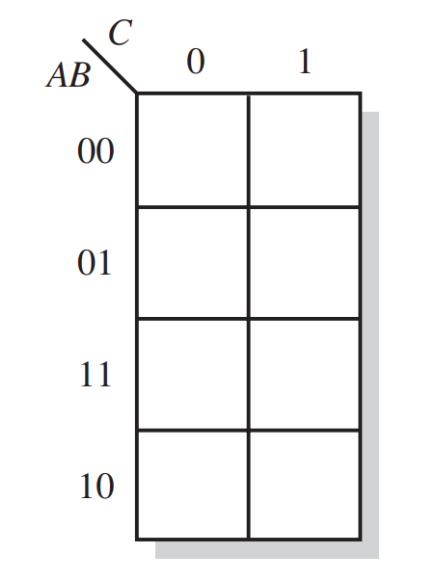
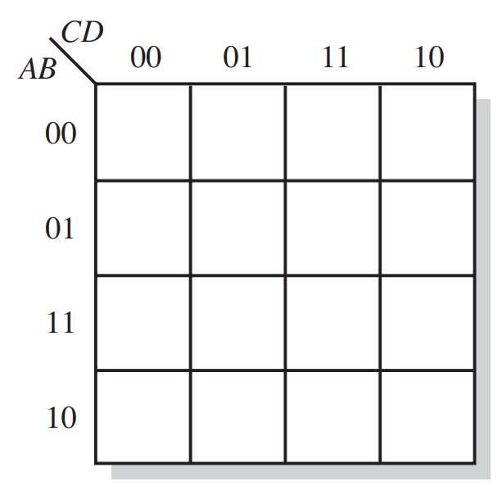
Karnaugh Map
Visual way to reduce logic statements to the simplest forms
Good for 4-5 inputs

Slide 9
Truth Table to Karnaugh Map
A | B | C | D | Output
0 | 0 | 0 | 0 | 0
0 | 0 | 0 | 1 | 0
0 | 0 | 1 | 0 | 0
0 | 0 | 1 | 1 | 0
0 | 1 | 0 | 0 | 0
0 | 1 | 0 | 1 | 0
0 | 1 | 1 | 0 | 0
0 | 1 | 1 | 1 | 0
A | B | C | D | Output
1 | 0 | 0 | 0 | 0
1 | 0 | 0 | 1 | 0
1 | 0 | 1 | 0 | 0
1 | 0 | 1 | 1 | 1
1 | 1 | 0 | 0 | 1
1 | 1 | 0 | 1 | 1
1 | 1 | 1 | 0 | 1
1 | 1 | 1 | 1 | 1
0
0
0
0
0
0
0
0
1
1
1
1
0
0
1
0

Slide 10
Karnaugh Map of Standard SOP
A standard SOP gives all terms that have output of 1
Same as converting a truth table

Slide 11
Karnaugh Map of Non-Standard SOP
Terms need to be expanded to include all input options
B’ + A’B + ABC’
Then put into the map
B’ | A’B | ABC’
000 | 010 | 110
001 | 011
100
101
1
1
1
1
1
0
1
1

Slide 12
SOP Minimization
Make groups of 1’s (by a power of 2)
1’s that are adjacent
Groups that are squares or rectangles only
Make the biggest ones possible
Overlap is okay
Complete overlaps are not used

Slide 13
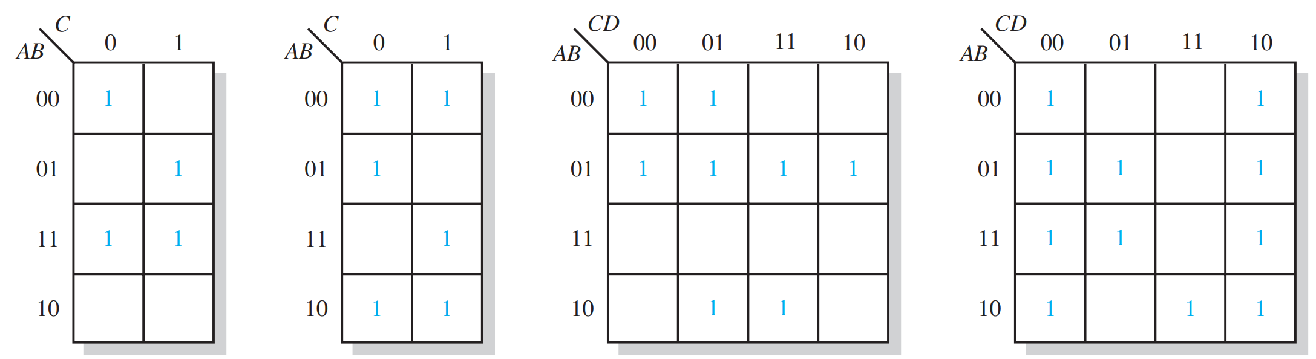
Examples

Slide 14
SOP Minimization
Next make a minimum product term for the group
4 Input Variables
1 cell | 4 input product term
2 cells | 3 input product term
4 cells | 2 input product term
8 cells | 1 input product term
16 cells | All terms true, F=1
3 Input Variables
1 cell | 3 input product term
2 cells | 2 input product term
4 cells | 1 input product term
8 cells | All terms true, F=1

Slide 15
Example
B’ + A’B + ABC’
3 4-cell groups
A’ + B’ + C’
1
1
1
1
1
0
1
1

Slide 16
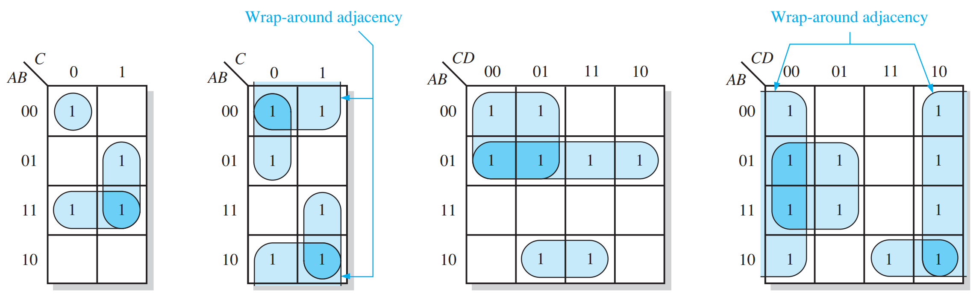
Examples

Slide 17
Examples
Minimize:
AB + AC’ + A’BC
ABC’ + BC’ + D

Slide 18
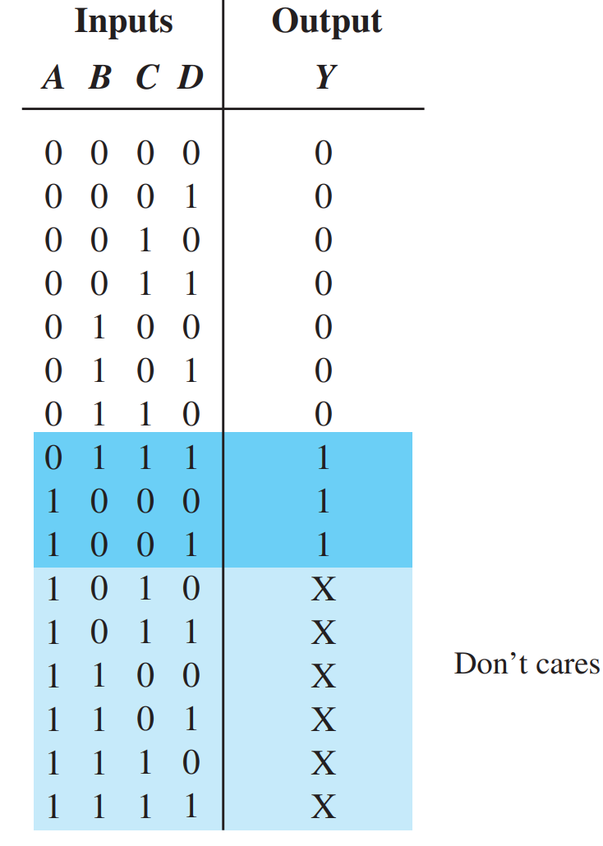
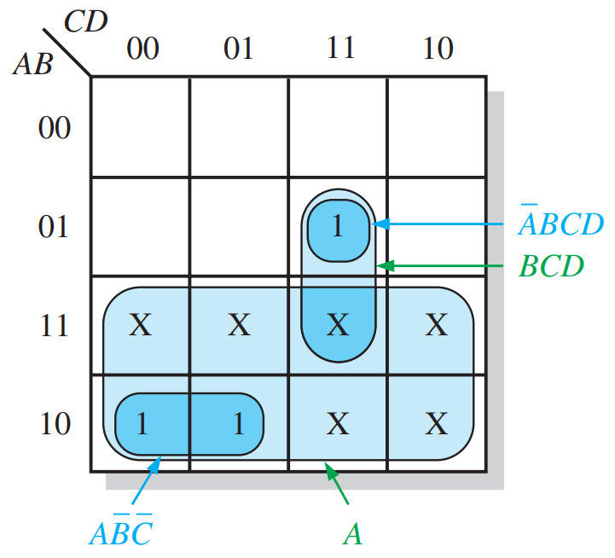
Don’t Care Condition
Used for conditions that cannot occur
Can be used to further simplify logic

Slide 19
Example
Can be used to further simplify logic
1
1
1
1
X
1
X

Slide 20
Reading
This lecture
Sections 4.7-4.9
Next lecture
Sections 1.8, 3.9, 4.10-4.11, Ch4 Applied Logic

