Slide 1
CPE201 Digital Design
By Benjamin Haas
Class 11: POS Karnaugh Maps and Troubleshooting

Slide 2
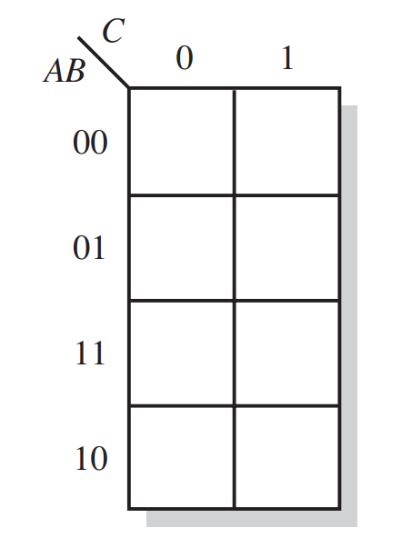
SOP Minimization Example
B’ + A’B + ABC’
3 4-cell groups
A’ + B’ + C’
1
1
1
1
1
0
1
1

Slide 3
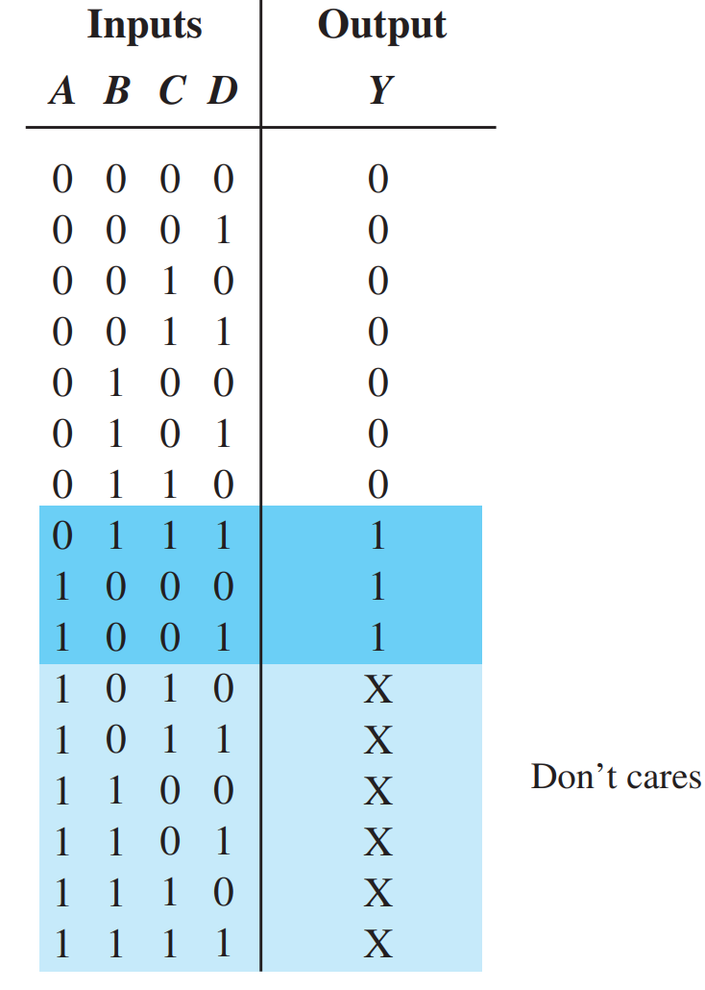
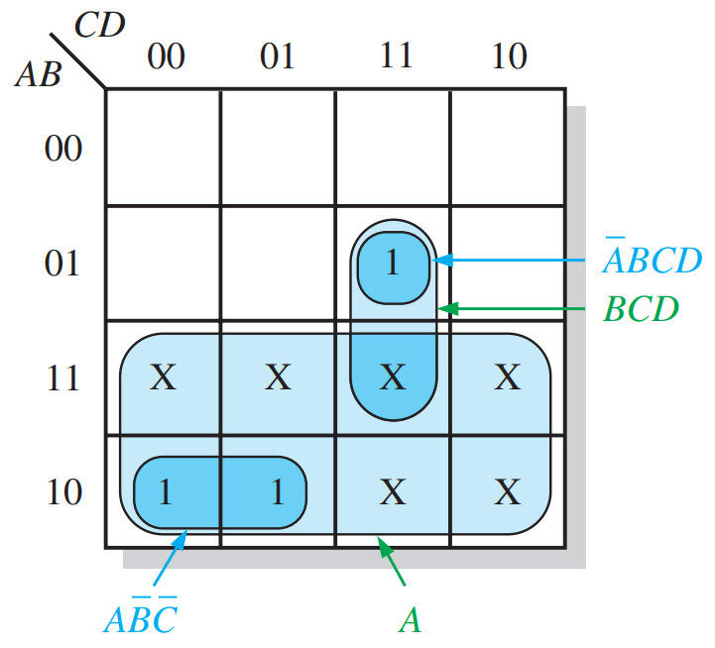
Don’t Care Condition
Used for conditions that cannot occur
Can be used to further simplify logic

Slide 4
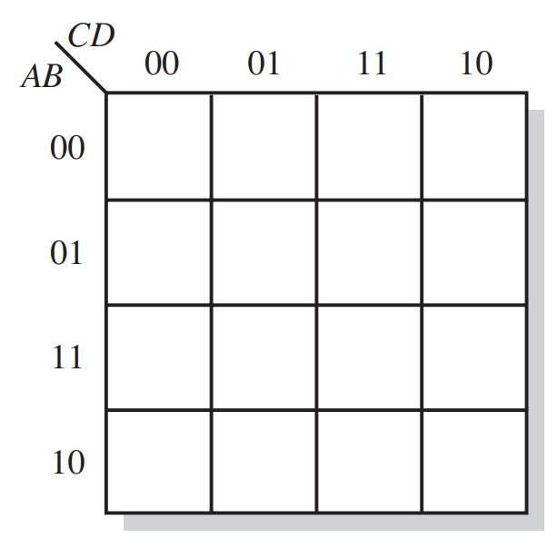
Example
Can be used to further simplify logic
1
1
X
1
1
1
1
1
X
1
1
X
1

Slide 5
Karnaugh Maps and POS
All the same concepts apply, but now with 0’s
Write all simplified terms as POS terms

Slide 6
Example
(A+B+C’)(A+B’+C’)(A’+B’)(A’+B+C)
(A’+C)(A’+B’)(A+C’)
0
0
0
0
0

Slide 7
Conversions
Same as with truth tables
Fill in the Karnaugh Map with what you have
Then group the other truth value
Finally write out the terms

Slide 8
Example
(A+B+C’)(A+B’+C’)(A’+B’)(A’+B+C)
A’C’ + AB’C
1
1
1

Slide 9
Minterms and Maxterms
Inputs that give 1 on truth table = minterms
Inputs that give 0 on truth table = maxterms

Slide 10
Example
A | B | C | Output | Minterm | Maxterm
0 | 0 | 0 | 1 | m₀
0 | 0 | 1 | 0 |  | M₁
0 | 1 | 0 | 0 |  | M₂
0 | 1 | 1 | 1 | m₃
1 | 0 | 0 | 1 | m₄
1 | 0 | 1 | 1 | m₅
1 | 1 | 0 | 1 | m₆
1 | 1 | 1 | 0 |  | M₇

Slide 11
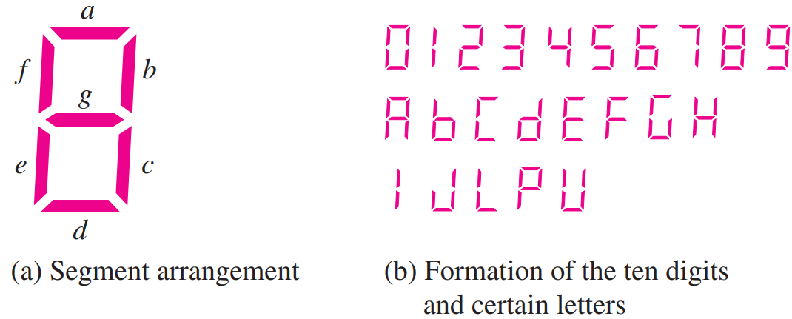
7-Segment Displays

Slide 12
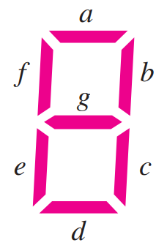
7-Segment Displays
Symbol | Segments Active
1 | b, c
2 | a, b, d, e, g
7 | a, b, c
A | a, b, c, e, f, g
b | c, d, e, f, g
C | a, d, e, f

Slide 13
Display Hex Digits
Symbol | Hex Input (H₃H₂H₁H₀) | Segments Active
1 | 0001 | b, c
2 | 0010 | a, b, d, e, g
7 | 0111 | a, b, c
A | 1010 | a, b, c, e, f, g
b | 1011 | c, d, e, f, g
C | 1100 | a, d, e, f

Slide 14
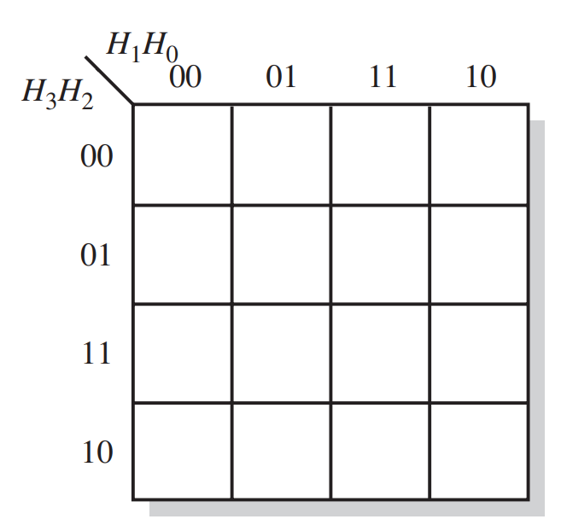
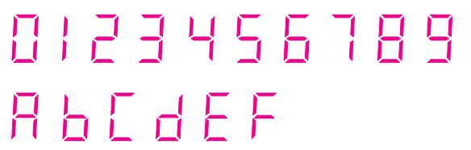
Logic for One Segment
Segment ‘a’ is used in: 0, 2, 3, 5, 6, 7, 8, 9, A, C, E, F
1
1
1
1
1
1
1
1
1
1
1
1

Slide 15
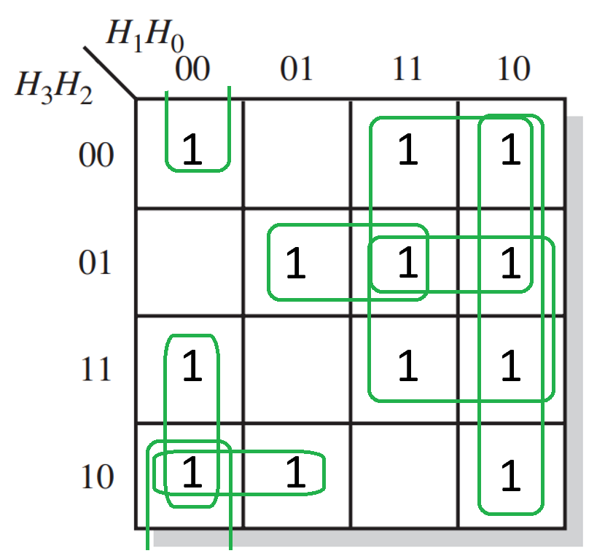
Logic for One Segment
H₂’H₁’H₀’ + H₃H₁’H₀’ + H₃H₂’H₁’ + H₃’H₂H₀’ + H₃’H₁ + H₂H₁ + H₁H₀’

Slide 16
Troubleshooting
Being a detective
Never discount something that looks off
Always test to narrow down what is wrong

Slide 17
The Basic Steps
1. Gather information on the problem
2. Identify the symptom and possible failures
3. Isolate the point(s) of failure
4. Apply proper tools to determine the cause of the problem
5. Fix the problem

Slide 18
Obvious Stuff First
Is there power to the circuit?
Are there any loose wires/connections?
Is there a troubleshooting guide?
Is there a wiring diagram?

Slide 19
Replace/Reproduce
Is there another circuit that works in place of this one?
Isolate the problem to one circuit
Is the problem reproduceable?
Can you change the input to make it reproduceable?

Slide 20
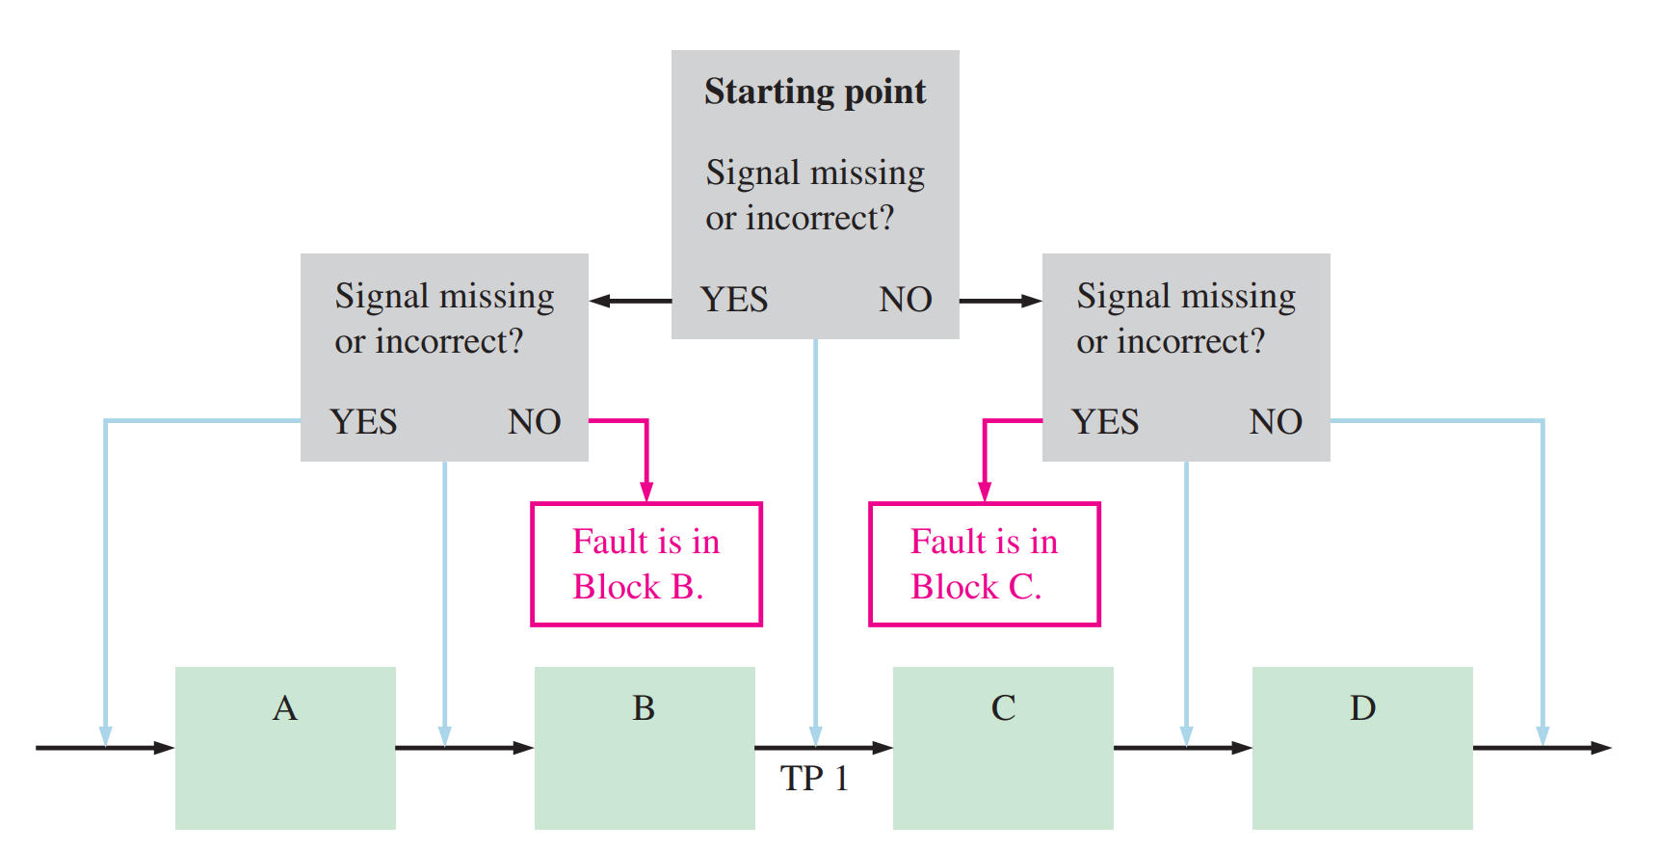
Half-Splitting Method

Slide 21
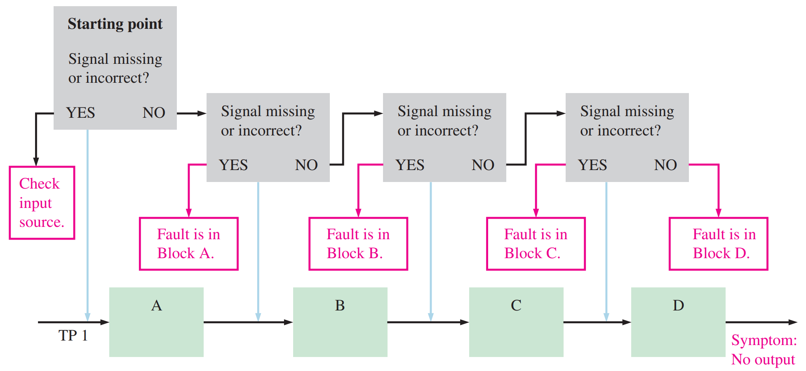
Signal-Tracing Method

Slide 22
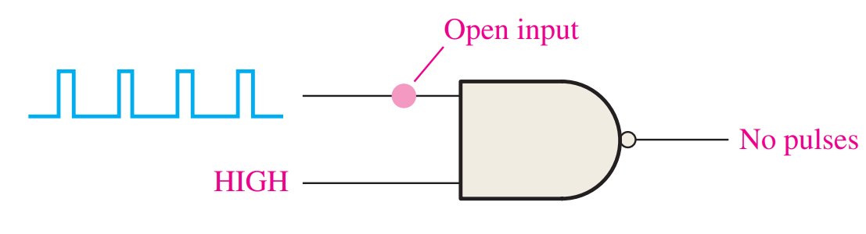

Open Circuits

Slide 23
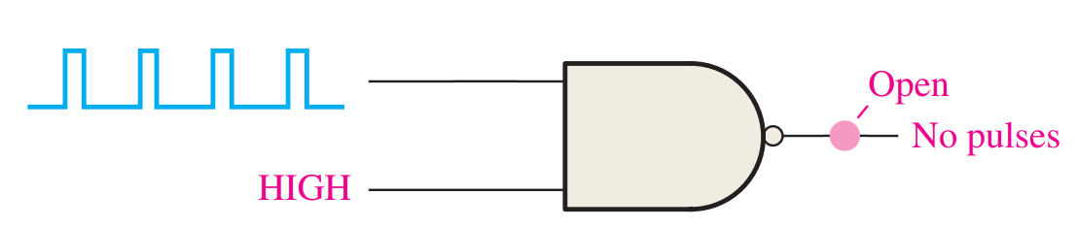
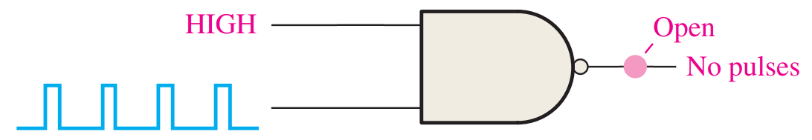
Open Circuits

Slide 24
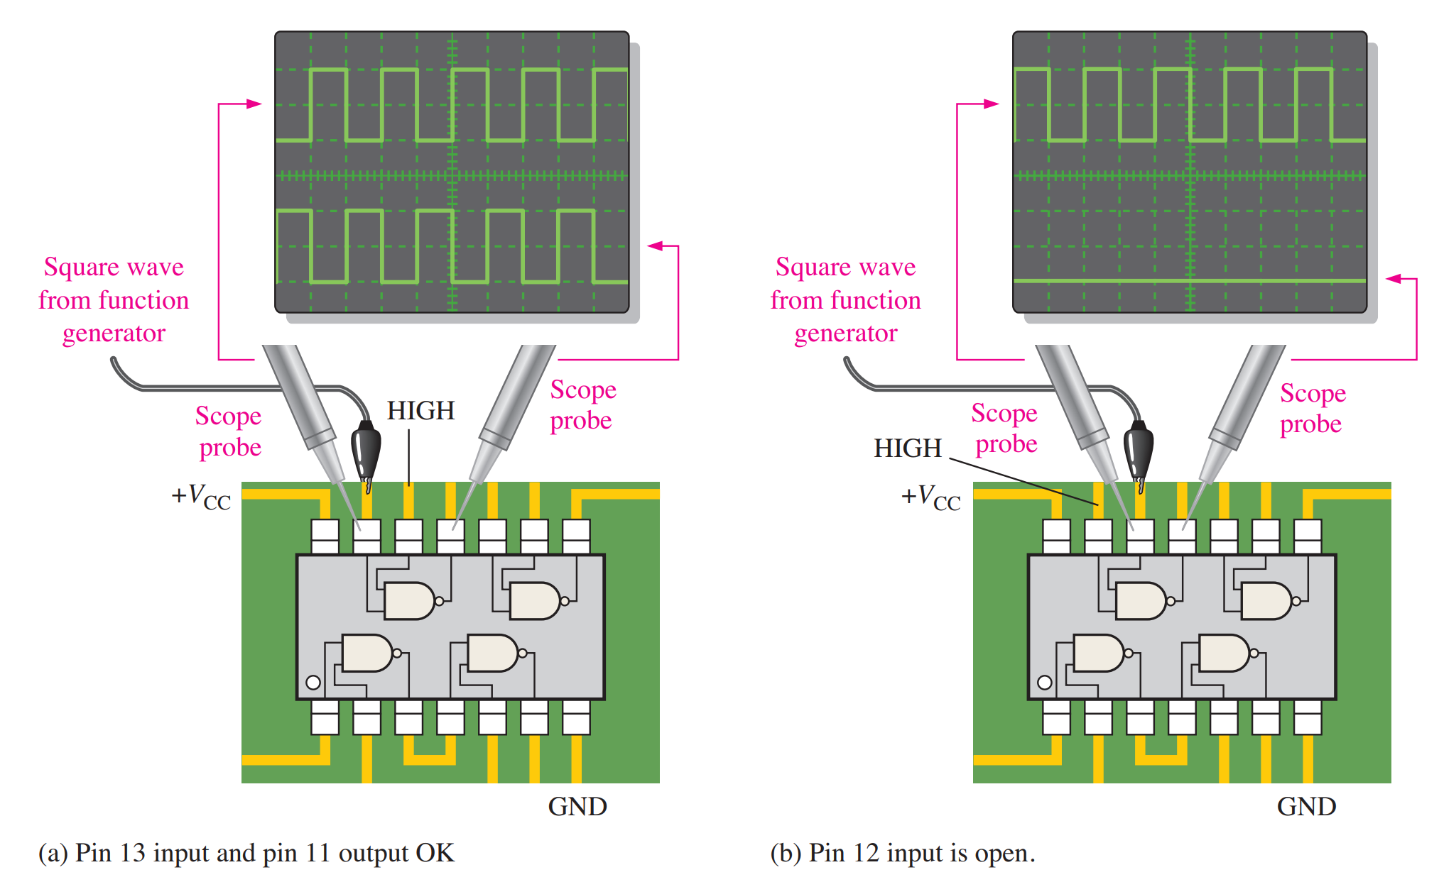
Internal Example

Slide 25
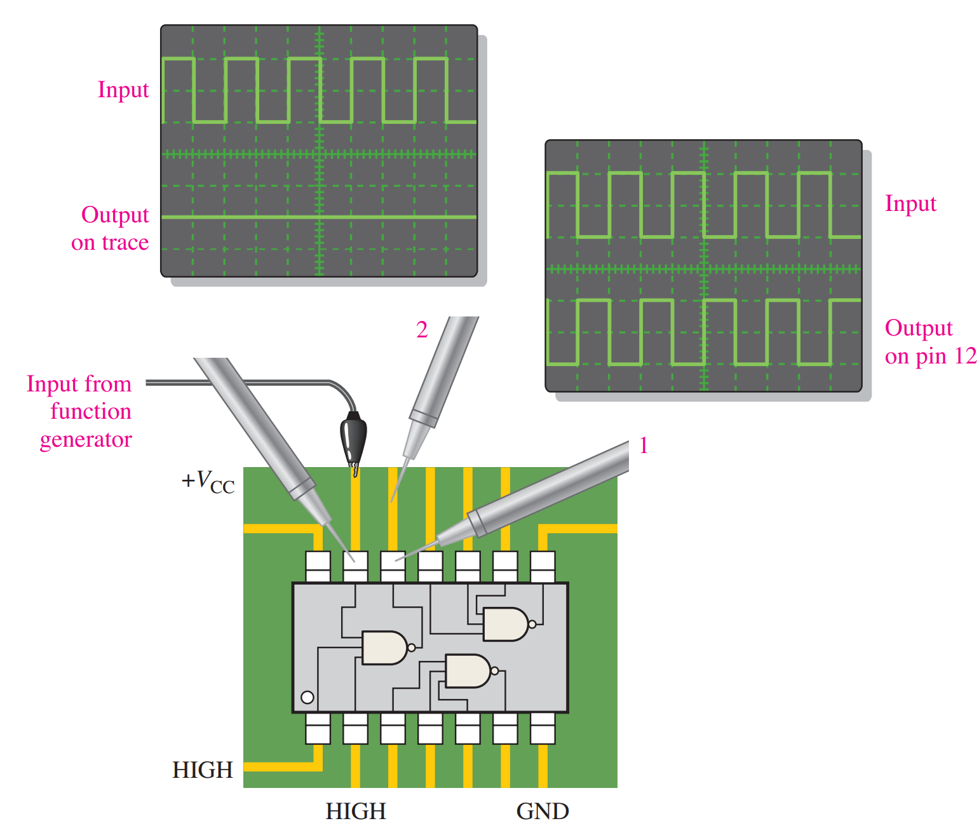
External Example

Slide 26
Reading
This lecture
Sections 1.8, 3.9, 4.10-4.11, Ch4 Applied Logic
Next lecture
Sections 5.1-5.3

