Slide 1
CPE201 Digital Design
By Benjamin Haas
Class 12: Combinational Logic

Slide 2
Focus on Implementation
Creating circuits from logic in Ch4
AND-OR Logic
AND-OR-Invert Logic
Quick Review
XOR
XNOR

Slide 3
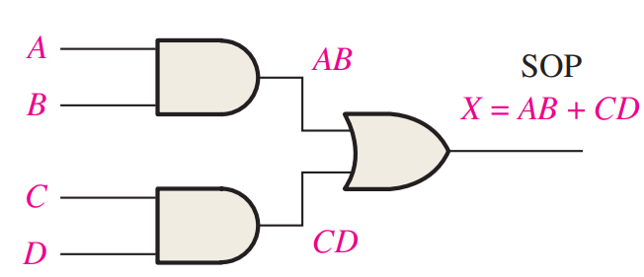
AND-OR Logic
What you already know from SOP expressions
Example: AB + CD

Slide 4
AND-OR-Invert Logic
Implements POS expressions
Heavy use of DeMorgan’s
Implementation looks like SOP

Slide 5
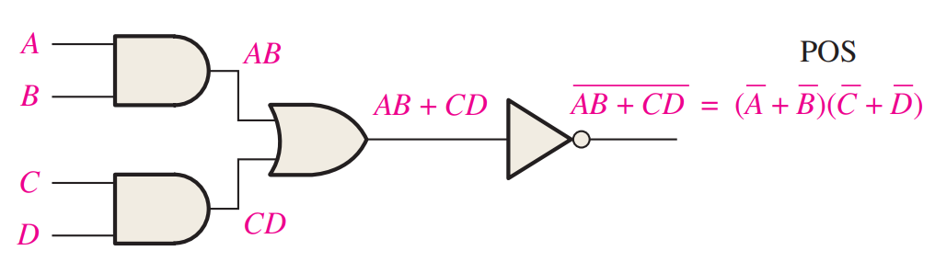
Example
(A’ + B’)(C’ + D’) = (AB)’(CD)’ = ((AB)’(CD)’)’’
Two NOTs would cancel, distribute one
=(AB + CD)’

Slide 6
Example
Convert POS terms to Invert SOP terms
(A + B’ + C’)(A’ + B’ + C)(A’ + B + C)=
(A’BC + ABC’ + AB’C’)’

Slide 7
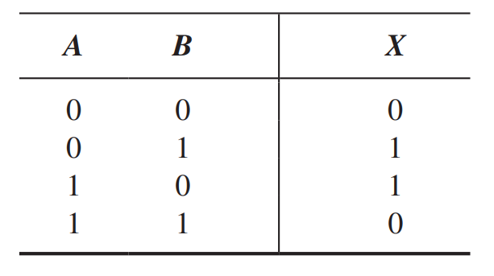
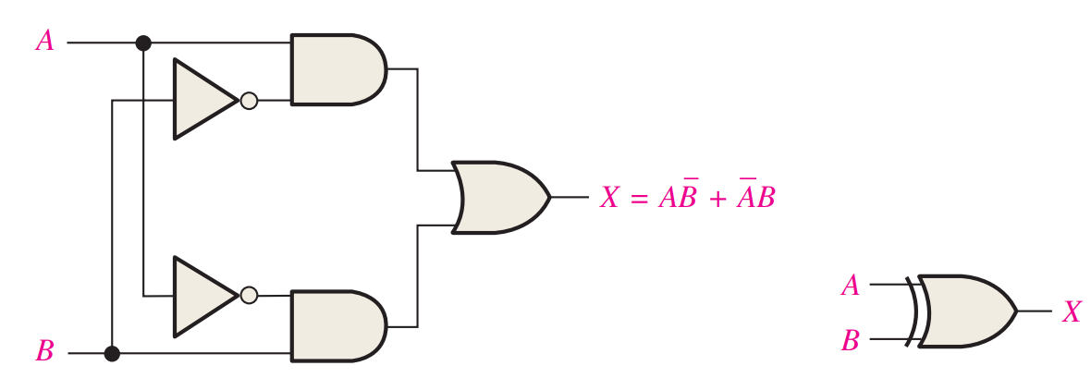
XOR
Simplify your logic

Slide 8
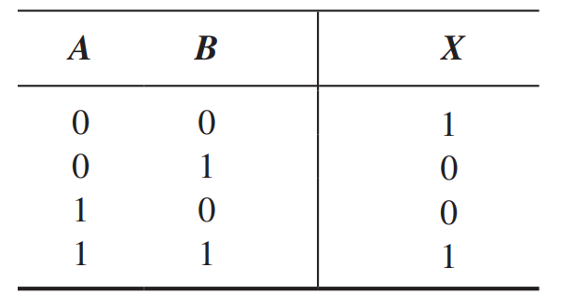
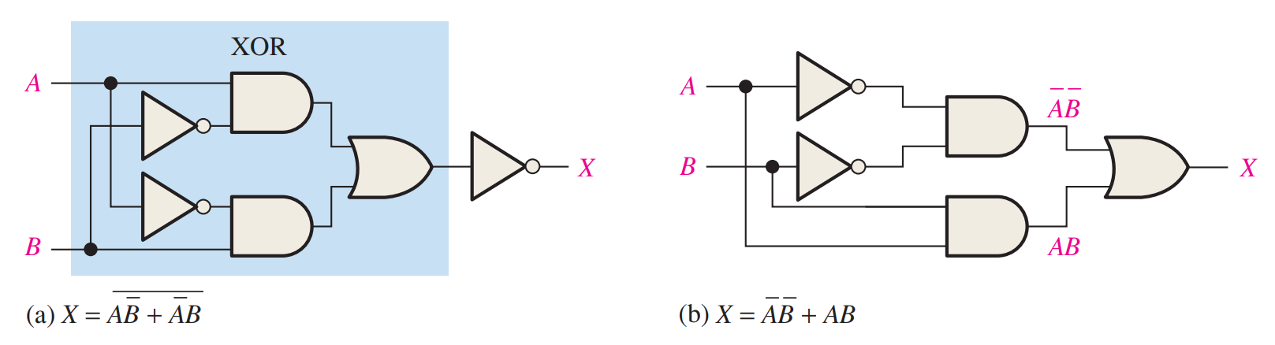
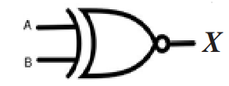
XNOR
Simplify your logic

Slide 9
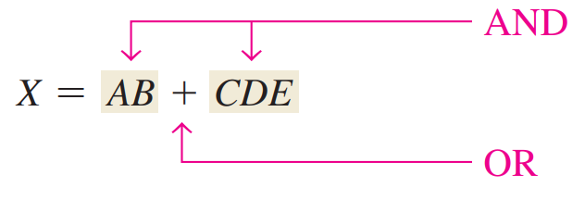
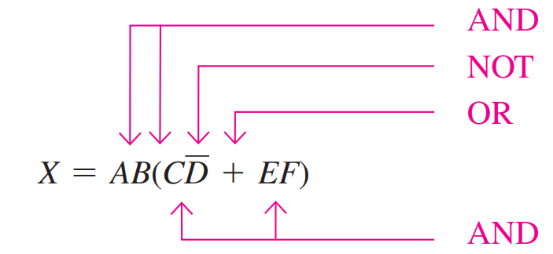
Implementation
Order of operations for Boolean expressions
Same as regular math expression symbols
NOT is highest after parentheses

Slide 10
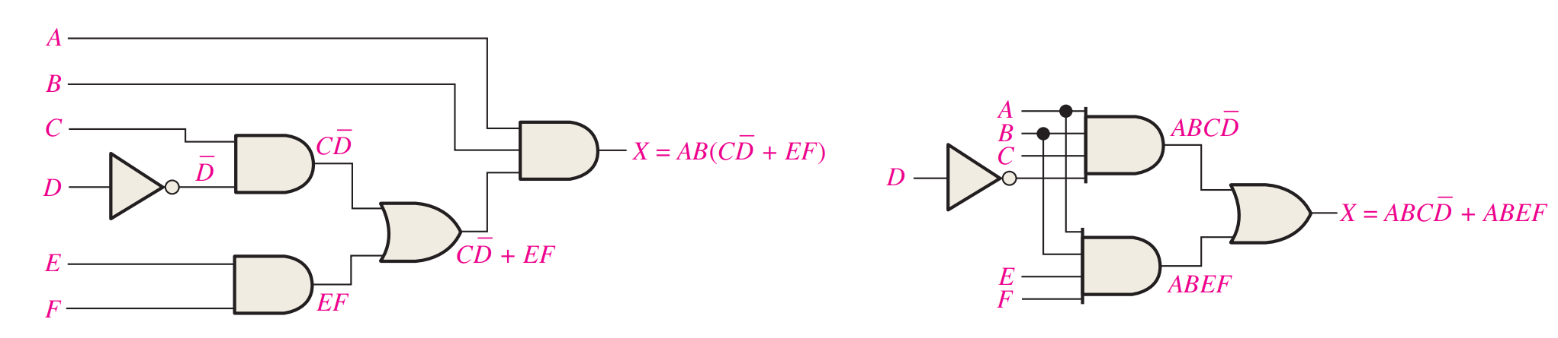
Example
AB(CD’ + EF) = ABCD’ + ABEF
Distributed to SOP

Slide 11
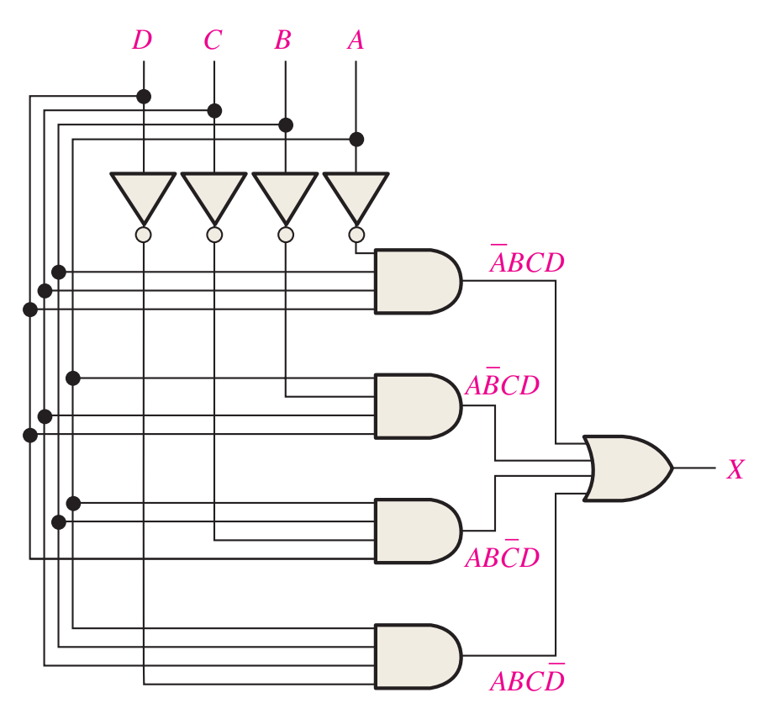
Ye Olde Grid
Makes Standard SOP
Add a NOT and get Standard POS

Slide 12
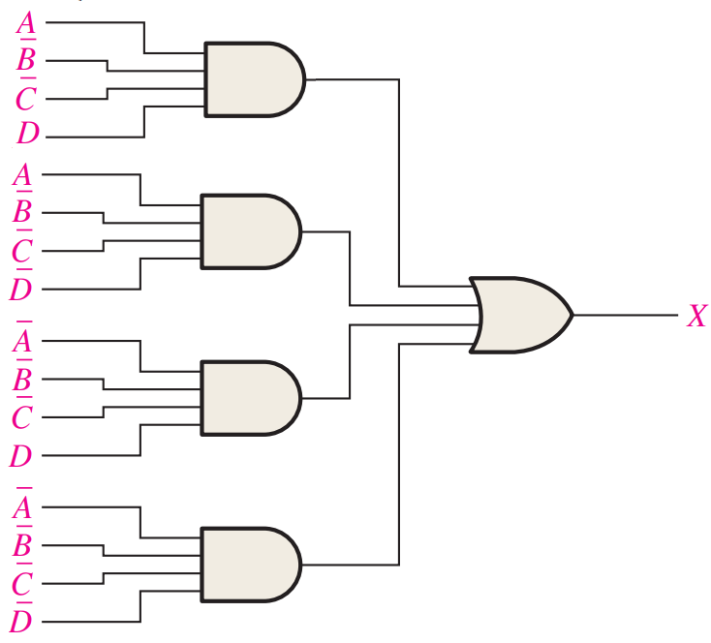
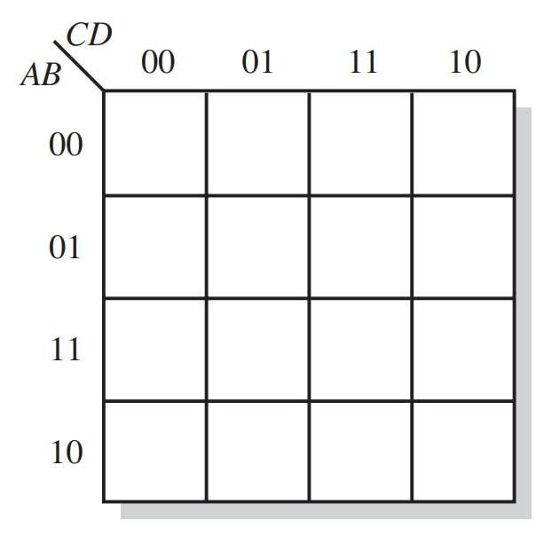
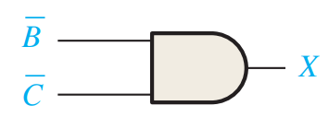
Minimize
1
1
1
1

Slide 13
Universal Gates
NAND and NOR
You can make every other gate with them
AND and OR are not universal
Can’t make NOT

Slide 14
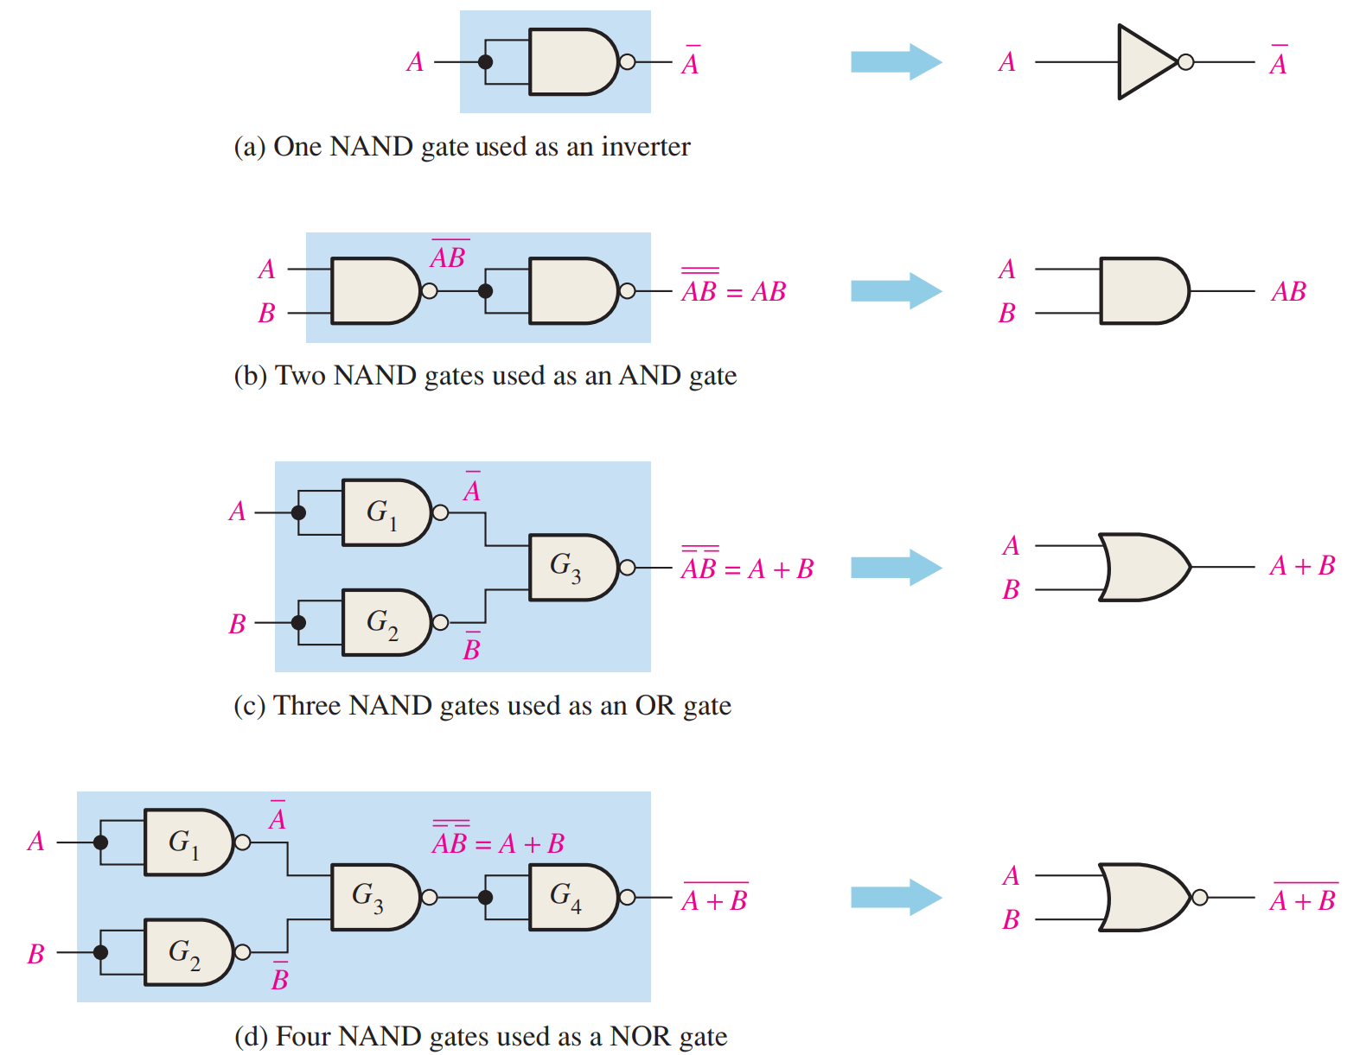
NAND to Other Gates

Slide 15
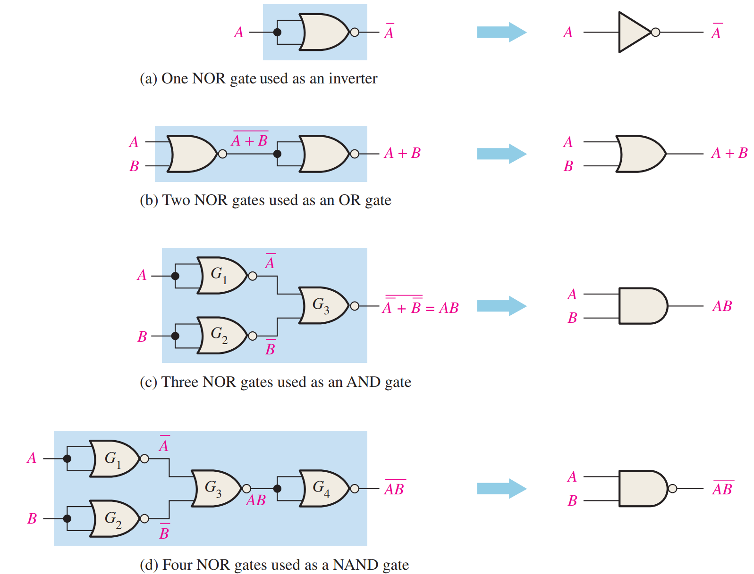
NOR to Other Gates

Slide 16
Reading
This lecture
Sections 5.1-5.3
Next lecture
Sections 5.4-5.5, 3.8

