Slide 1
CPE201 Digital Design
By Benjamin Haas
Class 13: NAND/NOR Combinational Logic, Chip Properties

Slide 2
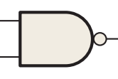
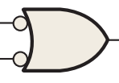

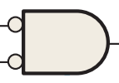
Dual Symbols
(AB)’ = A’ + B’ =
NAND = negative-OR
(A + B)’ = A’B’ =
NOR = negative-AND

Slide 3
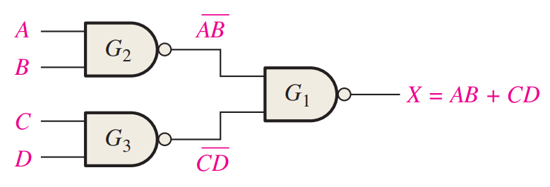
NAND Example
((AB)’(CD)’)’
= (AB)’’ + (CD)’’
= AB + CD
Now SOP

Slide 4
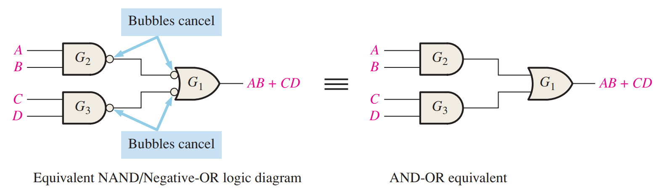
NAND Example

Slide 5
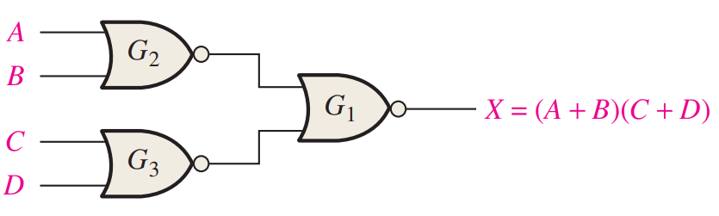
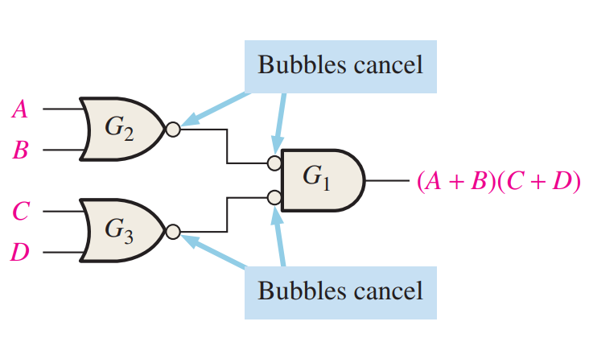
NOR Example
((A+B)’+(C+D)’)’
=(A+B)’’(C+D)’’
=(A+B)(C+D)
Now POS

Slide 6
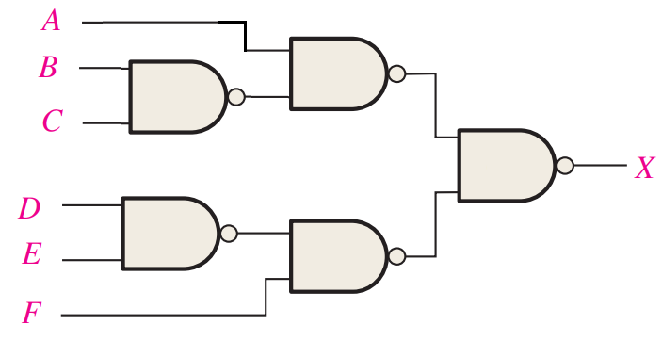
Example

Slide 7
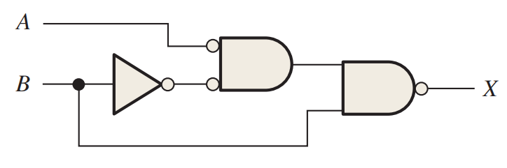
Example

Slide 8
Example
Implement using only NOR gates
X = ABC
Redo with only NAND gates
Notes:
X=(A’+B’+C’)’ X=(ABC)’’

Slide 9
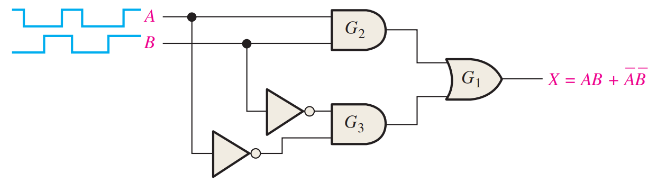
Waveforms
Logic applied at each transition

Slide 10
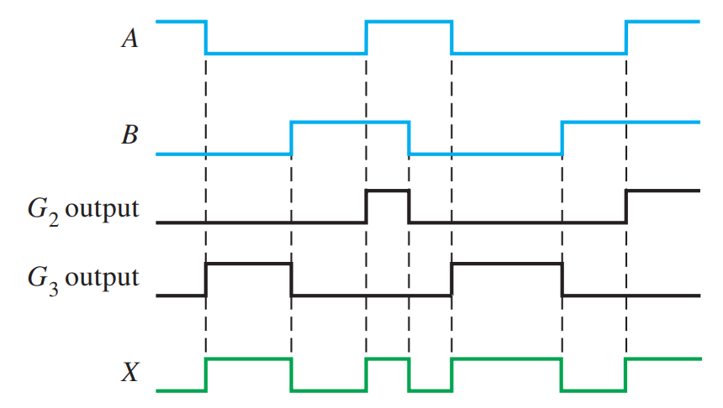
Waveforms

Slide 11
Real ICs
TTL vs CMOS
TTL is older and consumes more power
CMOS is more common
Usually used now to refer to the logic high level
5V vs 3.3V

Slide 12
Handling
Electrostatic Discharge (ESD)
Will let out the blue smoke, every time
Safe handling and usage
Carrying/Transport (cases, touching, storage)
Using (power up last, move unpowered)

Slide 13
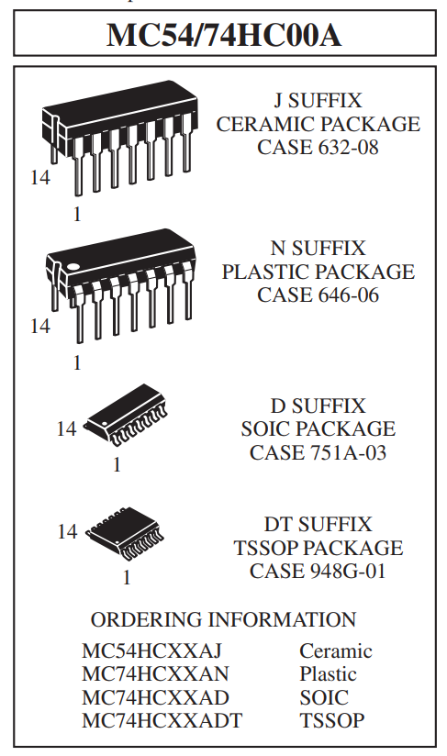
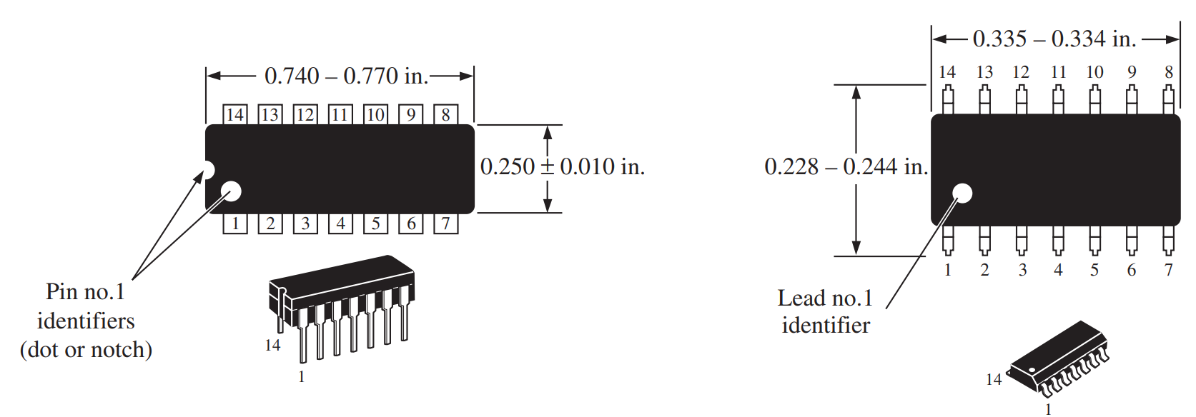
Glue Logic or Bubblegum Logic
Info review on ICs

Slide 14
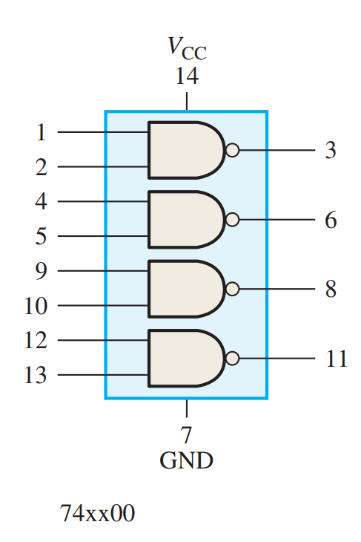
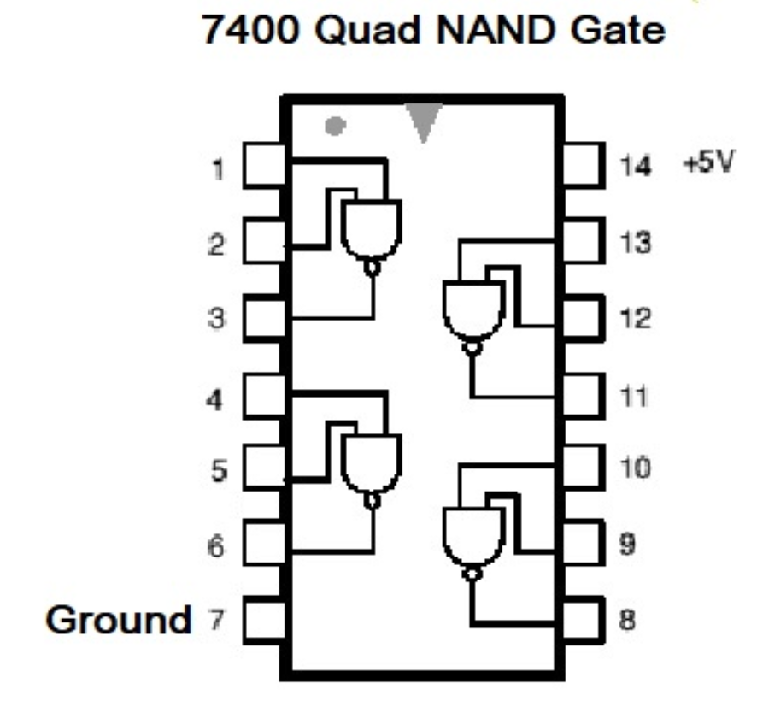
74 Series parts

Slide 15
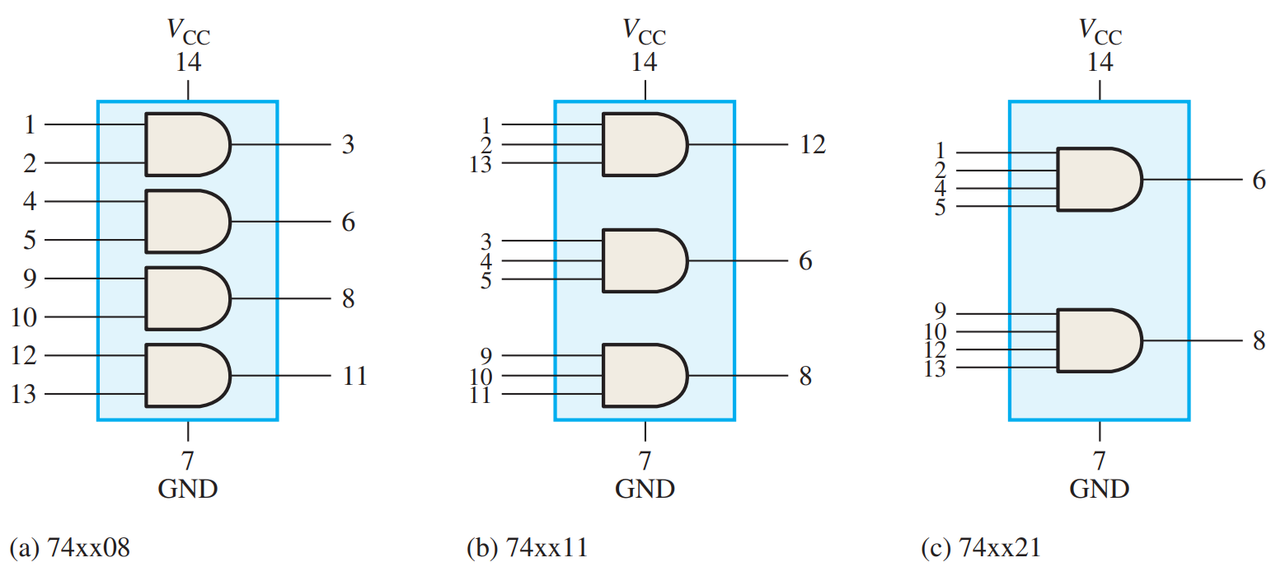
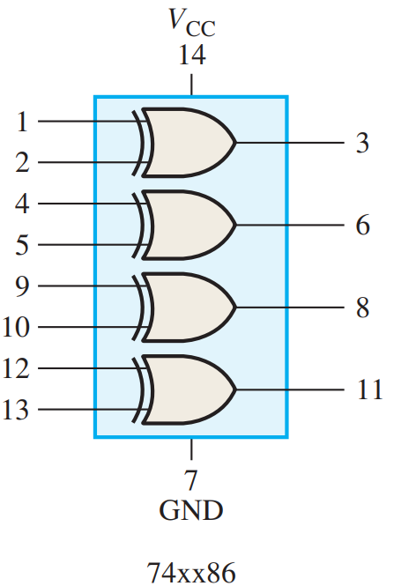
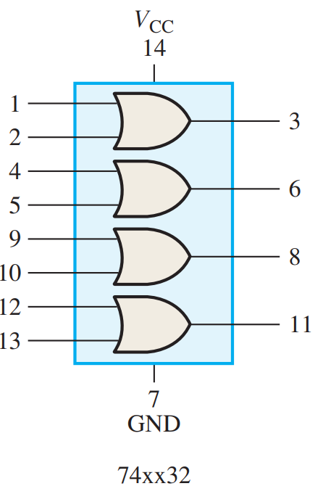
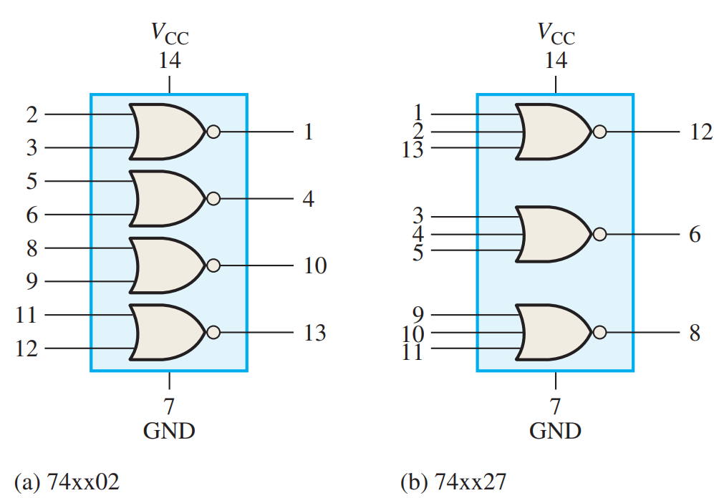
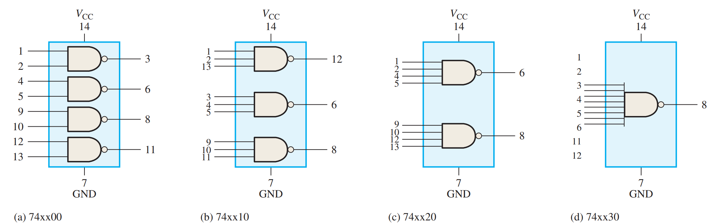
74 Series Parts

Slide 16
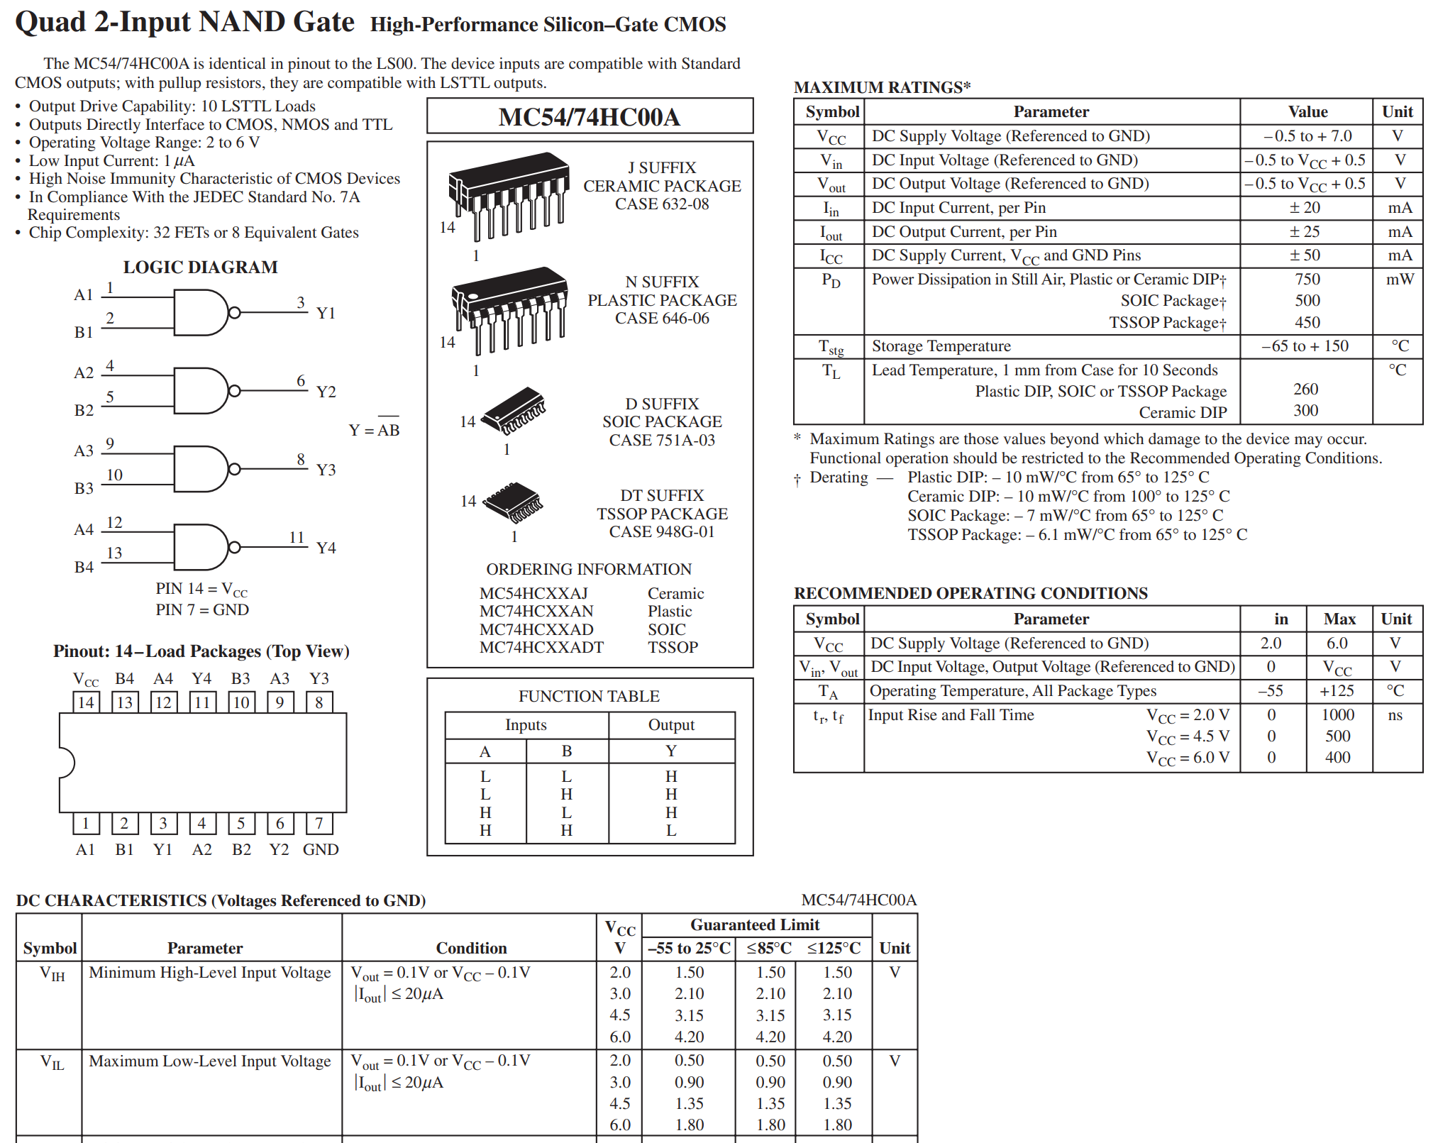
Reading a Datasheet

Slide 17
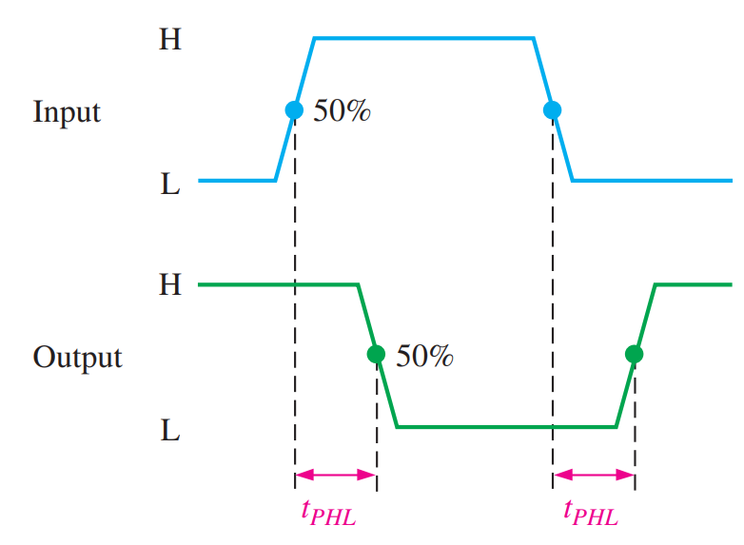
Propagation Delay
Switching speed limit
t_{PHL} – high to low propagation time
t_{PLH} – low to high propagation time
9ns for 7400 above
Be aware of race conditions

Slide 18
Supply voltage (Vcc)
5V, 3.3V, 2.5V, 1.8V
Input range can vary
Must match the rest of your circuits

Slide 19
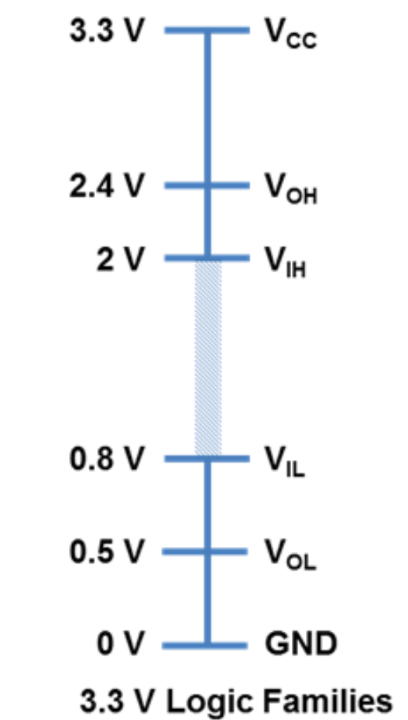
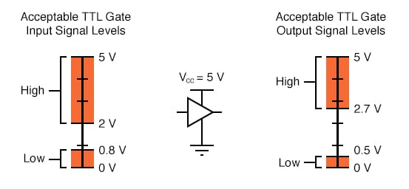
Input/Output Logic Levels
Varies with supply voltage
Stay out of the indeterminant zone

Slide 20
Power Dissipation
Each part draws power
Usually lost to heat
Keep it well below your maximum
Sometimes dependent on frequency of use

Slide 21
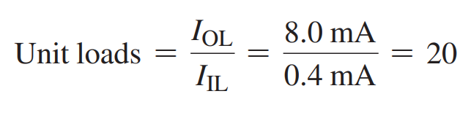
Fan-Out and Loading
Each chip can only output so much current
Fan-Out is how many of the same chips one chip could drive
Ratio of output current to input current

Slide 22
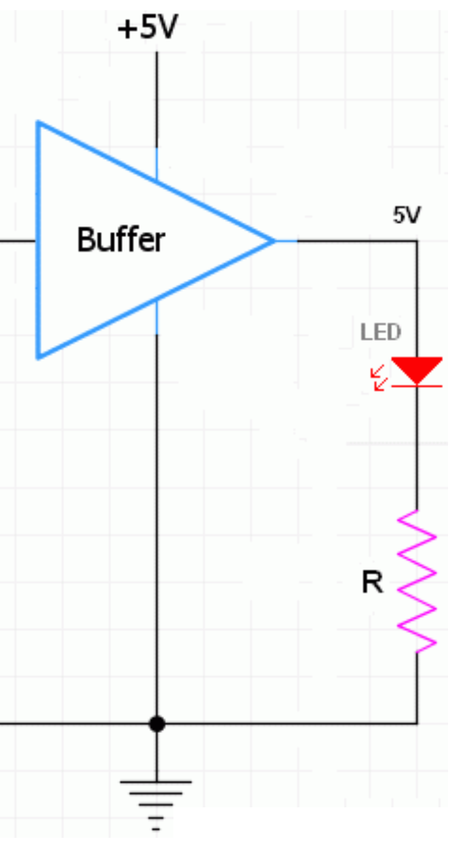
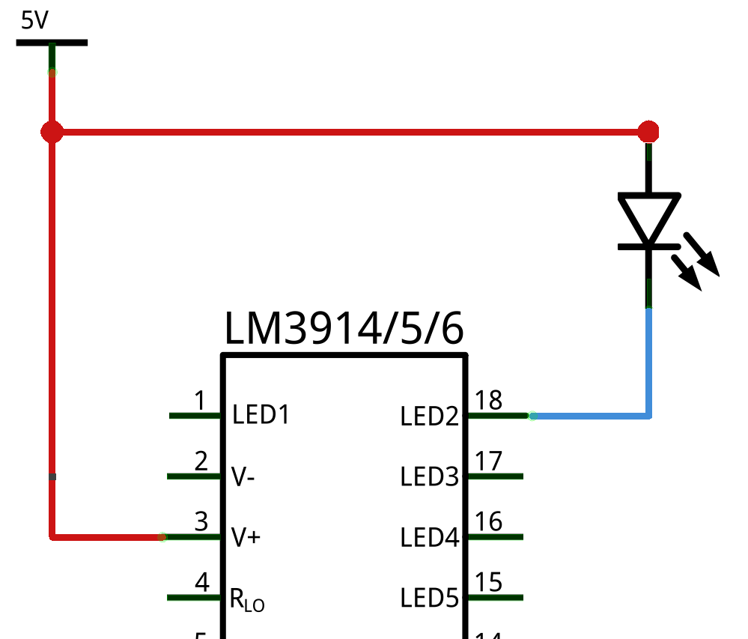


Driving LEDs
ICs can’t usually source much current (~10mA)
ICs can sink more current (~50mA)
LEDs usually take 30mA

Slide 23
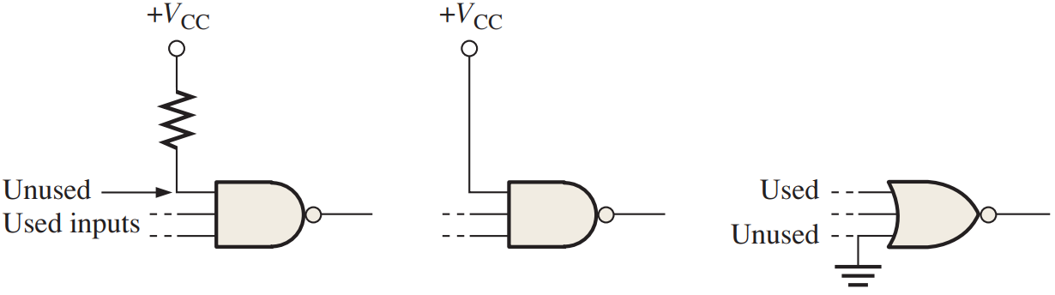
Terminating Un-used Inputs
Floating inputs is bad

Slide 24
Reading
This lecture
Sections 5.4-5.5, 3.8
Next lecture
Sections 6.1-6.3

