Slide 1
CPE201 Digital Design
By Benjamin Haas
Class 14: Adders

Slide 2
Outline
Half Adder
Full Adder
Parallel Adders
Ripple vs Look Ahead Carry

Slide 3
Combinational Logic Applications
You now know the basics
Let’s make cool stuff!
Adders
Comparators
Decoders/Encoders
Mux/Demux
And more!

Slide 4
Half Adder
Recall binary addition
0 + 0 = 0
0 + 1 = 1
1 + 0 = 1
1 + 1 = 10
A circuit that does this is a half adder

Slide 5
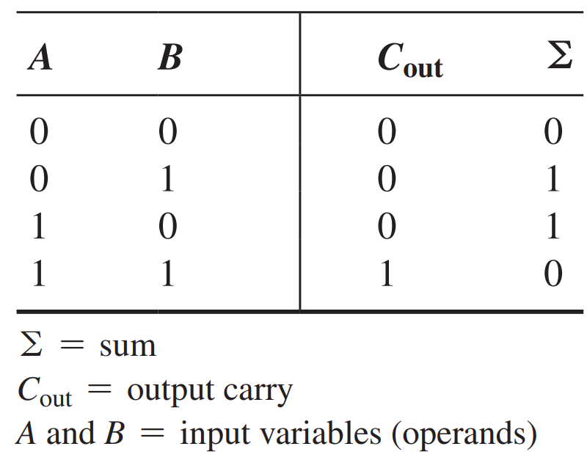
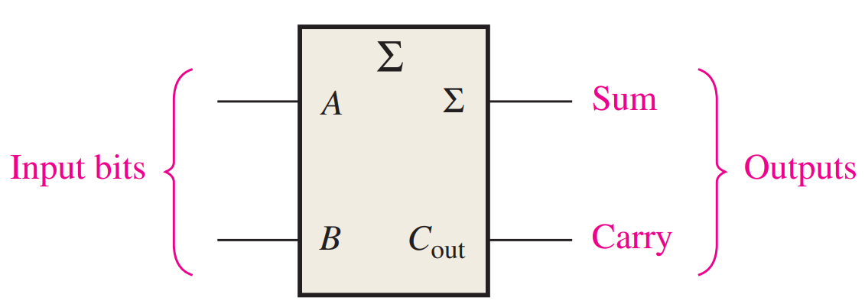
Half Adder
2 inputs, 2 outputs
Addition of 2 bits

Slide 6
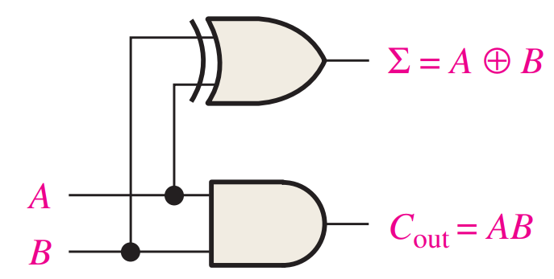

Half Adder
C_{out} = AB
Σ = A$⨁$ B

Slide 7
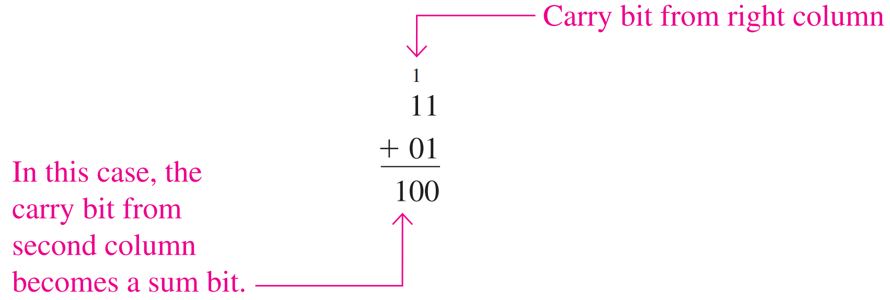
Half Adder+
Can add two input bits together
Not complete for full binary addition
Needs input carry AND output carry

Slide 8
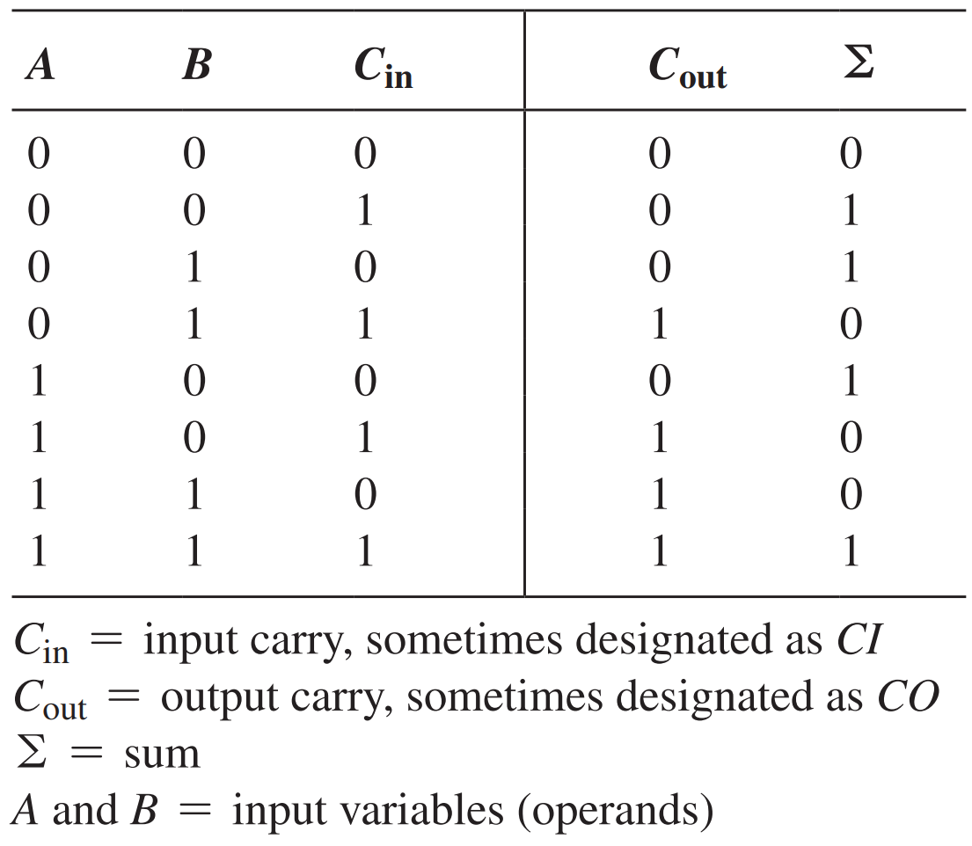
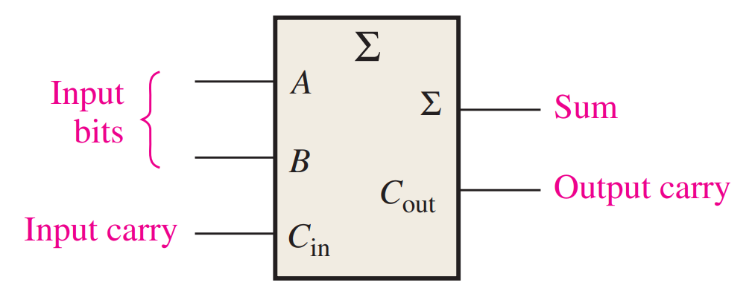
Full Adder
3 inputs, 2 outputs
Addition of 3 bits

Slide 9

Full Adder
C_{out} = AB + (A$⨁$ B)C_{in}
Σ = (A$⨁$ B) $⨁$ C_{in}
Not as obvious

Slide 10
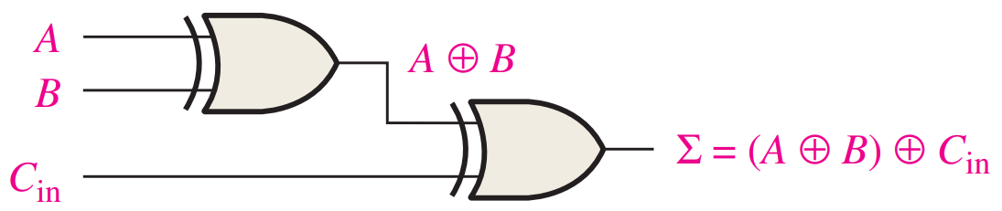
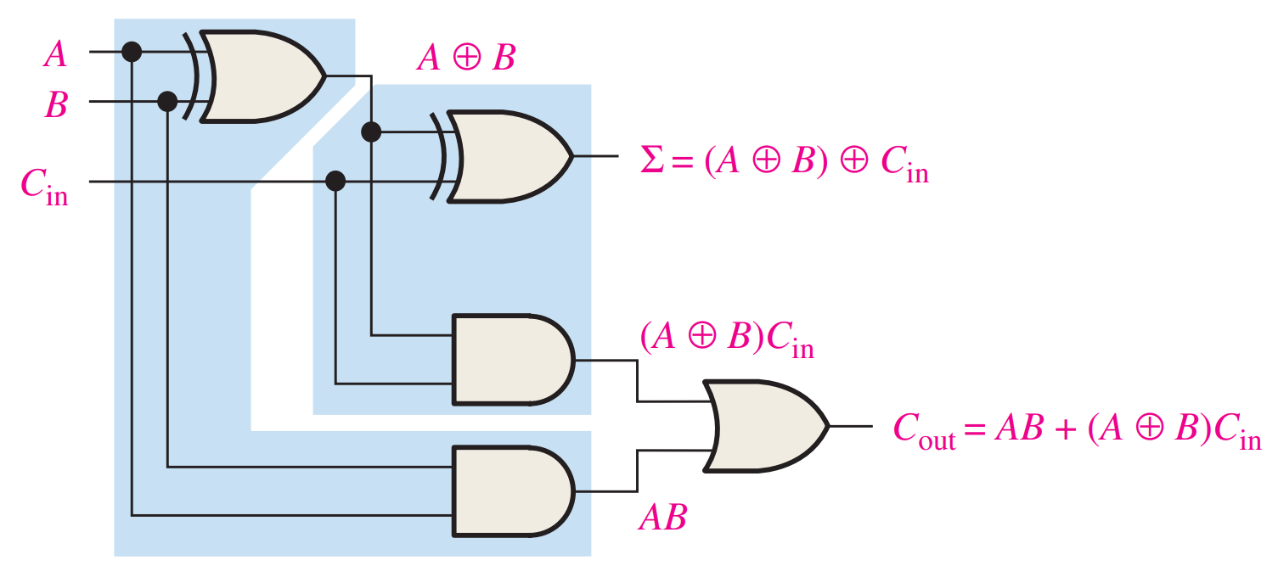
Full Adder

Slide 11
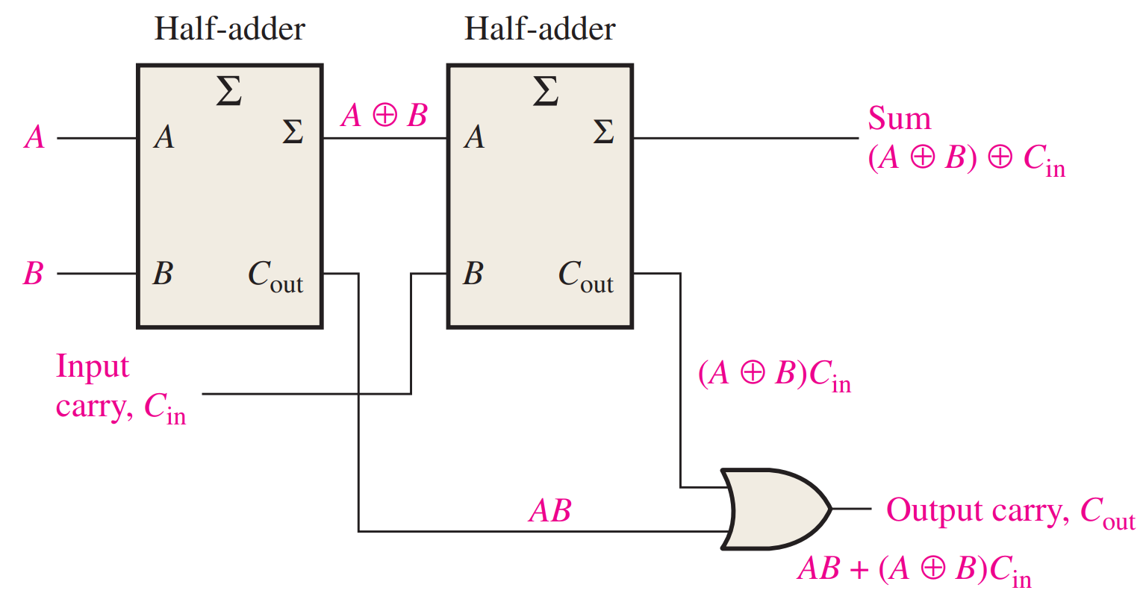
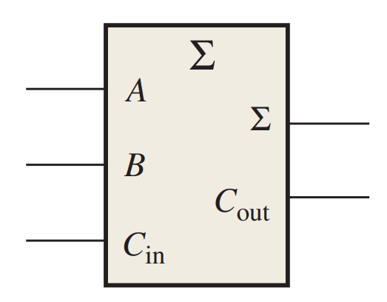
Full Adder

Slide 12
Full Adder+
Can add three input bits together
Complete for full binary addition
Let’s do that!

Slide 13
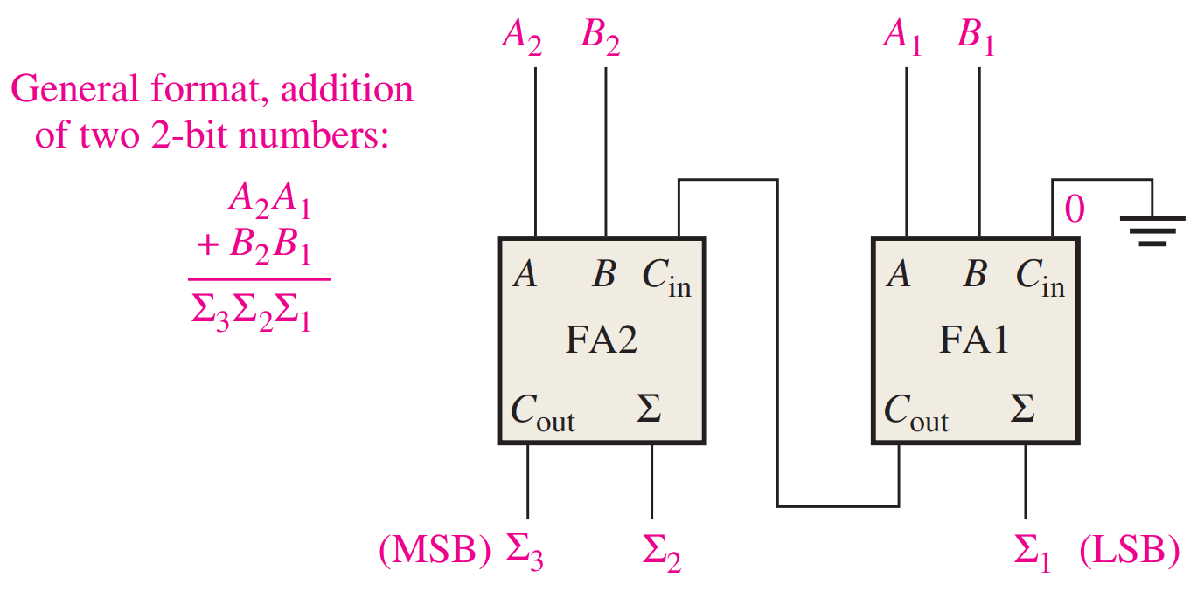
Parallel Binary Adders
Two or more full adders cascaded together

Slide 14
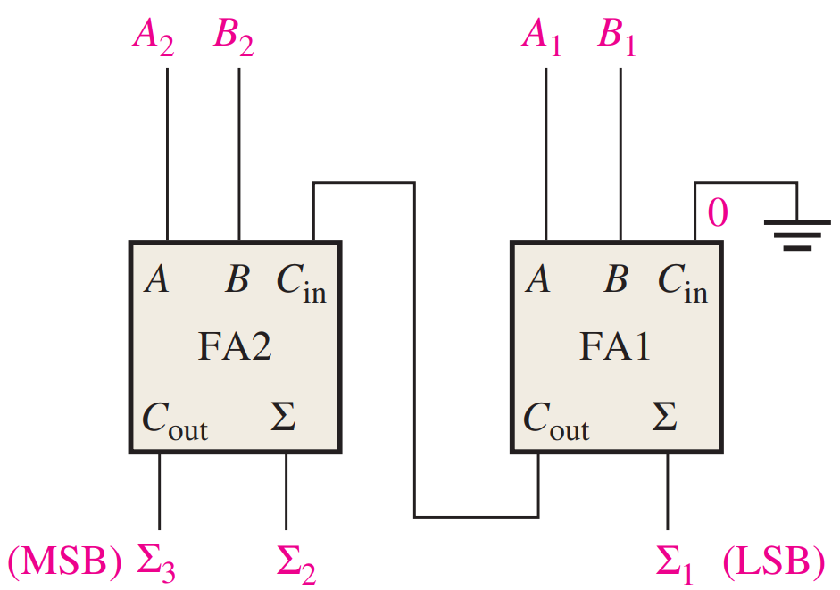
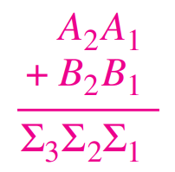
Example
For 11 + 01 = 100
A₁=1 A₂=1 B₁=1 B₂=0

Slide 15
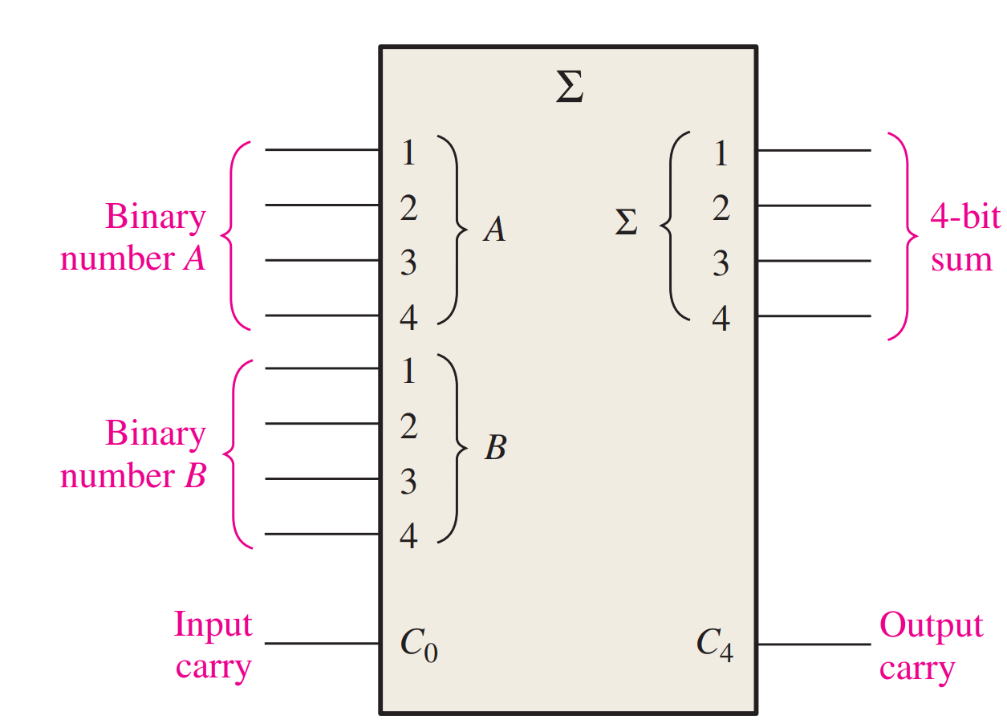
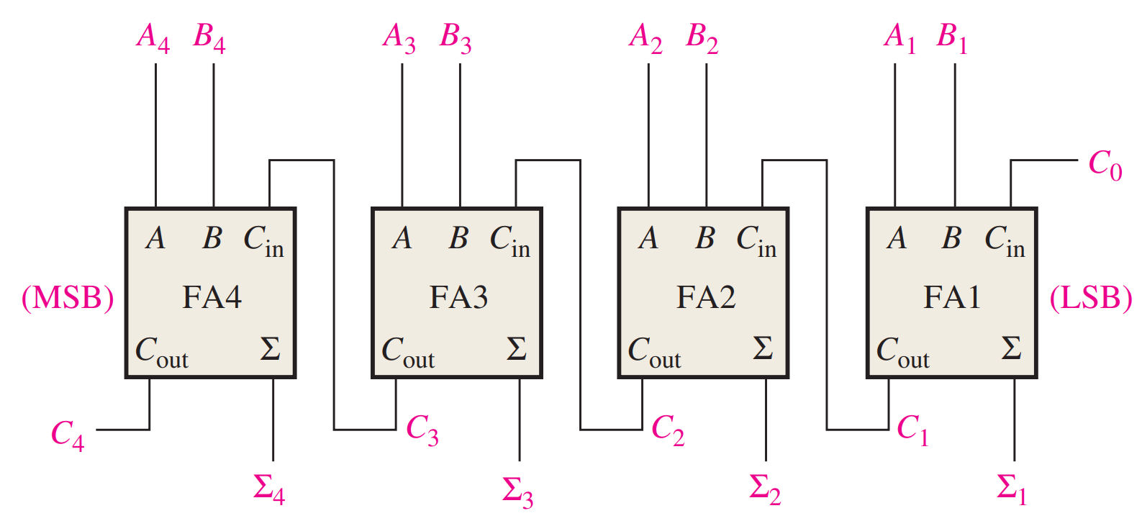
4-Bit Parallel Adder
You can buy those (74xx283)

Slide 16
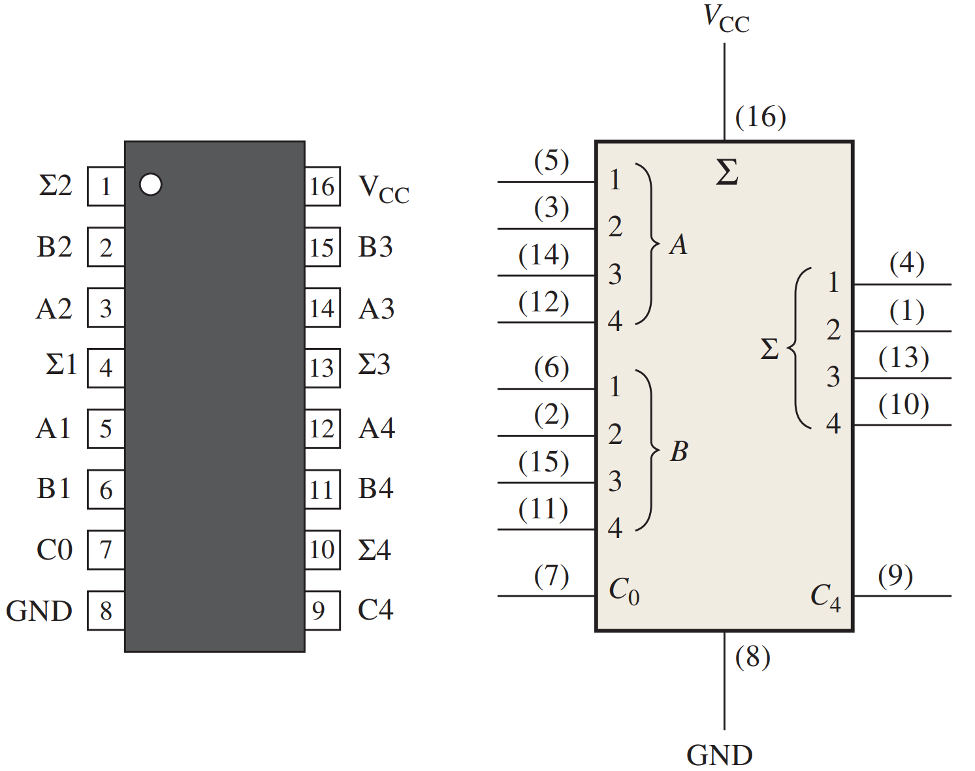
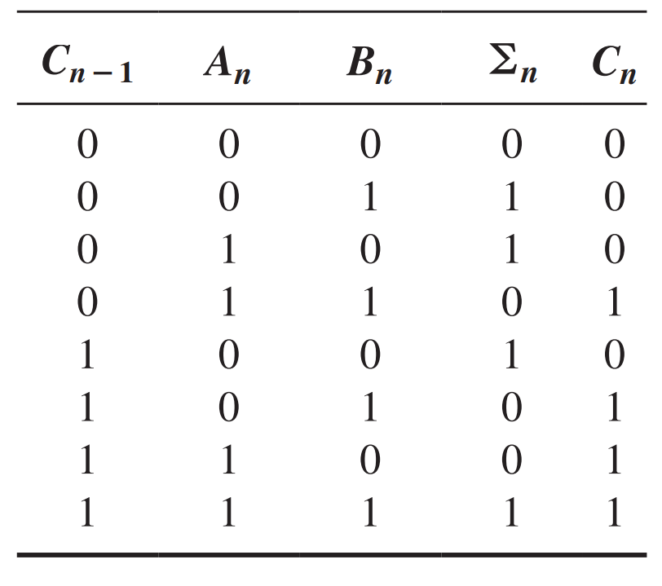
Nibble Adder

Slide 17
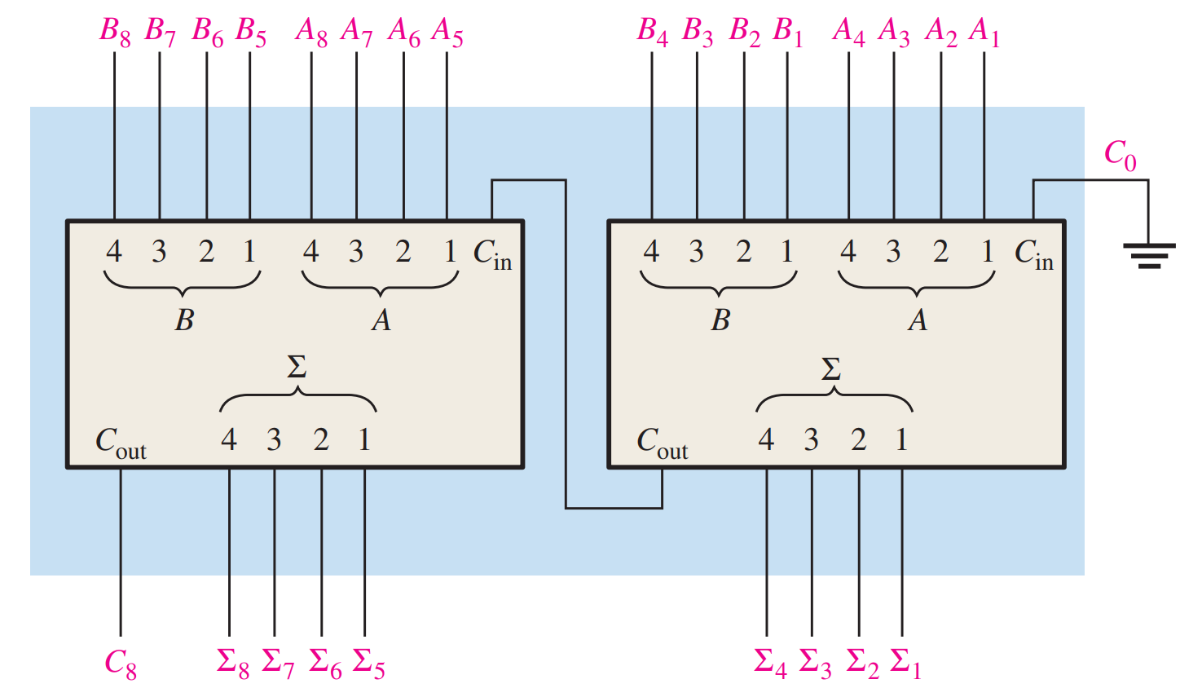
Byte Adder
More Cascading!

Slide 18
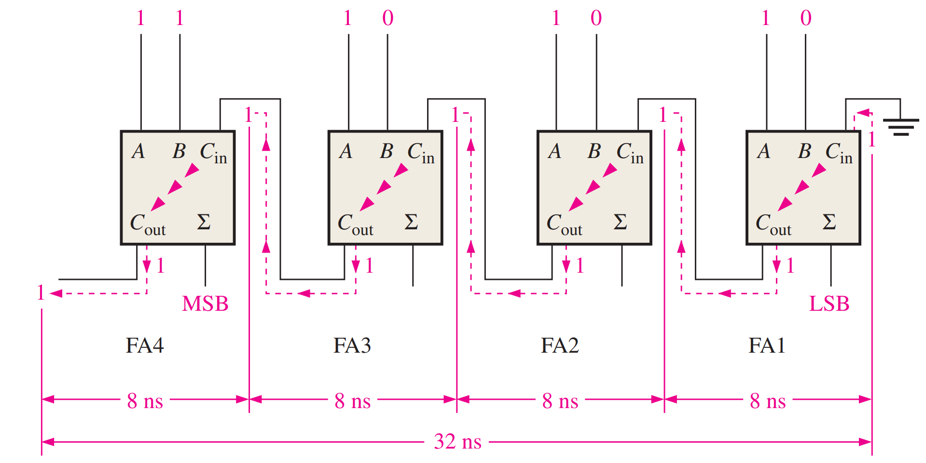
Problem = Ripple Carry Adder
Carry bits are slow
Total time = (3n)τ (time for 1 bit of adding)
Mult/Division =
Add/Subtr
Faster addition
makes all others
faster

Slide 19
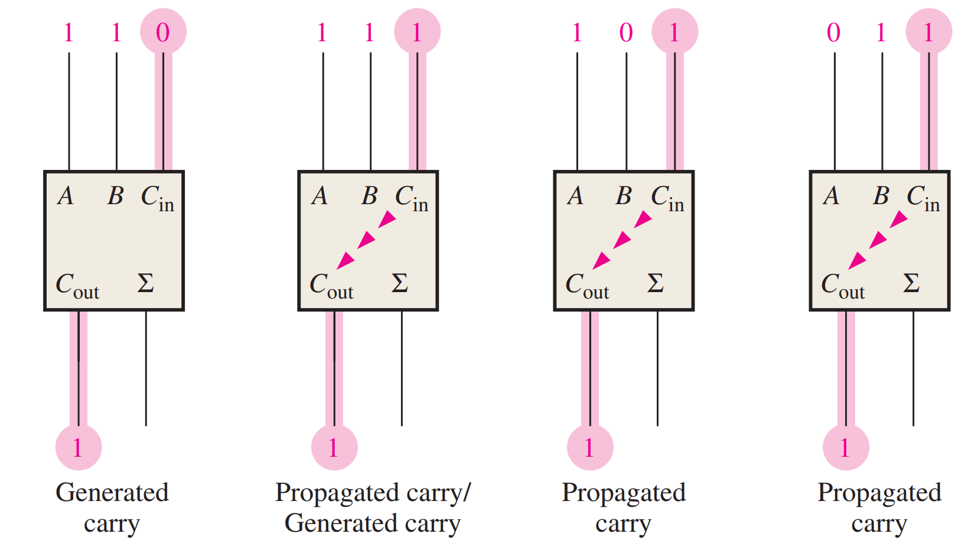
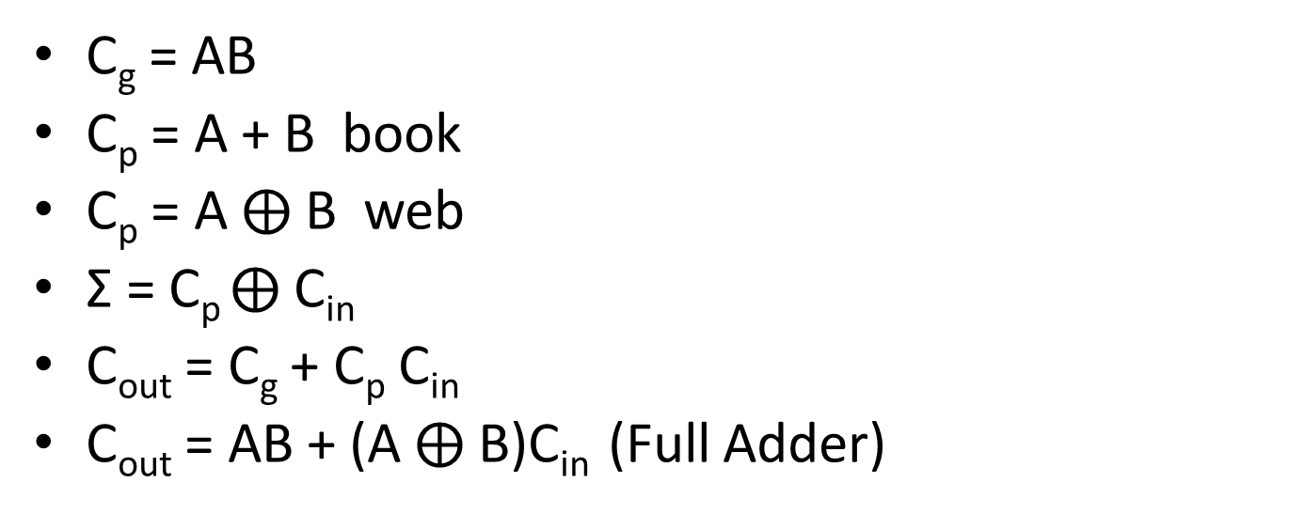
Generated and Propagated Carry
C_{g} = AB
C_{p} = A + B book
C_{p} = A $⨁$ B web
Σ = C_{p} $⨁$ C_{in}
C_{out} = C_{g} + C_{p} C_{in}
C_{out} = AB + (A$⨁$ B)C_{in} (Full Adder)
Notes:
https://www.electricaltechnology.org/2018/04/ripple-carry-and-carry-look-ahead-adder.html
https://electronics.stackexchange.com/questions/58235/what-are-carry-lookahead-adders-and-ripple-carry-adders

Slide 20
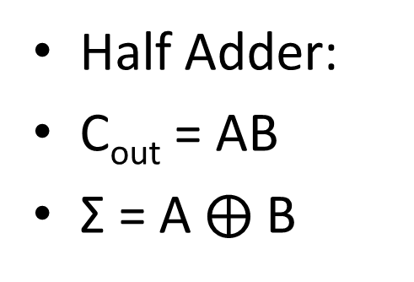
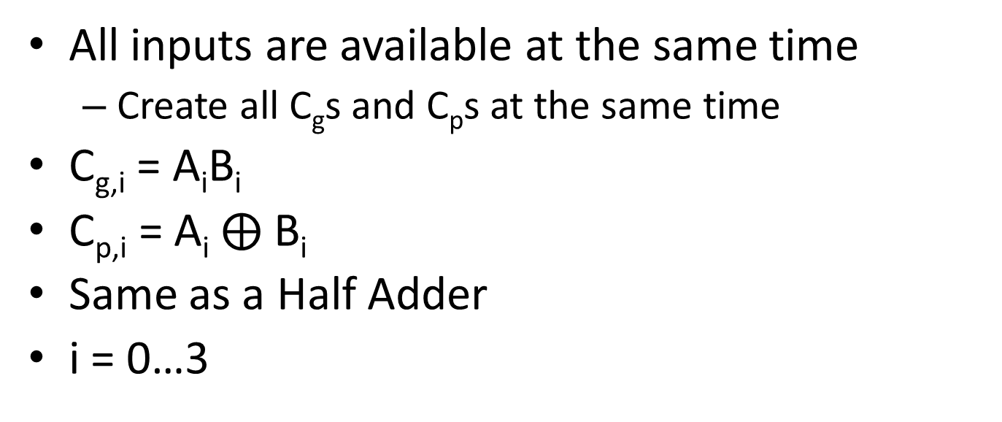
Carry Look-Ahead Adder
All inputs are available at the same time
Create all C_{g}s and C_{p}s at the same time
C_{g,i} = A_{i}B_{i}
C_{p,i} = A_{i} $⨁$ B_{i}
Same as a Half Adder
i = 0…3
Half Adder:
C_{out} = AB
Σ = A$⨁$ B

Slide 21
Carry Look-Ahead Adder
Create all Carry bits
C_{(i+1)} = C_{g,i} + C_{p,i} C_{i}
C₀ = C_{in}
C₄ = C_{out}

Slide 22

Carry Look-Ahead Adder
Last, create all sum bits
Σ_{i} = C_{p,i} $⨁$ C_{i}

Slide 23
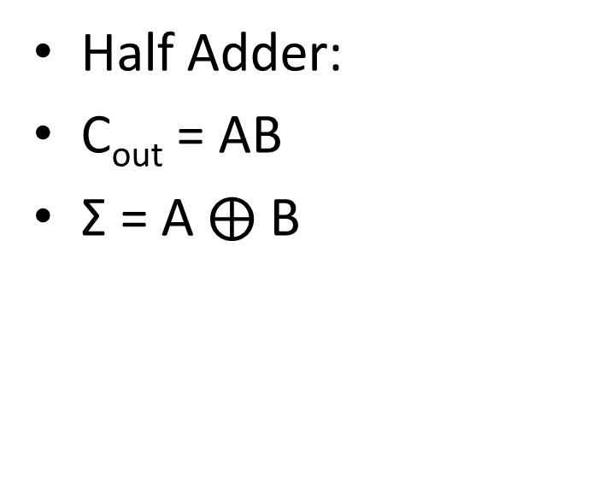
Carry Look-Ahead Adder

Slide 24
Carry Look-Ahead Adder
3 Stages of Logic with no ripple
Total time = 4τ (time for 1 bit of adding)
Ripple carry takes 9τ for 4 bits
Tradeoff of more complex circuitry (w/ more gates)

Slide 25
Reading
This lecture
Sections 6.1-6.3
Next lecture
Sections 6.4-6.6

