Slide 1
CPE201 Digital Design
By Benjamin Haas
Class 15: Comparators and Decoders/Encoders

Slide 2
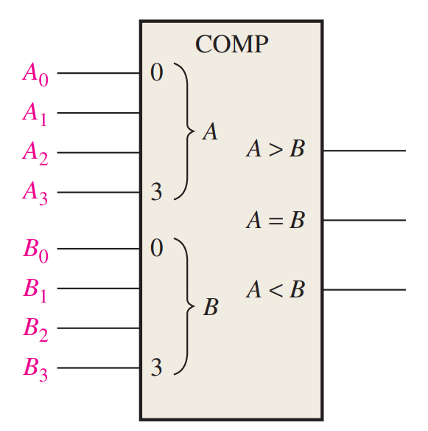
Comparator
End Goal:
4-bit input numbers
<, >, = outputs

Slide 3
Starting Small
1-bit
A<B
A=B
A>B

Slide 4
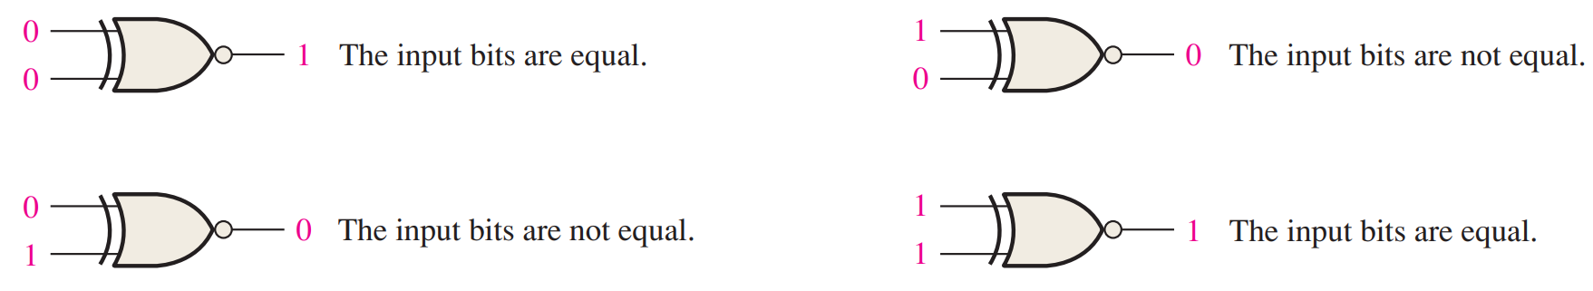

Equality
XNOR (A $⨀$ B)

Slide 5

Truth Table
A | B | A<B | A=B | A>B
0 | 0 | 0 | 1 | 0
0 | 1 | 1 | 0 | 0
1 | 0 | 0 | 0 | 1
1 | 1 | 0 | 1 | 0
A<B = A’B
A=B = A’B’ + AB = A $⨀$ B
A>B = AB’

Slide 6
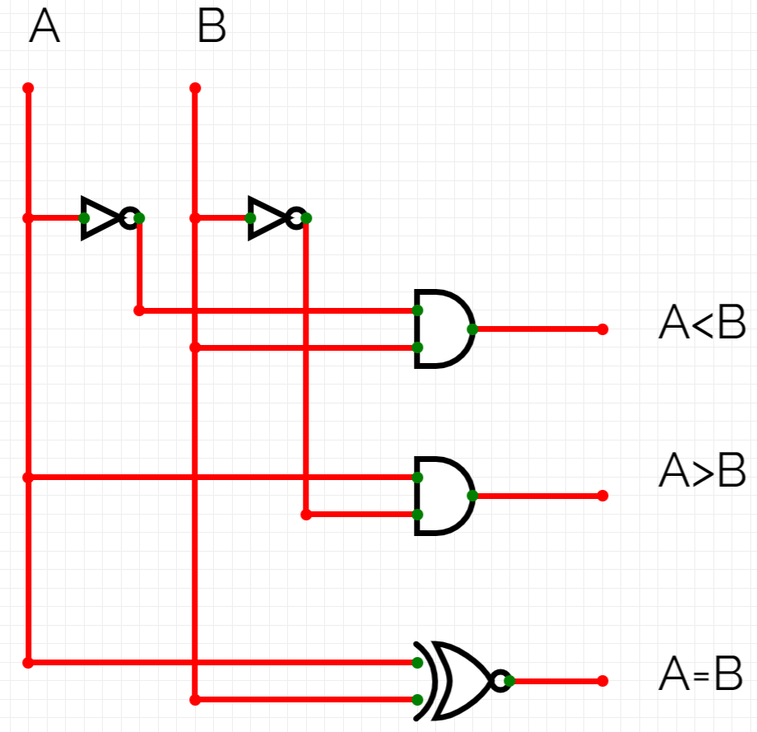

Circuit
A<B = A’B
A=B = A $⨀$ B
A>B = AB’

Slide 7
2-bit Comparator
Same process
A1 | A0 | B1 | B0 | A<B | A=B | A>B
0 | 0 | 0 | 0 | 0 | 1 | 0
0 | 0 | 0 | 1 | 1 | 0 | 0
0 | 0 | 1 | 0 | 1 | 0 | 0
0 | 0 | 1 | 1 | 1 | 0 | 0
0 | 1 | 0 | 0 | 0 | 0 | 1
0 | 1 | 0 | 1 | 0 | 1 | 0
0 | 1 | 1 | 0 | 1 | 0 | 0
0 | 1 | 1 | 1 | 1 | 0 | 0
A1 | A0 | B1 | B0 | A<B | A=B | A>B
1 | 0 | 0 | 0 | 0 | 0 | 1
1 | 0 | 0 | 1 | 0 | 0 | 1
1 | 0 | 1 | 0 | 0 | 1 | 0
1 | 0 | 1 | 1 | 1 | 0 | 0
1 | 1 | 0 | 0 | 0 | 0 | 1
1 | 1 | 0 | 1 | 0 | 0 | 1
1 | 1 | 1 | 0 | 0 | 0 | 1
1 | 1 | 1 | 1 | 0 | 1 | 0

Slide 8
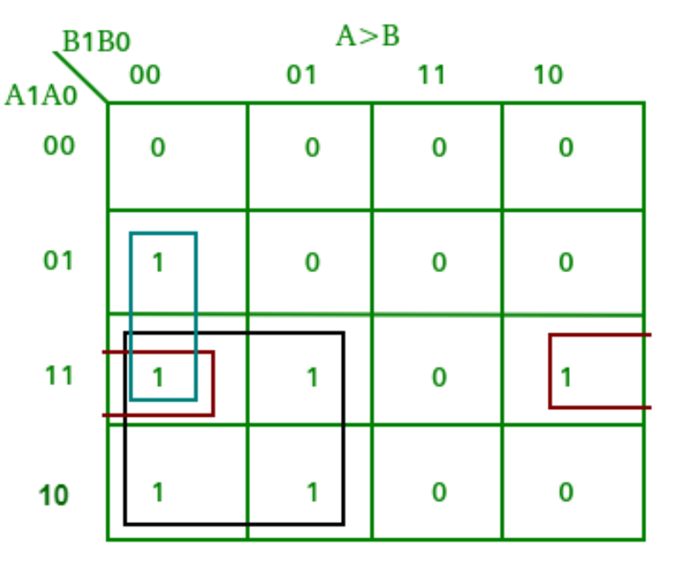
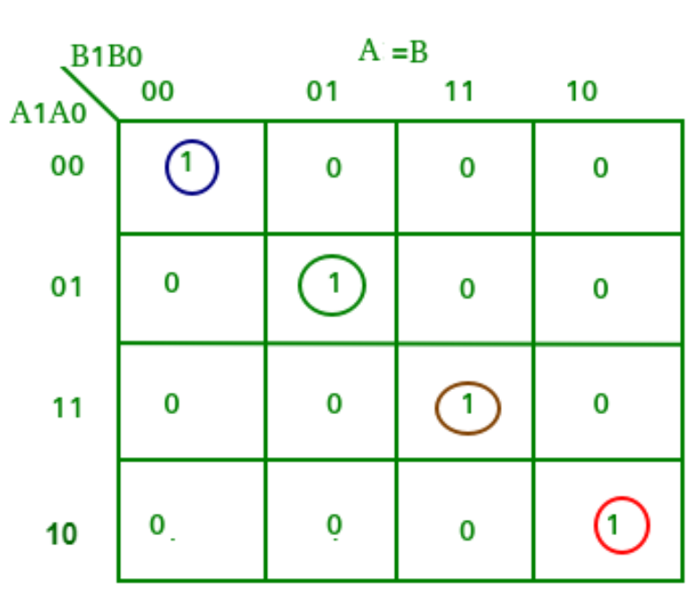
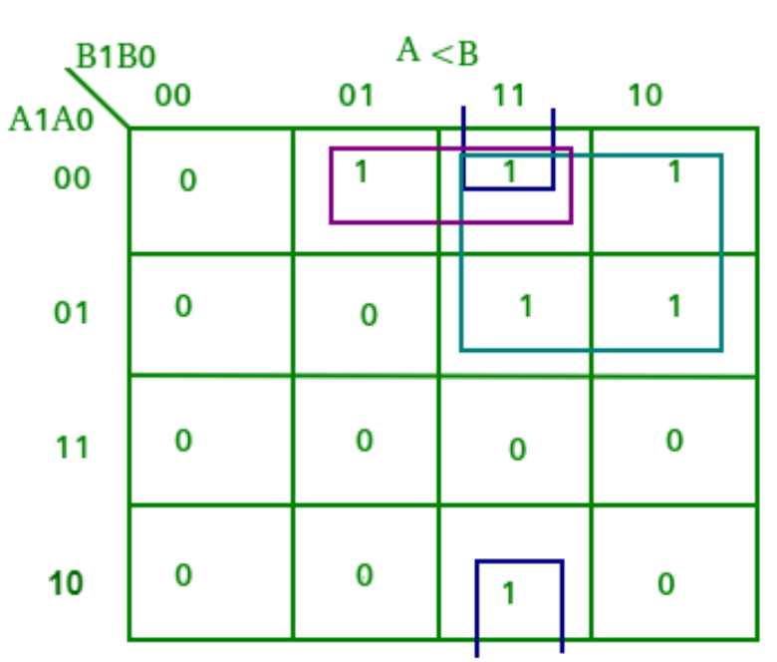
Karnaugh Maps

Slide 9
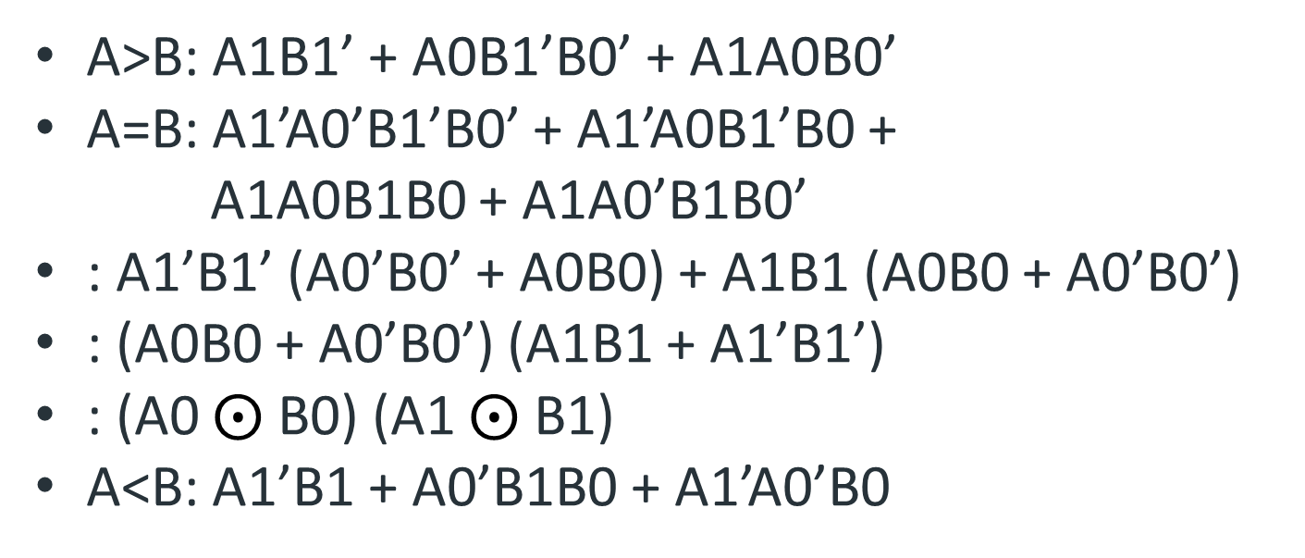
Boolean Expressions
A>B: A1B1’ + A0B1’B0’ + A1A0B0’
A=B: A1’A0’B1’B0’ + A1’A0B1’B0 +
A1A0B1B0 + A1A0’B1B0’
: A1’B1’ (A0’B0’ + A0B0) + A1B1 (A0B0 + A0’B0’)
: (A0B0 + A0’B0’) (A1B1 + A1’B1’)
: (A0 $⨀$ B0) (A1 $⨀$ B1)
A<B: A1’B1 + A0’B1B0 + A1’A0’B0

Slide 10
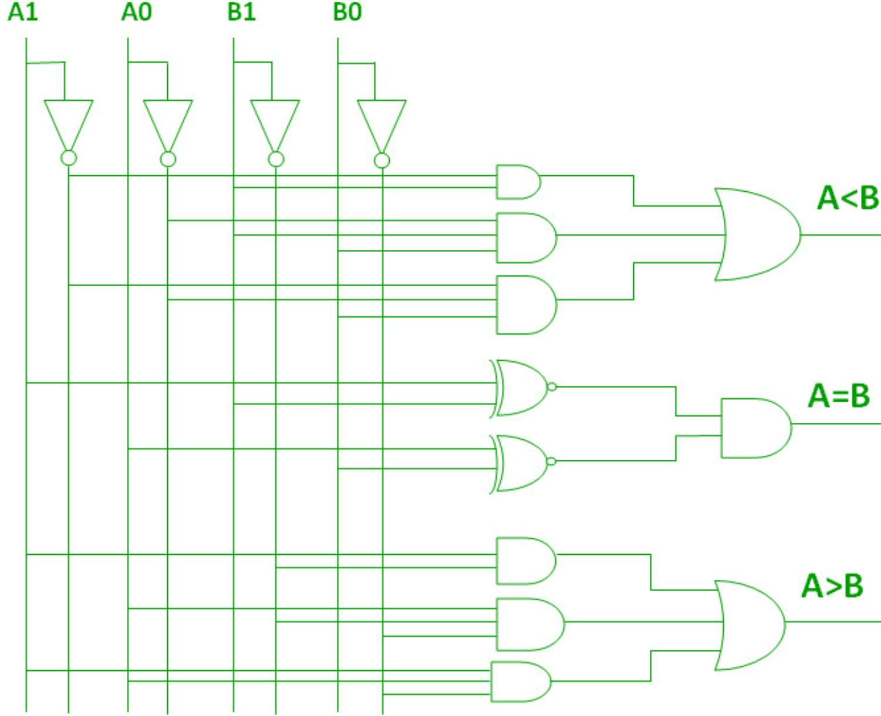
Circuit

Slide 11
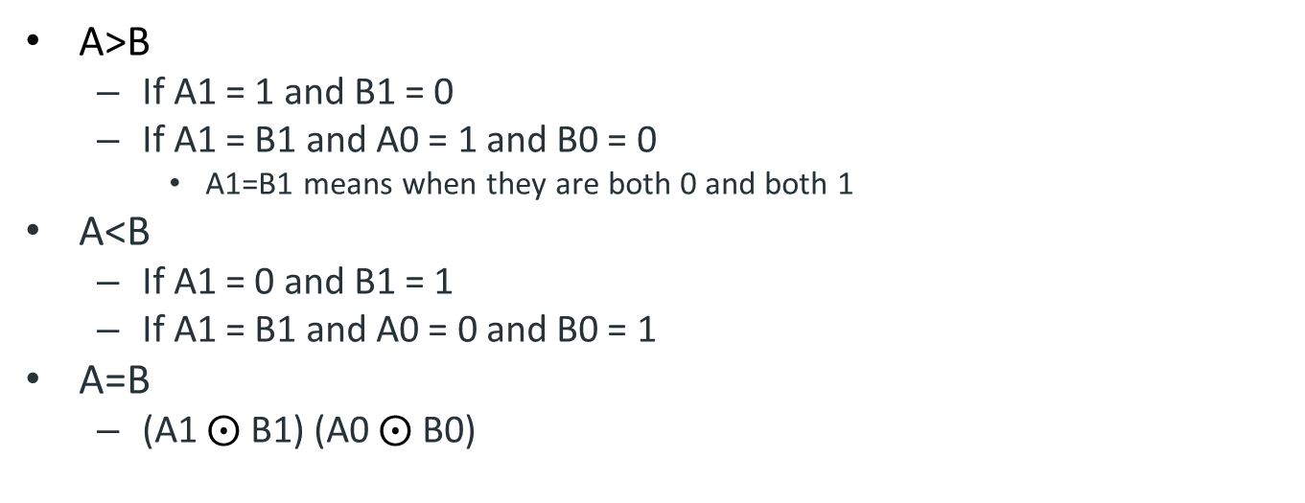
Generalize
A>B
If A1 = 1 and B1 = 0
If A1 = B1 and A0 = 1 and B0 = 0
A1=B1 means when they are both 0 and both 1
A<B
If A1 = 0 and B1 = 1
If A1 = B1 and A0 = 0 and B0 = 1
A=B
(A1 $⨀$ B1) (A0 $⨀$ B0)

Slide 12
4-bit Comparator
Use generalized rules
8-bits is too many inputs for a Karnaugh map
Create a circuit from the rules
A>B
If A3 = 1 and B3 = 0
If A3 = B3 and A2 = 1 and B2 = 0
If A3 = B3, A2 = B2 and A1 = 1 and B1 = 0
If A3 = B3, A2 = B2, A1 = B1 and A0 = 1 and B0 = 0

Slide 13
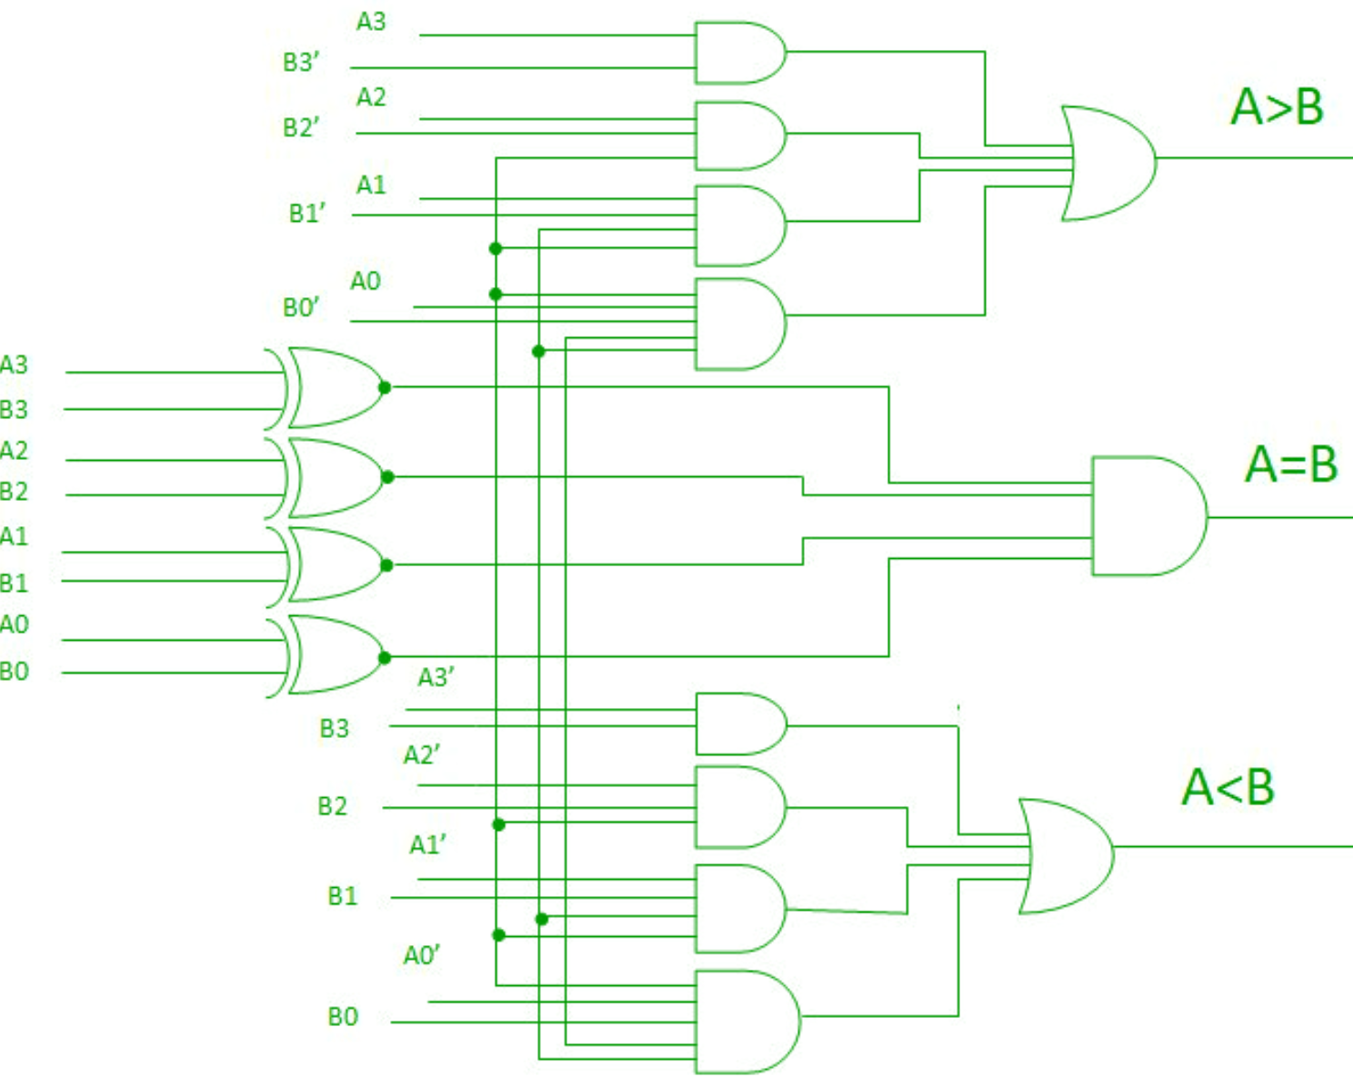
4-bit Comparator

Slide 14
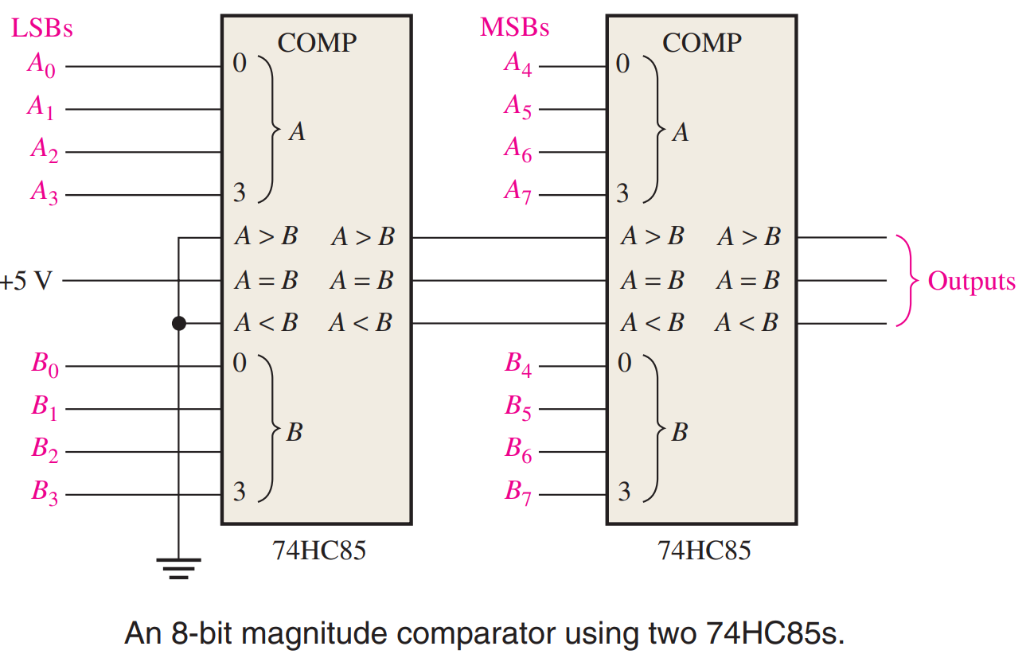
Larger Comparators
Input AND output comparator signals to ripple the results
Inputs treated
as 5th bit

Slide 15
Comparator Applications
Sensors
Temperature, position compared to a setting
Motor control
Like in 3-D printers
Password verification

Slide 16
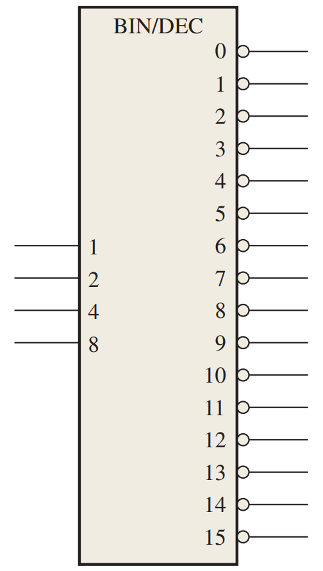
Decoders
An input combination
activates one output
n inputs, 2^n outputs
1 to 2, 2 to 4, 3 to 8, 4 to 16

Slide 17
Active High vs Active Low
Active High = ON means 1
Active Low = ON means 0
This chip is active low

Slide 18
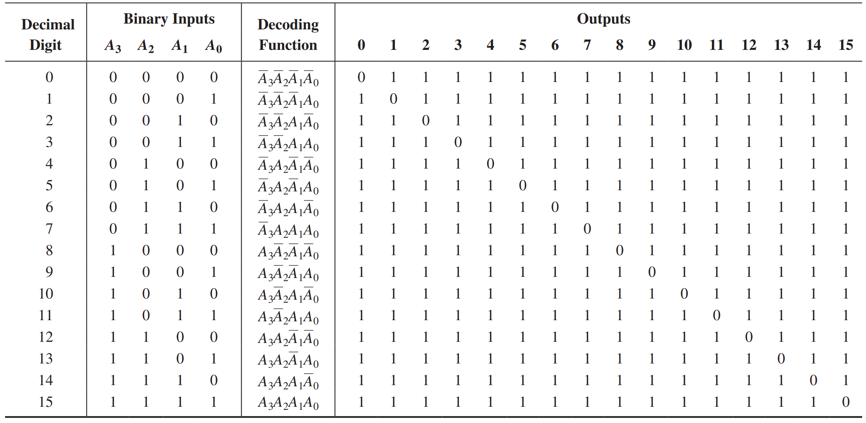
Active Low Decoder

Slide 19
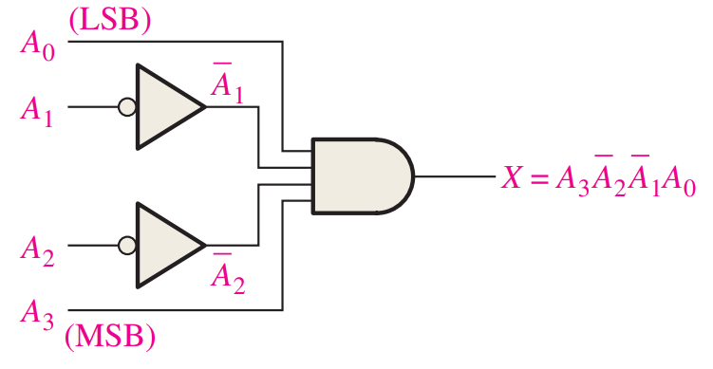
Basics
Input = 1001
Active high output
AND

Slide 20
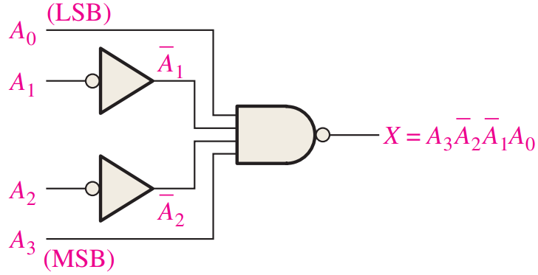
Basics
Input = 1001
Active low output
NAND
Chip would have
16 of these

Slide 21
Applications
Memory Addressing
Turn on a specific bank of memory
Turn specific things on and off
Ex TV vs projector screen

Slide 22
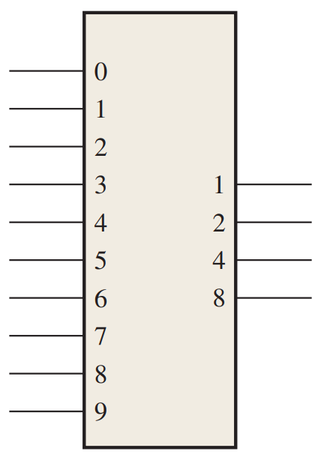
Encoders
Reverse of decoder
2^n inputs, n outputs

Slide 23
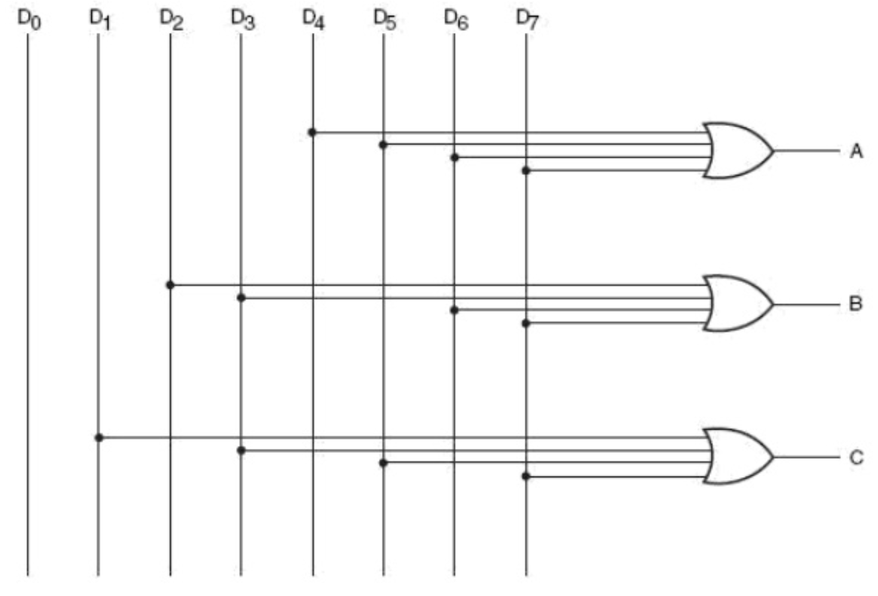
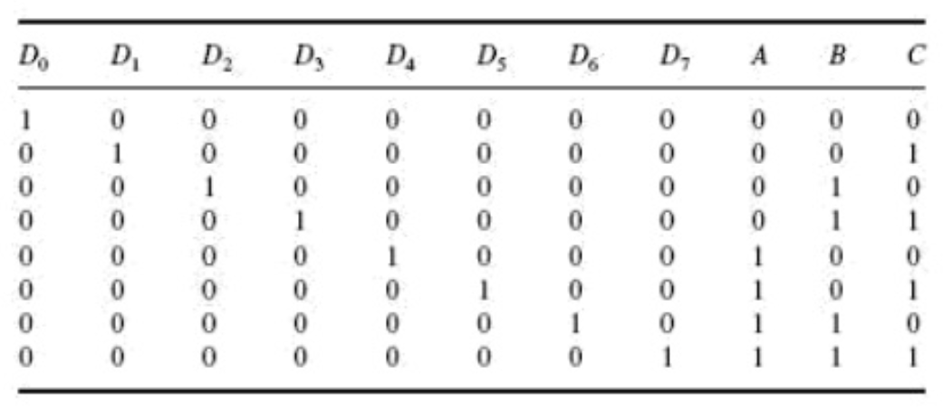
Basics
8 to 3 encoder (binary to octal)

Slide 24
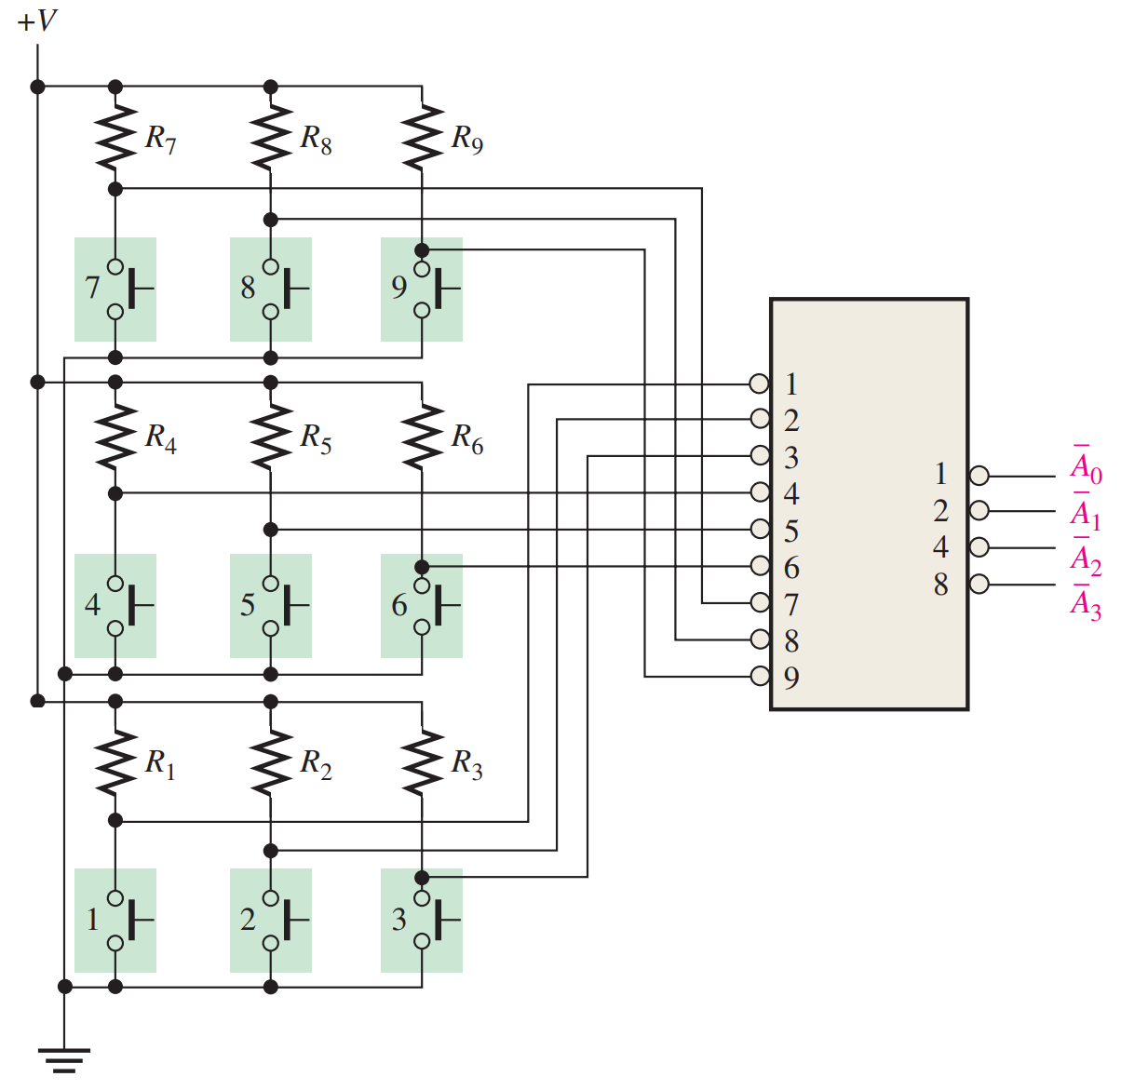
Application
Keypad
Encoded output
is easier to transmit
and use

Slide 25
Reading
This lecture
Sections 6.4-6.6
Next lecture
Sections 6.8-6.10

