Slide 1
CPE201 Digital Design
By Benjamin Haas
Class 16: Multiplexers and Parity

Slide 2
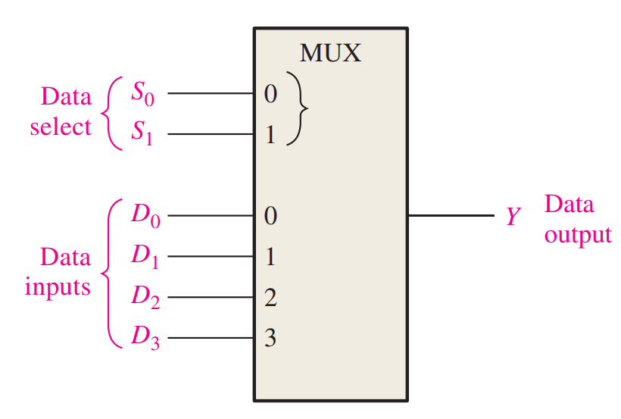
Multiplexer
Usually called a MUX
Has both encoder and decoder inputs
n selection inputs and 2^n data inputs
One output
n selects which of 2^n
is on the output

Slide 3
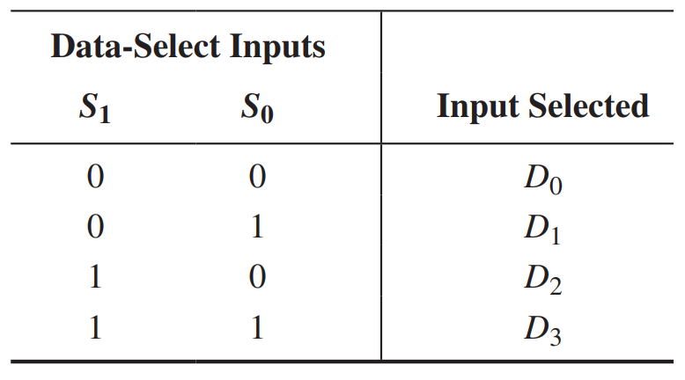
MUX

Slide 4
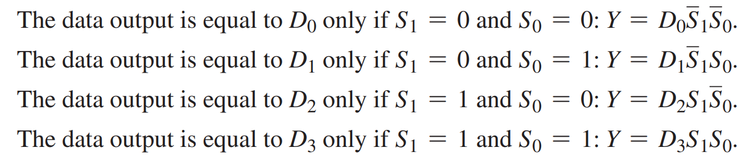
MUX

Slide 5
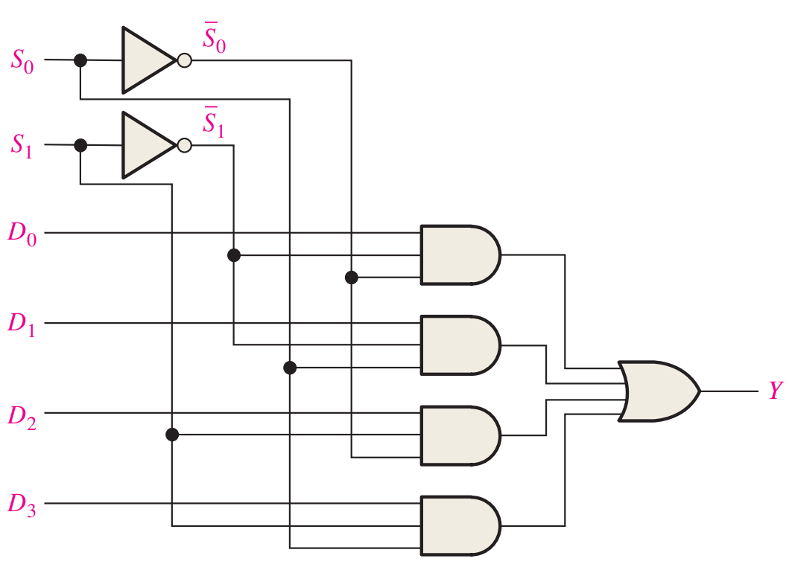
MUX

Slide 6
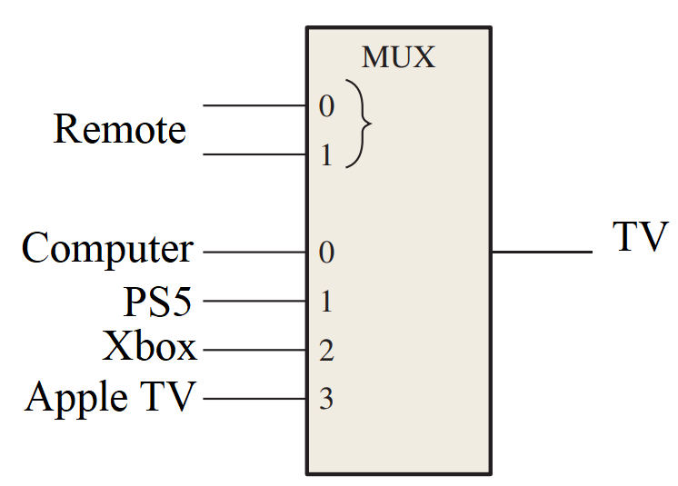
Example

Slide 7
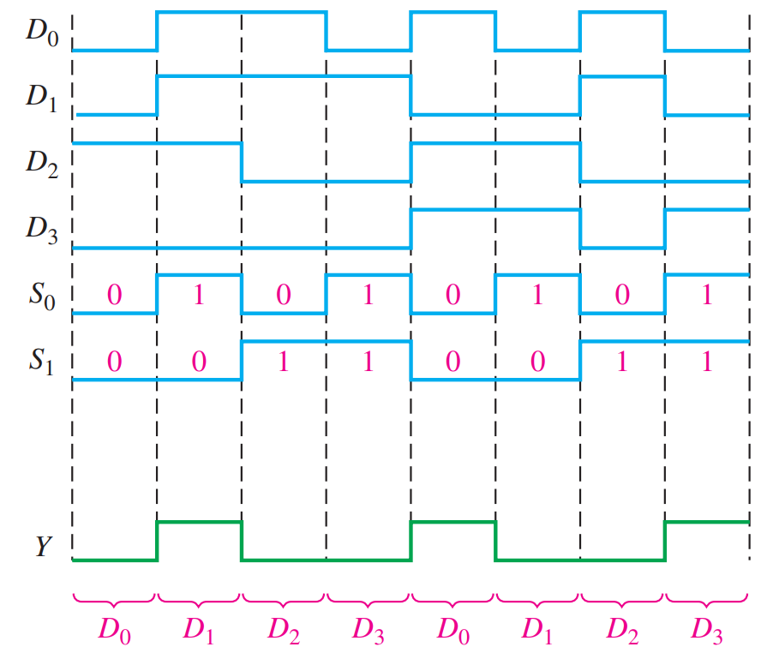
Example

Slide 8
Transmission Modes
Simplex Transmission Mode
Television, radio, above MUX circuit
Half Duplex Transmission Mode
Walkie-talkie
Full Duplex Transmission Mode
Phones

Slide 9
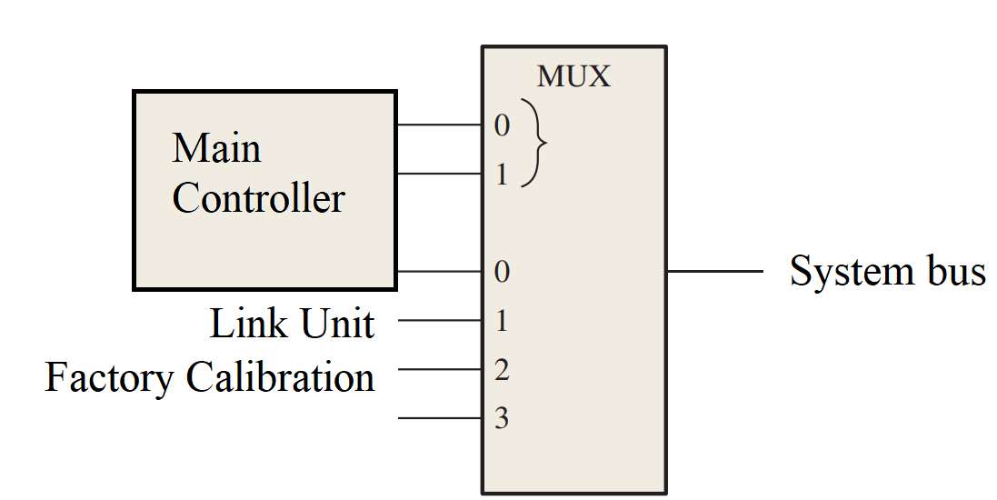
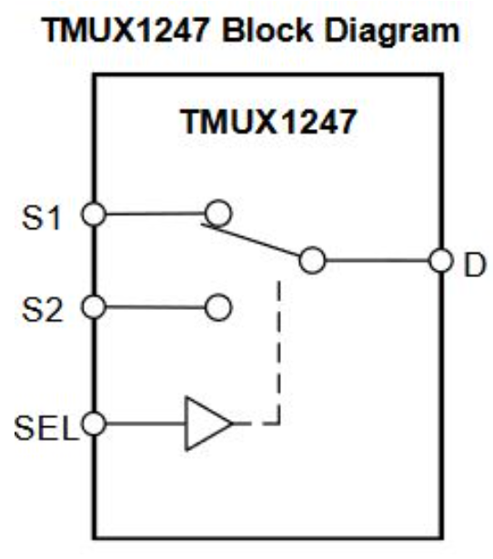
Half Duplex Example
Not really a MUX, but a MUX switch

Slide 10
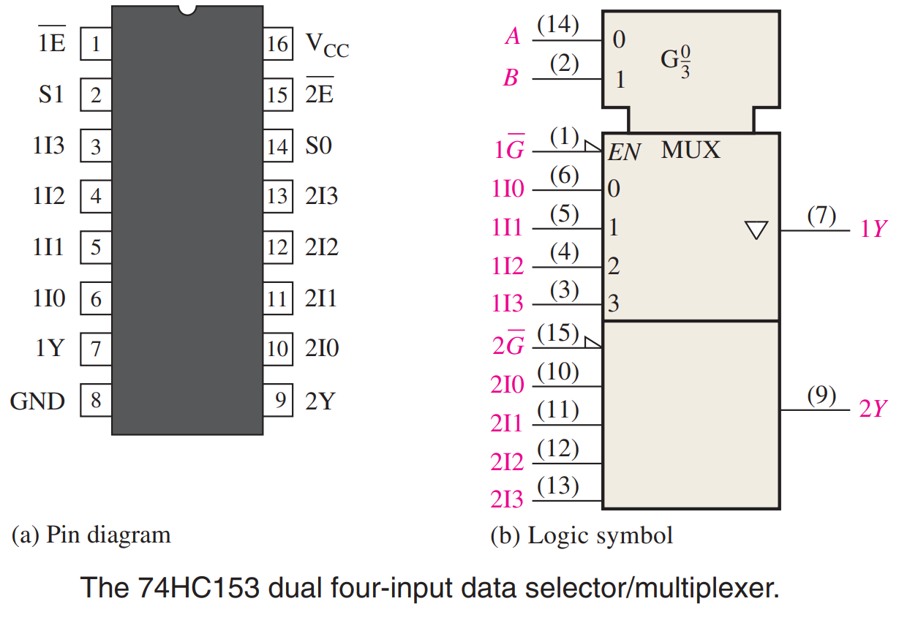
Real Chips – 74HC153
Dual 4-input MUX
Now with enable

Slide 11
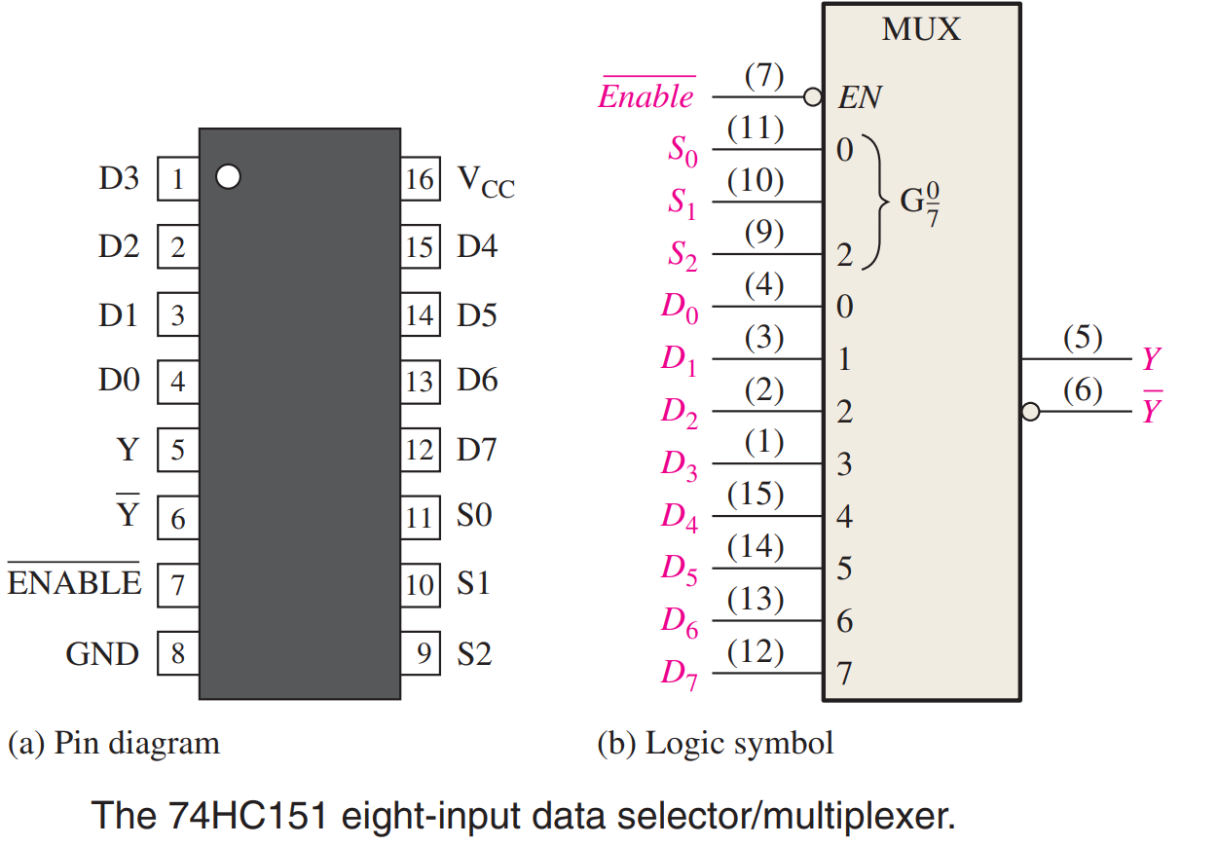
Real Chips – 74HC151
8-input MUX

Slide 12
Demultiplexer (DEMUX)
Reverse of MUX
n selection inputs and one data input
2^n data outputs
n selects pins tell which of 2^n
the input goes onto

Slide 13
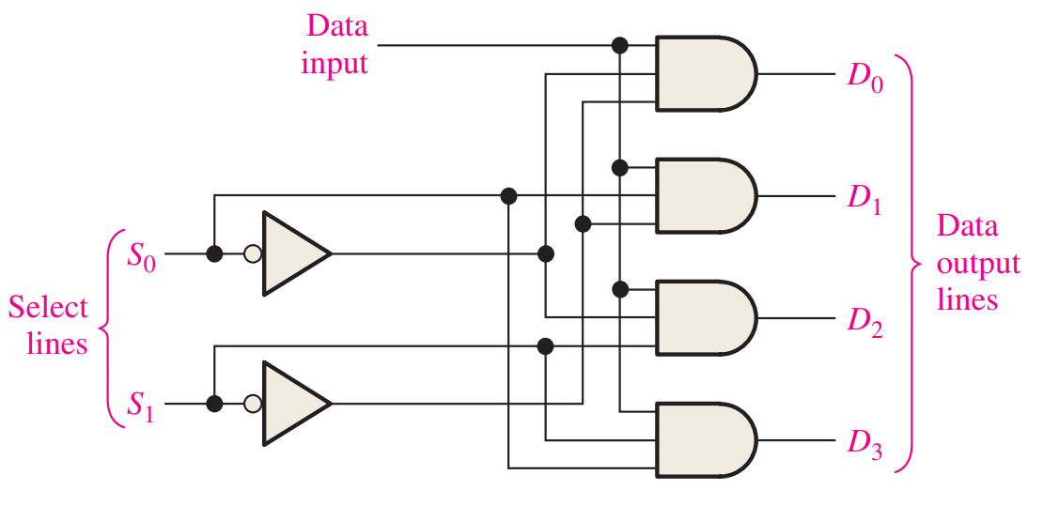
DEMUX
S1 | S0 | D3 | D2 | D1 | D0
0 | 0 | 0 | 0 | 0 | Input
0 | 1 | 0 | 0 | Input | 0
1 | 0 | 0 | Input | 0 | 0
1 | 1 | Input | 0 | 0 | 0

Slide 14
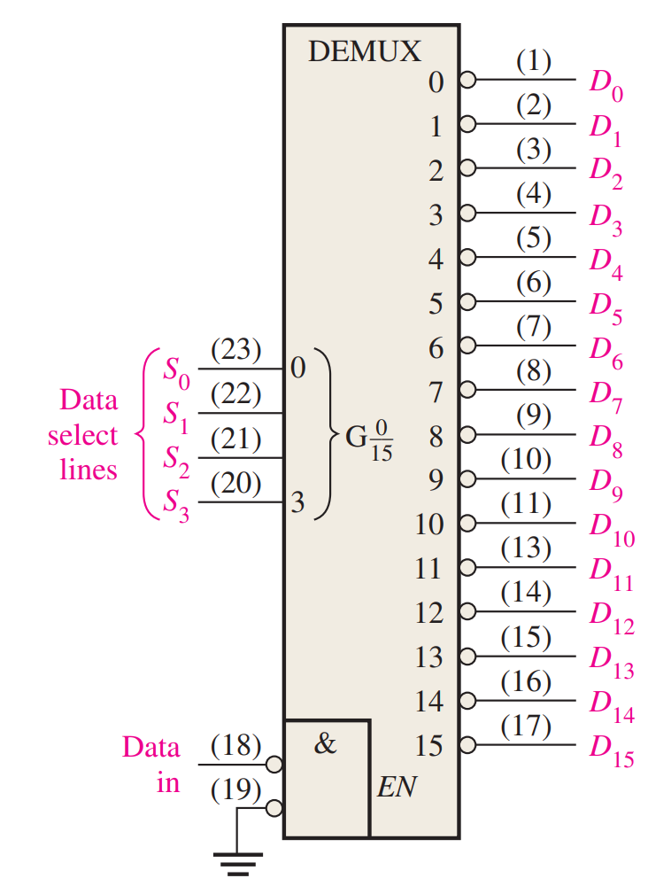
Decoder as DEMUX
One CS line becomes
data input
Active low example

Slide 15
DEMUX Applications
Like a chip select to pick what subsystem
to communicate with
Computer to projector or monitor
Memory addressing and comms
Serial to parallel conversion

Slide 16
Parity
A form of error checking
Even parity - # of 1’s in a transmission is even
Sum of all bits is 0
Odd parity - # of 1’s in a transmission is odd
Sum of all bits is 1

Slide 17
Examples
Even or odd parity?
1000 0100
1010 0101
1110 0000
0110 0100
0110 1010

Slide 18
Parity for Error Checking
One less data bit than packet size
Replaced with parity bit
Packets without parity are discarded
Packet can be any size
Larger packets should have more robust error checking

Slide 19
Communication w/Parity
One form of parity must be chosen
Generate parity bits to ensure the chosen form
Parity check passes if received data has the chosen form, otherwise error occurred

Slide 20
Examples
Assume even parity communication
Find the parity bit x
1000 010x
1010 010x
1110 000x
0110 010x
0110 101x

Slide 21
Examples
Assume even parity communication
Is there a packet error?
1000 0101
1010 0100
1110 0001
0110 0101
0110 1011

Slide 22
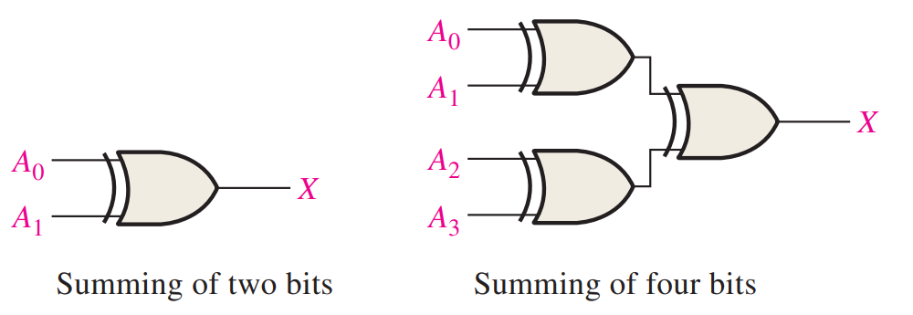
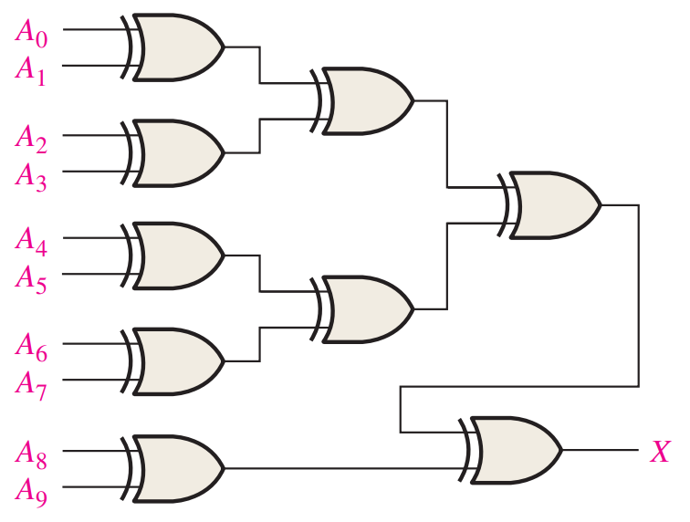
Generating Parity
Sum all bits to get even parity bit
Sum and NOT to get odd parity

Slide 23
Checking Parity
Same as generating, but with an extra bit
Use opposite parity to indicate an error

Slide 24
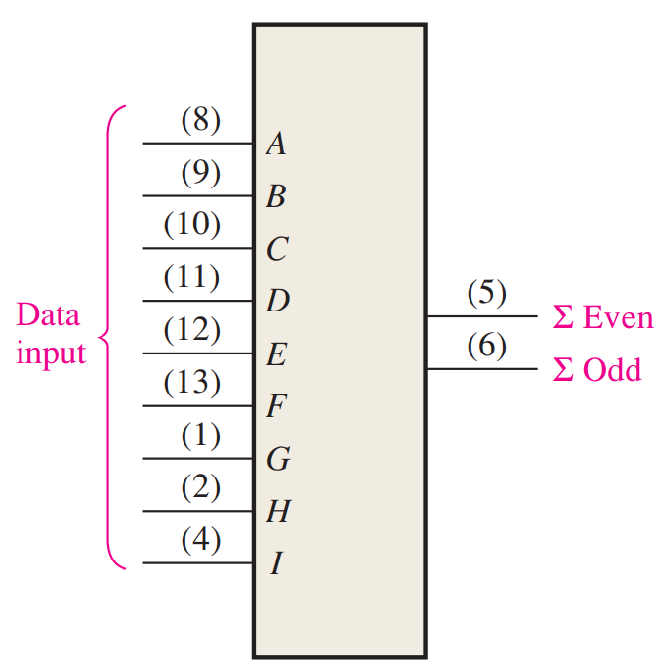
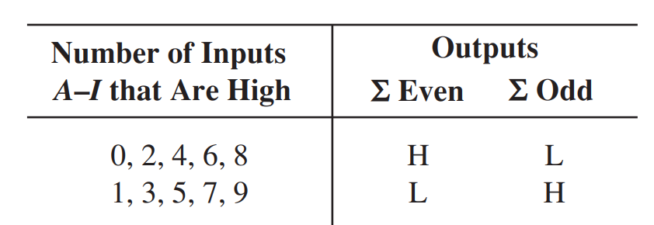
Real Chips – 74HC280
9-bit parity generator/checker

Slide 25
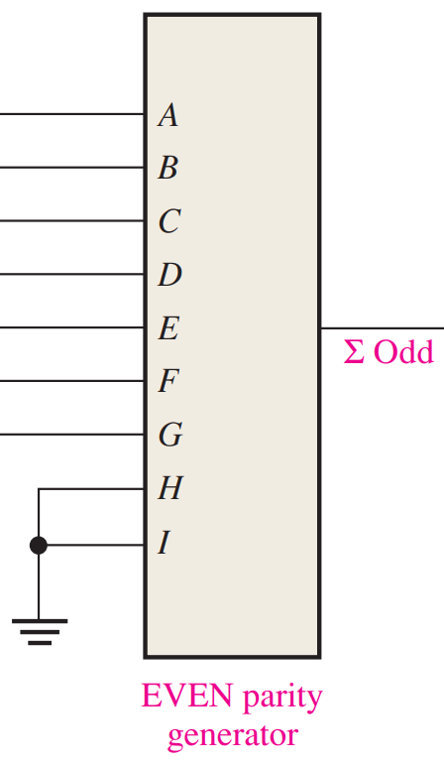
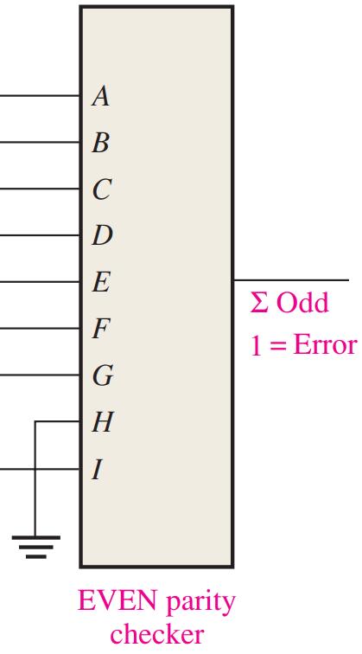
Use

Slide 26
Reading
This lecture
Sections 6.8-6.10
Next lecture
Sections 5.7, 6.11, 7.1

