Slide 1
CPE201 Digital Design
By Benjamin Haas
Class 17: Latches and Troubleshooting 2

Slide 2
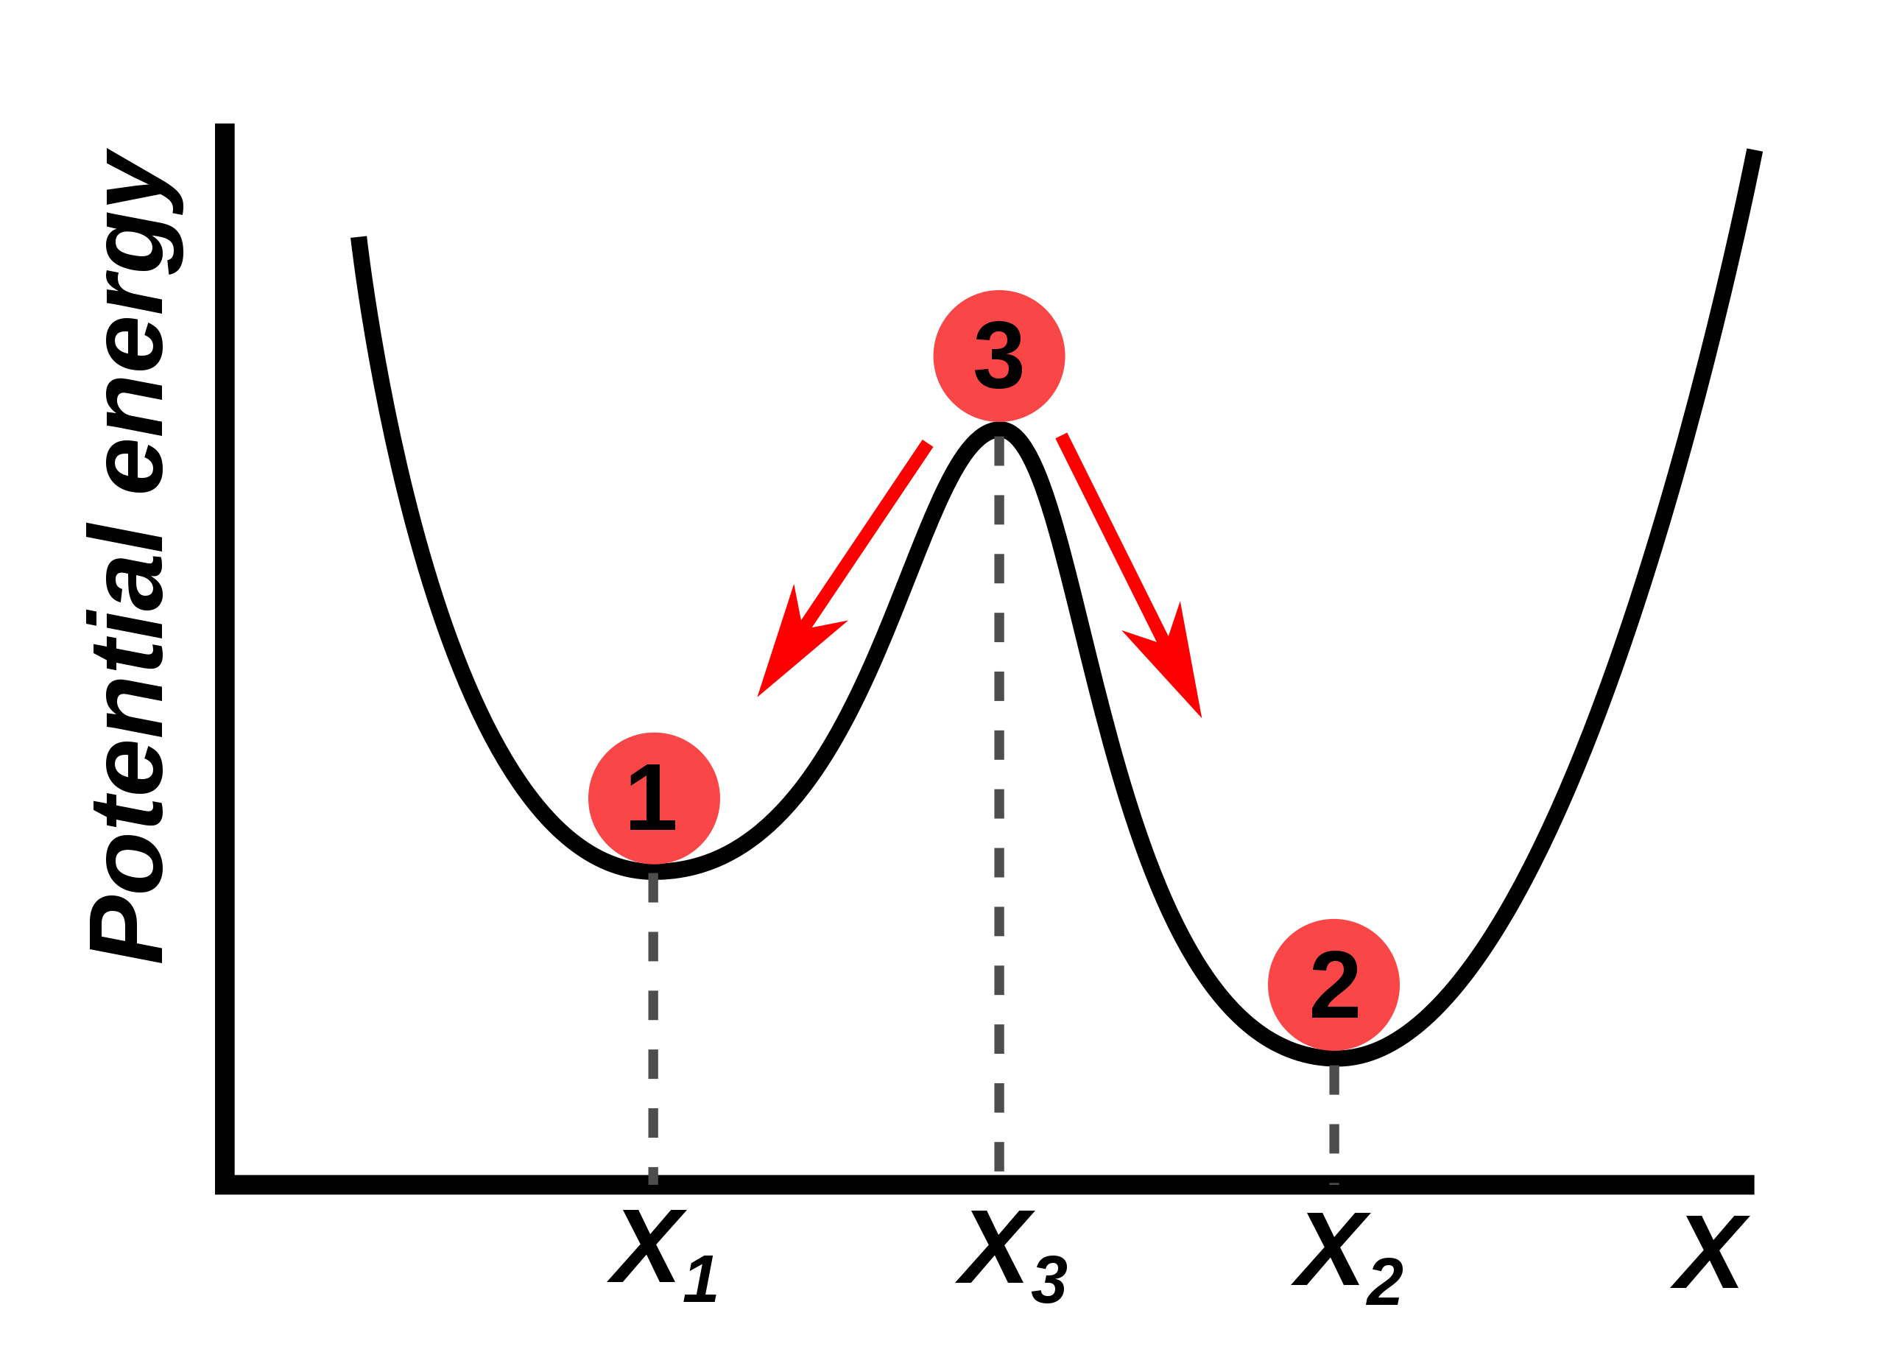
Latches
Stores a state
Memory (1-bit)!
Bistable Multivibrator
2 stable states
Feedback

Slide 3
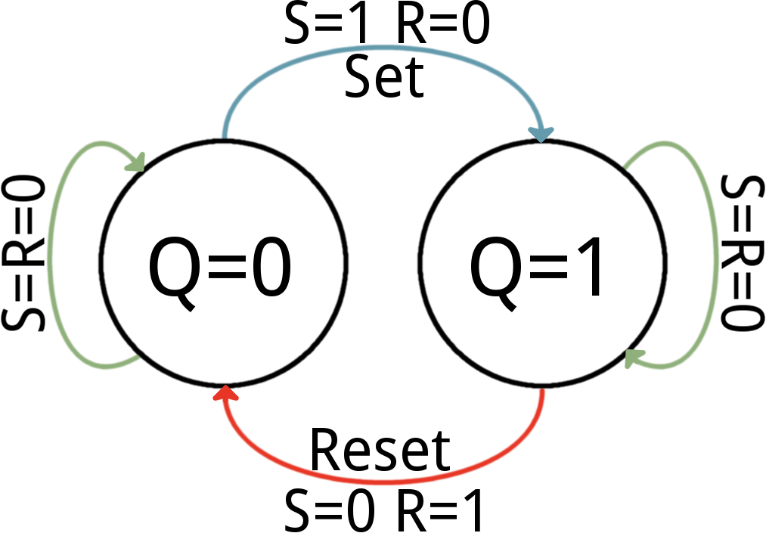
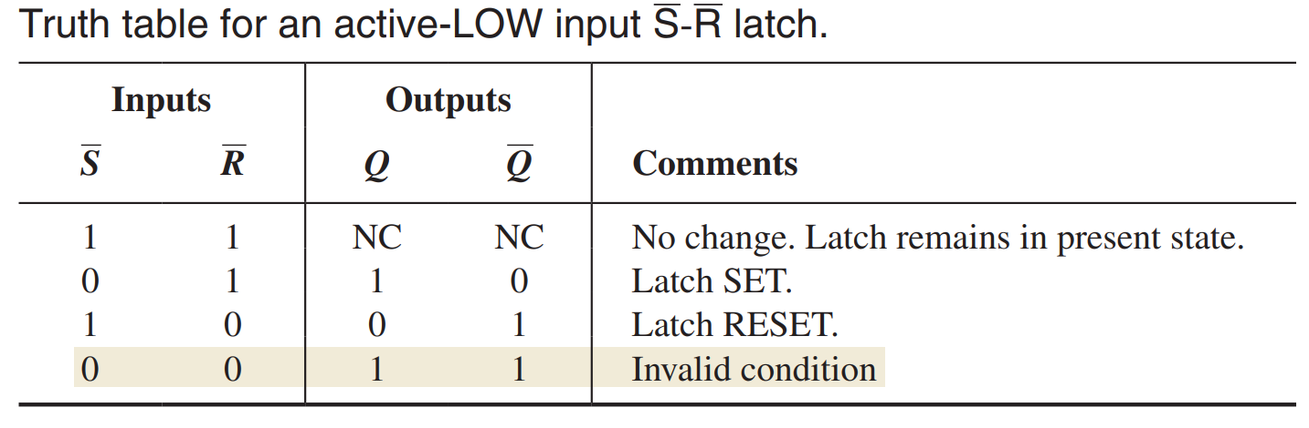
SR (Set-Reset) Latch
State machine
S = Set
R = Reset
Q = Output

Slide 4
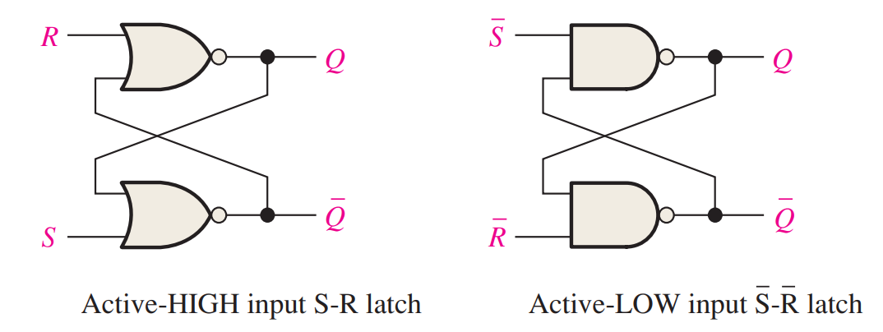
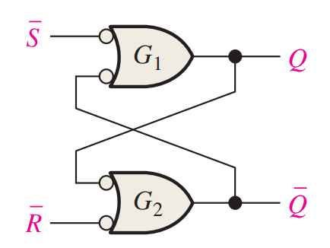
SR Latch

Slide 5
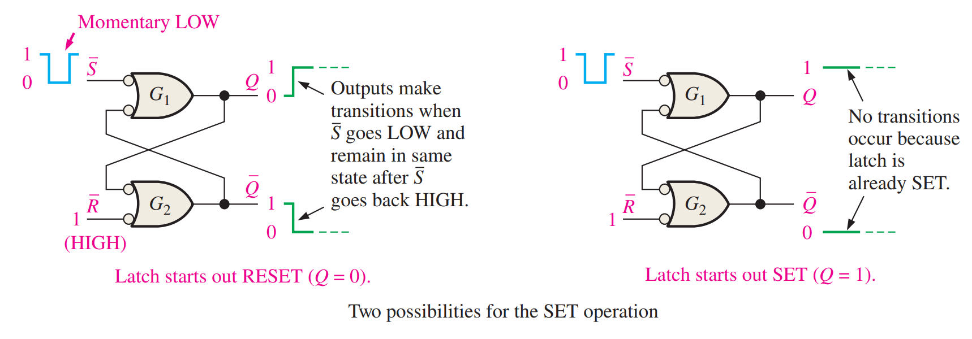
Set

Slide 6
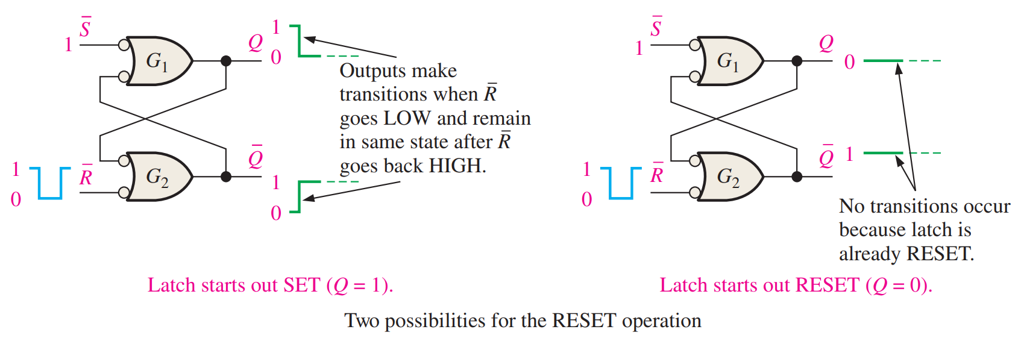
Reset

Slide 7
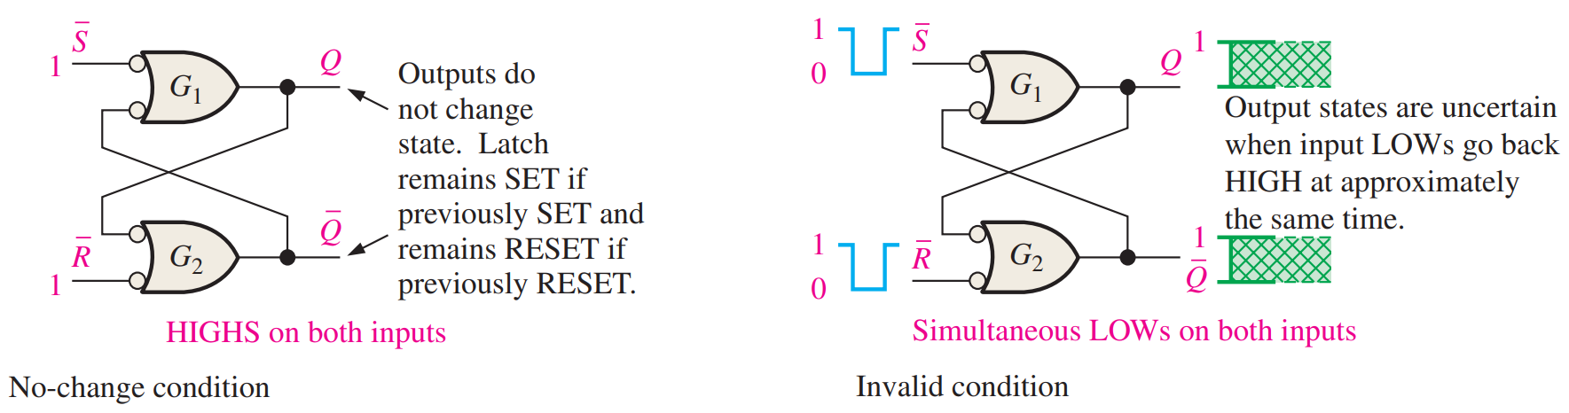
No Change & Invalid

Slide 8
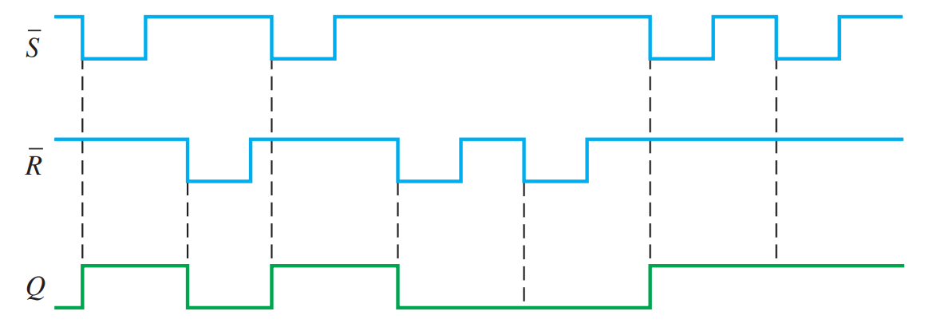
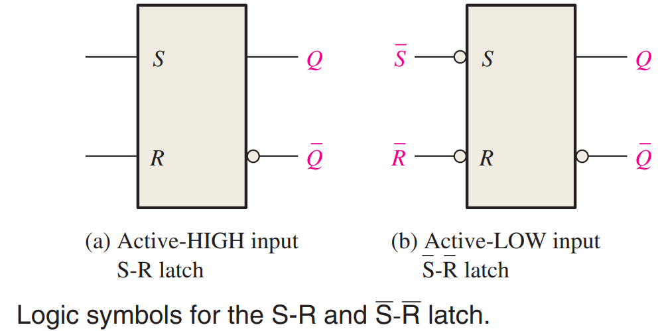
Symbol & Example

Slide 9
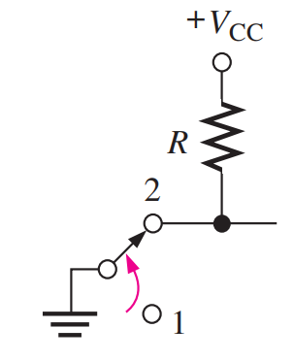
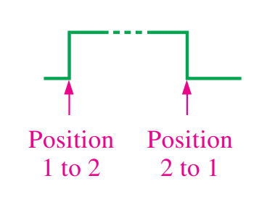
Debouncing Switches

Slide 10
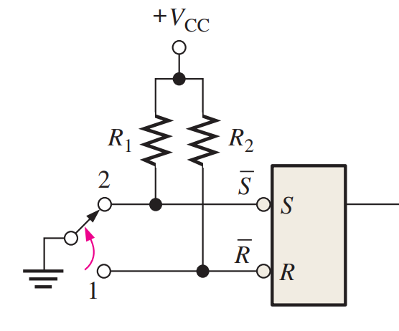
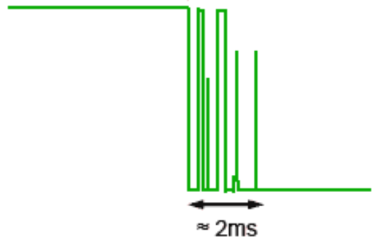
Debouncing Switches

Slide 11
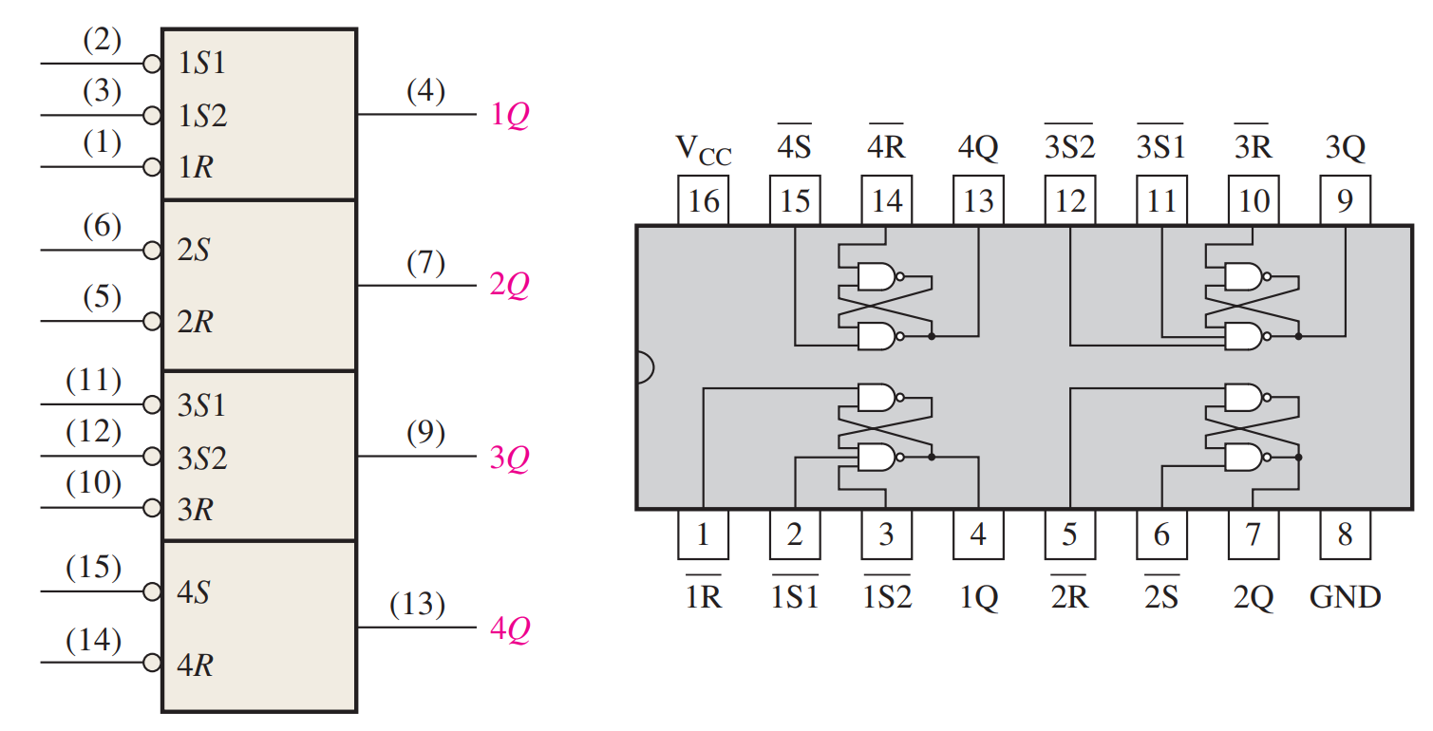
Real Chip – 74HC279A

Slide 12
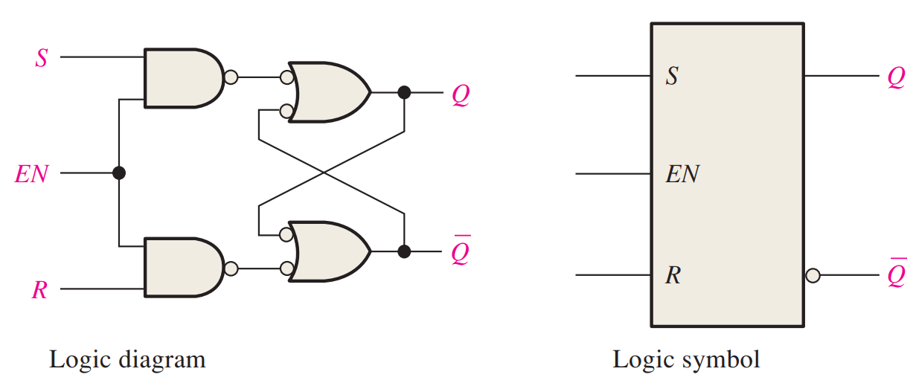
Gated SR Latch
Now with Enable!

Slide 13
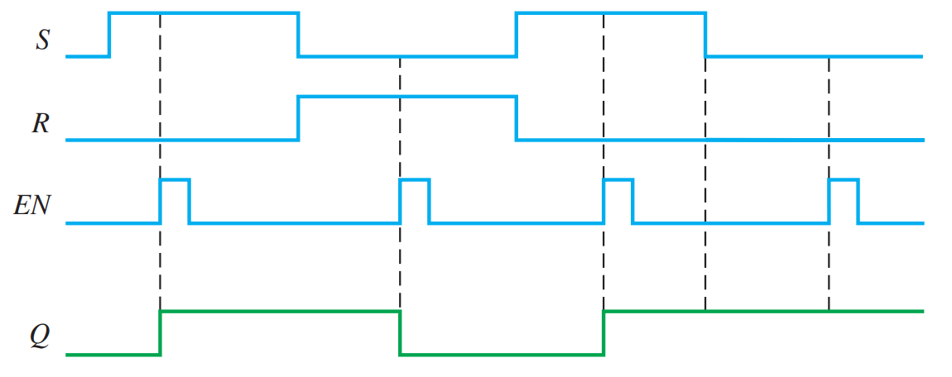
Example

Slide 14
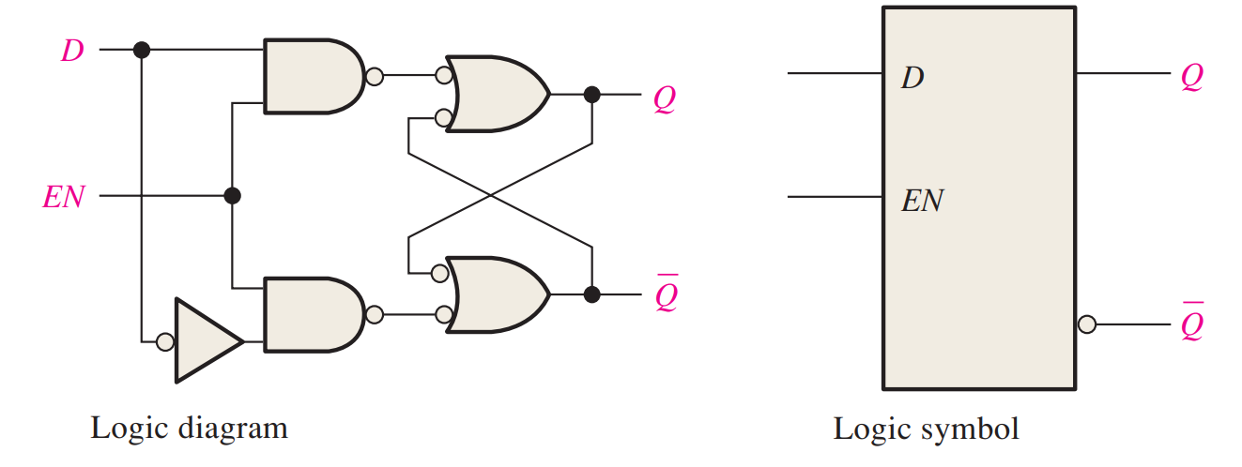
D Latch
Data Latch – saves D state when Enable is low

Slide 15
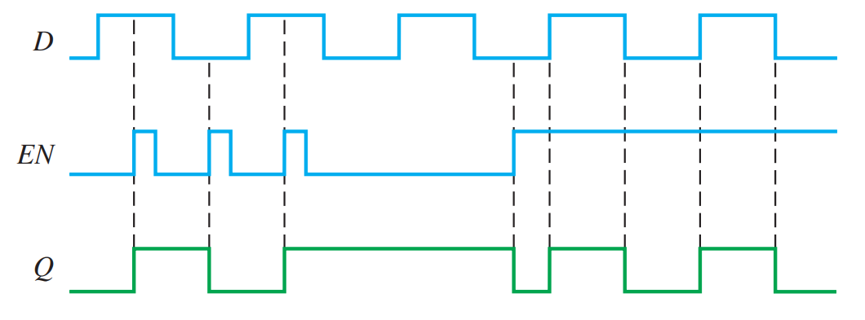
Example

Slide 16
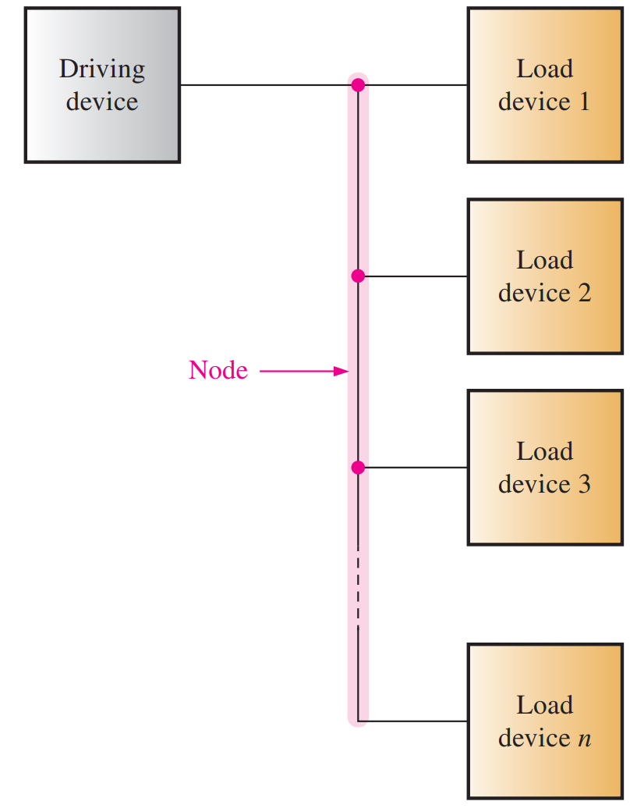
A Node
Electrically the same
on all points of the wire
Shorts vs Opens

Slide 17
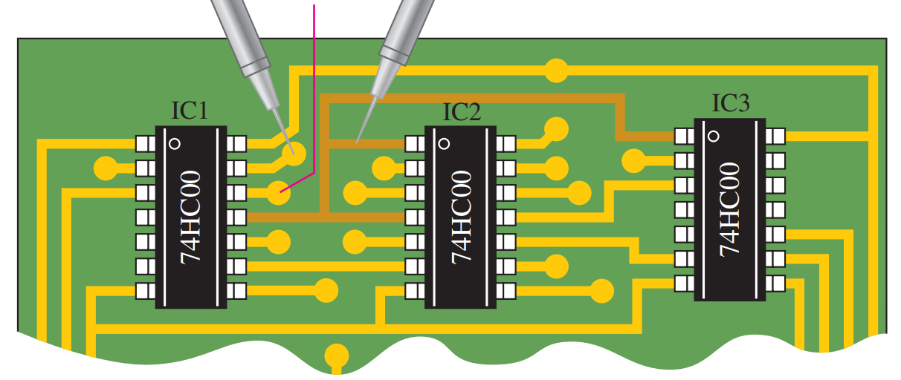
Checking Interconnects

Slide 18
Other Checks
Power
Ground
Inputs
Outputs
Wires?

Slide 19
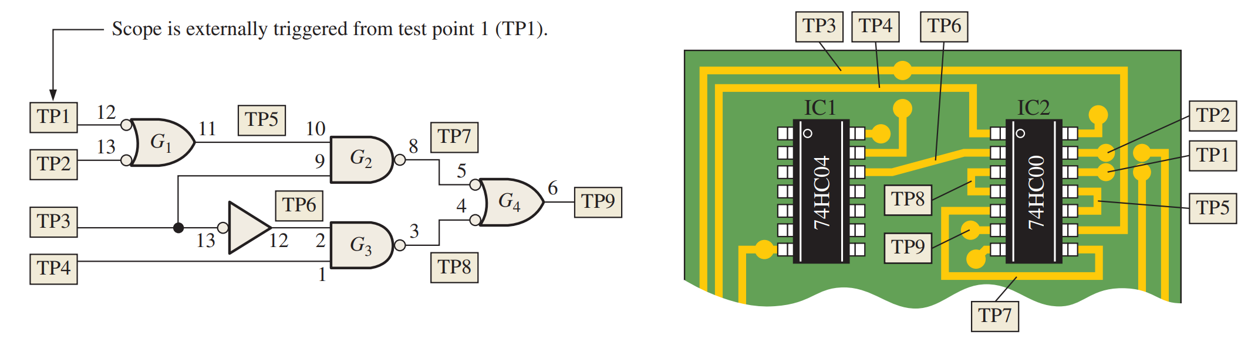
Signal Tracing

Slide 20
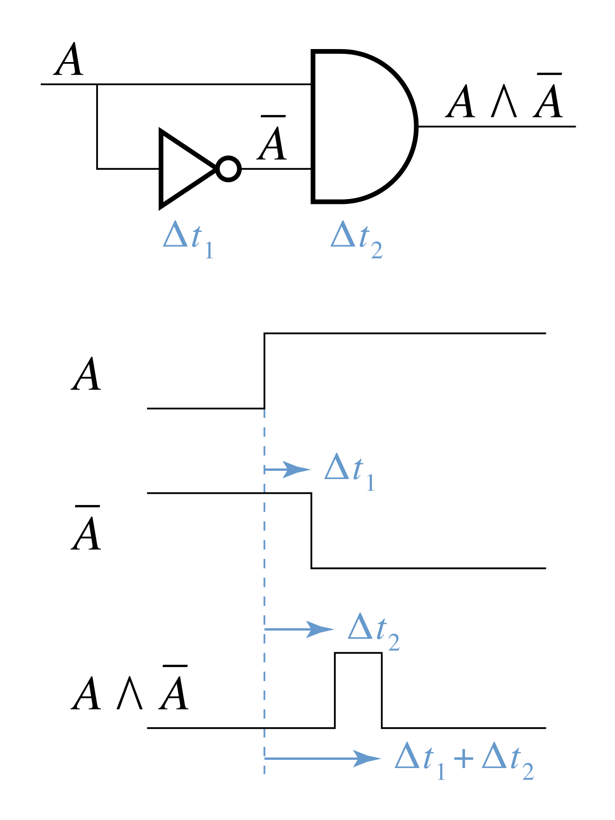
Glitches
Any undesired short duration voltage or current spike
Also called a race condition
Most common at signal
changes

Slide 21
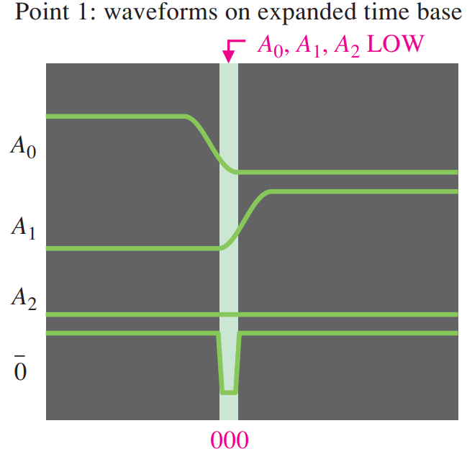
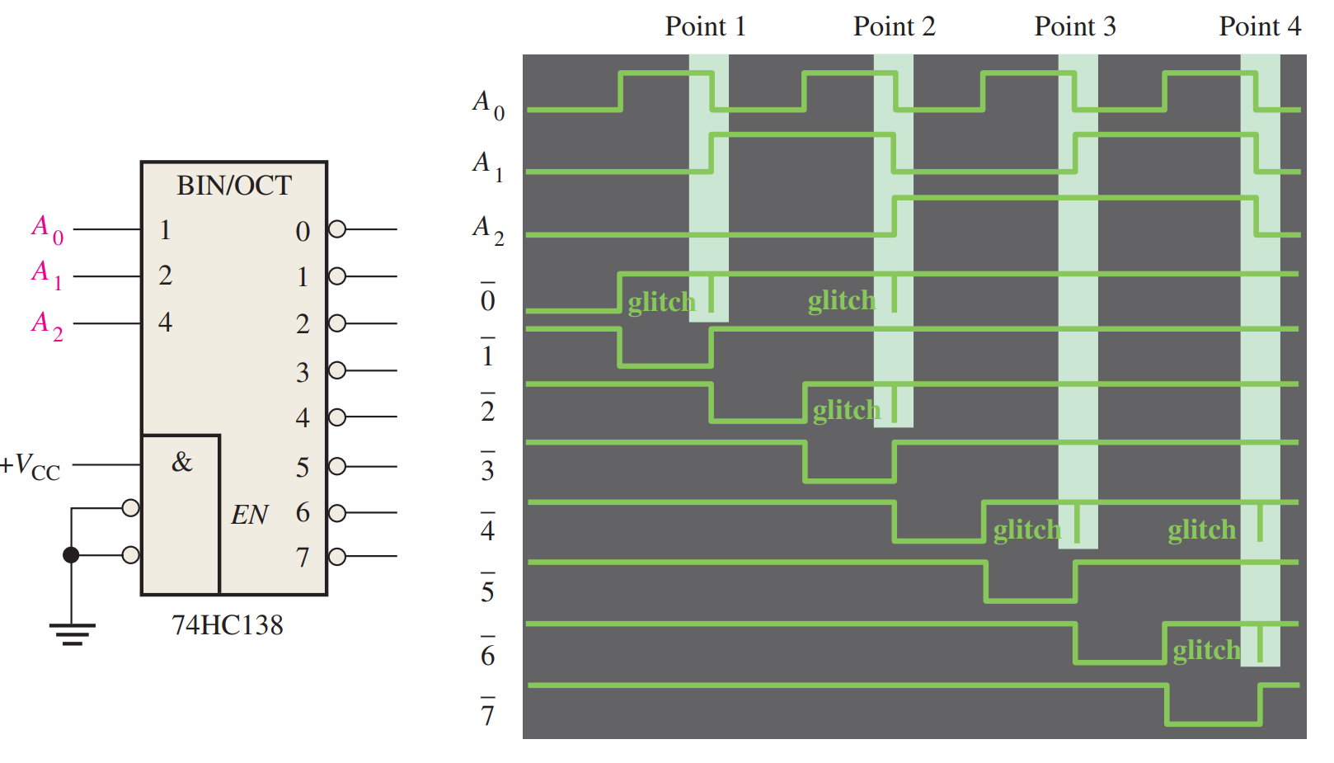
Example

Slide 22
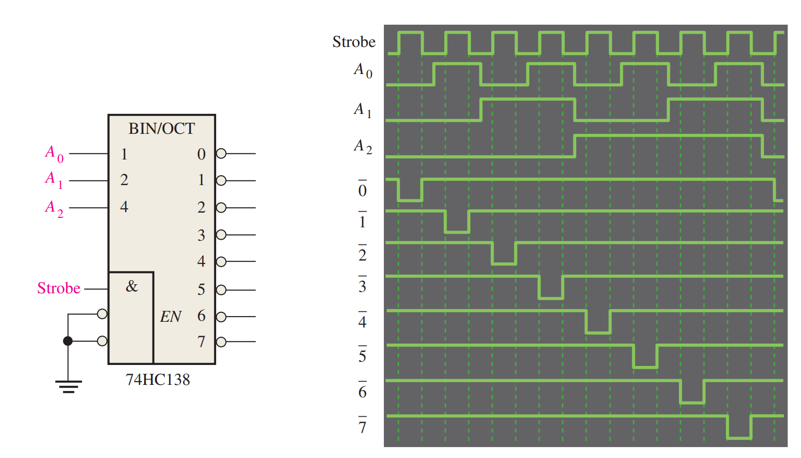
Strobing
Use the Enable!

Slide 23
Reading
This lecture
Sections 5.7, 6.11, 7.1
Next lecture
Sections 7.2-7.4

