Slide 1
CPE201 Digital Design
By Benjamin Haas
Class 18: Flip-Flops

Slide 2
Vocabulary
Bistable Multivibrator
2 States
Synchronous
There is a clock
Clock
Signal that alternates H/L at a set interval

Slide 3
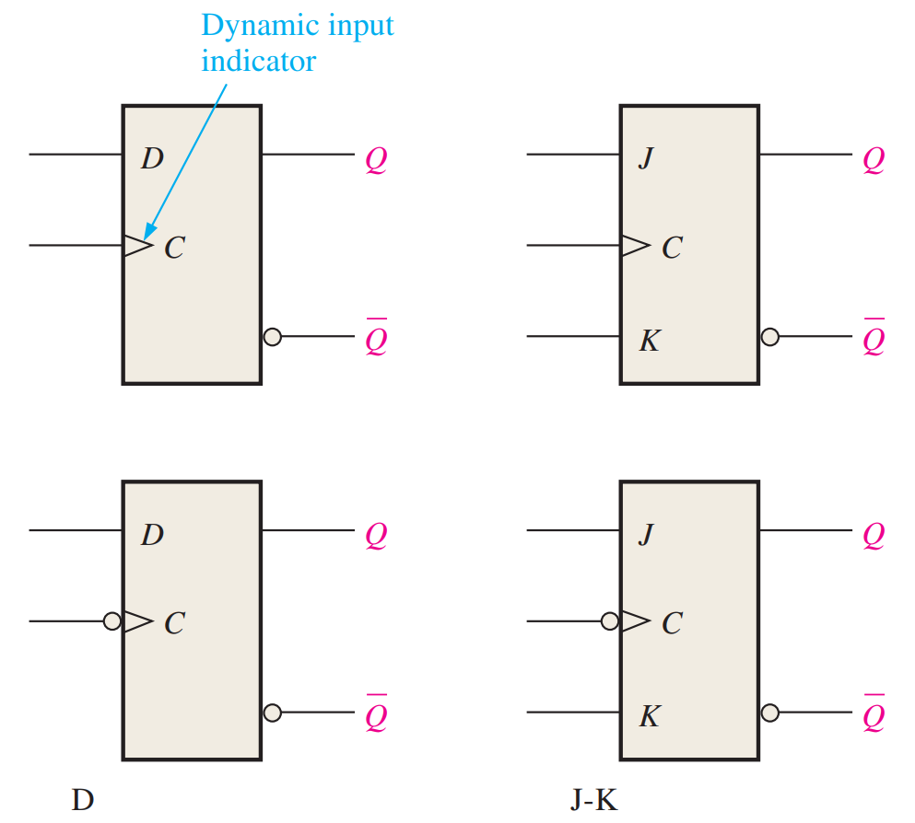
Vocab
Edge Triggered
State changes on edges
Positive or rising edge
Negative or falling edge

Slide 4
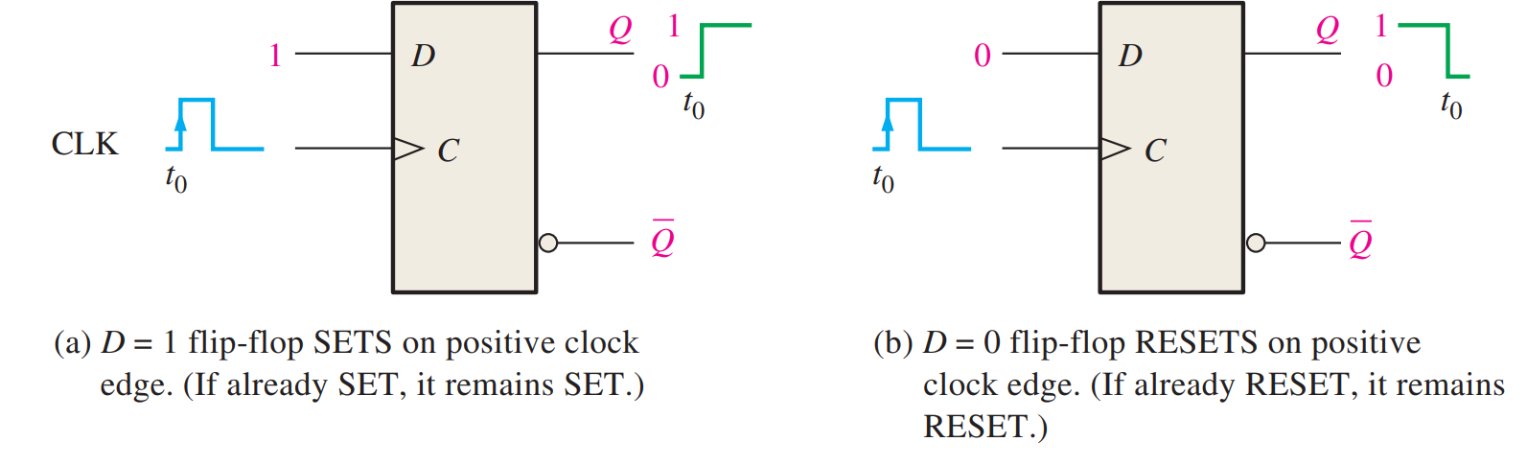
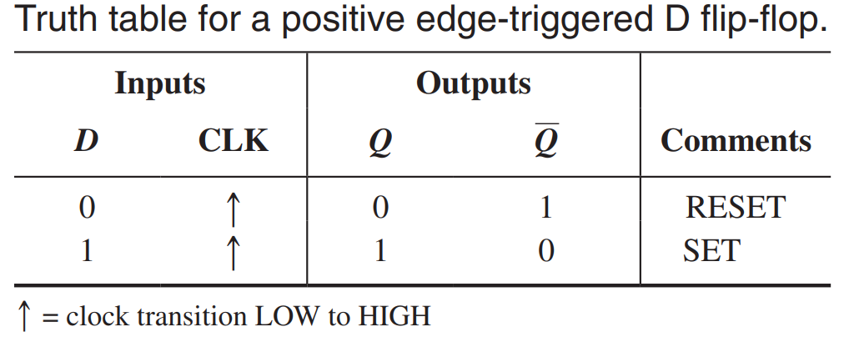
D Flip-Flop

Slide 5
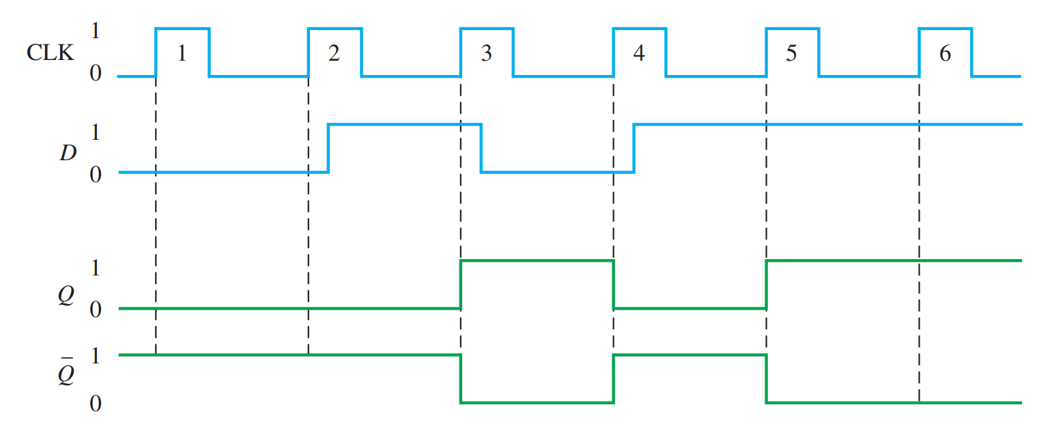
Example

Slide 6
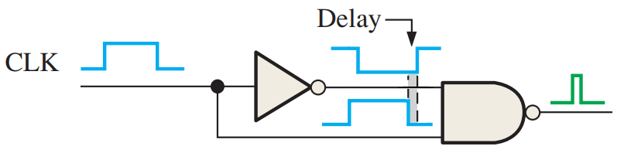
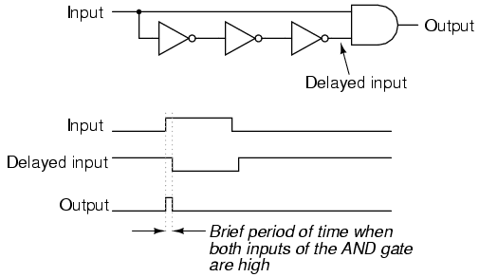
Edge Detection

Slide 7
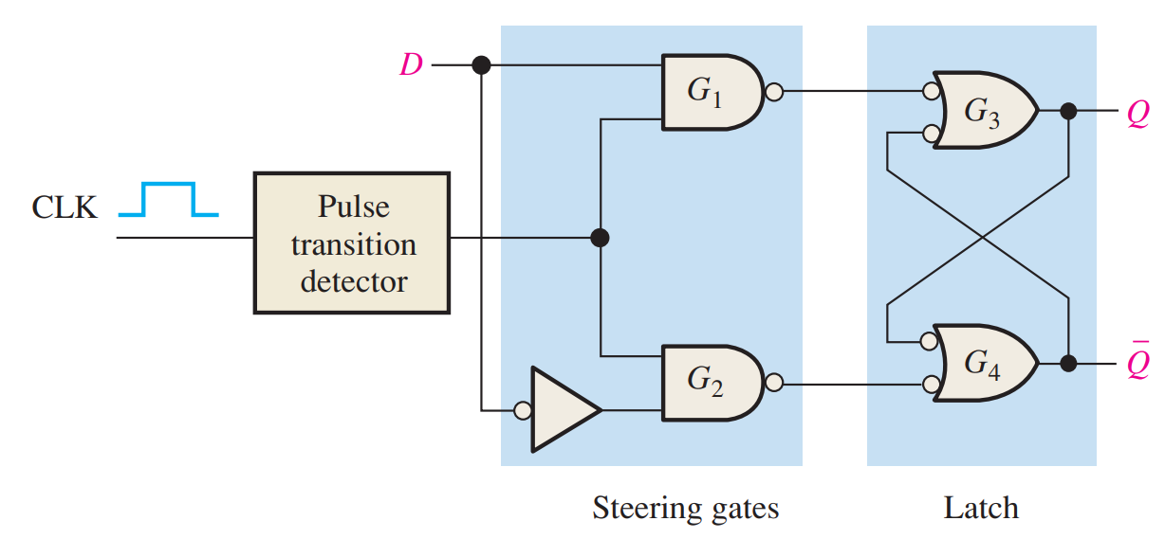
Circuit
G₃ and G₄ are NANDs (like from latches)

Slide 8
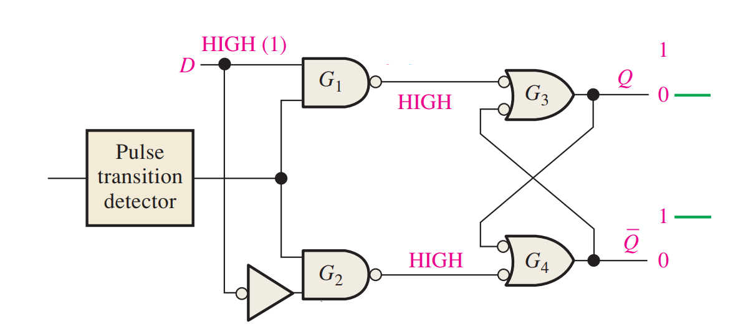
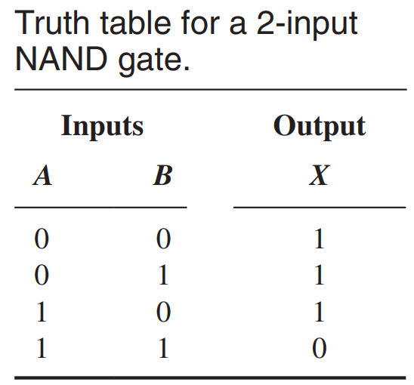
Circuit Walkthrough

Slide 9
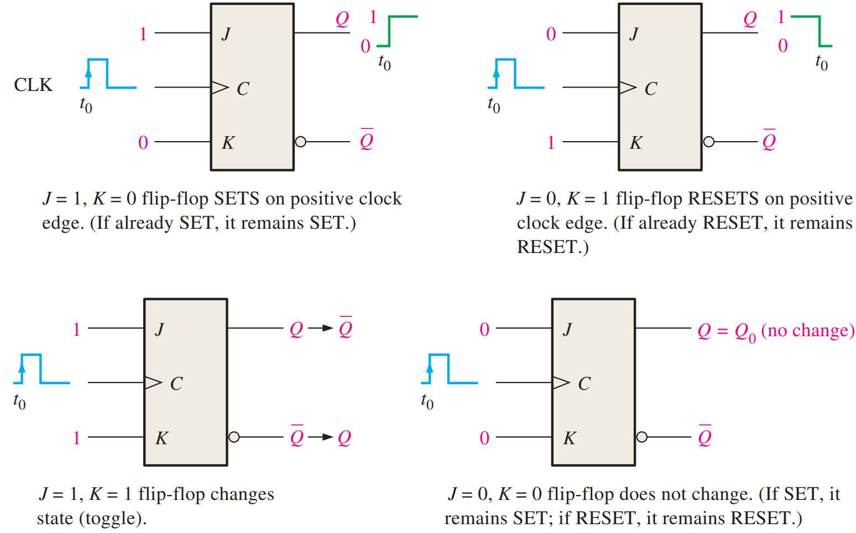
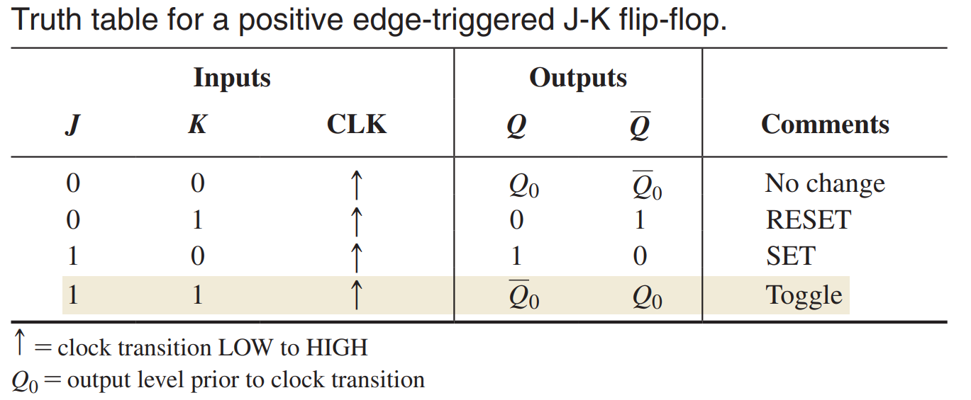
J-K Flip-Flop
S-R Latch+

Slide 10
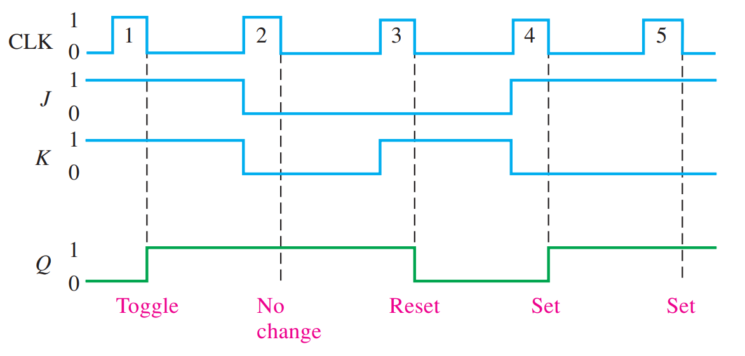
Example

Slide 11
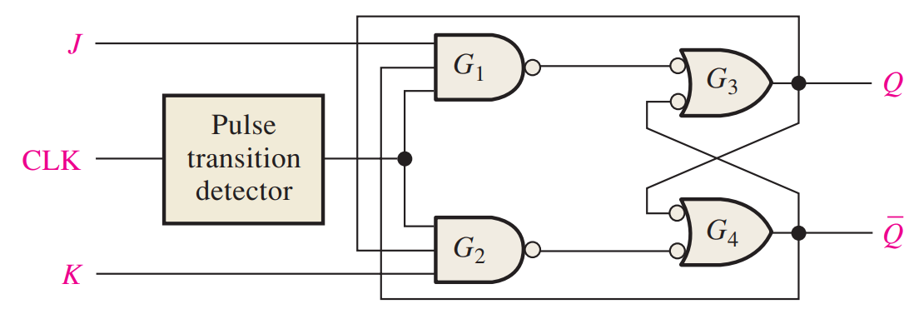
Circuit

Slide 12
Asynchronous Set and Reset
Independent on clock
Initialization on startup
Override
Also called Preset and Clear

Slide 13
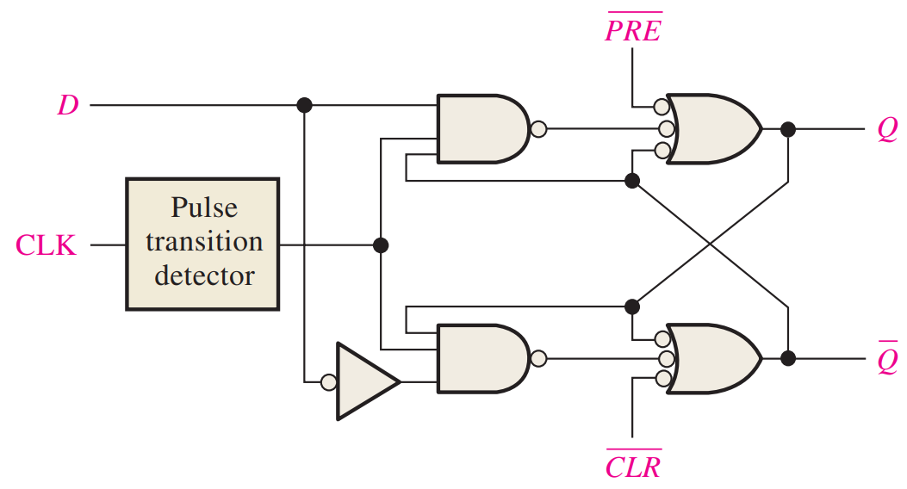
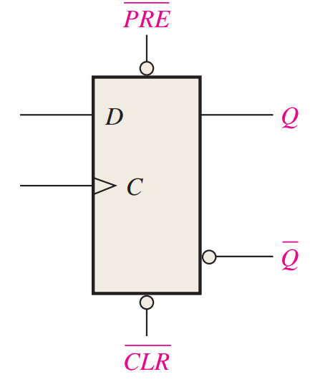
Circuit

Slide 14
Preset and Clear
Reaches into the Latch portion of the circuit
Can also be done in J-K Flip-Flop
Active Low inputs
Normal operation is both high
Both low creates latch invalid state

Slide 15
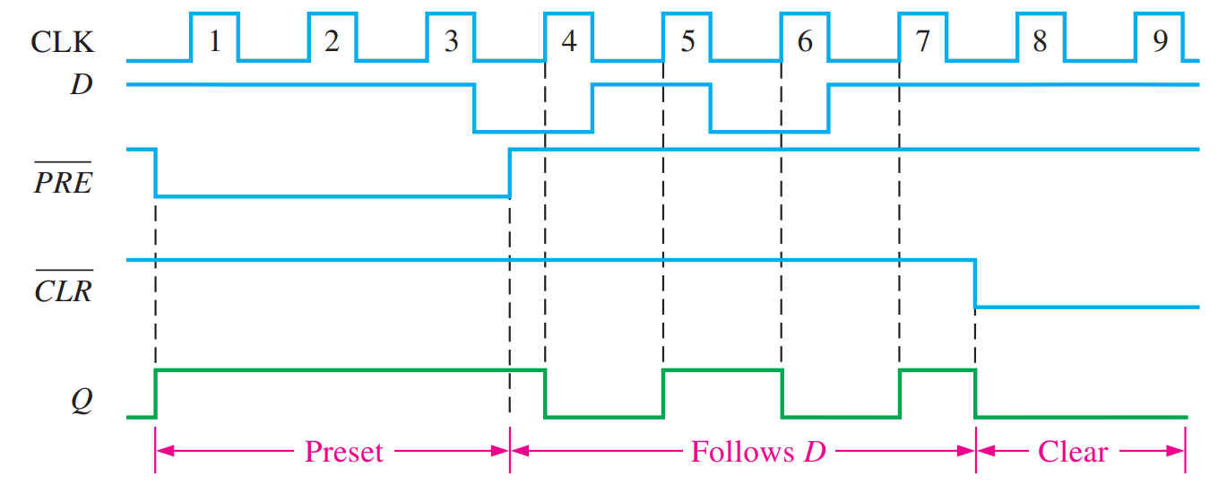
Example

Slide 16
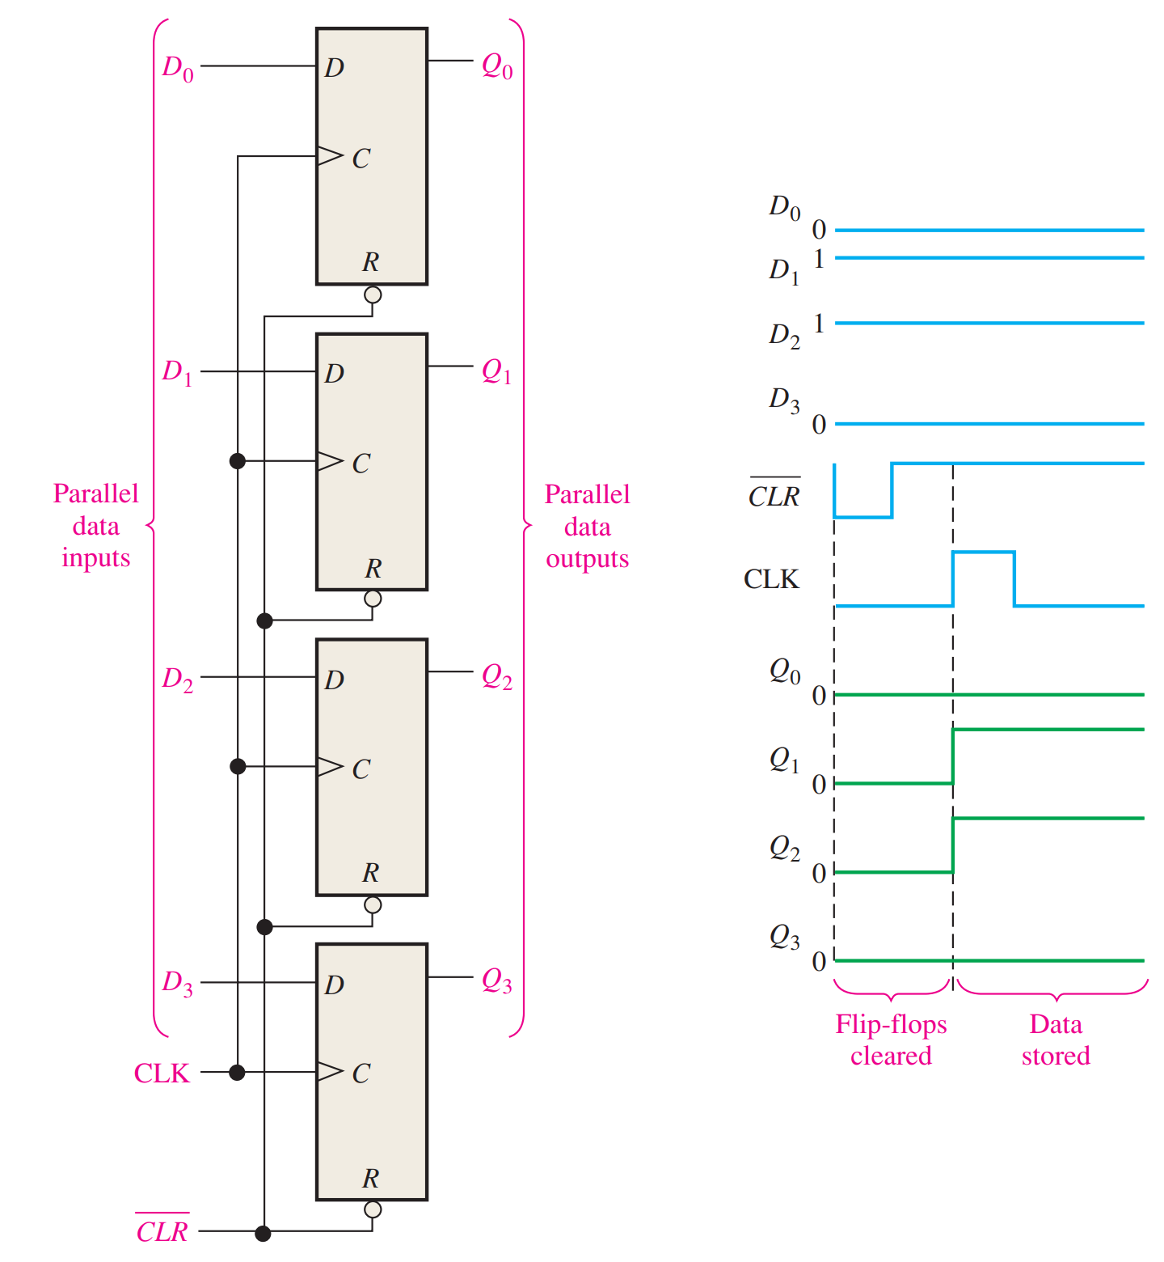
Application – Data Storage
Parallel storage
Data on lines stored
at each clock
Covered more later

Slide 17
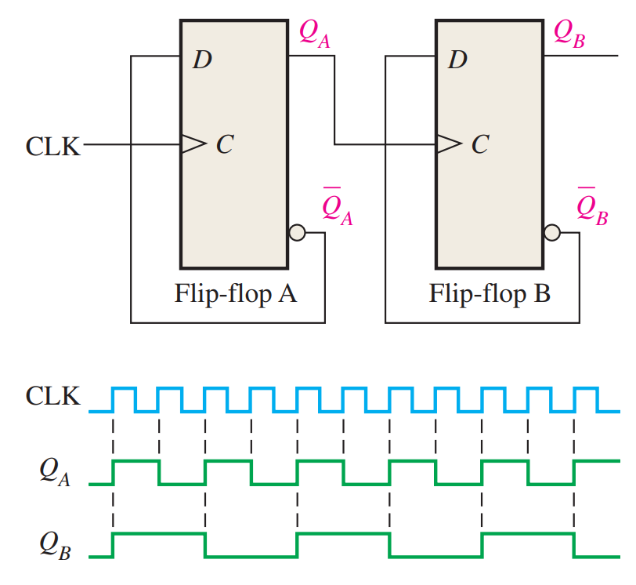
Application - Frequency Division
Divide by 2
Good for running
multiple subsystems

Slide 18
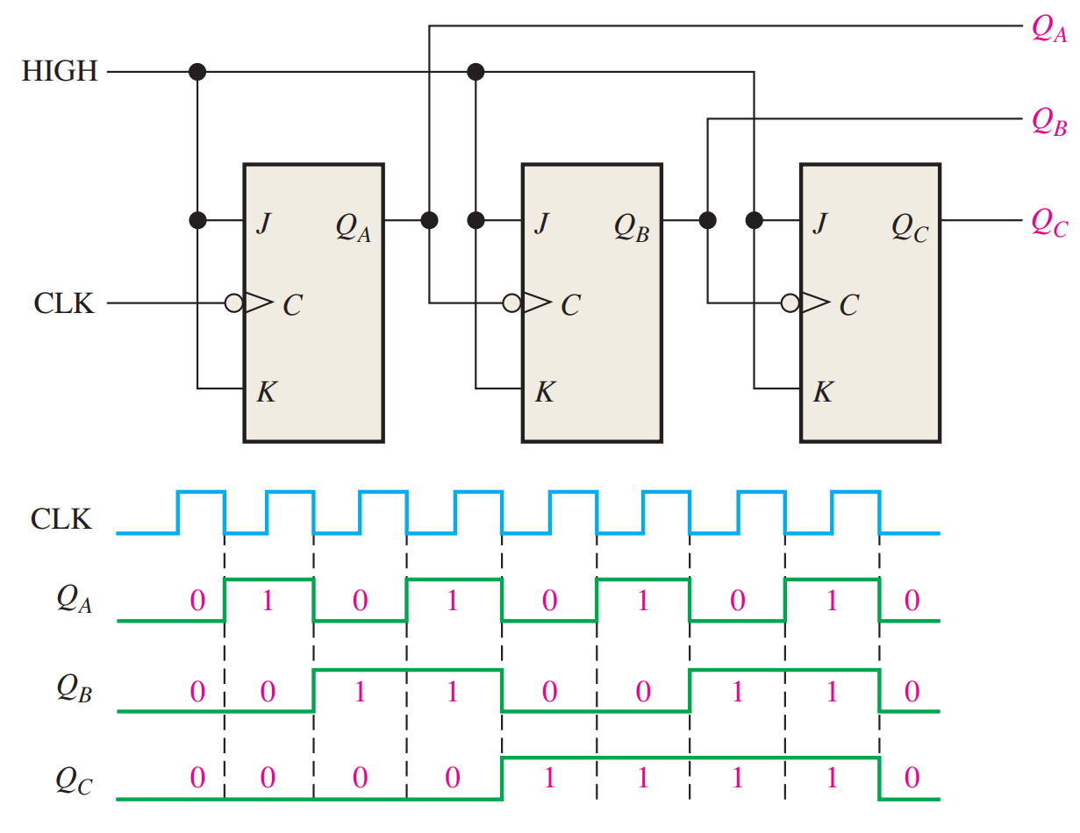
Application - Counting
Like freq division
Line up the divisions
to count in binary
Counts clock cycles
J-Ks instead of Ds

Slide 19
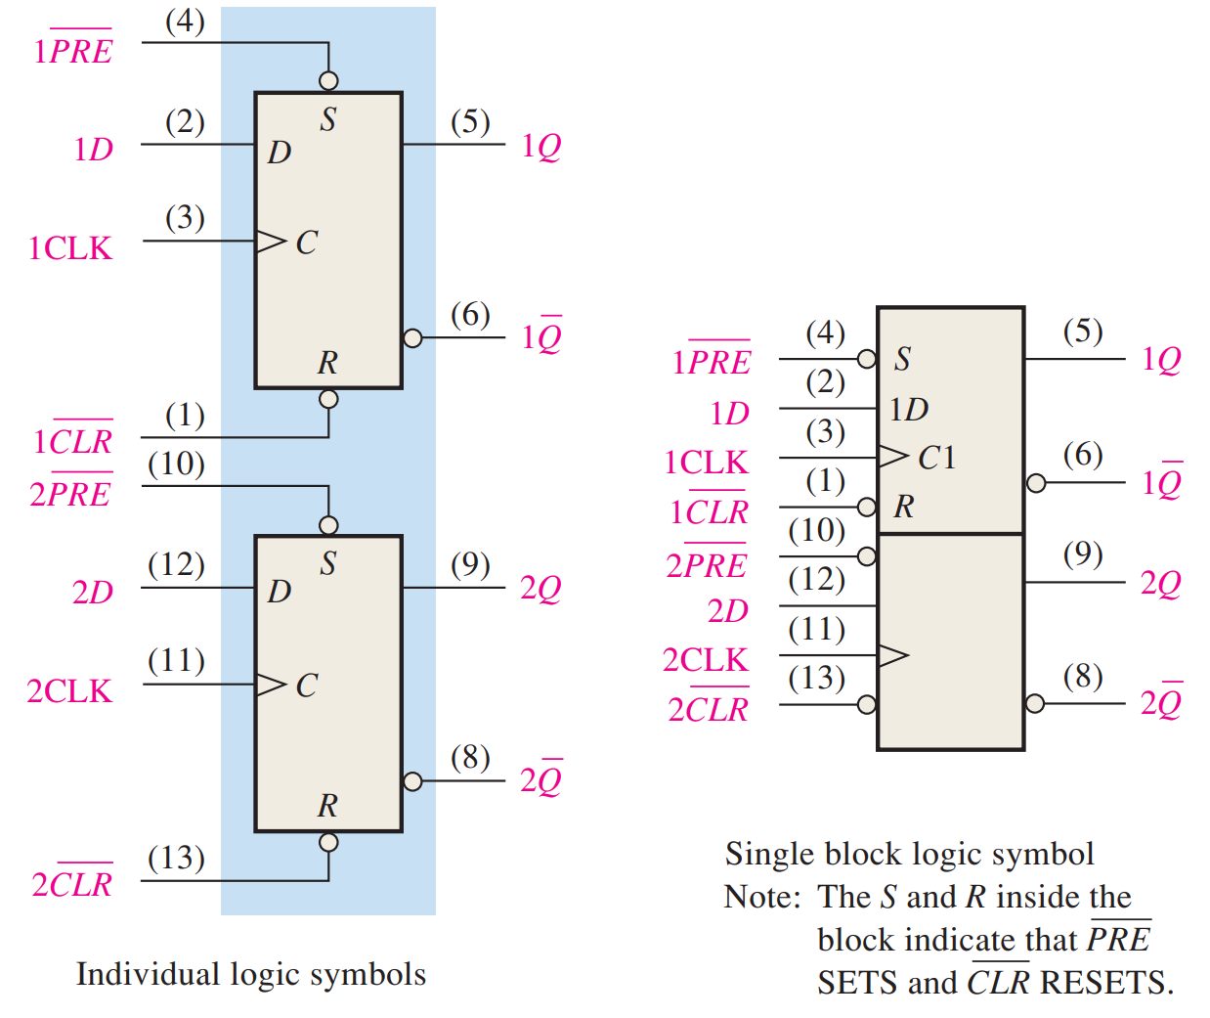
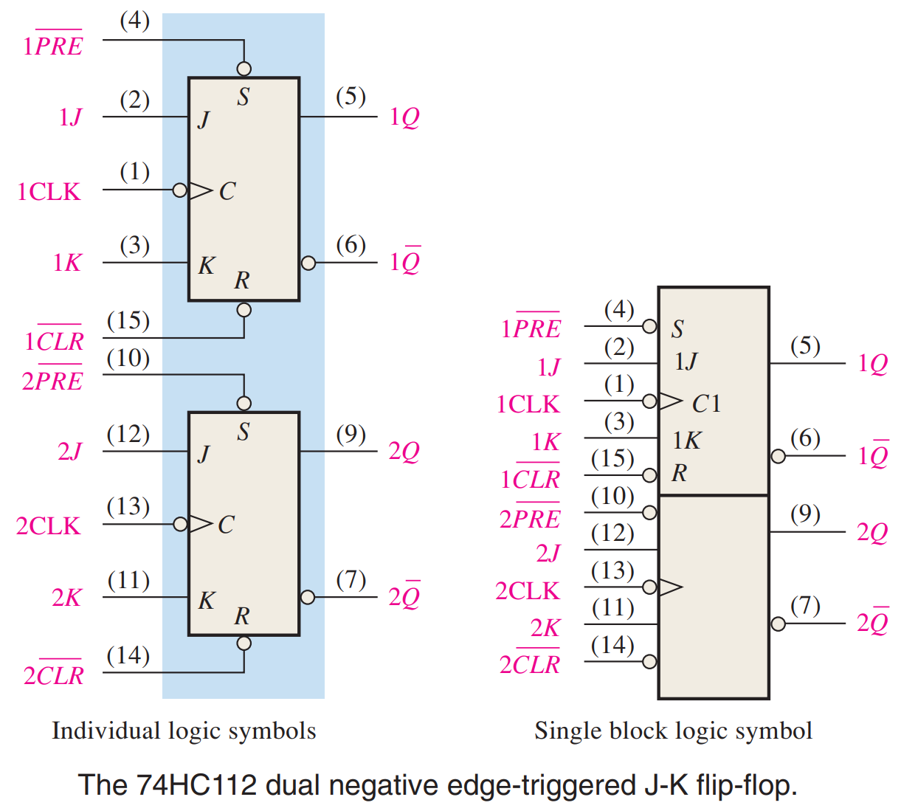
Real Chips – 74HC74 and 74HC112

Slide 20
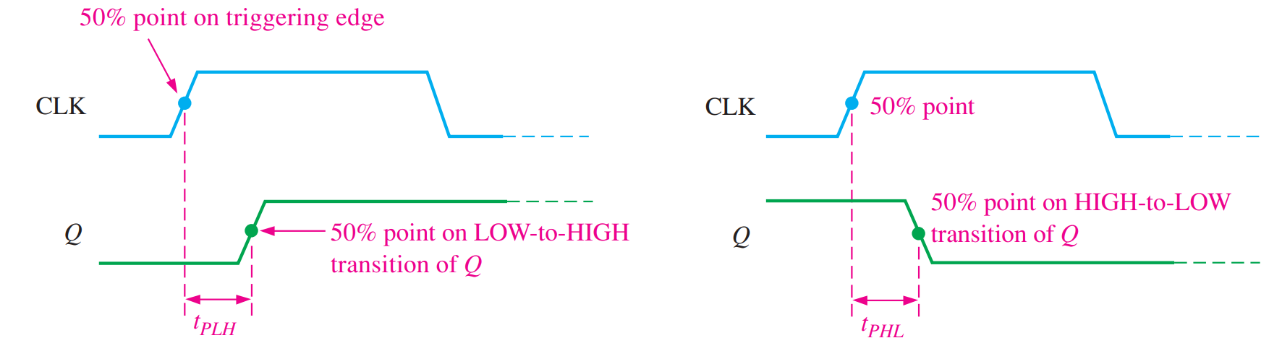
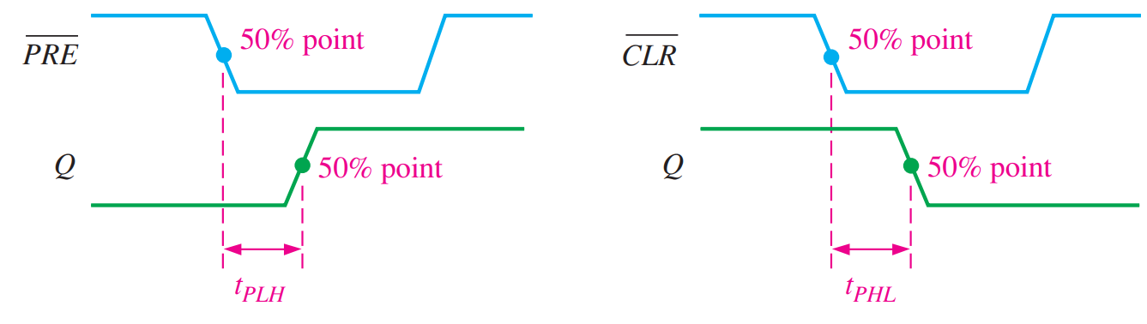
Propagation Delays

Slide 21
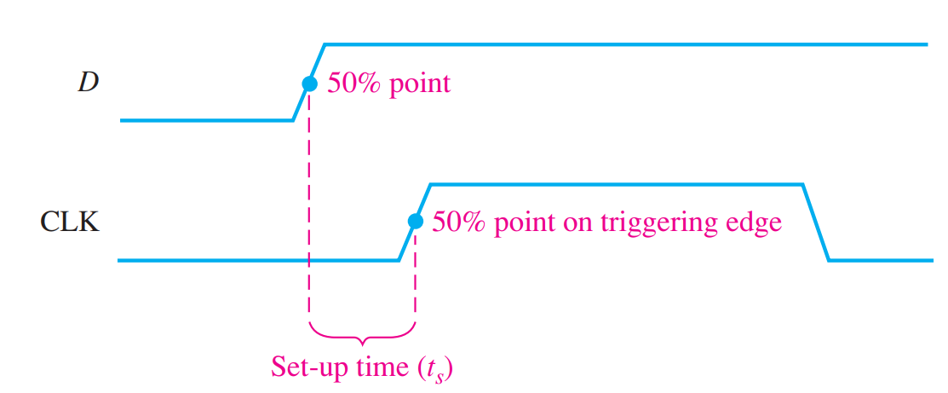
Setup Time
Data time on the line BEFORE clocking it in

Slide 22
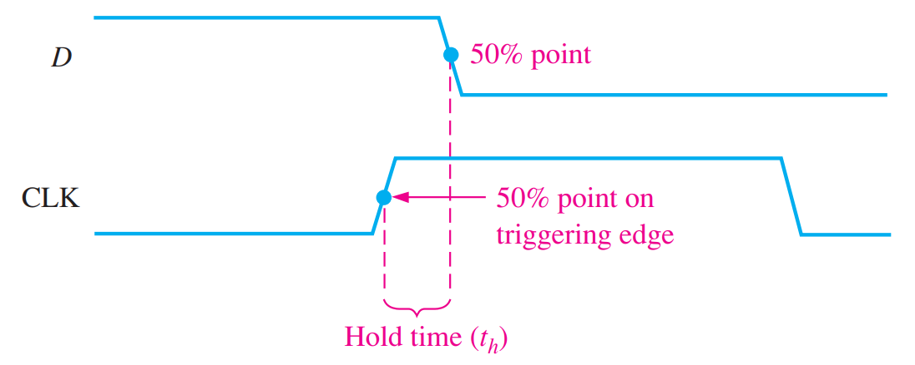
Hold Time
Data time on the line AFTER clocking it in

Slide 23
Reading
This lecture
Sections 7.2-7.4
Next lecture
Sections 7.5-7.7

