Slide 1
CPE201 Digital Design
By Benjamin Haas
Class 19: Vibrators

Slide 2
More Multivibrators
Monostable
One stable state
One-Shots and Timers
Astable
No stable states
Oscillators

Slide 3
One-Shot
Normally in its stable state
Trigger to unstable state
Returns to stable state after some time
Puts out a pulse of fixed width

Slide 4
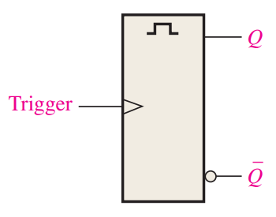
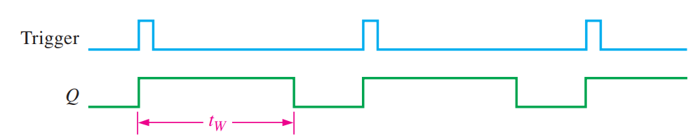
One-Shot
t_{W} = pulse width

Slide 5
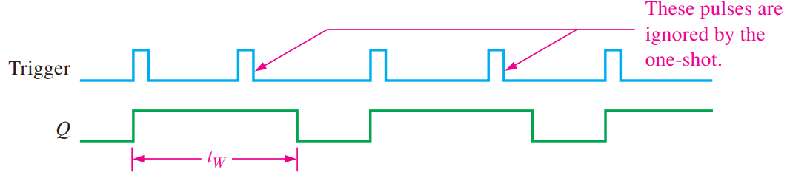
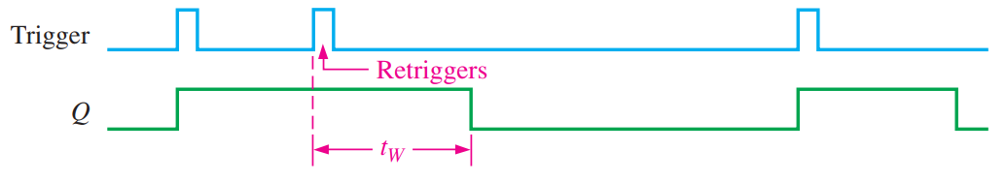
Nonretriggerable
Retriggerable

Slide 6
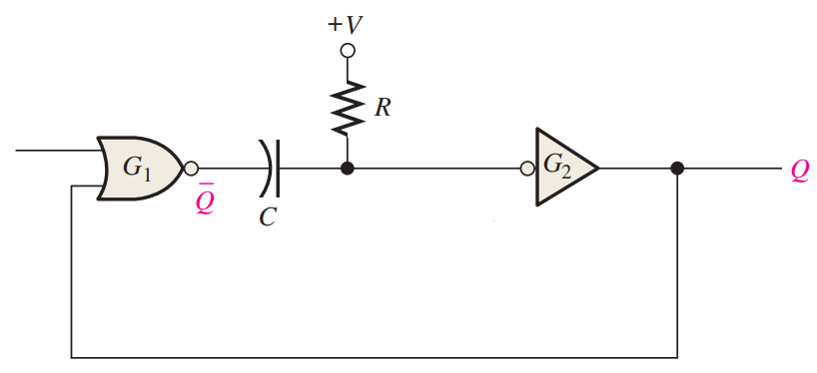
Circuit
Capacitor (F)
Resistor (Ω)

Slide 7
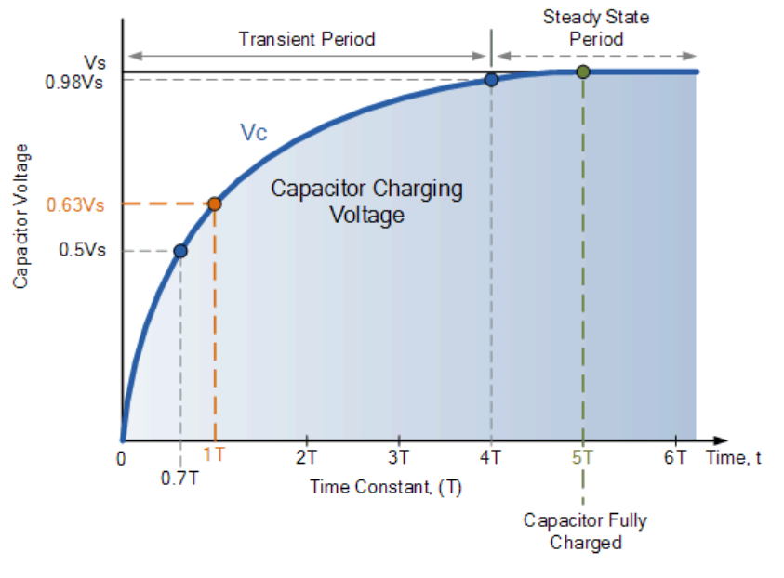
RC Time Constant
RC = seconds
Vs = supply voltage

Slide 8
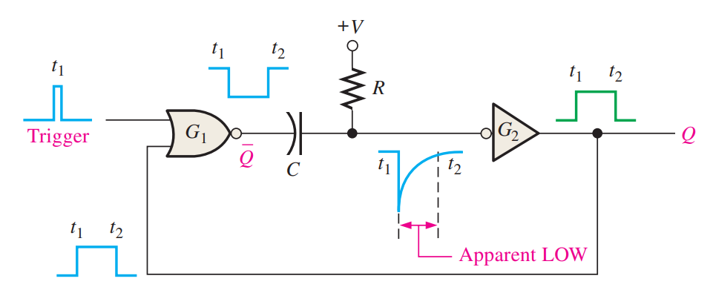
Circuit
Trigger is wide enough to propagate the input 1 to the output through both gates

Slide 9
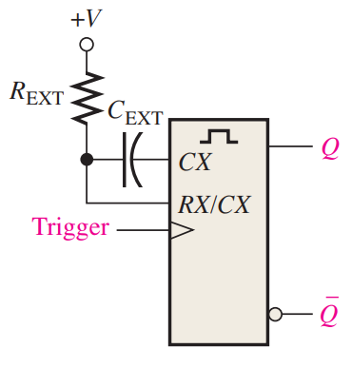
Configure Pulse Width
t_{W} = 0.7R_{EXT}C_{EXT}
R_{EXT} in kΩ (10³)
C_{EXT} in pF (10⁻¹²)
t_{W} in ns (10⁻⁹)
Corresponds to parts in the MHz frequencies

Slide 10
Examples
If R = 42kΩ and C = 12pF
t_{W} = 0.7RC = 0.7 * 42 * 12 = 352.8ns
OR t_{W} = 0.7 * 42E3 * 12E-12 = 352.8E-9
If we want t_{W} = 1ms = 1E-3 and R = 1E3
C = t_{W} / (0.7 * R) = 1E-3 / (0.7 * 1E3) = 1.42µF

Slide 11
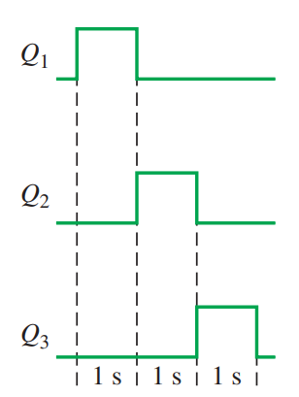
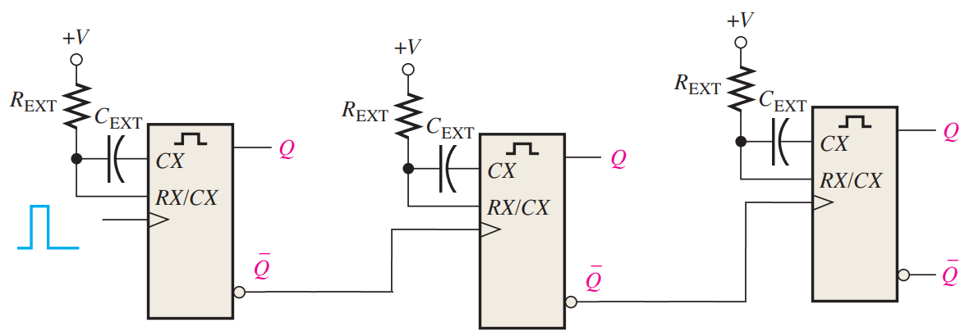
Application
Pulse sequence

Slide 12
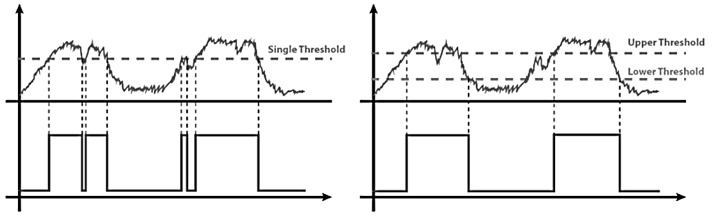
Hysteresis
Comparator+
Change threshold moves after it is crossed
⎎

Slide 13
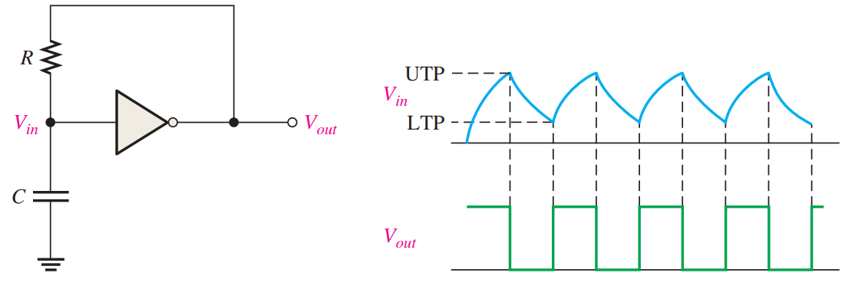
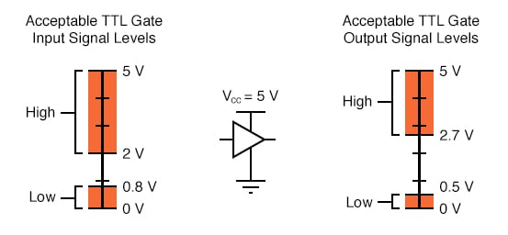
Oscillator
UTP = 2V
LTP = 0.8V

Slide 14
Reading
This lecture
Sections 7.5-7.7
Next lecture
Sections 8.1-8.3

