Slide 1
CPE201 Digital Design
By Benjamin Haas
Class 21: Shift Registers

Slide 2
Outline
Flip-Flop Review
Shift Register Intro
5 Types of shift register configurations
Notes on real chips

Slide 3
Flip-Flop Applications
Data Storage
Ch8
Frequency Division
Counting
Ch9

Slide 4
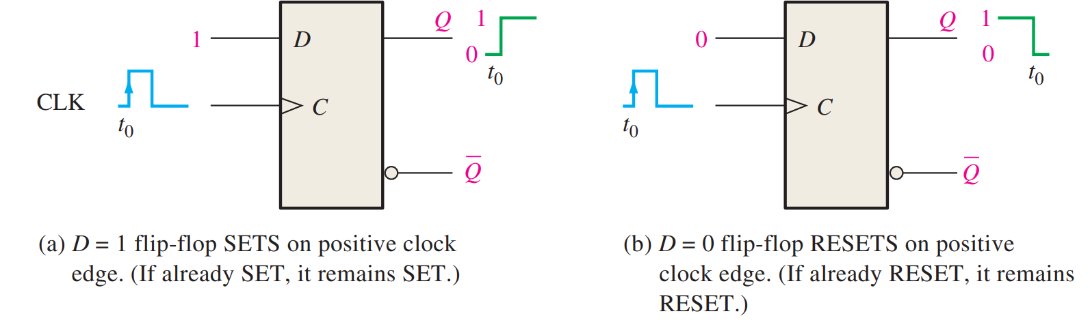
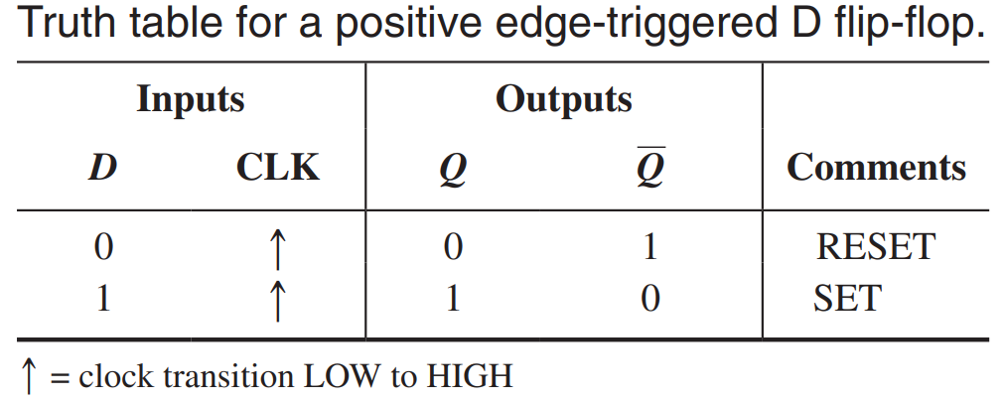
D Flip-Flop

Slide 5
Shift Registers
No set state machine
Shift data in from external sources
A series of flip-flops

Slide 6
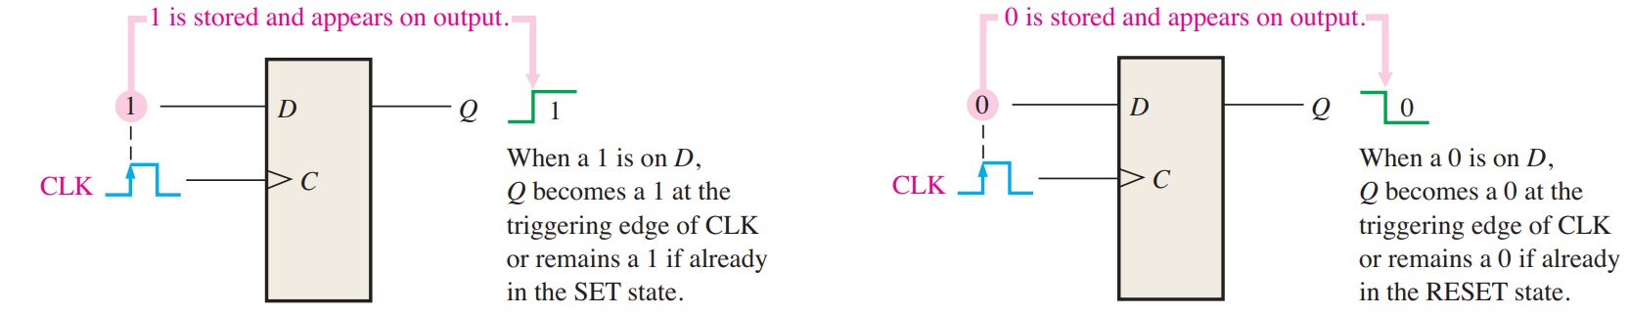
Register
A digital circuit with 2 functions
Data storage

Slide 7
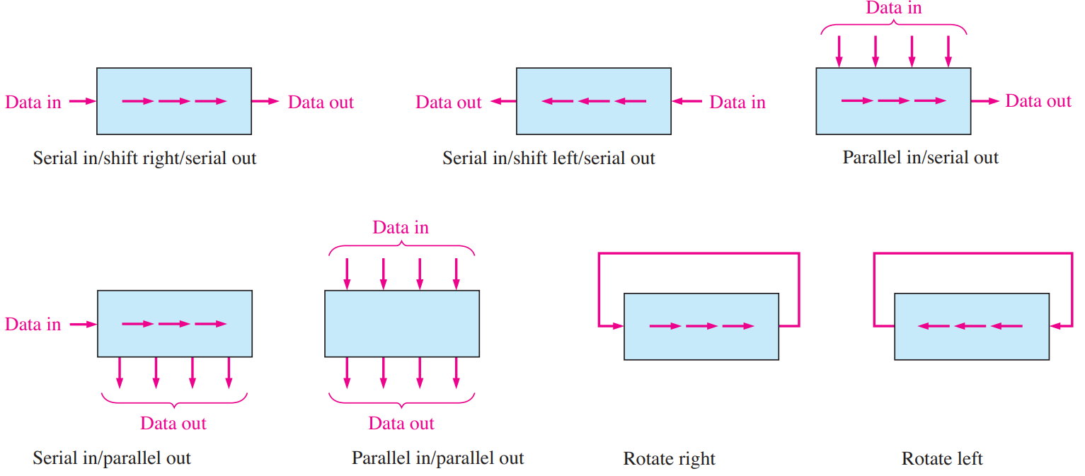
Register
Data movement (4-bit examples)

Slide 8
Serial vs. Parallel
Serial is one line
Connection count is small and takes little space
Used in long distance comms
Parallel is one line per bit
Very fast because all bits are xferred at once
Takes up much more space than serial
Used in short distance comms (moving variables)

Slide 9
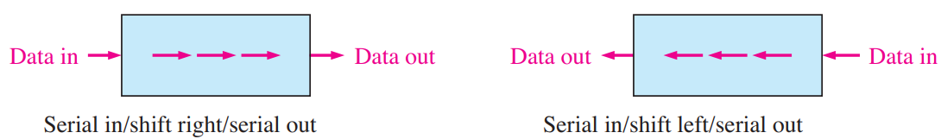
Serial in / Serial out (SISO)
Like a queue or buffer
Buffering in a long xfer line
Destructive readout (all these regs do this)

Slide 10
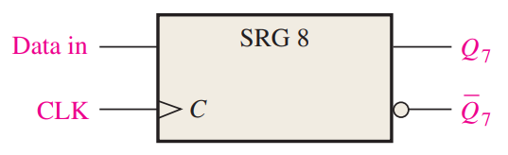
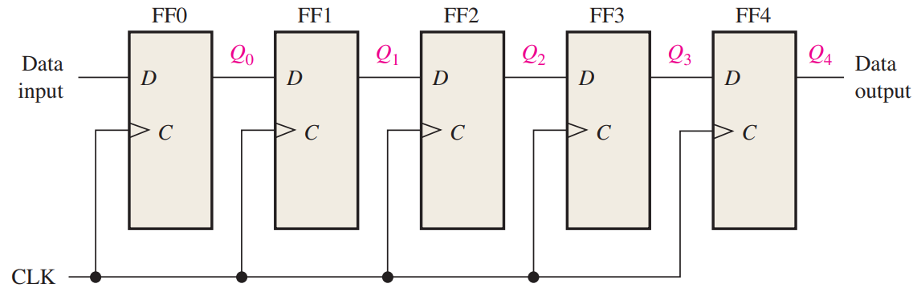
SISO Circuit
Simplest version

Slide 11
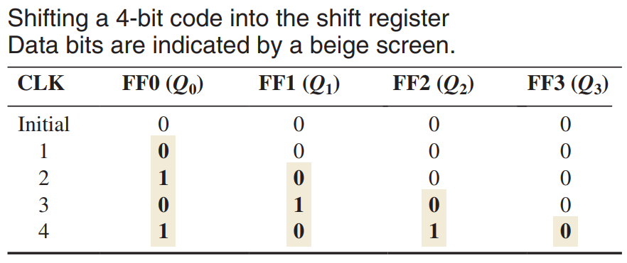
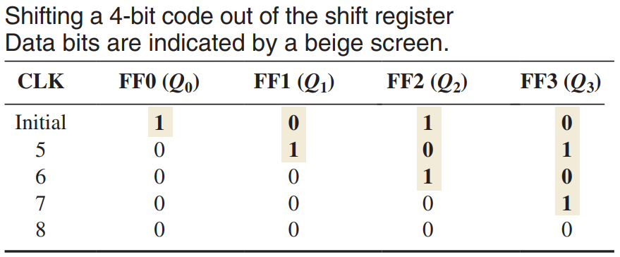
SISO Data Table Example

Slide 12
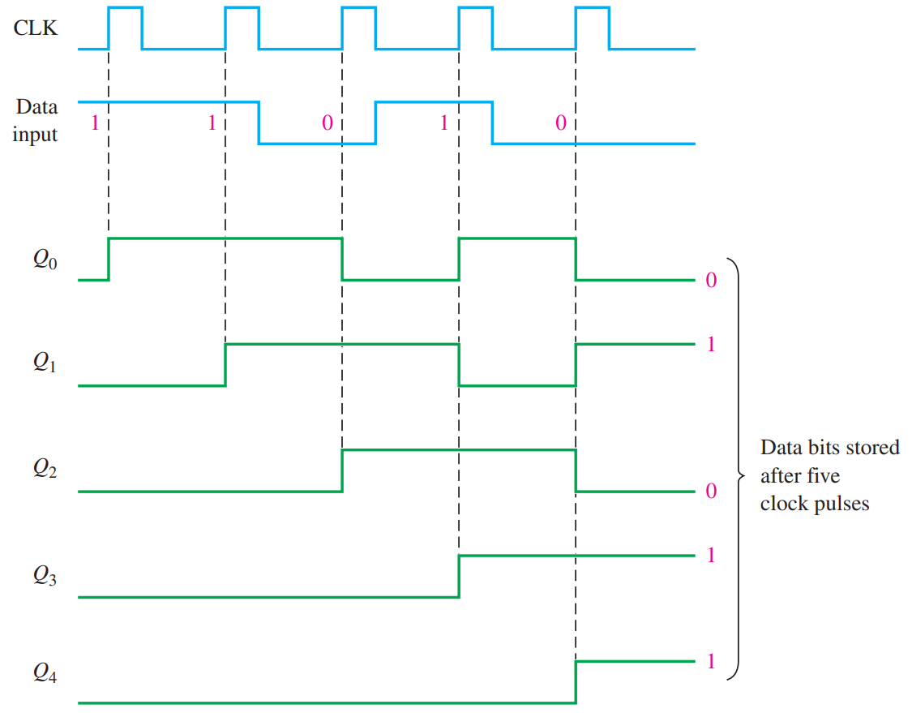
SISO Signal Example

Slide 13
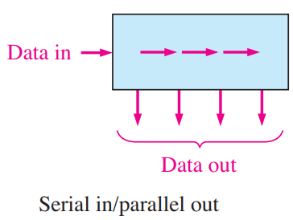
Serial in / Parallel out (SIPO)
Converts data format
Receives data from serial bus and stores into variable

Slide 14
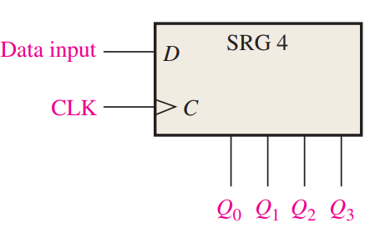
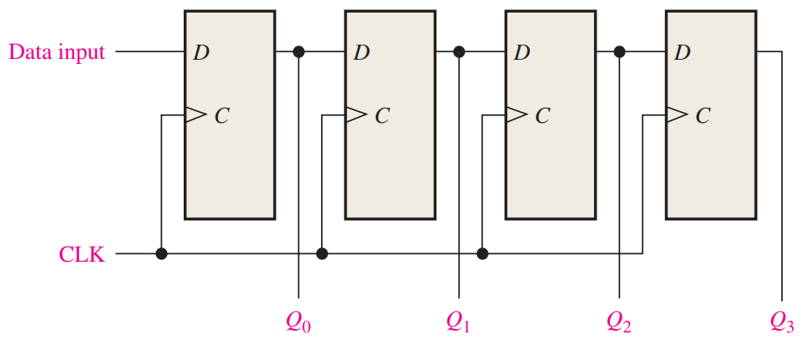
SIPO Circuit
Read all outputs at any time

Slide 15
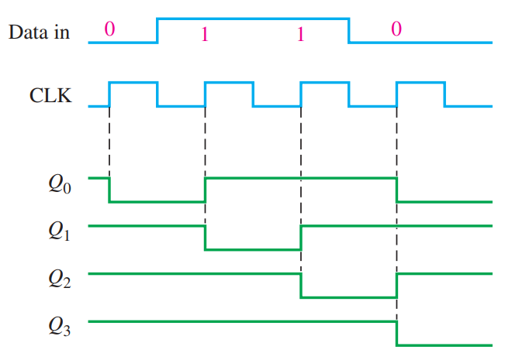
SIPO Signal Example

Slide 16
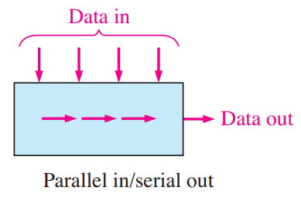
Parallel in / Serial out (PISO)
Converts data format
Gets data ready to be xferred on serial bus

Slide 17
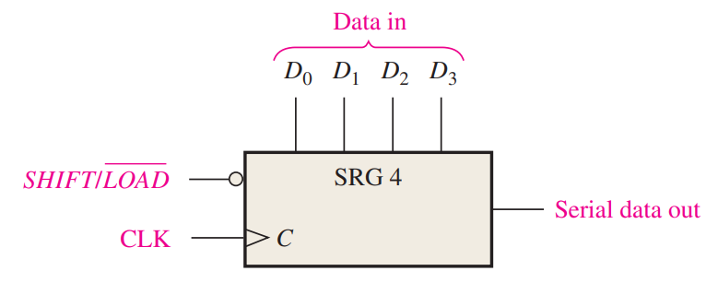
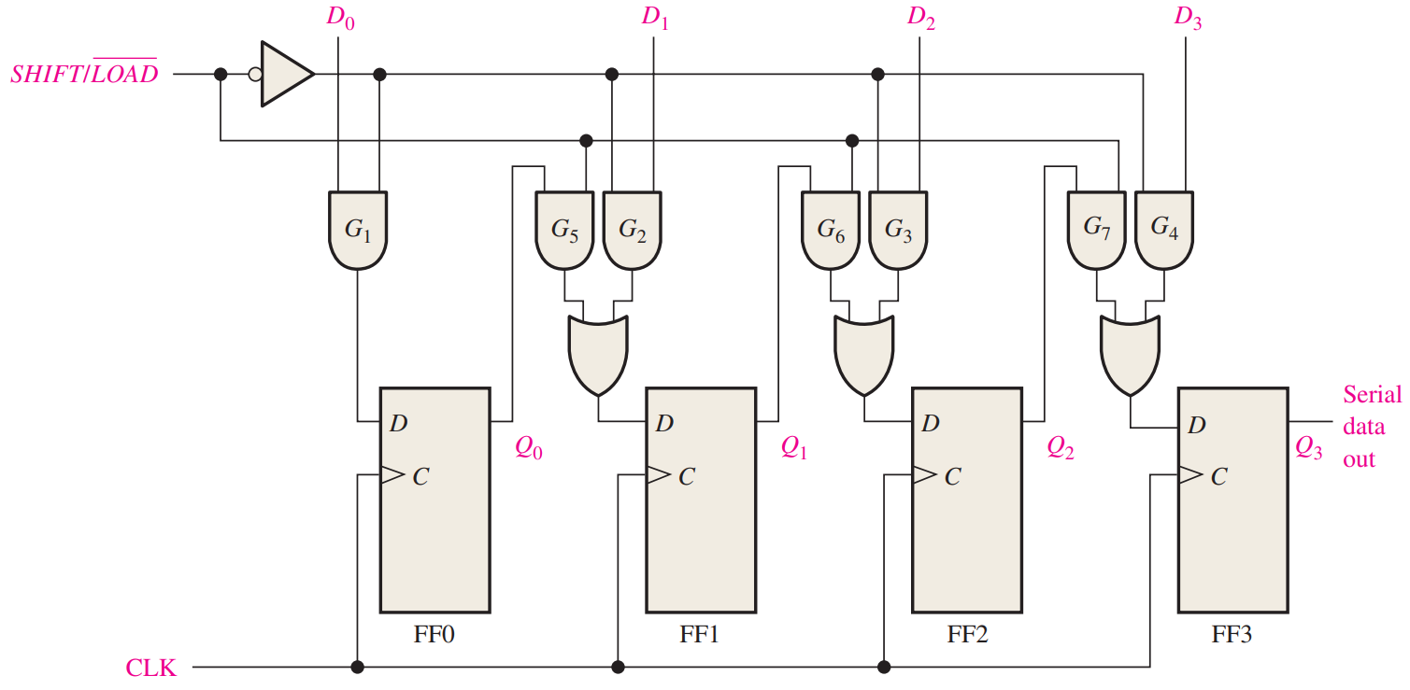
PISO Circuit

Slide 18
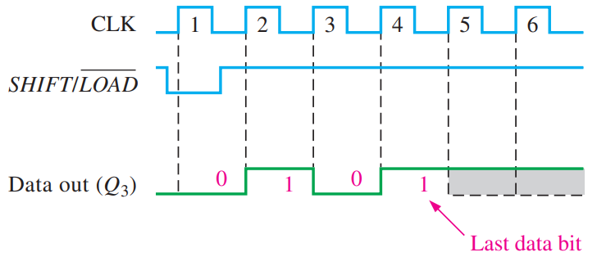
PISO Signal Example
|| data is 0101

Slide 19
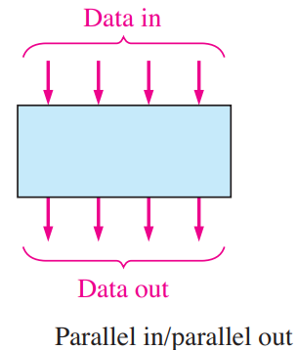
Parallel in / Parallel out (PIPO)
Move variables around
Between registers
Into/out of memory

Slide 20
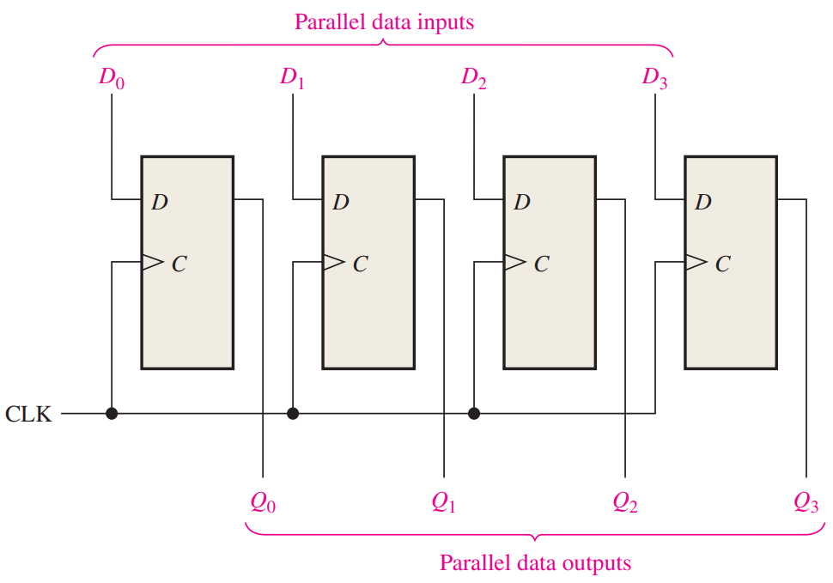
PIPO Circuit

Slide 21
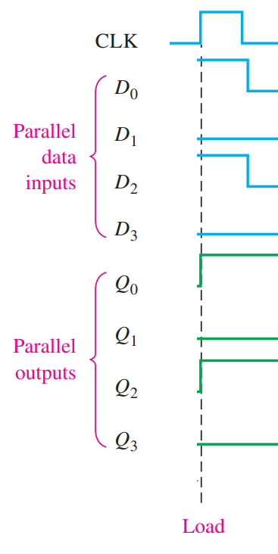
PIPO Signal Example

Slide 22
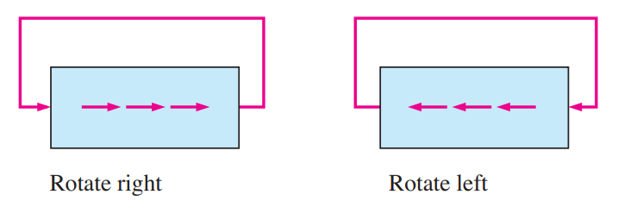
Bit Rotation
Usually bidirectional (data can go both directions)
Using direction input line

Slide 23
Bit Rotation
Shift 0100 to the left, get 1000 (0100 << 1)
What is that equivalent to?
Shift 0100 to the right, get 0010 (0100 >> 1)
What is that equivalent to?
What is 5<<1? 7>>1? 9>>2? 1<<4? 3>>3?

Slide 24
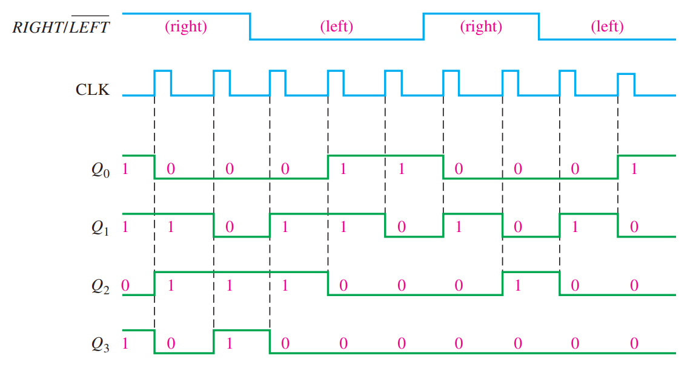
Signal Example

Slide 25
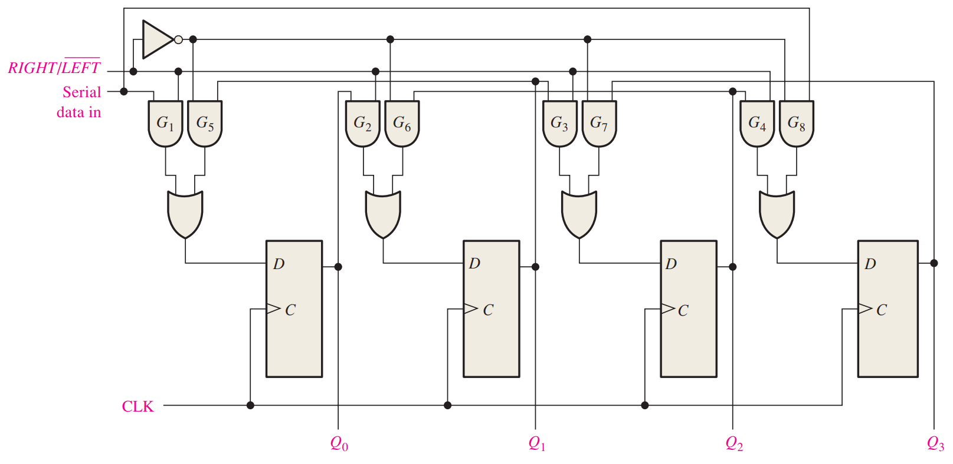
Circuit

Slide 26
Real Chips
The real chips have additional functionality
PIPO and SIPO in one chip
SISO and PISO in one chip
SISO, SIPO, PISO, and PIPO in one chip
Universal shift register

Slide 27
Reading
This lecture
Sections 8.1-8.3
Next lecture
Sections 8.4-8.7

