Slide 1
CPE201 Digital Design
By Benjamin Haas
Class 22: Shift Registers 2

Slide 2
Outline
Shift Register Counters
Johnson Counter
Ring Counter
Shift Register Applications
Troubleshooting

Slide 3
Shift Register Counter
Output is connected back to input
Are also considered counters (Ch9)
Have a specified sequence of states

Slide 4
Johnson Counter
Creates a clock frequency that is 2n slower that CLK
n is the number of bits in the counter
Ex: if CLK is 1MHz and the counter has 5 bits
Johnson counter freq = 1MHZ/(2*5) = 100kHz

Slide 5
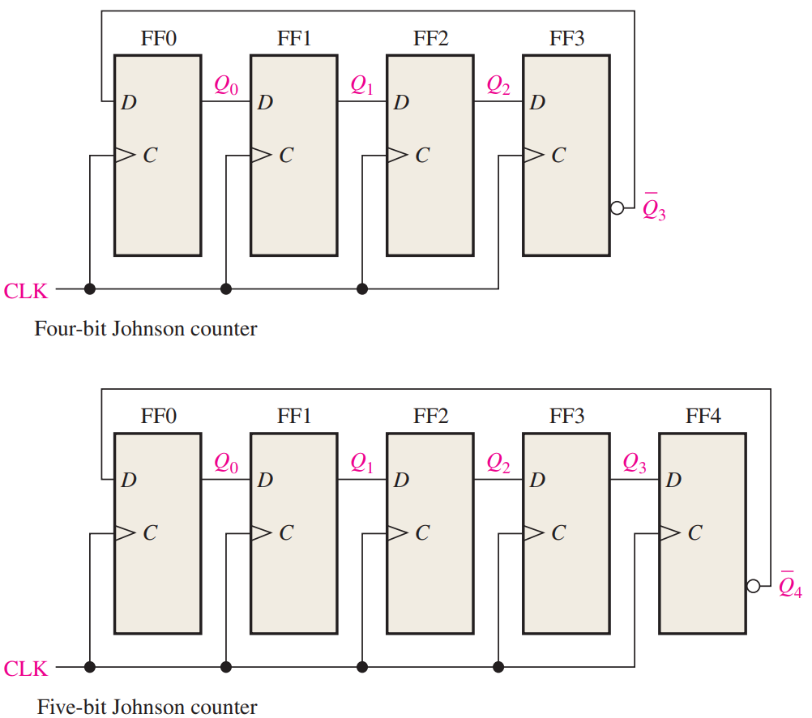
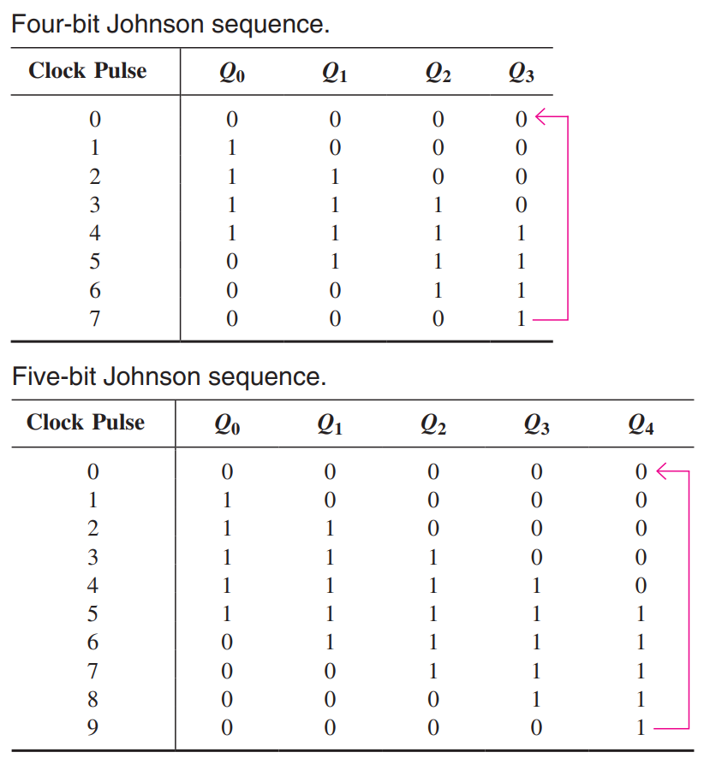
Circuit

Slide 6
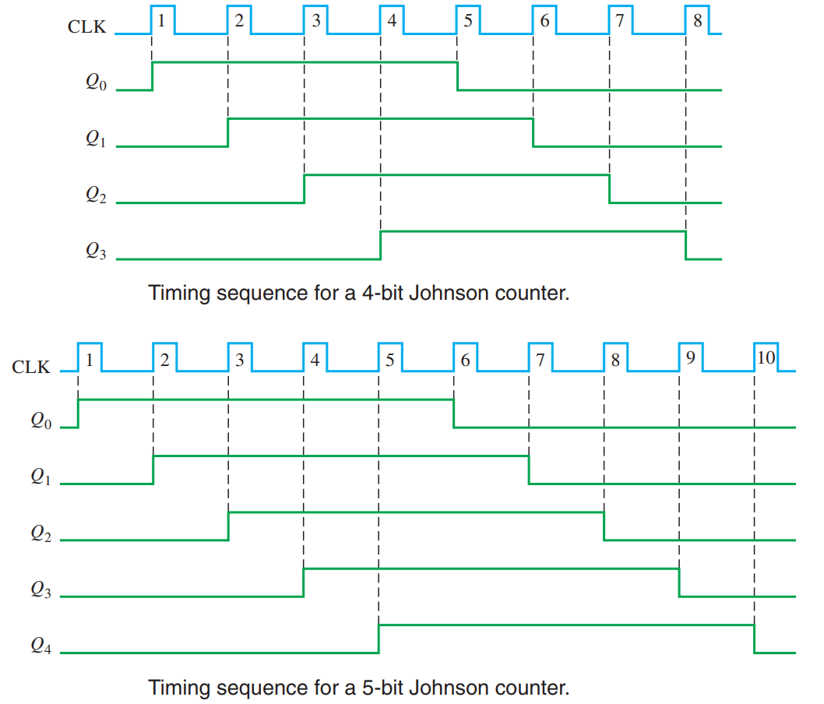
Signal Example
Measure output in
one spot
No signal
setup required

Slide 7
Ring Counter
Like a Johnson counter, but with any bit pattern
The pattern continuously goes through all flip-flops and then back to the beginning

Slide 8
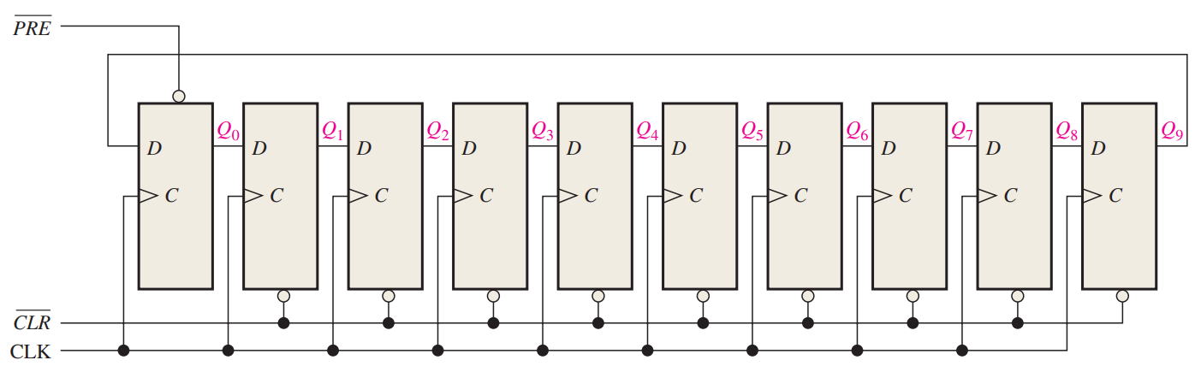
Circuit
No use of Q’
Use Preset to insert bit sequence

Slide 9
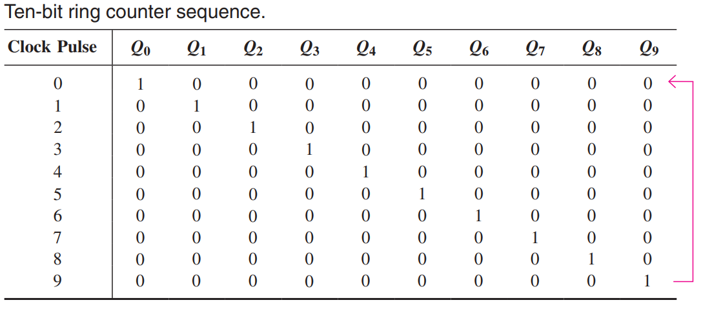
Logic Table
Read any flip-flop output to watch the sequence

Slide 10
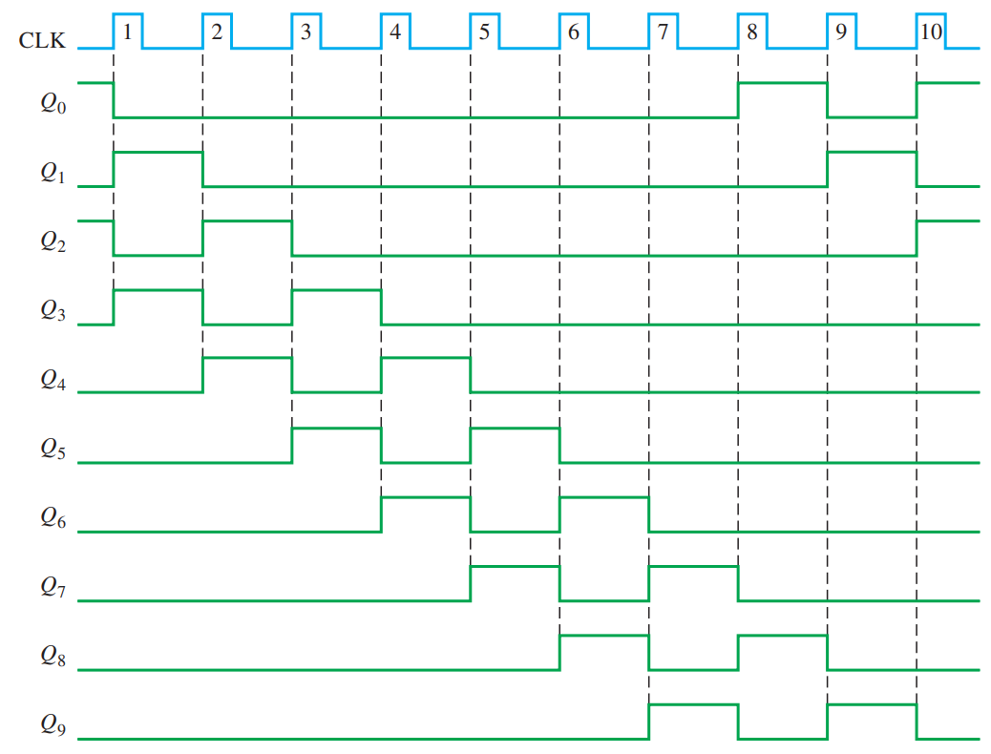
Signal Example
Needs PRE’
on CLK 1 & 3
to set the seq
You set that up
externally

Slide 11
Applications
Time Delay
Serial to Parallel Converter
UART Transmitter
Keyboard Encoder

Slide 12
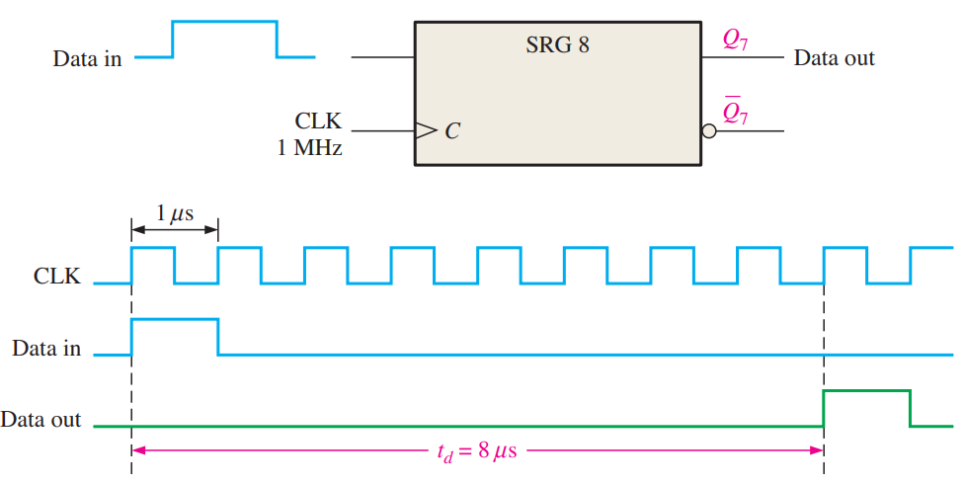
Time Delay
Insert a delay into some signals
Allow for setup time on a part w/o delaying a uC

Slide 13
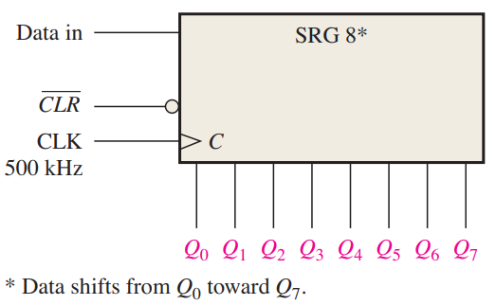
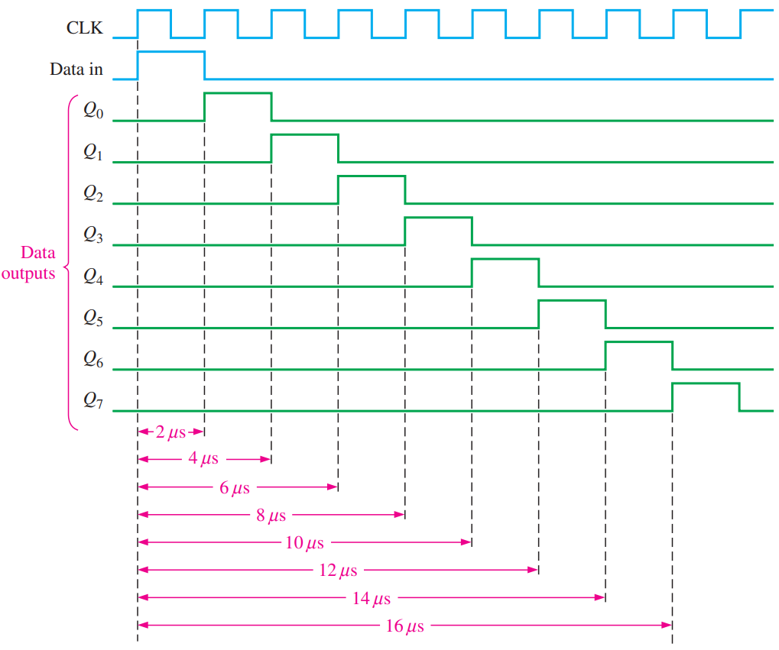
Another Option

Slide 14
Serial to Parallel Converter
Serial is one line
Connection count is small and takes little space
Parallel is one line per bit
Very fast because all bits are xferred at once
Takes up much more space than serial

Slide 15
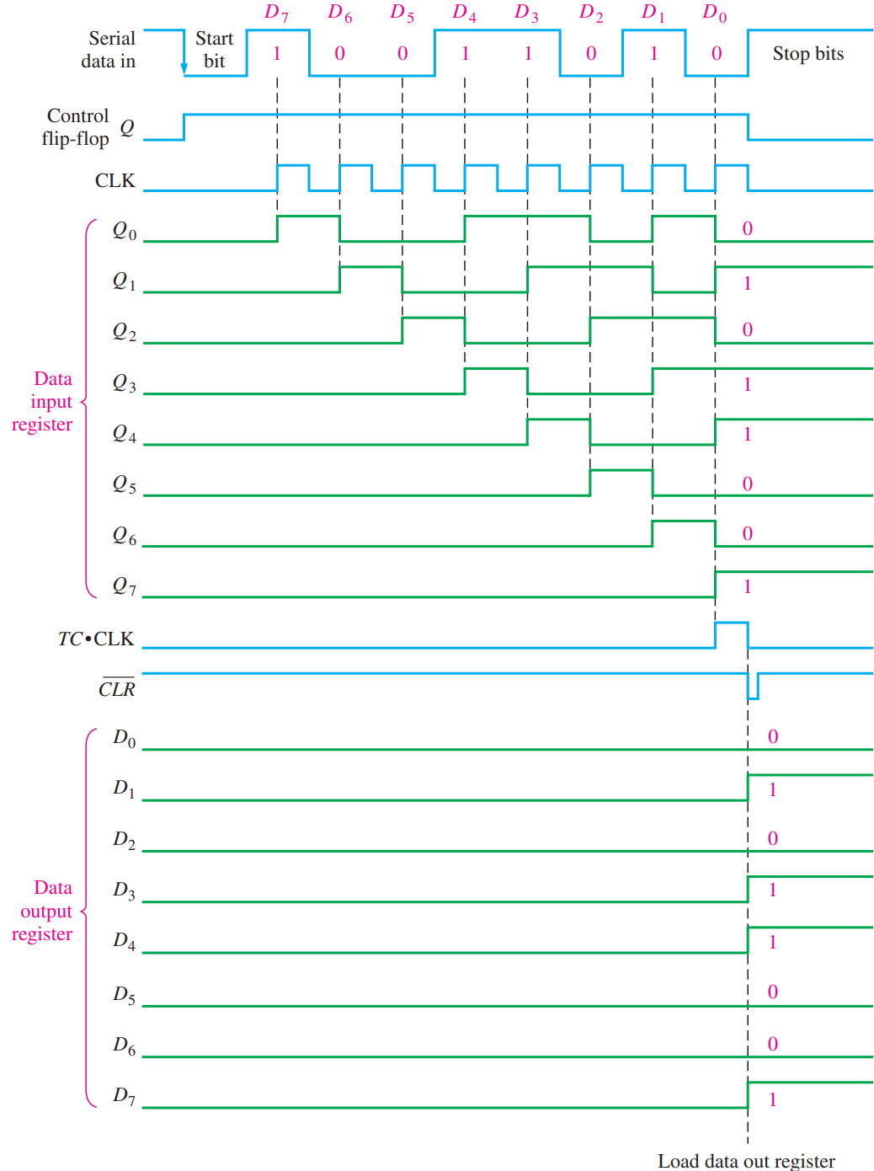
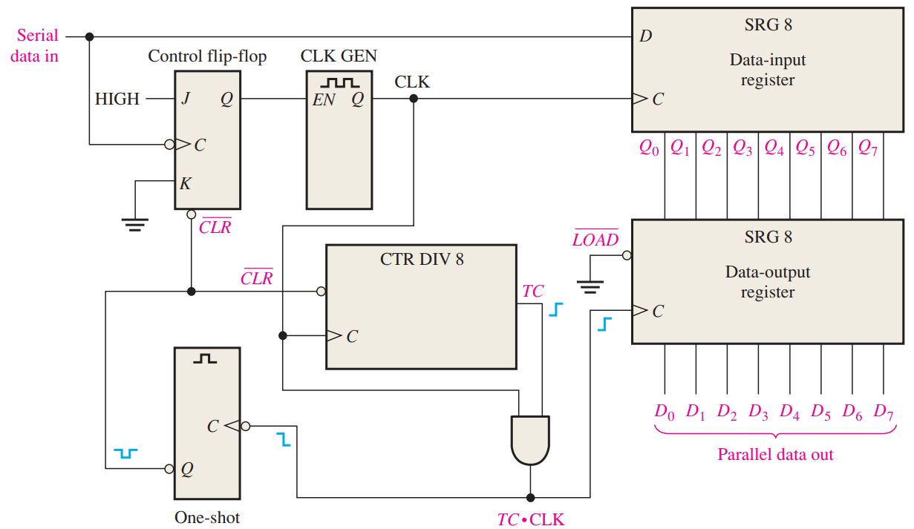
Serial to Parallel Converter

Slide 16
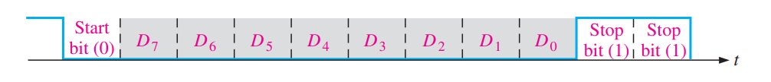
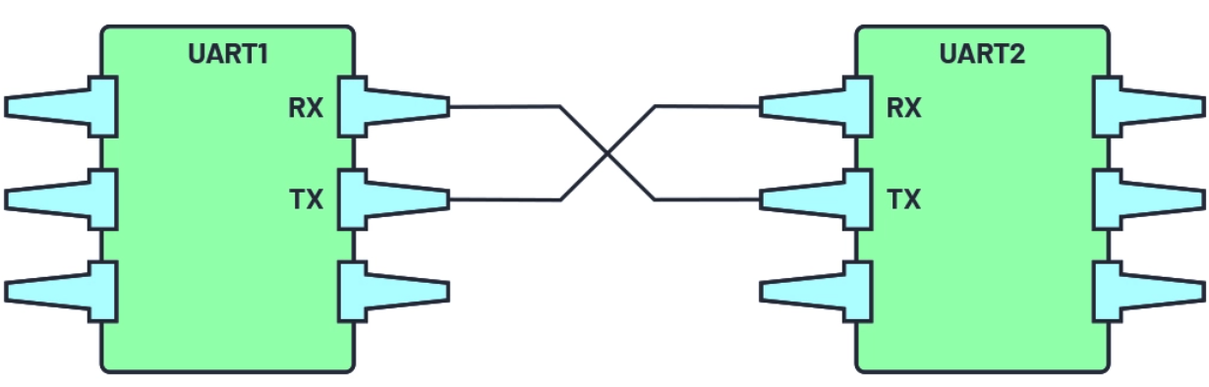
UART
Universal Asynchronous Receiver Transmitter
Full Duplex (RX and TX as same time)
Asynchronous (no clock)
Serial data xfer
Low overhead

Slide 17
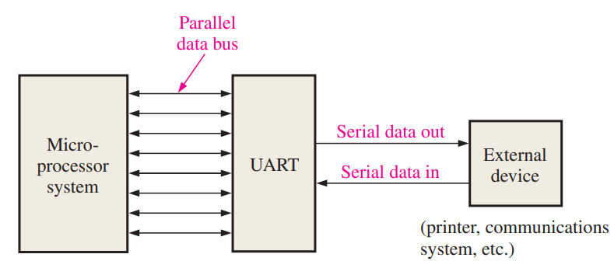
UART
PISO transmit / SIPO receive

Slide 18
Keyboard Encoder
Get key press data to send over USB to computer
Simplified with no key press memory buffer
Scans for pressed keys
Encodes key presses and stores for TX
Debounces a key press

Slide 19
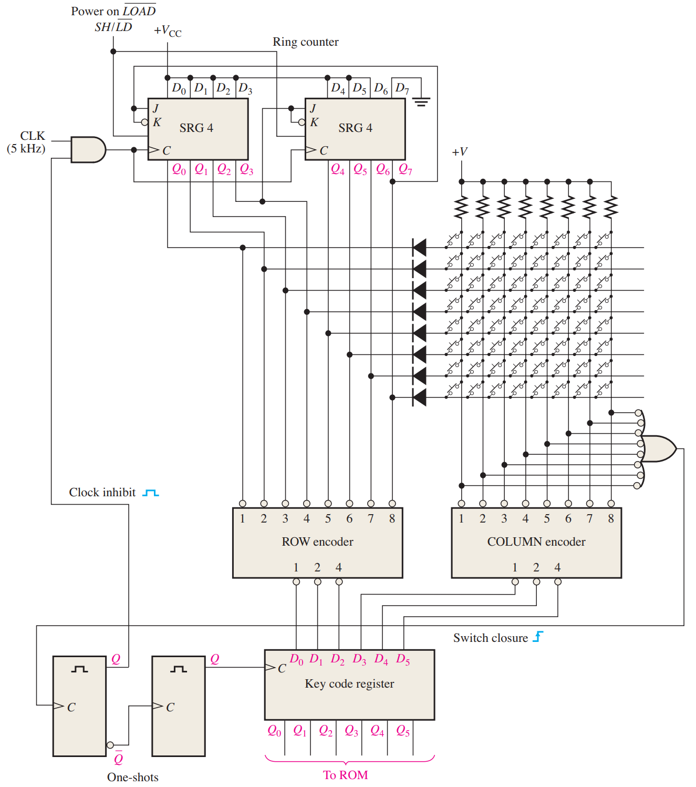

Slide 20
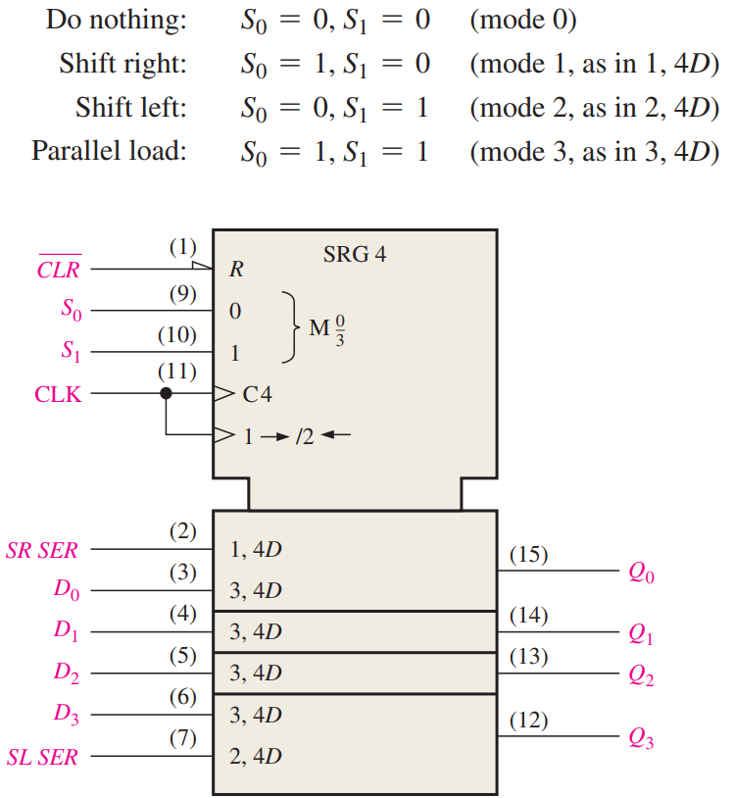
Real Chip – 74HC194
Universal shift reg

Slide 21
Exercising a Circuit
Put all parts of the circuit through all possible states
Tests all chips for working status
Tests all circuit connections
More complicated with more memory parts or complexity

Slide 22
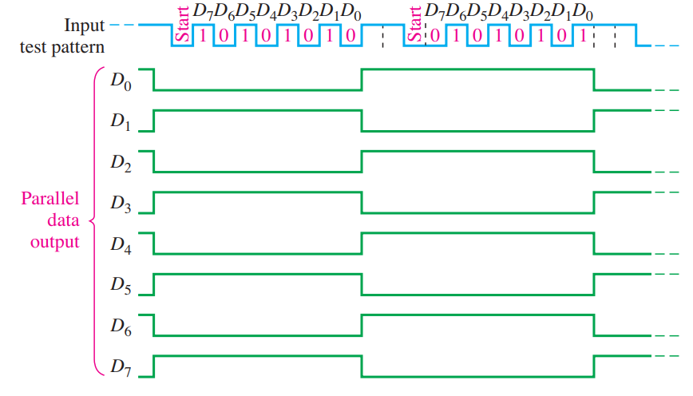
Example (SIPO Test)
Using circuit from Serial to Parallel Converter earlier

Slide 23
Reading
This lecture
Sections 8.4-8.7
Next lecture
9.1-9.4

