Slide 1
CPE201 Digital Design
By Benjamin Haas
Class 23: State Machines and Counters

Slide 2
Outline
Finite State Machines
Moore
Mealy
Asynchronous Counters
Synchronous Counters
Bidirectional Counters

Slide 3
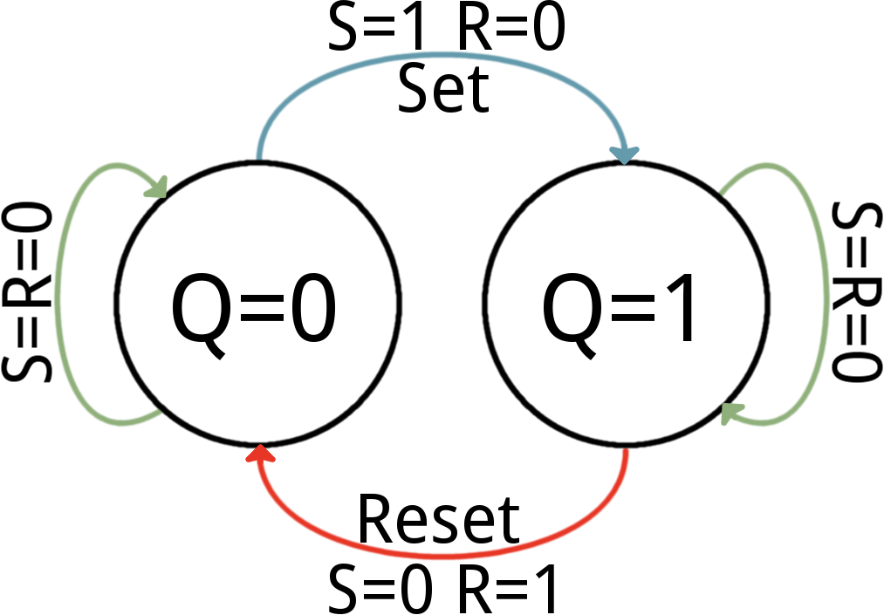
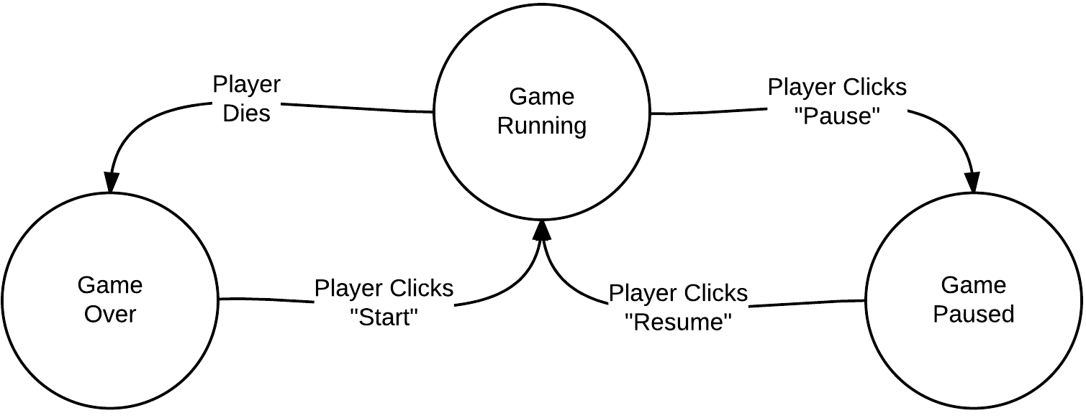
Finite State Machines
Not infinite
Describes how your system reacts to inputs and gives outputs

Slide 4
State Machines
Moore – Output depends on machine state
Simpler design, requires more states and circuitry
Mealy – Output depends on machine state and inputs
Complex design, less states and circuitry

Slide 5
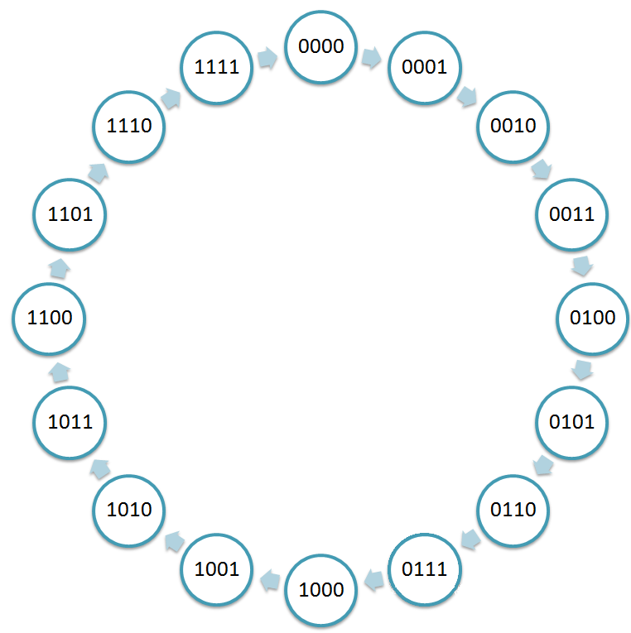
State Machines
Counters are simple
Moore machines
No inputs

Slide 6
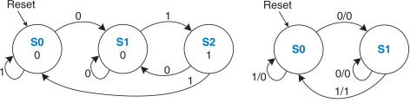
Sequence Detection
Typical example, but extensible
Detects sequence of 01, outputs 1 when found

Slide 7
Vocab
Synchronous – events happen with a fixed time relationship
In counters, CLK goes to all flip-flops
Asynchronous – no fixed time relationship
In counters, CLK does not go to all flip-flops

Slide 8
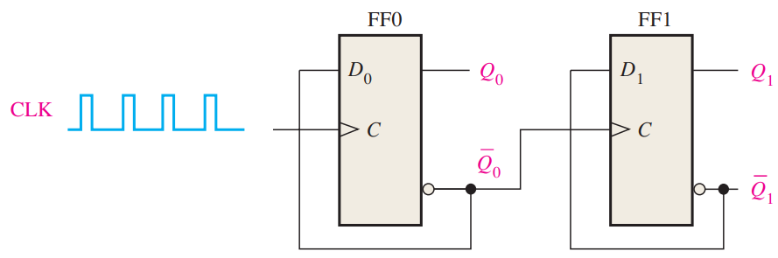
Asynchronous Binary Counters
2-bits, so 2² counts
LSB = FF0
C is positive edge triggered
CLK only goes into FF0, FF1 is fed by Q₀’
Ripple causes it to be asynchronous

Slide 9
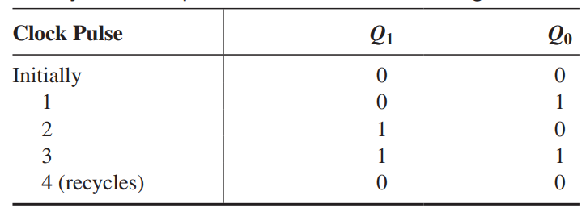
Asynchronous Binary Counters
Outputs read in binary 0…3

Slide 10
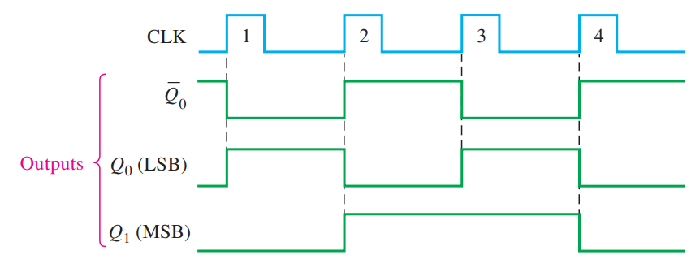
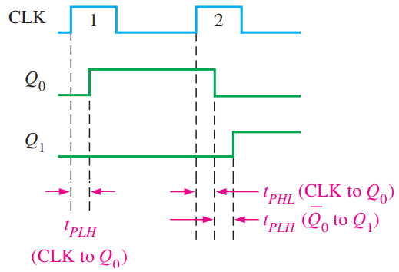
Asynchronous Binary Counters
Ideal Real

Slide 11
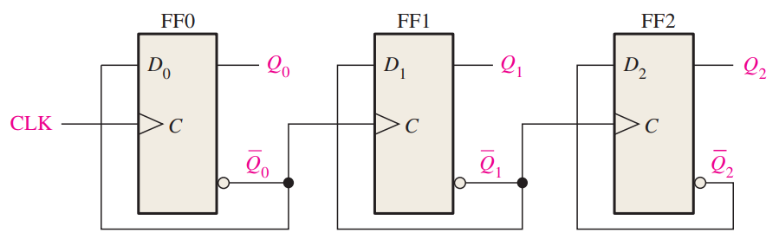
Ripple Binary Counter
Other name for Asynchronous Counter
3 bits, so 2³ states, counts 0..7
Exactly matches
counting app
from FFs
Just add FFs

Slide 12
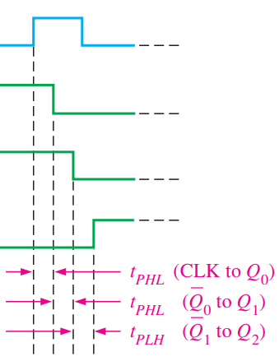
Problem
A large counter = many delays
If ripple not complete before
next CLK
The circuit can desynchronize

Slide 13
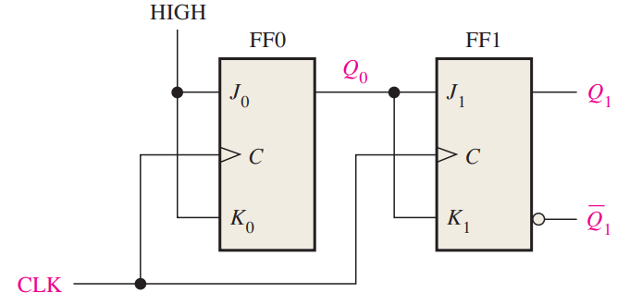
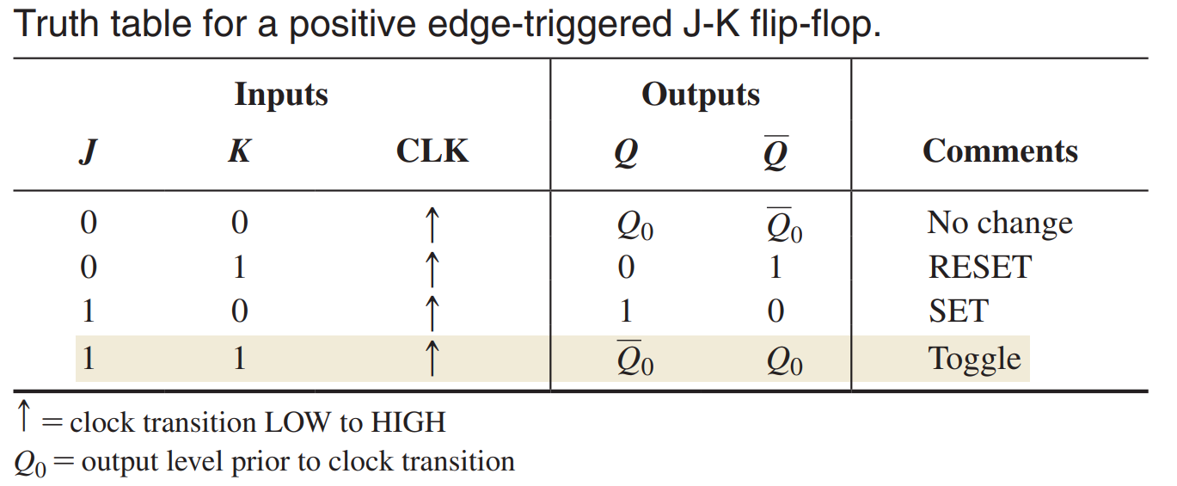
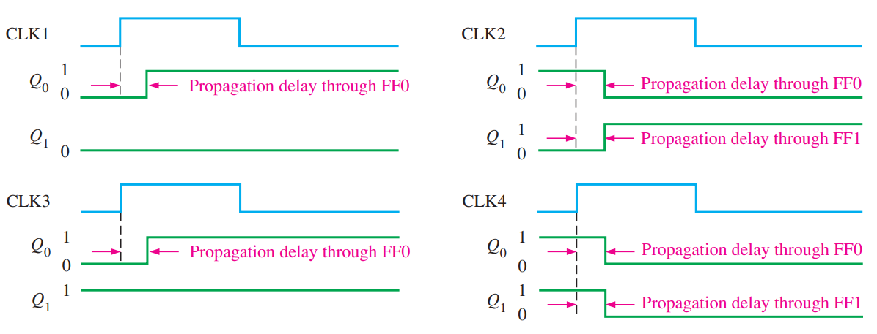
Synchronous Binary Counter

Slide 14
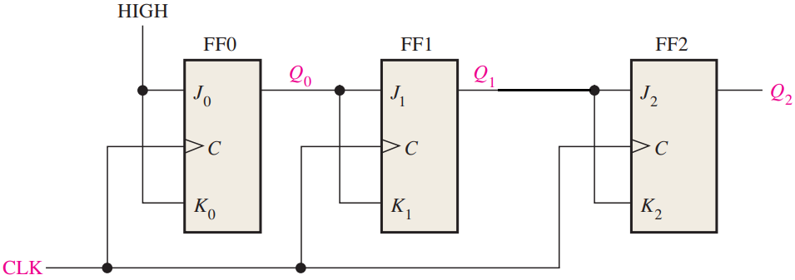
Synchronous Binary Counter
Can’t just add for JK FFs
0, 1, 2, 7, 0, …

Slide 15
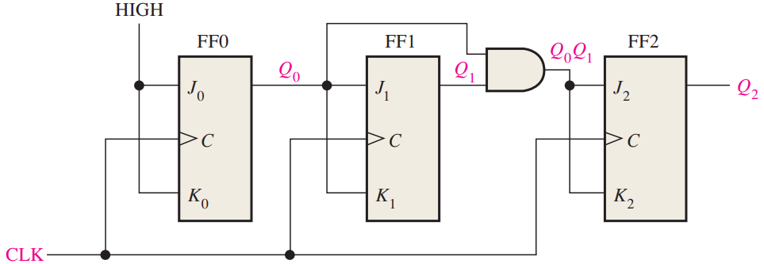
Synchronous Binary Counter
AND only lets Q2 toggle when Q1 and Q0 are 1, like in counting

Slide 16
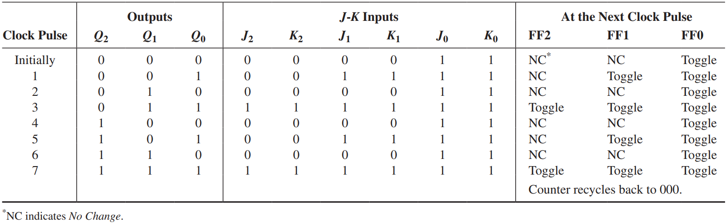
Synchronous Binary Counter

Slide 17
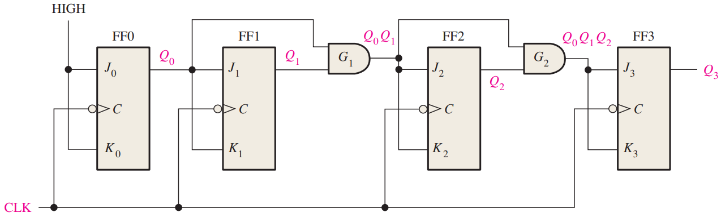
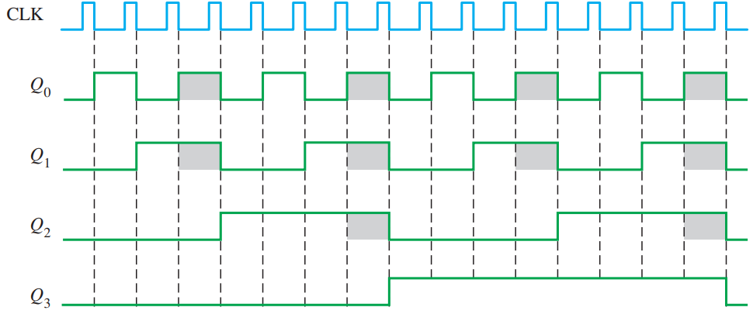

Slide 18
Truncated Asynchronous Counter
Usually 2^{n} states, with n flip-flops
Reset the counter early, truncate the count
Create other counts
There are synch and asynch versions
Next is MOD10 asynch (counts 0 to 9)

Slide 19
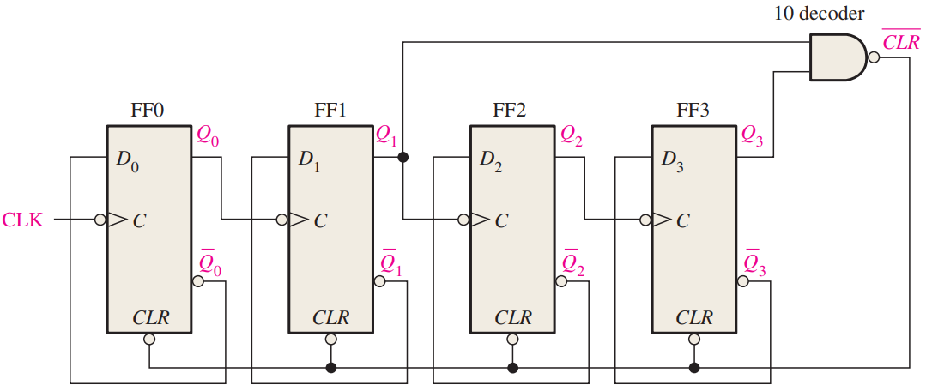
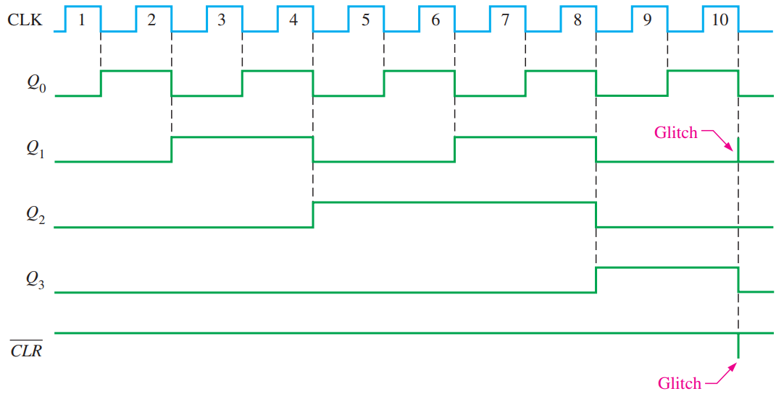

Slide 20
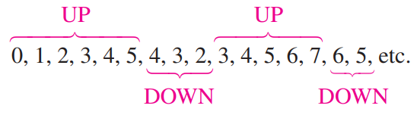
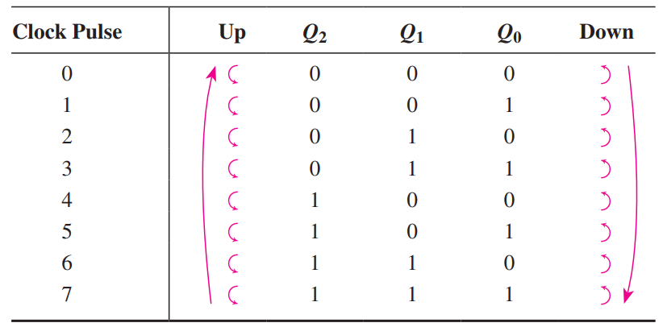
Bidirectional Counter
Also an up/down counter
Counts in either direction

Slide 21
Bidirectional Counter
J₀=K₀=1
J₁=K₁=(Q₀ ∙ UP) + (Q₀’ ∙ DOWN)
J₂=K₂=(Q₀ ∙ Q₁ ∙ UP) + (Q₀’ ∙ Q₁’ ∙ DOWN)

Slide 22
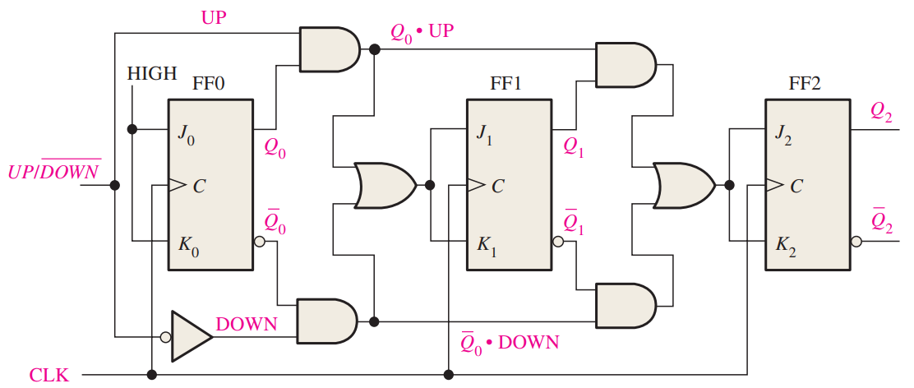
Bidirectional Counter
Copy and paste FF1 and circuitry to extend

Slide 23
Reading
This lecture
Sections 9.1-9.4
Next lecture
Sections 9.5-9.10

