Slide 1
CPE201 Digital Design
By Benjamin Haas
Class 24: Counters, Design and Applications

Slide 2
Outline
Cascading Counters
Counter Decoding
Counter Applications

Slide 3
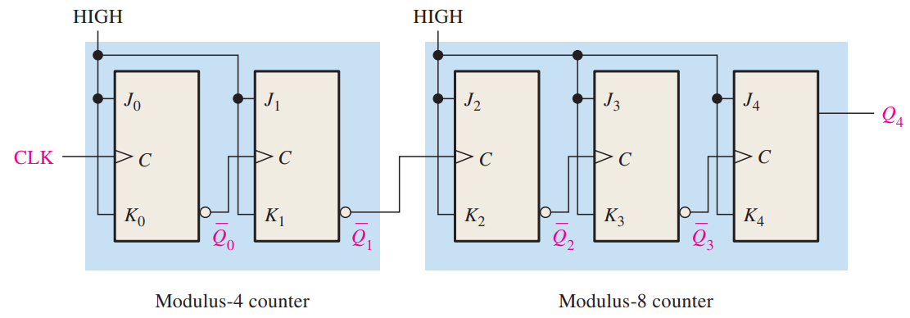
Asynchronous Cascading
Asynchronous is a simple cascade
Be wary of the time for ripple to complete

Slide 4
Synchronous Cascading
Synchronous uses chip features
Count Enable (CTEN)
Lets the counter run
Terminal Count (TC)
A pulse every time the counter rolls over

Slide 5
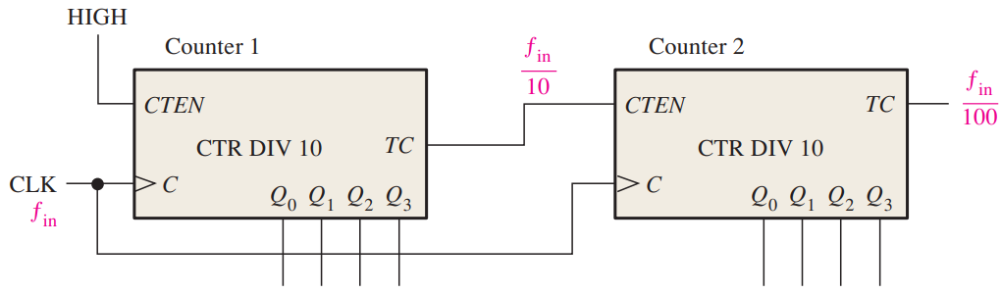
Synchronous Cascading
Counter 2 goes up one count every time Counter 1 rolls over
Frequency Divider

Slide 6
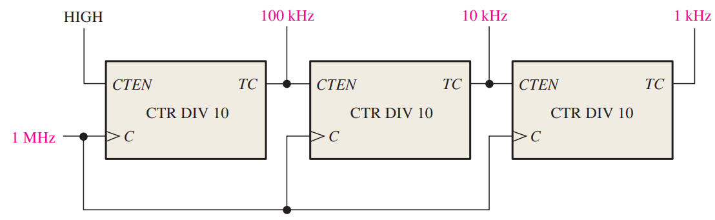
Cascading
Multiply the mod counts to get the total
Can also make multiple clock frequencies

Slide 7
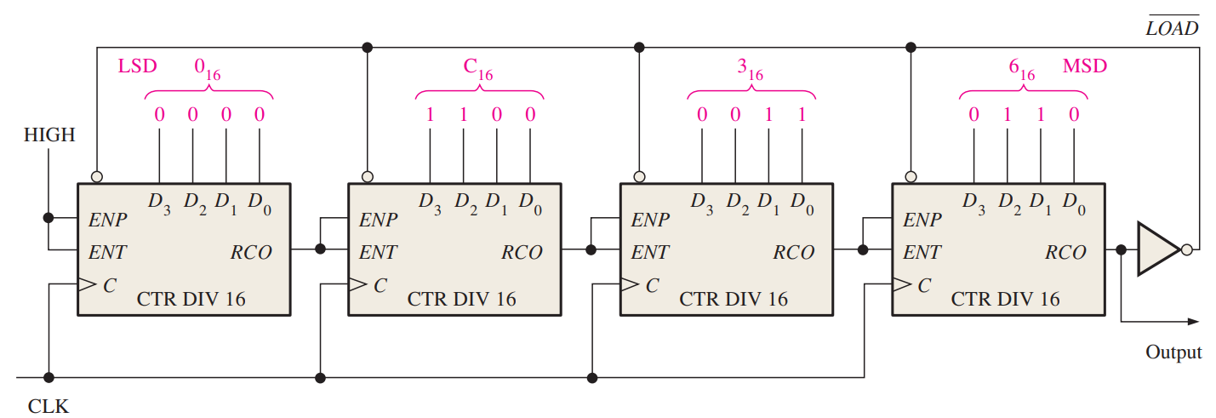
Truncated Cascading
Use loading capability to change start value
Ex start at 0x63C0 = 25,536 out of 2¹⁶=65,536
Leaves 65,536 – 25,536 = 40,000

Slide 8
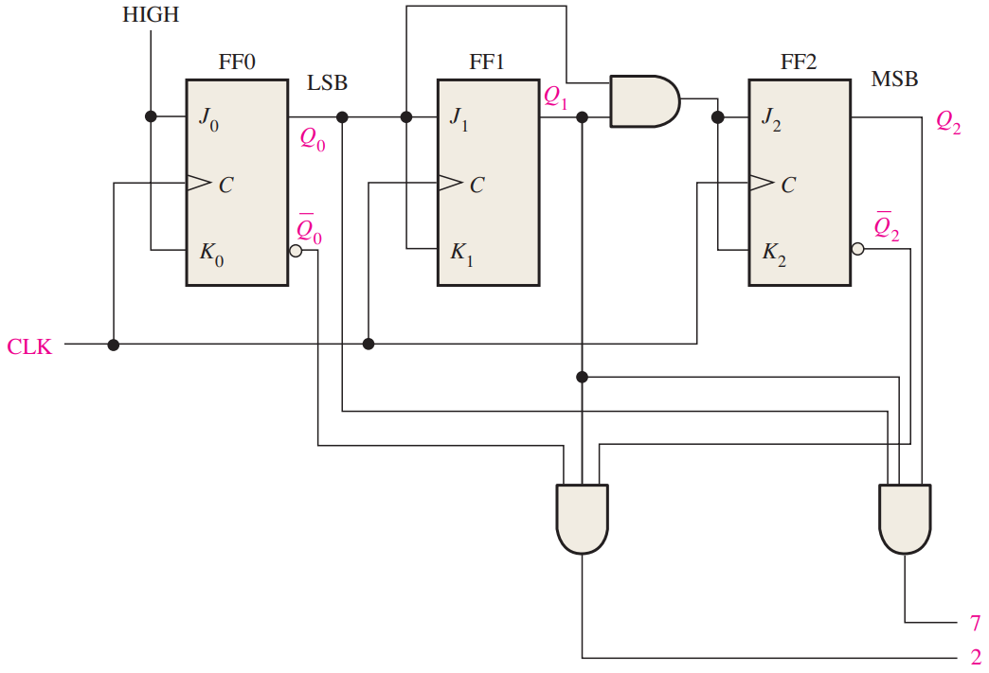
Counter Decoder
Simple decoder
A pulse when the counter has a certain value
After data bits in a UART packet

Slide 9
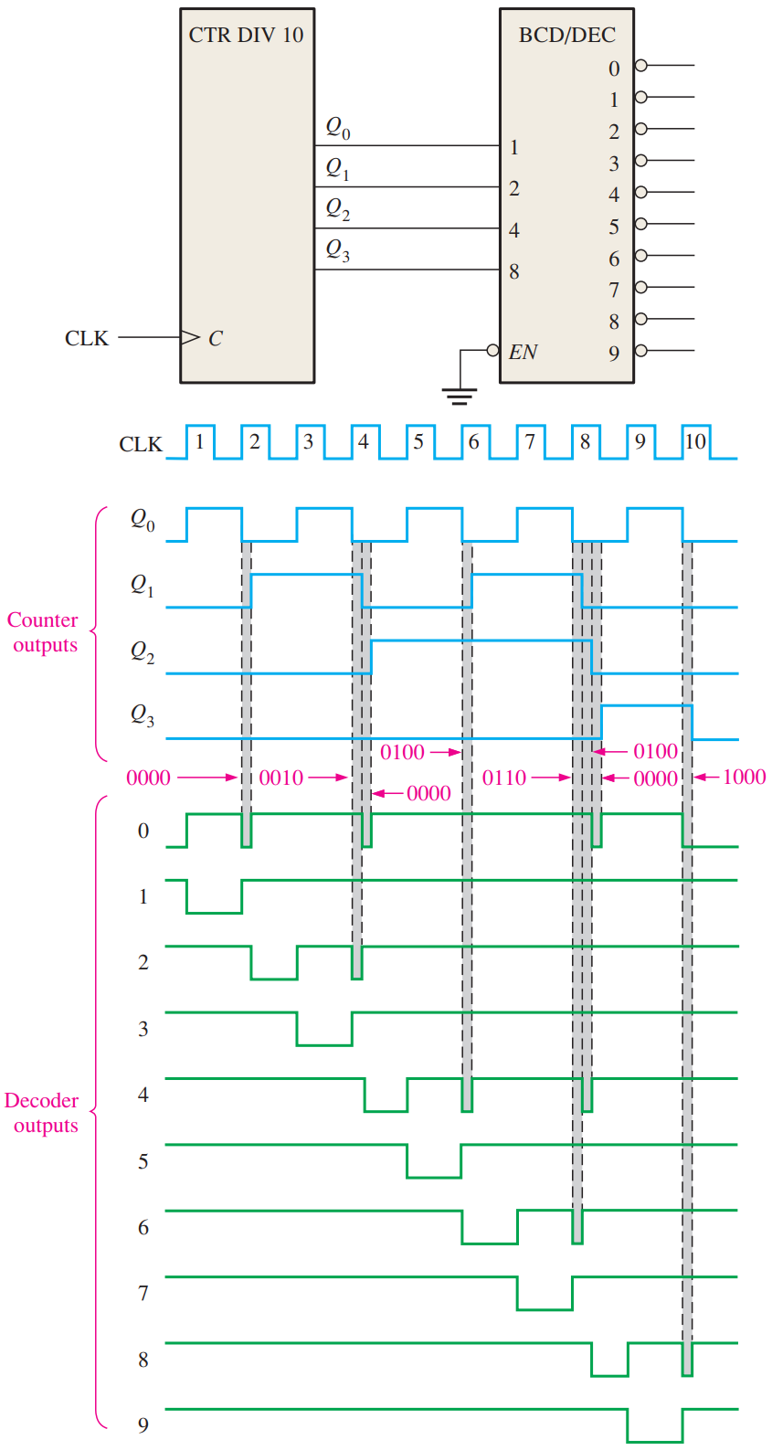
Avoid Glitches
Sample only when the data is ready, not continuously

Slide 10
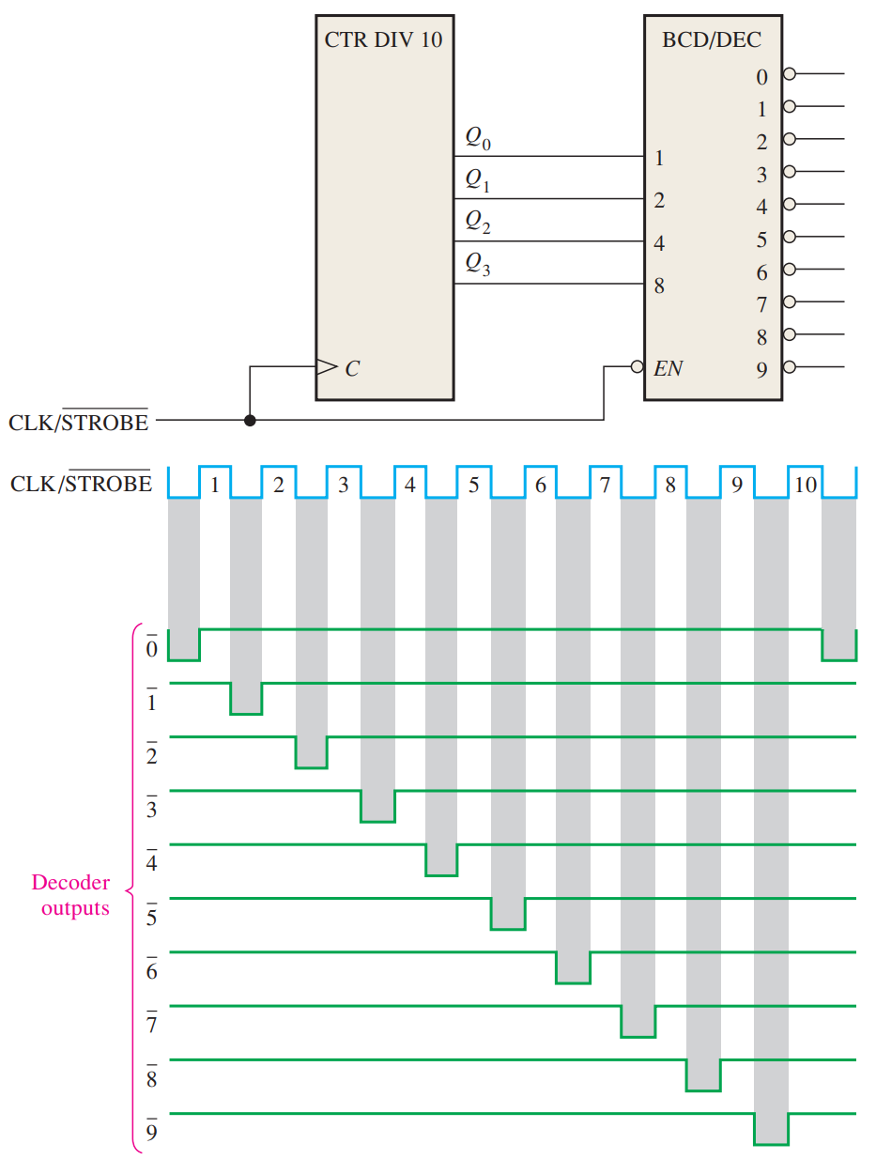
Strobe Inputs
Same concept as with MUX/DEMUX

Slide 11
Applications
Digital Clock
Car Parking Spot Indicator
Serial to Parallel Conversion

Slide 12
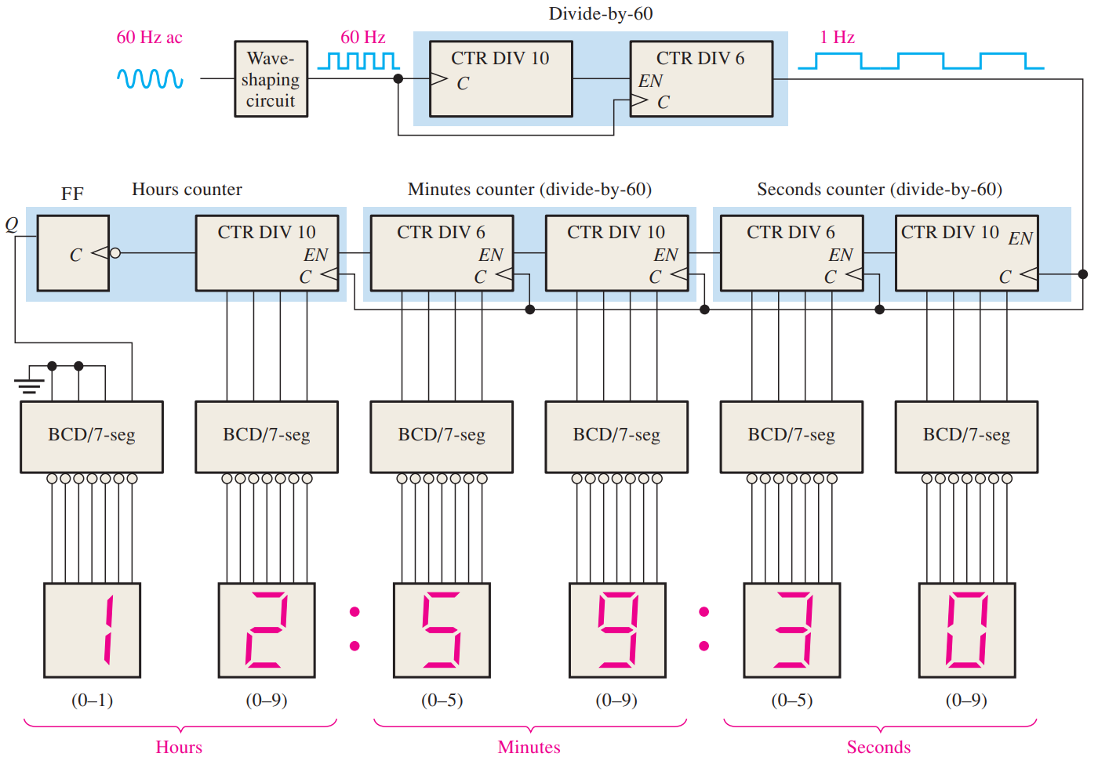
Digital Clock

Slide 13
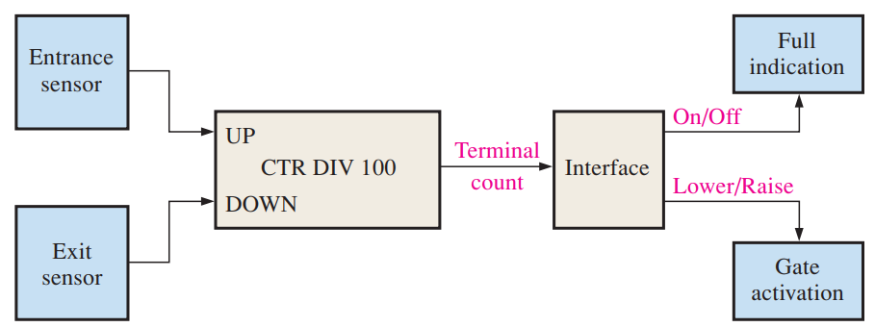
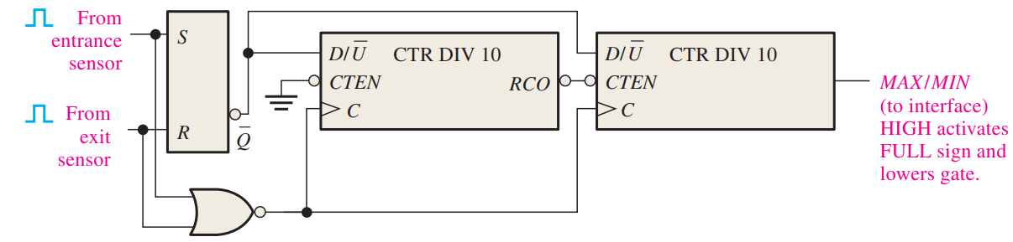
Car Parking Spot Indicator

Slide 14
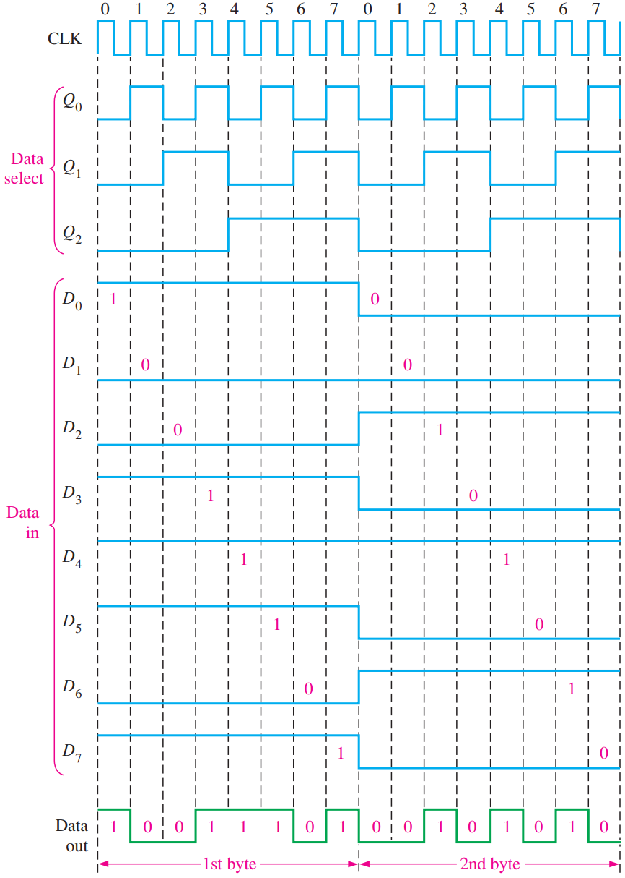
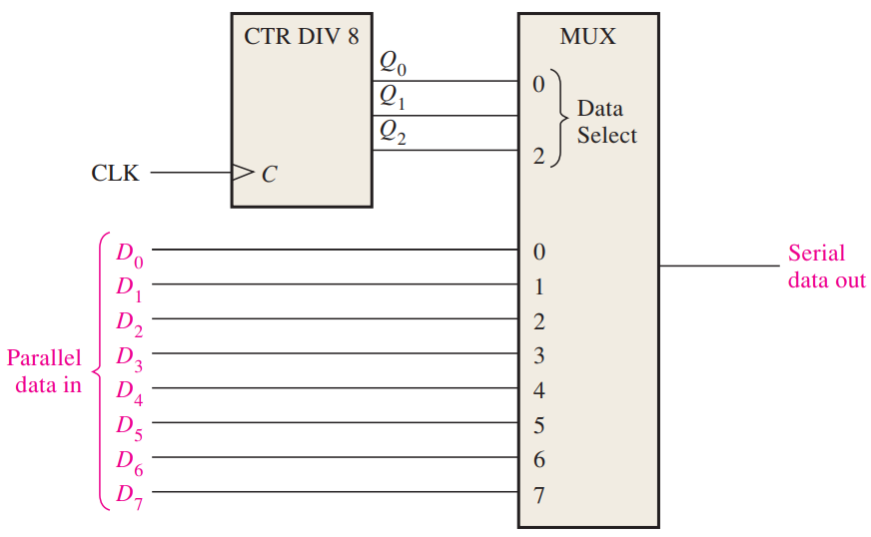
Parallel to Serial

Slide 15
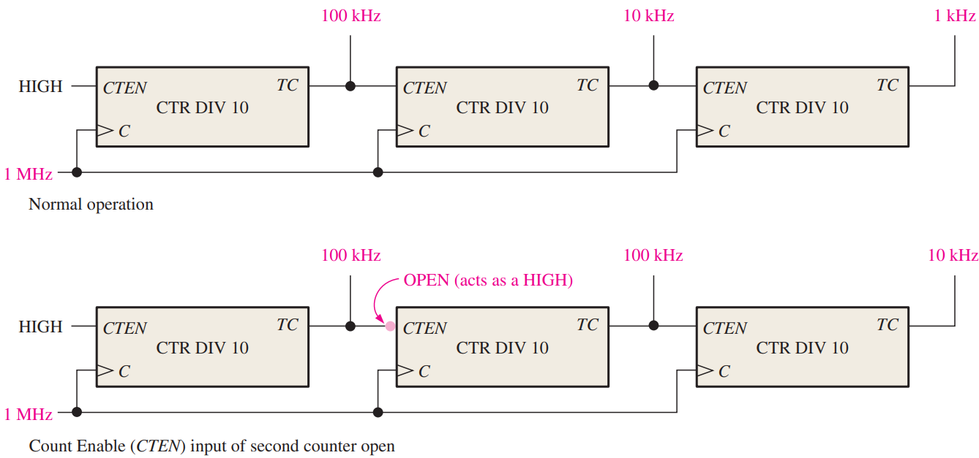
Troubleshooting

Slide 16


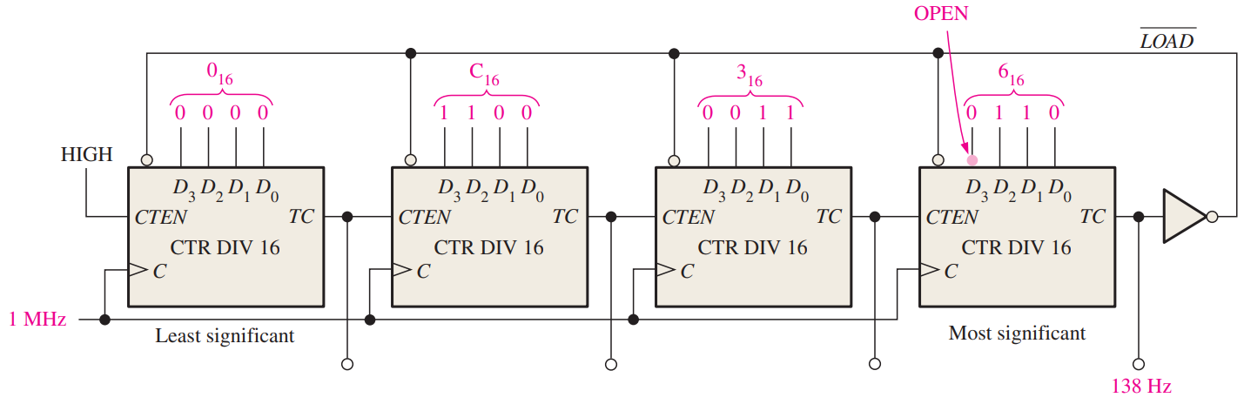
Troubleshooting
Open can change the output frequency
In this chip, open acts like a high input

Slide 17
Reading
This lecture
Sections 9.6-9.10
Next lecture
9.5, Ch7 and Ch8 Applied Logic

