Slide 1
CPE201 Digital Design
By Benjamin Haas
Class 25: Counter Design

Slide 2
Outline
Designing Counters
Examples
System Design Example

Slide 3
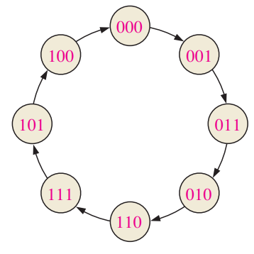
Design
Step 1 - Create state machine
For counters, the state is the output
Ex: 3-bit gray code counter

Slide 4
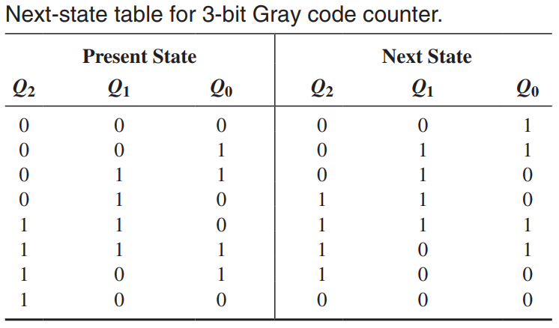
Design
Step 2 – Next state table

Slide 5
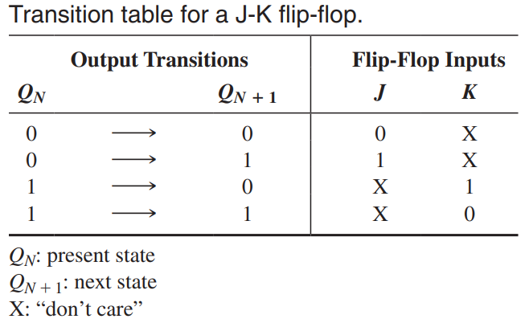
Design
Step 3 – Map state transitions to circuit inputs
JK Flip-flop inputs in this case

Slide 6
Design
Step 3b – Table of inputs to create next states
J₀ | K₀ | Q₂ | Q₁ | Q₀ | Q₀ next
1 | X | 0 | 0 | 0 | 1
X | 0 | 0 | 0 | 1 | 1
X | 1 | 0 | 1 | 1 | 0
0 | X | 0 | 1 | 0 | 0
1 | X | 1 | 1 | 0 | 1
X | 0 | 1 | 1 | 1 | 1
X | 1 | 1 | 0 | 1 | 0
0 | X | 1 | 0 | 0 | 0

Slide 7
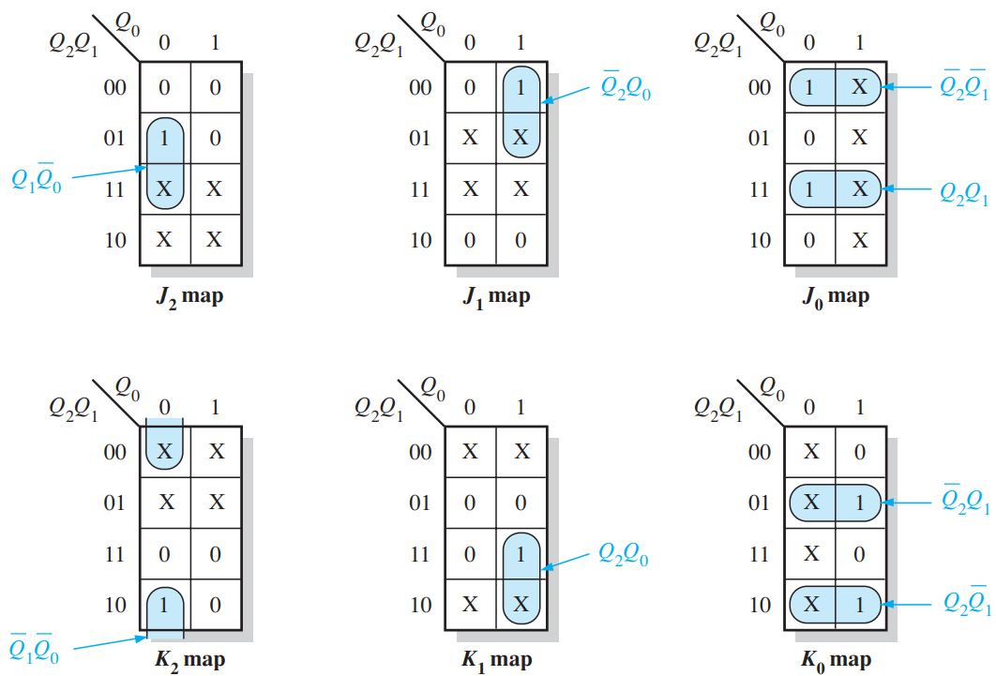
Design
Step 4 – Karnaugh Maps
JK FFs are ACTIVE HIGH, so SOP
J₀ | K₀ | Q₂ | Q₁ | Q₀ | Q₀ next
1 | X | 0 | 0 | 0 | 1
X | 0 | 0 | 0 | 1 | 1
X | 1 | 0 | 1 | 1 | 0
0 | X | 0 | 1 | 0 | 0
1 | X | 1 | 1 | 0 | 1
X | 0 | 1 | 1 | 1 | 1
X | 1 | 1 | 0 | 1 | 0
0 | X | 1 | 0 | 0 | 0

Slide 8
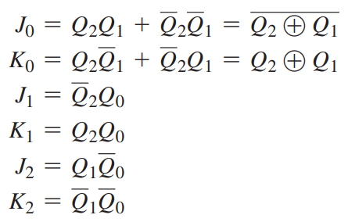
Design
Step 5 – Logical Expressions

Slide 9
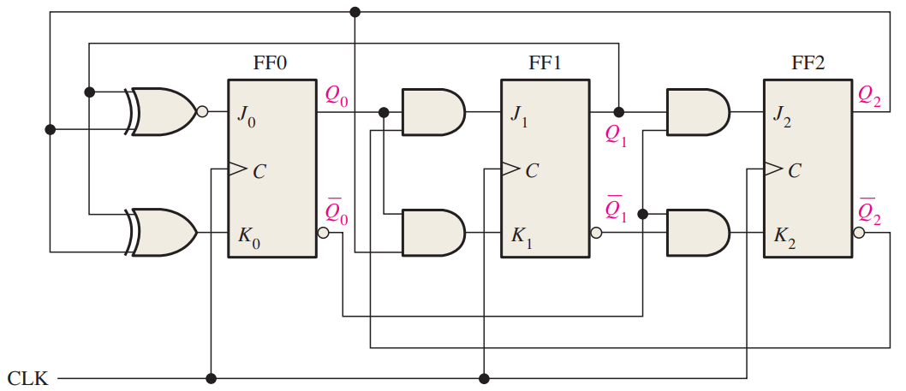
Design
Step 6 - Implementation

Slide 10
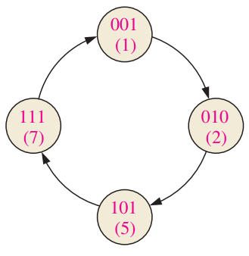
Example
3-bit irregular counter
State machine given (step 1)
Implement with D FFs

Slide 11
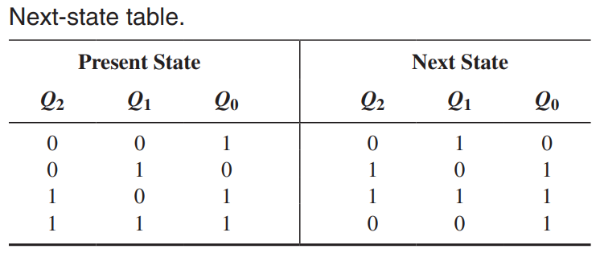
Example
Step 2 – next state table

Slide 12
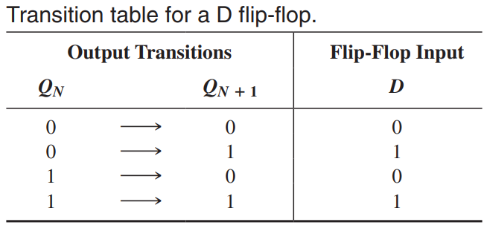
Example
Step 3b - Table of inputs to create next states
D₀ | Q₂ | Q₁ | Q₀ | Q₀ next
0 | 0 | 0 | 1 | 0
1 | 0 | 1 | 0 | 1
1 | 1 | 1 | 1 | 1
1 | 0 | 0 | 1 | 1

Slide 13
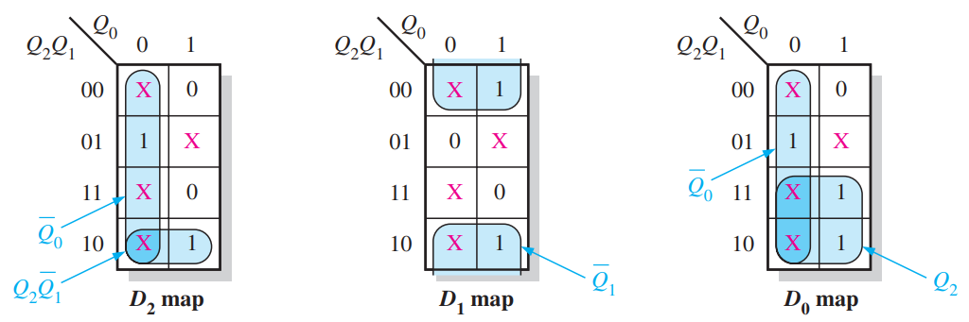
Example
Step 4 Karnaugh Maps
Pink X’s are Don’t Care because the state is not in the state machine
D FFs are ACTIVE HIGH, so SOP
D₀ | Q₂ | Q₁ | Q₀ | Q₀ next
0 | 0 | 0 | 1 | 0
1 | 0 | 1 | 0 | 1
1 | 1 | 1 | 1 | 1
1 | 0 | 0 | 1 | 1

Slide 14
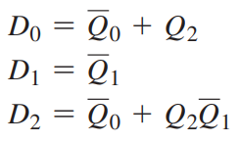
Example
Step 5 – Logical Expressions

Slide 15
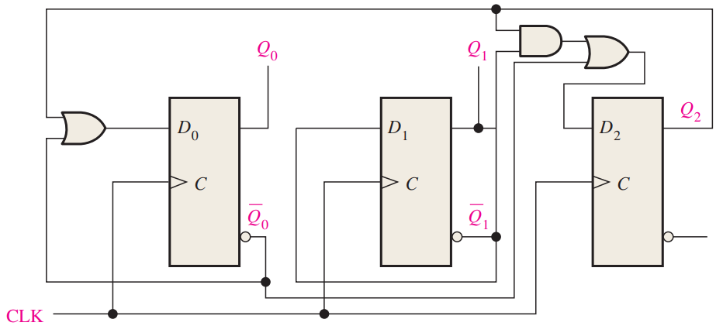
Example
Step 6 - Implementation

Slide 16
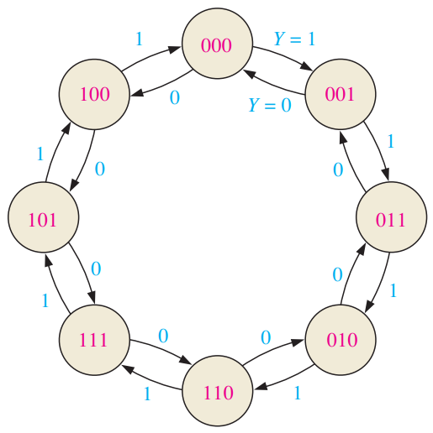
Example 2
3-bit Gray Code up/down counter
State machine given (step 1)
Implement with JK FFs

Slide 17
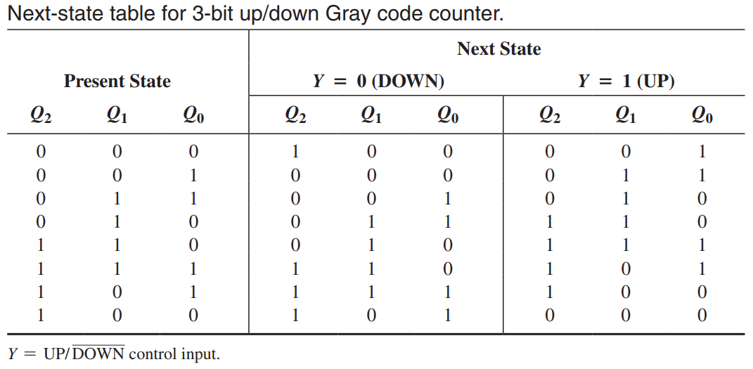
Example 2
Step 2 – Next state table

Slide 18
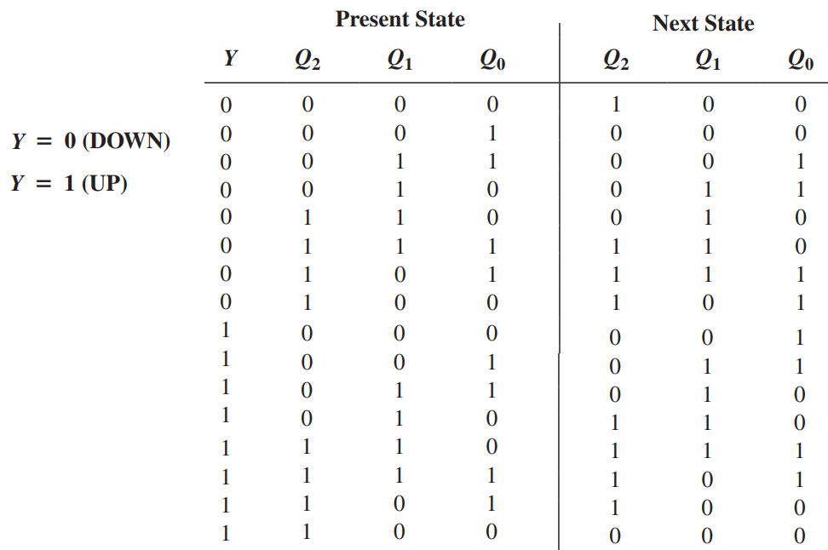
Example 2
Consider the up/down’ bit to be part of the state

Slide 19
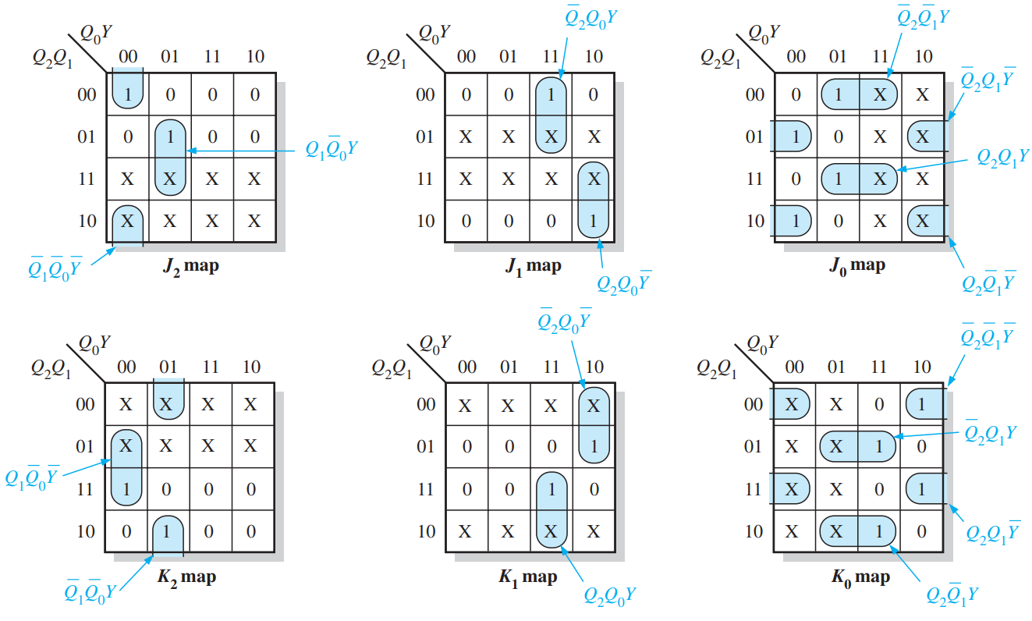
Example 2
Step 3b – Same process as before
Step 4 – Karnaugh Maps for 4 inputs
Step 5 and Step 6 are the same process as before

Slide 20
Traffic Signal Design
Lights at a busy road perpendicular to a side street
Requirements:
Green light on main for at least 25s before a change
Green light on side street as long as there are vehicles, up to 25s max
Yellow for 4s on both streets

Slide 21
Traffic Signal Design
Inputs:
Vehicle sensor input (1 = vehicle present)
System clock (1Hz)
Outputs:
Red, yellow, green signals for both streets (1 = on)

Slide 22
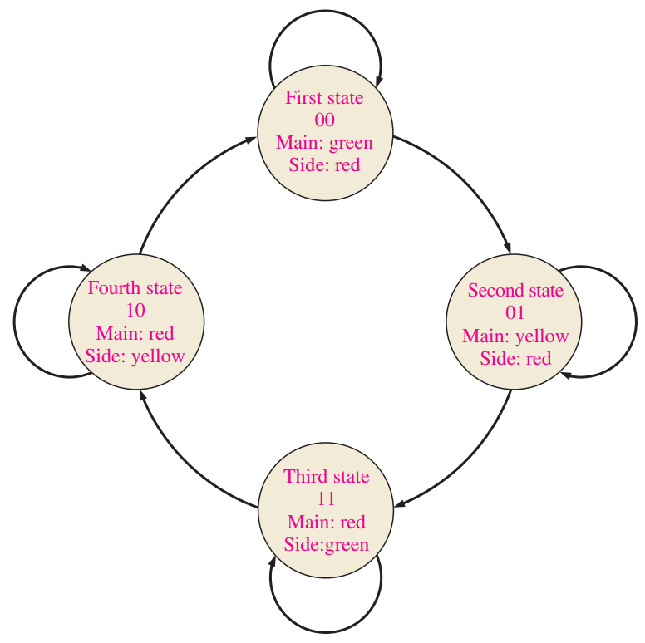
Traffic Signal Design
Basic state machine
You know how traffic lights work
Also added gray code to represent each state as a number

Slide 23
Traffic Signal Design
Let’s describe the transitions
First state is ‘normal’, takes a vehicle on side street and 25s to have passed to change to next state
Second state, wait for 4s on yellow
Third state, stay here as long as a vehicle is present and it is less than 25s in this state
Fourth state, same as second state

Slide 24
Traffic Signal Design
Now make some inputs/variables for the state machine
Make from state transitions, make vars binary
V_{S} = vehicle present on side street
T_{L} = long timer (25s) is on
T_{S} = short timer (4s) is on

Slide 25
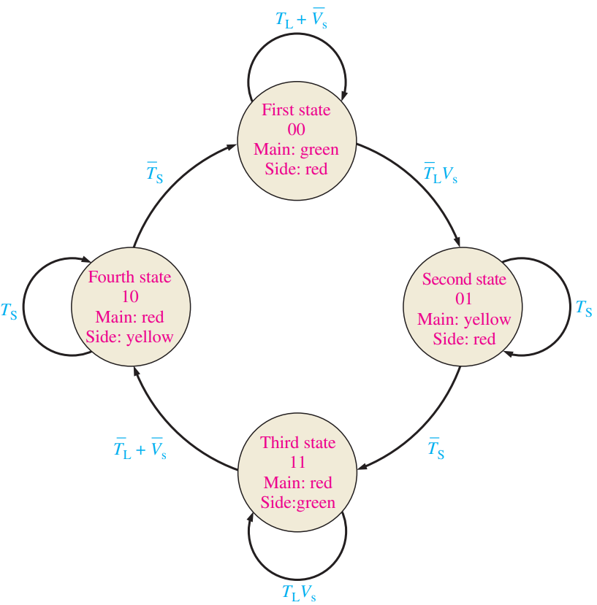
Traffic Signal Design
Note that each transition condition is literally the NOT of the looping condition

Slide 26
Traffic Signal Design
The controller can be broken into several parts
Sequential logic - takes in all inputs on state machine and outputs state gray code
Combinational Logic – decodes state, triggers timers, and creates light outputs
Timers – input triggers and clock, outputs for if each timer is running (creates T_{L} and T_{S})

Slide 27
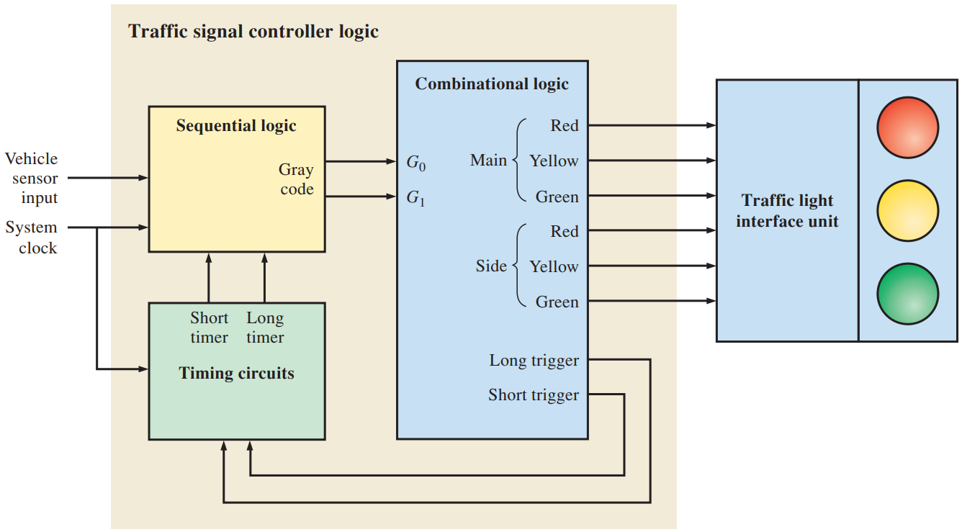
Traffic Signal Design
Break each block down until it does one thing
Sequential is counter
Timers
Combination still
does too much
Block Diagram

Slide 28
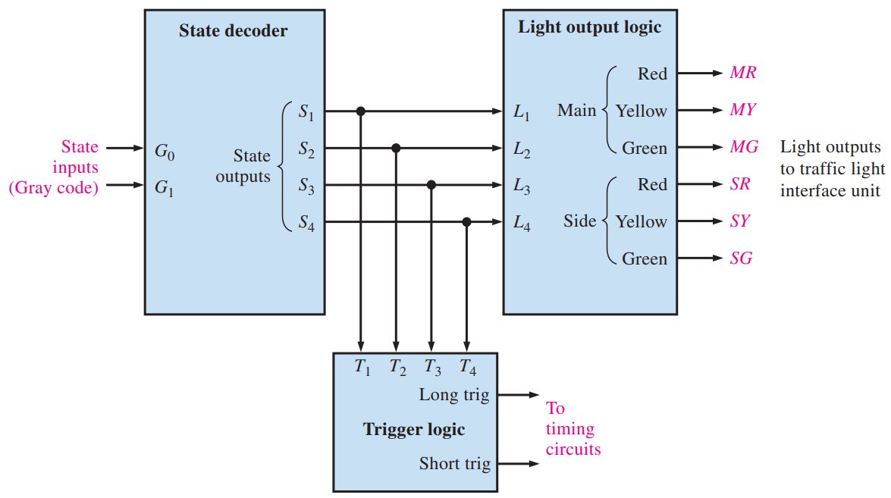
Traffic Signal Design
Do your thinking in blocks to simplify problems
State decoder – current state is HIGH
State directly ties
to light colors and
starts a timer

Slide 29
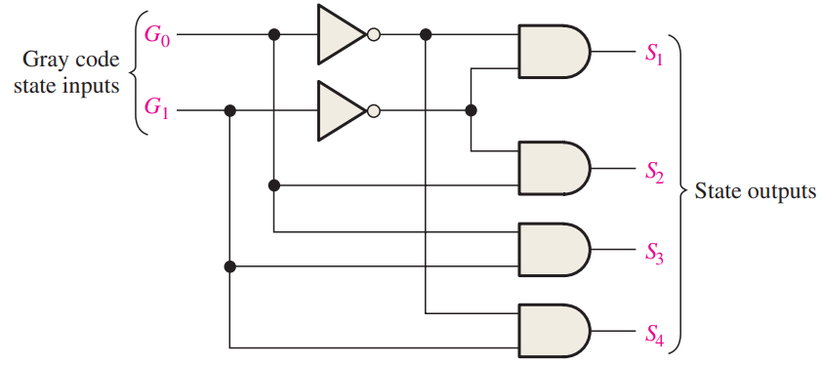
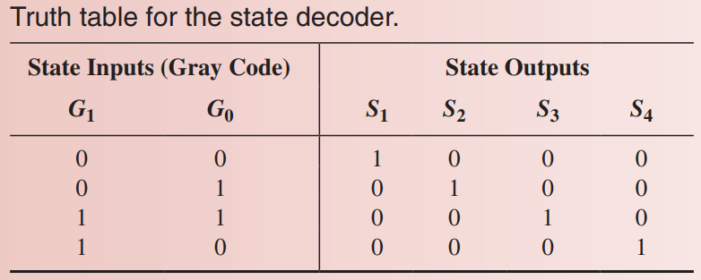
Traffic Signal Design
State decoder from truth table

Slide 30
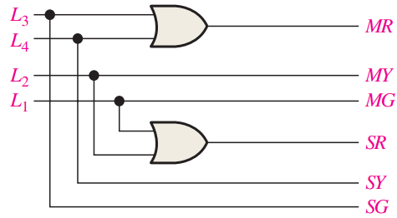
Traffic Signal Design
Inputs/Outputs are not usually named the same
MR = L3 + L4
MY = L2
MG = L1
SR = L1 + L2
SY = L4
SG = L3

Slide 31
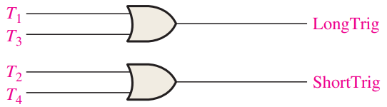
Traffic Signal Design
S1 and S3 start long timer
S2 and S4 start short timer

Slide 32
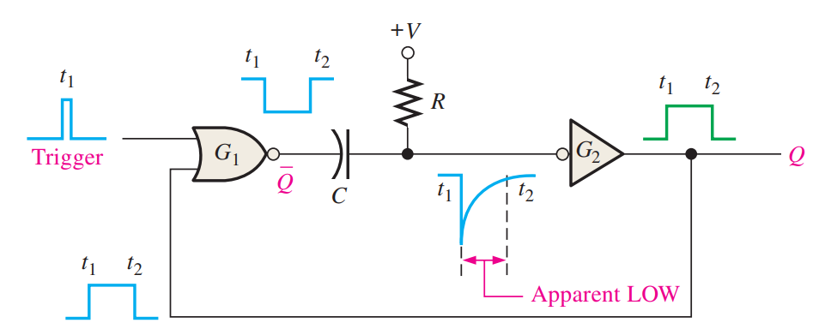
Traffic Signal Design
TS and TL are high when timer is running, just like a one shot

Slide 33
Traffic Signal Design
t_{W} = 0.7RC
4s = 0.7R_{4s}C_{4s}
If C_{4s} = 1000µF, then R_{4s} = 5,714Ω
25s = 0.7R_{25s}C_{25s}
If C_{25s} = 1000µF, then R_{25s} = 35,714Ω

Slide 34
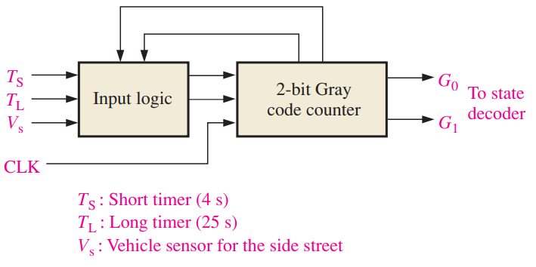
Traffic Signal Design
One chunk left, it’s a 2-bit counter

Slide 35
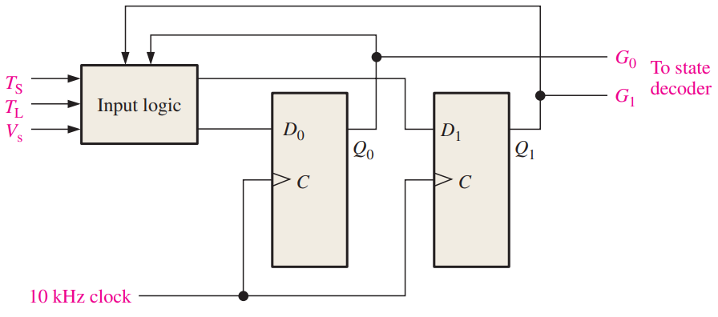
Traffic Signal Design
We’ll use D FFs
Arbitrarily pick system clock at 10kHz
Step 1 - State machine is given

Slide 36
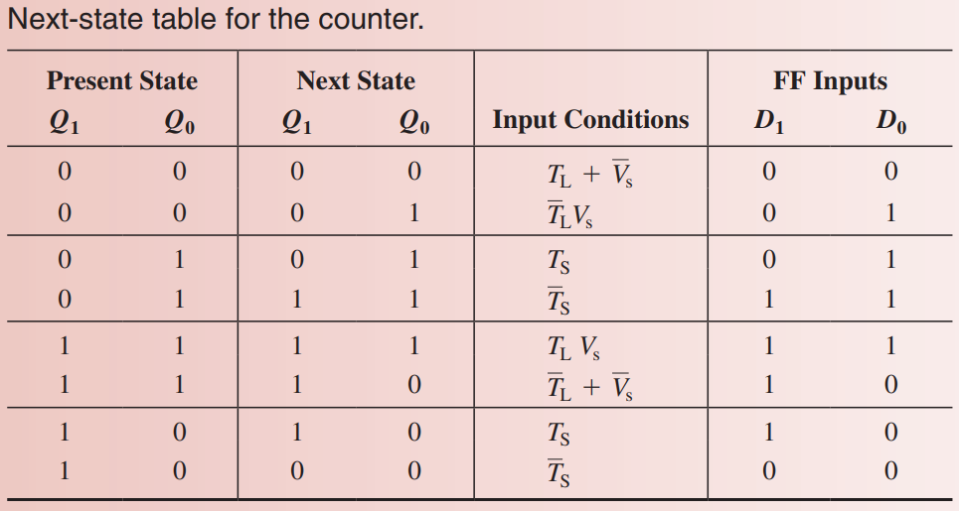
Traffic Signal Design
Step 2- Next state table

Slide 37
Traffic Signal Design
Karnaugh maps would be very complicated with 5 variables (G₁, G₀, V_{S}, T_{L}, T_{S})
Also a sparse table, so you can opt to not simplify the circuit to be quick
Write out the terms that make D₀ = 1

Slide 38
Traffic Signal Design
D₀ = G₁G₀’T_{L}’V_{S} + G₁G₀’T_{S} + G₁G₀T_{S}’ + G₁G₀T_{L}V_{S}
D₁ = G₁’G₀T_{S}’ + G₁G₀T_{L}V_{S} + G₁G₀(T_{L}’+V_{S}’) +
G₁G₀’T_{S}

Slide 39
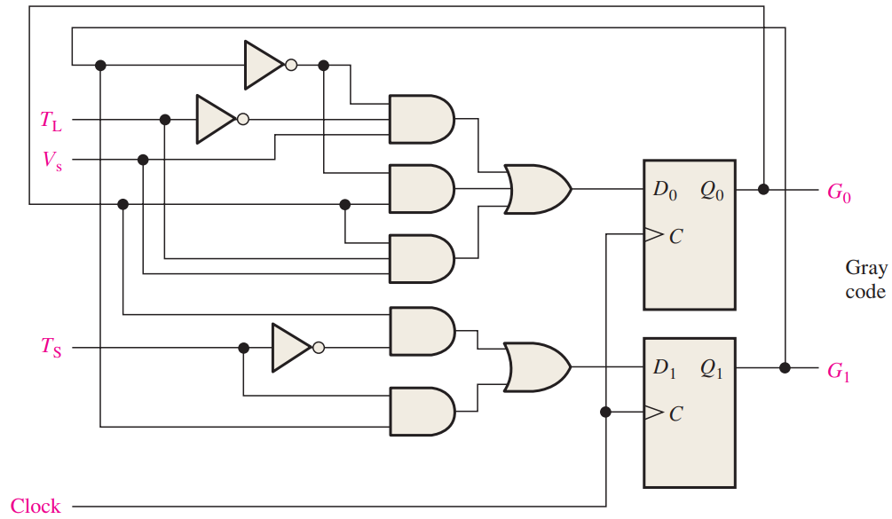
Traffic Signal Design
That’s all the pieces!

Slide 40
Reading
This lecture
9.5, Ch6 and Ch7 Applied Logic
Next lecture
Sections 12.1-12.3

