Slide 1
CPE201 Digital Design
By Benjamin Haas
Class 26: ADC and DAC

Slide 2
Outline
Analog to Digital Conversion
Digital to Analog Conversion

Slide 3
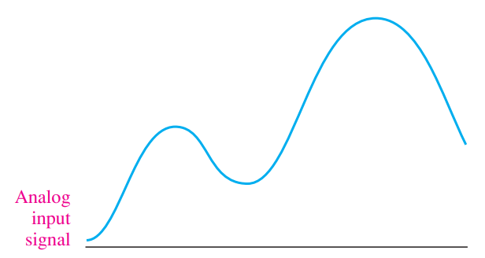
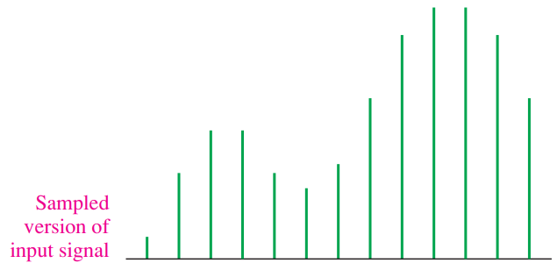
Continuous vs Discrete
Or Analog vs Digital
Anything Analog must be converted to Digital

Slide 4
Converters (Sensors)
There are many things that do this already
Microphones
Speakers
Digital thermometers, barometers, accelerometers
GPS
Cameras

Slide 5
Sensors
All of these work on the same principles
Convert a measurement to a voltage
Convert the voltage to a digital signal
Capture/store/manipulate the signal

Slide 6
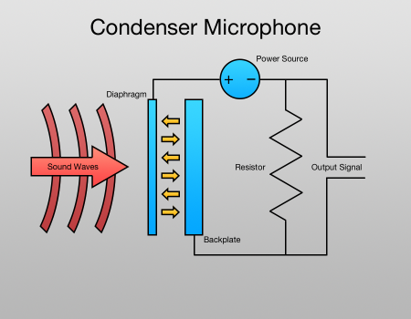
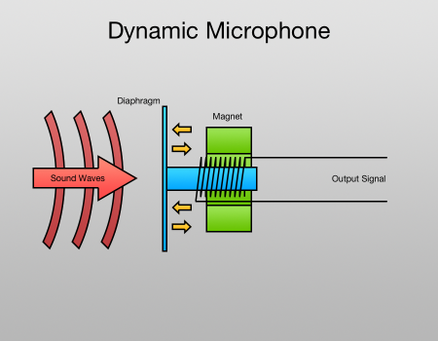
Convert to Voltage
Microphone

Slide 7
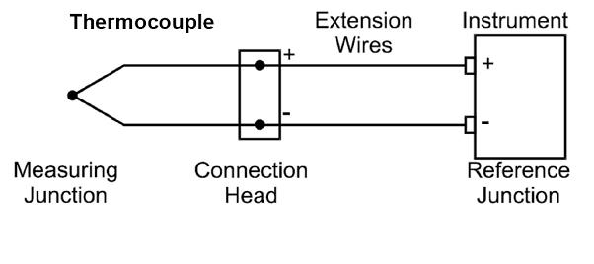
Convert to Voltage
Thermometer

Slide 8
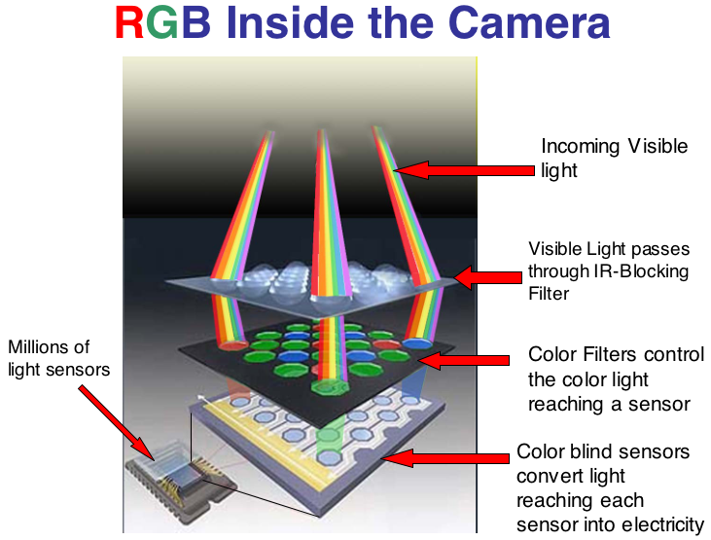
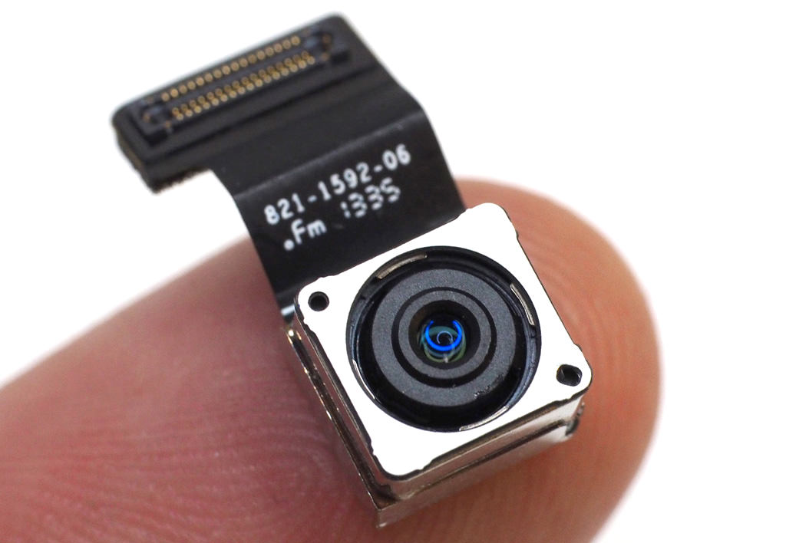
Convert to Voltage
Camera Sensor

Slide 9
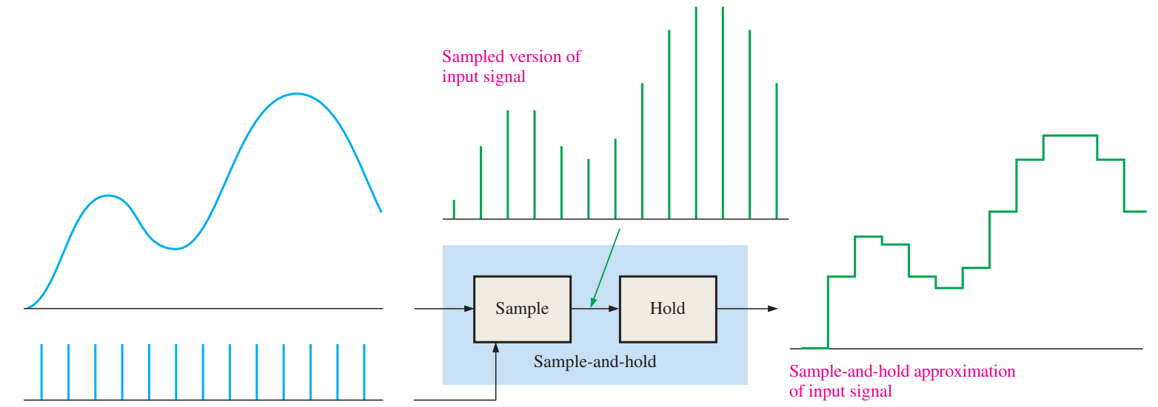
Sample the Voltage
The actual ADC part – usually sample and hold

Slide 10
ADC
Compares sample to a voltage reference (Vref)
An ADC has a set number of bits
Each ADC count is worth Vref/(2^{n}-1) volts
Most ADCs have 10-16 bits right now
So encoded as a 10-16-bit binary number

Slide 11
ADC
A 3-bit ADC can give 0-7 counts (2³-1)
If Vref is 7V, then each count is 1V
A 10-bit ADC can give 0-1023 counts
If Vref=5V, then each count is 4.89mV

Slide 12
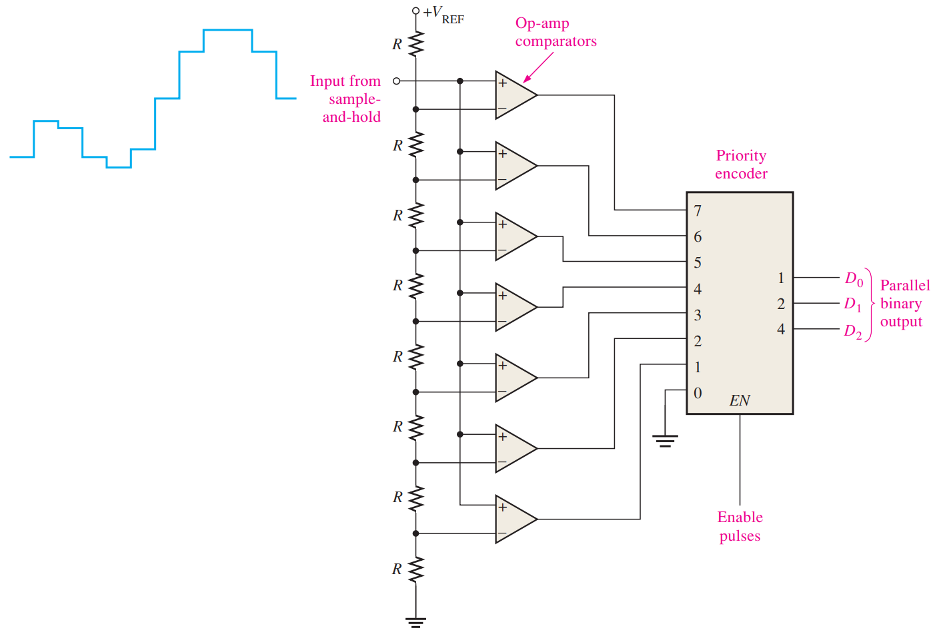
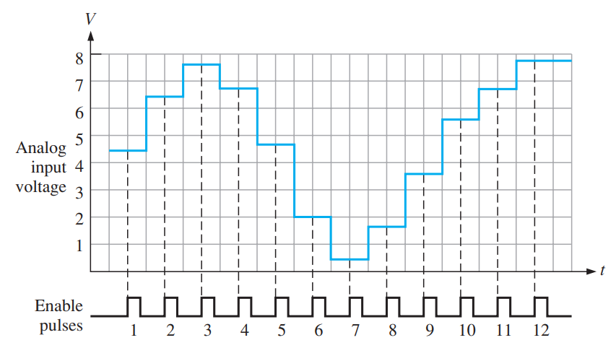
Convert the Sample
Flash (Simultaneous) ADC (Vref = 7V)

Slide 13
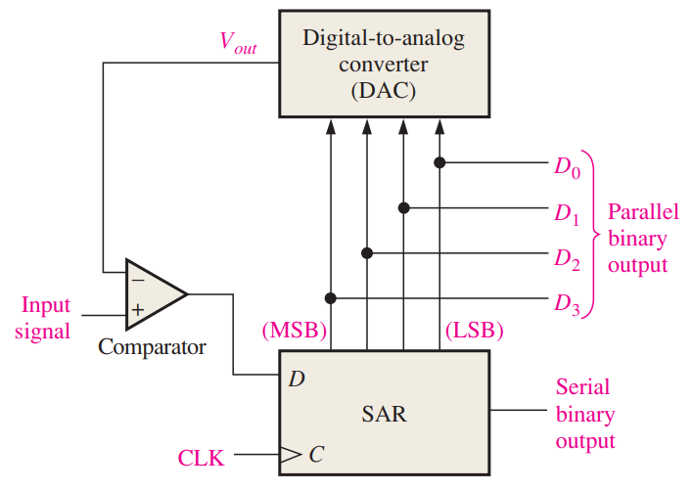
Convert the Sample
Successive-Approximation ADC

Slide 14
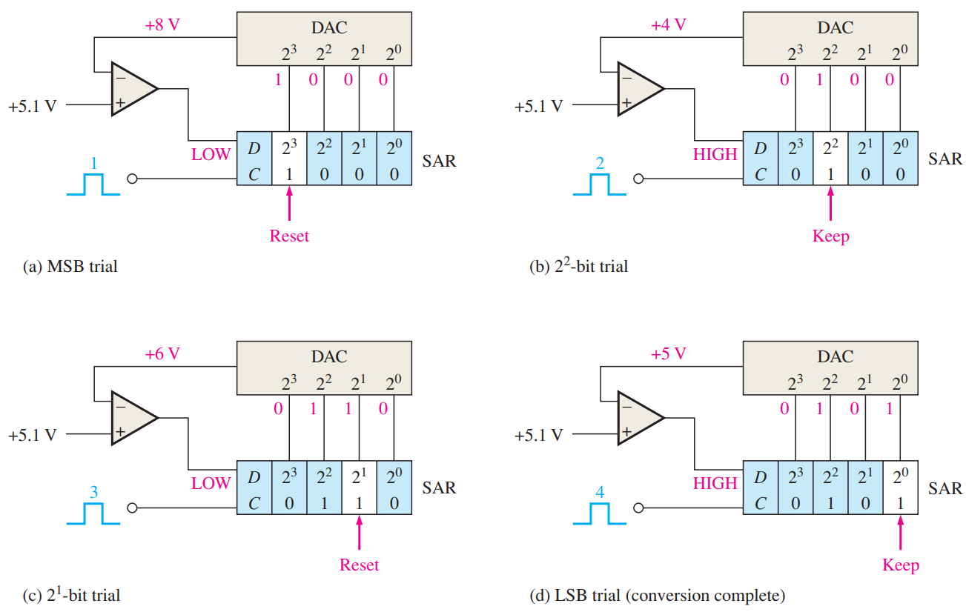
Example
Vref = 15V

Slide 15
Other Types
There are plenty
Flash ADC is more expensive (more hardware) but fast
SAR ADC is cheaper, but slower

Slide 16
DAC
Converting voltages back to analog
For anything where on/off is not great
Dimming lights
Amount of gas/brake in a car
Audio
https://www.youtube.com/watch?v=xNWv7htg7_c

Slide 17
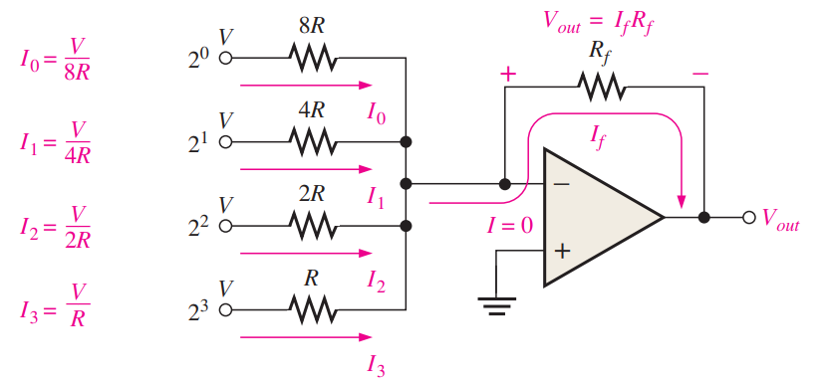
Binary-Weighted-Input DAC
Op-amp in summing mode
Resistors scaled like ADC, MSB = half of voltage
Gives 15
output levels

Slide 18
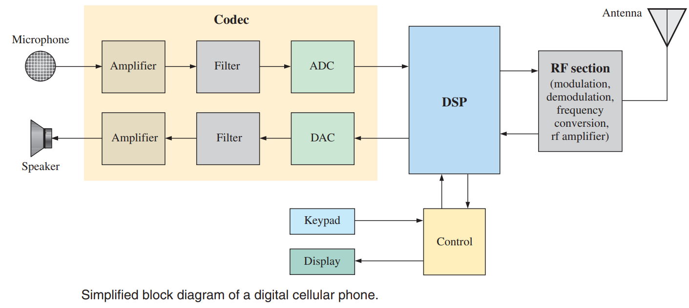
ADC & DAC
Common in most systems today

Slide 19
Reading
This lecture
Sections 12.1-12.3
Next lecture
Sections 13.6-13.9

