Slide 1
CPE201 Digital Design
By Benjamin Haas
Class 27: Transmission and Buses

Slide 2
Outline
Bus Parameters
Parallel Buses
Serial Buses

Slide 3
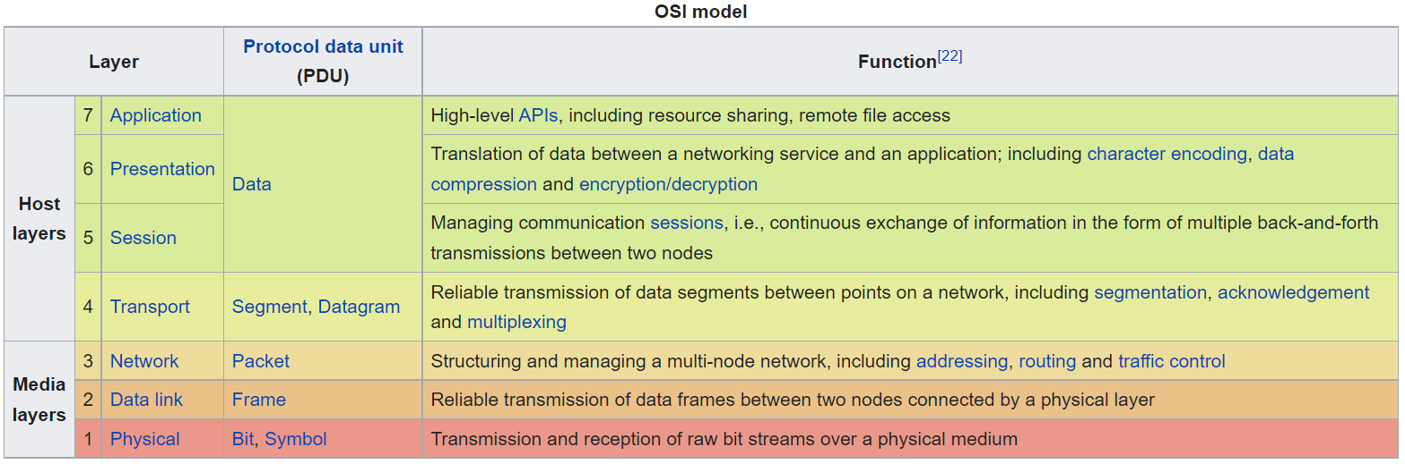
Buses
We are dealing with layer 1 and 2
1 is bus type (Bluetooth, SPI, RS232, USB, etc.)
2 is 802 standards (802.11 wifi, 802.3 eth, etc.)

Slide 4
Bus Parameters
Things You’ve Seen
Serial/Parallel
1 bit at a time transmission (TX), or more
Synchronous/Asychronous
Is there a clock signal, or not

Slide 5
Bandwidth/Throughput
Max data TX rate
BW = Bus width (bits) x Frequency (Hz)/8 bits/byte
BW = 16bits x 66MHz = 132MBps

Slide 6
Bandwidth
Be aware
MBps = Megabytes per second
Mbps = Megabits per second
1 MBps = 8Mbps

Slide 7
Bandwidth
Measurements made on decimal values
1 MB = 1,000,000 bytes instead of 1,048,576 bytes
Now 200 ‘MBps’ = 190 actual MBps
Same reason why your ‘1TB’ SSD has 931GB in it

Slide 8
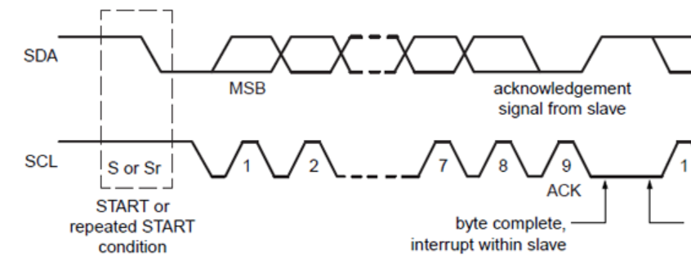
Handshaking
Basic flow control – makes sure data is received or acknowledged

Slide 9
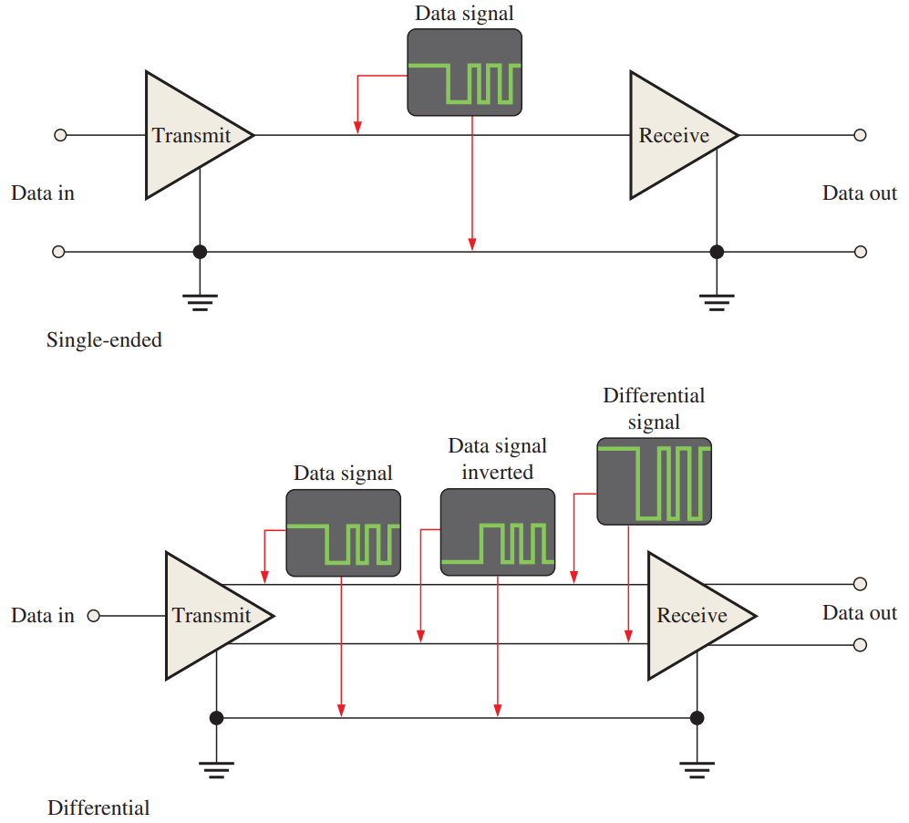
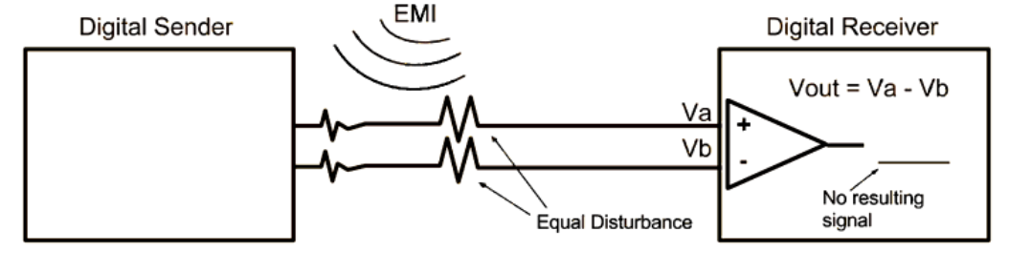
Single Ended vs Differential
Cheaper
More noise immunity

Slide 10
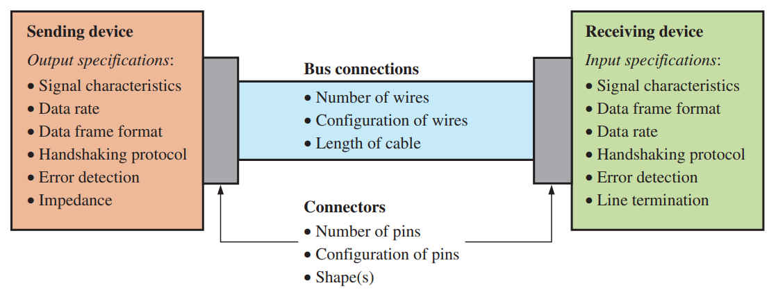
Buses
Picking a bus type will define many of these parameters

Slide 11
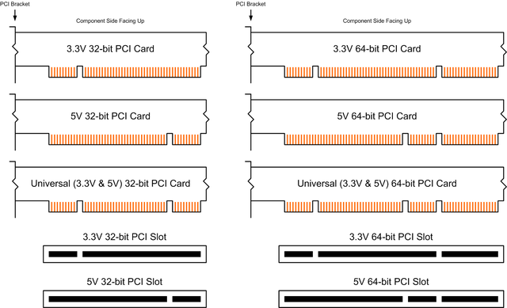
Parallel Buses - PCI
1992-2003
Half-duplex
Synchronous

Slide 12

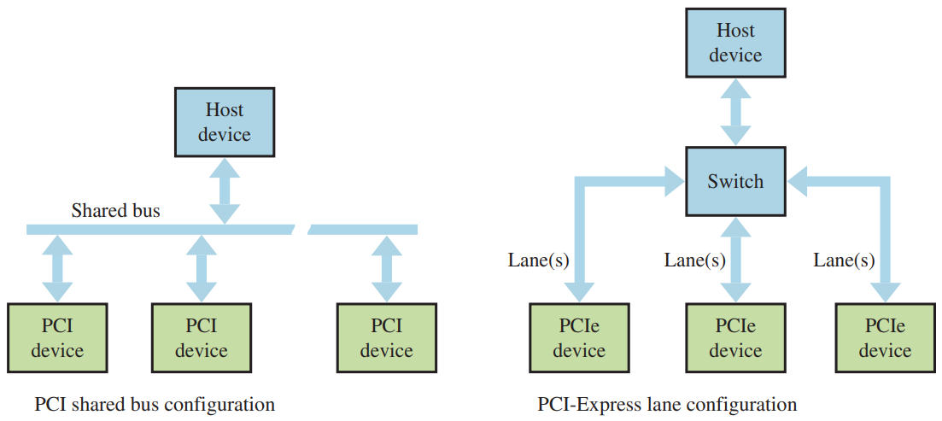
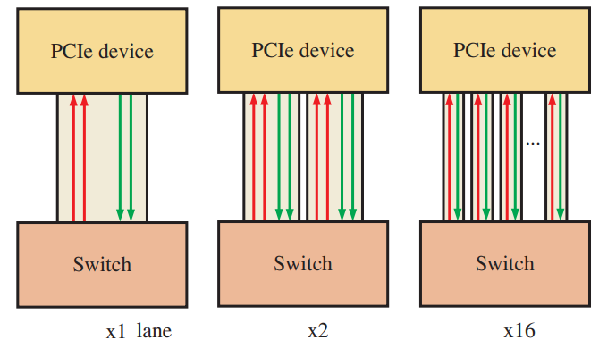
Parallel Buses - PCIe
Multiple smaller parallel buses
Full-duplex, synchronous

Slide 13

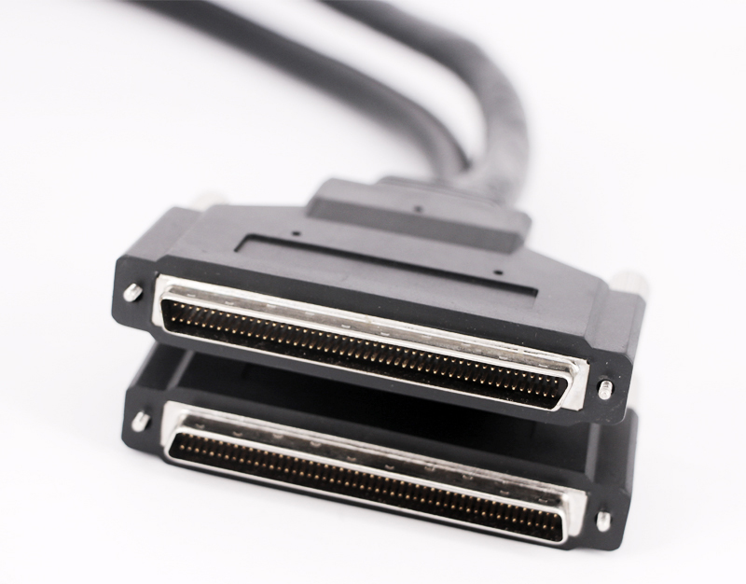
Parallel Buses - SCSI
Since 1981
Full-duplex, synchronous
Still popular for HD connections
Now serial and parallel options

Slide 14
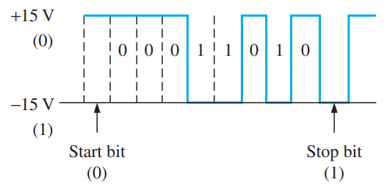
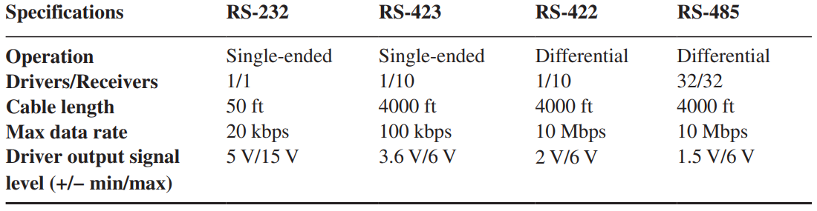
Serial Buses – RS232
Or RS422/423/485
Asynchronous
Half or full-duplex

Slide 15
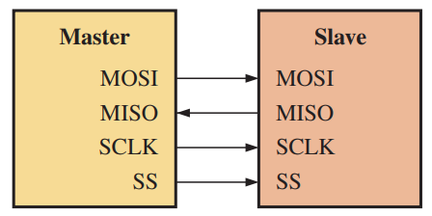
Serial Buses - SPI
Since 1979
Full duplex, synchronous
Select line for each device
Wonderfully simple

Slide 16

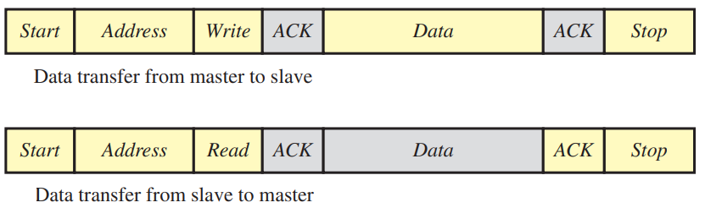
Serial Buses –I2C
Since 1982
Half-duplex, synchronous
Addresses

Slide 17
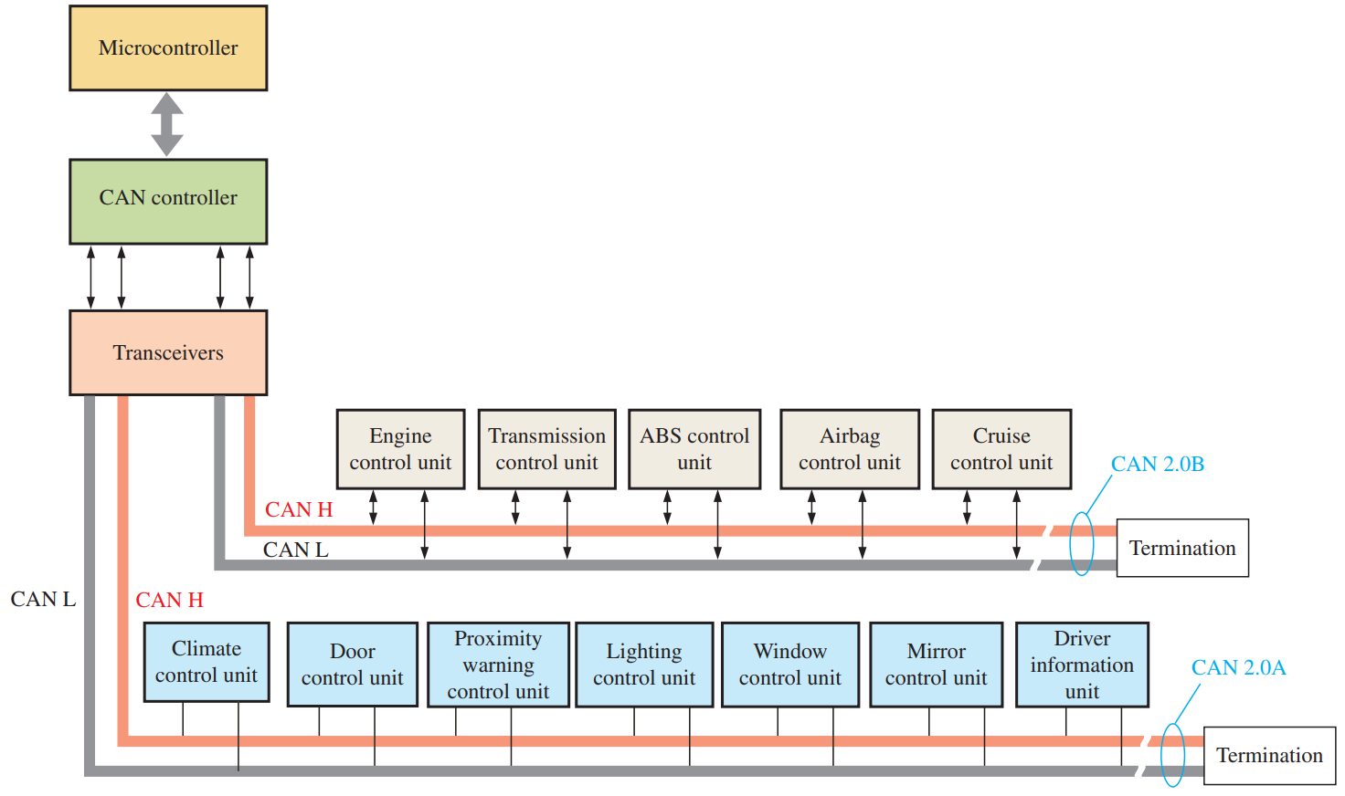
Serial Buses - CAN
Very robust – auto applications
Differential
Asynchronous
Half-duplex

Slide 18

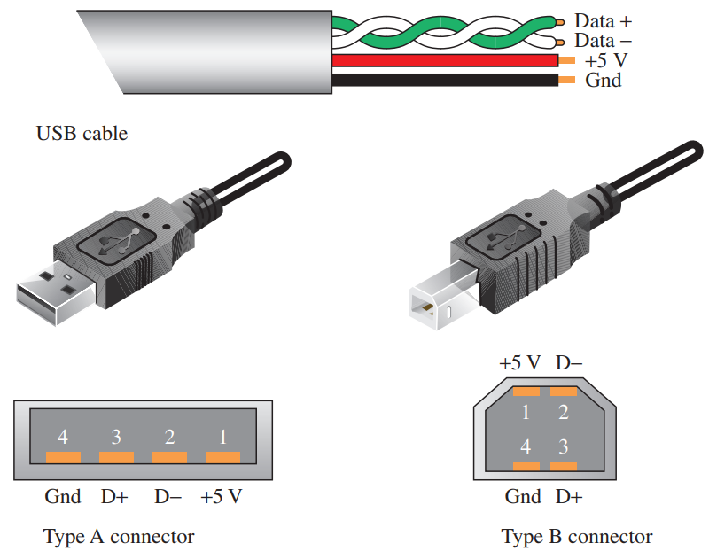
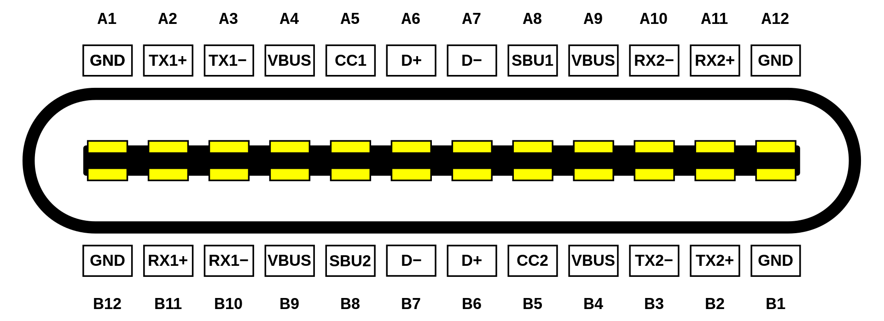
Serial Buses - USB
Since 1982
Full-duplex (3.0), asynchronous
Addresses, packets,
and types

Slide 19
Reading
This lecture
Sections 13.6-13.9
Final Exam
Friday May 6th, 9:50-11:50am

