Slide 1

University of Nevada – Reno
Computer Science & Engineering Department
CS454/654 Reliability and Security of Computing Systems - Fall 2024
Lecture 23
Dr. Batyr Charyyev
bcharyyev.com

Slide 2
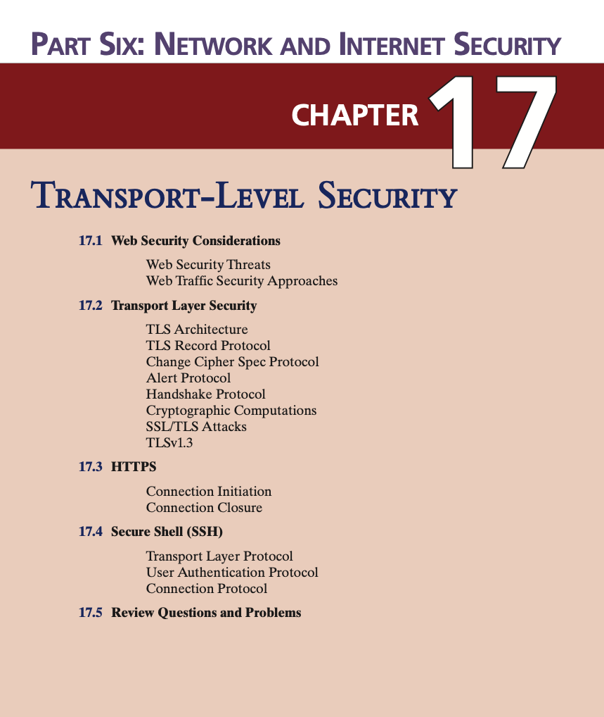

Slide 3
Web Security Considerations
The World Wide Web is fundamentally a client/server application running over the Internet and TCP/IP
Overall
Web servers are relatively easy to configure and manage.
Web content is increasingly easy to develop.
However
Web server as an entry point to organization's internal network.
SQL injections, remote code execution.
Users are everyday users and do not have technical expertise.
Lack of security awareness.
Phishing attacks, weak passwords, insecure browsing.

Slide 4
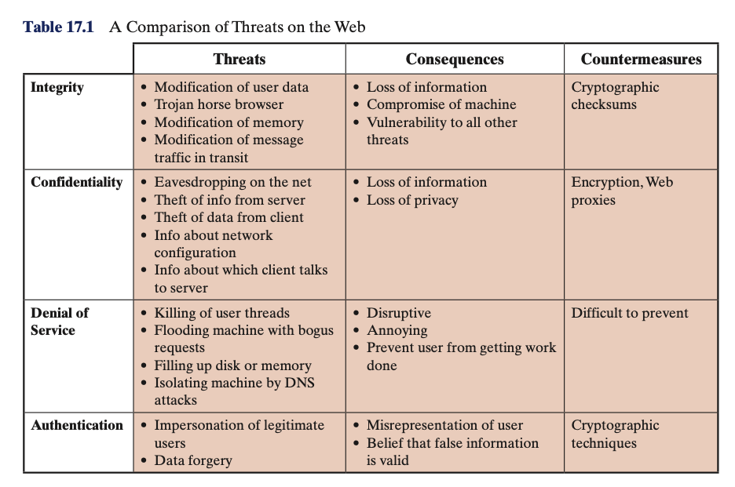
Way to group these threats
Passive and Active attacks.
Passive: monitoring network traffic between browser and server
Active: impersonating either browser, or server, altering message, etc.
In terms of the location of the threat: Web server, Web browser, and network traffic between browser and server.

Slide 5
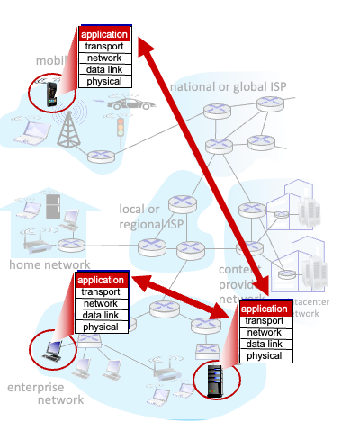
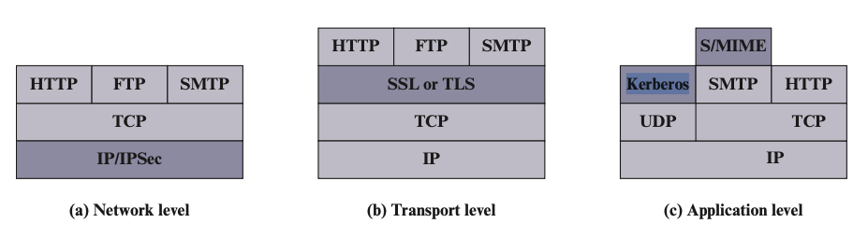
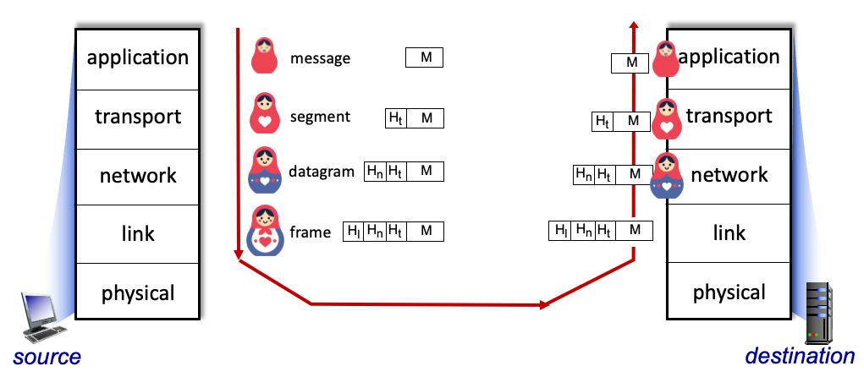
HTTPS
SSH: Secure Shell
SSL: Secure Sockets Layer SSL
TLS: Transport Layer Security

Slide 6
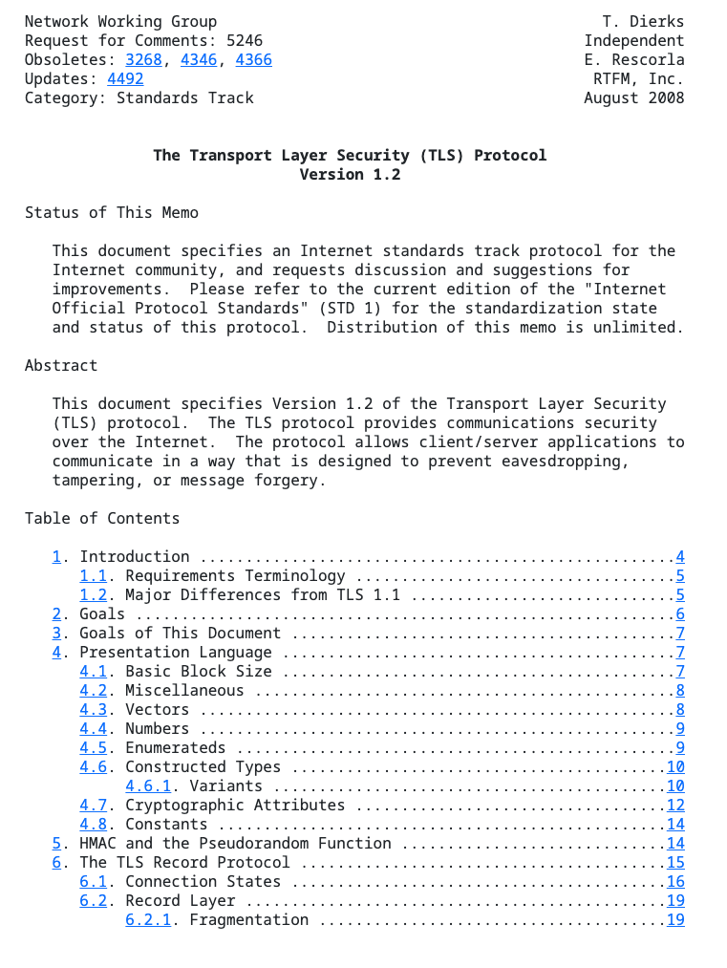
Transport Layer Security (TLS)
TLS: Transport Layer Security protocol
Evolved from SSL, and SSL is not used anymore.
TLS: RFC 5246
https://datatracker.ietf.org/doc/html/rfc5246
Rely on TCP.
Provides service to HTTP
Hypertext Transfer Protocol

Slide 7
Transport Layer Security (TLS)
Two important TLS concepts are the TLS session and the TLS connection
TLS session
Established during handshake phase.
Can be reused to establish new connection.
Persist until explicitly terminated or timed out.
Stores cryptographic parameters for connections.
TLS connection
Single peer to peer communication. GET request to URL
Uses parameters provided by the session, to enable secure transport of data.
Temporary, typically lasts for the duration of data transfer, and can not be reused one closed.

Slide 8
A session state is defined by the following parameters:
Session identifier
An arbitrary byte sequence chosen by the server to identify an active or resumable session state
Peer certificate
An X509.v3 certificate of the peer. Used to verify the identity.
Compression method
The algorithm used to compress data prior to encryption
Cipher
spec
Specifies the bulk data encryption algorithm and a hash algorithm used for MAC calculation; also defines cryptographic attributes such as the hash_size
Master
secret
48-byte secret shared between the client and the server. Used to generate session keys.
Is
resumable
A flag indicating whether the session can be used to initiate new connections

Slide 9
A connection state is defined by the following parameters:
Server and client random
Byte sequences that are chosen by the server and client for each connection. Used for key generation and prevent replay attack.
Server write MAC secret
The secret key used in MAC operations on data sent by the server
Client write MAC secret
The secret key used in MAC operations on data sent by the client
Server write key
The secret encryption key for data encrypted by the server and decrypted by the client
Client write key
The symmetric encryption key for data encrypted by the client and decrypted by the server
Initialization vectors
When a block cipher in Cipher Block Chaining mode is used, an initialization vector (IV) is maintained for each key
Sequence numbers
Each party maintains separate sequence numbers for transmitted and received messages for each connection
When a party sends or receives a change cipher spec message, the appropriate sequence number is set to zero
Sequence numbers may not exceed 2⁶⁴ – 1 (64 bits)
This field is first initialized by the TLS Handshake Protocol

Slide 10
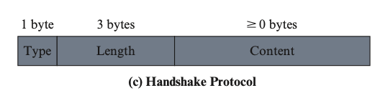
TLS Handshake
TLS messages Types
Handshake
Change_cipher_spec
Application_data
Alert
TLS Handshake
Allows the server and client to authenticate each other and to negotiate an encryption and MAC algorithm and cryptographic keys to be used to protect data sent over TLS.
All the messages exchanged in TLS Handshake is of this form.

Slide 11
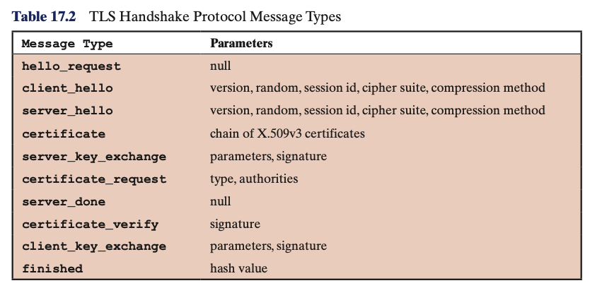
TLS Handshake
Type (1 byte): Type of the message (10 message types, listed in table).
Length (3 bytes): The length of the message in bytes.
Content (>= 0 bytes): The parameters associated with the message (for each message associated parameters are listed in table)

Slide 12
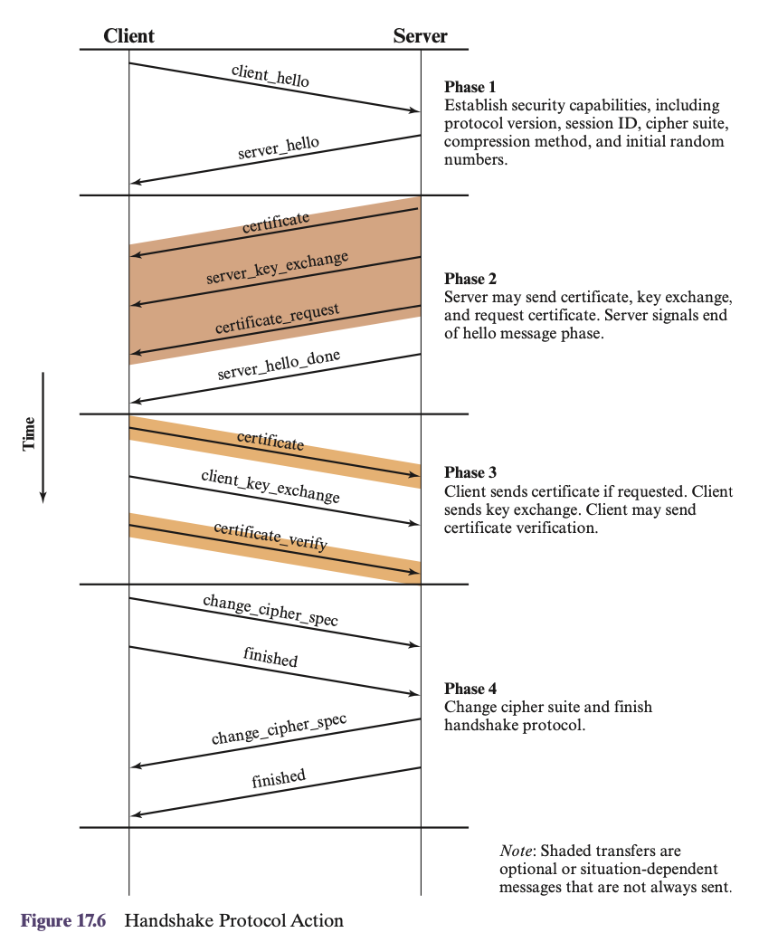
Phase – 1
Initiated by client, which sends client_hello message.
Inside client_hello
Version: version of TLS (highest that client knows)
Random: 28-bit timestamp, and random 28 bytes generated by random number generator. Used as Nonces.
Session ID: non-zero value indicates client wants to update parameters of existing connection or create new connection on this session. Zero value indicates client wishes to create new connection or new session.
CipherSuite: list of cryptographic algorithms supported by client, in decreasing order of preference.
Compression Method: list of compression methods supported by client.

Slide 13
Phase – 1
Client waits for server_hello message
server_hello message contains the same parameters as the client_hello message.
Version: lowest (client version, server version).
Random field: is independent of the client’s Random field.
If the SessionID field of the client was nonzero, the same value is used by the server; otherwise the server’s SessionID field contains the value for a new session.
The CipherSuite and Compression fields contain the single cipher suite and compression method selected from list provided by client.

Slide 14
Details on CipherSuite
Key exchange algorithms
RSA, Fixed Diffie–Hellman, Ephemeral Diffie-Hellman, Anonymous Diffie–Hellman
Cipher Algorithms for data encryption
DES, 3DES, DES40, RC4 etc.
MAC Algorithm for data integrity: MD5, SHA-1
CipherType: Stream or Block
HashSize
MD5 produces a 128-bit hash (16 bytes)
SHA-1 produces a 160-bit hash (20 bytes)
Key Material
Raw bytes used in generating the write keys (both encryption and MAC)
Initialization Vector Size
Size of block cipher operators.

Slide 15
Phase – 2
Server initiates phase2 and send certificate message
certificate: This message is used by the server to authenticate itself to the client by sending its public key in the form of an X.509 certificate.
server_key_exchange: sent when required (depending on the key exchange method). It contains key exchange parameters.
Anonymous Diffie-Helman
Prime number, public key, etc.
certificate_request: server can optionally request a certificate from the client for client authentication.
server_hello_ done: has no parameters, basically indicates the end of server’s hello and associated messages.

Slide 16
Phase – 3
Client sends certificate if requested.
Can be used for client authentication.
Certificate Verify: contains signature (HMAC) of all handshake messages up to this point, ensuring integrity.
Prevents Trudy to modifying the message (deleting strong encryption algorithms).
Proves client possession of its private key.
ClientPrivateKey(HMAC(all_messages))=ClientPublicKey(HMAC(all_messages))
HMAC is whatever MAC algorithm client server agreed on cipher suite.
Client_Key_Exchange: Similar to server_key_exchange sends key exchange parameters if needed.
Parameters are encrypted using servers private key.

Slide 17
Phase – 4
Change_cipher_spec: 1 byte message, if 0x01 indicates that session's negotiated cipher suite and keys are now active. All subsequent messages will be encrypted and protected using the negotiated cryptographic parameters.
Finished: both parties take hash of the all messages exchanged in handshake process. Then use agreed session key (Master Key) to compute HMAC of the hash.
HMAC=agreed MAC algorithm (Master Key, all messages)

Slide 18
In client_key_exchange and server_key_exchange messages parties agree on parameters of the key exchange algorithm. Using those parameters both client and server independently generate Master Key, using Pseudo Random Function.
Then using the Master Key both client and server generate following keys, again using the Pseudo Random Function.
K_{c} : encryption key for data sent from client to server
M_{c} : MAC key for data sent from client to server
K_{s} : encryption key for data sent from server to client
M_{s} : MAC key for data sent from server to client
The two encryption keys will be used to encrypt data; the two MAC keys will be used to verify the integrity of the data.

Slide 19
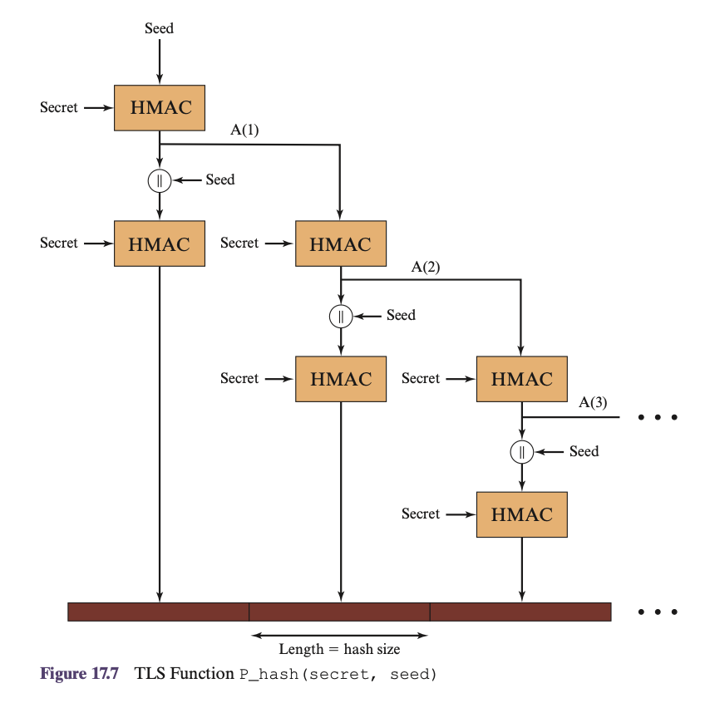
Pseudo Random Function.
master_secret = PRF(pre_master_secret, “master secret”, ClientHello.random || ServerHello .random)
pre_master_secret: exchanged as part of client_key_exchange and server_key_exchande. If key exchange algorithm is RSA it is value of 48 byte.
ClientHello.random and ServerHello .random: are random values exchanged in client_hello and server_hello.
|| means we combine them.
”master secret” is a just a label.
Seed is combination of
ClientHello.random
ServerHello .random
Label
HMAC=agreed MAC algorithm (pre_master_secret, Seed)

Slide 20
Pseudo Random Function.
secret_of_size_Total= PRF(master_secret, “key expansion”, ClientHello.random || ServerHello .random)
K_{c} and K_{s} both have size of X bytes
M_{c} and M_{s} both have size of Y bytes
Then we generate secret_of_size_Total = 2*X+2*Y
And split it into X X Y Y which will correspond to Kc, Ks, Mc, Ms.
If as a result of last iteration in PRF we have let’s say 2*X+2*Y + Z bytes, the Z bytes are ignored.

Slide 21
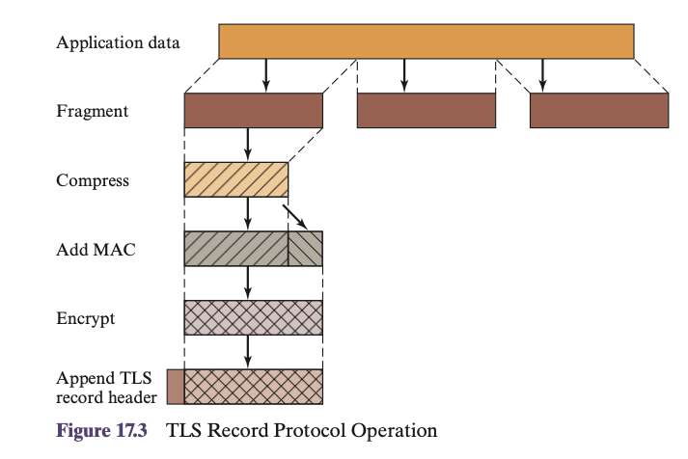
TLS Record Protocol
TLS Record Protocol provides Confidentiality and Message Integrity using the 4 keys derived in TLS Handshake.
Takes an application message to be transmitted, fragments the data into manageable blocks, optionally compresses the data, applies a MAC, encrypts, adds a header, and transmits the resulting unit in a TCP segment. Received data are decrypted, verified, decompressed, and reassembled before being delivered to higher-level users.

Slide 22
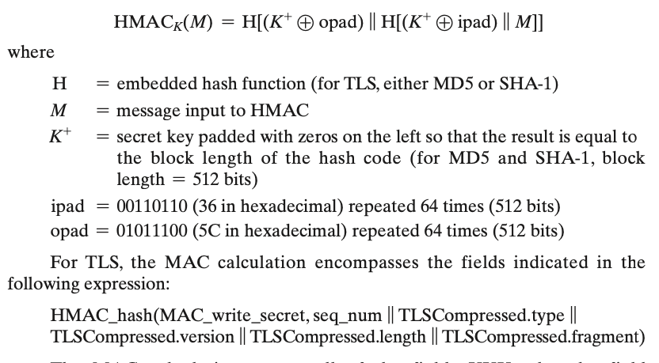
TLS Record Protocol
HMAC
Next, the compressed message plus the MAC are encrypted using symmetric encryption.

Slide 23
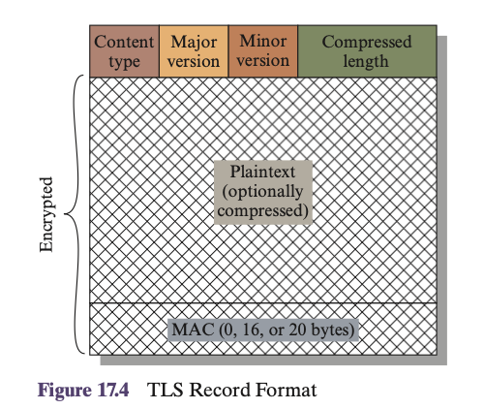
TLS Record Protocol
TLS Header
Content Type (8 bits)
Handshake
Change_cipher_spec
Alert
Application_data
Major Version (8 bits): Indicates major version of TLS in use (TLSv1.0, TLSv2.0, etc)
Minor Version (8 bits): Indicates minor version in use (TLSv1.1, TLSv1.2, etc).
Compressed Length (16 bits): The length in bytes of the plaintext fragment (or compressed fragment if compression is used).

Slide 24
Content Type (8 bits)
Handshake
Change_cipher_spec
Alert
Application_data
Change_cipher_spec: 1 byte message, if 0x01 indicates that session's negotiated cipher suite and keys are now active.
Application_data: indicates everything is working as expected and we are sending data to upper layer protocol (application layer protocol - HTTP)

Slide 25

Content Type (8 bits)
Handshake
Change_cipher_spec
Alert
Application_data
The Alert is used to convey TLS-related alerts to the peer entity.
Each message in this protocol consists of two bytes.
The first byte is either warning (1) or fatal (2) to convey the severity of the message.
If the level is fatal, TLS immediately terminates the connection. Other connections on the same session may continue, but no new connections on this session may be established.
The second byte contains a code that indicates the specific alert.
Examples:
Fatal - bad_record_mac (an incorrect MAC was received)
Fatal - handshake_failure (sender was unable to negotiate an acceptable set of security parameters given the options available).
Warning - unsupported_certificate (the type of the received certificate is not supported).
TLS: RFC 5246 https://datatracker.ietf.org/doc/html/rfc5246

Slide 26
SECURE SHELL (SSH)

Slide 27
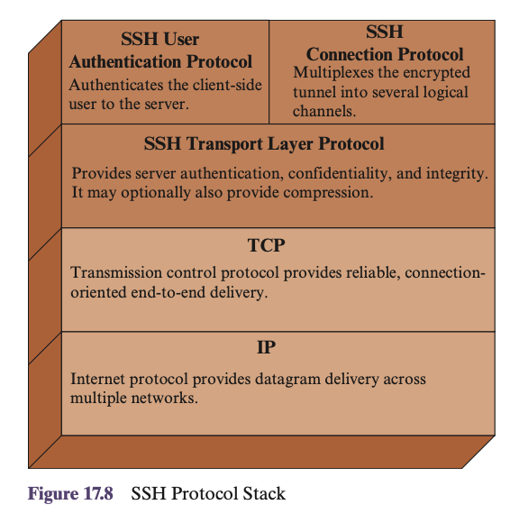
SECURE SHELL (SSH)
SSH is organized as three protocols that typically run on top of TCP
Transport Layer Protocol
User Authentication Protocol
Connection Protocol

Slide 28
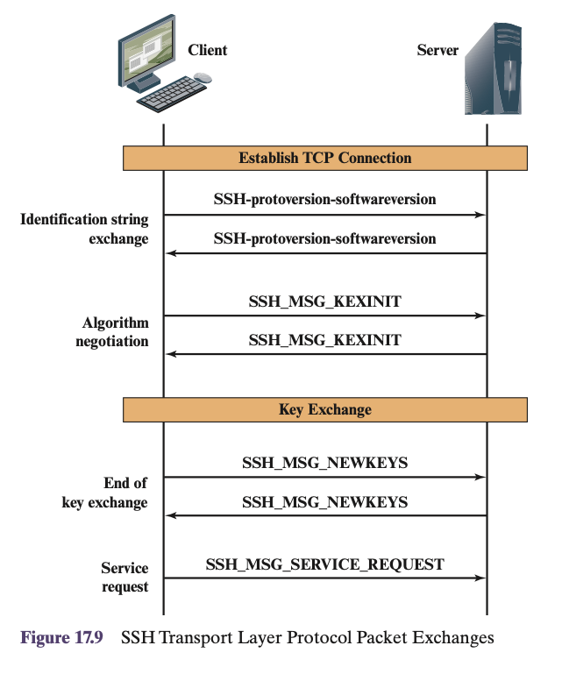
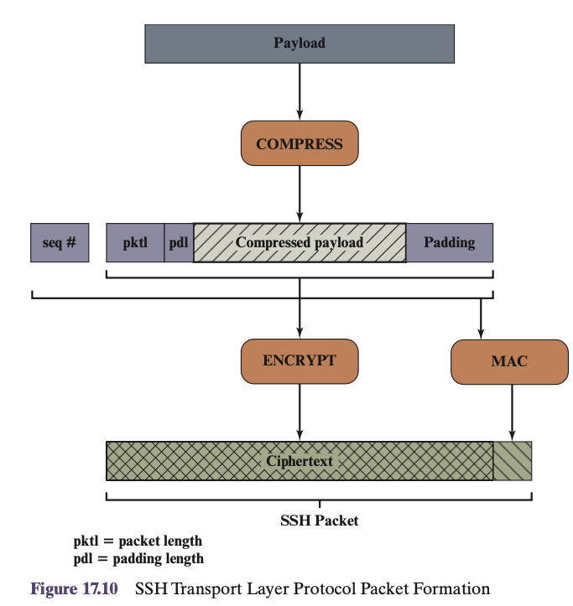
SSH - Transport Layer Protocol
Initially TCP connection is established which is separate from SSH Transport Layer Protocol.
Then set of packets are exchanged
SSH-protoversion-softwareversion
SSH_MSG_KEXINIT
Once the connection is established, the client and server exchange data, referred to as packets, in the data field of a TCP segment.
SSH - Transport Layer Protocol Packet Structure
Packet length: Length of the packet in bytes, not including the packet length and MAC fields.
Padding length: Length of the random padding field.
Payload: Useful contents of the packet.
Random padding: random bytes to make total length (excluding MAC) of the packet a multiply of cipher block size or 8 bytes for a stream cipher.
Message authentication code: If message authentication has been negotiated, this field contains the MAC value. It is computed over the (unecrypted) entire packet plus a sequence number, excluding the MAC field.
Sequence number: 32-bit packet sequence that is initialized to 0 for the 1st packet and incremented for every packet.

Slide 29
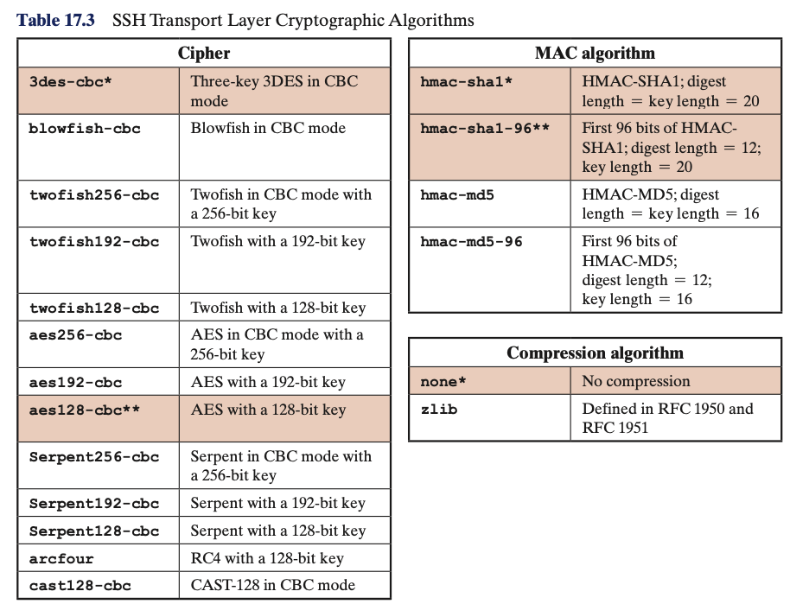
SSH - Transport Layer Protocol
Identification string exchange: it is a string value of the form
SSH-protoversion-softwareversion SP comments CR LF
protoversion: is a SSH protocol version -> 1.5, 2.0, etc.
softwareversion: implementation of SSH -> OpenSSH, Sun_SSH, etc
SP: is a space character -> “ ”, 0x20
Comment: an optional information about platform -> Ubuntu_20.04, Debian
CR (Carriage Return) -> 0x0D, used to terminate line along with LF
LF (Line Feed) -> 0x0A, which signals end of the identification string.
Example: SSH-2.0-OpenSSH_8.6 Ubuntu-20.04<CR><LF>
The Identification string might be different for client and server however overall, they should be compatible if they are not compatible then connection will fail. (update needed).
Algorithm negotiation: Each side sends an SSH_MSG_KEXINIT containing lists of supported algorithms in the order of preference to the sender.
There is one list for each type of cryptographic algorithm.
The algorithms include
Key exchange
Encryption
MAC algorithm
Compression algorithm

Slide 30
SSH - Transport Layer Protocol
Key exchange: This step is different for each type of the key.
It is used to establish shared secret key: Master Key between client and server. Book shows example with Diffie–Hellman.
p: large prime number - publicly known
g: a generator - publicly known
A- Alice’s private key - private
B-Bob’s private key - private
Alice computes her public key = A_public = g^A mod p
Sends it to Bob
Same is done by Bob
Alice and Bob calculate shared key => (A_public)^B mod p=(B_public)^A mod p
End of key exchange: Signaled with SSH_MSG_NEWKEYS
At this point both parties can start using the shared key.
Service request: The client sends an SSH_MSG_SERVICE_ REQUEST packet to request either the User Authentication or the Connection Protocol.
Subsequent to this, all data is exchanged as the payload of an SSH Transport Layer packet, protected by encryption and MAC.

Slide 31
SSH – User Authentication
Three types of messages
Authentication request
Authentication failure
Authentication success
Authentication request
Byte SSH_MSG_USERAUTH_REQUEST
(code 50 and value 0x32)
string user name
string service name
string method name
[method-specific fields]
Examples
user name: root, admin, bcharyyev
service name: ssh-connection, sftp
method name: password, public key
Message Exchange Steps
1. Initial Request: The client sends a SSH_MSG_USERAUTH_REQUEST with the method set to none.
This is essentially a probe to check the validity of the user name.
2. Username Validation: If the user name is invalid, the server sends SSH_MSG_USERAUTH_FAILURE with no methods listed and partial success = false.
If the user name is valid, the server responds with a SSH_MSG_USERAUTH_FAILURE listing acceptable authentication methods.
3. Authentication Method Selection: The client selects one of the listed methods and sends another SSH_MSG_USERAUTH_REQUEST with the chosen method and its required fields.
4. Method Execution: The server and client may exchange additional messages depending on the method (e.g., public key or password verification).
5. Partial Success or Final Success:
If multiple methods are required: On success of one method, the server sends SSH_MSG_USERAUTH_FAILURE with partial success = true.
When all required methods succeed, the server sends SSH_MSG_USERAUTH_SUCCESS.
Authentication failure
Byte SSH_MSG_USERAUTH_FAILURE
(code 51 and value 0x33)
string name-list
boolean partial success
Examples
name-list: password, public key
partial success: Indicates if any previous authentication attempt succeeded.
Authentication success
Byte SSH_MSG_USERAUTH_SUCCESS
(code 52 and value 0x34)

Slide 32
SSH – Connection Protocol
In SSH Transport Layer Protocol we established encryption, server authentication, and data integrity, in SSH User Authentication Protocol we authenticated client.
Three packet types are used.
Note that for given SSH session we can have multiple channels.
Open Channel: to open the channel between client and server
Data Transfer: to transfer the data
Close Channel: to close the channel
Message header format looks as follows
Byte SSH_MSG_CHANNEL_OPEN
String Channel type
Uint32 sender channel
Uint32 initial window size
Uint32 maximum packet size
Channel type: Can be session, x11, Forwarded-TCP/IP Channel, Direct-TCP/IP Channel.
Session: remote shell, sftp
Sender Channel: Locally assigned channel number.
Initial Window Size: Used for flow control.
Max Packet Size: Maximum size of a single data packet.

