Slide 1

University of Nevada – Reno
Computer Science & Engineering Department
CS454/654 Reliability and Security of Computing Systems - Fall 2024
Lecture 21
Dr. Batyr Charyyev
bcharyyev.com

Slide 2
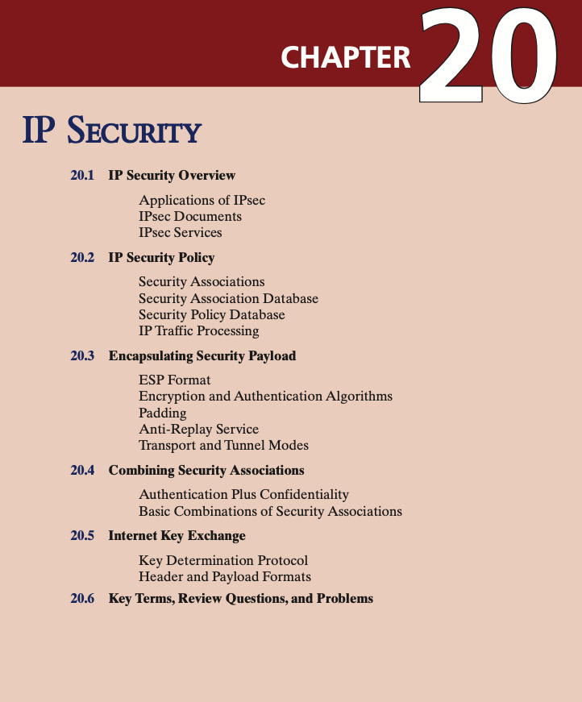

Slide 3
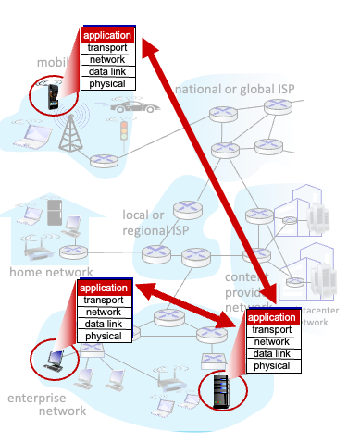
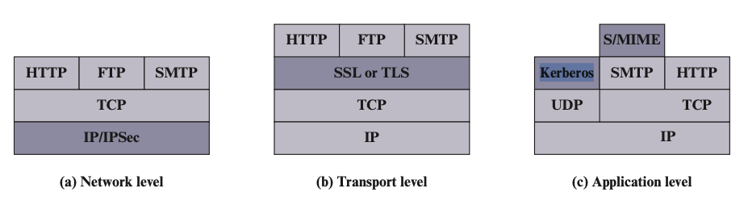
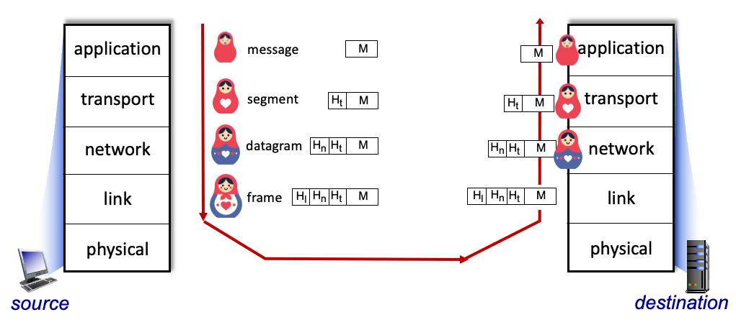
TLS: Transport Layer Security
IPSec: IP Security

Slide 4
IPSec
IPsec provides security services at the IP layer.
IPsec specification is scattered across dozens of RFCs.
Architecture: https://datatracker.ietf.org/doc/html/rfc4301
Authentication Header: https://datatracker.ietf.org/doc/html/rfc4302
Encapsulating Security Payload: https://datatracker.ietf.org/doc/html/rfc4303
Internet Key Exchange: https://datatracker.ietf.org/doc/html/rfc7296
IPsec is not used by default. It is typically utilized when you configure and use a VPN service that relies on IPsec for secure communication.
Secure branch office connectivity over the Internet
Security Associations
Security Policy Database
Security Association Database

Slide 5
Security Associations (SA)
It is like logical connection between sender and receiver.
Unidirectional, for secure connection in both direction, 2 separate SAs created.
Identified with 3 parameters.
Security Parameters Index (SPI): 32-bit identifier.
IP destination address.
Security Protocol Identifier: indicates whether association is Authentication Header (AH) or Encapsulating Security Payload (ESP) protocol.
AH provides authentication.
ESP provides both encryption and authentication.

Slide 6
Security Associations Database (SAD)
The SAD contains entries for each active SA (Security Association).
Each entry holds all the parameters required to define/process the associated SA.
Key parameters in each SAD entry
Security Parameter Index (SPI): 32-bit unique identifier for each SA.
Sequence Number Counter (SNC): 32-bit value, ensures ordered delivery.
Sequence Counter Overflow: A flag indicating whether overflow of the SNC should generate an auditable event and prevent further transmission of packets on this SA.
Anti-Replay Window: A mechanism to detect and reject replayed packets.
AH Information: Details of the Authentication Header (AH) -> authentication algorithm, key, lifetime of key.
ESP Information: Details of the Encapsulating Security Payload (ESP) -> encryption algorithm, keys, lifetime of key.
Lifetime of the SA: Defines when the SA expires.
IPsec Protocol Mode
Tunnel mode: Encrypts the entire IP packet (used for VPNs)
Transport mode: Encrypts only the payload of the IP packet.
Path MTU (Maximum Transmission Unit): Tracks the largest packet size that can be sent without fragmentation.
SA and SAD relation: lookup mechanism, using 3 unique identifiers of SA we find SAD entry which will contain details of SA.

Slide 7
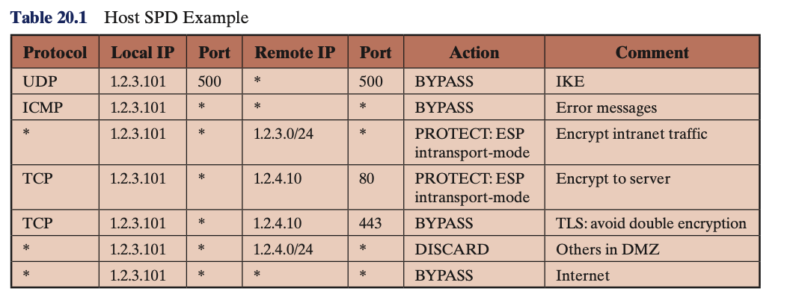
Security Policy Database (SPD)
SPD defines how to handle incoming/outgoing IP traffic in relation to security.
Protected using IPsec (AH or ESP processing).
Bypassed without IPsec protection.
Discarded if it doesn’t meet security requirements.
The SPD contains rules (entries) that match subsets of IP traffic to specific SAs or specify that the traffic bypasses IPsec.
Selectors are filters used to match packets to SPD entries.
Remote IP Address
Local IP Address
Next Layer Protocol
Local and Remote Ports

Slide 8
Relation: SA – SAD – SPD
SPD → Determines Traffic Treatment
Each packet is checked against the SPD, based on packet's source/destination IPs, ports, and protocols to determine:
If it needs IPsec protection.
Which SA (if any) it should use.
Once the SPD determines that traffic requires IPsec, it points to an existing SA in the SAD or triggers the creation of a new SA.
The SAD provides the operational details for the SA referenced by the SPD.
SAD, SPD are created and stored locally on your device when you setup your device (install VPN) to use IPSec connection.
strongswan -> ipsec
https://wiki.strongswan.org/projects/strongswan/wiki/ipseccommand

Slide 9
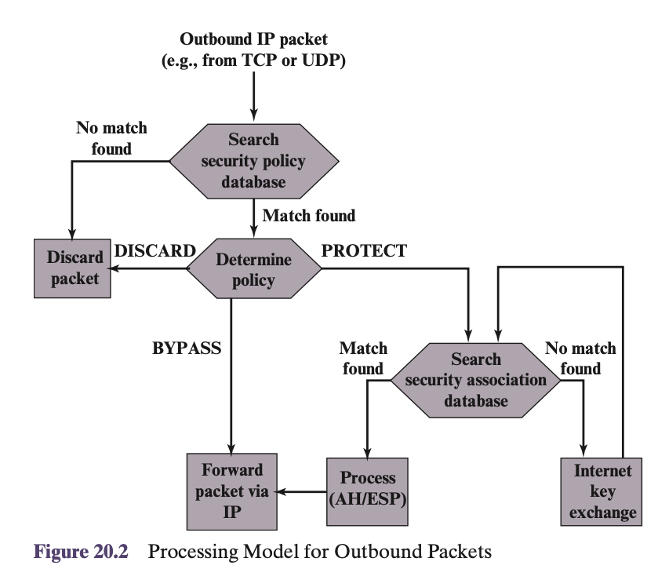
IP Traffic Processing - Outbound Packets
A block of data from a higher layer (TCP/UDP), is passed down to the IP layer and an IP packet is formed, consisting of an IP header and an IP body. Then the following steps occur:
1. IPsec searches the SPD for a match to this packet.
2. If no match is found, then the packet is discarded and an error message is generated.
3. If a match is found, further processing is determined by the first matching entry in the SPD. If the policy for this packet is DISCARD, then the packet is discarded. If the policy is BYPASS, then there is no further IPsec processing; the packet is forwarded to the network for transmission.
4. If the policy is PROTECT, then a search is made of the SAD for a matching entry. If no entry is found, then IKE (Internet Key Exchange) is invoked to create an SA with the appropriate keys and an entry is made in the SA.
5. The matching entry in the SAD determines the processing for this packet. Either encryption, authentication, or both can be performed, and either transport or tunnel mode can be used. The packet is then forwarded to the network for transmission.

Slide 10
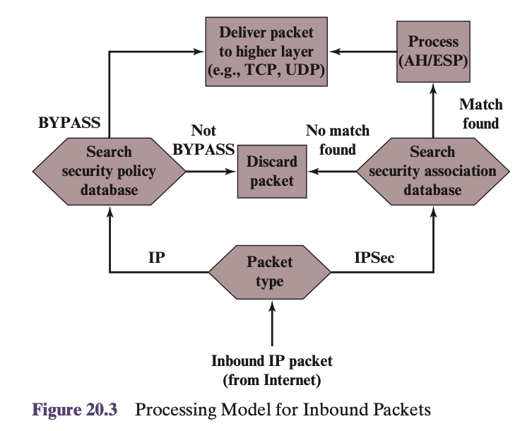
IP Traffic Processing - Inbound Packets
An incoming IP packet triggers the IPsec processing. The following steps occur:
1. IPsec determines whether this is an unsecured IP packet or one that has ESP or AH headers/trailers, by examining the IP Protocol field (IPv4) or Next Header field (IPv6).
2. If the packet is unsecured, IPsec searches the SPD for a match to this packet. If the first matching entry has a policy of BYPASS, the IP header is processed and stripped off and the packet body is delivered to the next higher layer, such as TCP. If the first matching entry has a policy of PROTECT or DISCARD, or if there is no matching entry, the packet is discarded.
3. For a secured packet, IPsec searches the SAD. If no match is found, the packet is discarded. Otherwise, IPsec applies the appropriate ESP or AH processing. Then, the IP header is processed and stripped off and the packet body is delivered to the next higher layer, such as TCP.

Slide 11
Security Association (SA)
Security Associations Database (SAD)
Security Policy Database (SPD)
SA – SAD – SPD (Relation)
IP Traffic processing Incoming/Outgoing
Encapsulating Security Payload (ESP)
Transport Mode
Tunnel Mode
Authentication Header (AH) (in comparison to ESP)
Internet Key Exchange

Slide 12
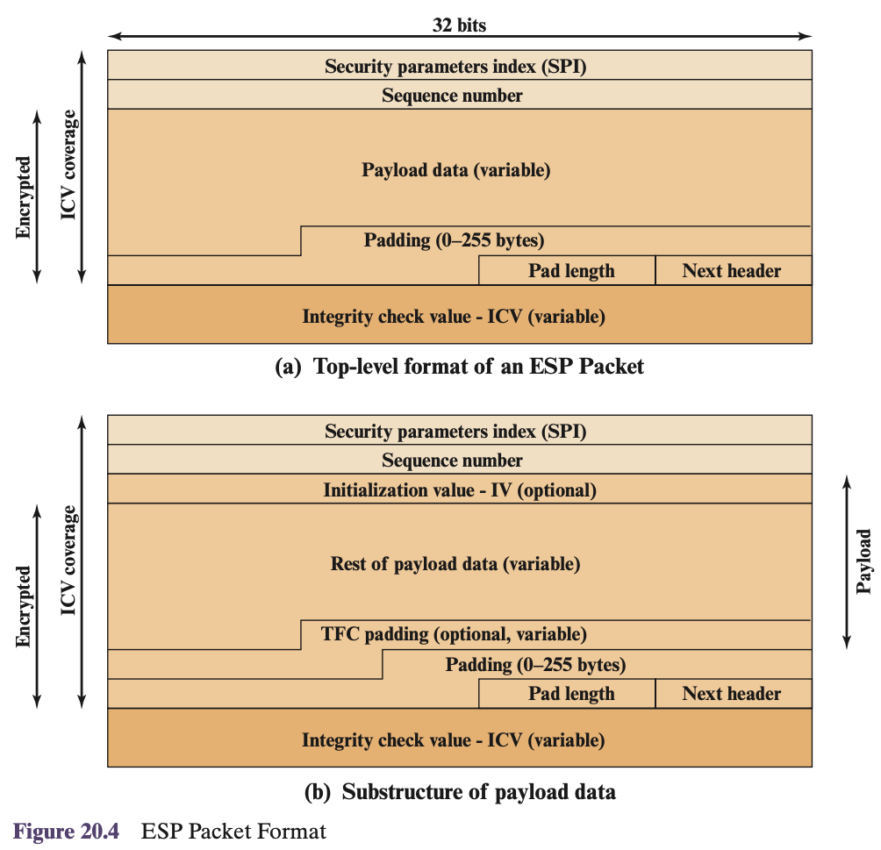
Encapsulating Security Payload (ESP)
ESP can be used to provide confidentiality, data origin authentication, integrity, an anti-replay service.
The set of services provided depends on options selected at the time of Security Association (SA) establishment.
ESP packet format
Security Parameters Index (32 bits)
Sequence Number (32 bits)
Payload Data (variable): This is a transport-level segment (transport mode) or IP packet (tunnel mode) that is protected by encryption.
Padding (0–255 bytes)
Pad Length (8 bits)
Next Header (8 bits): Type of data contained in the payload (TCP, IP)
Integrity Check Value (variable-multiple of 32-bits): computed over the ESP packet minus the Authentication Data field.

Slide 13
Encapsulating Security Payload (ESP)
ESP packet format – additional fields
Two additional fields may be present in the payload (Figure 20.4b).
An initialization value (IV), or nonce, is present if this is required by the encryption or authenticated encryption algorithm used for ESP.
If tunnel mode is being used, then the IPsec implementation may add traffic flow confidentiality (TFC).
Initialized Vector (IV) is not encrypted.
ICV is calculated after encryption.
Enables quickly reject malicious data by first checking the integrity with ICV and if it is pass then decrypting it. Thus IV is not encrypted.
Padding and Pad length to make data of multiple of 32 bits.

Slide 14

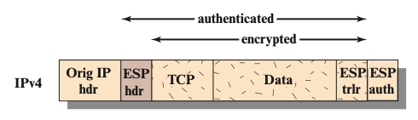
Transport and Tunnel Modes
Both AH and ESP support two modes of use: transport and tunnel mode.
Transport Mode
Transport mode provides protection primarily for upper-layer protocols (TCP, UDP, ICMP). That is, transport mode protection extends to the payload of an IP packet.
In the context of ESP - provides both encryption and authentication.
ESP header is inserted right before upper layer protocol header.
ESP trailer (Padding, Pad length, Next header fields) is placed after IP packet.
If authentication is selected, the ESP Authentication Data field is added after the ESP trailer.
Coverage - authentication and encryption.
Notice that Origin IP header is not encrypted thus it enables routing the data to final destination.
Once data is sent to receiver, based on SA, receiver checks authentication with ESP auth, and then decrypts the data.

Slide 15
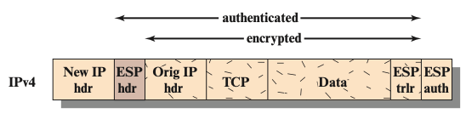
Tunnel Modes
Tunnel mode provides protection to the entire IP packet.
No routers along the way are able to examine the inner IP header.
With tunnel mode, a number of hosts on networks behind firewalls may engage in secure communications without implementing IPsec. The SAs set up by the IPsec software in the firewall or secure router at the boundary of the local network.

Slide 16
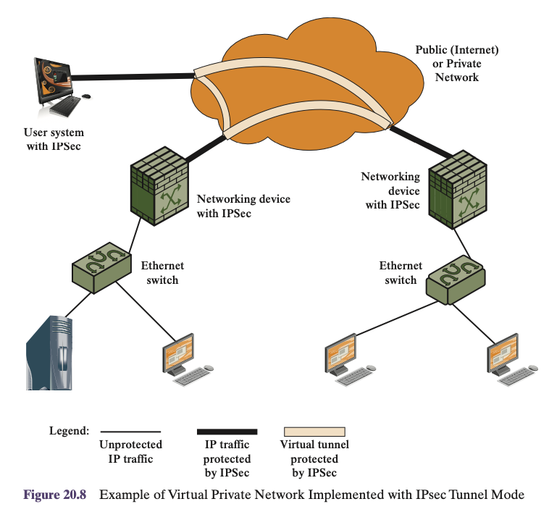
Tunnel Modes
1. Initial Packet Generation: Host A creates an IP packet with the destination set to Host B.
The packet originates from Host A and is sent toward Host B via the network.
2. Processing at the Firewall: The packet reaches a firewall or secure router at the boundary of Host A's network.
The firewall evaluates whether the packet requires IPsec protection.
3. IPsec Encapsulation: If IPsec is needed, the original packet is encapsulated in a new IP packet.
Outer IP header: Contains the firewall’s IP as the source and the destination firewall’s IP as the destination.
The original packet is encrypted and encapsulated inside.
4. Routing to the Destination Firewall:
Routing based on outer (firewall) IP
5. Decapsulation at Destination Firewall:
Upon reaching the destination firewall, the outer IP header is stripped off.
The inner packet is decrypted and forwarded to Host B.

Slide 17
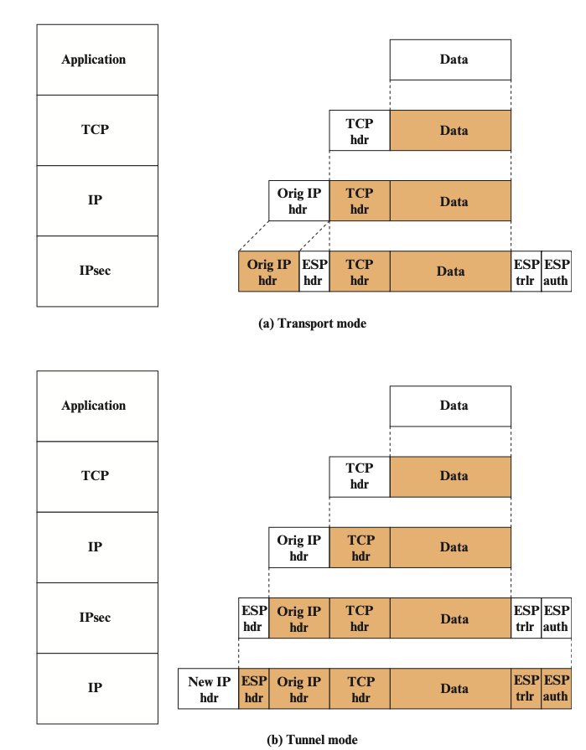
Transport mode and Tunnel mode comparison
Transport Mode
Protects connections directly between two hosts (e.g., A and B).
The original packet header is not encrypted, but the payload is.
Suitable for scenarios where both hosts support IPsec.
Tunnel Mode
Protects traffic between security gateways (firewalls) or between a host and a security gateway.
Entire original packet (header + payload) is encrypted and encapsulated.
Better for securing networks, as it:
Reduces the encryption burden on internal hosts.
Simplifies key management by reducing the number of encryption keys.
Prevents external traffic analysis by hiding the ultimate destination.

Slide 18

Authentication Header (AH) (in comparison to ESP)
AH is primarily used for integrity, authentication, and anti-replay protection.
It does not provide encryption or confidentiality.
ESP provides confidentiality (encryption), integrity, authentication, and anti-replay protection.
AH Transport mode
AH Tunnel mode
ESP Transport mode
Original IP Header
ESP Tunnel mode

Slide 19
Authentication Header (AH) (in comparison to ESP)
In terms of Integrity coverage
The authentication code is stored in AH Header for both AH Transport and Tunnel modes
AH Transport mode
AH Tunnel mode
ESP Transport mode
ESP Tunnel mode

Slide 20
Security Association (SA)
Security Associations Database (SAD)
Security Policy Database (SPD)
SA – SAD – SPD (Relation)
IP Traffic processing Incoming/Outgoing
Encapsulating Security Payload (ESP)
Transport Mode
Tunnel Mode
Authentication Header (AH) (in comparison to ESP)
Internet Key Exchange

Slide 21
Internet Key Exchange (IKE)
Requirement is determining and distributing keys.
Four keys are required for secure communication – Similar to TLS
2 keys for encryption (sender/receiver)
2 keys for authentication (sender/receiver)
IPsec Architecture document mandates support for two types of key management.
Manual: A system administrator manually configures each system with its own keys and with the keys of other communicating systems. This is practical for small, relatively static environments.
Automated: An automated system enables the on-demand creation of keys for SAs and facilitates the use of keys in a large distributed system with an evolving configuration.
Uses Diffie–Hellman based approach
Three message types
Initial Exchange
CREATE_CHILD_SA Exchange
Informational Exchange
Data format: Header and Payload

Slide 22
Internet Key Exchange (IKE)
Initial Exchange
1.1 Negotiating Parameters and Generating Key Material
Both peers exchange their supported cryptographic algorithms (e.g., encryption, authentication) and agree on a common set.
Nonces: Random values exchanged to ensure freshness and mitigate replay attacks.
Diffie–Hellman Values: Exchanged to generate a shared secret, which is used for deriving key material.
The result of this exchange is the creation of the IKE SA, which protects further communication.
1.2 Authentication and Establishing the First IPsec SA
Both peers authenticate each other using predefined methods, such as digital signatures, or public-key certificates.
The authenticated keys derived from the Diffie–Hellman exchange are used to encrypt and authenticate the messages.
The first IPsec SA is created and stored in the Security Association Database (SADB), allowing secure non-IKE communication (e.g., protecting ordinary data traffic).

Slide 23
Internet Key Exchange (IKE)
Initial Exchange
CREATE_CHILD_SA Exchange
Used when additional IPsec SAs are needed for protecting new traffic flows.
Each IPsec SA is negotiated independently and added to the Security Association Database (SADB).
Used to replace an existing SA that is nearing expiration.
Process
1. Initiator Sends CREATE_CHILD_SA Request: Specifies the desired cryptographic algorithms, and other SA parameters.
2. Responder Processes the Request: Selects parameters from the initiator’s proposal.
3. Responder Sends CREATE_CHILD_SA Response: Confirms the creation the SA with agreed parameters.
4. SA is Added to the SADB: The newly created SA is stored in the Security Association Database (SADB) for use in protecting traffic.

Slide 24
Internet Key Exchange (IKE)
Initial Exchange
CREATE_CHILD_SA Exchange
Informational Exchange
Exchange management information, error messages, and notifications.
Examples include reporting errors, responding to liveness checks, or updating configuration details.
Does not create new SAs or modify existing ones.

Slide 25
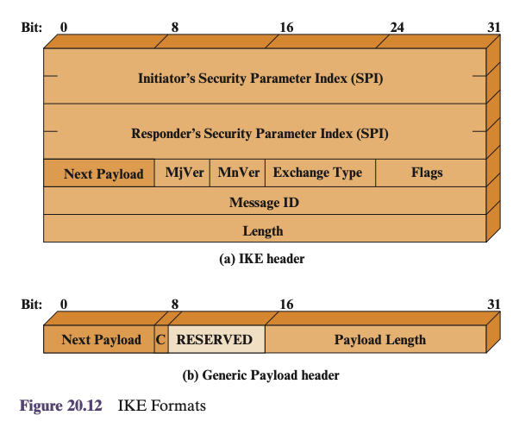
Internet Key Exchange (IKE)
IKE Header Format
Initiator SPI (64 bits): A unique identifier chosen by the initiator for the SA.
Responder SPI (64 bits): A unique identifier chosen by the responder for the SA.
Next Payload (8 bits): Indicates the type of the first payload in the message. 0 for no more payload.
Major and Minor Version (4 bits each): Specify the version of the IKE protocol in use.
Exchange Type (8 bits): Defines the type of exchange, few examples shown below.
Establish SA
Information exchange such as error reporting
Establish Key parameters
Flags (8 bits): initiator, response, version bits
Message ID (32 bits): used for retransmission control.
Each request in an IKE exchange is assigned a unique Message ID. The responder includes the same Message ID in its response to indicate which request it is replying to.
Length (32 bits): Total length of the IKE message, including the header and all payloads.

Slide 26
Internet Key Exchange (IKE)
IKE Payload Format
Next Payload (8 bits): Indicates the type of the next payload in the message. 0 for no more payload.
Critical bit (1 bit): has it is own use cases (custom logging, or new security feature)
If set to 1, the recipient must reject the message if the payload type is unsupported.
If set to 0, the recipient can skip the payload if unsupported.
Payload Length: Length of the payload in bytes, including the generic header.
Reserved (8 bits): For potential future features.

Slide 27
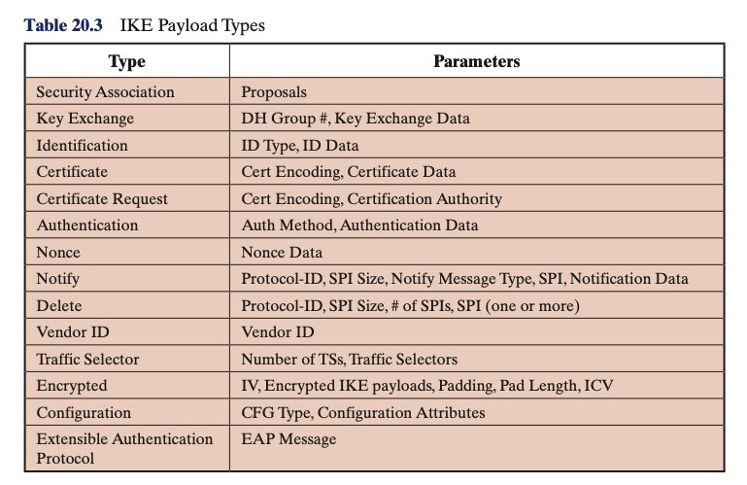
Internet Key Exchange (IKE)
IKE Payload Format
Next Payload (8 bits): Indicates the type of the next payload in the message. 0 for no more payload.
Payload Length: Length of the payload in bytes, including the generic header.
The actual data for a payload (e.g., nonce in the Nonce Payload) is stored immediately after the generic payload header.

Slide 28
Security Association (SA)
Security Associations Database (SAD)
Security Policy Database (SPD)
SA – SAD – SPD (Relation)
IP Traffic processing Incoming/Outgoing
Encapsulating Security Payload (ESP)
Transport Mode
Tunnel Mode
Authentication Header (AH) (in comparison to ESP)
Internet Key Exchange
Couple other topics

Slide 29
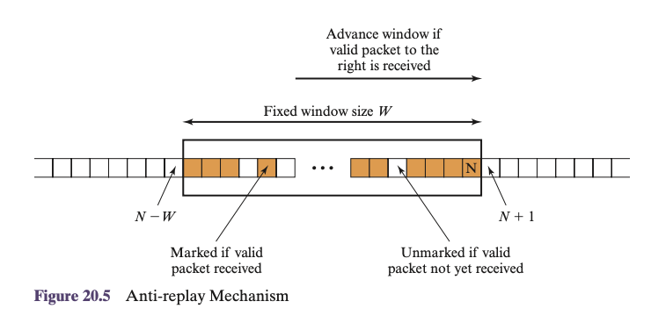
Anti-Replay Service
The Sequence Number field is designed to stop such attacks.
When a new SA is established, the sender initializes a sequence number counter to 0. Incremented every time packet is sent.
If anti-replay is enabled (the default), the sender must not allow the sequence number to cycle past 2³² - 1 back to zero. Otherwise, there would be multiple valid packets with the same sequence number. If the limit of 2³² - 1 is reached, the sender should terminate this SA and negotiate a new SA with a new key.
We have window of size 64. We we only consider sequence numbers in the range of that window.

Slide 30
Anti-Replay Service
Sequence number processing rule
1. If the received packet falls within the window and is new, the MAC is checked. If the packet is authenticated, the corresponding slot in the window is marked.
2. If the received packet is to the right of the window and is new, the MAC is checked. If the packet is authenticated, the window is advanced so that this sequence number is the right edge of the window, and the corresponding slot in the window is marked.
3. If the received packet is to the left of the window or if authentication fails, the packet is discarded; this is an auditable event – basically logged for security analysis.
What is the issue?
What if we keep getting packets to the right of window?
Window grows indefinitely?
Or do we keep discard sequence numbers to the left of window and keep moving window to left?
Reliability is not responsibility of IPSec.

Slide 31
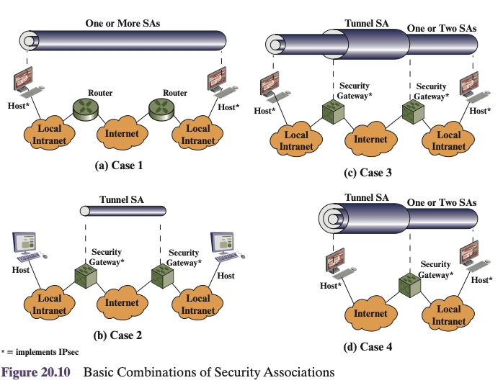
Combinations of Security Associations
Security association bundle refers to a sequence of SAs through which traffic must be processed to provide a desired set of IPsec services.

