Slide 1
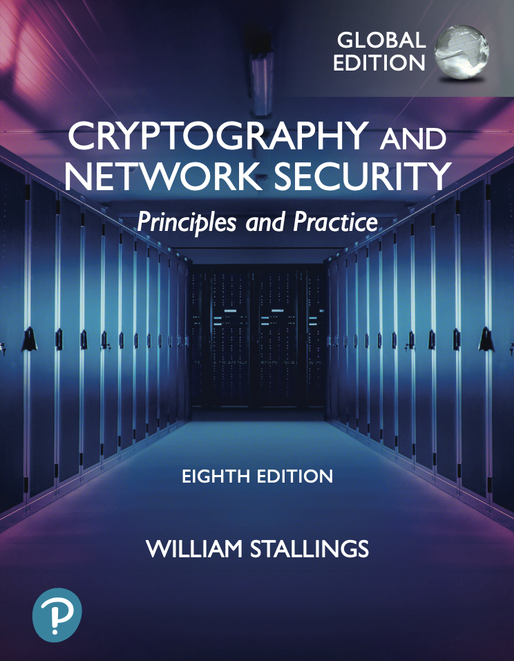
University of Nevada – Reno
Computer Science & Engineering Department
CS454/654 Reliability and Security of Computing Systems - Fall 2024
Lecture 4
Dr. Batyr Charyyev
bcharyyev.com

Slide 2
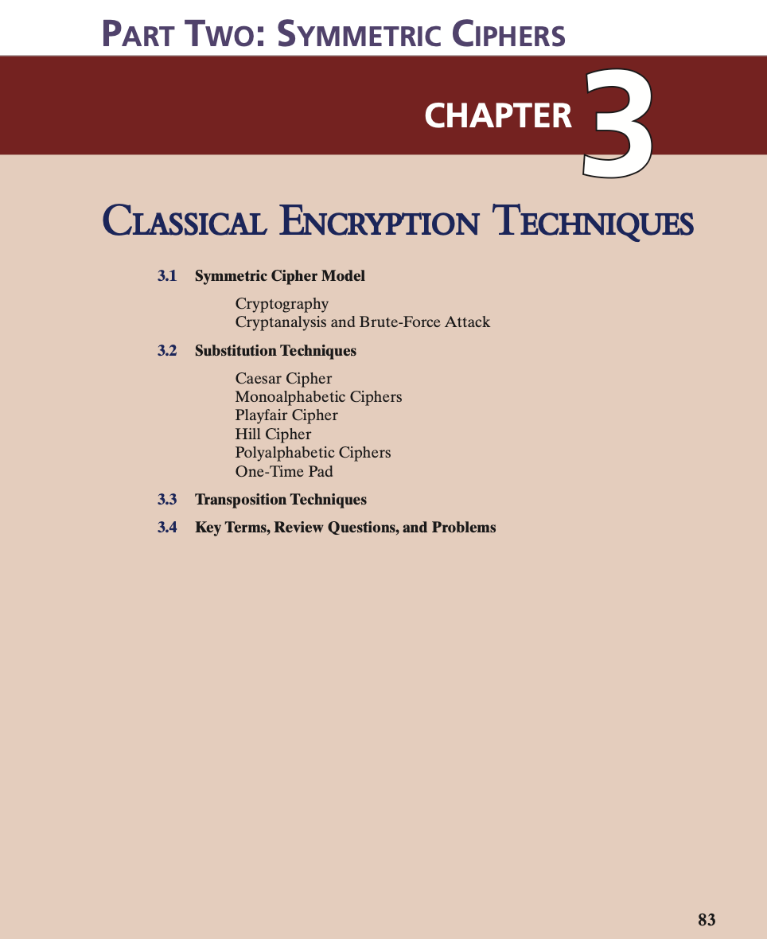

Slide 3
Definitions
Plaintext
An original message
Ciphertext
The coded message
Encryption
The process of converting from plaintext to ciphertext
Decryption
Restoring the plaintext from the ciphertext
Cryptography
The area of study of the many schemes used for encryption
Cryptographic system/cipher
A scheme (a specific method)
Cryptanalysis
Techniques used for decrypting a message without any knowledge of the enciphering details
Cryptology
The areas of cryptography and cryptanalysis
Breaking the code

Slide 4
Symmetric Cipher Model
There are two requirements for secure use of conventional encryption:
A strong encryption algorithm
Sender and receiver must have obtained copies of the secret key in a secure fashion and must keep the key secure

Slide 5
Cryptographic Systems
Characterized along three independent dimensions:
The type of operations used for transforming plaintext to ciphertext
Substitution
substitute elements in plaintext
Transposition
rearrange elements in plaintext
The number of keys used
Symmetric, single-key, secret-key, conventional encryption
Asymmetric, two-key, or public-key encryption
The way in which the plaintext is processed
Block cipher
processes the input one block of elements at a time
Stream cipher
processes the input elements continuously, producing output one element at a time
Most product systems involve multiple stages of substitutions and transpositions.

Slide 6
Cryptanalysis and Brute-Force Attack
Cryptanalysis
Attack relies on the nature of the algorithm plus some knowledge of the general characteristics of the plaintext
Attack exploits the characteristics of the algorithm to attempt to deduce a specific plaintext or to deduce the key being used
Brute-force attack
Attacker tries every possible key on a piece of ciphertext until an intelligible translation into plaintext is obtained
On average, half of all possible keys must be tried to achieve success
To supplement the brute-force approach, some degree of knowledge about the expected plaintext is needed, and some means of automatically distinguishing plaintext from garble is also needed

Slide 7
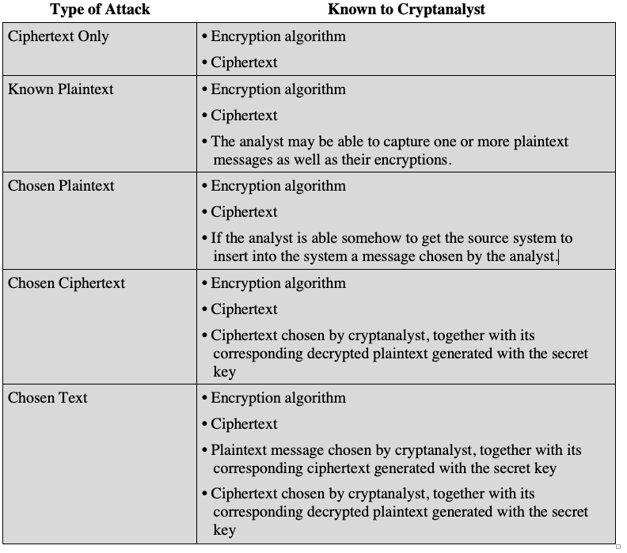
Table 3.1 Types of Attacks on Encrypted Messages
(Table is on page 68 in the textbook)

Slide 8
Encryption Scheme Security
Unconditionally secure
No matter how much time and ciphertext an opponent has, it is impossible for him or her to decrypt the ciphertext.
With the exception of a scheme known as the one- time pad (described later in this chapter), there is no encryption algorithm that is unconditionally secure.
Computationally secure
The cost of breaking the cipher exceeds the value of the encrypted information
The time required to break the cipher exceeds the
useful lifetime of the information

Slide 9
Strong Encryption
The term strong encryption refers to encryption schemes that make it impractically difficult for unauthorized persons or systems to gain access to plaintext that has been encrypted
Properties that make an encryption algorithm strong are:
Appropriate choice of cryptographic algorithm
Use of sufficiently long key lengths
Appropriate choice of protocols
A well-engineered implementation
Absence of deliberately introduced hidden flaws

Slide 11
Substitution Technique
The letters (bits) of plaintext are replaced by other letters (bits) or by numbers or symbols
Substitution Techniques
Caesar Cipher
Monoalphabetic Ciphers
Playfair Cipher
Hill Cipher
Polyalphabetic Ciphers
One-Time Pad

Slide 12

Caesar Cipher
Simplest and earliest known use of a substitution cipher
Involves replacing each letter of the alphabet with the letter standing three places further down the alphabet
Alphabet is wrapped around so that the letter following Z is A
plain: meet me after the toga party
cipher: PHHW PH DIWHU WKH WRJD SDUWB

Slide 13
Monoalphabetic Cipher
Compared to Caesar Cipher, Monoalphabetic Cipher allows an arbitrary substitution.
The cipher line can be any permutation of the 26 alphabetic characters
Q: How many possible keys?
26! possible keys.
Possible attack can be analyzing the relative frequency of letters, and compare it to frequency distribution for English.
Attacker should know the nature of plaintext (text is in English)
Should have long message to generate correct frequency distribution.

Slide 14
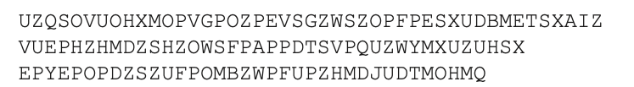
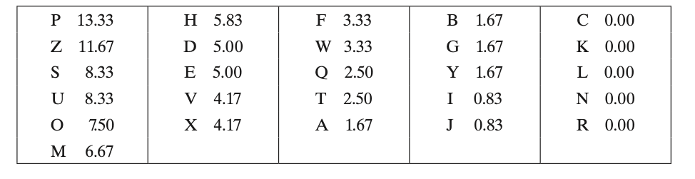
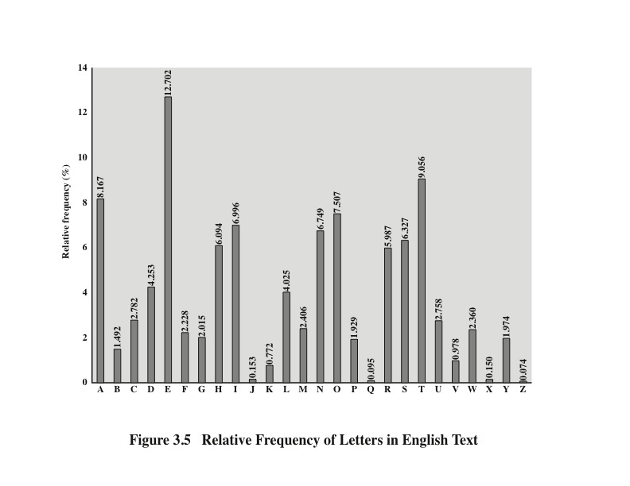
P and Z are the equivalents of plain letters e and t
The letters S, U, O, M, and H are all of relatively high frequency and probably correspond to plain letters from the set {a, h, i, n, o, r, s}

Slide 15
Monoalphabetic Ciphers
Digram
Two-letter combination
Most common is th
In our ciphertext, the most common digram is ZW, which appears three times. So we make the correspondence of Z with t and W with h.
Trigram
Three-letter combination
Most frequent is the
ZWP is most frequent trigram thus we can assume P correspond to e
Monoalphabetic ciphers are easy to break because they reflect the frequency data of the original alphabet.

Slide 16
Playfair Cipher
Best-known multiple-letter encryption cipher
Treats digrams in the plaintext as single units and translates these units into ciphertext digrams
Invented by British scientist Sir Charles Wheatstone in 1854
Used as the standard field system by the British Army in World War I and the U.S. Army and other Allied forces during World War II

Slide 17
Playfair Key Matrix
Constructing 5x5 matrix from keyword.
Assume keyword is “jurisdiction”
Remove duplicates, keyword become “J U R I S D C T O N”
Treat I and J same, “J/I U R S D C T O N”
Fill the letters in keyword from left to right and then fill other letters in alphabetic order
J/I U R S D
C T O N A
B E F G H
K L M P Q
V W X Y Z

Slide 18
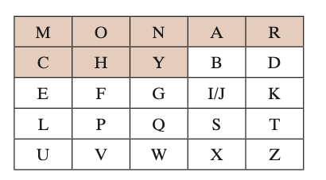
Playfair Key Matrix
Plaintext is encrypted two letters at a time, according to the following rules:
Repeating plaintext letters that are in the same pair are separated with a filler letter, such as x, so that balloon would be treated as ba lx lo on.
Two plaintext letters that fall in the same row of the matrix are each replaced by the letter to the right, with the first element of the row circularly following the last. For example, ar is encrypted as RM.
Two plaintext letters that fall in the same column are each replaced by the letter beneath, with the top element of the column circularly following the last. For example, mu is encrypted as CM.
Otherwise, each plaintext letter in a pair is replaced by the letter that lies in its own row and the column occupied by the other plaintext letter. Thus, hs becomes BP and ea becomes IM (or JM, as the encipherer wishes). (Create rectangle).
Play ➔ pl ay => QP NB
Game
➔ ga me => IN CL
hell
➔ he lx lx =>CF SU SU
hello
➔ he lx lo =>CF SU PM

Slide 19
Substitution Technique
The letters (bits) of plaintext are replaced by other letters (bits) or by numbers or symbols
Substitution Techniques
Caesar Cipher
Monoalphabetic Ciphers
Playfair Cipher
Hill Cipher
Polyalphabetic Ciphers
One-Time Pad

Slide 20
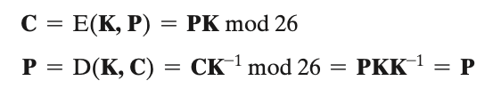
Hill Cipher
Take nxn (3x3, 2x2, etc.) matrix which should be invertible.
Inverse M⁻¹ of square matrix M is defined by the equation M(M⁻¹) = (M⁻¹) M = I where I is identity matrix.

Slide 21
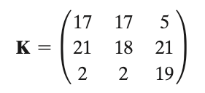
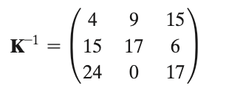
Hill Cipher
Example: consider plaintext “paymoremoney” and use the encryption key above.
First three letters (pay) of the plaintext are represented by the vector (15 0 24)
Then (15 0 24) K = (303 303 531) mod 26 = (17 17 11) = RRL. And if we continue “paymoremoney” ->RRLMWBKASPDH
For decryption if we repeat the process for RRLMWBKASPDH with K⁻¹ we get the ”paymoremoney”.

Slide 22
Substitution Technique
The letters (bits) of plaintext are replaced by other letters (bits) or by numbers or symbols
Substitution Techniques
Caesar Cipher
Monoalphabetic Ciphers
Playfair Cipher
Hill Cipher
Polyalphabetic Ciphers
One-Time Pad

Slide 23
Polyalphabetic Ciphers
Polyalphabetic substitution cipher
Improves on the simple monoalphabetic technique by using different monoalphabetic substitutions as one proceeds through the plaintext message
Polyalphabetic Ciphers: Vigenere and Vernam

Slide 24
Vigenère Cipher
To encrypt a message, a key is needed that is as long as the message
Usually, the key is a repeating keyword
For example, if the keyword is deceptive, the message “we are discovered save yourself” is encrypted as:
key: deceptivedeceptivedeceptive
plaintext: wearediscoveredsaveyourself
ciphertext: ZICVTWQNGRZGVTWAVZHCQYGLMGJ
d+w=z => (3+22) mod 26=25

Slide 25
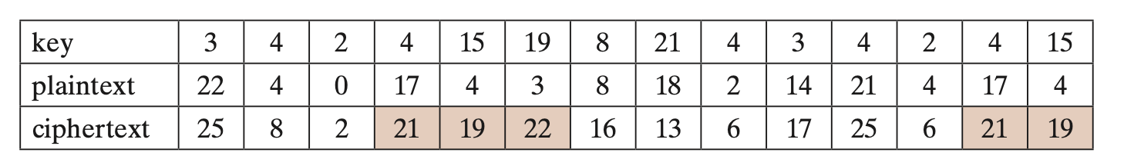
Vigenère Cipher
In the example, two instances of the sequence “red” are separated by nine character positions.
If the message is long enough, there will be a number of such repeated ciphertext sequences.
By looking for common factors in the displacements of the various sequences, the analyst should be able to make a good guess of the keyword length.

Slide 26
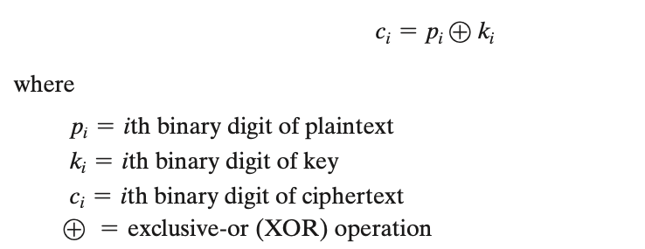
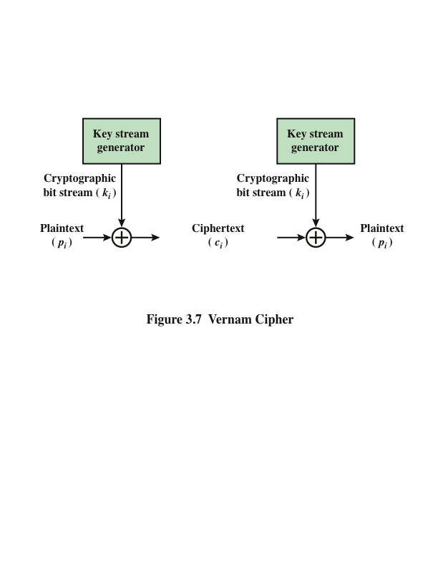
Vernam Cipher
Key can be shorter or equal to message, and can be reused.
Key is just a random bits

Slide 27
One-Time Pad
Improvement to Vernam cipher proposed by an Army Signal Corp officer, Joseph Mauborgne
Use a random key that is as long as the message so that the key need not be repeated
Key is used to encrypt and decrypt a single message and then is discarded
Each new message requires a new key of the same length as the new message
Produces random output that bears no statistical relationship to the plaintext

Slide 28
Difficulties
The one-time pad offers complete security but, in practice, has two fundamental difficulties:
There is the practical problem of making large quantities of random keys
Any heavily used system might require millions of random characters on a regular basis
Mammoth key distribution problem
For every message to be sent, a key of equal length is needed by both sender and receiver. Thus, distribution (exchanging) of keys is challenging.

Slide 30
Rail Fence Cipher
Simplest transposition cipher
Plaintext is written down as a sequence of diagonals and then read off as a sequence of rows
To encipher the message “meet me after the toga party” with a rail fence of depth 2, we would write:
m e m a t r h t g p r y
e t e f e t e o a a t
Encrypted message is:
MEMATRHTGPRYETEFETEOAAT
Q: What is key here?
The Depth: number of rows

Slide 31
Row Transposition Cipher
Write the message in a rectangle, row by row, and read the message off, column by column, but permute the order of the columns
The order of the columns then becomes the key to the algorithm
Key: 4 3 1 2 5 6 7
Plaintext: a t t a c k p
o s t p o n e
d u n t i l t
w o a m x y z
Ciphertext: TTNAAPTMTSUOAODWCOIXKNLYPETZ
The transposition cipher can be made significantly more secure by performing more than one stage of transposition

