Slide 1
Analysis of Algorithms CS 477/677
Instructor: Monica Nicolescu
Lecture 13

Slide 2
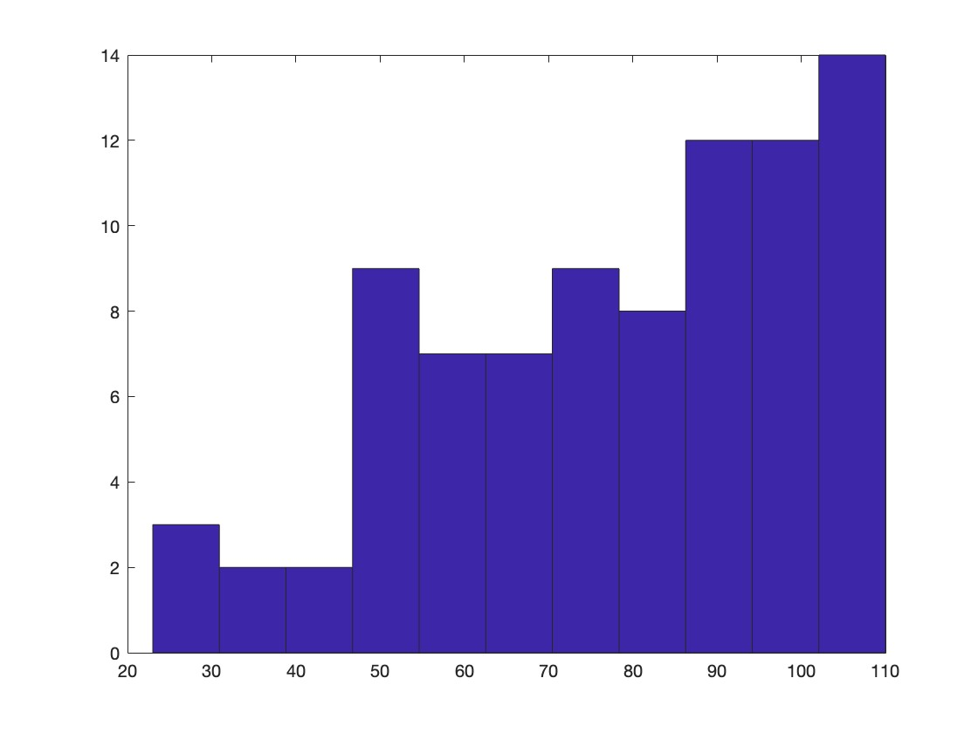
Midterm Results - CS 477
Min = 23 Max = 110 Average = 78.2

Slide 3
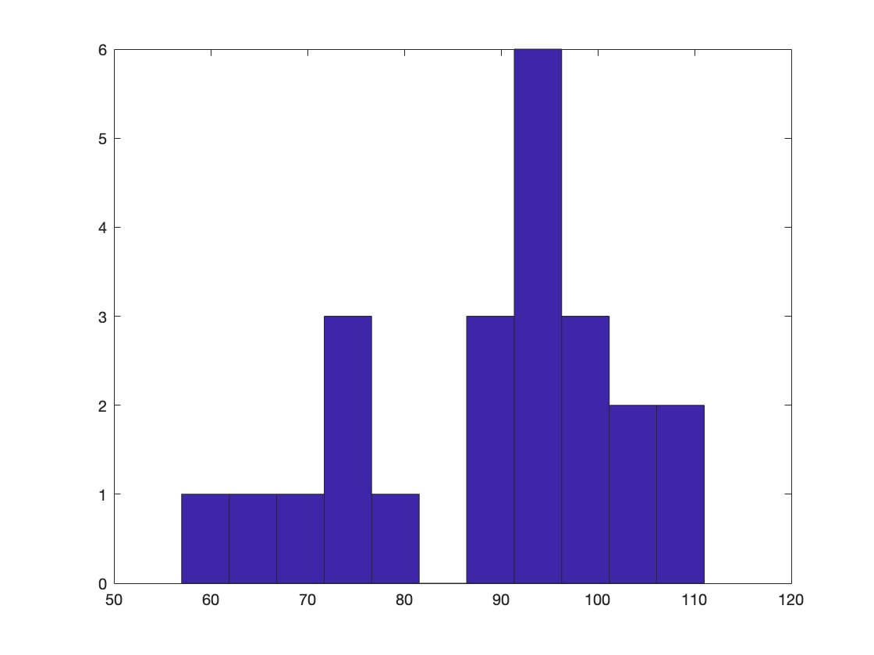
Midterm Results - CS 677
Min = 57 Max = 111 Average = 89.26

Slide 4
Binary Search Trees
Tree representation:
A linked data structure in which each node is an object
Node representation:
Key field
Satellite data
Left: pointer to left child
Right: pointer to right child
p: pointer to parent (p [root [T]] = NIL)
Satisfies the binary search tree property
parent
L
R
key
data
Left child
Right child

Slide 5
Binary Search Tree Example
Binary search tree property:
If y is in left subtree of x,
then key [y] ≤ key [x]
If y is in right subtree of x,
then key [y] ≥ key [x]
5
3
7
2
5
9

Slide 6
Binary Search Trees
Support many dynamic set operations
SEARCH, MINIMUM, MAXIMUM, PREDECESSOR, SUCCESSOR, INSERT, DELETE
Running time of basic operations on binary search trees
On average: Θ(lgn)
The expected height of the tree is lgn
In the worst case: Θ(n)
The tree is a linear chain of n nodes

Slide 7
Red-Black Trees
“Balanced” binary trees guarantee an O(lgn) running time on the basic dynamic-set operations
Red-black tree
Binary tree with an additional attribute for its nodes: color which can be red or black
Constrains the way nodes can be colored on any path from the root to a leaf
Ensures that no path is more than twice as long as another ⇒ the tree is balanced
The nodes inherit all the other attributes from the binary-search trees: key, left, right, p

Slide 8
Red-Black Trees Properties
Every node is either red or black
The root is black
Every leaf (NIL) is black
If a node is red, then both its children are black
No two red nodes in a row on a simple path from the root to a leaf
For each node, all paths from the node to descendant leaves contain the same number of black nodes

Slide 9
Example: RED-BLACK TREE
26
17
41
NIL
NIL
30
47
38
NIL
50
NIL
NIL
NIL
NIL
NIL
For convenience we use a sentinel NIL[T] to represent all the NIL nodes at the leafs
NIL[T] has the same fields as an ordinary node
Color[NIL[T]] = BLACK
The other fields may be set to arbitrary values

Slide 10
Black-Height of a Node
h = 4
bh = 2
26
h = 1
bh = 1
h = 3
bh = 2
17
41
NIL
NIL
h = 2
bh = 1
h = 2
bh = 1
30
47
h = 1
bh = 1
38
50
h = 1
bh = 1
NIL
NIL
NIL
NIL
NIL
NIL
Height of a node: the number of edges in a longest path to a leaf
Black-height of a node x: bh(x) is the number of black nodes (including NIL) on a path from x to leaf, not counting x

Slide 11
Properties of Red-Black Trees
Claim
Any node with height h has black-height ≥ h/2
Proof
By property 4, there are at most h/2 red nodes on the path from the node to a leaf
Hence at least h/2 are black
26
17
41
Property 4: if a node is red then both its children are black
30
47
38
50

Slide 12
Properties of Red-Black Trees
Claim
The subtree rooted at any node x contains at least 2^{bh(x)} - 1 internal nodes
Proof: By induction on height of x
Basis: height[x] = 0 ⇒
x is a leaf (NIL[T]) ⇒
bh(x) = 0 ⇒
# of internal nodes: 2⁰ - 1 = 0
x
NIL

Slide 13
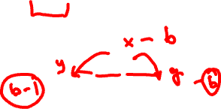
Properties of Red-Black Trees
Inductive step:
Let height(x) = h and bh(x) = b
Any child y of x has:
bh (y) =
bh (y) =
b (if the child is red), or
b - 1 (if the child is black)
26
17
41
30
47
38
50

Slide 14
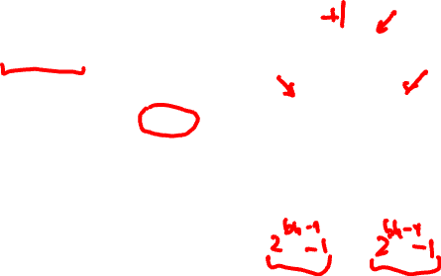
Properties of Red-Black Trees
Want to prove:
The subtree rooted at any node x contains at least 2^{bh(x)} - 1 internal nodes
Assume true for children of x:
Their subtrees contain at least 2^{bh(x) - 1} – 1 internal nodes
The subtree rooted at x contains at least:
(2^{bh(x) - 1} – 1) + (2^{bh(x) - 1} – 1) + 1 =
2 · (2^{bh(x) - 1} - 1) + 1 =
2^{bh(x)} - 1 internal nodes
x
l
r

Slide 15

Properties of Red-Black Trees
Lemma: A red-black tree with n internal nodes has height at most 2lg(n + 1).
Proof:
n
Add 1 to all sides and then take logs:
n + 1 ≥ 2^{b} ≥ 2^{h/2}
lg(n + 1) ≥ h/2 ⇒
h ≤ 2 lg(n + 1)
height(root) = h
root
bh(root) = b
≥ 2^{b} - 1
≥ 2^{h/2} - 1
l
r
number n
of internal
nodes
since b ≥ h/2

Slide 16
Operations on Red-Black Trees
The non-modifying binary-search tree operations MINIMUM, MAXIMUM, SUCCESSOR, PREDECESSOR, and SEARCH run in O(h) time
They take O(lgn) time on red-black trees
What about TREE-INSERT and TREE-DELETE?
They will still run in O(lgn)
We have to guarantee that the modified tree will still be a red-black tree

Slide 17
INSERT
INSERT: what color to make the new node?
Red? Let’s insert 35!
Property 4: if a node is red, then both its children are black
Black? Let’s insert 14!
Property 5: all paths from a node to its leaves contain the same number of black nodes
26
17
41
30
47
38
50

Slide 18
DELETE
26
17
41
DELETE: what color was the
node that was removed? Red?
Every node is either red or black
The root is black
Every leaf (NIL) is black
If a node is red, then both its children are black
For each node, all paths from the node to descendant leaves contain the same number of black nodes
30
47
38
50
OK!
OK!
OK!
OK! Does not change
any black heights
OK! Does not create
two red nodes in a row

Slide 19
DELETE
26
17
41
DELETE: what color was the
node that was removed? Black?
Every node is either red or black
The root is black
Every leaf (NIL) is black
If a node is red, then both its children are black
For each node, all paths from the node to descendant leaves contain the same number of black nodes
30
47
38
50
OK!
Not OK! If removing the root and the child that replaces it is red
OK!
Not OK! Could change the
black heights of some nodes
Not OK! Could create
two red nodes in a row

Slide 20
Rotations
Operations for restructuring the tree after insert and delete operations on red-black trees
Rotations take a red-black tree and a node within the tree and:
Together with some node re-coloring they help restore the red-black tree property
Change some of the pointer structure
Do not change the binary-search tree property
Two types of rotations:
Left & right rotations

Slide 21
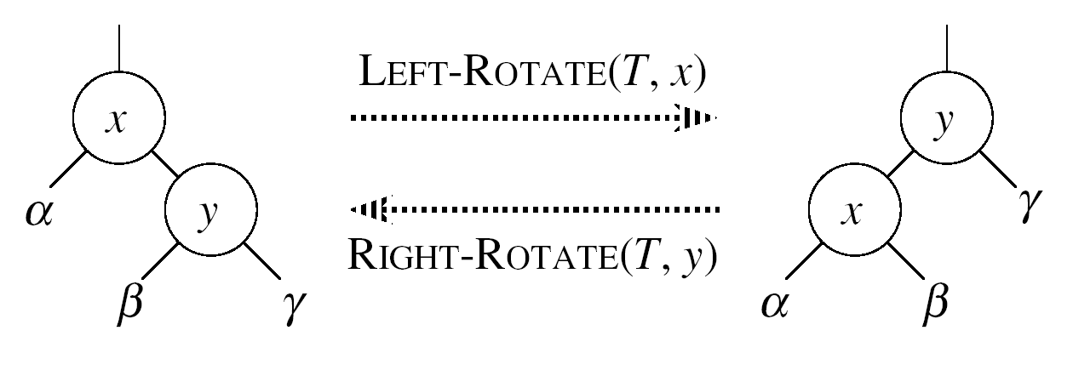

Left Rotations
Assumption for a left rotation on a node x:
The right child of x (y) is not NIL
Idea:
Pivots around the link from x to y
Makes y the new root of the subtree
x becomes y’s left child
y’s left child becomes x’s right child

Slide 22
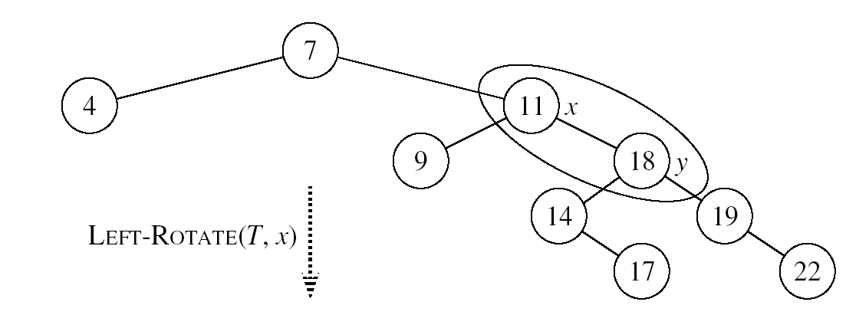
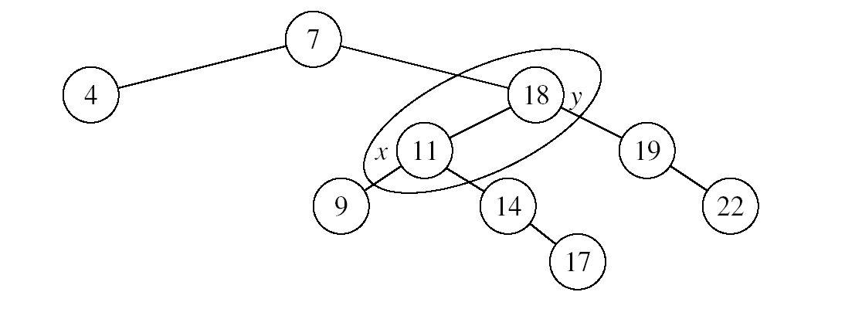

Example: LEFT-ROTATE

Slide 23
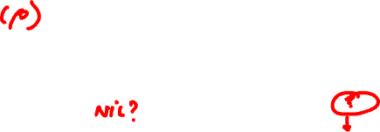
LEFT-ROTATE(T, x)
y ← right[x] ►Set y
right[x] ← left[y] ► y’s left subtree becomes x’s right subtree
if left[y] ≠ NIL
then p[left[y]] ← x ► Set the parent relation from left[y] to x
p[y] ← p[x] ► The parent of x becomes the parent of y
if p[x] = NIL
then root[T] ← y
else if x = left[p[x]]
then left[p[x]] ← y
else right[p[x]] ← y
left[y] ← x ► Put x on y’s left
p[x] ← y ► y becomes x’s parent
5,6-10
11,12
2,3-4

Slide 24
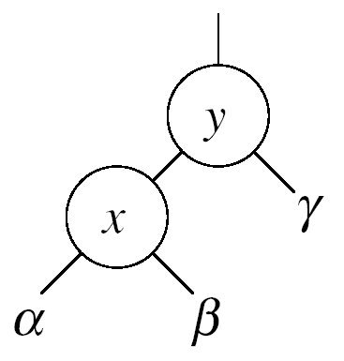
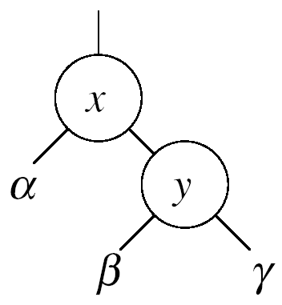



Right Rotations
Assumption for a right rotation on a node x:
The left child of y (x) is not NIL
Idea:
Pivots around the link from y to x
Makes x the new root of the subtree
y becomes x’s right child
x’s right child becomes y’s left child

Slide 25
Insertion
Goal:
Insert a new node z into a red-black tree
Idea:
Insert node z into the tree as for an ordinary binary search tree
Color the node red
Restore the red-black tree properties
Use an auxiliary procedure RB-INSERT-FIXUP

Slide 26

RB-INSERT(T, z)
26
17
41
30
47
Initialize nodes x and y
Throughout the algorithm y points
to the parent of x
y ← NIL
x ← root[T]
while x ≠ NIL
do y ← x
if key[z] < key[x]
then x ← left[x]
else x ← right[x]
p[z] ← y
38
50
Go down the tree until
reaching a leaf
At that point y is the
parent of the node to be
inserted
Sets the parent of z to be y

Slide 27
RB-INSERT(T, z)
26
17
41
if y = NIL
then root[T] ← z
else if key[z] < key[y]
then left[y] ← z
else right[y] ← z
left[z] ← NIL
right[z] ← NIL
color[z] ← RED
RB-INSERT-FIXUP(T, z)
30
47
The tree was empty:
set the new node to be the root
38
50
Otherwise, set z to be the left or right child of y, depending on whether the inserted node is smaller or larger than y’s key
Set the fields of the newly added node
Fix any inconsistencies that could have
been introduced by adding this new red
node

Slide 28
RB Properties Affected by Insert
OK!
Every node is either red or black
The root is black
Every leaf (NIL) is black
If a node is red, then both its children are black
For each node, all paths
from the node to descendant
leaves contain the same number
of black nodes
If z is the root
⇒ not OK
OK!
If p(z) is red ⇒ not OK
z and p(z) are both red
OK!
26
17
41
38
47
50

Slide 29
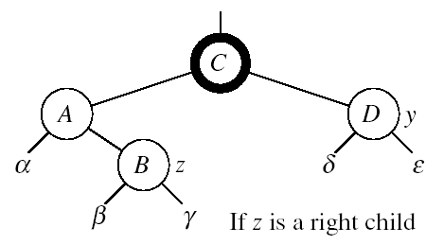
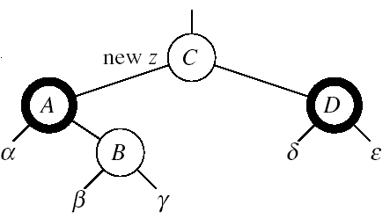

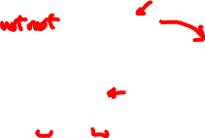
RB-INSERT-FIXUP – Case 1
z’s “uncle” (y) is red
Idea: (z is a right child)
p[p[z]] (z’s grandparent) must be black: z and p[z] are both red
Color p[z] black
Color y black
Color p[p[z]] red
Push the red node up the tree
Make z = p[p[z]]

Slide 30
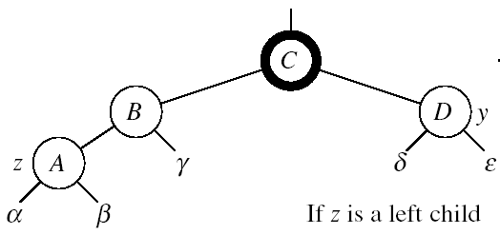
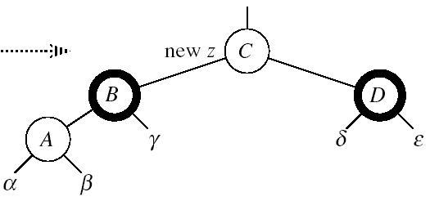

RB-INSERT-FIXUP – Case 1
z’s “uncle” (y) is red
Idea: (z is a left child)
p[p[z]] (z’s grandparent) must be black: z and p[z] are both red
color[p[z]] ← black
color[y] ← black
color p[p[z]] ← red
z = p[p[z]]
Push the red node up the tree
Case1

Slide 31
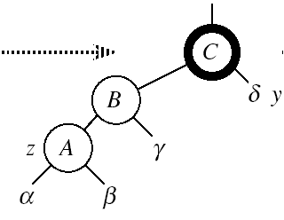

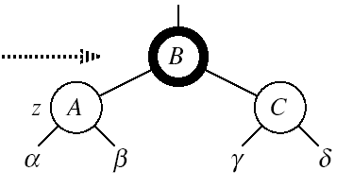

RB-INSERT-FIXUP – Case 3
Case 3:
z’s “uncle” (y) is black
z is a left child
Idea:
color[p[z]] ← black
color[p[p[z]]] ← red
RIGHT-ROTATE(T, p[p[z]])
No longer have 2 reds in a row
p[z] is now black
Case3
Case 3

Slide 32
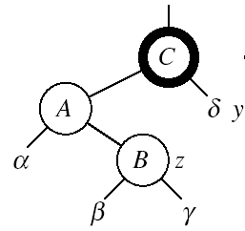

RB-INSERT-FIXUP – Case 2
Case 2:
z’s “uncle” (y) is black
z is a right child
Idea:
z ← p[z]
LEFT-ROTATE(T, z)
⇒ now z is a left child, and both z and p[z] are red ⇒ case 3
Case2
Case 2
Case 3

Slide 33
RB-INSERT-FIXUP(T, z)
while color[p[z]] = RED
do if p[z] = left[p[p[z]]]
then y ← right[p[p[z]]]
if color[y] = RED
then Case1
else if z = right[p[z]]
then Case2
Case3
else (same as then clause with “right” and “left” exchanged)
color[root[T]] ← BLACK
The while loop repeats only when
case1 is executed: O(lgn) times
Set the value of x’s “uncle”
We just inserted the root, or
the red node reached the root

Slide 34

Example
Insert 4
11
Case 1
11
Case 2
2
14
2
14
y
1
7
7
z
15
1
15
5
8
y
5
8
z and p[z] are both red
z’s uncle y is red
z and p[z] are both red
z’s uncle y is black
z is a right child
z
4
4
11
7
Case 3
z
7
14
y
2
11
z
2
8
15
1
5
8
14
1
5
z and p[z] are red
z’s uncle y is black
z is a left child
4
15
4

Slide 35
Analysis of RB-INSERT
Inserting the new element into the tree O(lgn)
RB-INSERT-FIXUP
The while loop repeats only if CASE 1 is executed
The number of times the while loop can be executed is O(lgn)
Total running time of RB-INSERT: O(lgn)

Slide 36
Red-Black Trees - Summary
Operations on red-black trees:
SEARCH O(h)
PREDECESSOR O(h)
SUCCESOR O(h)
MINIMUM O(h)
MAXIMUM O(h)
INSERT O(h)
DELETE O(h)
Red-black trees guarantee that the height of the tree will be O(lgn)

Slide 37
Augmenting Data Structures
Let’s look at two new problems:
Dynamic order statistic
Interval search
It is unusual to have to design all-new data structures from scratch
Typically: store additional information in an already known data structure
The augmented data structure can support new operations
We need to correctly maintain the new information without loss of efficiency

Slide 38
Dynamic Order Statistics
Def.: the i-th order statistic of a set of n elements, where i ∈ {1, 2, …, n} is the element with the i-th smallest key.
We can retrieve an order statistic from an unordered set:
Using:
In:
We will show that:
With red-black trees we can achieve this in O(lgn)
Finding the rank of an element takes also O(lgn)
RANDOMIZED-SELECT
O(n) time

Slide 39
Order-Statistic Tree
Def.: Order-statistic tree: a red-black tree with additional information stored in each node
Node representation:
Usual fields: key[x], color[x], p[x], left[x], right[x]
Additional field: size[x] that contains the number of (internal) nodes in the subtree rooted at x (including x itself)
For any internal node of the tree:
size[x] =
size[left[x]] + size[right[x]] + 1

Slide 40
Example: Order-Statistic Tree
key
10
7
size
8
15
3
3
4
9
11
19
1
1
1
1

Slide 41
OS-SELECT
Goal:
Given an order-statistic tree, return a pointer to the node containing the i-th smallest key in the subtree rooted at x
Idea:
size[left[x]] = the number of nodes
that are smaller than x
rank’[x] = size[left[x]] + 1
in the subtree rooted at x
If i = rank’[x] Done!
If i < rank’[x]: look left
If i > rank’[x]: look right
10
7
8
15
3
3
4
9
11
19
1
1
1
1

Slide 42
OS-SELECT(x, i)
r ← size[left[x]] + 1
if i = r
then return x
elseif i < r
then return OS-SELECT(left[x], i)
else return OS-SELECT(right[x], i - r)
Initial call: OS-SELECT(root[T], i)
Running time: O(lgn)
► compute the rank of x within the subtree rooted at x

Slide 43
Example: OS-SELECT
OS-SELECT(root, 3)
10
r = 3 + 1 = 4
OS-SELECT(‘8’, 3)
7
r = 1 + 1 = 2
OS-SELECT(‘9’, 1)
8
15
3
3
4
9
11
19
1
1
1
1
r = 1
Found!

Slide 44
OS-RANK
Goal:
Given a pointer to a node x in an order-statistic tree, return the rank of x in the linear order determined by an inorder walk of T
Its parent plus the left
subtree if x is a right child
10
7
x
Idea:
Add elements in the left
subtree
Go up the tree and
if a right child: add
the elements in the left
subtree of the parent + 1
8
15
3
3
4
9
11
19
1
1
1
1
The elements in the left subtree

Slide 45
OS-RANK(T, x)
r ← size[left[x]] + 1
y ← x
while y ≠ root[T]
do if y = right[p[y]]
then r ← r + size[left[p[y]]] + 1
y ← p[y]
return r
Add to the rank the elements in
its left subtree + 1 for itself
Set y as a pointer that will traverse the tree
If a right child add the size of the parent’s left subtree + 1 for the parent
Running time: O(lgn)

Slide 46
Example: OS-RANK
26
20
y = root[T]
r = r + 12 + 1 = 17
17
12
41
7
y
r = r = 4
r = r + 1 + 1 = 4
14
7
21
4
y
30
5
47
1
x
y = x
10
4
16
2
19
2
21
1
28
1
38
3
r = 1 + 1 = 2
7
2
12
1
14
1
20
1
35
1
39
1
3
1

Slide 47
Maintaining Subtree Sizes
We need to maintain the size field during INSERT and DELETE operations
Need to maintain them efficiently
Otherwise, might have to recompute all size fields, at a cost of 𝝮(n)

Slide 48
Maintaining Size for OS-INSERT
Insert in a red-black tree has two stages
Perform a binary-search tree insert
Perform rotations and change node colors to restore red-black tree properties

Slide 49
OS-INSERT
Idea for maintaining the size field during insert
Phase 1 (going down):
Increment size[x] for each node x on the traversed path from the root to the leaves
The new node gets a size of 1
Constant work at each node, so still O(lgn)
10
7
8
15
3
3
4
9
11
19
1
1
1
1

Slide 50
OS-INSERT
Idea for maintaining the size field during insert
Phase 2 (going up):
During RB-INSERT-FIXUP there are:
O(lgn) changes in node colors
At most two rotations
Rotations affect the subtree sizes !!
42
x
93
y
size[y] = size[x]
19
19
LEFT-ROTATE(T, x)
6
93
y
42
x
7
12
size[x] = size[left[x]] +
size[right[x]] + 1
11
4
7
6
4
Maintain size in: O(lgn)

Slide 51
Augmenting a Data Structure
Choose an underlying data structure
Determine additional information to maintain
Verify that we can maintain additional information for existing data structure operations
Develop new operations
⇒ Red-black trees
⇒ size[x]
⇒ Shown how to maintain size during modifying operations
⇒ Developed OS-RANK and OS-SELECT

Slide 52
Augmenting Red-Black Trees
Theorem: Let f be a field that augments a red-black tree. If the contents of f for a node can be computed using only the information in x, left[x], right[x] ⇒ we can maintain the values of f in all nodes during insertion and deletion, without affecting their O(lgn) running time.

Slide 53
Examples
Can we augment a RBT with size[x]?
Yes: size[x] = size[left[x]] + size[right[x]] + 1
Can we augment a RBT with height[x]?
Yes: height[x] = 1 + max(height[left[x]], height[right[x]])
Can we augment a RBT with rank[x]?
No, inserting a new minimum will cause all n rank values to change

Slide 54
Readings
For this lecture
Sections 6.3, 6,5
Chapter 13
Coming next
Chapter 17

