Slide 1
Analysis of Algorithms CS 477/677
Instructor: Monica Nicolescu
Lecture 14

Slide 2
Augmenting Data Structures
Let’s look at two new problems:
Dynamic order statistic
Interval search
It is unusual to have to design all-new data structures from scratch
Typically: store additional information in an already known data structure
The augmented data structure can support new operations
We need to correctly maintain the new information without loss of efficiency

Slide 3
Dynamic Order Statistics
Def.: the i-th order statistic of a set of n elements, where i ∈ {1, 2, …, n} is the element with the i-th smallest key.
We can retrieve an order statistic from an unordered set:
Using:
In:
We will show that:
With red-black trees we can achieve this in O(lgn)
Finding the rank of an element takes also O(lgn)
RANDOMIZED-SELECT
O(n) time

Slide 4
Order-Statistic Tree
Def.: Order-statistic tree: a red-black tree with additional information stored in each node
Node representation:
Usual fields: key[x], color[x], p[x], left[x], right[x]
Additional field: size[x] that contains the number of (internal) nodes in the subtree rooted at x (including x itself)
For any internal node of the tree:
size[x] =
size[left[x]] + size[right[x]] + 1

Slide 5
Example: Order-Statistic Tree
key
10
7
size
8
15
3
3
4
9
11
19
1
1
1
1

Slide 6
OS-SELECT
Goal:
Given an order-statistic tree, return a pointer to the node containing the i-th smallest key in the subtree rooted at x
Idea:
size[left[x]] = the number of nodes
that are smaller than x
rank’[x] = size[left[x]] + 1
in the subtree rooted at x
If i = rank’[x] Done!
If i < rank’[x]: look left
If i > rank’[x]: look right
10
7
8
15
3
3
4
9
11
19
1
1
1
1

Slide 7
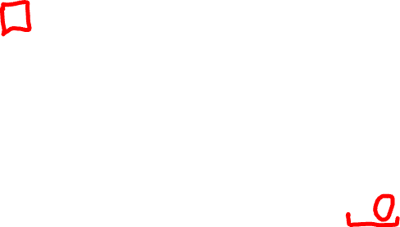
OS-SELECT(x, i)
r ← size[left[x]] + 1
if i = r
then return x
elseif i < r
then return OS-SELECT(left[x], i)
else return OS-SELECT(right[x], i - r)
Initial call: OS-SELECT(root[T], i)
Running time: O(lgn)
► compute the rank of x within the subtree rooted at x

Slide 8
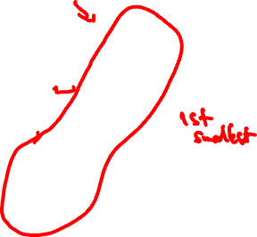
Example: OS-SELECT
OS-SELECT(root, 3)
10
r = 3 + 1 = 4
OS-SELECT(‘8’, 3)
7
r = 1 + 1 = 2
OS-SELECT(‘9’, 1)
8
15
3
3
4
9
11
19
1
1
1
1
r = 1
Found!

Slide 9
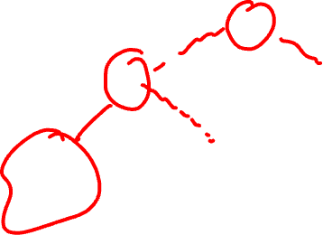
OS-RANK
Goal:
Given a pointer to a node x in an order-statistic tree, return the rank of x in the linear order determined by an inorder walk of T
Its parent plus the left
subtree if x is a right child
10
7
x
Idea:
Add elements in the left
subtree
Go up the tree and
if a right child: add
the elements in the left
subtree of the parent + 1
8
15
3
3
4
9
11
19
1
1
1
1
The elements in the left subtree

Slide 10
OS-RANK(T, x)
r ← size[left[x]] + 1
y ← x
while y ≠ root[T]
do if y = right[p[y]]
then r ← r + size[left[p[y]]] + 1
y ← p[y]
return r
Add to the rank the elements in
its left subtree + 1 for itself
Set y as a pointer that will traverse the tree
If a right child add the size of the parent’s left subtree + 1 for the parent
Running time: O(lgn)

Slide 11

Example: OS-RANK
26
20
y = root[T]
r = r + 12 + 1 = 17
17
12
41
7
y
r = r = 4
r = r + 1 + 1 = 4
14
7
21
4
y
30
5
47
1
x
y = x
10
4
16
2
19
2
21
1
28
1
38
3
r = 1 + 1 = 2
7
2
12
1
14
1
20
1
35
1
39
1
3
1

Slide 12
Maintaining Subtree Sizes
We need to maintain the size field during INSERT and DELETE operations
Need to maintain them efficiently
Otherwise, might have to recompute all size fields, at a cost of 𝝮(n)

Slide 13
Maintaining Size for OS-INSERT
Insert in a red-black tree has two stages
Perform a binary-search tree insert
Perform rotations and change node colors to restore red-black tree properties

Slide 14
OS-INSERT
Idea for maintaining the size field during insert
Phase 1 (going down):
Increment size[x] for each node x on the traversed path from the root to the leaves
The new node gets a size of 1
Constant work at each node, so still O(lgn)
10
7
8
15
3
3
4
9
11
19
1
1
1
1

Slide 15
OS-INSERT
Idea for maintaining the size field during insert
Phase 2 (going up):
During RB-INSERT-FIXUP there are:
O(lgn) changes in node colors
At most two rotations
Rotations affect the subtree sizes !!
42
x
93
y
size[y] = size[x]
19
19
LEFT-ROTATE(T, x)
6
93
y
42
x
7
12
size[x] = size[left[x]] +
size[right[x]] + 1
11
4
7
6
4
Maintain size in: O(lgn)

Slide 16
Augmenting a Data Structure
Choose an underlying data structure
Determine additional information to maintain
Verify that we can maintain additional information for existing data structure operations
Develop new operations
⇒ Red-black trees
⇒ size[x]
⇒ Shown how to maintain size during modifying operations
⇒ Developed OS-RANK and OS-SELECT

Slide 17
Augmenting Red-Black Trees
Theorem: Let f be a field that augments a red-black tree. If the contents of f for a node can be computed using only the information in x, left[x], right[x] ⇒ we can maintain the values of f in all nodes during insertion and deletion, without affecting their O(lgn) running time.

Slide 18
Examples
Can we augment a RBT with size[x]?
Yes: size[x] = size[left[x]] + size[right[x]] + 1
Can we augment a RBT with height[x]?
Yes: height[x] = 1 + max(height[left[x]], height[right[x]])
Can we augment a RBT with rank[x]?
No, inserting a new minimum will cause all n rank values to change

Slide 19
Interval Trees
Def.: Interval tree = a red-black tree that maintains a dynamic set of elements, each element x having associated an interval int[x].
Operations on interval trees:
INTERVAL-INSERT(T, x)
INTERVAL-DELETE(T, x)
INTERVAL-SEARCH(T, i)

Slide 20

Interval Properties
Intervals i and j overlap iff:
low[i] ≤ high[j] and low[j] ≤ high[i]
Intervals i and j do not overlap iff:
high[i] < low[j] or high[j] < low[i]
i
i
i
i
j
j
j
j
i
j
j
i

Slide 21
Interval Trichotomy
Any two intervals i and j satisfy the interval trichotomy: exactly one of the following three properties holds:
i and j overlap,
i is to the left of j (high[i] < low[j])
i is to the right of j (high[j] < low[i])

Slide 22
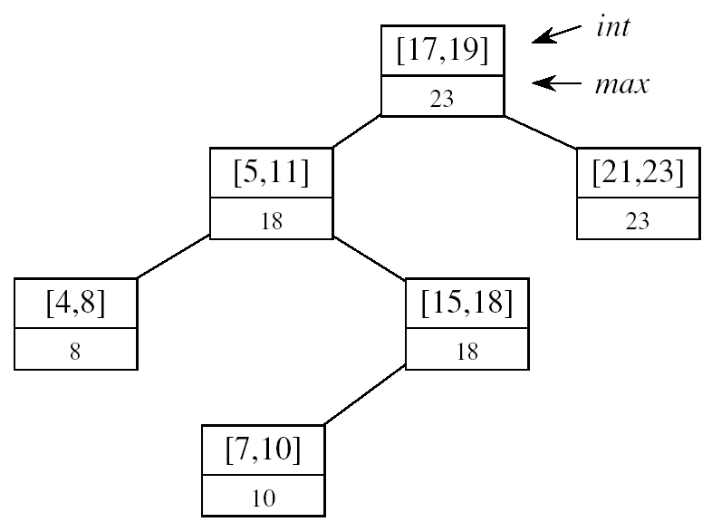
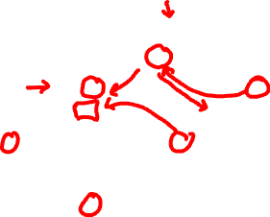
Designing Interval Trees
Underlying data structure
Red-black trees
Each node x contains: an interval int[x], and the key: low[int[x]]
An inorder tree walk will list intervals sorted by their low endpoint
Additional information
max[x] = maximum endpoint value in subtree rooted at x
Maintaining the information
max[x] =
Constant work at each node, so still O(lgn) time
high[int[x]]
max max[left[x]]
max[right[x]]

Slide 23
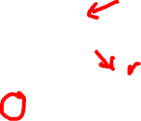
Designing Interval Trees
Develop new operations
INTERVAL-SEARCH(T, i):
Returns a pointer to an element x in the interval tree T, such that int[x] overlaps with i, or NIL otherwise
Idea:
Check if int[x]
overlaps with i
Max[left[x]] ≥ low[i]
Go left
Otherwise,
go right
low
high
[16, 21]
30
[22, 25]
[8, 9]
23
[25, 30]
30
[5, 8]
10
[15, 23]
23
[17, 19]
20
[26, 26]
26
[0, 3]
3
[6, 10]
10
[19, 20]
20

Slide 24

Example
i = [11, 14]
[16, 21]
30
x
i = [22, 25]
x
[8, 9]
23
[25, 30]
30
x
[5, 8]
10
[15, 23]
23
[17, 19]
20
[26, 26]
26
[0, 3]
3
[6, 10]
10
x = NIL
[19, 20]
20

Slide 25

INTERVAL-SEARCH(T, i)
x ← root[T]
while x ≠ nil[T] and i does not overlap int[x]
do if left[x] ≠ nil[T] and max[left[x]] ≥ low[i]
then x ← left[x]
else x ← right[x]
return x

Slide 26
Theorem
At the execution of interval search: if the search goes right, then either:
There is an overlap in right subtree, or
There is no overlap in either subtree
Similar when the search goes left
It is safe to always proceed in only one direction

Slide 27
Theorem
Proof: If search goes right:
If there is an overlap in right subtree, done
If there is no overlap in right ⇒ show there is no overlap in left
Went right because:
left[x] = nil[T] ⇒ no overlap in left, or
max[left[x]] < low[i] ⇒ no overlap in left
i
max[left[x]]
low[x]

Slide 28
Theorem - Proof
If search goes left:
If there is an overlap in left subtree, done
If there is no overlap in left, show there is no overlap in right
Went left because:
low[i] ≤ max[left[x]] = high[j] for some j in left subtree
int[root]
max
max[left]
[low[j], high[j]]
max[j]
[low[k], high[k]]
max[k]
i
j
i
k
No overlap!
high[i] < low[k]
high[i] < low[j]
high[j] < low[i]
low[j] < low[k]

Slide 29
Mid-term 2
Material up to this point included in the second midterm

Slide 30

Second Midterm Exam
Tuesday, April 2 in class
75 minutes
Exam structure:
TRUE/FALSE questions
short questions on the topics discussed in class
homework-like problems

Slide 31
Topics
All topics from midterm 1 up to dynamic programming
Randomized quicksort
Probability background
The selection problem
Sorting in linear time
Heaps
Augmenting data structures (RBT, OS-Trees, interval trees)

Slide 32
General Advice for Study
Understand how the algorithms are working
Work through the examples we did in class
“Narrate” for yourselves the main steps of the algorithms in a few sentences
Know when or for what problems the algorithms are applicable
Do not memorize algorithms

Slide 33
Dynamic Programming
An algorithm design technique used for optimization problems
Find a solution with the optimal value (minimum or maximum)
A set of choices must be made to get an optimal solution
There may be multiple solutions that return the optimal value: we want to find one of them

Slide 34
Dynamic Programming
Similar to divide and conquer, but with one key difference
Subproblems are not independent: subproblems share subsubproblems
Divide and conquer
Partition the problem into independent subproblems
Solve the subproblems recursively
Combine the solutions to solve the original problem

Slide 35
Dynamic Programming
Applicable when subproblems are not independent
Subproblems share subsubproblems
E.g.: Fibonacci numbers:
Recurrence: F(n) = F(n-1) + F(n-2)
Boundary conditions: F(1) = 0, F(2) = 1
Compute: F(5) = 3, F(3) = 1, F(4) = 2
A divide and conquer approach would repeatedly solve the common subproblems
Dynamic programming solves every subproblem just once and stores the answer in a table

Slide 36
Dynamic Programming Algorithm
Characterize the structure of an optimal solution
Recursively define the value of an optimal solution
Compute the value of an optimal solution in a bottom-up fashion
Construct an optimal solution from computed information

Slide 37
Elements of Dynamic Programming
Optimal Substructure
An optimal solution to a problem contains within it an optimal solution to subproblems
Optimal solution to the entire problem is built in a bottom-up manner from optimal solutions to subproblems
Overlapping Subproblems
If a recursive algorithm revisits the same subproblems again and again ⇒ the problem has overlapping subproblems

Slide 38
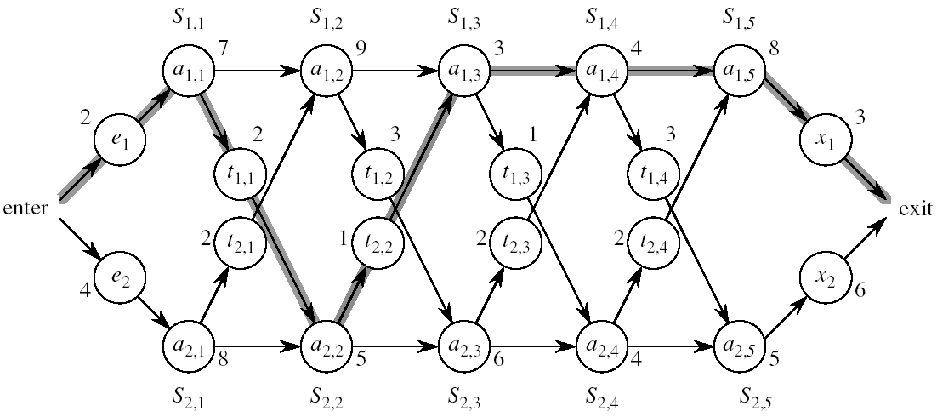
Assembly Line Scheduling
Automobile factory with two assembly lines
Each line has n stations: S_{1,1}, . . . , S_{1,n} and S_{2,1}, . . . , S_{2,n}
Corresponding stations S_{1, j} and S_{2, j} perform the same function but can take different amounts of time a_{1, j} and a_{2, j}
Times to enter are e₁ and e₂ and times to exit are x₁ and x₂

Slide 39
Assembly Line
After going through a station, the car can either:
stay on same line at no cost, or
transfer to other line: cost after S_{i,j} is t_{i,j} , i = 1, 2, j = 1, . . . , n-1

Slide 40
Assembly Line Scheduling
Problem:
What stations should be chosen from line 1 and what from line 2 in order to minimize the total time through the factory for one car?

Slide 41
One Solution
Brute force
Enumerate all possibilities of selecting stations
Compute how long it takes in each case and choose the best one
There are 2^{n} possible ways to choose stations
Infeasible when n is large
1
2
3
4
n
1
0
0
1
1
0 if choosing line 2
at step j (= 3)
1 if choosing line 1
at step j (= n)

Slide 42
1. Structure of the Optimal Solution
How do we compute the minimum time of going through the station?

Slide 43
Readings
For this lecture
Chapter 17, 14
Coming next
Sections 14.2-14.4

