Slide 1
Analysis of Algorithms CS 477/677
Instructor: Monica Nicolescu
Lecture 15

Slide 2
Dynamic Programming
An algorithm design technique used for optimization problems
Find a solution with the optimal value (minimum or maximum)
A set of choices must be made to get an optimal solution
There may be multiple solutions that return the optimal value: we want to find one of them

Slide 3
Dynamic Programming
Similar to divide and conquer, but with one key difference
Subproblems are not independent: subproblems share subsubproblems
Divide and conquer
Partition the problem into independent subproblems
Solve the subproblems recursively
Combine the solutions to solve the original problem

Slide 4
Dynamic Programming
Applicable when subproblems are not independent
Subproblems share subsubproblems
E.g.: Fibonacci numbers:
Recurrence: F(n) = F(n-1) + F(n-2)
Boundary conditions: F(1) = 0, F(2) = 1
Compute: F(5) = 3, F(3) = 1, F(4) = 2
A divide and conquer approach would repeatedly solve the common subproblems
Dynamic programming solves every subproblem just once and stores the answer in a table

Slide 5
Dynamic Programming Algorithm
Characterize the structure of an optimal solution
Recursively define the value of an optimal solution
Compute the value of an optimal solution in a bottom-up fashion
Construct an optimal solution from computed information

Slide 6
Elements of Dynamic Programming
Optimal Substructure
An optimal solution to a problem contains within it an optimal solution to subproblems
Optimal solution to the entire problem is built in a bottom-up manner from optimal solutions to subproblems
Overlapping Subproblems
If a recursive algorithm revisits the same subproblems again and again ⇒ the problem has overlapping subproblems

Slide 7
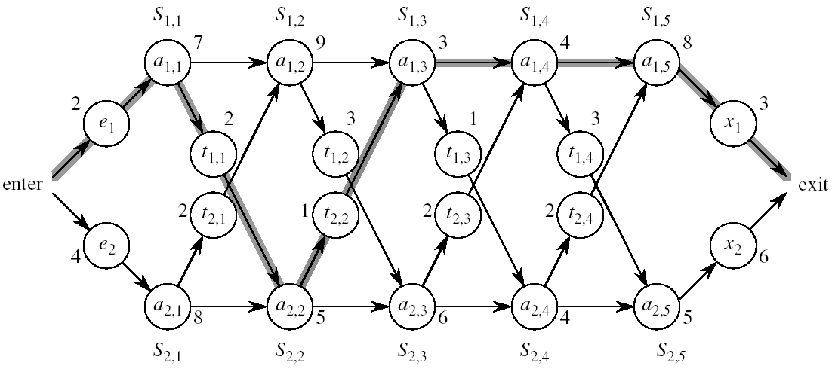
Assembly Line Scheduling
Automobile factory with two assembly lines
Each line has n stations: S_{1,1}, . . . , S_{1,n} and S_{2,1}, . . . , S_{2,n}
Corresponding stations S_{1, j} and S_{2, j} perform the same function but can take different amounts of time a_{1, j} and a_{2, j}
Times to enter are e₁ and e₂ and times to exit are x₁ and x₂

Slide 8
Assembly Line
After going through a station, the car can either:
stay on same line at no cost, or
transfer to other line: cost after S_{i,j} is t_{i,j} , i = 1, 2, j = 1, . . . , n-1

Slide 9
Assembly Line Scheduling
Problem:
What stations should be chosen from line 1 and what from line 2 in order to minimize the total time through the factory for one car?

Slide 10
One Solution
Brute force
Enumerate all possibilities of selecting stations
Compute how long it takes in each case and choose the best one
There are 2^{n} possible ways to choose stations
Infeasible when n is large
1
2
3
4
n
1
0
0
1
1
0 if choosing line 2
at step j (= 3)
1 if choosing line 1
at step j (= n)

Slide 11
1. Structure of the Optimal Solution
How do we compute the minimum time of going through the station?

Slide 12
1. Structure of the Optimal Solution
Let’s consider all possible ways to get from the starting point through station S_{1,j}
We have two choices of how to get to S_{1, j}:
Through S_{1, j - 1}, then directly to S_{1, j}
Through S_{2, j - 1}, then transfer over to S_{1, j}
S_{1,j-1}
S_{1,j}
a_{1,j-1}
a_{1,j}
t_{2,j-1}
a_{2,j-1}
S_{2,j-1}

Slide 13
1. Structure of the Optimal Solution
Suppose that the fastest way through S_{1, j} is through S_{1, j – 1}
We must have taken the fastest way from entry through S_{1, j – 1}
If there were a faster way through S_{1, j - 1}, we would use it instead
Similarly for S_{2, j – 1}
S_{1,j-1}
S_{1,j}
a_{1,j-1}
a_{1,j}
t_{2,j-1}
a_{2,j-1}
S_{2,j-1}

Slide 14
Optimal Substructure
Generalization: an optimal solution to the problem find the fastest way through S_{1, j} contains within it an optimal solution to subproblems: find the fastest way through S_{1, j - 1} or S_{2, j - 1}.
This is referred to as the optimal substructure property
We use this property to construct an optimal solution to a problem from optimal solutions to subproblems

Slide 15

2. A Recursive Solution
Define the value of an optimal solution in terms of the optimal solution to subproblems
Assembly line subproblems
Finding the fastest way through each station j on each line i
(i = 1,2, j = 1, 2, …, n)

Slide 16
2. A Recursive Solution
f* = the fastest time to get through the entire factory
f_{i}[j] = the fastest time to get from the starting point through station S_{i,j}
f* = min (f₁[n] + x₁, f₂[n] + x₂)

Slide 17
2. A Recursive Solution
f_{i}[j] = the fastest time to get from the starting point through station S_{i,j}
j = 1 (getting through station 1)
f₁[1] = e₁ + a_{1,1}
f₂[1] = e₂ + a_{2,1}

Slide 18
2. A Recursive Solution
Compute f_{i}[j] for j = 2, 3, …,n, and i = 1, 2
Fastest way through S_{1, j} is either:
the way through S_{1, j - 1} then directly through S_{1, j}, or
f₁[j - 1] + a_{1,j}
the way through S_{2, j - 1}, transfer from line 2 to line 1, then through S_{1, j}
f₂[j -1] + t_{2,j-1} + a_{1,j}
f₁[j] = min(f₁[j - 1] + a_{1,j} ,f₂[j -1] + t_{2,j-1} + a_{1,j})
S_{1,j-1}
S_{1,j}
a_{1,j-1}
a_{1,j}
t_{2,j-1}
a_{2,j-1}
S_{2,j-1}

Slide 19
2. A Recursive Solution
e₁ + a_{1,1} if j = 1
f₁[j] =
min(f₁[j - 1] + a_{1,j} ,f₂[j -1] + t_{2,j-1} + a_{1,j}) if j ≥ 2
e₂ + a_{2,1} if j = 1
f₂[j] =
min(f₂[j - 1] + a_{2,j} ,f₁[j -1] + t_{1,j-1} + a_{2,j}) if j ≥ 2

Slide 20
3. Computing the Optimal Value
f* = min (f₁[n] + x₁, f₂[n] + x₂)
f₁[j] = min(f₁[j - 1] + a_{1,j} ,f₂[j -1] + t_{2,j-1} + a_{1,j})
Solving top-down would result in exponential running time
1
2
3
4
5
f₁[j]
f₁(1)
f₁(2)
f₁(3)
f₁(4)
f₁(5)
f₂[j]
f₂(1)
f₂(2)
f₂(3)
f₂(4)
f₂(5)
4 times
2 times

Slide 21
3. Computing the Optimal Value
For j ≥ 2, each value f_{i}[j] depends only on the values of f₁[j – 1] and f₂[j - 1]
Compute the values of f_{i}[j]
in increasing order of j
Bottom-up approach
First find optimal solutions to subproblems
Find an optimal solution to the problem from the subproblems
increasing j
1
2
3
4
5
f₁[j]
f₂[j]

Slide 22
4. Construct the Optimal Solution
We need the information about which line has been used at each station:
l_{i}[j] – the line number (1, 2) whose station (j - 1) has been used to get in fastest time through S_{i,j}, j = 2, 3, …, n
l* – the line number (1, 2) whose station n has been used to get in fastest time through the exit point
increasing j
2
3
4
5
l₁[j]
l₂[j]

Slide 23
FASTEST-WAY(a, t, e, x, n)
f₁[1] ← e₁ + a_{1,1}
f₂[1] ← e₂ + a_{2,1}
for j ← 2 to n
do if f₁[j - 1] + a_{1,j} ≤ f₂[j - 1] + t_{2, j-1} + a_{1, j}
then f₁[j] ← f₁[j - 1] + a_{1, j}
l₁[j] ← 1
else f₁[j] ← f₂[j - 1] + t_{2, j-1} + a_{1, j}
l₁[j] ← 2
if f₂[j - 1] + a_{2, j} ≤ f₁[j - 1] + t_{1, j-1} + a_{2, j}
then f₂[j] ← f₂[j - 1] + a_{2, j}
l₂[j] ← 2
else f₂[j] ← f₁[j - 1] + t_{1, j-1} + a_{2, j}
l₂[j] ← 1
Compute initial values of f₁ and f₂
Compute the values of
f₁[j] and l₁[j]
Compute the values of
f₂[j] and l₂[j]

Slide 24
FASTEST-WAY(a, t, e, x, n) (cont.)
if f₁[n] + x₁ ≤ f₂[n] + x₂
then f* = f₁[n] + x₁
l* = 1
else f* = f₂[n] + x₂
l* = 2
Compute the values of
the fastest time through the
entire factory

Slide 25
Example
e₁ + a_{1,1}, if j = 1
f₁[j] = min(f₁[j - 1] + a_{1,j} ,f₂[j -1] + t_{2,j-1} + a_{1,j}) if j ≥ 2
1
2
3
4
5
f₁[j]
9
18^{[1]}
20^{[2]}
24^{[1]}
32^{[1]}
f* = 35^{[1]}
f₂[j]
12
16^{[1]}
22^{[2]}
25^{[1]}
30^{[2]}

Slide 26
4. Construct an Optimal Solution
Alg.: PRINT-STATIONS(l, n)
i ← l*
print “line ” i “, station ” n
for j ← n downto 2
do i ←l_{i}[j]
print “line ” i “, station ” j - 1
line 1, station 5
line 1, station 4
line 1, station 3
line 2, station 2
line 1, station 1
1
2
3
4
5
f₁[j] ^{l1[j]}
9
18^{[1]}
20^{[2]}
24^{[1]}
32^{[1]}
l* = 1
f₂[j] ^{l2[j]}
12
16^{[1]}
22^{[2]}
25^{[1]}
30^{[2]}

Slide 27
Readings
For this lecture
Chapter 14
Coming next
Chapter 14

