Slide 1
Analysis of Algorithms CS 477/677
Instructor: Monica Nicolescu
Lecture 16

Slide 2
Dynamic Programming
An algorithm design technique used for optimization problems
Find a solution with the optimal value (minimum or maximum)
A set of choices must be made to get an optimal solution
There may be multiple solutions that return the optimal value: we want to find one of them

Slide 3
Dynamic Programming Algorithm
Characterize the structure of an optimal solution
Top down: how can an optimal value for a problem be obtained from combinations of optimal solutions to similar, smaller problems of the same type
Recursively define the value of an optimal solution
Top down: write a recursive formula based on the step above
Compute the value of an optimal solution
Bottom up: compute “smaller subproblems” first, store values and choices made at each step
Construct an optimal solution
Top down: start with last choice made and backtrack, finding all choices made

Slide 4
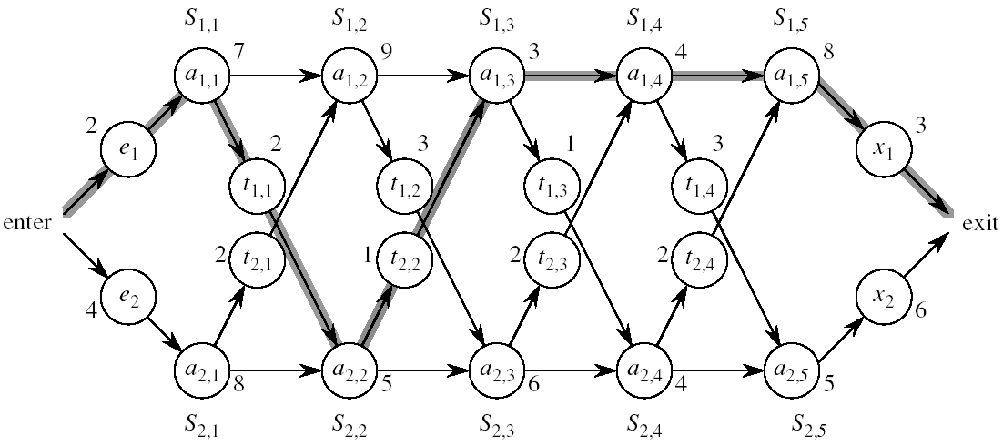
Assembly Line Scheduling
Problem:
What stations should be chosen from line 1 and what from line 2 in order to minimize the total time through the factory for one car?

Slide 5

Dynamic Programming Algorithm
Characterize the structure of an optimal solution
Fastest time through a station depends on the fastest time on previous stations
Recursively define the value of an optimal solution
f₁[j] = min(f₁[j - 1] + a_{1,j} ,f₂[j -1] + t_{2,j-1} + a_{1,j})
Compute the value of an optimal solution in a bottom-up fashion
Fill in the fastest time table in increasing order of j (station #)
Construct an optimal solution from computed information
Use an additional table to help reconstruct the optimal solution

Slide 6
Matrix-Chain Multiplication
Problem: given a sequence ⟨A₁, A₂, …, A_{n}⟩ of matrices, compute the product:
A₁ ∙ A₂ ∙∙∙ A_{n}
Matrix compatibility:
C = A ∙ B
col_{A} = row_{B}
row_{C} = row_{A}
col_{C} = col_{B}
A₁ ∙ A₂ ∙ A_{i} ∙ A_{i+1} ∙∙∙ A_{n}
col_{i} = row_{i+1}

Slide 7
Matrix-Chain Multiplication
In what order should we multiply the matrices?
A₁ ∙ A₂ ∙∙∙ A_{n}
Matrix multiplication is associative:
E.g.: A₁ ∙ A₂ ∙ A₃ = ((A₁ ∙ A₂) ∙ A₃)
= (A₁ ∙ (A₂ ∙ A₃))
Which one of these orderings should we choose?
The order in which we multiply the matrices has a significant impact on the overall cost of executing the entire chain of multiplications

Slide 8
MATRIX-MULTIPLY(A, B)
if columns[A] ≠ rows[B]
then error “incompatible dimensions”
else for i ← 1 to rows[A]
do for j ← 1 to columns[B]
do C[i, j] = 0
for k ← 1 to columns[A]
do C[i, j] ←C[i, j] + A[i, k] B[k, j]
rows[A] ∙ cols[A] ∙ cols[B]
multiplications
k
j
cols[B]
j
cols[B]
i
*
=
i
k
A
B
C
rows[A]
rows[A]

Slide 9
Example
A₁ ∙ A₂ ∙ A₃
A₁: 10 x 100
A₂: 100 x 5
A₃: 5 x 50
((A₁ ∙ A₂) ∙ A₃): A₁ ∙ A₂ takes 10 x 100 x 5 = 5,000
(its size is 10 x 5)
((A₁ ∙ A₂) ∙ A₃) takes 10 x 5 x 50 = 2,500
Total: 7,500 scalar multiplications
2. (A₁ ∙ (A₂ ∙ A₃)): A₂ ∙ A₃ takes 100 x 5 x 50 = 25,000
(its size is 100 x 50)
(A₁ ∙ (A₂ ∙ A₃)) takes 10 x 100 x 50 = 50,000
Total: 75,000 scalar multiplications
one order of magnitude difference!!

Slide 10
Matrix-Chain Multiplication
Given a chain of matrices ⟨A₁, A₂, …, A_{n}⟩, where for i = 1, 2, …, n matrix A_{i} has dimensions p_{i-1}x p_{i}, fully parenthesize the product A₁ ∙A₂ ∙∙∙A_{n} in a way that minimizes the number of scalar multiplications.
A₁ ∙ A₂ ∙∙∙ A_{i} ∙ A_{i+1} ∙∙∙ A_{n}
p₀ x p₁ p₁ x p₂ p_{i-1} x p_{i} p_{i} x p_{i+1} p_{n-1} x p_{n}

Slide 11

1. The Structure of an Optimal Parenthesization
Notation:
A_{i…j} = A_{i} A_{i+1} ∙∙∙A_{j}, i ≤ j
For i < j:
A_{i…j} = A_{i} A_{i+1} ∙∙∙ A_{j}
= A_{i} A_{i+1} ∙∙∙ A_{k} A_{k+1} ∙∙∙ A_{j}
= A_{i…k} A_{k+1…j}
Suppose that an optimal parenthesization of A_{i…j} splits the product between A_{k} and A_{k+1}, where i ≤ k < j

Slide 12

Optimal Substructure
A_{i…j} = A_{i…k} A_{k+1…j}
The parenthesization of the “prefix” A_{i…k} must be an optimal parentesization
If there were a less costly way to parenthesize A_{i…k}, we could substitute that one in the parenthesization of A_{i…j} and produce a parenthesization with a lower cost than the optimum ⇒ contradiction!
An optimal solution to an instance of the matrix-chain multiplication contains within it optimal solutions to subproblems

Slide 13

2. A Recursive Solution
Subproblem:
determine the minimum cost of parenthesizing A_{i…j} = A_{i} A_{i+1} ∙∙∙A_{j} for 1 ≤ i ≤ j ≤ n
Let m[i, j] = the minimum number of multiplications needed to compute A_{i…j}
Full problem (A_{1..n}): m[1, n]
i = j: A_{i…i} = A_{i} ⇒ m[i, i] =
0, for i = 1, 2, …, n

Slide 14
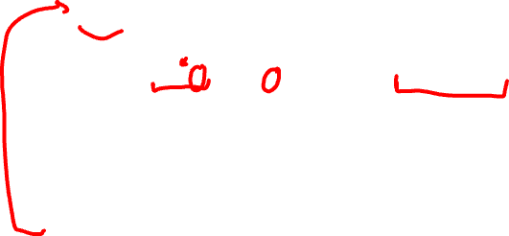
2. A Recursive Solution
Consider the subproblem of parenthesizing A_{i…j} = A_{i} A_{i+1} ∙∙∙A_{j} for 1 ≤ i ≤ j ≤ n
= A_{i…k} A_{k+1…j} for i ≤ k < j
Assume that the optimal parenthesization splits the product A_{i} A_{i+1} ∙∙∙ A_{j} at k (i ≤ k < j)
m[i, j] =
p_{i-1}p_{k}p_{j}
m[i, k]
m[k+1,j]
m[i, k] + m[k+1, j] + p_{i-1}p_{k}p_{j}
min # of multiplications
to compute A_{i…k}
min # of multiplications
to compute A_{k+1…j}
# of multiplications
to compute A_{i…k}A_{k…j}

Slide 15

2. A Recursive Solution
m[i, j] = m[i, k] + m[k+1, j] + p_{i-1}p_{k}p_{j}
We do not know the value of k
There are j – i possible values for k: k = i, i+1, …, j-1
Minimizing the cost of parenthesizing the product A_{i} A_{i+1} ∙∙∙ A_{j} becomes:
0 if i = j
m[i, j] = min {m[i, k] + m[k+1, j] + p_{i-1}p_{k}p_{j}} if i < j
^{i≤ k<j}

Slide 16
3. Computing the Optimal Costs
0 if i = j
m[i, j] = min {m[i, k] + m[k+1, j] + p_{i-1}p_{k}p_{j}} if i < j
^{i≤k<j}
How many subproblems do we have?
Parenthesize A_{i…j}
for 1 ≤ i ≤ j ≤ n
One subproblem for each
choice of i and j
1
2
3
n
⇒ Θ (n²)
n
j
3
2
1
i

Slide 17
3. Computing the Optimal Costs
0 if i = j
m[i, j] = min {m[i, k] + m[k+1, j] + p_{i-1}p_{k}p_{j}} if i < j
^{i≤k<j}
How do we fill in table m[1..n, 1..n]?
Determine which entries of the table are used in computing m[i, j]
A_{i…j} = A_{i…k} A_{k+1…j}
Fill in m such that it corresponds to solving problems of increasing length

Slide 18
3. Computing the Optimal Costs
0 if i = j
m[i, j] = min {m[i, k] + m[k+1, j] + p_{i-1}p_{k}p_{j}} if i < j
^{i≤k<j}
Length = 1: i = j, i = 1, 2, …, n
Length = 2: j = i + 1, i = 1, 2, …, n-1
second
1
2
3
n
first
n
m[1, n] gives the optimal
solution to the problem
j
Compute elements on each diagonal, starting with the longest diagonal.
In a similar matrix s we keep the optimal values of k.
3
2
1
i

Slide 19

Example: min {m[i, k] + m[k+1, j] + p_{i-1}p_{k}p_{j}}
m[2, 2] + m[3, 5] + p₁p₂p₅
m[2, 3] + m[4, 5] + p₁p₃p₅
m[2, 4] + m[5, 5] + p₁p₄p₅
k = 2
m[2, 5] = min
k = 3
k = 4
1
2
3
4
5
6
6
5
Values m[i, j] depend only on values that have been previously computed
4
j
3
2
1
i

Slide 20
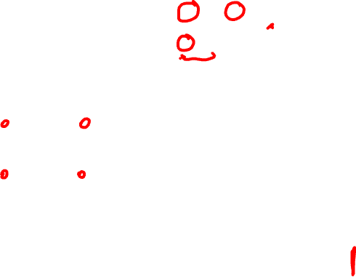
Example min {m[i, k] + m[k+1, j] + p_{i-1}p_{k}p_{j}}
1
2
3
Compute A₁ ∙ A₂ ∙ A₃
A₁: 10 x 100 (p₀ x p₁)
A₂: 100 x 5 (p₁ x p₂)
A₃: 5 x 50 (p₂ x p₃)
m[i, i] = 0 for i = 1, 2, 3
m[1, 2] = m[1, 1] + m[2, 2] + p₀p₁p₂ (A₁A₂)
= 0 + 0 + 10 *100* 5 = 5,000
m[2, 3] = m[2, 2] + m[3, 3] + p₁p₂p₃ (A₂A₃)
= 0 + 0 + 100 * 5 * 50 = 25,000
m[1, 3] = min m[1, 1] + m[2, 3] + p₀p₁p₃ = 75,000 (A₁(A₂A₃))
m[1, 2] + m[3, 3] + p₀p₂p₃ = 7,500 ((A₁A₂)A₃)
3
2
2
7500
25000
0
2
1
5000
0
1
0

Slide 21
4. Construct the Optimal Solution
Top-down approach
Store the optimal choice made at each subproblem
s[i, j] = a value of k such that an optimal parenthesization of A_{i..j} splits the product between A_{k} and A_{k+1}
1
2
3
n
n
 |  | k
j
3
2
1
i

Slide 22
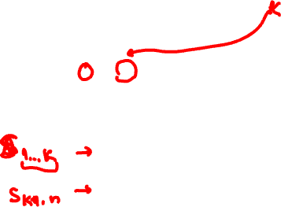
4. Construct the Optimal Solution
s[1, n] is associated with the entire product A_{1..n}
The final matrix multiplication will be split at k = s[1, n]
A_{1..n} = A_{1..k} ∙ A_{k+1..n}
A_{1..n} = A_{1..s[1, n]} ∙ A_{s[1, n]+1..n}
For each subproduct recursively find the corresponding value of k that results in an optimal parenthesization
1
2
3
n
n
j
3
2
1
i

Slide 23

4. Construct the Optimal Solution
s[i, j] = value of k such that the optimal parenthesization of A_{i} A_{i+1} ∙∙∙A_{j} splits the product between A_{k} and A_{k+1}
1
2
3
4
5
6
6
3 | 3 | 3 | 5 | 5 | -
3 | 3 | 3 | 4 | -
3 | 3 | 3 | -
1 | 2 | -
1 | -
-
s[1, n] = 3 ⇒ A_{1..6} = A_{1..3} A_{4..6}
s[1, 3] = 1 ⇒ A_{1..3} = A_{1..1} A_{2..3}
s[4, 6] = 5 ⇒ A_{4..6} = A_{4..5} A_{6..6}
5
4
3
j
2
1
i

Slide 24

4. Construct the Optimal Solution
PRINT-OPT-PARENS(s, i, j)
if i = j
then print “A”_{i}
else
print “(”
PRINT-OPT-PARENS(s, i, s[i, j])
PRINT-OPT-PARENS(s, s[i, j] + 1, j)
print “)”
1
2
3
4
5
6
6
3 | 3 | 3 | 5 | 5 | -
3 | 3 | 3 | 4 | -
3 | 3 | 3 | -
1 | 2 | -
1 | -
-
5
4
j
3
2
1
i

Slide 25
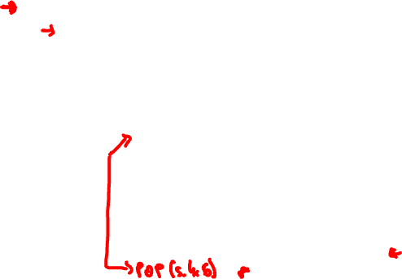
Example: A₁∙∙∙A₆
(
(
A₁
(
A₂
A₃
)
)
( ( A₄ A₅ ) A₆ ) )
s[1..6, 1..6]
1
2
3
4
5
6
PRINT-OPT-PARENS(s, i, j)
if i = j
then print “A”_{i}
else print “(”
PRINT-OPT-PARENS(s, i, s[i, j])
PRINT-OPT-PARENS(s, s[i, j] + 1, j)
print “)”
6
3 | 3 | 3 | 5 | 5 | -
3 | 3 | 3 | 4 | -
3 | 3 | 3 | -
1 | 2 | -
1 | -
-
5
4
j
3
2
1
P-O-P(s, 1, 6) s[1, 6] = 3
i = 1, j = 6 “(“ P-O-P (s, 1, 3) s[1, 3] = 1
i = 1, j = 3 “(“ P-O-P(s, 1, 1) ⇒ “A₁”
P-O-P(s, 2, 3) s[2, 3] = 2
i = 2, j = 3 “(“ P-O-P (s, 2, 2) ⇒ “A₂”
P-O-P (s, 3, 3) ⇒ “A₃”
“)”
“)”
i
…

Slide 26
Readings
For this lecture
Sections 6.3, 6,5
Chapter 13
Coming next
Chapter 17

