Slide 1
Analysis of Algorithms CS 477/677
Instructor: Monica Nicolescu
Lecture 18

Slide 2
Longest Common Subsequence
Given two sequences
X = ⟨x₁, x₂, …, x_{m}⟩
Y = ⟨y₁, y₂, …, y_{n}⟩
find a maximum length common subsequence (LCS) of X and Y
E.g.:
X = ⟨A, B, C, B, D, A, B⟩
Subsequence of X:
A subset of elements in the sequence taken in order (but not necessarily consecutive)
⟨A, B, D⟩, ⟨B, C, D, B⟩, etc.

Slide 3
Recursive Solution
0 if i,j = 0
c[i, j] = c[i-1, j-1] + 1 if x_{i} = y_{j}
max(c[i, j-1], c[i-1, j]) if x_{i} ≠ y_{j}
A matrix b[i, j]:
For a subproblem [i, j] it tells us what choice was made to obtain the optimal value
If x_{i} = y_{j}
b[i, j] = “ ”
Else, if c[i - 1, j] ≥ c[i, j-1]
b[i, j] = “ ↑ ”
else
b[i, j] = “ ←”
b & c:
0
1
2
3
n
y_{j:}
A
C
D
F
0
x_{i}
0 | 0 | 0 | 0 | 0 | 0
0
0
0
0
0
1
A
2
B
c[i-1,j]
i
3
C
c[i,j-1]
m
D
j

Slide 4
Improving the Code
What can we say about how each entry c[i, j] is computed?
It depends only on c[i -1, j - 1], c[i - 1, j], and c[i, j - 1]
Eliminate table b and compute in O(1) which of the three values was used to compute c[i, j]
We save Θ(mn) space from table b
However, we do not asymptotically decrease the auxiliary space requirements: still need table c

Slide 5
Improving the Code
If we only need the length of the LCS
LCS-LENGTH works only on two rows of c at a time
The row being computed and the previous row
We can reduce the asymptotic space requirements by storing only these two rows

Slide 6

Weighted Interval Scheduling
Job j starts at s_{j}, finishes at f_{j}, and has weight or value v_{j}
Two jobs are compatible if they don't overlap
Goal: find maximum weight subset of mutually compatible jobs
a
b
c
d
e
f
g
h
Time
0
1
2
3
4
5
6
7
8
9
10
11

Slide 7
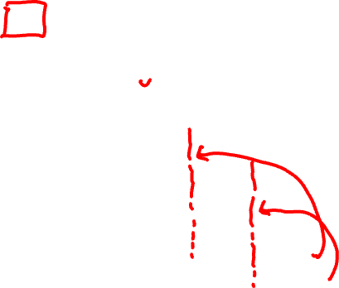
Weighted Interval Scheduling
Label jobs by finishing time: f₁ ≤ f₂ ≤ . . . ≤ f_{n}
Def. p(j) = largest index i < j such that job i is compatible with j
Ex: p(8) = 5, p(7) = 3, p(2) = 0
1
1
2
2
3
3
4
4
5
5
6
6
7
7
8
8
Time
0
1
2
3
4
5
6
7
8
9
10
11

Slide 8
1. Making the Choice
OPT(j) = value of optimal solution to the problem consisting of job requests 1, 2, ..., j
Case 1: OPT selects job j
Can't use incompatible jobs { p(j) + 1, p(j) + 2, ..., j - 1 }
Must include optimal solution to problem consisting of remaining compatible jobs 1, 2, ..., p(j)
Case 2: OPT does not select job j
Must include optimal solution to problem consisting of remaining compatible jobs 1, 2, ..., j-1
optimal substructure

Slide 9
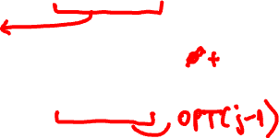
2. A Recursive Solution
OPT(j) = value of optimal solution to the problem consisting of job requests 1, 2, ..., j
Case 1: OPT selects job j
Can't use incompatible jobs { p(j) + 1, p(j) + 2, ..., j - 1 }
Must include optimal solution to problem consisting of remaining compatible jobs 1, 2, ..., p(j)
OPT(j) = v_{j} + OPT(p(j))
Case 2: OPT does not select job j
Must include optimal solution to problem consisting of remaining compatible jobs 1, 2, ..., j-1
OPT(i) = OPT(j-1)

Slide 10
Top-Down Recursive Algorithm
WRONG!
Input: n, s₁,…,s_{n ,} f₁,…,f_{n ,} v₁,…,v_{n}
Sort jobs by finish times so that f₁ ≤ f₂ ≤ ... ≤ f_{n}
Compute p(1), p(2), …, p(n)
Compute-Opt(j)
{
if (j = 0)
return 0
else
return max(v_{j} + Compute-Opt(p(j)), Compute-Opt(j-1))
}

Slide 11
Top-Down Recursive Algorithm
Recursive algorithm fails because of redundant sub-problems ⇒ exponential algorithms
Number of recursive calls for family of "layered" instances grows like Fibonacci sequence
Needs solutions for j-1 and j-2 at each call
5
1
4
3
2
3
3
2
2
1
4
2
1
1
0
1
0
5
p(1) = 0, p(j) = j-2
1
0

Slide 12
3. Compute the Optimal Value
Compute values in increasing order of j
Input: n, s₁,…,s_{n ,} f₁,…,f_{n ,} v₁,…,v_{n}
Sort jobs by finish times so that f₁ ≤ f₂ ≤ ... ≤ f_{n}
Compute p(1), p(2), …, p(n)
Iterative-Compute-Opt
{
M[0] = 0
for j = 1 to n
M[j] = max(v_{j} + M[p(j)], M[j-1])
}

Slide 13

Memoized Version
Store results of each sub-problem; lookup as needed
Input: n, s₁,…,s_{n ,} f₁,…,f_{n ,} v₁,…,v_{n}
Sort jobs by finish times so that f₁ ≤ f₂ ≤ ... ≤ f_{n}.
Compute p(1), p(2), …, p(n)
for j = 1 to n
M[j] = empty
M[j] = 0
M-Compute-Opt(j)
{
if (M[j] is empty)
M[j] = max(v_{j} + M-Compute-Opt(p(j)), M-Compute-Opt(j-1))
return M[j]
}
global array

Slide 14
Analysis of Running Time
Memoized version of algorithm takes O(n log n)
Sort by finish time: O(n log n)
Computing p(∙) : O(n) after sorting by start time
M-Compute-Opt(j): each invocation takes O(1) time and either
(i) returns an existing value M[j]
(ii) fills in one new entry M[j] and makes two recursive calls
Progress measure Φ = # nonempty entries of M[].
initially Φ = 0, throughout Φ ≤ n.
(ii) increases Φ by 1 ⇒ at most 2n recursive calls.
Overall running time of M-Compute-Opt(n) is O(n).
Running time: O(n) if jobs are pre-sorted by start and finish times

Slide 15
4. Finding the Optimal Solution
Two options
Store additional information: at each time step store either j or p(j) – value that gave the optimal solution
Recursively find the solution by iterating through array M
Find-Solution(j)
{
if (j = 0)
output nothing
else if (v_{j} + M[p(j)] > M[j-1])
print j
Find-Solution(p(j))
else
Find-Solution(j-1)
}

Slide 16
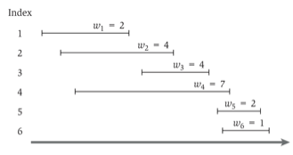







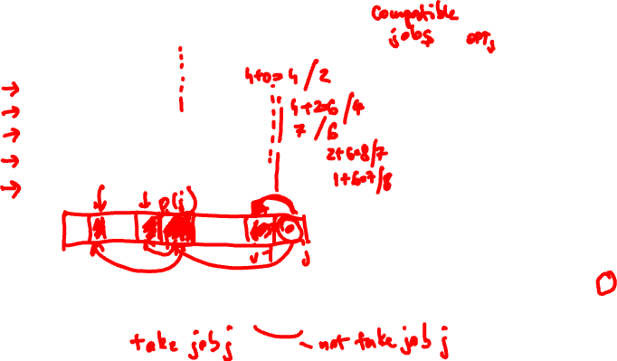
An Example

Slide 17
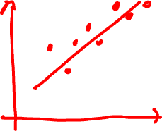
Segmented Least Squares
Least squares
Foundational problem in statistic and numerical analysis
Given n points in the plane: (x₁, y₁), (x₂, y₂) , . . . , (x_{n}, y_{n})
Find a line y = ax + b that minimizes the sum of the squared error:
Solution – closed form
Minimum error is achieved when
y
x
Notes:
the term "regression" stems from the work of Sir Francis Galton (1822-1911), a famous geneticist, who studied the heights of fathers and their sons. He found that offspring of a parent of larger than average height tended to be smaller than their parents, and offspring of parents of smaller than average size tended to be larger than their parents. "regression toward mediocrity".
Gauss (1809-1811) used Gaussian elimination to solve multiple linear regression
Gauss-Markov theorem (least squares estimates are uniformly minimum variance estimates (UMVUE) among all linear unbiased estimates)

Slide 18
Segmented Least Squares
Segmented least squares
Points lie roughly on a sequence of several line segments
Given n points in the plane (x₁, y₁), (x₂, y₂) , . . . , (x_{n}, y_{n}) with x₁ < x₂ < ... < x_{n}, find a sequence of lines that minimizes f(x)
What is a reasonable
choice for f(x) to balance
accuracy and parsimony?
y
goodness of fit
number of lines
x

Slide 19
Segmented Least Squares
Segmented least squares
Points lie roughly on a sequence of several line segments
Given n points in the plane (x₁, y₁), (x₂, y₂) , . . . , (x_{n}, y_{n}) with x₁ < x₂ < ... < x_{n}, find a sequence of lines that minimizes:
the sum of the sums of the squared errors E in each segment
the number of lines L
Tradeoff function:
E + c L, for some constant
c > 0
y
x

Slide 20

(1,2) Making the Choice and Recursive Solution
Notation
OPT(j) = minimum cost for points p₁, p_{i+1} , . . . , p_{j}
e(i, j) = minimum sum of squares for points p_{i}, p_{i+1}, .. , p_{j}
To compute OPT(j)
Last segment uses points p_{i}, p_{i+1} , . . . , p_{j} for some i
Cost = e(i, j) + c + OPT(i-1)

Slide 21

3. Compute the Optimal Value
INPUT: n, p₁,…,p_{N ,} c
Segmented-Least-Squares() {
M[0] = 0
for j = 1 to n
for i = 1 to j
compute the least square error e_{ij} for the segment p_{i},…, p_{j}
for j = 1 to n
M[j] = min _{1 ≤ i ≤ j} (e_{ij} + c + M[i-1])
return M[n]
}
Running time: O(n³)
Bottleneck = computing e(i, j) for O(n²) pairs, O(n) per pair using previous formula

Slide 22
Greedy Algorithms
Similar to dynamic programming, but simpler approach
Also used for optimization problems
Idea: When we have a choice to make, make the one that looks best right now
Make a locally optimal choice in the hope of getting a globally optimal solution
Greedy algorithms don’t always yield an optimal solution
When the problem has certain general characteristics (greedy choice property), greedy algorithms give optimal solutions

Slide 23

Activity Selection
Problem
Schedule the largest possible set of non-overlapping activities for a given room
 | Start | End | Activity
1 | 8:00am | 9:15am | Numerical methods class
2 | 8:30am | 10:30am | Movie presentation (refreshments served)
3 | 9:20am | 11:00am | Data structures class
4 | 10:00am | noon | Programming club mtg. (Pizza provided)
5 | 11:30am | 1:00pm | Computer graphics class
6 | 1:05pm | 2:15pm | Analysis of algorithms class
7 | 2:30pm | 3:00pm | Computer security class
8 | noon | 4:00pm | Computer games contest (refreshments served)
9 | 4:00pm | 5:30pm | Operating systems class

Slide 24
Activity Selection
Schedule n activities that require exclusive use of a common resource
S = {a₁, . . . , a_{n}} – set of activities
a_{i} needs resource during period [s_{i} , f_{i})
s_{i} = start time and f_{i} = finish time of activity a_{i}
0 ≤ s_{i} < f_{i} < ∞
Activities a_{i} and a_{j} are compatible if the intervals [s_{i} , f_{i}) and [s_{j}, f_{j}) do not overlap
f_{i} ≤ s_{j}
f_{j} ≤ s_{i}
i
j
j
i

Slide 25
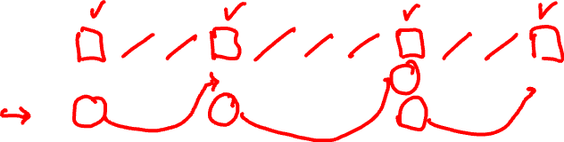
Activity Selection Problem
Select the largest possible set of non-overlapping (compatible) activities.
E.g.:
i | 1 | 2 | 3 | 4 | 5 | 6 | 7 | 8 | 9 | 10 | 11
s_{i} | 1 | 3 | 0 | 5 | 3 | 5 | 6 | 8 | 8 | 2 | 12
f_{i} | 4 | 5 | 6 | 7 | 8 | 9 | 10 | 11 | 12 | 13 | 14
Activities are sorted in increasing order of finish times
A subset of mutually compatible activities: {a₃, a₉, a₁₁}
Maximal set of mutually compatible activities:
{a₁, a₄, a₈, a₁₁} and {a₂, a₄, a₉, a₁₁}

Slide 26
Readings
For this lecture
Chapter 14
Coming next
Chapter 14

