Slide 1
Analysis of Algorithms CS 477/677
Instructor: Monica Nicolescu
Lecture 21

Slide 2
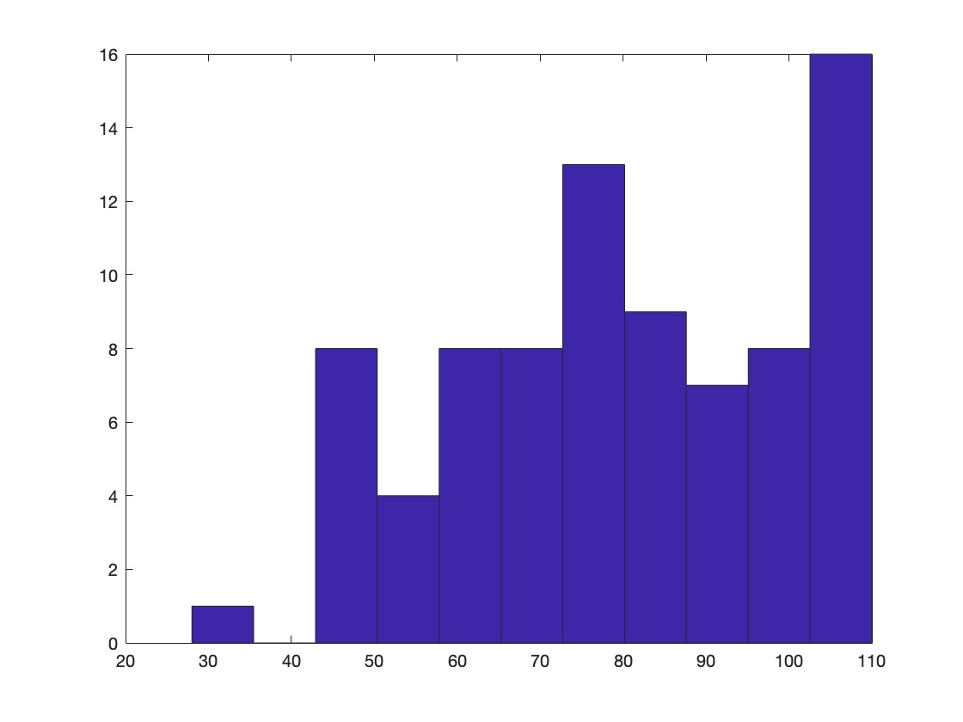
Midterm 2 Results – CS 477
min = 28 max = 110 average = 79.81

Slide 3
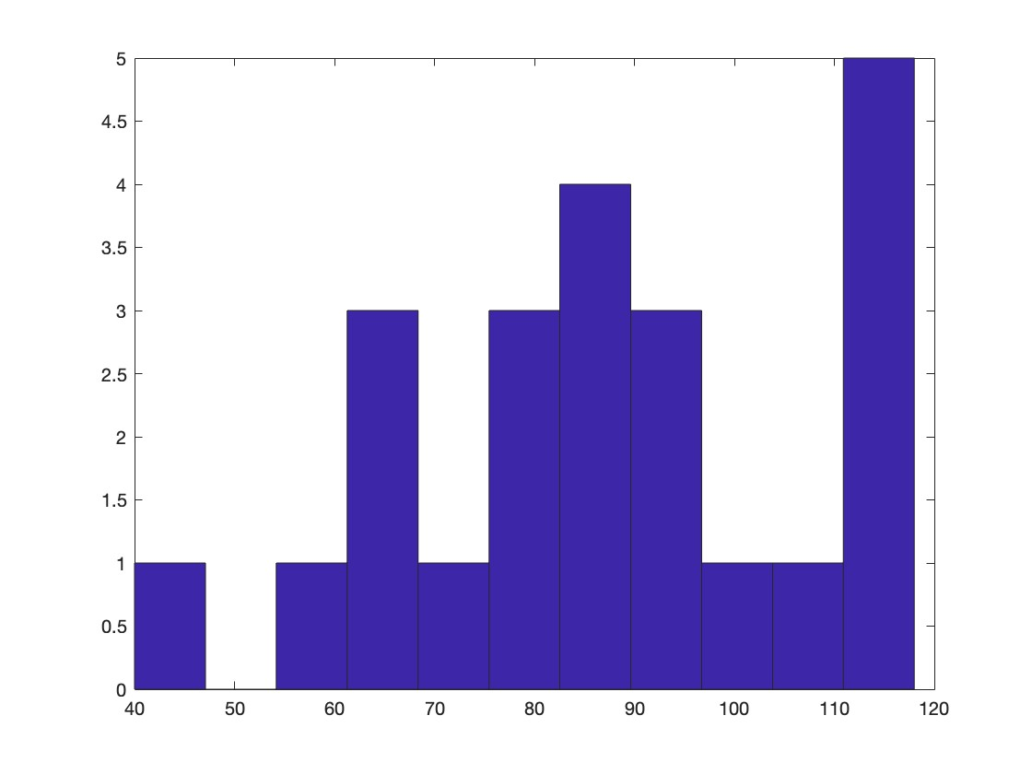
Midterm 2 Results – CS 677
min = 40 max = 118 average = 87.56

Slide 4
Midterm 2 - Feedback
Heap elements do not have pointers to children
In RBTs nodes are inserted as red
OS_Select finds the i-th order statistic not element with key = i
When working with trees, always check if the tree root is NULL first, before accessing t T.left or T.right
Cannot add pointers
The height of a node is the maximum of the left/right subtree heights + 1, not their sum
Recursive algorithms:
Pay attention to the return value for the base case
Make sure the return value is always the same type
Use the return values

Slide 5
Huffman Codes
Idea:
Use the frequencies of occurrence of characters to build a optimal way of representing each character
 | a | b | c | d | e | f
Frequency (thousands) | 45 | 13 | 12 | 16 | 9 | 5

Slide 6
Constructing a Huffman Code
Let’s build a greedy algorithm that constructs an optimal prefix code (called a Huffman code)
Assume that:
C is a set of n characters
Each character has a frequency f(c)
Idea:
The tree T is built in a bottom up manner
Start with a set of |C| = n leaves
At each step, merge the two least frequent objects: the frequency of the new node = sum of two frequencies
Use a min-priority queue Q, keyed on f to identify the two least frequent objects
f: 5
e: 9
c: 12
b: 13
d: 16
a: 45

Slide 7
Example
f: 5
e: 9
c: 12
b: 13
d: 16
a: 45
c: 12
b: 13
14
d: 16
a: 45
0
1
f: 5
e: 9
14
d: 16
25
a: 45
25
30
a: 45
0
1
0
1
0
1
0
1
f: 5
e: 9
c: 12
b: 13
c: 12
b: 13
14
d: 16
0
1
f: 5
e: 9
55
0
100
1
a: 45
0
1
a: 45
55
25
30
0
1
0
1
0
1
25
30
c: 12
b: 13
14
d: 16
0
1
0
1
0
1
c: 12
b: 13
14
d: 16
f: 5
e: 9
0
1
f: 5
e: 9

Slide 8
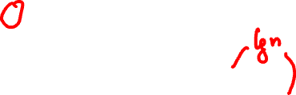
Building a Huffman Code
Alg.: HUFFMAN(C)
n ← ⎥C ⎥
Q ← C
for i ← 1 to n – 1
do allocate a new node z
left[z] ← x ← EXTRACT-MIN(Q)
right[z] ← y ← EXTRACT-MIN(Q)
f[z] ← f[x] + f[y]
INSERT (Q, z)
return EXTRACT-MIN(Q)
Running time: O(nlgn)
O(n)
O(nlgn)

Slide 9
Greedy Choice Property
Let C be an alphabet in which each character c ∈ C has frequency f[c]. Let x and y be two characters in C having the lowest frequencies.
Then, there exists an optimal prefix code for C in which the codewords for x and y have the same (maximum) length and differ only in the last bit.

Slide 10
Proof of the Greedy Choice
Idea:
Consider a tree T representing an arbitrary optimal prefix code
Modify T to make a tree representing another optimal prefix code in which x and y will appear as sibling leaves of maximum depth
⇒ The codes of x and y will have the same length and differ only in the last bit

Slide 11
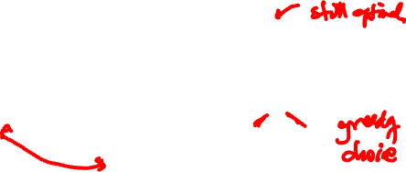

Proof of the Greedy Choice (cont.)
T
T’
T’’
x
a
a
y
y
b
a
b
x
b
x
y
a, b – two characters, sibling leaves of max. depth in T
Assume: f[a] ≤ f[b] and f[x] ≤ f[y]
f[x] and f[y] are the two lowest leaf frequencies, in order
⇒ f[x] ≤ f[a] and f[y] ≤ f[b]
Exchange the positions of a and x (T’) and of b and y (T’’)

Slide 12
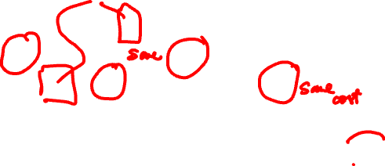
Proof of the Greedy Choice (cont.)
T
T’
T’’
x
a
a
y
y
b
a
b
x
b
x
y
$$\sum_{c∈C}{f(c)d_{T}(c)}−\sum_{c∈C}{f(c)d_{T^{′}}(c)}$$
B(T) – B(T’) =
= f[x]d_{T}(x) + f[a]d_{T}(a) – f[x]d_{T’}(x) – f[a]d_{T’}(a)
= f[x]d_{T}(x) + f[a]d_{T}(a) – f[x]d_{T}(a) – f[a]d_{T} (x)
= (f[a] - f[x]) (d_{T}(a) - d_{T}(x))
≥ 0
≥ 0
x is a minimum
frequency leaf
≥ 0
a is a leaf of
maximum depth

Slide 13
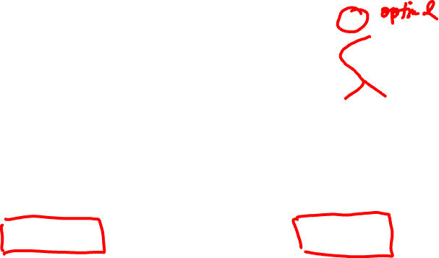
Proof of the Greedy Choice (cont.)
T
T’
T’’
x
a
a
y
y
b
a
b
x
b
x
y
B(T) – B(T’) ≥ 0
Similarly, exchanging y and b does not increase the cost:
B(T’) – B(T’’) ≥ 0
⇒ B(T’’) ≤ B(T). Also, since T is optimal, B(T) ≤ B(T’’)
Therefore, B(T) = B(T’’) ⇒ T’’ is an optimal tree, in which x and y are sibling leaves of maximum depth

Slide 14
Discussion
Greedy choice property:
Building an optimal tree by mergers can begin with the greedy choice: merging the two characters with the lowest frequencies
The cost of each merger is the sum of frequencies of the two items being merged
Of all possible mergers, HUFFMAN chooses the one that incurs the least cost

Slide 15
Interval Partitioning
Lecture j starts at s_{j} and finishes at f_{j}
Goal: find minimum number of classrooms to schedule all lectures so that no two occur at the same time in the same room
Ex: this schedule uses 4 classrooms to schedule 10 lectures
e
j
c
d
g
b
h
a
f
i
9
9:30
10
10:30
11
11:30
12
12:30
1
1:30
2
2:30
3
3:30
4
4:30
Time

Slide 16
Interval Partitioning
Lecture j starts at s_{j} and finishes at f_{j}
Goal: find minimum number of classrooms to schedule all lectures so that no two occur at the same time in the same room
Ex: this schedule uses only 3
c
d
f
j
b
g
i
a
e
h
9
9:30
10
10:30
11
11:30
12
12:30
1
1:30
2
2:30
3
3:30
4
4:30
Time

Slide 17
Interval Partitioning: Lower Bound on Optimal Solution
The depth of a set of open intervals is the maximum number that contain any given time
Key observation:
The number of classrooms needed ≥ depth
Ex: Depth of schedule below = 3 ⇒ schedule below is optimal
Does there always exist a schedule equal to depth of intervals?
a, b, c all contain 9:30
c
d
f
j
b
g
i
a
e
h
9
9:30
10
10:30
11
11:30
12
12:30
1
1:30
2
2:30
3
3:30
4
4:30
Time

Slide 18
Greedy Strategy
Consider lectures in increasing order of start time: assign lecture to any compatible classroom
Labels set {1, 2, 3, …, d}, where d is the depth of the set of intervals
Overlapping intervals are given different labels
Assign a label that has not been assigned to any previous interval that overlaps it

Slide 19

Greedy Algorithm
Sort intervals by start times, such that s₁ ≤ s₂ ≤ ... ≤ s_{n} (let I₁, I₂, .., I_{n} denote the intervals in this order)
for j = 1 to n
Exclude from set {1, 2, …, d} the labels of preceding and overlapping intervals I_{i} from consideration for I_{j}
if there is any label from {1, 2, …, d} that was not excluded assign that label to I_{j}
else
leave I_{j} unlabeled

Slide 20
Example
a
b
c
d
e
f
g
h
j
i
9
9:30
10
10:30
11
11:30
12
12:30
1
1:30
2
2:30
3
3:30
4
4:30
Time
3
c
d
f
j
2
b
g
i
1
a
e
h
9
9:30
10
10:30
11
11:30
12
12:30
1
1:30
2
2:30
3
3:30
4
4:30
Time

Slide 21
Claim
Every interval will be assigned a label
For interval I_{j}, assume there are t intervals earlier in the sorted order that overlap it
We have t + 1 intervals that pass over a common point on the timeline
t + 1 ≤ d, thus t ≤ d – 1
At least one of the d labels is not excluded by this set of t intervals, which we can assign to I_{j}

Slide 22
Claim
No two overlapping intervals are assigned the same label
Consider I and I’ that overlap, and I precedes I’ in the sorted order
When I’ is considered, the label for I is excluded from consideration
Thus, the algorithm will assign a different label to I

Slide 23
Greedy Choice Property
The greedy algorithm schedules every interval on a resource, using a number of resources equal to the depth of the set of intervals. This is the optimal number of resources needed.
Proof:
Follows from previous claims
Structural proof
Discover a simple “structural” bound asserting that every possible solution must have a certain value
Then show that your algorithm always achieves this bound

Slide 24
Scheduling to Minimizing Lateness
Single resource processes one job at a time
Job j requires t_{j} units of processing time, is due at time d_{j}
If j starts at time s_{j}, it finishes at time f_{j} = s_{j} + t_{j}
Lateness: _{j} = max { 0, f_{j} - d_{j} }
Goal: schedule all jobs to minimize maximum lateness L = max _{j}
Example:
1
2
3
4
5
6
t_{j}
3
2
1
4
3
2
d_{j}
6
8
9
9
14
15
lateness = 2
lateness = 0
max lateness = 6
d₃ = 9
d₂ = 8
d₆ = 15
d₁ = 6
d₅ = 14
d₄ = 9
0
1
2
3
4
5
6
7
8
9
10
11
12
13
14
15

Slide 25
Readings
For this lecture
Chapter 15
Coming next
Chapter 15

