Slide 1
Analysis of Algorithms CS 477/677
Instructor: Monica Nicolescu
Lecture 22

Slide 2
Scheduling to Minimizing Lateness
Single resource processes one job at a time
Job j requires t_{j} units of processing time, is due at time d_{j}
If j starts at time s_{j}, it finishes at time f_{j} = s_{j} + t_{j}
Lateness: _{j} = max { 0, f_{j} - d_{j} }
Goal: schedule all jobs to minimize maximum lateness L = max _{j}
Example:
1
2
3
4
5
6
t_{j}
3
2
1
4
3
2
d_{j}
6
8
9
9
14
15
lateness = 2
lateness = 0
max lateness = 6
d₃ = 9
d₂ = 8
d₆ = 15
d₁ = 6
d₅ = 14
d₄ = 9
0
1
2
3
4
5
6
7
8
9
10
11
12
13
14
15

Slide 3
Greedy Algorithms
Greedy strategy: consider jobs in some order
[Shortest processing time first] Consider jobs in ascending order of processing time t_{j}
[Smallest slack] Consider jobs in ascending order of slack d_{j} - t_{j}
counterexample
1
2
Choosing t₁ first: l₂ = 1
Choosing t₂ first: l₂ = l₁ = 0
t_{j}
1
10
d_{j}
100
10
counterexample
1
2
Choosing t₂ first: l₁ = 9
Choosing t₁ first: l₁ = 0 and l₂ = 1
t_{j}
1
10
d_{j}
2
10

Slide 4
Greedy Algorithm
Greedy choice: earliest deadline first
Sort n jobs by deadline so that d₁ < d₂ <… < d_{n}
t = 0
for j = 1 to n
Assign job j to interval [t, t + t_{j}]
s_{j} = t, f_{j} = t + t_{j}
t = t + t_{j}
output intervals [s_{j}, f_{j}]
max lateness = 1
d₁ = 6
d₂ = 8
d₃ = 9
d₄ = 9
d₅ = 14
d₆ = 15
0
1
2
3
4
5
6
7
8
9
10
11
12
13
14
15

Slide 5
Minimizing Lateness: No Idle Time
Observation: The greedy schedule has no idle time
Observation: There exists an optimal schedule with no idle time
d = 4
d = 6
d = 12
0
1
2
3
4
5
6
7
8
9
10
11
d = 4
d = 6
d = 12
0
1
2
3
4
5
6
7
8
9
10
11

Slide 6
Minimizing Lateness: Inversions
An inversion in schedule S is a pair of jobs i and j such that: d_{i} < d_{j} but j scheduled before i
Observation: greedy schedule has no inversions
inversion
j
i

Slide 7
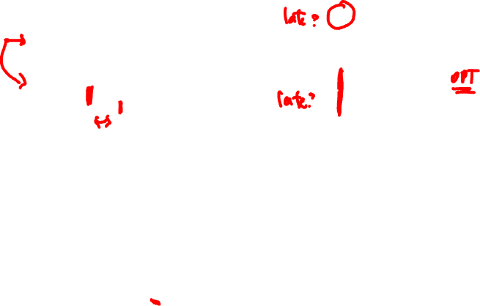
Greedy Choice Property
f_{j}
f_{i}
Optimal Sol
j
i
Greedy Sol
i
j
d_{i}
d_{j}
Optimal solution: d_{i} < d_{j} but j scheduled before i
Greedy solution: i scheduled before j
Job i finishes sooner, no increase in latency
Lateness(Job j)_{GREEDY} = f_{i} – d_{j}
Lateness(Job i)_{OPT} = f_{i} – d_{i}
≤
➔ No increase in latency

Slide 8
Greedy Analysis Strategies
Exchange argument
Gradually transform any solution to the one found by the greedy algorithm without hurting its quality
Structural
Discover a simple “structural” bound asserting that every possible solution must have a certain value, then show that your algorithm always achieves this bound
Greedy algorithm stays ahead
Show that after each step of the greedy algorithm, its solution is at least as good as any other algorithm’s

Slide 9







Coin Changing
Given currency denominations: 1, 5, 10, 25, 100, devise a method to pay amount to customer using fewest number of coins
Ex: 34¢
Ex: $2.89

Slide 10
Greedy Algorithm
Greedy strategy: at each iteration, add coin of the largest value that does not take us past the amount to be paid
Sort coins denominations by value: c₁ < c₂ < … < c_{n}.
S = {}
while (x > 0) {
let k be largest integer such that c_{k} <= x
if (k = 0)
return "no solution found"
x = x - c_{k}
S = S U {k}
}
return S
coins selected

Slide 11
Greedy Choice Property
Algorithm is optimal for U.S. coinage: 1, 5, 10, 25, 100
Change = D * 100 + Q * 25 + D * 10 + N * 5 + P
Consider optimal way to change c_{k} <= x < c_{k+1}: greedy takes coin k
We claim that any optimal solution must also take coin k
If not, it needs enough coins of type c₁, …, c_{k-1} to add up to x
Problem reduces to coin-changing x - c_{k} cents, which, by induction, is optimally solved by greedy algorithm

Slide 12
Greedy Choice Property
Algorithm is optimal for U.S. coinage: 1, 5, 10, 25, 100
Change = Dl * 100 + Q * 25 + D * 10 + N * 5 + P
Optimal solution: Dl Q D N P
Greedy solution: Dl’ Q’ D’ N’ P’
Value < 5
Both optimal and greedy use the same # of coins
10 (D) > Value > 5 (N)
Greedy uses one N and then pennies after that
If OPT does not use N, then it should use pennies for the entire amount => could replace 5 P for 1 N

Slide 13
Greedy Choice Property
Change = Dl * 100 + Q * 25 + D * 10 + N * 5 + P
Optimal solution: Dl Q D N P
Greedy solution: Dl’ Q’ D’ N’ P’
25 (Q) > Value > 10 (D)
Greedy uses dimes (D’s)
If OPT does not use D’s, it needs to use either 2 coins (2 N), or 6 coins (1 N and 5 P) or 10 coins (10 P) to cover 10 cents
Could replace those with 1 D for a better solution

Slide 14
Greedy Choice Property
Change = Dl * 100 + Q * 25 + D * 10 + N * 5 + P
Optimal solution: Dl Q D N P
Greedy solution: Dl’ Q’ D’ N’ P’
100 (Dl) > Value > 25 (Q)
Greedy picks at least one quarter (Q), OPT does not
If OPT has no Ds: take all the Ns and Ps and replace 25 cents into one quarter (Q)
If OPT has 2 or fewer dimes: it uses at least 3 coins to cover one quarter, so we can replace 25 cents with 1 Q
If OPT has 3 or more dimes (e.g., 40 cents: with 4 Ds): take the first 3 Ds and replace them with 1 Q and 1 N

Slide 15
Coin-Changing US Postal Denominations
Observation: greedy algorithm is sub-optimal for US postal denominations:
$.01, .02, .03, .04, .05, .10, .20, .32, .40, .44, .50, .64, .65, .75, .79, .80, .85, .98
$1, $1.05, $2, $4.95, $5, $5.15, $18.30, $18.95
Counterexample: 160¢
Greedy: 105, 50, 5
Optimal: 80, 80

Slide 16
Selecting Breakpoints
Road trip from Princeton to Palo Alto along fixed route
Refueling stations at certain points along the way (red marks)
Fuel capacity = C
Goal:
makes as few refueling stops as possible
Greedy strategy:
go as far as you can before refueling
C
C
C
C
Princeton
C
C
C
Palo Alto
1
2
3
4
5
6
7

Slide 17

Greedy Algorithm
Sort breakpoints so that: 0 = b₀ < b₁ < b₂ < ... < b_{n} = L
S = {0}
x = 0
while (x < b_{n})
let p be largest integer such that b_{p} <= x + C
if (b_{p} = x)
return "no solution"
x = b_{p}
S = S U {p}
return S
breakpoints selected
current location
Implementation: O(n log n)
Use binary search to select each breakpoint p

Slide 18
Greedy Choice Property
Let 0 = g₀ < g₁ < . . . < g_{p} = L denote set of breakpoints chosen by the greedy
Let 0 = f₀ < f₁ < . . . < f_{q} = L denote set of breakpoints in an optimal solution with f₀ = g₀, f₁= g₁ , . . . , f_{r} = g_{r}
Note: g_{r+1} > f_{r+1} by greedy choice of algorithm
g₀
g₁
g₂
g_{r}
g_{r+1}
Greedy:
The greedy solution has the same number of breakpoints as the optimal
OPT:
. . .
f₀
f₁
f₂
f_{r}
f_{r+1}
f_{q}
why doesn't optimal solution drive a little further?

Slide 19
Problem – Buying Licenses
Your company needs to buy licenses for n pieces of software
Licenses can be bought only one per month
Each license currently sells for $100, but becomes more expensive each month
The price increases by a factor r_{j} > 1 each month
License j will cost 100*r_{j}^{t} if bought t months from now
r_{i} < r_{j} for license i < j
In which order should the company buy the licenses, to minimize the amount of money spent?

Slide 20
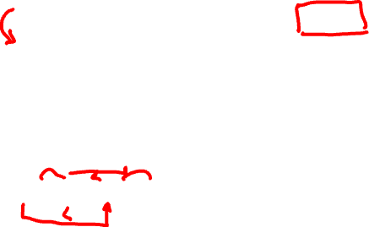
Solution
Greedy choice:
Buy licenses in decreasing order of rate r_{j}
r₁>r₂>r₃…
Proof of greedy choice property
Optimal solution: …. r_{i} r_{j}….. r_{i} < r_{j}
Greedy solution: …. r_{j} r_{i}…..
Cost by optimal solution:
Cost by greedy solution:
CG – CO = 100 * (r_{j}^{t} + r_{i}^{t+1} - r_{i}^{t} - r_{j}^{t+1}) < 0
r_{i}^{t+1} – r_{i}^{t} < r_{j}^{t+1} - r_{j}^{t}
r_{i}^{t}(r_{i} -1) < r_{j}^{t}(r_{j}-1)
100* r_{i}^{t} + 100* r_{j}^{t+1}
100* r_{j}^{t} + 100* r_{i}^{t+1}
OK! (because r_{i} < r_{j})

Slide 21
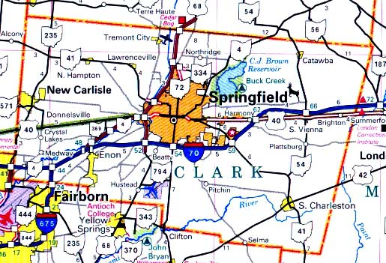
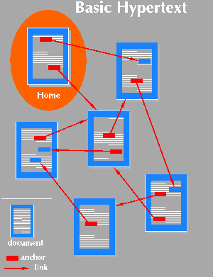

Graphs
Applications that involve not only a set of items, but also the connections between them
Maps
Schedules
Computer networks
Hypertext
Circuits

Slide 22
Graphs - Background
Graphs = a set of nodes (vertices) with edges (links) between them.
Notations:
G = (V, E) - graph
V = set of vertices (size of V = n)
E = set of edges (size of E = m)
1
2
1
2
1
2
3
4
3
4
3
4
Directed
graph
Undirected
graph
Acyclic
graph

Slide 23
Other Types of Graphs
A graph is connected if there is a path between every two vertices
A bipartite graph is an undirected graph G = (V, E) in which V = V₁ + V₂ and there are edges only between vertices in V₁ and V₂
1
2
1
2
3
4
3
4
Connected
Not connected
1
2
9
4
8
3
6
7
4

Slide 24
Graph Representation
Adjacency list representation of G = (V, E)
An array of n lists, one for each vertex in V
Each list Adj[u] contains all the vertices v such that there is an edge between u and v
Adj[u] contains the vertices adjacent to u (in arbitrary order)
Can be used for both directed and undirected graphs
1
2
5 | /
1
2
2
1
5
3
4 | /
3
3
2
4
5
4
4
2
5
3 | /
5
4
1
2
Undirected graph

Slide 25
Properties of Adjacency List Representation
Sum of the lengths of all the adjacency lists
Directed graph:
Edge (u, v) appears only once in u’s list
Undirected graph:
u and v appear in each other’s adjacency lists: edge (u, v) appears twice
1
2
3
4
size of E (m)
Directed graph
1
2
2* size of E (2E)
3
5
4
Undirected graph

Slide 26
Properties of Adjacency List Representation
Memory required
Θ(m+n)
Preferred when
the graph is sparse: m << n²
Disadvantage
no quick way to determine whether there is an edge between node u and v
Time to list all vertices adjacent to u:
Θ(degree(u))
Time to determine if (u, v) exists:
O(degree(u))
1
2
3
5
4
Undirected graph
1
2
3
4
Directed graph

Slide 27
Graph Representation
Adjacency matrix representation of G = (V, E)
Assume vertices are numbered 1, 2, … n
The representation consists of a matrix A_{nxn}
a_{ij} = 1 if (i, j) belongs to E
0 otherwise
1
2
3
4
5
1
0
1
0
0
1
For undirected graphs matrix A is symmetric:
a_{ij} = a_{ji}
A = A^{T}
1
2
3
2
1
0
1
1
1
5
4
3
0
1
0
1
0
4
0
1
1
0
1
Undirected graph
5
1
1
0
1
0

Slide 28
Properties of Adjacency Matrix Representation
Memory required
Θ(n²), independent on the number of edges in G
Preferred when
The graph is dense: m is close to n²
We need to quickly determine if there is an edge between two vertices
Time to list all vertices adjacent to u:
Θ(n)
Time to determine if (u, v) belongs to E:
Θ(1)

Slide 29
Weighted Graphs
Weighted graphs = graphs for which each edge has an associated weight w(u, v)
w: E -> R, weight function
Storing the weights of a graph
Adjacency list:
Store w(u,v) along with vertex v in u’s adjacency list
Adjacency matrix:
Store w(u, v) at location (u, v) in the matrix

Slide 30
Searching in a Graph
Graph searching = systematically follow the edges of the graph so as to visit the vertices of the graph
Two basic graph searching algorithms:
Breadth-first search
Depth-first search
The difference between them is in the order in which they explore the unvisited edges of the graph
Graph algorithms are typically elaborations of the basic graph-searching algorithms

Slide 31
Readings
For this lecture
Chapter 15
Coming next
Chapter 20

