Slide 1
Analysis of Algorithms CS 477/677
Instructor: Monica Nicolescu
Lecture 25

Slide 2
Shortest Path Problems
How can we find the shortest route between two points on a map?
Model the problem as a graph problem:
Road map is a weighted graph:
vertices = cities
edges = road segments between cities
edge weights = road distances
Goal: find a shortest path between two vertices (cities)

Slide 3
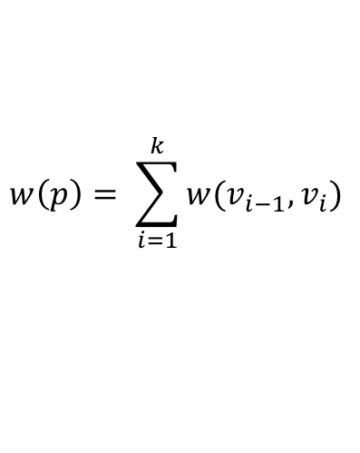
Shortest Path Problems
Input:
Directed graph G = (V, E)
Weight function w : E → R
Weight of path p = ⟨v₀, v₁, . . . , v_{k}⟩
Shortest-path weight from u to v:
δ(u, v) = min w(p) : u v if there exists a path from u to v
∞ otherwise
Shortest path u to v is any path p such that w(p) = δ(u, v)
t
x
3
6
9
3
4
s
0
2
1
2
7
5
3
5
11
$$w\left(p\right)= \sum_{i=1}^{k}{w(v_{i−1}, v_{i})}$$
6
y
z
p

Slide 4
Variants of Shortest Paths
Single-source shortest path
G = (V, E) ⇒ find a shortest path from a given source vertex s to each vertex v ∈ V
Single-destination shortest path
Find a shortest path to a given destination vertex t from each vertex v
Reverse the direction of each edge ⇒ single-source
Single-pair shortest path
Find a shortest path from u to v for given vertices u and v
Still have to solve the single-source problem
All-pairs shortest-paths
Find a shortest path from u to v for every pair of vertices u and v

Slide 5

Optimal Substructure of Shortest Paths
Given:
A weighted, directed graph G = (V, E)
A weight function w: E → R,
A shortest path p = ⟨v₁, v₂, . . . , v_{k}⟩ from v₁ to v_{k}
A subpath of p: p_{ij} = ⟨v_{i}, v_{i+1}, . . . , v_{j}⟩, with 1 ≤ i ≤ j ≤ k
Then: p_{ij} is a shortest path from v_{i} to v_{j}
Proof: p = v₁ v_{i} v_{j} v_{k}
w(p) = w(p_{1i}) + w(p_{ij}) + w(p_{jk})
Assume ∃ p_{ij}’ from v_{i} to v_{j} with w(p_{ij}’) < w(p_{ij})
⇒ w(p’) = w(p_{1i}) + w(p_{ij}’) + w(p_{jk}) < w(p) contradiction!
v_{j}
p_{ij}
p_{jk}
v₁
p_{1i}
p_{ij}’
v_{k}
v_{i}
p_{1i}
p_{ij}
p_{jk}

Slide 6

Negative-Weight Edges
s → a: only one path
𝛅(s, a) = w(s, a) = 3
s → b: only one path
𝛅(s, b) = w(s, a) + w(a, b) = -1
s → c: infinitely many paths
⟨s, c⟩, ⟨s, c, d, c⟩, ⟨s, c, d, c, d, c⟩
cycle ⟨c, d, c⟩ has positive weight (6 - 3 = 3)
⟨s, c⟩ is shortest path with weight 𝛅(s, b) = w(s, c) = 5
What if we have negative-weight edges?
a
b
3
-4
-1
3
4
c
6
d
g
s
0
5
5
11
8
-∞
-3
2
3
7
-∞
-∞
e
-6
f

Slide 7

Negative-Weight Edges
s → e: infinitely many paths:
⟨s, e⟩, ⟨s, e, f, e⟩, ⟨s, e, f, e, f, e⟩
cycle ⟨e, f, e⟩ has negative weight:
3 + (- 6) = -3
can find paths from s to e with arbitrarily large negative weights
𝛅(s, e) = - ∞ ⇒ no shortest path exists between s and e
Similarly: 𝛅(s, f) = - ∞, 𝛅(s, g) = - ∞
a
b
3
-4
-1
3
4
c
6
d
g
s
0
5
5
11
8
-∞
-3
2
3
7
-∞
-∞
e
-6
f
h
i
∞
2
∞
h, i, j not
reachable
from s
-8
3
∞
j
𝛅(s, h) = 𝛅(s, i) = 𝛅(s, j) = ∞

Slide 8
Negative-Weight Edges
Negative-weight edges may form negative-weight cycles
If such cycles are reachable from
the source: 𝛅(s, v) is not properly
defined for any node v on the cycle
Keep going around the cycle, and get
w(s, v) = - ∞ for all v on the cycle
a
b
-4
3
4
c
6
d
g
s
0
5
8
-3
2
3
7
e
-6
f

Slide 9
Cycles
Can shortest paths contain cycles?
Negative-weight cycles
Positive-weight cycles:
By removing the cycle we can get a shorter path
Zero-weight cycles
No reason to use them
Can remove them to obtain a path with same weight
We will assume that when we are finding shortest paths, the paths will have no cycles
No!
No!

Slide 10
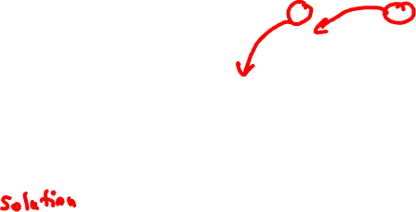
Shortest-Path Representation
For each vertex v ∈ V:
d[v] = δ(s, v): a shortest-path estimate
Initially, d[v]=∞
Reduces as algorithms progress
𝛑[v] = predecessor of v on a shortest path from s
If no predecessor, 𝛑[v] = NIL
𝛑 induces a tree—shortest-path tree
Shortest paths & shortest path trees are not unique
t
x
3
6
9
3
4
s
0
2
1
2
7
5
3
5
11
6
y
z

Slide 11
Initialization
Alg.: INITIALIZE-SINGLE-SOURCE(V, s)
for each v ∈ V
do d[v] ← ∞
𝛑[v] ← NIL
d[s] ← 0
All the shortest-paths algorithms start with INITIALIZE-SINGLE-SOURCE

Slide 12
Relaxation
Relaxing an edge (u, v) = testing whether we can improve the shortest path to v found so far by going through u
If d[v] > d[u] + w(u, v)
we can improve the shortest path to v
⇒ update d[v] and 𝛑[v]
s
s
u
v
u
v
After relaxation:
d[v] ≤ d[u] + w(u, v)
5
2
9
5
2
6
RELAX(u, v, w)
RELAX(u, v, w)
u
v
u
v
5
2
7
5
2
6

Slide 13
RELAX(u, v, w)
if d[v] > d[u] + w(u, v)
then d[v] ← d[u] + w(u, v)
𝛑[v] ← u
All the single-source shortest-paths algorithms
start by calling INIT-SINGLE-SOURCE
then relax edges
The algorithms differ in the order and how many times they relax each edge

Slide 14

Bellman-Ford Algorithm
Single-source shortest paths problem
Computes d[v] and 𝛑[v] for all v ∈ V
Allows negative edge weights and cycles
Returns:
TRUE if no negative-weight cycles are reachable from the source s
FALSE otherwise ⇒ no solution exists
Idea:
Traverse all the edges |V| – 1 times, every time performing a relaxation step of each edge

Slide 15
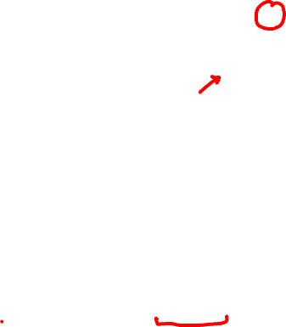
BELLMAN-FORD(V, E, w, s)
INITIALIZE-SINGLE-SOURCE(V, s)
for i ← 1 to |V| - 1
do for each edge (u, v) ∈ E
do RELAX(u, v, w)
for each edge (u, v) ∈ E
do if d[v] > d[u] + w(u, v)
then return FALSE
return TRUE
t
5
x
∞
∞
6
-2
-3
s
0
8
7
-4
7
2
∞
∞
9
y
z
t
5
x
∞
∞
6
6
-2
-3
s
0
8
7
-4
7
2
Running time: Θ(VE)
∞
∞
7
9
E: (t, x), (t, y), (t, z), (x, t), (y, x), (y, z), (z, x), (z, s), (s, t), (s, y)
y
z

Slide 16
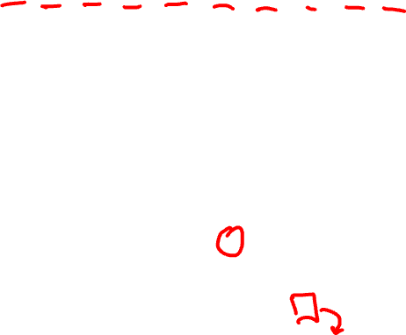
Example
(t, x), (t, y), (t, z), (x, t), (y, x), (y, z), (z, x), (z, s), (s, t), (s, y)
t
5
x
t
x
Pass 1
Pass 2
5
6
∞
6
∞
4
11
6
-2
6
-2
-3
-3
s
0
8
7
8
7
s
0
-4
-4
7
2
7
2
7
∞
7
∞
9
2
y
z
9
y
z
Pass 3
t
5
x
Pass 4
t
5
x
6
∞
6
∞
2
4
11
2
4
11
6
-2
6
-2
-3
-3
s
0
8
7
0
8
7
s
-4
-4
7
2
7
2
7
∞
7
∞
2
2
9
9
-2
y
z
y
z

Slide 17
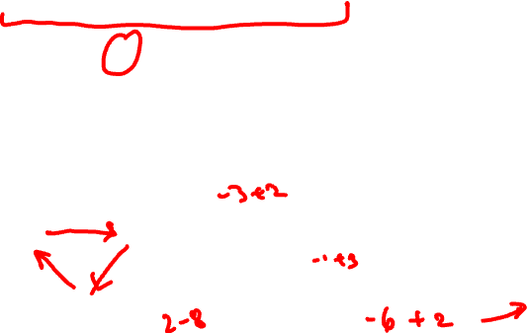
Detecting Negative Cycles
for each edge (u, v) ∈ E
do if d[v] > d[u] + w(u, v)
then return FALSE
return TRUE
s
b
0
2
∞
-8
3
∞
c
s
b
s
b
Look at edge (s, b):
d[b] = -1
d[s] + w(s, b) = -4
⇒ d[b] > d[s] + w(s, b)
0
2
∞
-3
2
2
-3
2
-6
-1
-8
3
-8
3
∞
5
5
2
c
c

Slide 18
Single-Source Shortest Paths in DAGs
Given a weighted DAG: G = (V, E)
solve the shortest path problem
Idea:
Topologically sort the graph
Relax the edges according to the order given by the topological sort
for each vertex, we relax each edge that starts from that vertex
Are shortest-paths well defined in a DAG?
Yes, (negative-weight) cycles cannot exist
u
2
v
6
∞
11
5
y
4
4
x

Slide 19
DAG-SHORTEST-PATHS(G, w, s)
topologically sort the vertices of G
INITIALIZE-SINGLE-SOURCE(V, s)
for each vertex u, taken in topologically sorted order
do for each vertex v ∈ Adj[u]
do RELAX(u, v, w)
Running time: Θ(V+E)
Θ(V+E)
Θ(V)
Θ(V)
Θ(E)

Slide 20
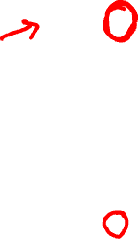
Example
6
1
r
s
t
x
y
z
∞
5
0
2
∞
7
∞
-1
∞
-2
∞
3
4
2
6
1
r
s
t
x
y
z
∞
5
0
2
∞
7
∞
-1
∞
-2
∞
3
4
2
6
1
r
s
t
x
y
z
∞
5
0
2
∞
7
∞
-1
∞
-2
∞
2
6
3
4
2

Slide 21
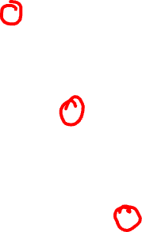
Example (cont.)
6
1
r
s
t
x
y
z
∞
5
0
2
2
7
6
-1
∞
-2
∞
6
4
3
4
2
6
1
r
s
t
x
y
z
∞
5
0
2
2
7
6
-1
6
-2
∞
5
4
3
4
2
6
1
r
s
t
x
y
z
∞
5
0
2
2
7
6
-1
5
-2
∞
4
3
3
4
2

Slide 22
Example (cont.)
6
1
r
s
t
x
y
z
∞
5
0
2
2
7
6
-1
5
-2
3
3
4
2

Slide 23
Dijkstra’s Algorithm
Single-source shortest path problem:
No negative-weight edges: w(u, v) > 0 ∀ (u, v) ∈ E
Maintains two sets of vertices:
S = vertices whose final shortest-path weights have already been determined
Q = vertices in V – S: min-priority queue
Keys in Q are estimates of shortest-path weights (d[v])
Repeatedly select a vertex u ∈ V – S, with the minimum shortest-path estimate d[v]

Slide 24

Dijkstra (G, w, s)
t
1
x
INITIALIZE-SINGLE-SOURCE(V, s)
S ← ∅
Q ← V[G]
while Q ≠ ∅
do u ← EXTRACT-MIN(Q)
S ← S ⋃ {u}
for each vertex v ∈ Adj[u]
do RELAX(u, v, w)
∞
∞
10
9
s
0
2
3
4
6
5
7
∞
∞
2
y
z
t
1
x
∞
∞
10
10
9
s
0
2
3
4
6
5
7
∞
∞
5
2
y
z

Slide 25

Example
t
1
x
t
1
x
10
∞
8
14
8
14
13
10
9
10
9
s
0
2
3
4
6
s
0
2
3
4
6
5
7
5
7
5
∞
5
7
7
2
2
y
z
y
z
t
x
t
1
x
1
8
9
8
13
9
10
9
10
9
2
3
4
6
s
0
2
3
4
6
s
0
5
7
5
7
5
7
5
7
2
2
y
z
y
z

Slide 26
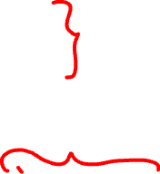
Dijkstra (G, w, s)
INITIALIZE-SINGLE-SOURCE(V, s)
S ← ∅
Q ← V[G]
while Q ≠ ∅
do u ← EXTRACT-MIN(Q)
S ← S ⋃ {u}
for each vertex v ∈ Adj[u]
do RELAX(u, v, w)
Running time: O(VlgV + ElgV) = O(ElgV)
Θ(V)
O(V) build min-heap
Executed O(V) times
O(lgV)
O(E) times; O(lgV)

Slide 27
Readings
Chapters 25, 31

Slide 28
Additional slides
optional

Slide 29
Shortest Path Properties
Triangle inequality
For all (u, v) ∈ E, we have:
δ(s, v) ≤ δ(s, u) + w(u, v)
If u is on the shortest path to v we have the equality sign
s
u
v
5
2
7
s
u
v
5
2
6

Slide 30
Shortest Path Properties
Upper-bound property
We always have d[v] ≥ δ(s, v) for all v.
Once d[v] = δ(s, v), it never changes.
The estimate never goes up – relaxation only lowers the estimate
v
5
x
v
5
x
6
∞
6
∞
4
2
4
11
11
6
-2
Relax (x, v)
6
-2
-3
-3
s
0
8
7
s
0
8
7
-4
-4
7
2
7
2
7
∞
7
∞
2
2
9
9
y
z
y
z

Slide 31
Shortest Path Properties
No-path property
If there is no path from s to v then d[v] = ∞ always.
δ(s, h) = ∞ and d[h] ≥ δ(s, h) ⇒ d[h] = ∞
a
b
-4
h
i
3
-1
2
4
∞
∞
3
c
d
g
6
h, i, j not
reachable
from s
s
0
5
5
11
8
-∞
-8
3
y
-3
∞
2
3
7
-∞
-∞
j
e
-6
f
𝛅(s, h) = 𝛅(s, i) = 𝛅(s, j) = ∞

Slide 32
Shortest Path Properties
Convergence property
If s u → v is a shortest path, and if d[u] = δ(s, u) at any time prior to relaxing edge (u, v), then
d[v] = δ(s, v) at all times afterward
u
v
If d[v] > δ(s, v) ⇒ after relaxation:
d[v] = d[u] + w(u, v)
d[v] = 5 + 2 = 7
Otherwise, the value remains unchanged, because it must have been the shortest path value
2
6
∞
5
8
11
5
s
0
4
4
7

Slide 33
Shortest Path Properties
Path relaxation property
Let p = ⟨v₀, v₁, . . . , v_{k}⟩ be a shortest path from s = v₀ to v_{k}. If we relax, in order, (v₀, v₁), (v₁, v₂), . . . , (v_{k-1}, v_{k}), even intermixed with other relaxations, then d[v_{k} ] = δ(s, v_{k}).
v₁
2
v₂
d[v₂] = δ(s, v₂)
6
∞
v₄
∞
∞
11
5
7
∞
5
3
14
d[v₁] = δ(s, v₁)
4
v₃
s
0
∞
d[v₄] = δ(s, v₄)
11
d[v₃] = δ(s, v₃)

