Slide 1
Analysis of Algorithms CS 477/677
Instructor: Monica Nicolescu
Lecture 27

Slide 2
Final Exam
Tuesday, May 14, 12:45-2:45pm, in class
Exam structure:
TRUE/FALSE questions
short questions on the topics discussed in class
homework-like problems
Questions will be from the entire semester, with emphasis on material after midterms

Slide 3
General Advice for Study
Understand how the algorithms are working
Work through the examples we did in class
“Narrate” for yourselves the main steps of the algorithms in a few sentences
Know when or for what problems the algorithms are applicable
Do not memorize algorithms

Slide 4
Topics Covered after Midterms
Dynamic programming (recurrence only)
Greedy algorithms (greedy choice + proof)
Graph algorithms
Search (BFS, DFS)
Topological Sort
Minimum spanning trees
Shortest paths (single source)
NP-completeness (general questions only)
Definitions
Do not say ”An X is when [story here]”
Do say: “An X is a/an [noun phrase here]”
Material prior to midterms
True/false, short questions/mini-problems, extra-credit/grad

Slide 5
Dynamic Programming
Used for optimization problems
A set of choices must be made to get an optimal solution
Find a solution with the optimal value (minimum or maximum)
Applicability:
Subproblems are not independent, i.e., subproblems share subsubproblems
A divide-and-conquer approach would repeatedly solve the common subproblems
Dynamic programming solves every subproblem just once and stores the answer in a table

Slide 6
Elements of Dynamic Programming
Optimal Substructure
An optimal solution to a problem contains within it an optimal solution to subproblems
Optimal solution to the entire problem is build in a bottom-up manner from optimal solutions to subproblems
Overlapping Subproblems
If a recursive algorithm revisits the same subproblems again and again ⇒ the problem has overlapping subproblems

Slide 7
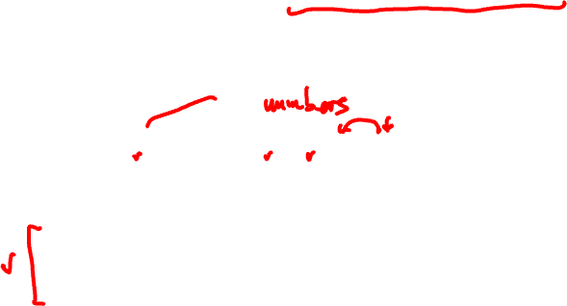
Exercise
Give an O(n²) algorithm to find the longest montonically increasing sequence in a sequence of n numbers.
Take an example: (5, 2, 8, 7, 3, 1, 6, 4)
Define: s_{i} = the length of the longest sequence ending with the i-th character
5 | 2 | 8 | 7 | 3 | 1 | 6 | 4
s₀ = 0
1
1
2
2
2
1
3
3
s_{i} = 1 more than the
greatest value for a previous number that
is smaller than seq[i]
s_{i} =
max {s_{j}} + 1
0<j<i, seq[j] <seq[i]

Slide 8
Greedy Algorithms
Similar to dynamic programming, but simpler approach
Also used for optimization problems
Idea:
When we have a choice to make, make the one that looks best right now in hope of getting a globally optimal solution
Problems:
Greedy algorithms don’t always yield an optimal solution
When the problem has certain general characteristics, greedy algorithms give optimal solutions

Slide 9
Correctness of Greedy Algorithms
Greedy Choice Property
A globally optimal solution can be arrived at by making a locally optimal (greedy) choice
Optimal Substructure Property
Optimal solution to subproblem + greedy choice ⇒ optimal solution for the original problem

Slide 10
Dynamic Programming vs. Greedy Algorithms
Dynamic programming
We make a choice at each step
The choice depends on solutions to subproblems
Bottom up solution, from smaller to larger subproblems
Greedy algorithm
Make the greedy choice and THEN
Solve the subproblem arising after the choice is made
The choice we make may depend on previous choices, but not on solutions to subproblems
Top down solution, problems decrease in size

Slide 11
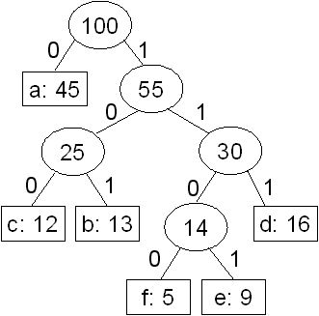
Huffman Codes
Technique for data compression
Idea:
Represent each character as a binary string
Variable length code: assign short codewords
to frequent characters
Represent the codes as full binary trees whose
leaves are the given characters
Constructing an optimal prefix code (Huffmann code)
Start with a set of |C| leaves
At each step, merge the two least frequent objects: the frequency of the new node = sum of two frequencies

Slide 12
Adj. List - Adj. Matrix Comparison
Graph representation: adjacency list, adjacency matrix
Comparison | Better
Faster to test if (x, y) exists?
Faster to find vertex degree?
Less memory on sparse graphs?
Faster to traverse the graph?
matrices
lists
lists (m+n) vs. n²
lists (m+n) vs. n²
Adjacency list representation is better for most applications

Slide 13
BFS vs. DFS
BFS
DFS
Input:
A graph G = (V, E) (directed or undirected)
A source vertex s ∈ V
Idea:
Explore the edges of G to “discover” every vertex reachable from s, taking the ones closest to s first
Output:
d[v] = distance (smallest # of edges, or shortest path) from s to v, for all v ∈ V
BFS tree
Input:
A Graph G = (V, E) (directed or undirected)
No source vertex given!
Idea:
Explore the edges of G to “discover” every vertex in V starting at the most recently visited node
Search may be repeated from multiple sources
Output:
2 timestamps on each vertex: d[v], f[d]
DFS forest

Slide 14

Example - Question
G = (V, E). True or false?
All DFS forests (for traversal starting at different vertices) will have the same number of trees.
1
2
1
2
1
2
3
3
3
5
4
5
4
5
4
{1, 2, 5}, {3, 4}
{2, 5}, {1}, {4}, {3}

Slide 15
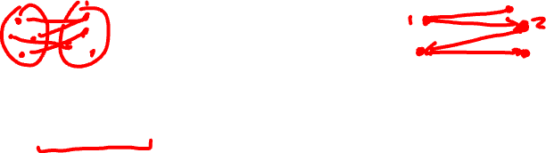
Exercise
Show how you can detect whether a graph is bipartite.
Idea:
Nodes in the same set will never be adjacent to each other
While doing a BFS, color
nodes in two colors
(red, blue), always alternating
from a parent to a child
The graph is bipartite if all adjacent nodes have different colors

Slide 16
Exercise
Give an O(n) algorithm to test if an undirected graph has a cycle (n = # of vertices)
Idea:
The graph has a cycle if it has more than n – 1 edges
Checking this takes O(n)
1
2
3
4
5

Slide 17

Sample Problem
Give an Θ(n+m) algorithm that tests whether an undirected graph is connected. The graph is given in adjacency list representation and has n vertices and m edges.
Run DFS using any vertex as a start vertex and then check whether all nodes were visited.
The graph is connected if and only if all nodes were visited, that is, if and only if all nodes are reachable from the start vertex.

Slide 18
Properties of DFS
Descendant – ancestor relationships
Relations on discovery – finish times for descendant, parent (ancestor) nodes
Parenthesis Theorem
White Path Theorem
Review these properties!

Slide 19
Topological Sort
Topological sort of a directed acyclic graph G = (V, E): a linear order of vertices such that if there exists an edge (u, v), then u appears before v in the ordering.
TOPOLOGICAL-SORT(V, E)
Call DFS(V, E) to compute finishing times f[v] for each vertex v
When each vertex is finished, insert it onto the front of a linked list
Return the linked list of vertices

Slide 20
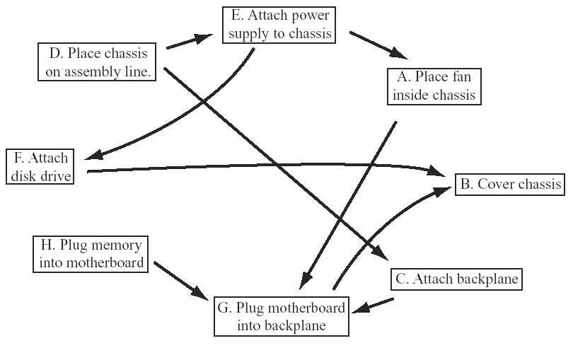
Sample Problem
In the following graph, boxes represent tasks that must be performed in the assembly of a computer, and arrows represent constraints that one task must be performed before another (for instance, the disk drive must be attached before the chassis can be covered). Write down a sequence in which all of these tasks can be performed, satisfying all constraints.
D
E
A
F
H
C
G
B

Slide 21
Minimum Spanning Trees
Given:
A connected, undirected, weighted graph G = (V, E)
A minimum spanning tree:
T connects all vertices
w(T) = Σ_{(u,v)∈T} w(u, v) is minimized
b
8
c
7
d
4
9
2
a
11
i
4
14
e
8
7
6
10
g
g
f
1
2

Slide 22
Exercise
True or False?
If all the weights of a connected, weighted graph are distinct, then distinct spanning trees of G have distinct weights
4
4
4
a
b
a
b
a
b
2
1
5
2
1
5
2
1
5
d
c
d
c
d
c
6
6
6
Cost 12
Cost 12

Slide 23
Minimum Spanning Trees
Kruskal’s algorithm
Start with each vertex being its own component
Repeatedly merge two components into one by choosing the light edge (minimum cost) that connects them
During the algorithm the MST is a forest of trees
Prim’s algorithm
The edges added to the MST always form a single tree
Repeatedly add light edges that connect vertices from outside the MST to vertices in the MST

Slide 24
Variants of Shortest Paths
Single-source shortest path
G = (V, E) ⇒ find a shortest path from a given source vertex s to each vertex v ∈ V
Belmann-Ford algorithm
Single-source shortest paths in acyclic graphs
Dijkstra’s algorithm
Know when the algorithms are applicable and how they work

Slide 25
Relaxation
Relaxing an edge (u, v) = testing whether we can improve the shortest path to v found so far by going through u
If d[v] > d[u] + w(u, v)
we can improve the shortest path to v
⇒ update d[v] and 𝛑[v]
After relaxation:
d[v] ≤ d[u] + w(u, v)
u
v
u
v
5
2
9
5
2
6
RELAX(u, v, w)
RELAX(u, v, w)
u
v
u
v
5
2
7
5
2
6

Slide 26
Single Source Shortest Paths
Bellman-Ford Algorithm
Allows negative edge weights
TRUE if no negative-weight cycles are reachable from the source s and FALSE otherwise
Traverse all the edges |V – 1| times, every time performing a relaxation step of each edge
Single-Source Shortest Paths in DAGs
Topologically sort the vertices of the graph
Relax the edges according to the order given by the topological sort
Dijkstra’s Algorithm
No negative-weight edges
Repeatedly select a vertex with the minimum shortest-path estimate d[v] – uses a queue, in which keys are d[v]

Slide 27
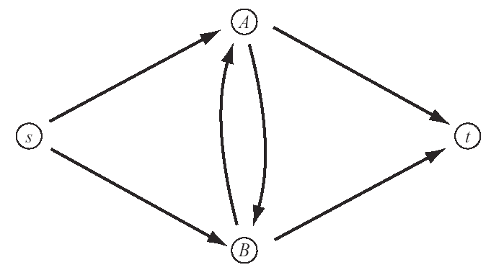
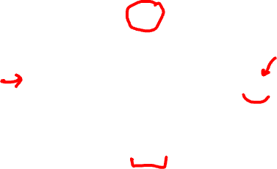
Sample Problem
(a) Write down lengths for the edges of the following graph, so that Dijkstra’s algorithm would not find the correct shortest path from s to t.
d=1
1
2
3
4
d=3
6
-5
d=5
d=6
Dijkstra’s algorithm will visit the vertices in the order s – A – t
d[t] = 3 and d[B] = 5
However, the path s-A-B-t is the shortest.

Slide 28
Sample Problem
(b) Which of the shortest path algorithms described in class would be most appropriate for finding paths in the graph of part (a) with the weights you gave? Explain your answer.
Bellman-Ford, because it can handle graphs with negative edge weights and cycles.
We can’t use the DAG algorithm because this graph is not a DAG.

Slide 29
True/False Questions
(a) True False
Merge sort, Quicksort and Insertion sort are comparison-based sorting algorithms.
(b) True False
In a red-black tree, if a node is black than both its children are red.
(c) True False
A reverse-sorted array (i.e., decreasing order) is always a max-heap.

Slide 30
True/False Questions
(d) True False
In a directed graph with positive edge weights, the edge with minimum weight belongs to the shortest paths tree for any source vertex.
(e) True False
Given any weighted directed graph with all distinct edge weights and any specified source vertex, the shortest paths tree is unique.

Slide 31
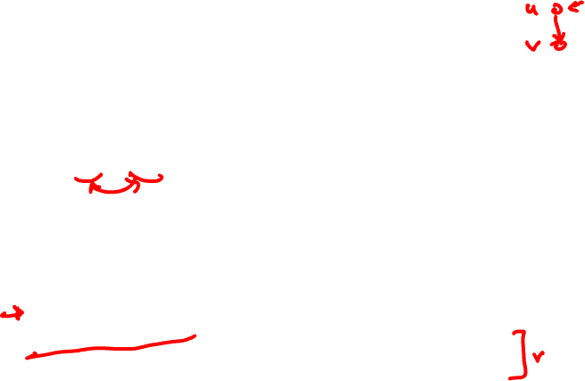
True/False Questions
(f) True False
After running DFS in a graph G = (V, E), a vertex v (∈ V) is a proper descendant of another vertex u (∈ V) ⟺ d[v] < d[u] < f[u] < f[v]
(g) True False
The problem of determining an optimal order for multiplying a chain of matrices can be solved by a greedy algorithm, since it displays the optimal substructure and overlapping subproblems properties.

Slide 32
True/False Questions
(h) True False
Kruskal’s algorithm for finding a minimum spanning tree of a weighted, undirected graph is an example of a dynamic programming algorithm.

Slide 33
True/False Questions
(i) TRUE FALSE
The depths of nodes in a red-black tree can be efficiently maintained as fields in the nodes of the tree.
No, because the depth of a node depends on the depth of its parent
When the depth of a node changes, the depths of all nodes below it in the tree must be updated
Updating the root node causes n - 1 other nodes to be updated

Slide 34
Sample Questions
What do we mean by the running time of an algorithm?
The running time of an algorithm is the number of (primitive) operations it performs before coming to a halt. The running time is expressed as a function of the input size n.
List at least three methods for solving recurrences.
Masters method, iteration, substitution

Slide 35
Sample Questions
Describe the characteristic feature of randomized algorithms. What is the main advantage of using such algorithms?
The behavior is determined in part by values produced by a random-number generator: the algorithm generates its own randomness.
Advantage: No particular input can consistently elicit worst case behavior.

Slide 36
Sample Questions
What does dynamic programming have in common with divide-and-conquer, and what is the principal difference between the two techniques?
Common: Both divide the initial problem into subproblems.
Difference: Dynamic programming is used when the subproblems are not independent.

Slide 37
Exercise
In an OS-tree, the size field can be used to compute the rank’ of a node x, in the subtree for which x is the root. If we want to store this rank in each of the nodes, show how can we maintain this information during insertion and deletion.
Insertion
add 1 to rank’[x] if z is inserted within x’s left subtree
leave rank’[x] unchanged if z is inserted within x’s right subtree
Deletion
subtract 1 from rank’[x] whenever the deleted node y had been in x’s left subtree.
rank’[x] = size[left] + 1

Slide 38
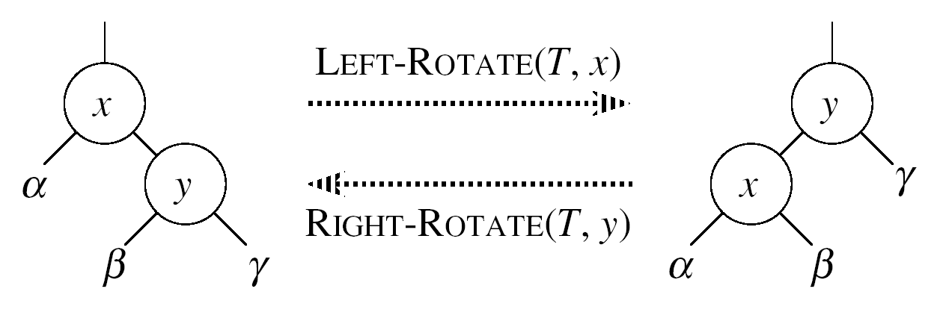
Exercise (cont.)
We also need to handle the rotations that occur during insertion and deletion
rank’(y) = r_{y} + rank’(x)
rank’(x) = r_{x}
rank’(y) = r_{y}
rank’(x) = r_{x}

Slide 39
Readings
All topics covered during the semester

