Slide 1

Cyber Resiliency Measurement Tool Database
Claire Kamobaya, Richard Flores,
Kristian Alleyne, and Matt Penn

Slide 2
Introduction and Business Summary
Company Name: CyberGuard Solutions
Business Type: Small Start-Up Cybersecurity Solutions
Overview: CyberGuard Solutions is an innovative, small start-up focused on creating a cybersecurity assessment tool for IT teams. Our tool helps organizations identify cybersecurity gaps, provides tailored recommendations for remediation, and tracks security data for detailed analysis and reporting. By empowering teams to make informed, proactive decisions, we aim to enhance their overall security posture.
Core Team and Roles:
Python Developers: Build and optimize the cybersecurity tool.
SCRUM Master: Guides agile development processes.
Technical Writers: Ensure clear and accessible documentation.
Researchers: Track emerging cybersecurity trends.
Database Architect: Manages data storage, tracking, and reporting.
Mission: Our goal is to provide a streamlined, accessible cybersecurity solution to a growing market, helping organizations stay ahead of evolving cyber threats.

Slide 3
Database Purpose and Function
Functions:
Tracking Critical Node Functions: Captures and maps critical node functions to specific infrastructure nodes.
Assigning Criticality Scores: Qualitative names are assigned to quantitative criticality scores for better assessment.
Organizing Infrastructure: Categorizes infrastructure racks and network nodes for easy identification and analysis.
Software Inventory Management: Logs software names, versions, and maps them to corresponding infrastructure nodes.
Vulnerability Tracking: Tracks vulnerabilities detected in the system, mapping each to the affected software versions.
APT Group Management: Maintains a list of Advanced Persistent Threat (APT) groups by ID and name.
AI-based Threat Scoring: Links APT groups to vulnerabilities and provides reasoning for each assigned threat level.
Database Structure: Each of these functions is represented by a dedicated table, ensuring a structured and efficient system for cybersecurity analysis.

Slide 4
Anticipated Users
End Users: The anticipated end users of this database are Cybersecurity Analysts, Network Engineers, and IT Staff.
User Roles and Benefits:
Cybersecurity Analysts: Use the system to identify, assess, and respond to vulnerabilities within the infrastructure.
Network Engineers: Benefit from the ability to map critical functions to infrastructure nodes and efficiently manage network assets.
IT Staff: Monitor software versions, track infrastructure categories, and oversee overall network health.
Collaborative Impact: By centralizing essential cybersecurity and infrastructure data, the system allows each user group to quickly access relevant information. This fosters collaboration on addressing security gaps and improving system resilience.

Slide 5


Project Inspiration and Origin

Slide 6
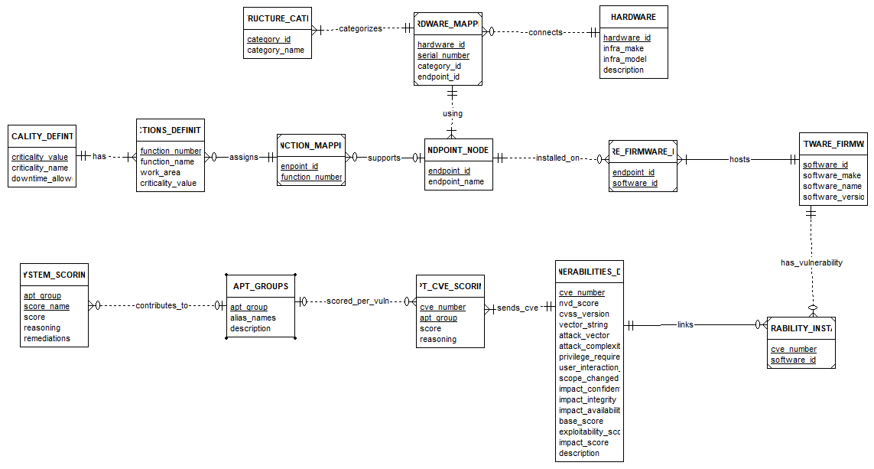
Entity Relationship Diagram

Slide 7
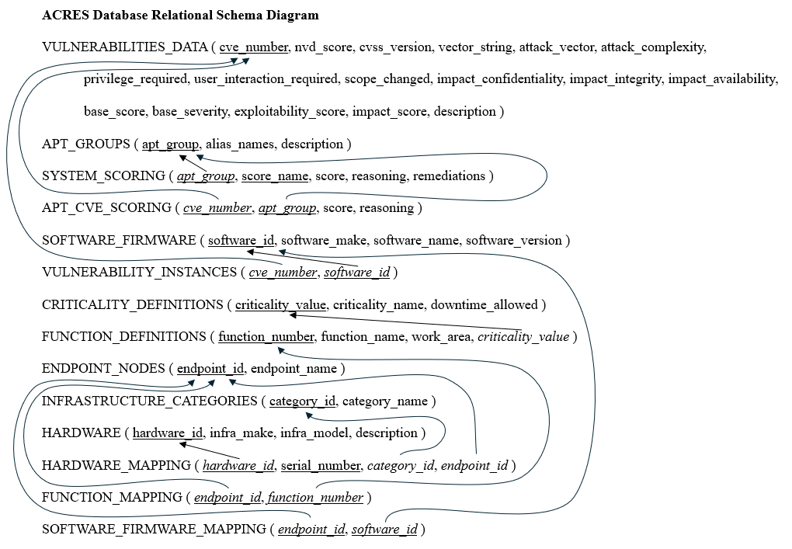
Relational Schema

Slide 8
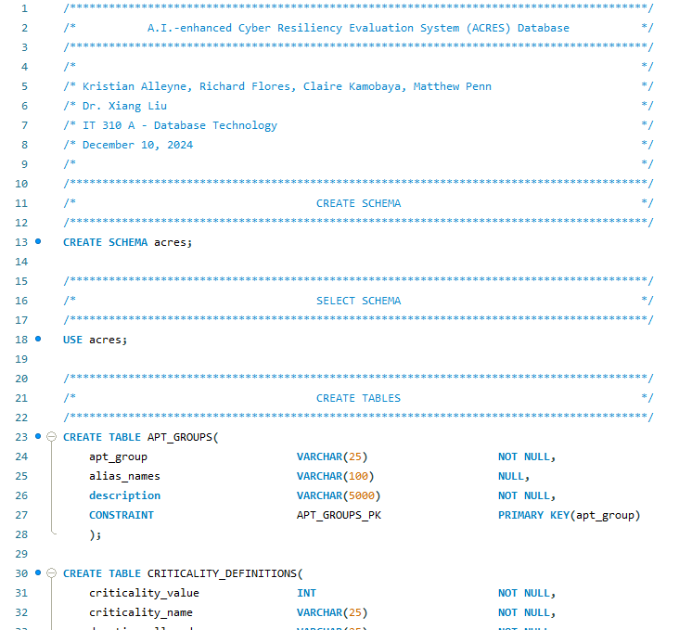
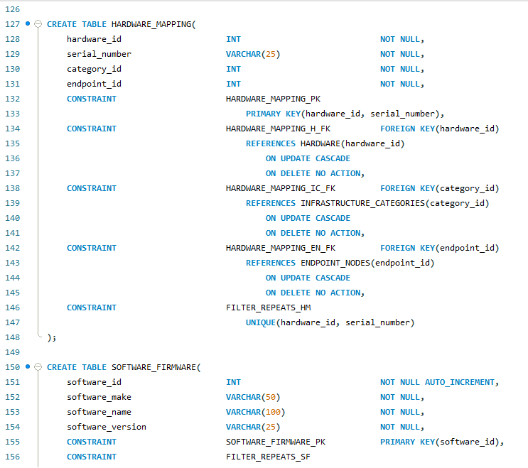
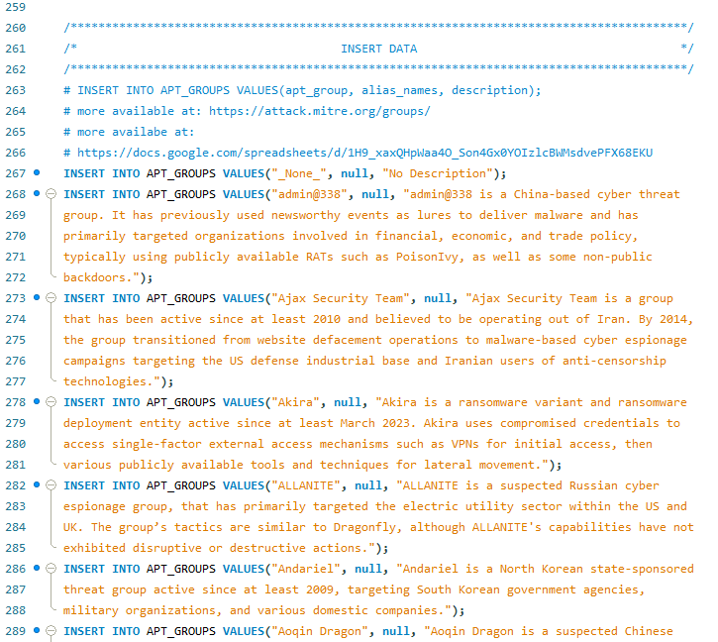
DDL
Script
Database Implementation

Slide 9
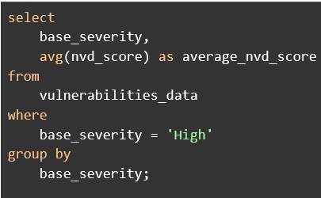
Code Part 1.
Purpose - Calculates the average nvd_score for vulnerabilities classified as having a “HIGH” base severity.

Slide 10
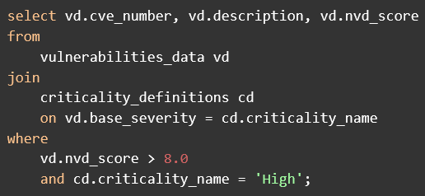
Code Part 2.
Purpose - Retrieves vulnerabilities with an nvd_score above 8.0 and mapped to a criticality level of "HIGH."

Slide 11
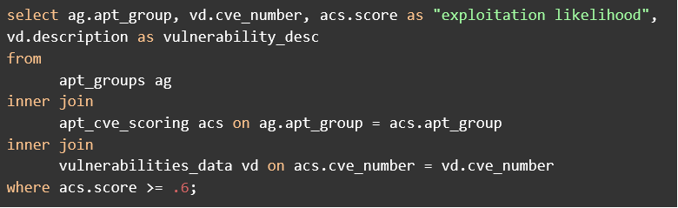
Code Part 3.
Purpose - To find the CVE’s that a given APT is most likely to exploit. Any score above .60 are vulnerabilities that would need to be patched immediately if the customer would like to prepare against this APT.

Slide 12
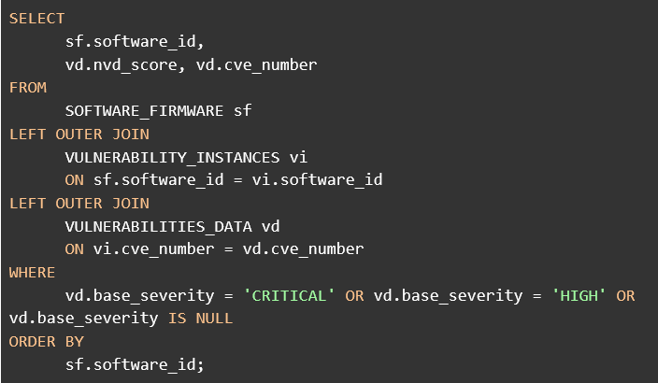
Code Part 4.
Purpose - Showcases all software id and shows the “HIGH” and “CRITICAL” vulnerabilities on the software. Also highlights the software that has no detected vulnerabilities.

Slide 13
Thanks!

