Slide 1
Starting with Bug Bounties – Naïve Recon
Satyam Gothi

Slide 2
whoami
Associate Security Consultant @ SecureLayer7
Part Time Bug Bounty Hunter – Found several bugs in Sony, Dell, Underarmour, Mail.ru, etc.
CTF Player
Youtuber, Blogger
Just another Newbie in the Infosec Scene

Slide 3
Bug Bounty Myths vs. Reality
Myths
Reality
Easy Money
Less input, more output
Minimal Efforts
Not much knowledge needed
Can easily replace a Full time Job for anyone
Uneven Payout, not easy
More Input, Less Output (Hard Work)
You fail 10x more than you succeed
Definitely need some knowledge of how stuff works and an eye for details
Really really difficult to do Bounties full time unless you’re too good at it.

Slide 4
Yet some more Facts
Anyone can do it
You don’t need to know absolutely everything
Can learn a lot of stuff
Helps develop a Hacker Mindset and Out of the Box though process
With persistence and consistency, can a earn decent amount
A Huge live playground to test your skills legally!

Slide 5
Some Secrets to Start with Bug Bounties
JUST START
There’s always something new to learn
Approach it like a game or a puzzle
STOP LOOKING FOR A MAGIC FORMULA
Get ready to be Duped
Expectations hurt

Slide 6
First Step in Hacking – Reconnaissance
What’s Recon?
Some Ideas to Initial Recon
Some Advanced stuff
Is it actually worth our time?

Slide 7
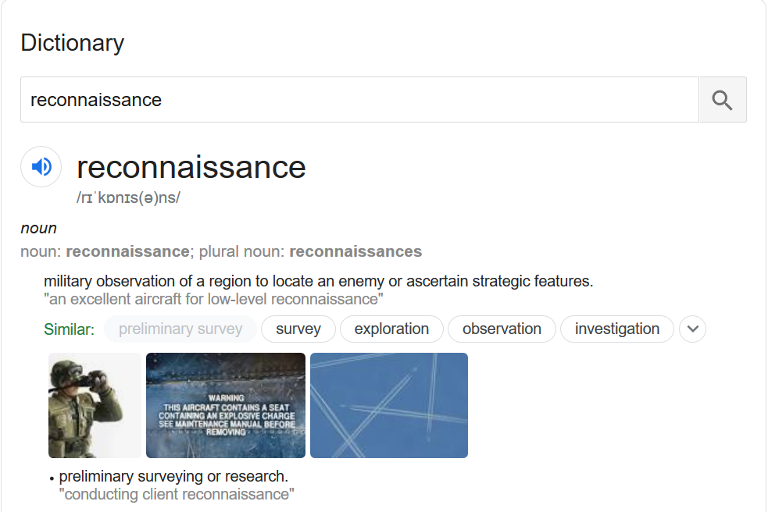
What is Recon?

Slide 8
Some Ideas to Initial Recon
Robots.txt
Source Code
Find Techstacks
JS Files – Dumb Static Analysis
Burp Crawl
Active Recon

Slide 9
Further moving on with some Adv. Recon
Open Ports(if in scope)
Brute Force
Find Directories and Paths
Find Parameters
OSINT
Historic Public Urls/Links
Google Dorking
More effective JS File Analysis
Burp Search
Funky Grep
Mix match things and Sort out “Interesting” stuff
Naïve Automation - Scavenger

Slide 10
All this even worth it?
Found multiple bugs using:
Simple dorks
Brute Forcing for Directories/Files
Some Internal Unauthenticated Panel/Dashboard on another Port
Parameter Discovery

Slide 11
Finding “New” Things
Wayback Machine
Google Dorking
Tools:
GAU(get all urls):
gau example.com
Ffuf:
ffuf -w /path/to/wordlist -u https://target/FUZZ -recursion -recursion-depth 2
ffuf -w /path/to/values.txt -u https://target/script.php?valid_name=FUZZ -fc 401
Arjun:
python3 arjun.py -u https://api.example.com/endpoint --get

Slide 12
What more with JS Files?
Hardcoded Stuff – api keys, credentials, Hidden links, etc.
Tools:
Jsscanner:
Jsscanner alive.txt

Slide 13
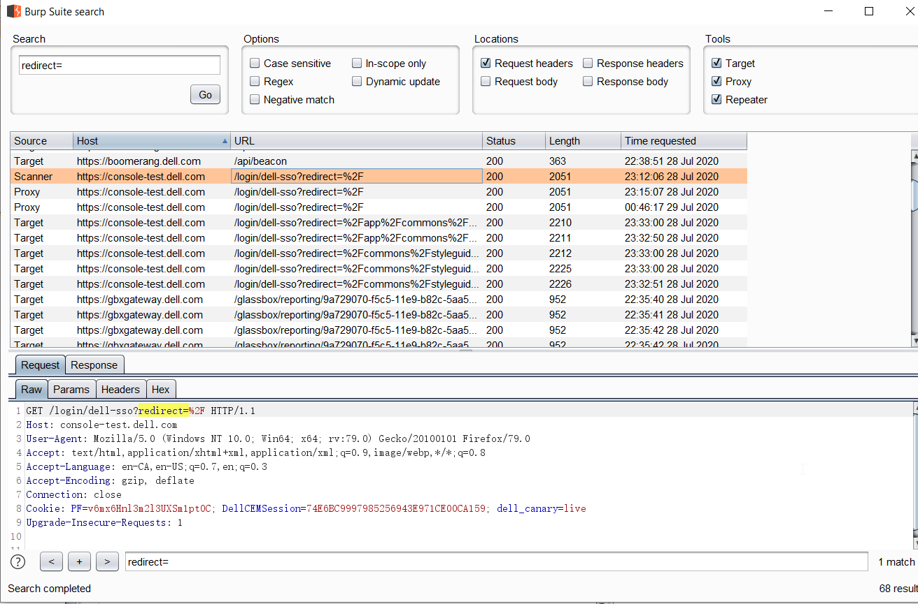
Burp Search?

Slide 14
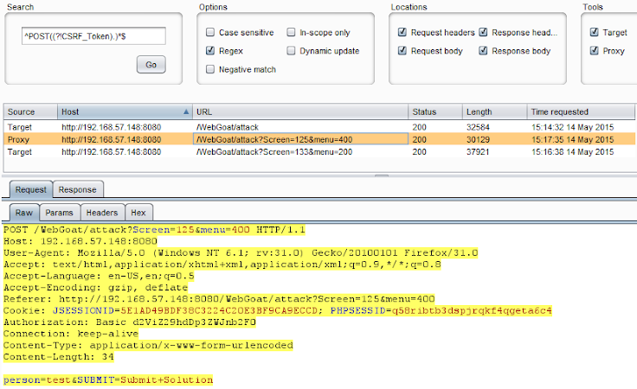
Burp Search, again?

Slide 15
Grep the Bugs
Grepping out “Interesting” stuff
cat links.txt | unfurl format %p | grep api | awk -F '[/]' '{print };{print };{print };{print };{print };{print };' | egrep -v 'api|^[[:space:]]*$' | sort -u
Tool(kind of):
GF
GF-Patterns

