Slide 1
Lecture 13: Final Review
CS420: Introduction to AI
Zhize LI

Slide 2
Agenda
Quiz 2 solutions
Course review
Final exam preparation
Q&A

Slide 3
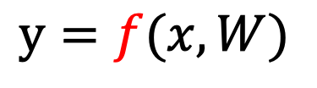
AI System
Reasoning · Vision · Language · Decision
Probabilistic reasoning (Bayesian Networks, Inference)
Computer vision (CNN)
NLP (Word2Vec, Attention)
Decision making (Search, MDP, RL)
Deep neural networks ( )
A general learning framework for modern AI, applicable across all components
$$y=f(x,W)$$

Slide 4
Probability Fundamentals
Random variables, events
Conditional probability
Chain rule
Bayes rule
Marginalization
Independence
Conditional independence (key for Bayes Nets)

Slide 5
Bayesian Networks & Inference
Naïve Bayes
Directed Acyclic Graph (DAG) representation
Factorization of joint distribution
Local Markov property (conditional independence)
D-separation (cascade, common cause, v-structure)
Marginal inference, posterior inference
Variable Elimination (intermediate factors)

Slide 6
Neural Networks
Linear transformation (dot product, matrix-vector multiplication)
Activation functions (ReLU, softmax)
Loss functions (cross-entropy, mean squared error)
Optimization (gradient descent)
Training (learning parameters by minimizing the loss)

Slide 7
Computer Vision
CNN (convolution, filters, stride, padding)
Max pooling (downsampling, )
Output shape
Number of trainable parameters

Slide 8
Natural Language Processing (NLP)
NLP pipeline (tokenization, POS tag, lemmatization)
Word embeddings (Co-occurrence matrix,Word2Vec)
Similar words, analogies (cosine similarity)
Compose representations for documents (e.g., average)
Feed into DNNs to accomplish complex NLP tasks
Modern NLP: Attention (core of Transformers)
Dynamic context embeddings
Query Q, Key K, Value V

Slide 9
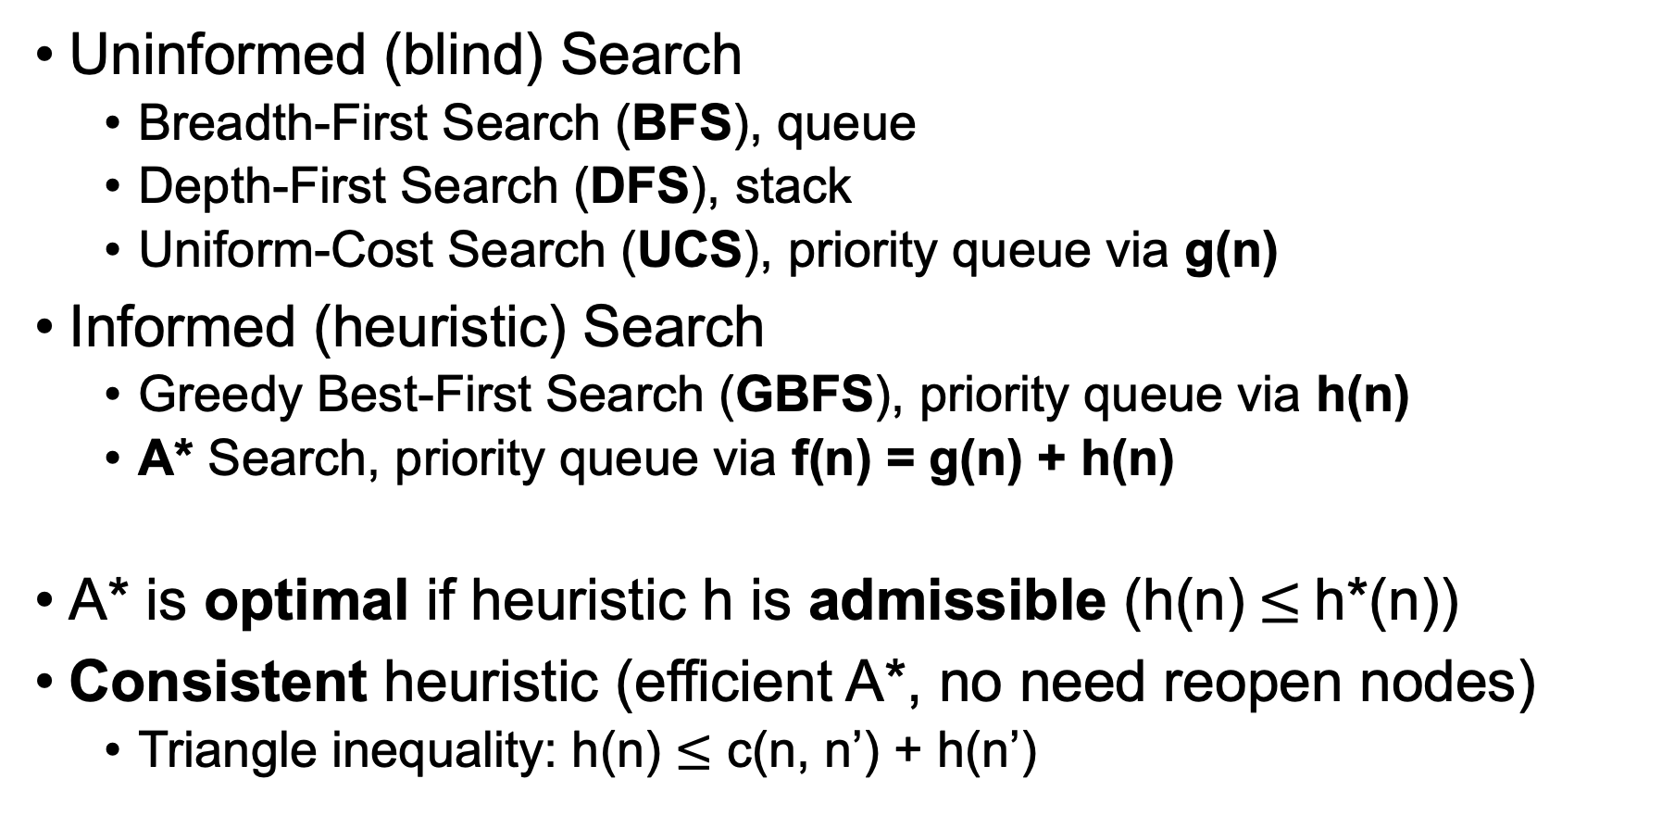
Search Algorithms
Uninformed (blind) Search
Breadth-First Search (BFS), queue
Depth-First Search (DFS), stack
Uniform-Cost Search (UCS), priority queue via g(n)
Informed (heuristic) Search
Greedy Best-First Search (GBFS), priority queue via h(n)
A* Search, priority queue via f(n) = g(n) + h(n)
A* is optimal if heuristic h is admissible (h(n)$≤$h*(n))
Consistent heuristic (efficient A*, no need reopen nodes)
Triangle inequality: h(n) $≤$ c(n, n’) + h(n’)

Slide 10
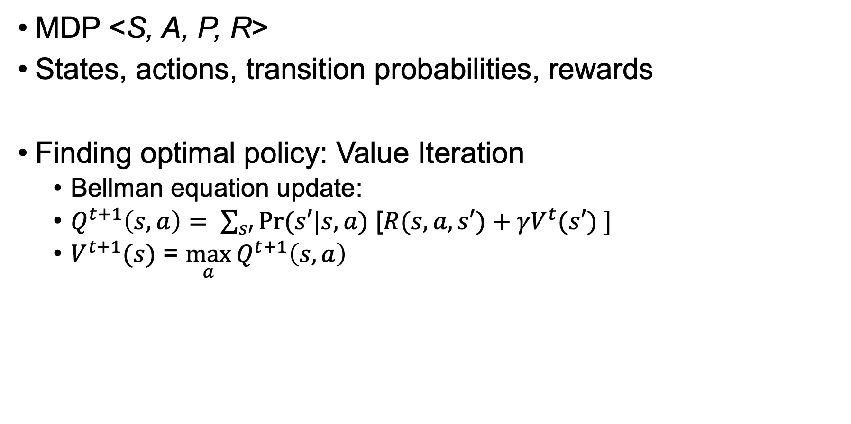
Markov Decision Process (MDP)
MDP <S, A, P, R>
States, actions, transition probabilities, rewards
Finding optimal policy: Value Iteration
Bellman equation update:
$Q^{t+1}\left(s,a\right)= \sum_{s′}{Pr⁡(s′|s,a)\text{ [}R(s, a, s′)+{γV}^{t}(s′) ]}$
$V^{t+1}(s)$ = $\max_{a}{Q^{t+1}\left(s,a\right)}$

Slide 11
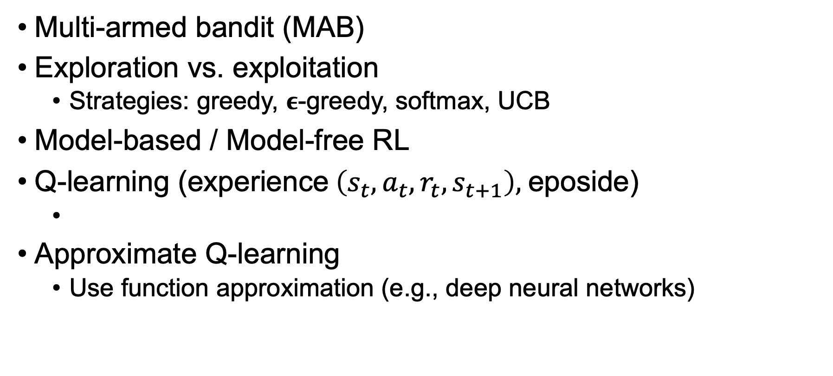
Reinforcement Learning (RL)
Multi-armed bandit (MAB)
Exploration vs. exploitation
Strategies: greedy, 𝛜-greedy, softmax, UCB
Model-based / Model-free RL
Q-learning (experience$\left(s_{t}, a_{t}, r_{t},s_{t+1}\right),$eposide)
Approximate Q-learning
Use function approximation (e.g., deep neural networks)
$$Q^{new}\left(s_{t}, a_{t}\right)=Q\left(s_{t},a_{t}\right)+α∗[r_{t}+γ∗\max_{a} Q\left(s_{t+1},a\right)−Q(s_{t}, a_{t})]$$

Slide 12
Final Exam Preparation
Duration: 2 hours
Format:
Closed book
One A4-size cheat sheet allowed
Calculator allowed (no phones, tablets, laptops, etc.)
A sample exam will be provided for practice
Focus on understanding and reasoning rather than memorization
Show your steps clearly
Use your cheat sheet wisely

Slide 13
Q&A
Any questions?

Slide 14

Thank You – Teaching Assistant
Pengwen CHEN

Slide 15

Thank You – Teaching Assistant
Cledwyn CHAN

Slide 16

Course Feedback
Please take a few minutes to complete the feedback now
It only takes about 5 minutes
Your feedback helps improve the course for future students
Access via:
OASIS > BOSS Bidding app > Quick Links > Course Feedback
Or scan the QR code (for phone access)
https://coursefeedback.intranet.smu.edu.sg/student/selection.asp

Slide 17
Thank You
Thank you all for being part of CS420
Reasoning · Vision · Language · Decision
All the best for your final exams

