Slide 1
Lecture 10: Markov Decision Process (MDP)
CS420: Introduction to AI
Zhize LI

Slide 2
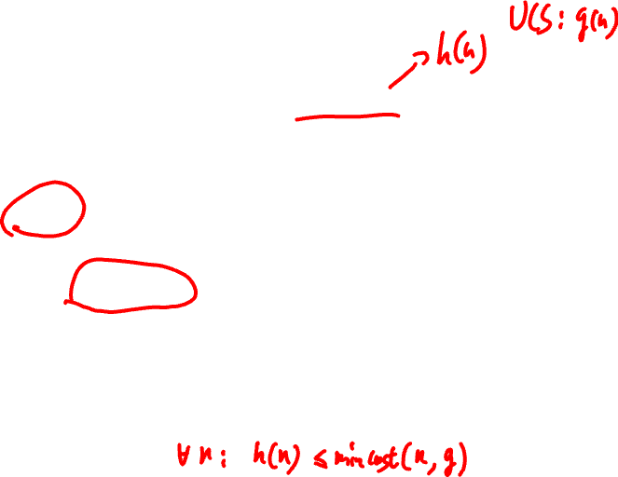
Recap: A* Search
Greedy Best-First Search (GBFS) is not optimal since it does not consider the cost incurred so far
Let g(n) be the cost-so-far to state n from start state
Let h(n) be the estimated cost-to-goal from state n
A* Search is a heuristic search using f value:
f(n) = g(n) + h(n)
Compared to GBFS:
Dequeue state n from front of a priority queue (with respect to f(n))
Enqueue all successors with priorities, f(n’) (node expansion)
A* Search is optimal if with admissible heuristic h
Notes:
h(n) \leq mincost(n, goal) forall n
h(n) \leq h*(n)
Admissible: h always underestimates the true cost
A heuristic $h\left(n\right)$ is admissible if it never overestimates the true cost to reach the goal, i.e., the heuristic value of a state is less than or equal to minimum cost from that state to the goal

Slide 3

Recap: A* Search: Node Expansion
For each child node n’ of node n:
Compute f value of node n’: f(n’) = g(n’) + h(n’) = g(n) + c(n,n’) + h(n’)
Case1: New node
If n’ is not in Frontier (Open List) or Explored (Closed List):
Add n’ to the Open List (i.e., priority queue)
Case 2: Already in Open List
If n’ is in Open List & the new f value is lower:
Replace the existing node n’ with new version
Case 3: Already in Closed List (reopen)
If n’ is in Closed List & the new f value is lower:
Reopen the node n’, i.e., delete n’ from Closed List and add n’ to Open List
Notes:
g(n): cost-so-far
h(n): estimated cost-to-goal
c(n, n’) is the cost for the action mapping state n to state n’
f(child) = g(parent) + cost_action + h(child)
f(n’) = g(n’) + h(n’) = g(n) + c(n,n’) + h(n’)
>= g(n) + h(n) = f(n)
If the heuristic is consistent, a node never needs to be reopened. If the heuristic is only admissible, A* need to reopen nodes to remain optimal.

Slide 4
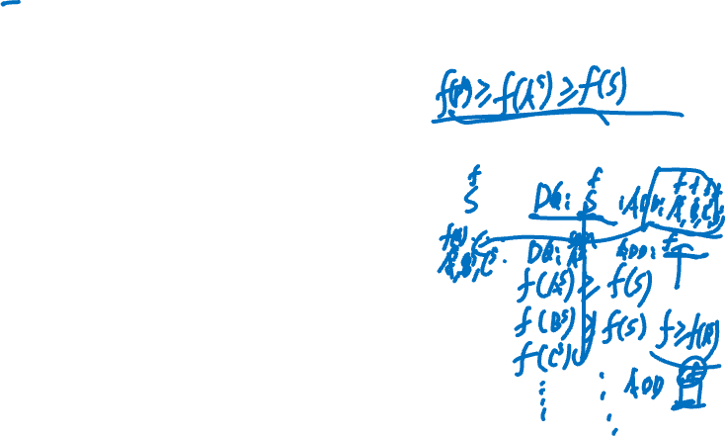
Recap: A* Search
Open List
A* Search
f value
Closed List
Reopen
node
f value
else if child.STATE is in explored with higher f value then delete child from explored, add to frontier with new f value
Notes:
1. g(n) in UCS or h(n) in GBFS, replaced by f(n) = g(n) + h(n)
2. reopen the closed/explored nodes with lower f value
If the heuristic is consistent, a node never needs to be reopened. If the heuristic is only admissible, A* must allow reopening nodes to remain optimal.

Slide 5
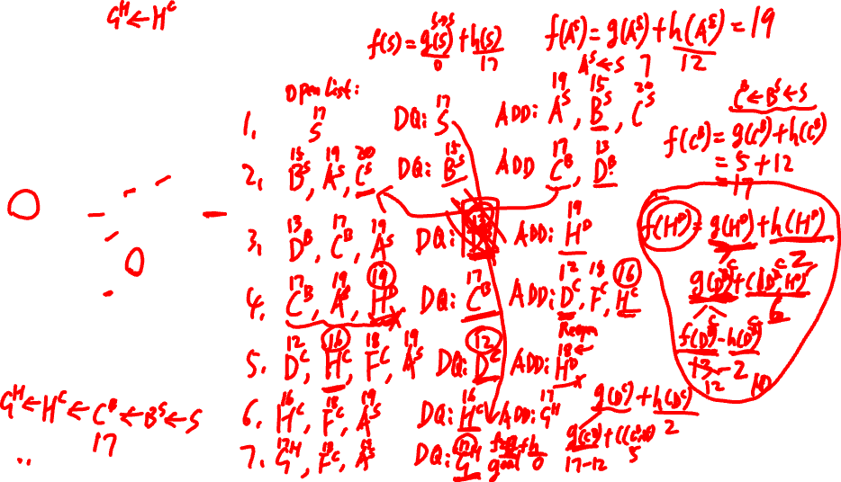
Homework
A* Search
17
S
7
8
4
11
B
1
C
12
12
A
7
5
6
6
9
4
E
D
2
F
7
5
6
4
H
2
3
G
0
Notes:
admissible or not? Yes (admissible -> A* optimal)
min_cost h*: G 0, H 3, E 8, D 9, F 7, A 14, B 13, C 12, S 17
A-E: h(A)> c(A,E)+h(E), not consistent, need reopen closed nodes
1. S(17) DQ: S(17) ADD: A^S(19), B^S(15), C^S(20)
2. B^S(15), A^S(19), C^S(20) DQ: B^S(15) ADD: C^B(17), D^B(13)
3. D^B(13), C^B(17), A^S(19) DQ: D^B(13) ADD: H^D(19)
4. C^B(17), A^S(19), H^D(19) DQ: C^B(17) ADD: D^C(12) (reopen node D), F^C(18), H^C(16) (replace node H)
5. D^C(12), H^C(16), F^C(18), A^S(19) DQ: D^C(12) ADD: H^D(18) (ignore higher cost)
6. H^C(16), F^C(18), A^S(19) DQ: H^C(16) ADD: G^H(17)
7. G^H(17), F^C(18), A^S(19) DQ: G^H(17) (goal test) Retrieve the path (from closed/explored list)
G^H <– H^C <– C^B <– B^S <– S path cost: 17 Optimal

Slide 6
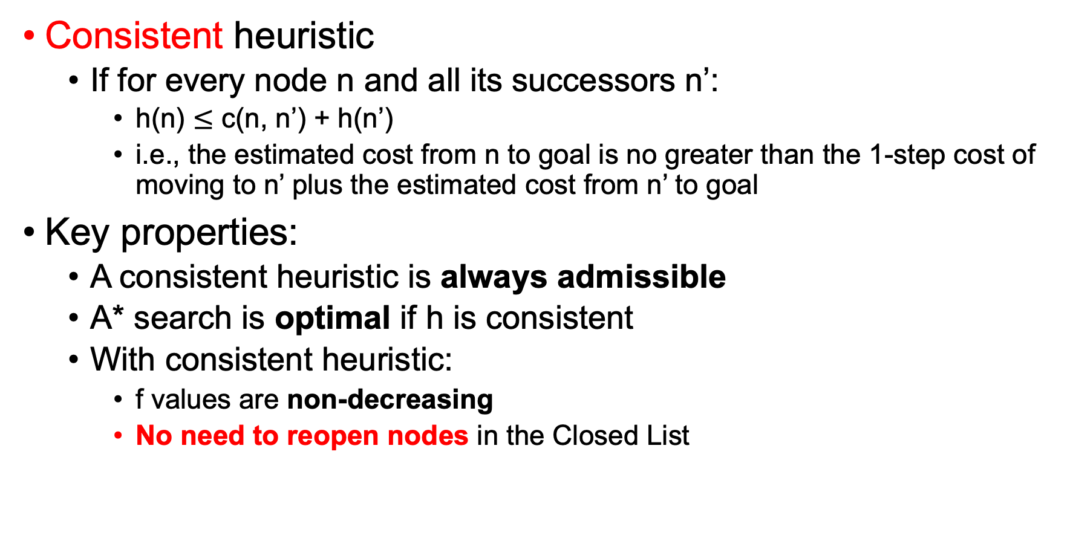
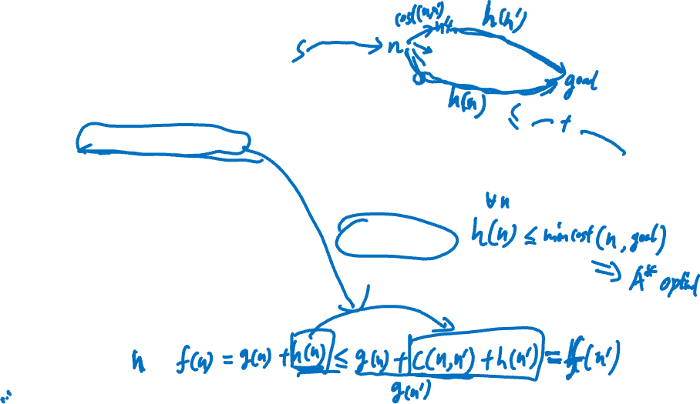
Efficient A* Search
Consistent heuristic
If for every node n and all its successors n’:
h(n) $≤$ c(n, n’) + h(n’)
i.e., the estimated cost from n to goal is no greater than the 1-step cost of moving to n’ plus the estimated cost from n’ to goal
Key properties:
A consistent heuristic is always admissible
A* search is optimal if h is consistent
With consistent heuristic:
f values are non-decreasing
No need to reopen nodes in the Closed List
Notes:
triangle inequality
f(n’) = g(n’) + h(n’) = g(n) + c(n,n’) + h(n’)
>= g(n) + h(n) = f(n)
h(n) \leq mincost(n, goal) forall n
h(n) \leq h*(n)
Admissiable: h always underestimates the true cost
A heuristic $h\left(n\right)$ is admissible if it never overestimates the true cost to reach the goal, i.e., the heuristic value of a state is less than or equal to minimum cost from that state to the goal

Slide 7
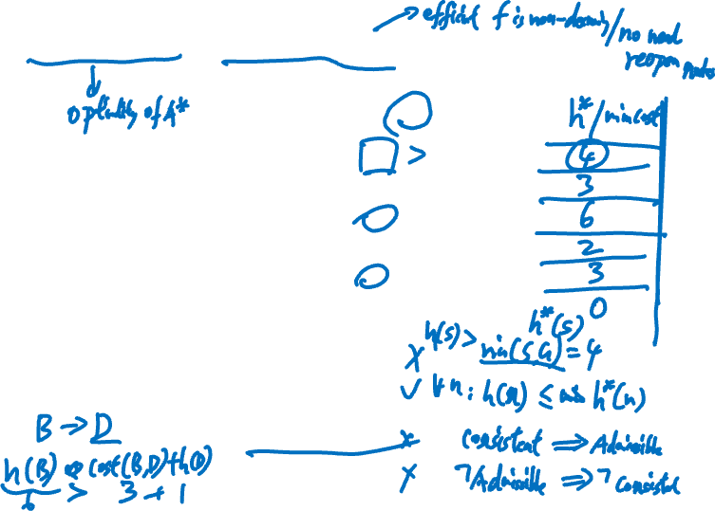
Exercise: Admissible/Consistent Heuristic
State | Heuristic h₁ | Heuristic h₂
S | 5 | 3
A | 3 | 2
B | 6 | 6
C | 2 | 1
D | 1 | 1
G | 0 | 0
Is h₁ admissible?
Is h₂ admissible?
Is h₁ consistent?
Is h₂ consistent?
Notes:
never overestimates / always underestimates the true cost
h(n) \leq min_cost(n, goal)
h(n) \leq h*(n)
h*: 4, 3, 6, 2, 3, 0
No: h₁(S) > h*(S)
Yes.
No. Consistent implies admissible. Contrapositive
h₁(S) > c(S, A) + h₁(A);
No. h₂(B) > c(B, D) + h₂(D);
What if we change h₂(D) = 3, is it consistent? Yes.

Slide 8
Markov Decision Process (MDP)
Notes:
So far, we’ve assumed deterministic outcomes — actions lead to predictable results.
But in many real-world problems, outcomes are uncertain.

Slide 9
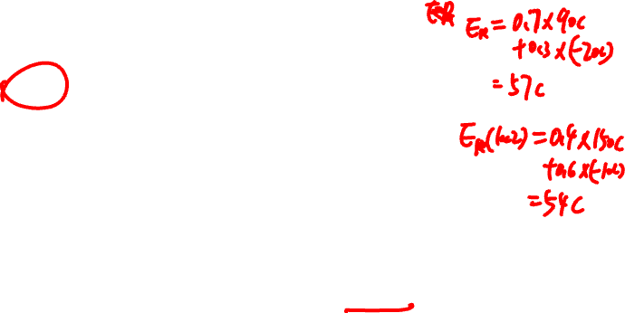
Example: Bike Sharing
Trucks have to relocate bikes periodically (e.g., every few hours) to ensure they are in right places
0.7
Rented
90 C
Loc 1
0.3
Idle
-20 C
Loc 2
0.4
Rented
150 C
0.6
Idle
-10 C
Let us take a simple problem where there are 2 locations and there is only one bike. Should it be put at Loc1 or Loc2?
Notes:
EU(Loc 1) = 0.7*90 + 0.3*(-20) = 57
EU(Loc 2) = 0.4*150 + 0.6*(-10) = 54
Probabilistic Planning: For a given action, the mapping is stochastic. Transitional uncertainty
Location 1: higher success probability
Location 2: higher reward
How do we make decisions under uncertainty?

Slide 10
Example: Bike Sharing
Which one will you pick:
Loc 1: High chance of success
Loc 2: Higher reward for success
Make a choice based on two elements
Chance of success
Consequence of success/failure
Notes:
0.7 vs 0.4
90c vs 150c

Slide 11
Decision Theory
Uncertainty changes the decision making process
Probability Theory + Utility Theory
Probability theory deals with chance
Utility theory deals with consequence
Fundamental Idea
Maximum Expected Utility (MEU)
Choose the action with the highest EU
Will focus on single decisions first, then come back to sequential decisions (MDP)
Notes:
Probabilistic Planning: For a given action, the mapping is stochastic. Transitional uncertainty

Slide 12
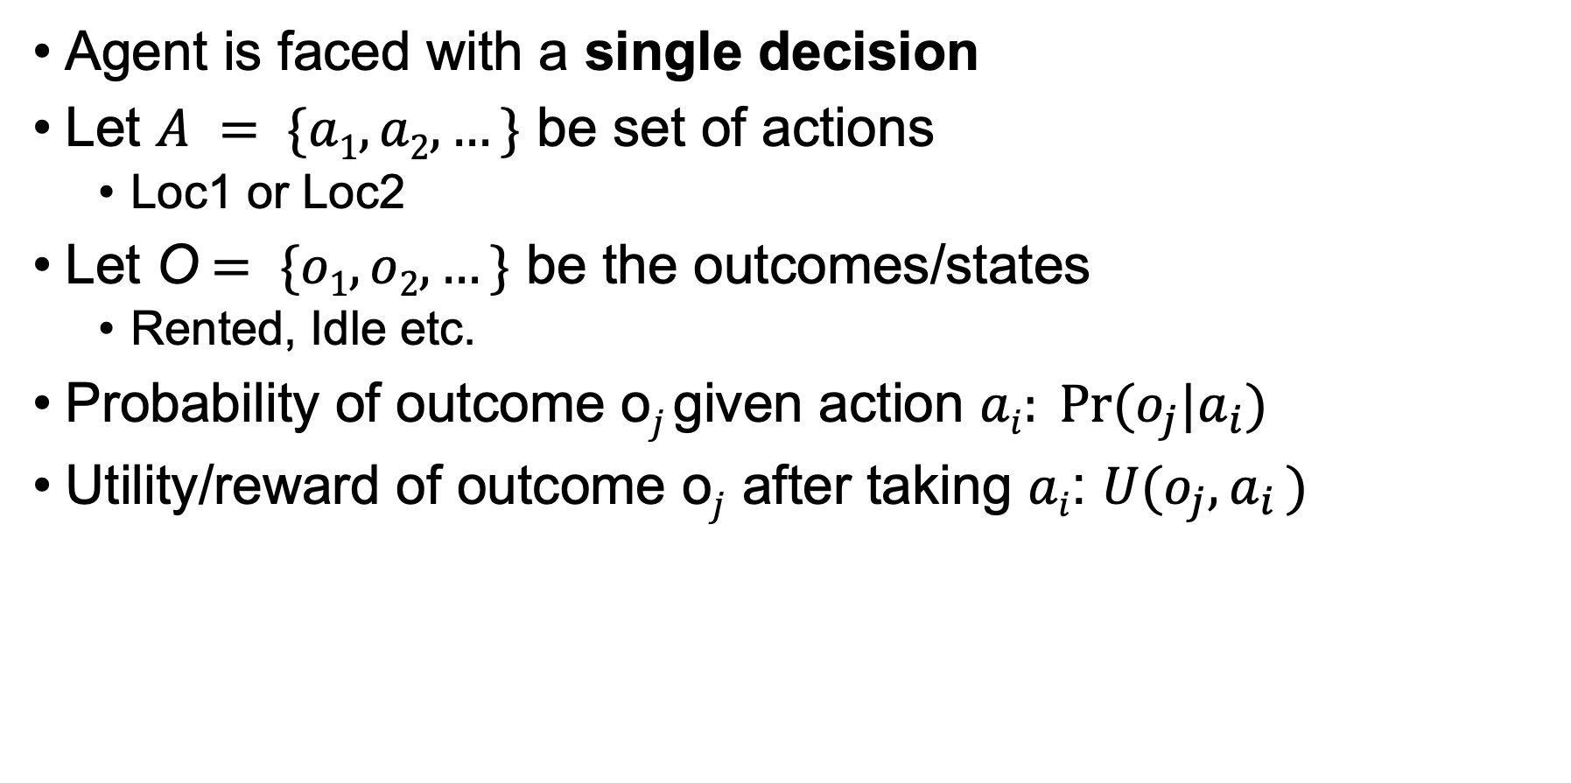
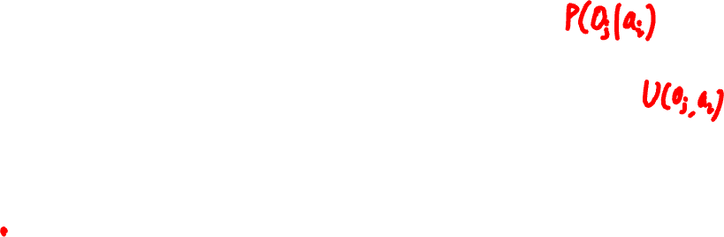
Maximum Expected Utility (MEU)
Agent is faced with a single decision
Let $A = \{a1, a2, …\}$ be set of actions
Loc1 or Loc2
Let O$= \{o1, o2, …\}$ be the outcomes/states
Rented, Idle etc.
Probability of outcome o$j$given action $ai: Pr⁡(o_{j}|a_{i})$
Utility/reward of outcome o$j$after taking $ai$: $U(o_{j}{,a}_{i})$
Notes:
Utility is like a prior domain knowledge, or learn from experience
A = {Loc1, Loc2}
O = {Rented, Idle}
P(Rented | Loc1) = 0.7
U(Rented, Loc1) = 90c

Slide 13
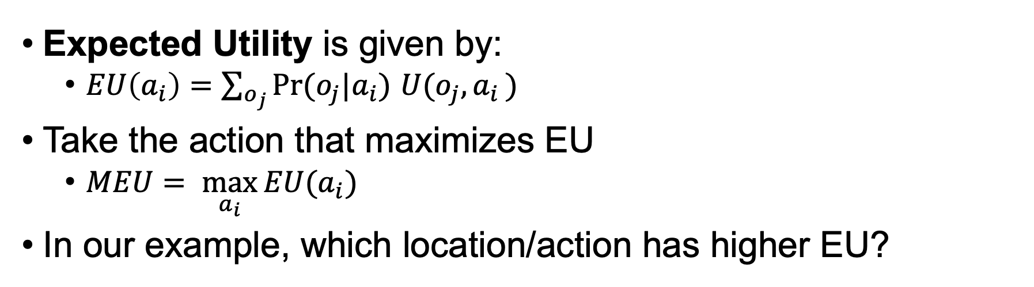
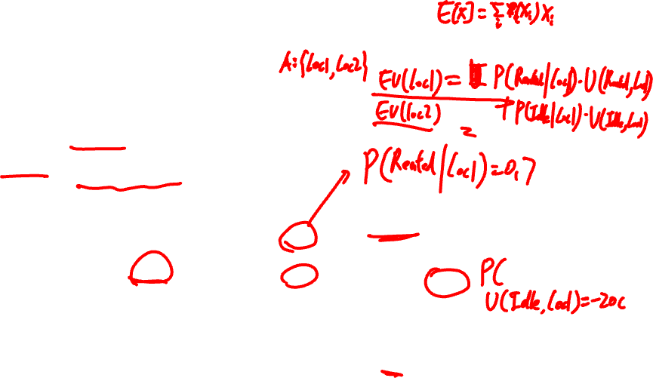
Maximum Expected Utility (MEU)
Expected Utility is given by:
$EU\left(a_{i}\right)=\sum_{o_{j}}{Pr⁡(o_{j}|a_{i}) U(o_{j}{,a}_{i})}$
Take the action that maximizes EU
$MEU= \max_{a_{i}}{EU(a_{i})}$
In our example, which location/action has higher EU?
0.7
Rented
90 C
Loc 1
0.3
Idle
-20 C
Loc 2
0.4
Rented
150 C
0.6
Idle
-10 C
Notes:
Utility is like a prior domain knowledge, or learn from experience
E[utility]
E[X] = \sum_i p(x_i) x_i
A = {Loc1, Loc2}
O={Rented, Idle}
EU(Loc 1) = P(Rented|Loc1)*U(Rented, Loc1) + P(Idle|Loc1)*U(Idle, Loc1) = 0.7*90 + 0.3*(-20) = 57
EU(Loc 2) = 0.4*150 + 0.6*(-10) = 54
MEU = 57, choose the action Loc1

Slide 14
So far …
We have considered a problem where a single decision (loc1 or loc2) is made
Due to uncertainty, each action can lead to multiple possible outcomes
Next, we consider problems where a sequence of decisions has to be made
Imagine repeatedly relocating the bike during the day
Notes:
Rented/Idle
So far, we’ve only considered one decision.
But in many problems, we need to make a sequence of decisions.
For example:
relocating bikes multiple times
navigating a maze step by step

Slide 15
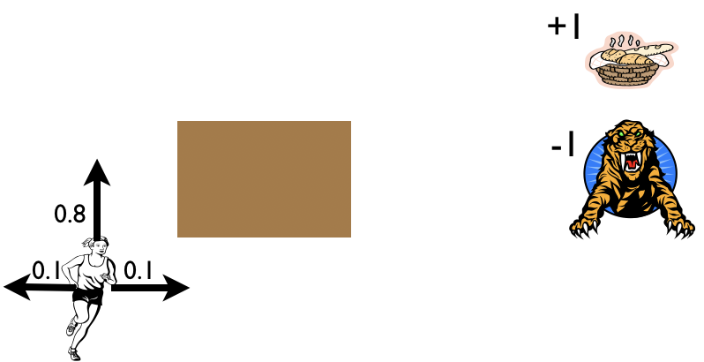
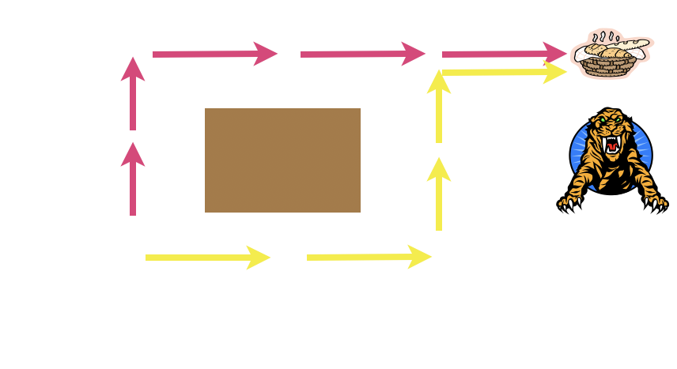
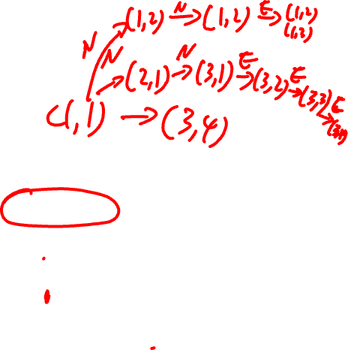
Sequential Decision Making
Example: Maze
Agent lives in a grid
Walls block the agent’s path
Needs to get to food cell without getting eaten by the tiger
Moves have transition uncertainty
What sequence of actions to take?
N, N, E, E, E? E, E, N, N, E?
3
2
1
1
2
3
4
Notes:
Slippery floor/cell
Walls/obstacles (stay the same cell if hit the wall/obstacle)
Agent starts at 𝑆₀ =(1,1), can move N,S,E,W
80% chance in moving in the intended direction, 20% change perpendicular to intended direction (split equally)
If deterministic, these two solutions will work
However, the transition is stochastic
Slippery floor/cells, the actions are not reliable. may slip to unintended direction
what does a solution to the problem look like? Not a fixed sequence of actions (cannot solve the problem due to uncertainty)
A solution must specify what the agent should do for any state that the agent might reach.
A solution of this kind is called a policy (not a fixed path). \pi(s) is the action recommended by the policy pi for state s.

Slide 16
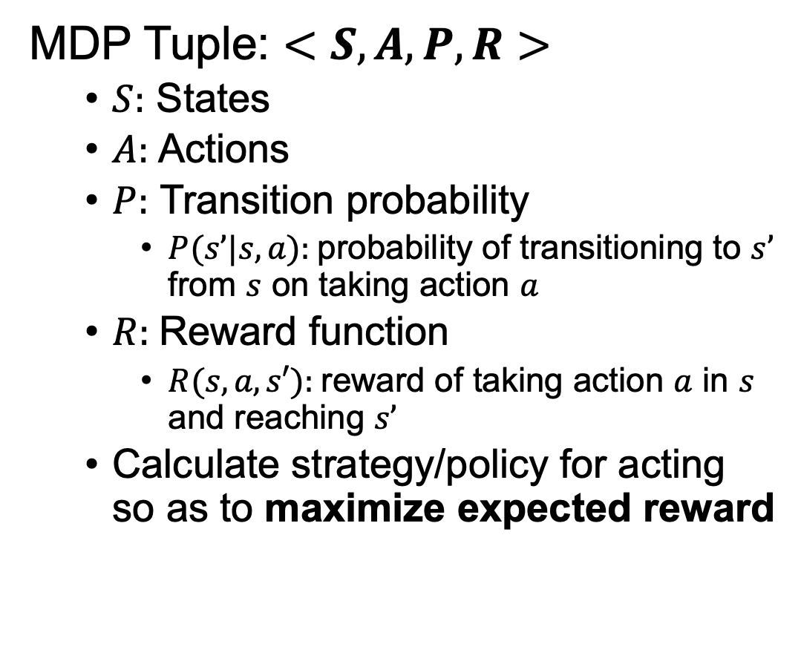
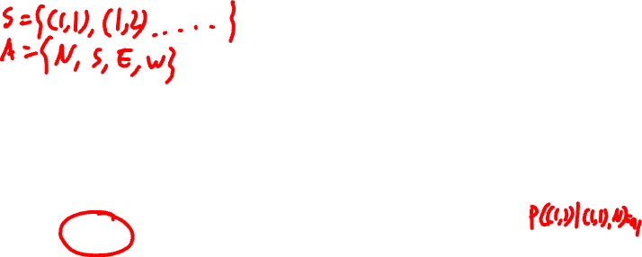
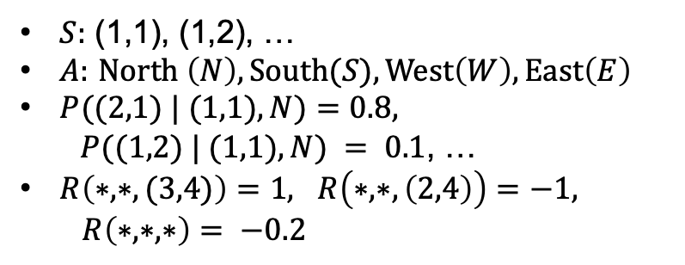
Markov Decision Process (MDP)
MDP Tuple: $<S, A, P, R>$
$S:$ States
$A:$ Actions
$P:$ Transition probability
$P(s’|s,a):$probability of transitioning to $s’$ from $s$ on taking action $a$
$R:$Reward function
$R(s,a,s′):$reward of taking action $a$ in $s$ and reaching $s’$
Calculate strategy/policy for acting so as to maximize expected reward
3
2
1
1
2
3
4
$S:$ (1,1), (1,2), …
$A:$ $North \left(N\right), South(S), West\left(W\right), East\left(E\right)$
$P((2,1) | (1,1), N)=0.8,$
$P((1,2) | (1,1), N) = 0.1$, …
$R\left(∗,∗,(3,4)\right)=1, R\left(∗,∗,\left(2,4\right)\right)=−1,$
$R\left(∗,∗,∗\right)= −0.2$
Notes:
Slippery floor/cell
Walls/obstacles (stay the same cell if hit the wall/obstacle)
Agent starts at 𝑆₀ =(1,1), can move N,S,E,W
80% chance in moving in the intended direction, 20% change perpendicular to intended direction (split equally)
The negative reward of -0.2 gives the agent an incentive to reach (3,4) quickly.
Goal: go to the food cell as fast as possible, maximize the reward
Markovian: future states only depends on current state and action, not the past history of states and actions
P(s_{t+1}|s_t, a_t, s_{t-1}, a_{t-1}, …, s_0, a_0) = P(s_{t+1}|s_t, a_t)
Simplifies decision-making and allows the problem to be modeled using Bellman Equations.
P and R are like prior domain knowledge, or learn from experience
what does a solution to the problem look like? Not a fixed sequence of actions (cannot solve the problem due to uncertainty)
A solution must specify what the agent should do for any state that the agent might reach.
A solution of this kind is called a policy (not a fixed path). \pi(s) is the action recommended by the policy pi for state s.

Slide 17

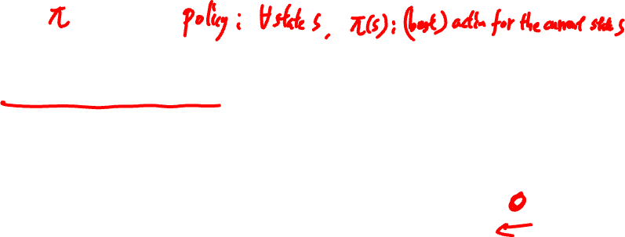
Policy
Policy is like a plan
(best) action for each state
Unlike traditional plans/paths, it is not just a sequence of actions
If there are failures, policy can still be executed (action for all states)
Maximize expected utility over all states
3
2
1
1
2
3
4
Notes:
A policy pi denoted as red arrows in the example
a mapping from states to actions
it tells the agent what to do in every possible state
what does a solution to the problem look like?
Not a fixed sequence of actions (cannot solve the problem due to uncertainty) N,N,E,E,E
A solution must specify what the agent should do for any state that the agent might reach.
A solution of this kind is called a policy (not a fixed path). \pi(s) is the action recommended by the policy pi for state s.
Learn from experience

Slide 18
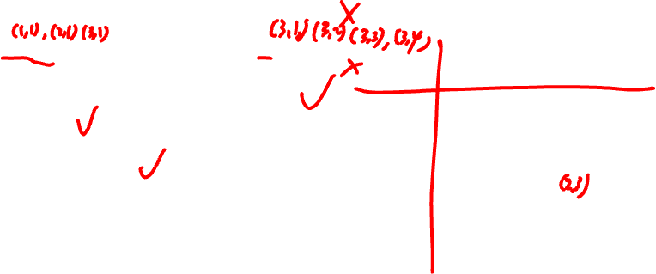
Exercise: Policy
Which ones are policies?
(1,1) → (2,1) → (3,1) → (3,2) → (3,3) → (3,4)
If state = (m,1) go North. If state = (3,n) go East
If state = (m,1) go North, otherwise go East
Always go North
Randomly pick a direction
3
2
1
1
2
3
4
Notes:
No
No
Yes
Yes
Yes

Slide 19
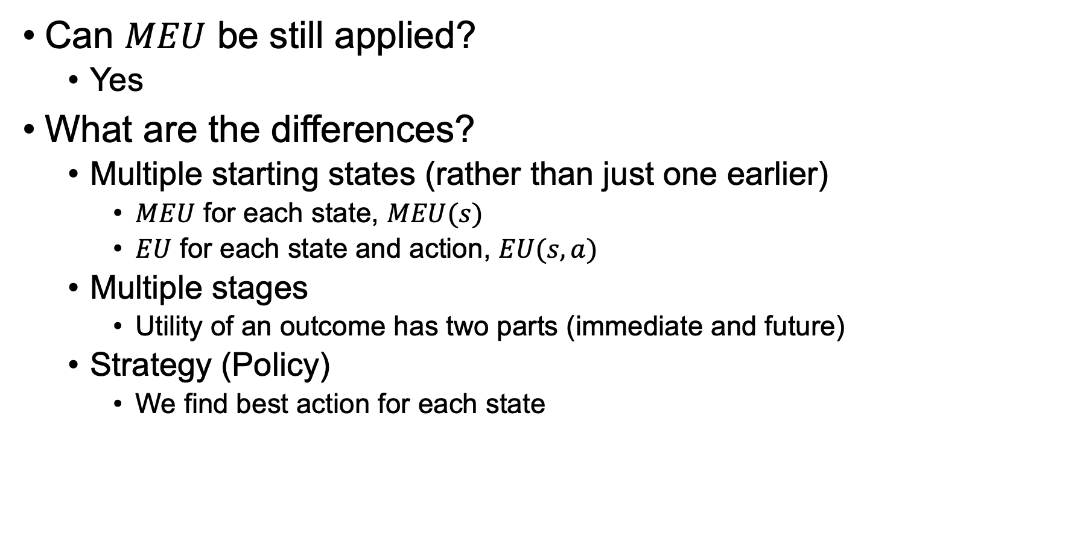
Maximum Expected Utility (MEU)
Can $MEU$ be still applied?
Yes
What are the differences?
Multiple starting states (rather than just one earlier)
$MEU$ for each state, $MEU(s)$
$EU$ for each state and action, $EU(s, a)$
Multiple stages
Utility of an outcome has two parts (immediate and future)
Strategy (Policy)
We find best action for each state
Notes:
MEU(s): (best) total expected reward starting from state s
MEU(s) = max_a EU(s,a)
EU(s,a): (best) total expected reward starting from (s,a) state s with action a

Slide 20

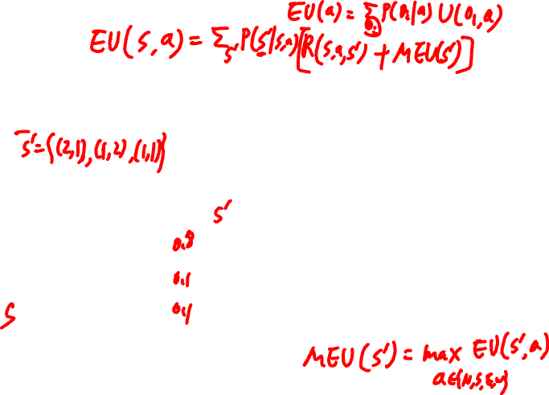
MEU
What is the formula for EU?
$EU((1,1),N) =\sum_{s′}{\operatorname{Pr}\left(s^{′} | \left(1,1\right),N\right) [R(\left(1,1\right),N,s^{′})+ MEU\left(s^{′}\right)]}$
(3,1)
…
(2,1)
…
N
S
…
(2,1)
E
…
(1,2)
W
…
N
…
S
…
(1,1)
…
(1,1)
E
…
W
…
Notes:
MEU(s): (best) total expected reward starting from state s
EU(s,a): (best) total expected reward starting from (s,a) state s with action a
MEU(1,1) = max_a\in{N,S,W,E} EU((1,1), a)

Slide 21
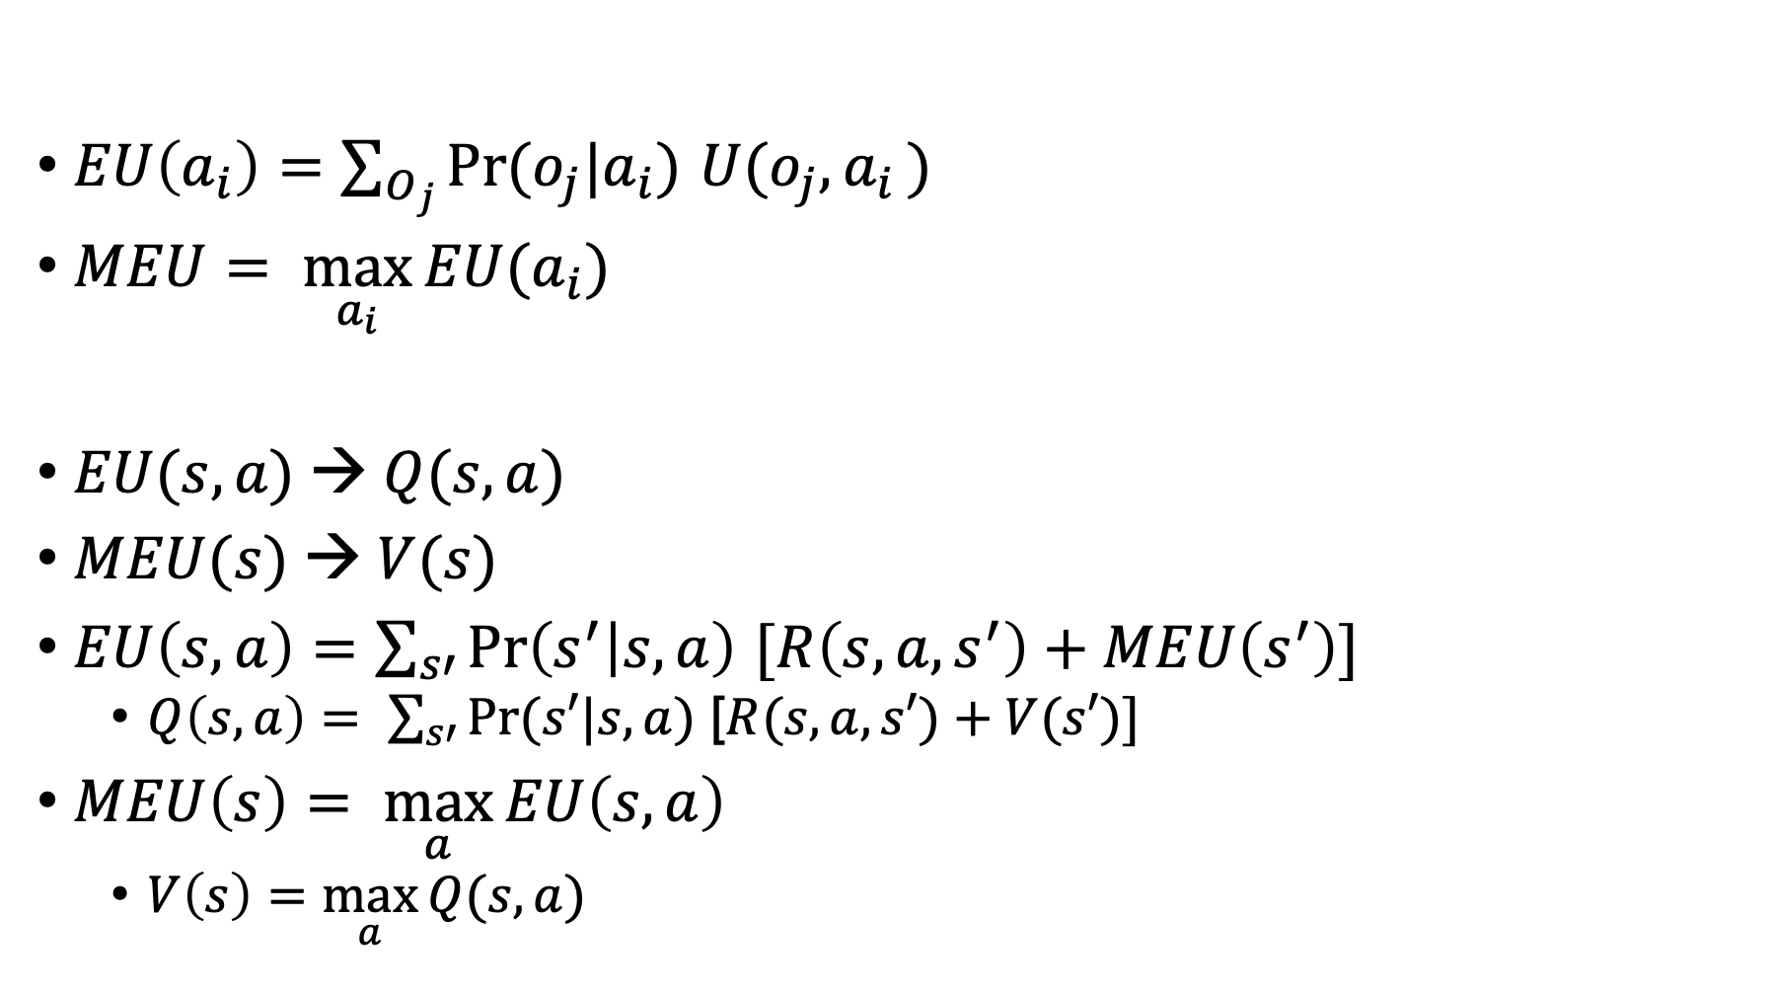
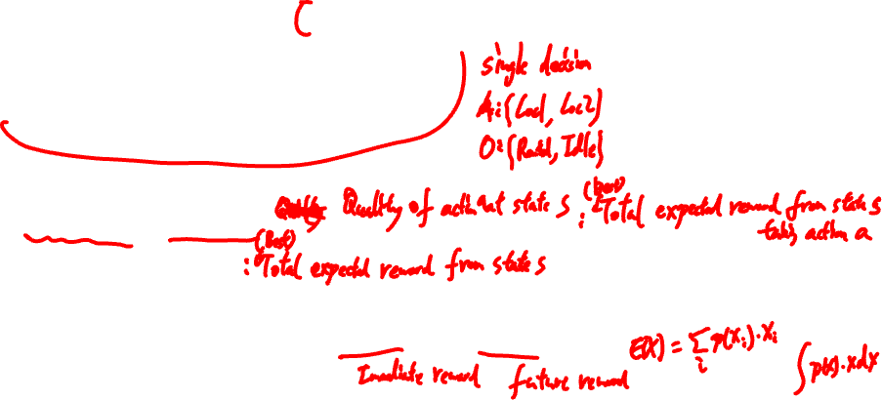
MDP Terminology (MEU Analogy)
$EU\left(a_{i}\right)=\sum_{O_{j}}{Pr(o_{j}|a_{i}) U(o_{j}{,a}_{i})}$
$MEU= \max_{a_{i}}{EU(a_{i})}$
$EU(s,a) → Q(s,a)$
$MEU(s) → V(s)$
$EU\left(s,a\right)=\sum_{s′}{Pr\left(s^{′} | s,a\right) [R\left(s,a,s^{′}\right)+MEU\left(s^{′}\right)]}$
$Q\left(s,a\right)= \sum_{s′}{Pr(s′|s,a)\text{ [}R(s, a, s′)+V(s′)]}$
$MEU\left(s\right)= \max_{a}{EU\left(s,a\right) }$
$V\left(s\right)=\max_{a}{Q(s,a)}$
Notes:
Q-function (quality of action a in state s) Q-value of (s,a)
Value function (value of state)
MEU(s): (best) total expected reward starting from state s
EU(s,a): (best) total expected reward starting from (s,a) state s with action a
Sum over all possible action outcomes
Immediate reward, future reward, discount factor gamma, inflation
Bellman Equations
Q(s,a): |S|*|A| = 12*4=48
V(s): |S| = 3*4=12
(non-linear) MDPs cannot be simply solved using linear equations

Slide 22
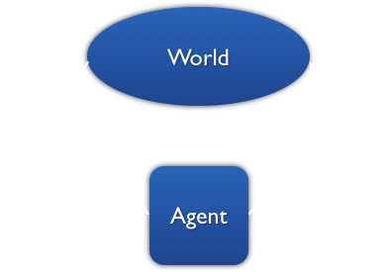
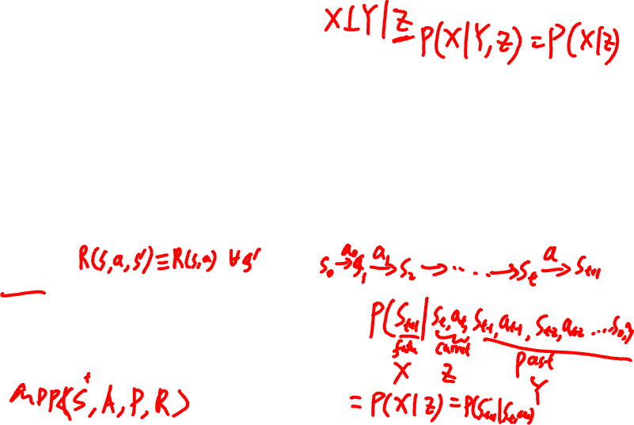
MDP Terminology (Model)
Decision step: points at which decisions are made
Finite horizon
Infinite horizon
Terminal (absorbing) state: states that do not allow any transitions out
Typically goal states
May not exist (e.g., in infinite horizon problems)
Reward:
R(s), R(s,a), R(s,a,s’)
Markov property: given current state, the future is independent of the past
Future states only depends on current state and action: P(s_{t+1}|s_{t},a)
Notes:
#steps, time T
Markovian: future states only depends on current state and action, not the past history of states and actions
P(X|Y, Z) = P(X|Z)
P(s_{t+1}|s_t, a_t, s_{t-1}, a_{t-1}, …, s_0, a_0) = P(s_{t+1}|s_t, a_t)
Simplifies decision-making and allows the problem to be modeled using Bellman Equations.
P and R are like prior domain knowledge, or learn from experience

Slide 23
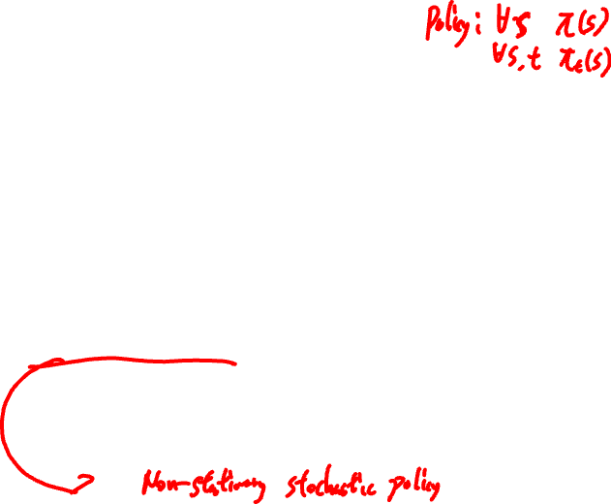
MDP Terminology (Policy)
Decision rule: specifies the action to take in each state at a given decision step
Policy: a collection of decision rules to be applied across all decision steps
Example: 2 states, 2 actions, horizon = 4
D1 | D2 | D3 | D4
S1 => A1 (0.7), A2 (0.3) S2 => A2 (1.0) | S1 => A1 (0.7), A2 (0.3) S2 => A2 (1.0) | S1 => A1 (1.0) S2 => A2 (1.0) | …
Stationary policy: (D, D, D, D…)
Non-stationary policy: (D1, D2, D3, D4,..)
Deterministic policy: all decision rules have S_{i} => A_{k} (1.0)
selects one action with probability 1 for each state
Stochastic policy: assigns a probability distribution over actions
What type of policy is the example above?
Notes:
Non-stationary stochastic policy

Slide 24

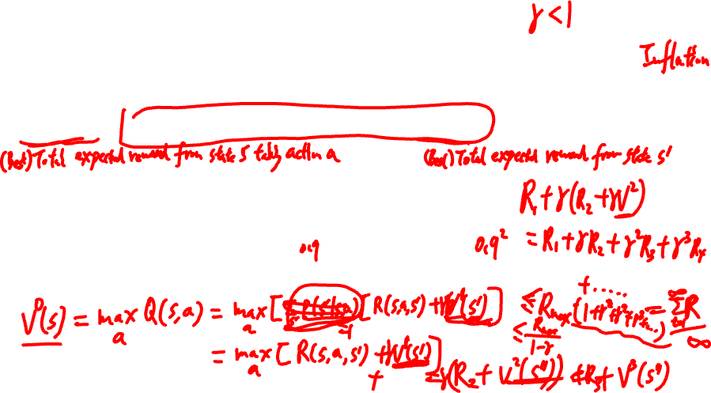
MDP Terminology (Discount Factor)
It is reasonable to prefer rewards now over rewards later
Discounting: future rewards decays exponentially over time
$Q\left(s,a\right)=\sum_{s′}{Pr(s′|s,a)\text{ [}R(s, a, s′)+γV(s′)]}$
Notes:
Inflation
Immediate, future
Typically gives incentive to reach the goal quickly.
V(s) = max_a Q(s,a)
Without gamma, V can be infinity for infinity H
With gamma < 1
Each Reward r(*,*,*) \leq R_max
V \leq R_max + R_max * gamma + R_max * gamma^2 + … \leq R_max / 1-gamma (geometric sequence)

Slide 25
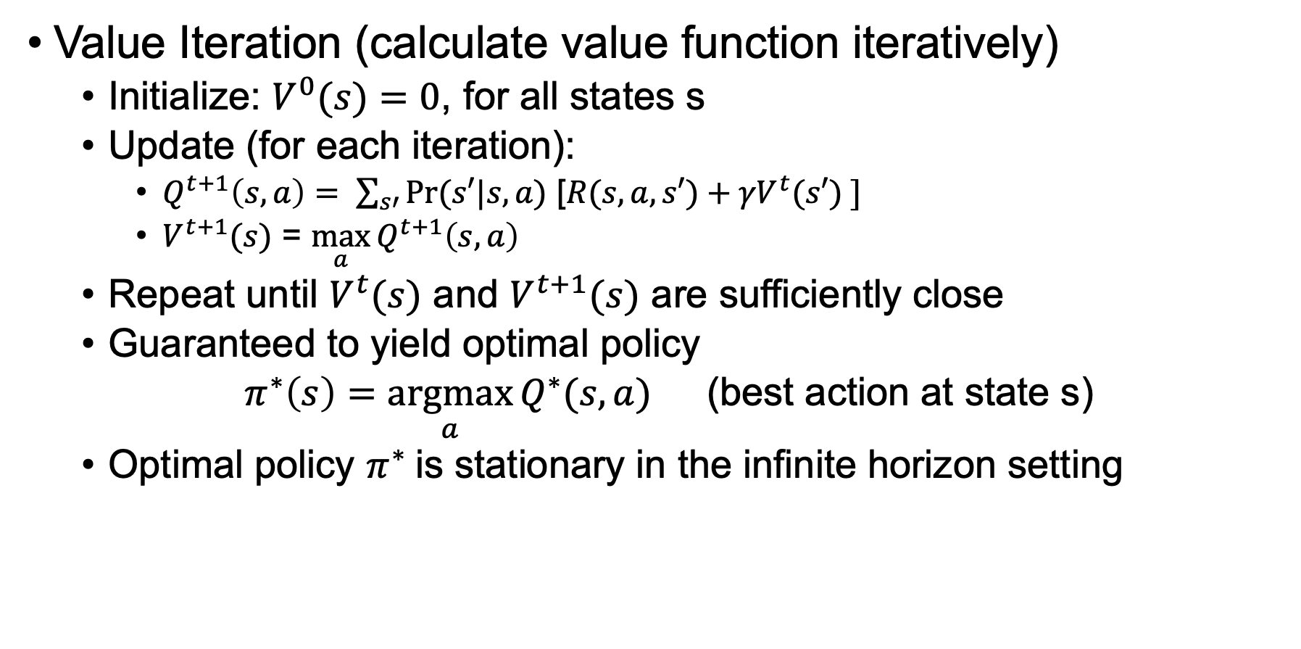
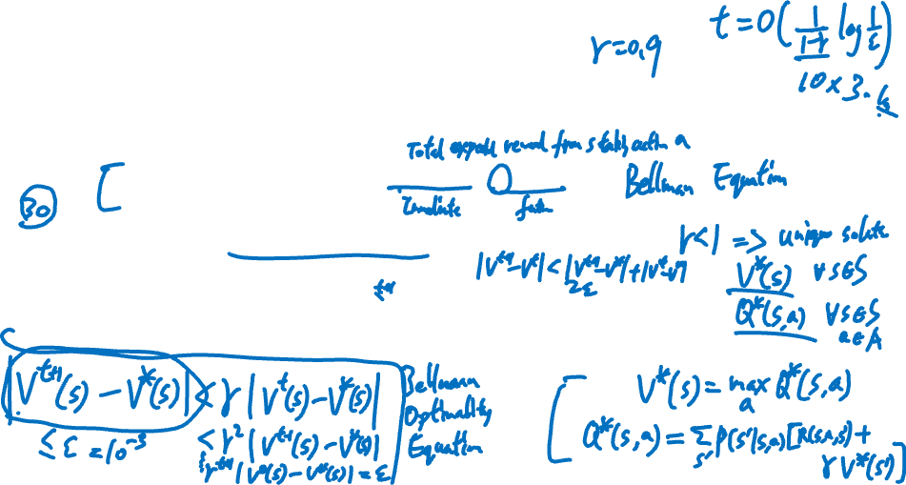
Finding Optimal Policy: Value Iteration
Value Iteration (calculate value function iteratively)
Initialize: $V^{0}(s)=0$, for all states s
Update (for each iteration):
$Q^{t+1}\left(s,a\right)= \sum_{s′}{Pr⁡(s′|s,a)\text{ [}R(s, a, s′)+{γV}^{t}(s′) ]}$
$V^{t+1}(s)$ = $\max_{a}{Q^{t+1}\left(s,a\right)}$
Repeat until $V^{t}(s)$ and $V^{t+1}(s)$ are sufficiently close
Guaranteed to yield optimal policy
$π^{∗}\left(s\right)=\underset{a}{argmax}{Q^{∗}(s,a)}$ (best action at state s)
Optimal policy $π^{∗}$is stationary in the infinite horizon setting
Notes:
t: iteration number/step
Bellman Equation, Bellman Optimality Equation
max_s |V^{t+1}(s) - V^{t}(s)| < \epsilon (e.g., 0.01)
The values are no longer changing much, we’ve basically converged.
Bellman update is a contraction: |V^{t+1}(s) – V*(s)| \leq gamma |V^t(s) –V*(s)|
T|S|^2|A|, T=O(1/(1-gamma) log1/eps)

Slide 26

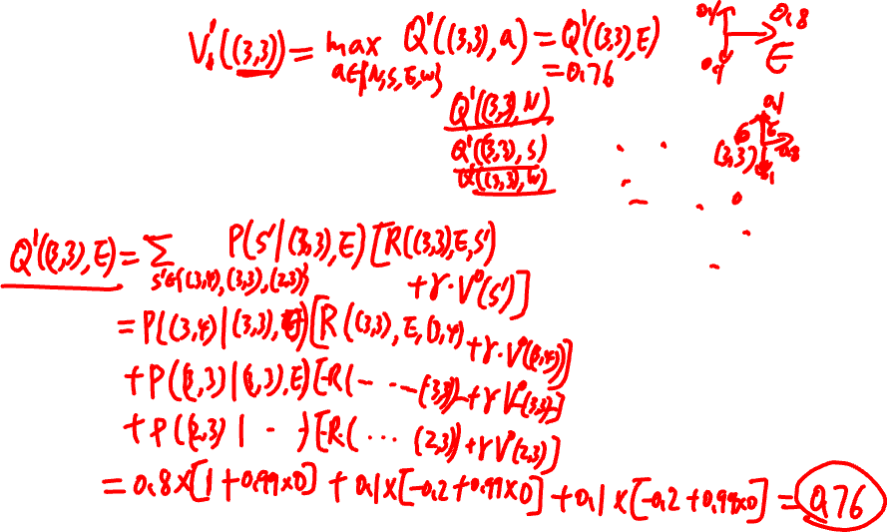
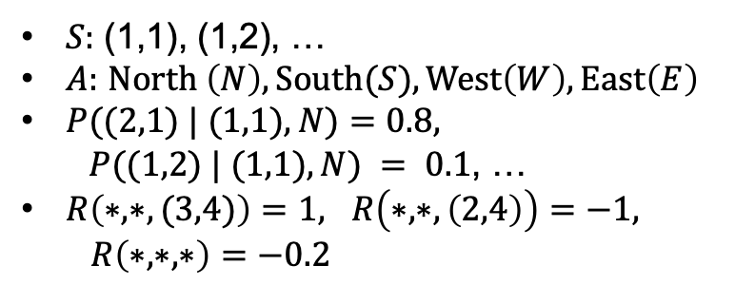
Example
Let discount factor $γ$ = 0.99
$V^{0}(s)=0$ for $s∈\left\{\left(1,1\right), \left(1,2\right),…\right\}$
What is $Q^{1}\left((3,3),E\right)$ and $V^{1}((3,3))$?
3
2
1
1
2
3
4
$S:$ (1,1), (1,2), …
$A:$ $North \left(N\right), South(S), West\left(W\right), East\left(E\right)$
$P((2,1) | (1,1), N)=0.8,$
$P((1,2) | (1,1), N) = 0.1$, …
$R\left(∗,∗,(3,4)\right)=1, R\left(∗,∗,\left(2,4\right)\right)=−1,$
$R\left(∗,∗,∗\right)=−0.2$
Notes:
Q^1((3,3),E) = \sum_s’\in{(3,4), (3,3), (2,3)} P(s’|(3,3), E) [R((3,3), E, s’) + gamma V^0(s’)]
Q^1((3,3), E) = 0.8 * [1+0.99*0] + 0.1 *[-0.2 + 0.99*0] + 0.1*[-0.2 + 0.99*0]= 0.8 -0.02 -0.02= 0.76
Q((3,3), N) = 0.8 * -0.2 + 0.1 *-0.2 + 0.1*1 = -0.16 -0.02 +0.1 = -0.08
Q((3,3), S) = 0.8 * -0.2 + 0.1 *-0.2 + 0.1*1 = -0.16 -0.02 +0.1 = -0.08
Q((3,3), W) = 0.8 * -0.2 + 0.1 *-0.2 + 0.1*-0.2 = -0.16 -0.02 -0.02 = -0.2
V^1((3,3)) = max_a\in{N,S,E,W} Q^1((3,3), a) = Q^1((3,3), E) = 0.76
Slippery floor/cell
Walls/obstacles (stay the same cell if hit the wall/obstacle)
Agent starts at 𝑆₀ =(1,1), can move N,S,E,W
80% chance in moving in the intended direction, 20% change perpendicular to intended direction (split equally)
The negative reward of -0.2 gives the agent an incentive to reach (3,4) quickly.
Goal: go to the food cell as fast as possible, maximize the reward

Slide 27
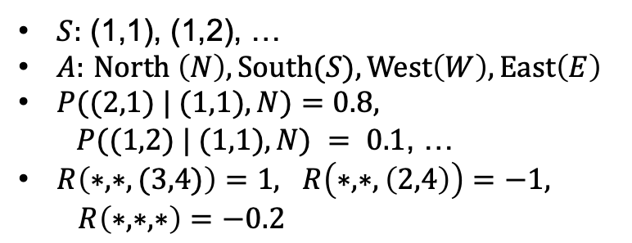
3
2
1
1
2
3
4
$S:$ (1,1), (1,2), …
$A:$ $North \left(N\right), South(S), West\left(W\right), East\left(E\right)$
$P((2,1) | (1,1), N)=0.8,$
$P((1,2) | (1,1), N) = 0.1$, …
$R\left(∗,∗,(3,4)\right)=1, R\left(∗,∗,\left(2,4\right)\right)=−1,$
$R\left(∗,∗,∗\right)=−0.2$
Notes:
Q^1((3,3),E) = \sum_s’\in{(3,4), (3,3), (2,3)} P(s’|(3,3), E) [R((3,3), E, s’) + gamma V^0(s’)]
Q^1((3,3), E) = 0.8 * [1+0.99*0] + 0.1 *[-0.2 + 0.99*0] + 0.1*[-0.2 + 0.99*0]= 0.8 -0.02 -0.02= 0.76
Q((3,3), N) = 0.8 * -0.2 + 0.1 *-0.2 + 0.1*1 = -0.16 -0.02 +0.1 = -0.08
Q((3,3), S) = 0.8 * -0.2 + 0.1 *-0.2 + 0.1*1 = -0.16 -0.02 +0.1 = -0.08
Q((3,3), W) = 0.8 * -0.2 + 0.1 *-0.2 + 0.1*-0.2 = -0.16 -0.02 -0.02 = -0.2
V^1((3,3)) = max_a\in{N,S,E,W} Q^1((3,3), a) = Q^1((3,3), E) = 0.76
Slippery floor/cell
Walls/obstacles (stay the same cell if hit the wall/obstacle)
Agent starts at 𝑆₀ =(1,1), can move N,S,E,W
80% chance in moving in the intended direction, 20% change perpendicular to intended direction (split equally)
The negative reward of -0.2 gives the agent an incentive to reach (3,4) quickly.
Goal: go to the food cell as fast as possible, maximize the reward

Slide 28

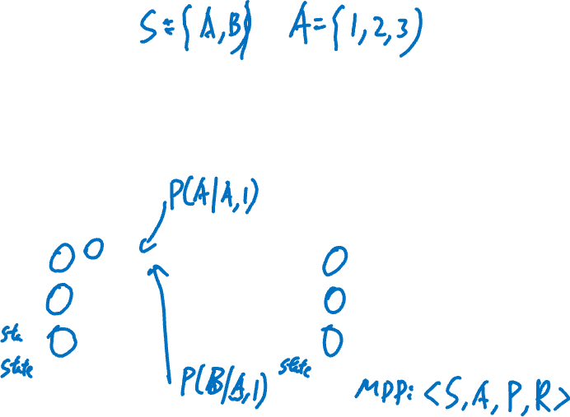
Exercise
Consider the MDP with transition probability and reward function as given in the tables below with discount factor $γ$ = 1 (i.e., no discounting).
If $V^{0}(A)=0$and $V^{0}(B)$ = 0, first calculate values $V^{1}\left(A\right), V^{1}\left(B\right),{ V}^{2}\left(A\right), V^{2}\left(B\right)$
From those values indicate the best actions (current policy): $π^{1}(A)$, $π^{1}(B)$, $π^{2}(A)$, $π^{2}\left(B\right)\text{.}$
s | a | s’ | P(s’|s,a) | R(s,a,s’)
A | 1 | A | 0 | 0
 |  | B | 1 | 0
 | 2 | A | 1 | 1
 |  | B | 0 | 0
 | 3 | A | 0.5 | 0
 |  | B | 0.5 | 0
s | a | s’ | P(s’|s,a) | R(s,a,s’)
B | 1 | A | 0.5 | 10
 |  | B | 0.5 | 0
 | 2 | A | 1 | 0
 |  | B | 0 | 0
 | 3 | A | 0.5 | 2
 |  | B | 0.5 | 4
Notes:
2 states, 3 actions

Slide 29
s | a | s’ | P(s’|s,a) | R(s,a,s’)
A | 1 | A | 0 | 0
 |  | B | 1 | 0
 | 2 | A | 1 | 1
 |  | B | 0 | 0
 | 3 | A | 0.5 | 0
 |  | B | 0.5 | 0
s | a | s’ | P(s’|s,a) | R(s,a,s’)
B | 1 | A | 0.5 | 10
 |  | B | 0.5 | 0
 | 2 | A | 1 | 0
 |  | B | 0 | 0
 | 3 | A | 0.5 | 2
 |  | B | 0.5 | 4
Notes:
Q^1(A,1) = 1*[0 + 1*0] =0
Q^1(A,2) = 1*[1 + 1*0] =1
Q^1(A,3) = 0.5*[0 + 1*0] + 0.5*[0 + 1*0] =0
V^1(A) = max_a Q^1(A,a) =1
pi^1(A) = argmax_a Q^1(A,a) = 2
…

Slide 30
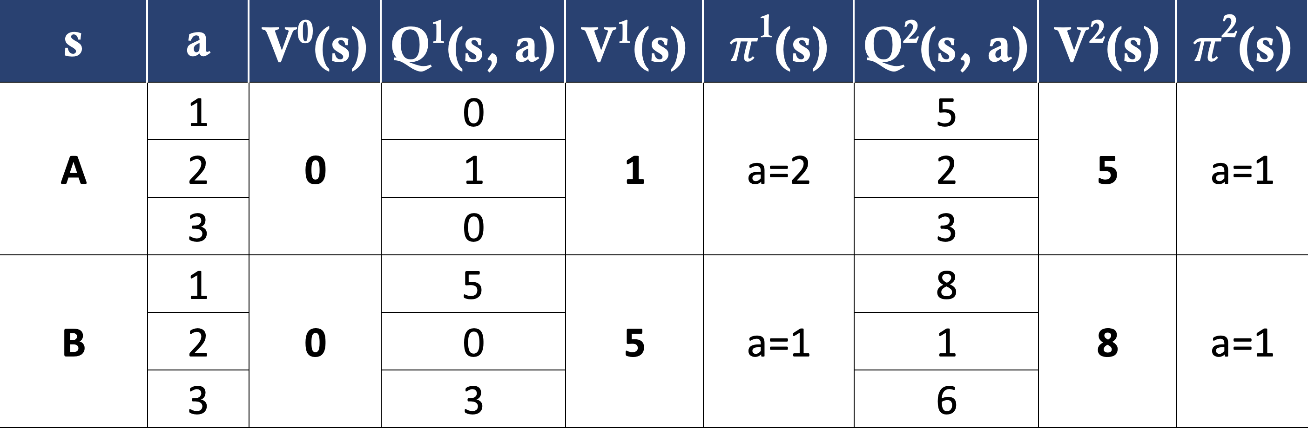
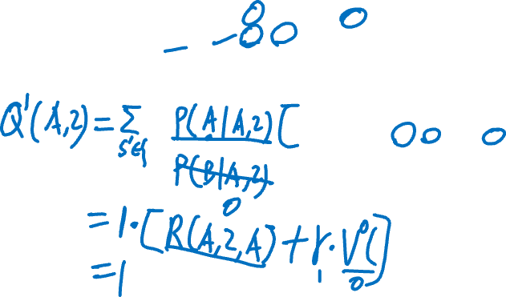
s | a | s’ | P(s’|s,a) | R(s,a,s’)
A | 1 | A | 0 | 0
 |  | B | 1 | 0
 | 2 | A | 1 | 1
 |  | B | 0 | 0
 | 3 | A | 0.5 | 0
 |  | B | 0.5 | 0
s | a | s’ | P(s’|s,a) | R(s,a,s’)
B | 1 | A | 0.5 | 10
 |  | B | 0.5 | 0
 | 2 | A | 1 | 0
 |  | B | 0 | 0
 | 3 | A | 0.5 | 2
 |  | B | 0.5 | 4
Notes:
Q^1(A,1) = 1*[0 + 1*0] =0
Q^1(A,2) = 1*[1 + 1*0] =1
Q^1(A,3) = 0.5*[0 + 1*0] + 0.5*[0 + 1*0] =0
V^1(A) = max_a Q^1(A,a) =1
pi^1(A) = argmax_a Q^1(A,a) = 2
…

Slide 31
Reminder
No homework this week
A sample quiz has been provided for practice
In-class Quiz 2: Next week’s session (March 25)
Similar to Quiz 1
Duration: 45 minutes
Closed book
One A4-size cheat sheet allowed
Calculator allowed (no smartphones, tablets, etc.)

