Slide 1
Lecture 11: Reinforcement Learning
CS420: Introduction to AI
Zhize LI

Slide 2
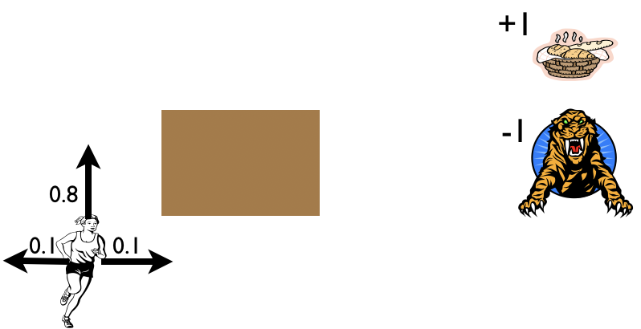

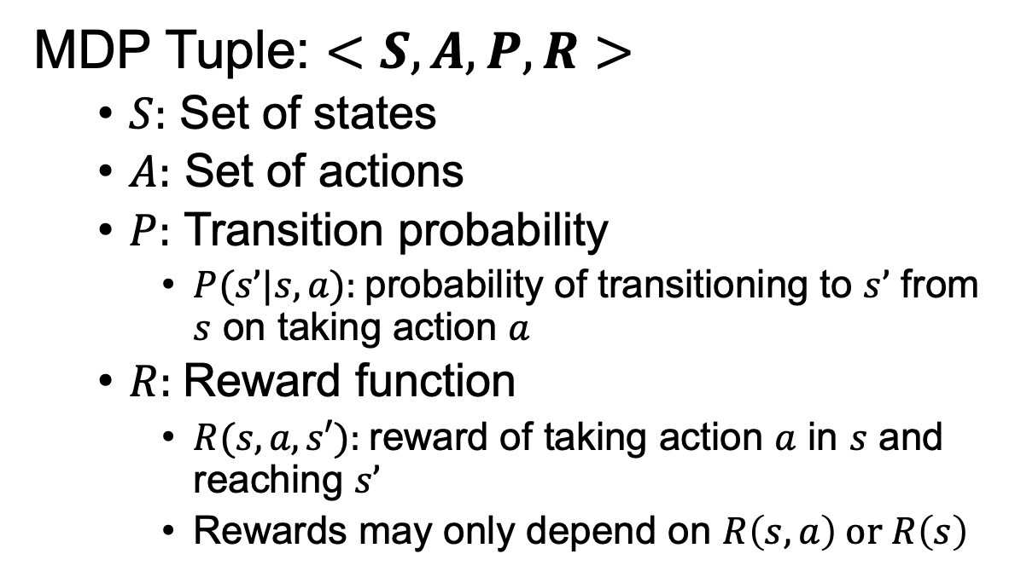
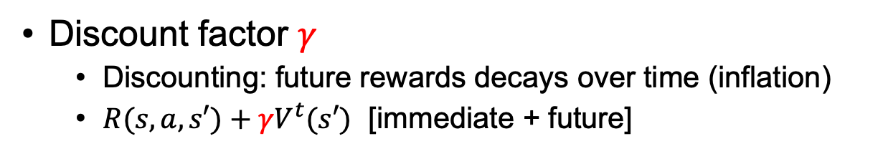
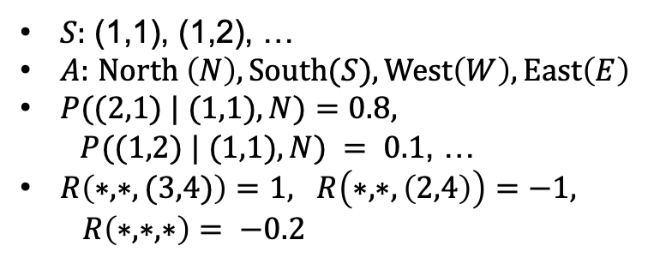
Recap: Markov Decision Process (MDP)
MDP Tuple: $<S, A, P, R>$
$S:$ Set of states
$A:$ Set of actions
$P:$ Transition probability
$P(s’|s,a):$probability of transitioning to $s’$ from $s$ on taking action $a$
$R:$Reward function
$R(s,a,s′):$reward of taking action $a$ in $s$ and reaching $s’$
Rewards may only depend on $R\left(s,a\right) or R\left(s\right)$
3
2
1
1
2
3
4
$S:$ (1,1), (1,2), …
$A:$ $North \left(N\right), South(S), West\left(W\right), East\left(E\right)$
$P((2,1) | (1,1), N)=0.8,$
$P((1,2) | (1,1), N) = 0.1$, …
$R\left(∗,∗,(3,4)\right)=1, R\left(∗,∗,\left(2,4\right)\right)=−1,$
$R\left(∗,∗,∗\right)= −0.2$
Discount factor $γ$
Discounting: future rewards decays over time (inflation)
$R(s, a, s′)+{γV}^{t}(s′)$ [immediate + future]
Notes:
Slippery floor/cell
Walls/obstacles (stay the same cell if hit the wall/obstacle)
Agent starts at 𝑆₀ =(1,1), can move N,S,W,E
80% chance in moving in the intended direction, 20% change perpendicular to intended direction (split equally)
The negative reward of -0.2 gives the agent an incentive to reach (3,4) quickly.
Goal: go to the food cell as fast as possible, maximize the reward
Markovian: future states only depends on current state and action, not the past history of states and actions
P(s_{t+1}|s_t, a_t, s_{t-1}, a_{t-1}, …, s_0, a_0) = P(s_{t+1}|s_t, a_t)
Simplifies decision-making and allows the problem to be modeled using Bellman Equations.
P and R are like prior domain knowledge, or learn from experience
what does a solution to the problem look like? Not a fixed sequence of actions (cannot solve the problem due to uncertainty)
A solution must specify what the agent should do for any state that the agent might reach.
A solution of this kind is called a policy (not a fixed path). \pi(s) is the action recommended by the policy pi for state s.

Slide 3
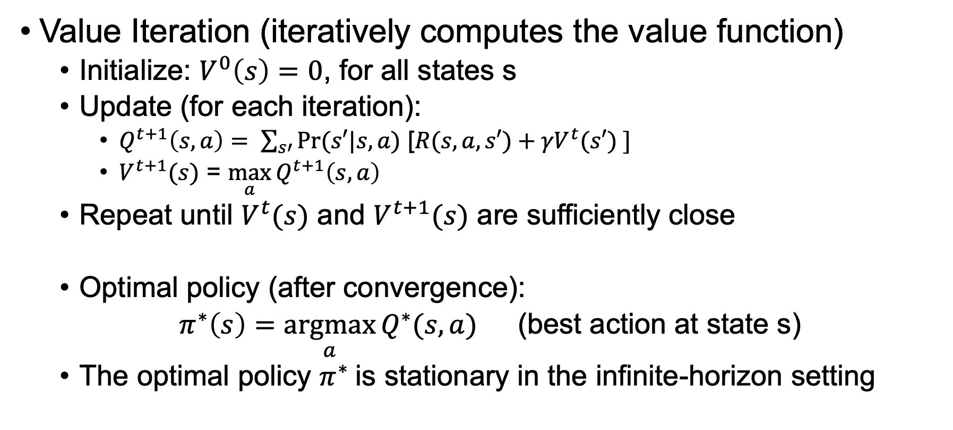
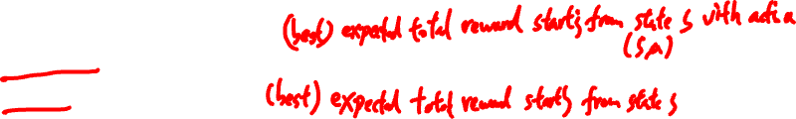
Recap: Finding Optimal Policy: Value Iteration
Value Iteration (iteratively computes the value function)
Initialize: $V^{0}\left(s\right)=0$, for all states s
Update (for each iteration):
$Q^{t+1}\left(s,a\right)= \sum_{s′}{Pr⁡(s′|s,a)\text{ [}R(s, a, s′)+{γV}^{t}(s′) ]}$
$V^{t+1}(s)$ = $\max_{a}{Q^{t+1}\left(s,a\right)}$
Repeat until $V^{t}(s)$ and $V^{t+1}(s)$ are sufficiently close
Optimal policy (after convergence):
$π^{∗}\left(s\right)=\underset{a}{argmax}{Q^{∗}(s,a)}$ (best action at state s)
The optimal policy $π^{∗}$is stationary in the infinite-horizon setting
Notes:
V(s): (best) expected total reward starting from state s
Q(s,a): (best) expected total reward starting from (s,a) state s with action a
t: iteration number/step
Bellman Equation, Bellman Optimality Equation
max_s |V^{t+1}(s) - V^{t}(s)| < \epsilon (e.g., 0.01)
The values are no longer changing much, we’ve basically converged.
Bellman update is a contraction: |V^{t+1}(s) – V*(s)| \leq gamma |V^t(s) –V*(s)|
T|S|^2|A|, T=O(1/(1-gamma) log1/eps)

Slide 4

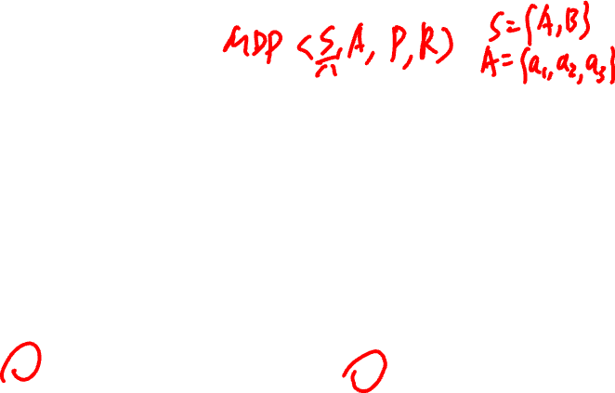
Recap: Exercise
Consider the MDP defined by the transition probability and reward function in the tables below with discount factor $γ$= 1 (no discounting, for simplicity).
Initialize $V^{0}(A)=0$and $V^{0}(B)$ = 0, use VI to compute $V^{1}\left(A\right), V^{1}\left(B\right),{ V}^{2}\left(A\right), V^{2}\left(B\right)$
From these values indicate the best actions: $π^{1}(A)$, $π^{1}(B)$, $π^{2}(A)$, $π^{2}\left(B\right)$. (current policy: $π^{t}\left(s\right)=\underset{a}{argmax}{Q^{t}(s,a)}$)
s | a | s’ | P(s’|s,a) | R(s,a,s’)
A | a₁ | A | 0 | 0
 |  | B | 1 | 0
 | a₂ | A | 1 | 1
 |  | B | 0 | 0
 | a₃ | A | 0.5 | 0
 |  | B | 0.5 | 0
s | a | s’ | P(s’|s,a) | R(s,a,s’)
B | a₁ | A | 0.5 | 10
 |  | B | 0.5 | 0
 | a₂ | A | 1 | 0
 |  | B | 0 | 0
 | a₃ | A | 0.5 | 2
 |  | B | 0.5 | 4
Notes:
2 states, 3 actions

Slide 5
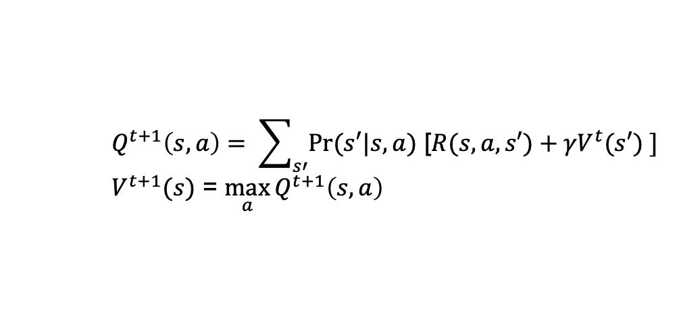
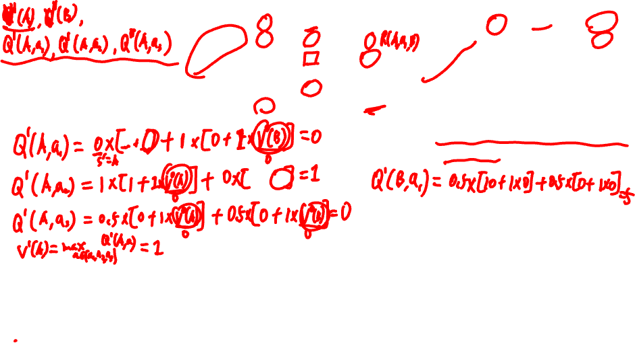
s | a | s’ | P(s’|s,a) | R(s,a,s’)
A | a₁ | A | 0 | 0
 |  | B | 1 | 0
 | a₂ | A | 1 | 1
 |  | B | 0 | 0
 | a₃ | A | 0.5 | 0
 |  | B | 0.5 | 0
s | a | s’ | P(s’|s,a) | R(s,a,s’)
B | a₁ | A | 0.5 | 10
 |  | B | 0.5 | 0
 | a₂ | A | 1 | 0
 |  | B | 0 | 0
 | a₃ | A | 0.5 | 2
 |  | B | 0.5 | 4
$$Q^{t+1}\left(s,a\right)= \sum_{s′}{Pr⁡(s′|s,a)\text{ [}R(s, a, s′)+{γV}^{t}(s′) ]}$$
$V^{t+1}(s)$ = $\max_{a}{Q^{t+1}\left(s,a\right)}$
Notes:
Q^1(A,1) = 1*[0 + 1*0] =0
Q^1(A,2) = 1*[1 + 1*0] =1
Q^1(A,3) = 0.5*[0 + 1*0] + 0.5*[0 + 1*0] =0
V^1(A) = max_a Q^1(A,a) =1
pi^1(A) = argmax_a Q^1(A,a) = 2
…
Q^3, V^3, pi^3:
8 8 a1
6
6.5
11.5 11.5 a1
5
9.5

Slide 6
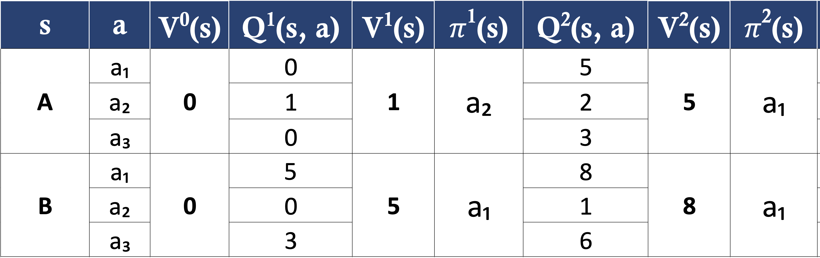
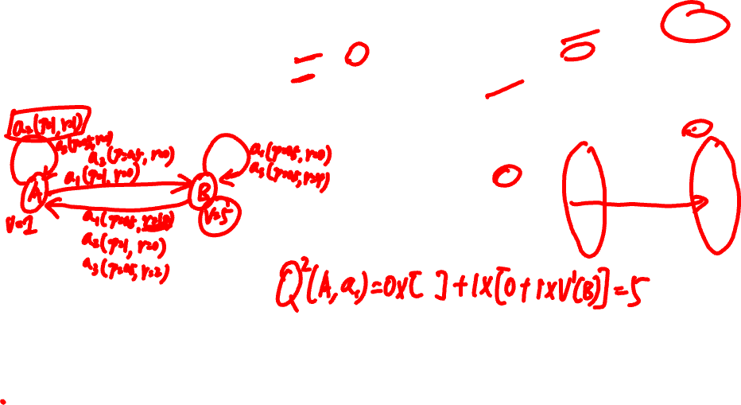
s | a | s’ | P(s’|s,a) | R(s,a,s’)
A | a₁ | A | 0 | 0
 |  | B | 1 | 0
 | a₂ | A | 1 | 1
 |  | B | 0 | 0
 | a₃ | A | 0.5 | 0
 |  | B | 0.5 | 0
s | a | s’ | P(s’|s,a) | R(s,a,s’)
B | a₁ | A | 0.5 | 10
 |  | B | 0.5 | 0
 | a₂ | A | 1 | 0
 |  | B | 0 | 0
 | a₃ | A | 0.5 | 2
 |  | B | 0.5 | 4
Notes:
Q^1(A,1) = 1*[0 + 1*0] =0
Q^1(A,2) = 1*[1 + 1*0] =1
Q^1(A,3) = 0.5*[0 + 1*0] + 0.5*[0 + 1*0] =0
V^1(A) = max_a Q^1(A,a) =1
pi^1(A) = argmax_a Q^1(A,a) = 2
…
Q^3, V^3, pi^3:
8 8 a1
6
6.5
11.5 11.5 a1
5
9.5

Slide 7
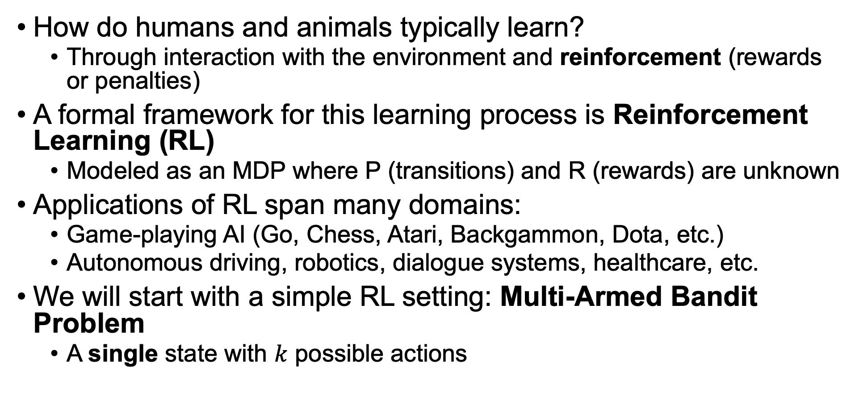
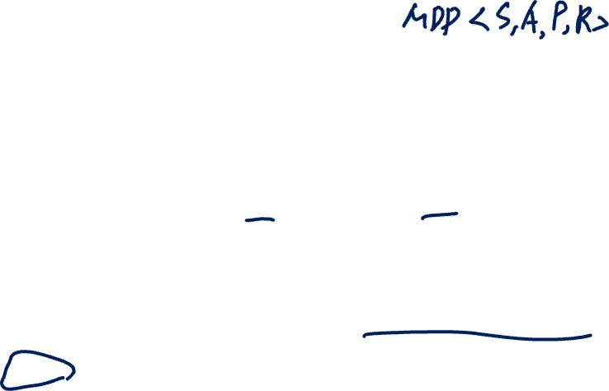
Reinforcement Learning (RL)
How do humans and animals typically learn?
Through interaction with the environment and reinforcement (rewards or penalties)
A formal framework for this learning process is Reinforcement Learning (RL)
Modeled as an MDP where P (transitions) and R (rewards) are unknown
Applications of RL span many domains:
Game-playing AI (Go, Chess, Atari, Backgammon, Dota, etc.)
Autonomous driving, robotics, dialogue systems, healthcare, etc.
We will start with a simple RL setting: Multi-Armed Bandit Problem
A single state with $k$ possible actions
Notes:
MDP= <S, A, P, R, gamma> discount factor
Experiences, exploration, exploitation
Do not know transition probability P, reward function R
the agent learns through interaction with the environment: RL is a learning process where an agent learns to act optimally through experience

Slide 8
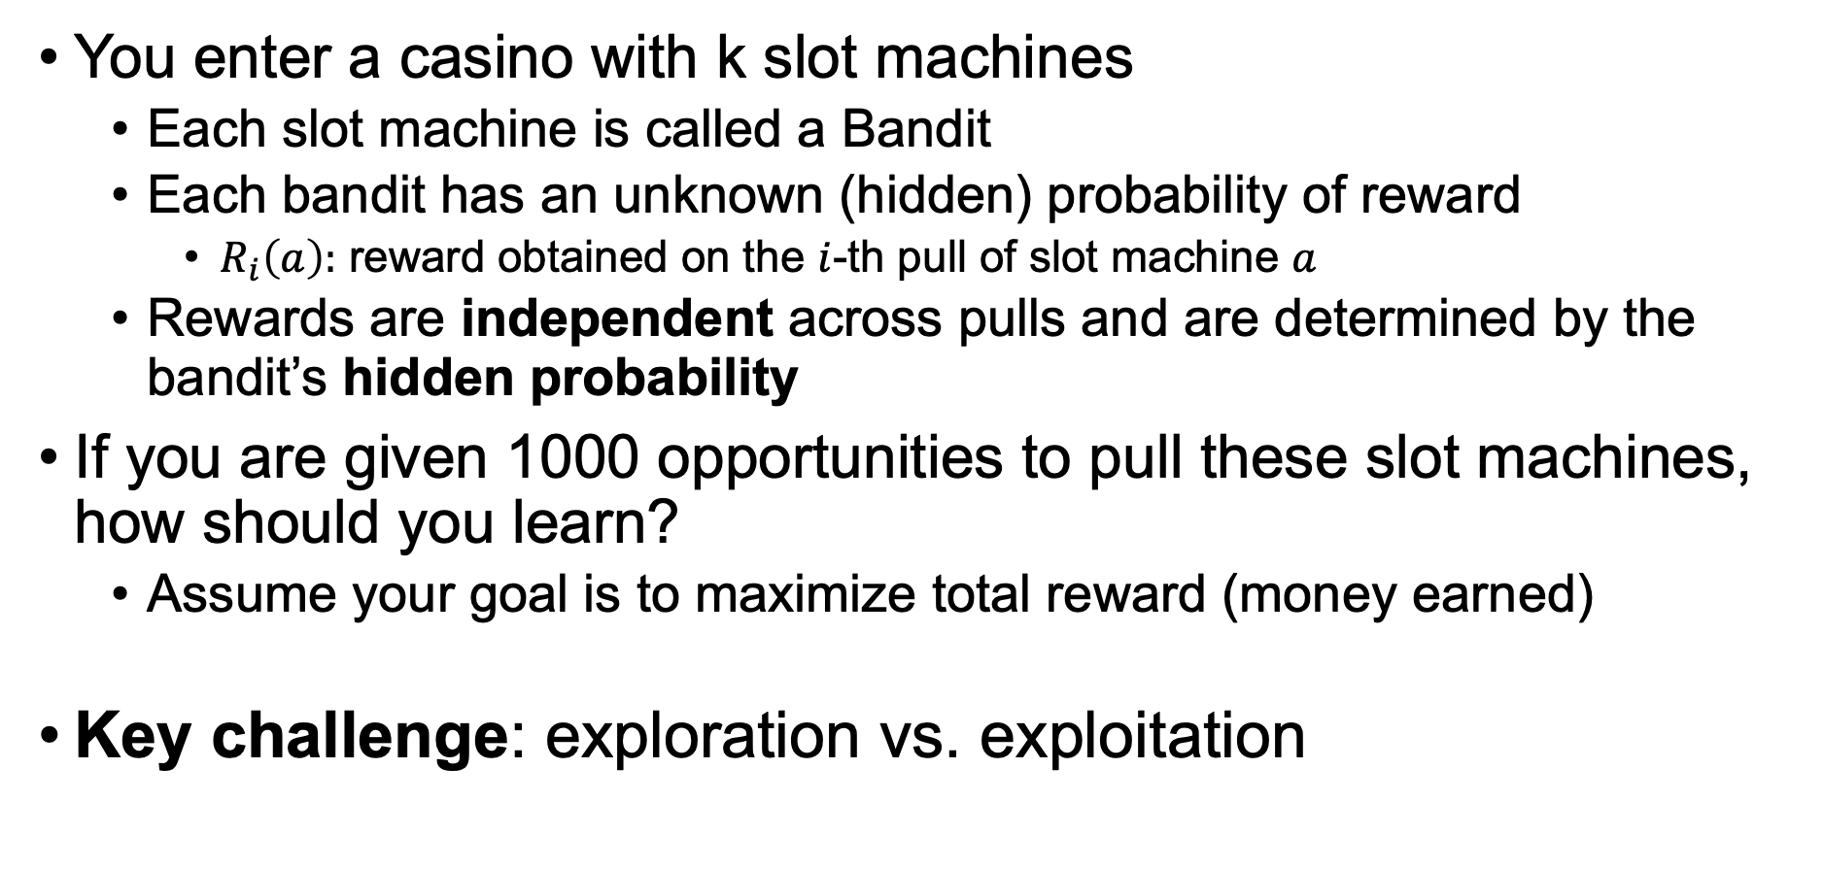
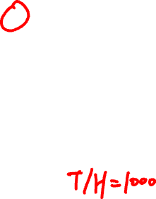
Multi-Armed Bandit
You enter a casino with k slot machines
Each slot machine is called a Bandit
Each bandit has an unknown (hidden) probability of reward
$R_{i}\left(a\right):$ reward obtained on the $i$-th pull of slot machine $a$
Rewards are independent across pulls and are determined by the bandit’s hidden probability
If you are given 1000 opportunities to pull these slot machines, how should you learn?
Assume your goal is to maximize total reward (money earned)
Key challenge: exploration vs. exploitation
Notes:
Learn quickly while maximizing reward

Slide 9
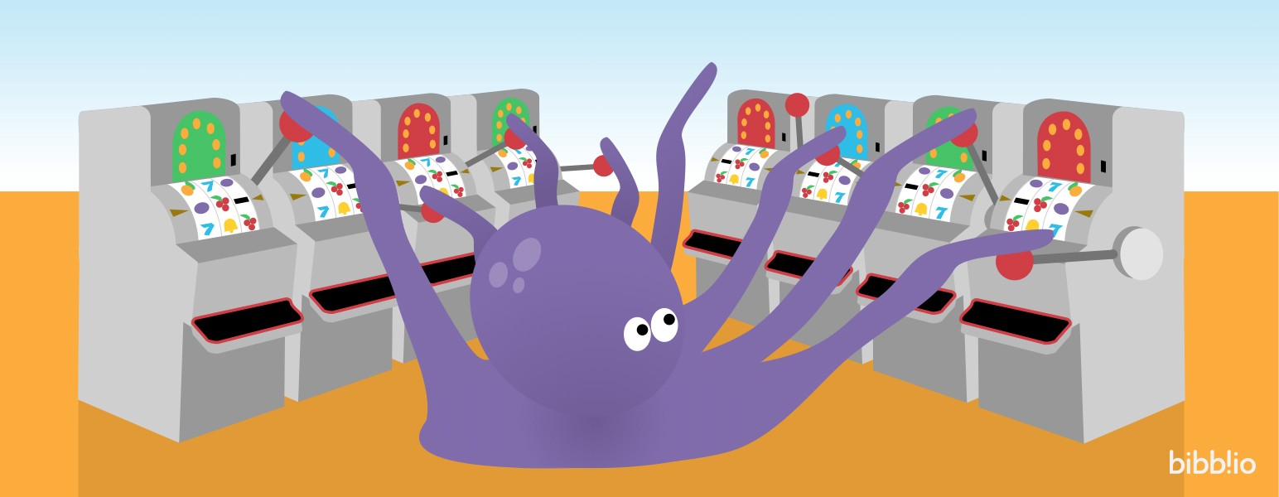
Multi-Armed Bandit
Source: https://towardsdatascience.com/reinforcement-learning-multi-arm-bandit-implementation/
Notes:
Unknown reward distribution R(M_1)…
N=1000 trials/pulls
Do you have any ideas to pull the arms to maximize your total reward of 1000 pulls?

Slide 10
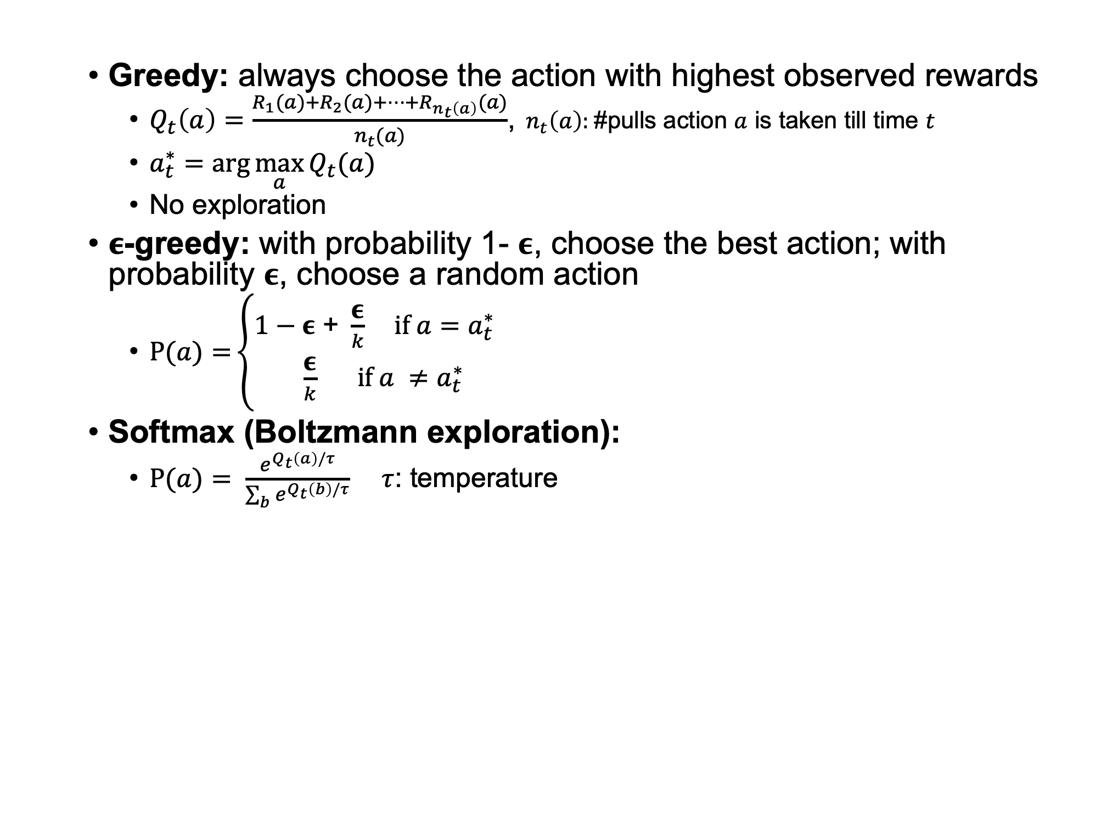
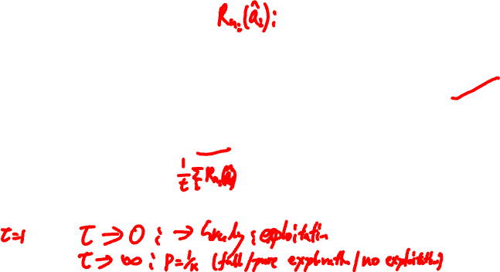
Bandit Strategies
Greedy: always choose the action with highest observed rewards
$Q_{t}\left(a\right)=\frac{R_{1}(a)+R_{2}(a)+…+R_{n_{t}\left(a\right)}(a)}{n_{t}(a)}$,${ n}_{t}\left(a\right):$#pulls action $a$ is taken till time $t$
$a_{t}^{∗}=\arg{\max_{a}{Q_{t}(a)}}$
No exploration
𝛜-greedy: with probability 1- 𝛜, choose the best action; with probability 𝛜, choose a random action
$P(a){=}\left\{\begin{aligned}1−\text{ε}\text{ + }\frac{\text{ε}}{k}{ if a=a}_{t}^{∗} \\ \frac{\text{ε}}{k} if a ≠a_{t}^{∗}\end{aligned}\right.$
Softmax (Boltzmann exploration):
$P(a){= \frac{e^{Q_{t}\left(a\right)/τ}}{\sum_{b}{e^{Q_{t}\left(b\right)/τ}}}}$ $τ$: temperature
Notes:
Pure exploitation
Q_m = average rewards of action after m observations
NewEstimate = OldEstimate + StepSize [Target – OldEstimate]
Q_{m+1} = Q_m + 1/(m+1) (R_{m+1} - Q_m) = (mQ_m + R_{m+1}) / (m+1)
Epsilon: exploration vs exploitation
hyperparameter eps, common eps=0.1, 0.01.
Or start with large eps=1 and decay to small eps=0.1/0.01, or decay schedule, e.g., 1/\sqrt{t}
Softmax:
tau->infinity, probabilities become uniform (pure exploration)
tau->0, becomes greedy (selects the action with highest Q_t(a)) exploitation
Linear decay: tau_t = tau_0 – beta*t (e.g., beta = 0.01)
exponential decay: tau_t = tau_0 * alpha^t (e.g., alpha = 0.99)

Slide 11
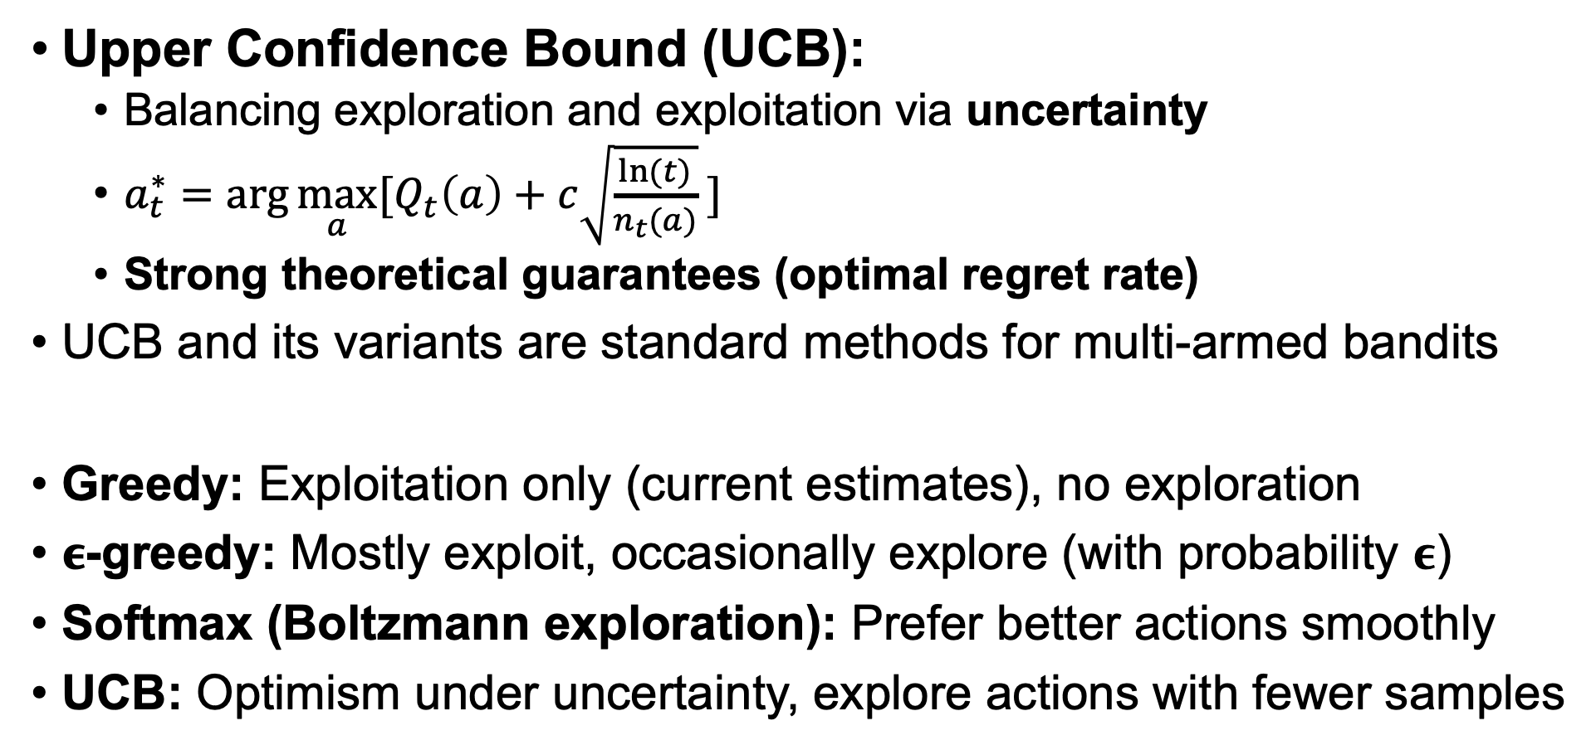
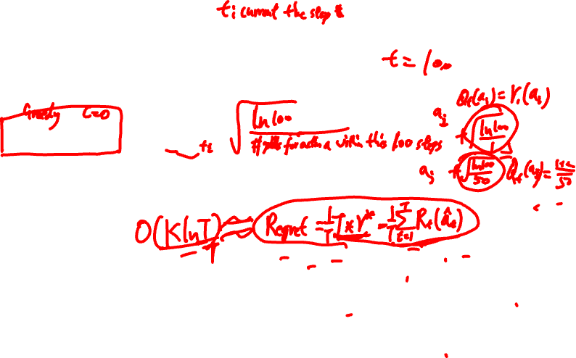
Bandit Strategies
Upper Confidence Bound (UCB):
Balancing exploration and exploitation via uncertainty
$a_{t}^{∗}=\arg{\max_{a}{[Q_{t}\left(a\right)+c\sqrt{\frac{ln(t)}{n_{t}(a)}}}} ]$
Strong theoretical guarantees (optimal regret rate)
UCB and its variants are standard methods for multi-armed bandits
Greedy: Exploitation only (current estimates), no exploration
𝛜-greedy: Mostly exploit, occasionally explore (with probability 𝛜)
Softmax (Boltzmann exploration): Prefer better actions smoothly
UCB: Optimism under uncertainty, explore actions with fewer samples
Notes:
t: time/step t
n_t(a) is the number of pulls action a is taken so far
Initialization: pull each arm once for t = 0, 1, .. k-1. Then for t = k, k+1, …, use the UCB strategy
Exploit, Explore (prefer arms that have been less explored)
c: balance hyperparameter, e.g., c=\sqrt{2}
Hoeffding’s inequality
ln(T) regret
Regret = T*u* - sum_t R(a_t) = O(\sum_i ln T / delta_i) \approx O(k ln T)

Slide 12

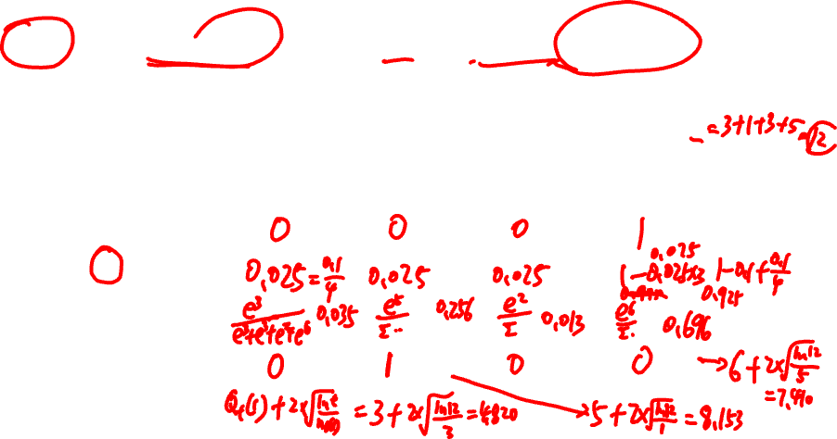
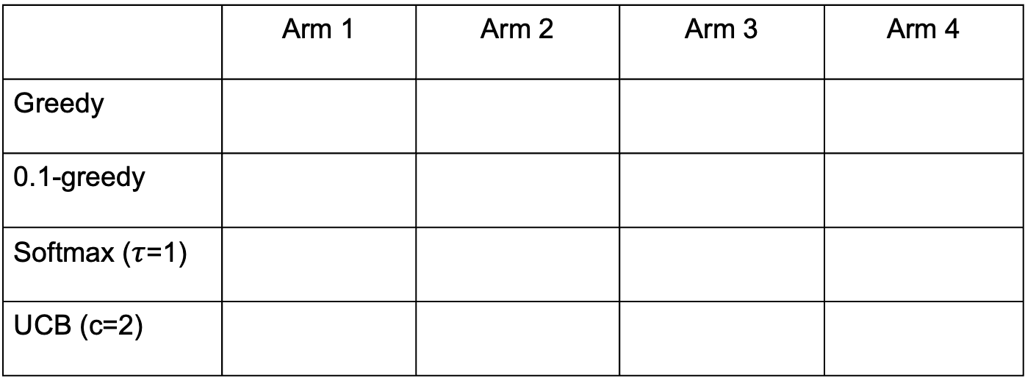
Exercise
Four arms: $Q_{t}\left(1\right)=$ 3; $Q_{t}\left(2\right)=5;$ $Q_{t}\left(3\right)=$ 2; $Q_{t}\left(4\right)=6$
#pulls for each arm till t: n_{t}(1) = 3, n_{t}(2) = 1, n_{t}(3) = 3, n_{t}(4) = 5
Compute probabilities of taking each action/arm in time t
 | Arm 1 | Arm 2 | Arm 3 | Arm 4
Greedy
0.1-greedy
Softmax ($τ$=1)
UCB (c=2)
Notes:
Greedy: 0,0,0,1
0.1-greedy: 0.1/4 = 0.025, 0.1/4, 0.1/4, 1-0.3/4=0.925
Softmax: e^3/(e^3+e^5+e^2+e^6) = 0.035,
e^5/… = 0.256,
e^2/… = 0.013,
e^6/… = 0.696
Optimism under uncertainty, explore actions with fewer samples
UCB: 0, 1, 0, 0
3+2*\sqrt{ln 12 / 3} = 4.820,
8.153,
3.820,
7.410

Slide 13
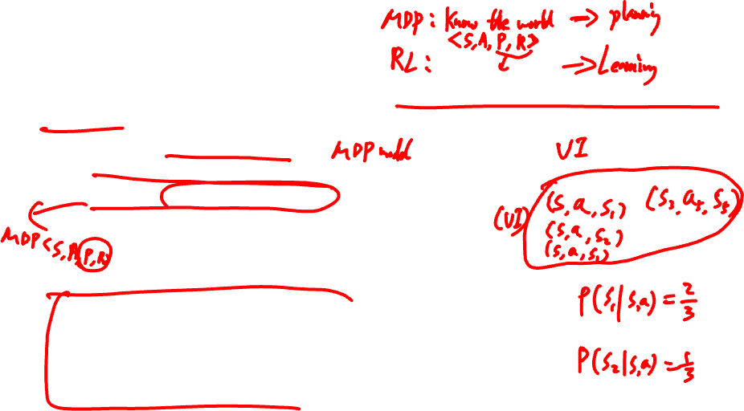
Reinforcement Learning
How should an agent act when it does not know how the world works?
Option 1: Model-Based RL
Learn a model of the environment, then solve it using planning techniques
Estimate P (transition) and R (reward) from data
Solve the resulting MDP to obtain an optimal policy
When to update/re-estimate the model?
Re-estimate as more data is collected, or at a computationally affordable frequency
Option 2: Model-Free RL
Learn the optimal policy or value function without explicitly modeling P or R
Learn directly from experience (data collected through interaction with the environment)
Notes:
Markov decision process (MDP)
Once we have the model, the problem becomes a standard MDP.
Value iteration
Model-based: Learn the world, then plan.
Model-free: Just learn what works.

Slide 14
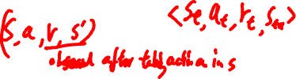
Agent-Environment Interaction
Environment
State: s
Reward: r
Actions: a
Agent
Notes:
The agent interacts with the environment sequentially:
At each time step, the agent observes the current state, takes an action, receives a reward, and moves to a new state.
This generates experience data that the agent uses to learn.
Interaction is sequential within a trajectory, but multiple trajectories can be collected in parallel.

Slide 15
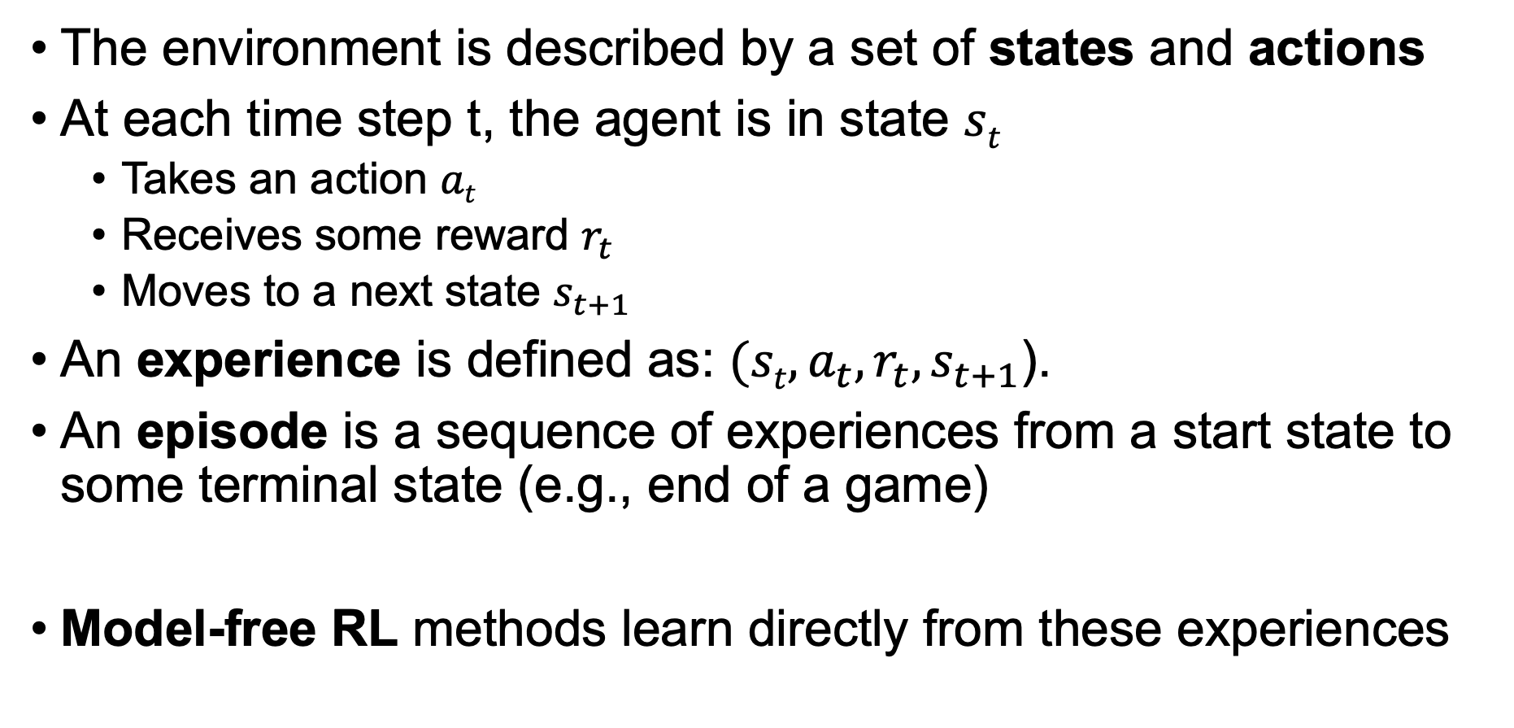

RL Formulation
The environment is described by a set of states and actions
At each time step t, the agent is in state $st$
Takes an action $at$
Receives some reward $r_{t}$
Moves to a next state $s_{t+1}$
An experience is defined as: $(st, a_{t},r_{t},s_{t+1}$).
An episode is a sequence of experiences from a start state to some terminal state (e.g., end of a game)
Model-free RL methods learn directly from these experiences
Notes:
Ex: for our previous tiger problem,
Action N/S/W/E
Reward +1, -1, -0.2
(s, a, r, s’)
any trajectories of the agent from the start cell to the food cell/tiger cell will be an episode.
Mario:
Forward, backward, jump, etc
current game screen (pixels)
next game screen
For infinite set, can use neural networks to model that

Slide 16
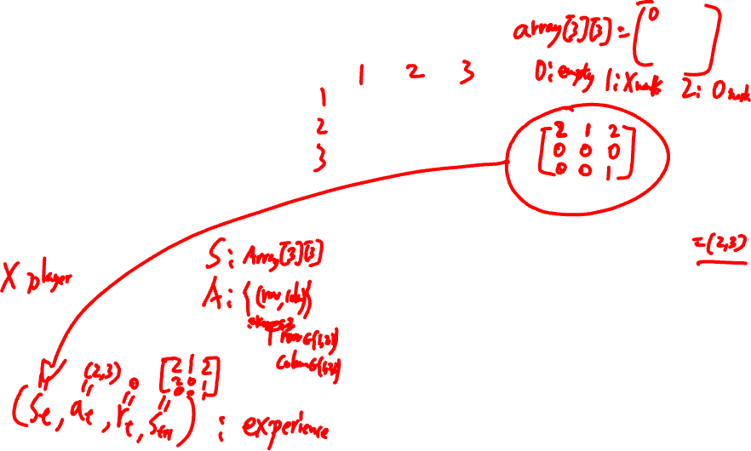
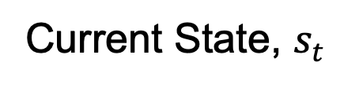
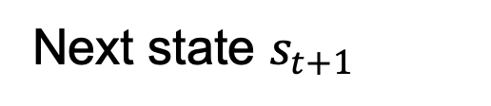
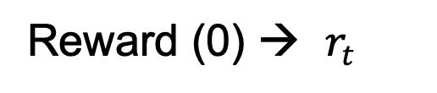
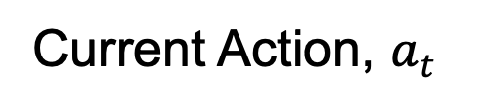
Example: Tic Tac Toe
Reward: win/lose/tie the game (+1/-1/0)
State: positions of X’s and O’s on the board
Action: next X to be placed on board
0 | X | 0
 |  | X
Current State, $s_{t}$
0 | X | 0
 |  | X
 |  | X
Current Action, $a_{t}$
0 | X | 0
0 |  | X
 |  | X
Next state $s_{t+1}$
Reward (0) → $r_{t}$
Notes:
Array 3*3 array[3][3]
Reward of all transitions to non-terminals, 0
O player: random agent, AI agent / environment

Slide 17

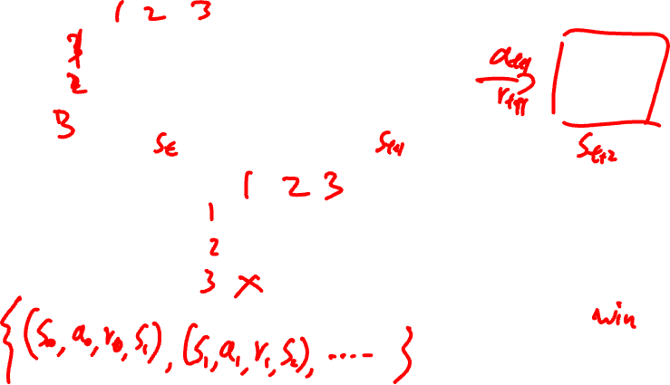






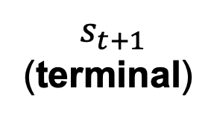

Experience & Episode
Experience (s, a, r, s’)
 | 0
0
 | 0
 |  | X
$r_{t}$ = 0
$a_{t}$ = (3,3)
Episode
 | 0
0 | X | 0
 | 0 | 0
 | X | X
0 | X | 0
 | 0 | 0
X | X | X
$r_{t}$ = 0
$r_{t}$ = +1
…
$a_{t}$ = (1,2)
$a_{t}$ = (3,1)
$$s_{0}$$
$$s_{t}$$
$$s_{t+1}$$
(terminal)
Notes:
A single interaction step: current state → action → reward → next state
A sequence of experiences
Ends at a terminal state
represents one complete trajectory
Total reward: r_0+ r_1 + … + r_H (horizon)

Slide 18

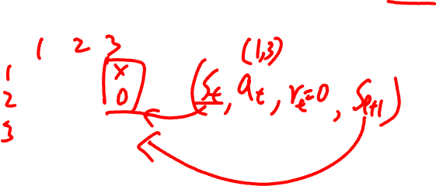

Exercise
Write down the experience tuple associated with tic-tac-toe starting at the state $s_{t}$, you place X on (1,3) and your opponent (or the environment) place 0 on (2,3)
0
 | 0
 |  | X
$$s_{t}$$
Notes:
(s_t, a_t, r_t, s_{t+1})

Slide 19
RL Methods (next session)
Q-Learning
A model-free RL algorithm that learns the optimal Q-function Q*(s,a)
Approximate Q-Learning
Extends Q-learning to large or continuous state spaces
Uses function approximation (e.g., neural networks)
Forms the foundation of modern methods such as Deep Q-Networks (DQN), Q-learning with deep neural networks
Notes:
Reinforcement learning aims to learn a policy that maximizes total (long-term) reward. Q-learning is a model-free method that directly learns the optimal Q-function. From the Q-function, we can derive the optimal policy by selecting the action with the highest Q-value.
pi*(s)=argmax_a​ Q*(s,a)

Slide 20
Reminder
No homework this week
Assignment 1 is currently under review; grades will be released once finalized
Regarding the final exam, I will try to prepare a sample exam for you (expected release in Week 12/13)

