Slide 1
Lecture 12: Reinforcement Learning II
CS420: Introduction to AI
Zhize LI

Slide 2
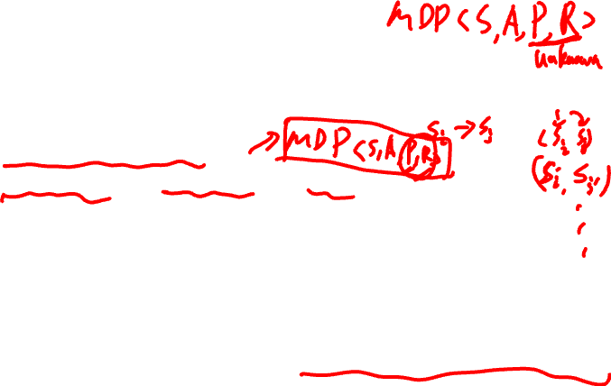
Recap: Reinforcement Learning
How should an agent act when the environment is unknown?
Option 1: Model-Based RL
Learn a model of the environment
Estimate P (transition) and R (reward) from data
Solve the resulting MDP using planning methods (e.g., value iteration) to obtain an optimal policy
When to update/re-estimate the model?
Re-estimate as more data is collected, or at a computationally affordable frequency
Option 2: Model-Free RL
Learn the optimal policy or value function without explicitly modeling P or R
Learn directly from experience (data collected through interaction with the environment)
Notes:
Markov decision process (MDP)
Once we have the model, the problem becomes a standard MDP.
Value iteration
Model-based: Learn the world, then plan.
Model-free: Just learn what works.

Slide 3

Recap: Agent-Environment Interaction
Environment
Reward: r
State: s
Actions: a
Agent
Notes:
The agent interacts with the environment sequentially:
At each time step, the agent observes the current state, takes an action, receives a reward, and moves to a new state.
This generates experience data that the agent uses to learn.
Interaction is sequential within a trajectory, but multiple trajectories can be collected in parallel.

Slide 4
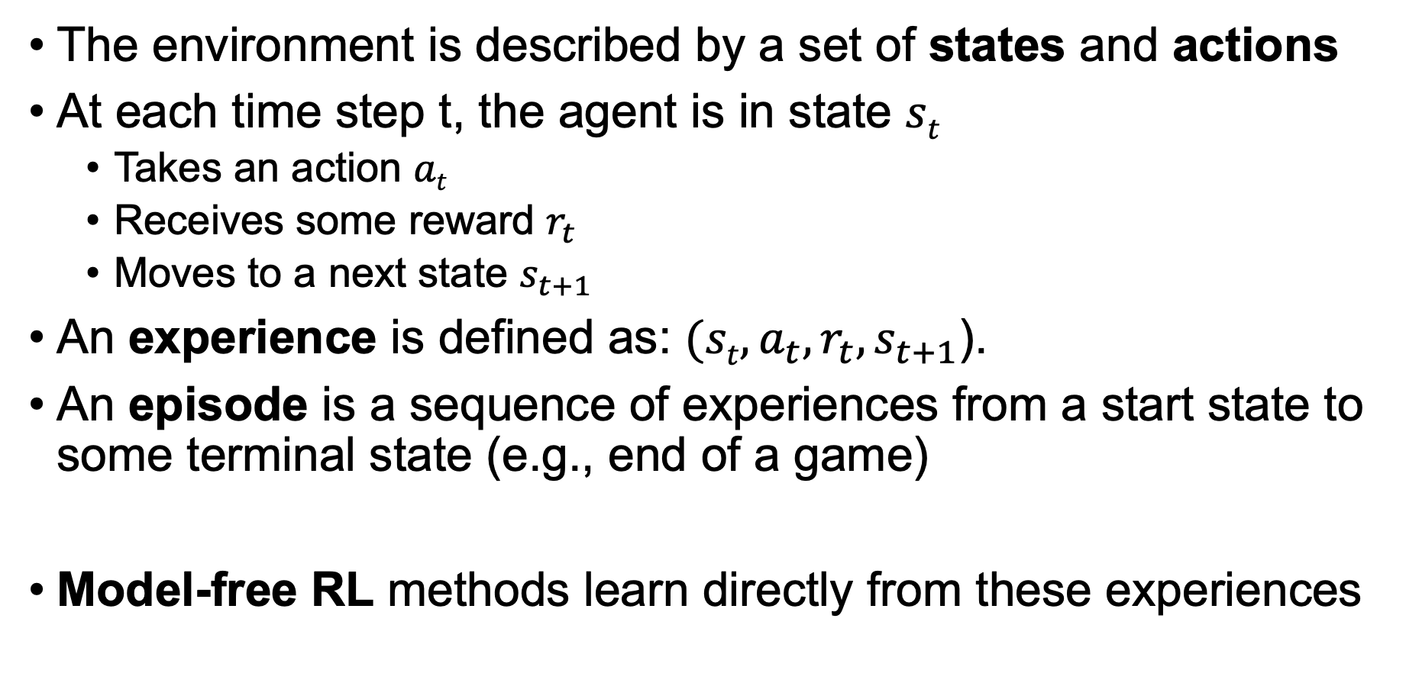
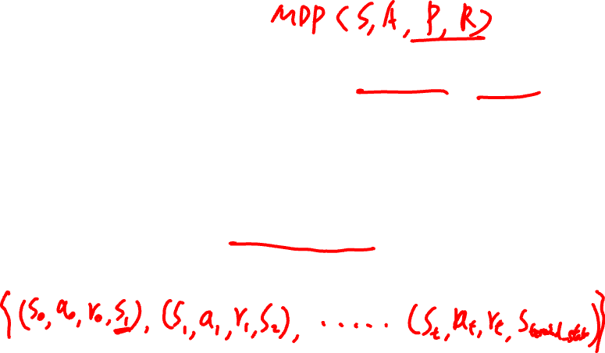
Recap: RL Formulation
The environment is described by a set of states and actions
At each time step t, the agent is in state $st$
Takes an action $at$
Receives some reward $r_{t}$
Moves to a next state $s_{t+1}$
An experience is defined as: $(st, a_{t},r_{t},s_{t+1}$).
An episode is a sequence of experiences from a start state to some terminal state (e.g., end of a game)
Model-free RL methods learn directly from these experiences
Notes:
Ex: for our previous tiger problem,
Action N/S/W/E
Reward +1, -1, -0.2
(s, a, r, s’)
any trajectories of the agent from the start cell to the food cell/tiger cell will be an episode.
Mario:
Forward, backward, jump, etc
current game screen (pixels)
next game screen
For infinite set, can use neural networks to model that

Slide 5

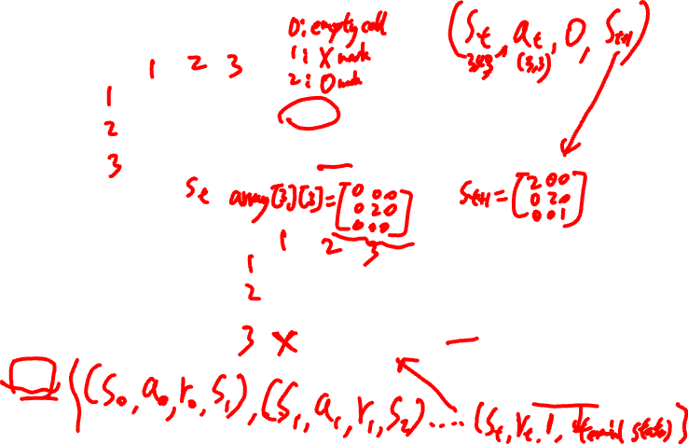






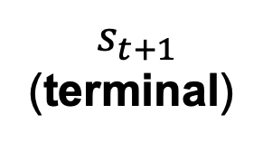

Recap: Experience & Episode
Experience (s, a, r, s’)
 | 0
0
 | 0
 |  | X
$r_{t}$ = 0
$a_{t}$ = (3,3)
Episode
 | 0
0 | X | 0
 | 0 | 0
 | X | X
0 | X | 0
 | 0 | 0
X | X | X
$r_{t}$ = 0
$r_{t}$ = +1
…
$a_{t}$ = (1,2)
$a_{t}$ = (3,1)
$$s_{0}$$
$$s_{t}$$
$$s_{t+1}$$
(terminal)
Notes:
A single interaction step: current state → action → reward → next state
A sequence of experiences
Ends at a terminal state
represents one complete trajectory
Total reward: r_0+ r_1 + … + r_H (horizon)

Slide 6
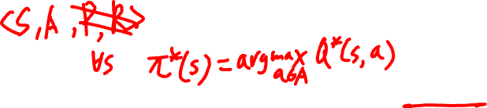
RL Methods
Q-Learning
A model-free RL algorithm that learns the optimal Q-function Q*(s,a)
Approximate Q-Learning
Extends Q-learning to large or continuous state spaces
Uses function approximation (e.g., neural networks)
Forms the foundation of modern methods such as Deep Q-Networks (DQN), Q-learning with deep neural networks
Notes:
Reinforcement learning aims to learn a policy that maximizes total (long-term) reward. Q-learning is a model-free method that directly learns the optimal Q-function. From the Q-function, we can derive the optimal policy by selecting the action with the highest Q-value.
pi*(s)=argmax_a​ Q*(s,a)

Slide 7
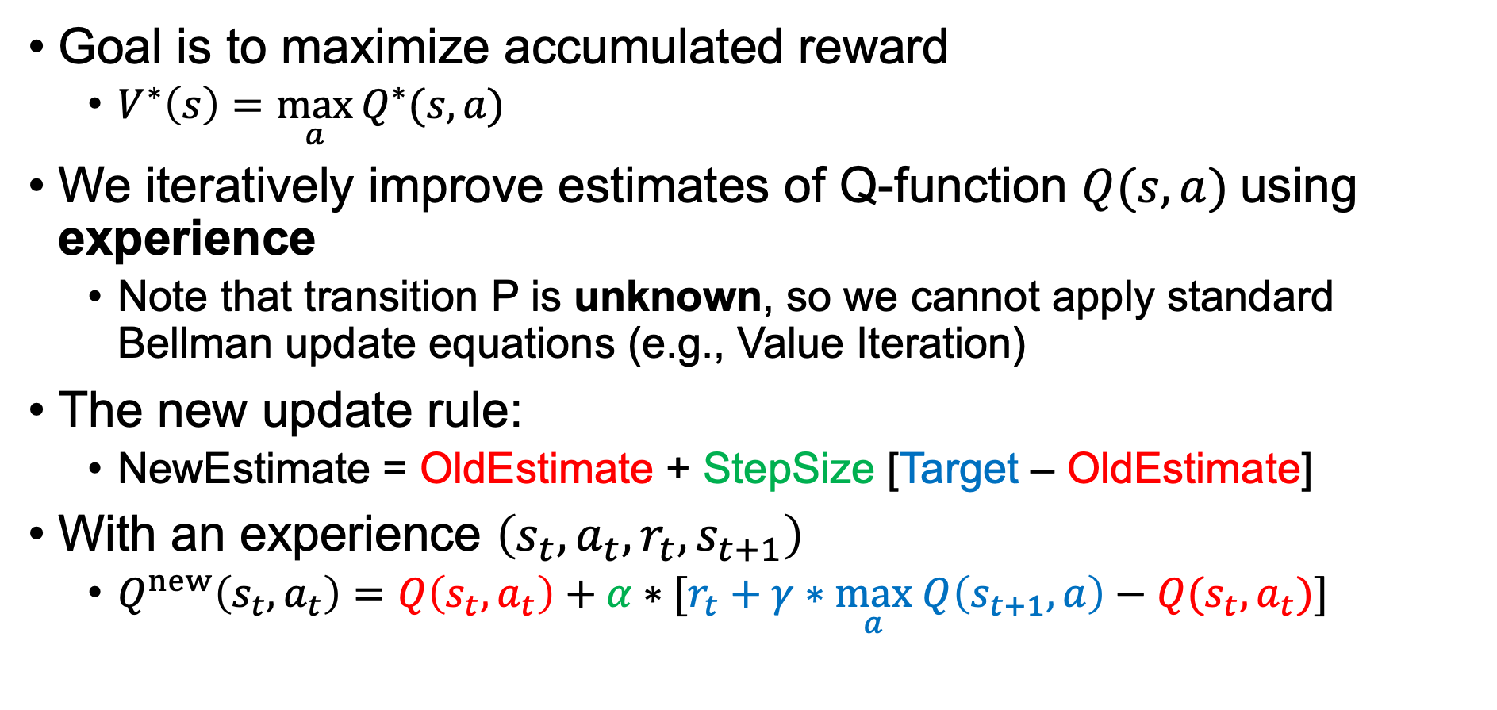

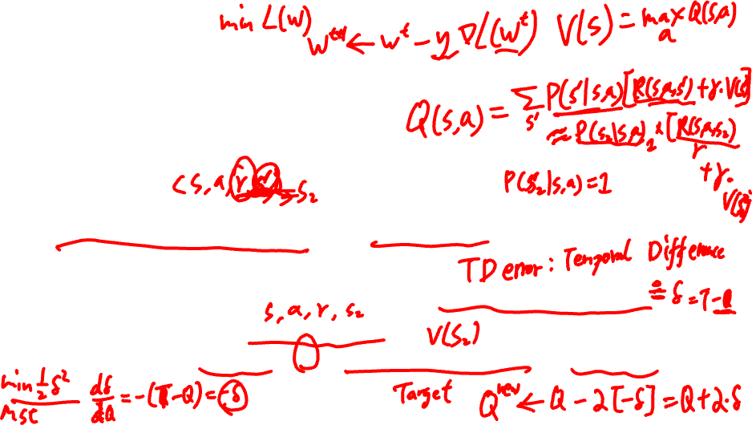
Q-Learning
Goal is to maximize accumulated reward
$V^{∗}\left(s\right)=\max_{a}{Q^{∗}(s, a)}$
We iteratively improve estimates of Q-function $Q(s,a)$using experience
Note that transition P is unknown, so we cannot apply standard Bellman update equations (e.g., Value Iteration)
The new update rule:
NewEstimate = OldEstimate + StepSize [Target – OldEstimate]
With an experience $\left(s_{t}, a_{t}, r_{t},s_{t+1}\right)$
$Q^{new}\left(s_{t}, a_{t}\right)=Q\left(s_{t},a_{t}\right)+α∗[r_{t}+γ∗\max_{a} Q\left(s_{t+1},a\right)−Q(s_{t}, a_{t})]$
Notes:
V(s): (best) expected total (cumulative) reward starting from state s
Q(s,a): (best) expected total reward starting from (s,a) state s with action a
$$V(s_{t+1})= \max_{a} Q\left(s_{t+1},a\right)$$
Each update follows a simple idea: move the current estimate toward a better target. This difference is called the temporal difference (TD) error, which drives learning.
Temporal Difference (TD) target, T = r+gamma V(s’)
is an improved estimate, represents the target value you want your current state estimation to move towards
TD Error is the difference between this target and the current estimate
TD error delta: gradient of loss in an NN-based RL 1/2 delta^2, -delta

Slide 8
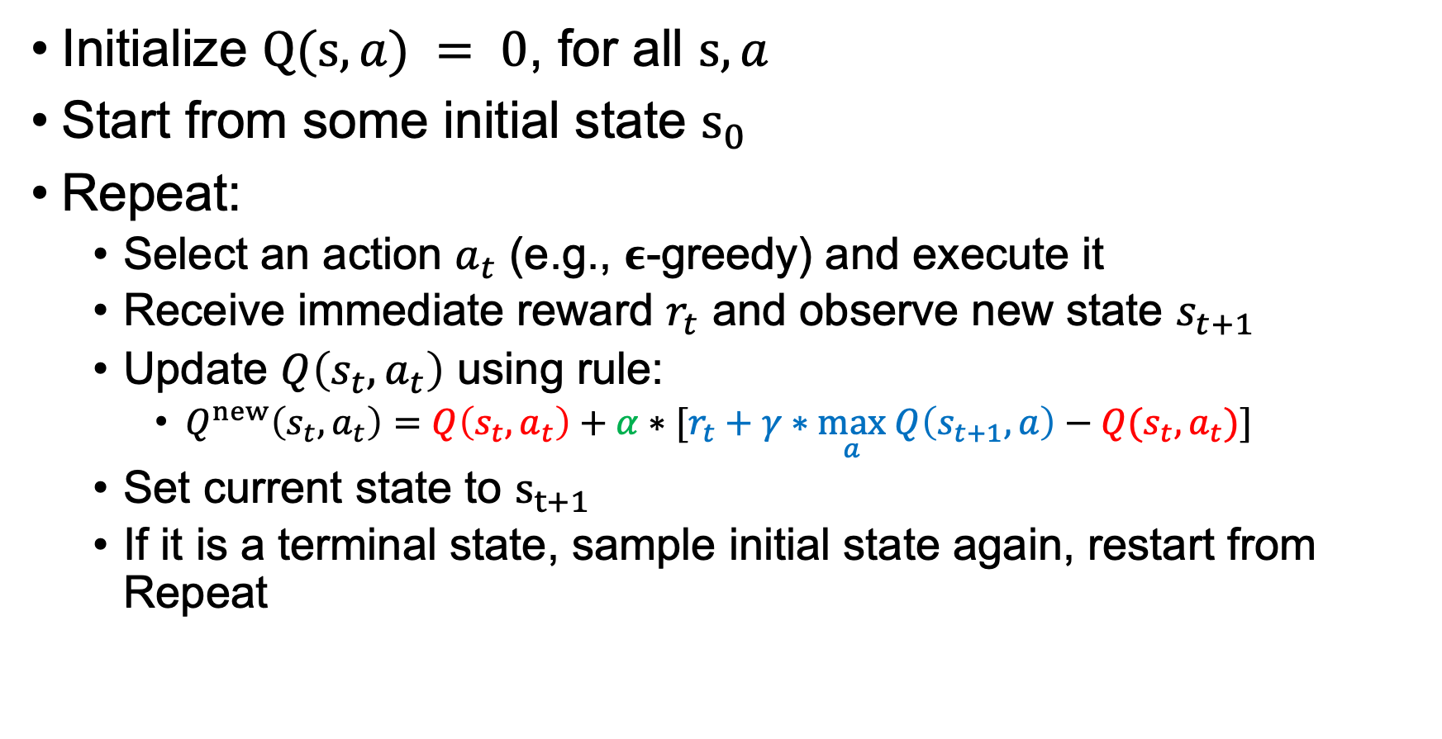
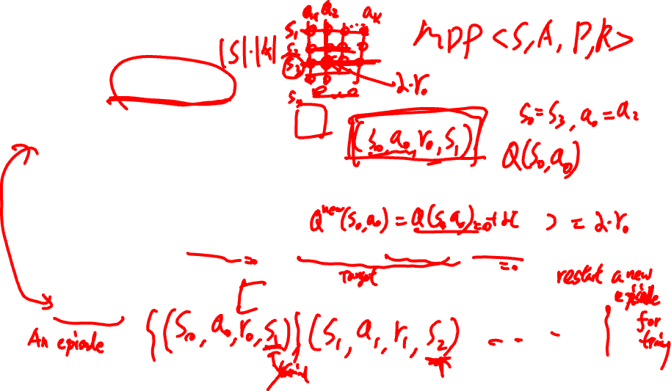
Q-Learning
Initialize $Q(s,a) = 0$, for all $s,a$
Start from some initial state $s_{0}$
Repeat:
Select an action $a_{t}$ (e.g., 𝛜-greedy) and execute it
Receive immediate reward $r_{t}$ and observe new state $s_{t+1}$
Update $Q\left(s_{t},a_{t}\right)$ using rule:
$Q^{new}\left(s_{t}, a_{t}\right)=Q\left(s_{t},a_{t}\right)+α∗[r_{t}+γ∗\max_{a} Q\left(s_{t+1},a\right)−Q(s_{t}, a_{t})]$
Set current state to $s_{t+1}$
If it is a terminal state, sample initial state again, restart from Repeat
Notes:
Tabular Q-learning
Sample an episode
New episode
Greedy, epsilon-greedy, softmax (temperature tau), upper confidence bound (UCB) (balance factor c)
When to stop:
Fixed number of episode
max |Q^new(s,a) – Q(s,a)| \leq \eps, infinity norm
Performance-based stopping, e.g., average reward reaches a threshold
Time or resource limit, in practice

Slide 9
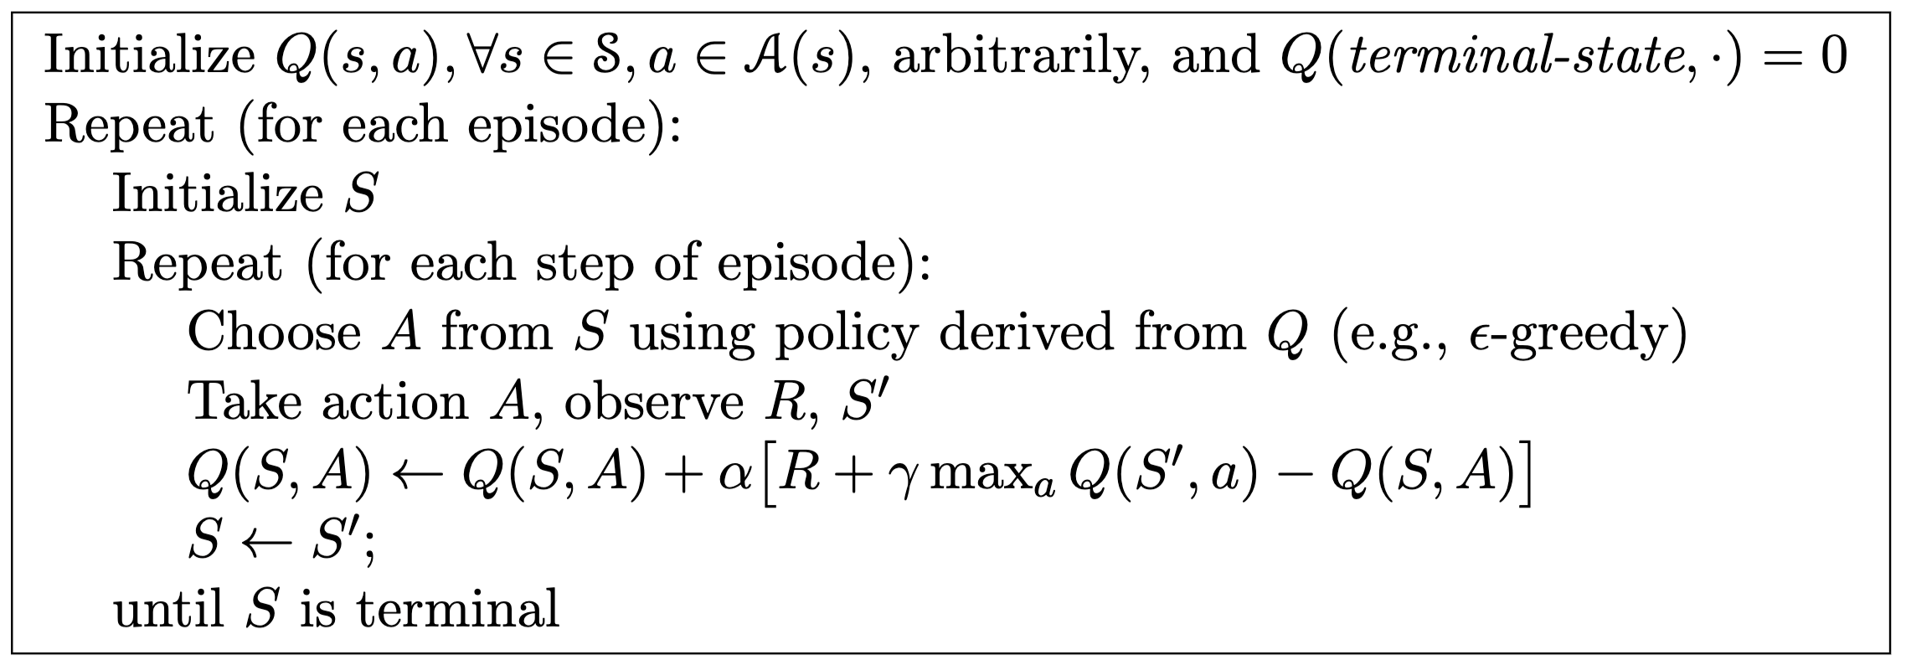
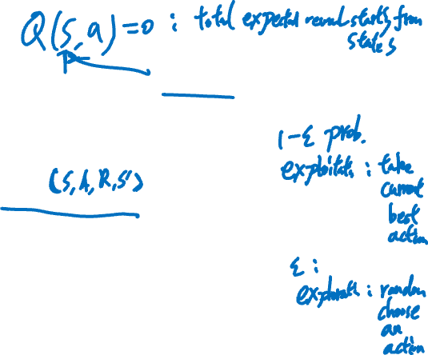
Q-Learning
From Sutton & Barto’s RL book.
Note: For terminal state, there are no future reward (or future value is zero).
Notes:
Tabular Q-learning
Sample an episode
New episode
Greedy, epsilon-greedy, softmax (temperature tau), upper confidence bound (UCB) (balance factor c)
When to stop:
Fixed number of episode
max |Q^new(s,a) – Q(s,a)| \leq \eps, infinity norm
Performance-based stopping, e.g., average reward reaches a threshold
Time or resource limit, in practice

Slide 10
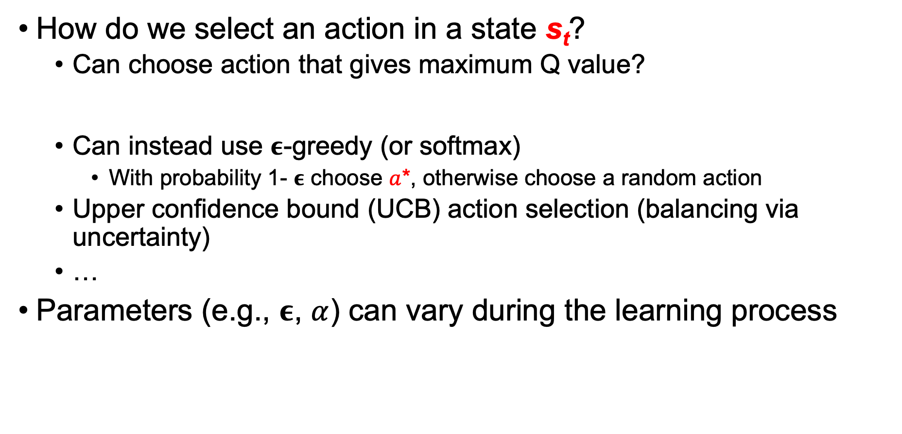
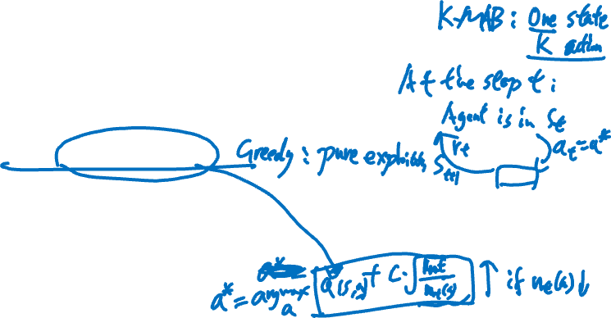
Q-Learning: Exploration/Exploitation
How do we select an action in a state s_{t}?
Can choose action that gives maximum Q value?
Can instead use 𝛜-greedy (or softmax)
With probability 1- 𝛜 choose $a$*, otherwise choose a random action
Upper confidence bound (UCB) action selection (balancing via uncertainty)
…
Parameters (e.g., 𝛜, $α$) can vary during the learning process
Notes:
Multi-armed bandit (MAB): single state
Greedy,
epsilon,
softmax (temperature tau),
upper confidence bound (UCB) (balance factor c)
Q-learning stepsize alpha

Slide 11


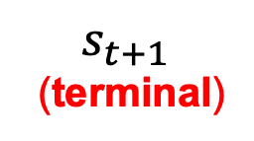

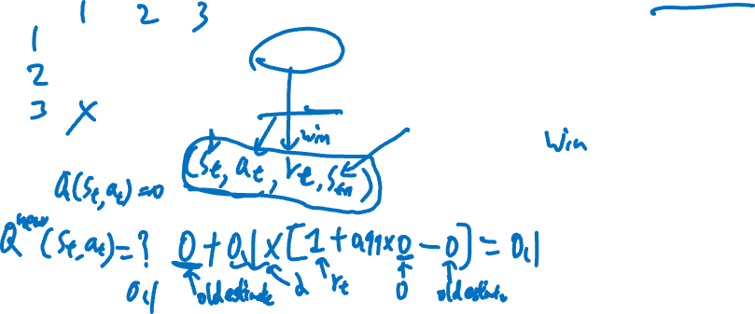
Exercise: Tic Tac Toe
What is $Q^{new}\left(s_{t}, a_{t}\right)$? If all current $Q(s,a)=0 and α=0.1, γ=0.99$
0 | X | 0
 | 0 | 0
 | X | X
0 | X | 0
 | 0 | 0
X | X | X
$r_{t}$ = +1
$a_{t}$ = (3,1)
$$s_{t}$$
$$s_{t+1}$$
(terminal)
Notes:
0 + 0.1 * [1 + 0.99*0 - 0] = 0.1

Slide 12
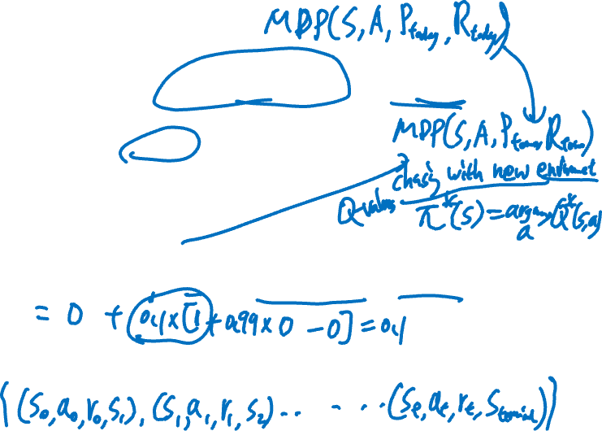
Exercise: Tic Tac Toe
What is $Q^{new}\left(s_{t}, a_{t}\right)$? If all current $Q(s,a)=0 and α=0.1, γ=0.99$
0 | X | 0
 | 0 | 0
 | X | X
0 | X | 0
 | 0 | 0
X | X | X
$r_{t}$ = +1
$a_{t}$ = (3,1)
$$s_{t}$$
$$s_{t+1}$$
(terminal)
$$Q^{new}\left(s_{t}, a_{t}\right)=Q\left(s_{t},a_{t}\right)+α∗[r_{t}+γ∗\max_{a} Q\left(s_{t+1},a\right)−Q(s_{t}, a_{t})]$$
Q-Learning is guaranteed to converge in stationary environments
Transitions P and rewards R are fixed (but unknown)
Notes:
Q = 0 + 0.1*[1 + 0.99*0 - 0] = 0.1
Because the next state is terminal, there is no future reward—so we only learn from the immediate reward.
The transition probabilities P(s′∣s,a) are fixed
The reward function R(s,a,s’) is fixed
The dynamics of the environment remain consistent throughout training
keep chasing a moving target, may not converge
the "best action" today may not be the best tomorrow.
If the environment changes, the algorithm doesn’t converge, it keeps adapting.

Slide 13
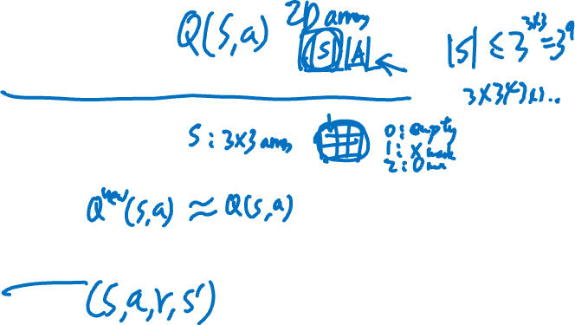
Q-Learning: Limitations
Not scalable for large or continuous state spaces
Ex: Tic-tac-toe is okay, but Pacman becomes intractable
Inefficient use of experience
If rewards are sparse, Q-learning can run for many iterations without learning
Slow convergence
Requires many interactions with the environment
Notes:
|Q| = |S||A|
Q-table

Slide 14
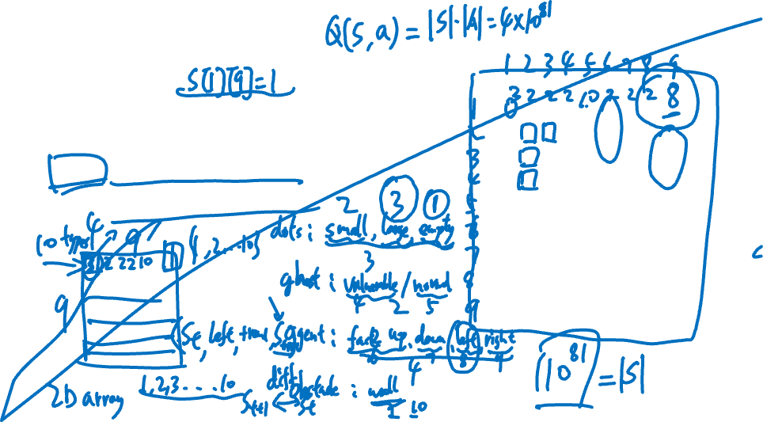
Example: Pacman
Reward:
Eating small dots, big dots and vulnerable ghosts gives positive reward
Eaten by ghost gives negative reward
State: full board configuration
Action: move up, down, left, right
Notes:
9*9 grid,
|{Different dots, different ghosts, agent (face different directions), obstacles}|^9*9: exponential
Small/large/empty; vulnerable/normal; up/down/left/right; wall; 10^81
The state space here is extremely large, makes naïve Q-learning impractical

Slide 15
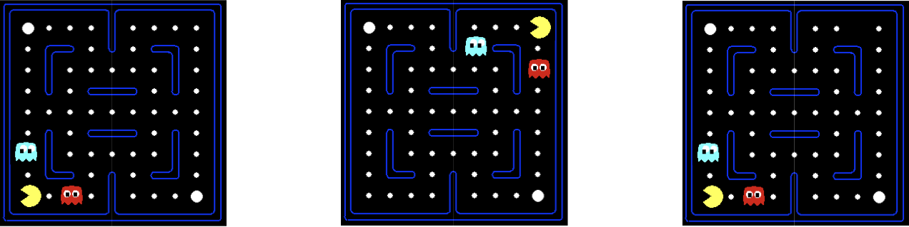
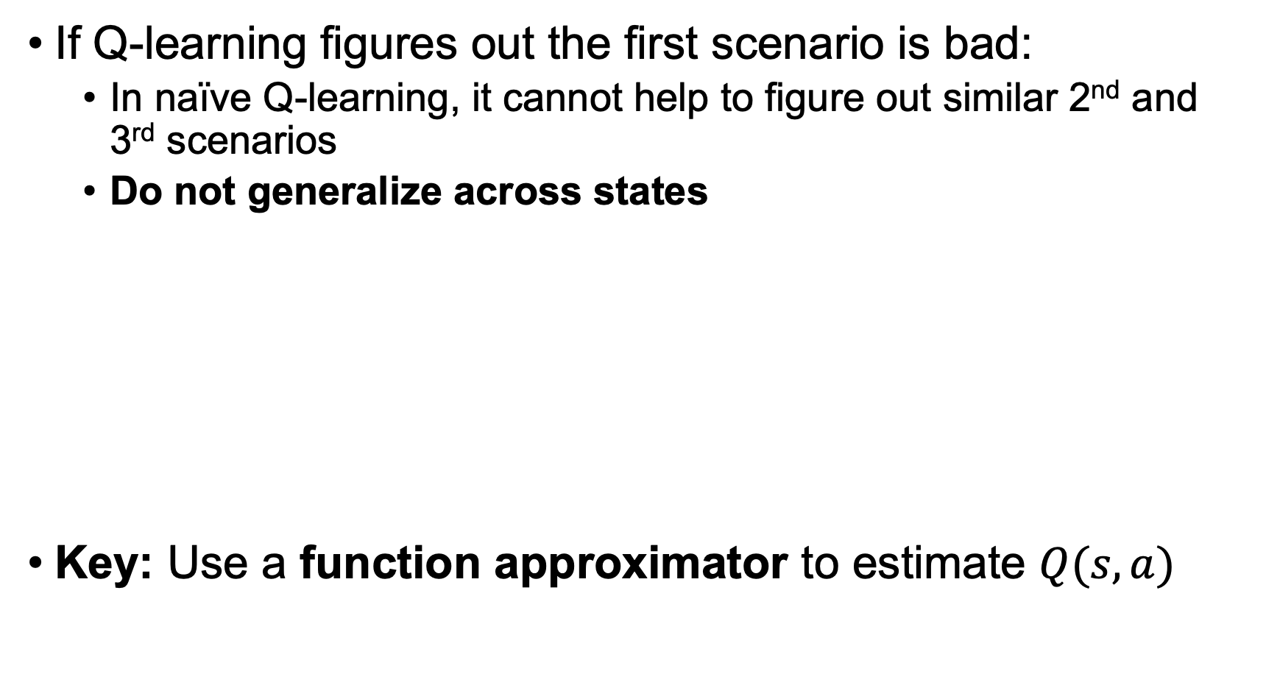
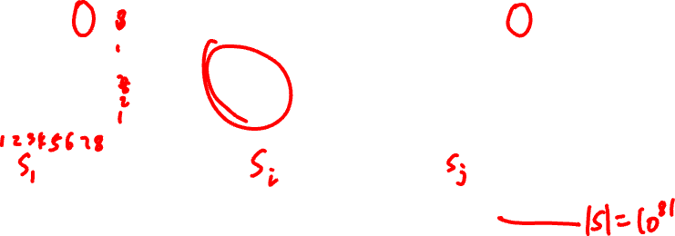
Approximate Q-Learning
If Q-learning figures out the first scenario is bad:
In naïve Q-learning, it cannot help to figure out similar 2nd and 3rd scenarios
Do not generalize across states
Key: Use a function approximator to estimate $Q(s,a)$
Notes:
Features, e.g., deadend in the figure
Extract features
Learning in one state does not transfer to similar states

Slide 16
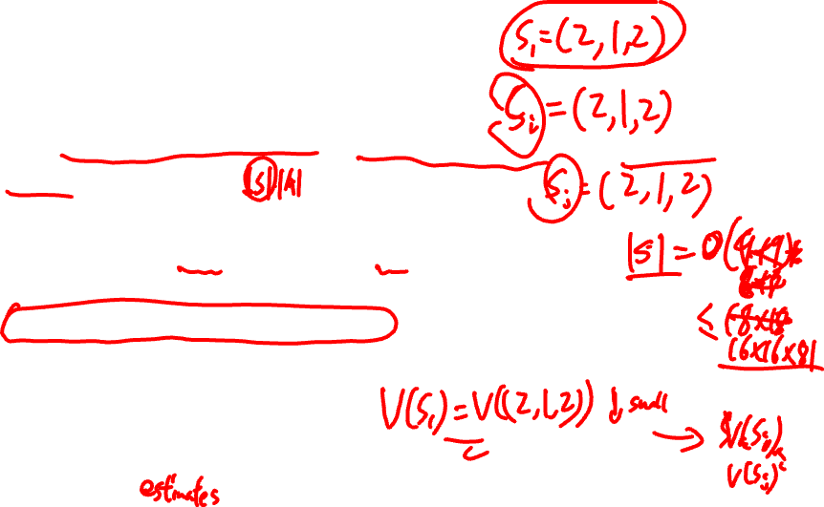
Feature-based Representations
Idea 1: represent a state using features
Ex: (distance to closest ghost, distance to closest dot, number of ghosts, …)
Idea 2: approximate Q-value using features
Advantage:
Compact representation of states
Enables generalization across similar states
Leads to faster training
Disadvantage:
States may share similar features, but are actually very different (inaccurate)
Notes:
Feature representations can accidentally treat different situations as the same, which can lead to inaccurate value estimates.
State A: ghost is 2 step away behind a wall
State B: ghost is 2 step away directly reachable
Feature: "distance to ghost = 2"
But:
A is safe
B is dangerous
Domain experts
Feature extractor
can by replaced by deep neural networks
Input state s, output Q(s,a)

Slide 17
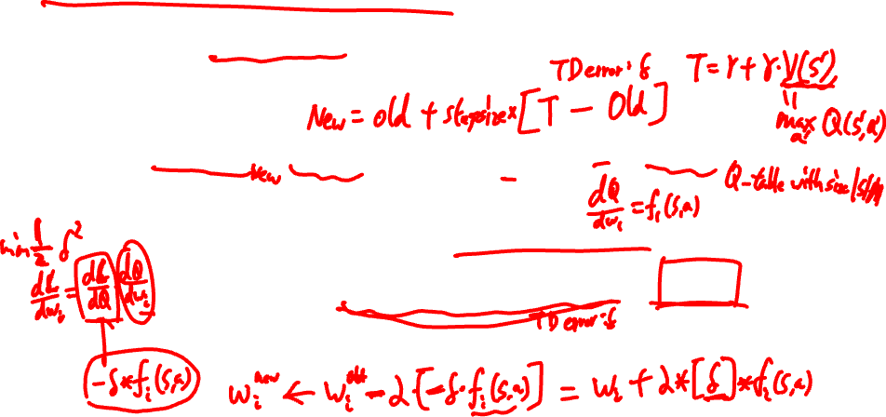
Q-Learning with Features
Experience: (s, a, r, s’)
Exact Q-learning:
Approximate Q-learning with features:
Adjust all weights, as Q is a function of weights
Notes:
TD error: delta = r + gamma*max Q - Q
m features
L(w) = \frac{1}{2} delta^2
dL/dw_i = dL/dQ * dQ/dw_i = -delta * f_i(s,a)
gradient via chain rule

Slide 18
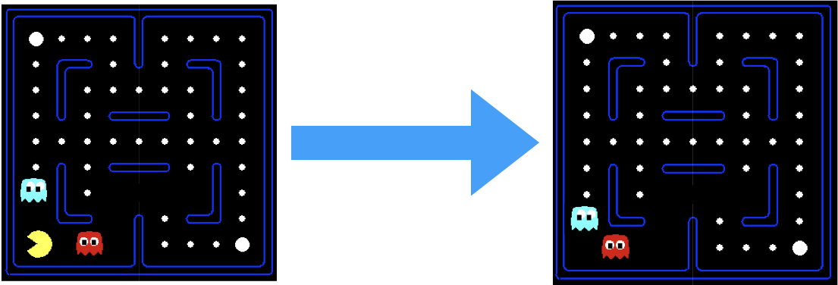
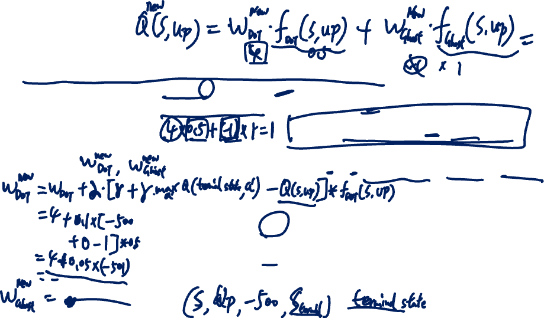

Example
Q(s,a) = w_{DOT} $×$ f_{DOT}(s,a) + w_{GHOST} $×$ f_{GHOST}(s,a)
Current weights: w_{DOT} = 4, w_{GHOST} = -1
Current features: f_{DOT}(s, Up) = 0.5, f_{GHOST}(s, Up) = 1
Current: Q(s, Up) = ?
How to update weights for this experience?
r = -500
a = Up
Notes:
Two features
Current Q-value Q(s, Up) = 4*0.5 – 1*1 = 1
Q(terminal_state, a)=0 the Q-value in terminal state is 0

Slide 19
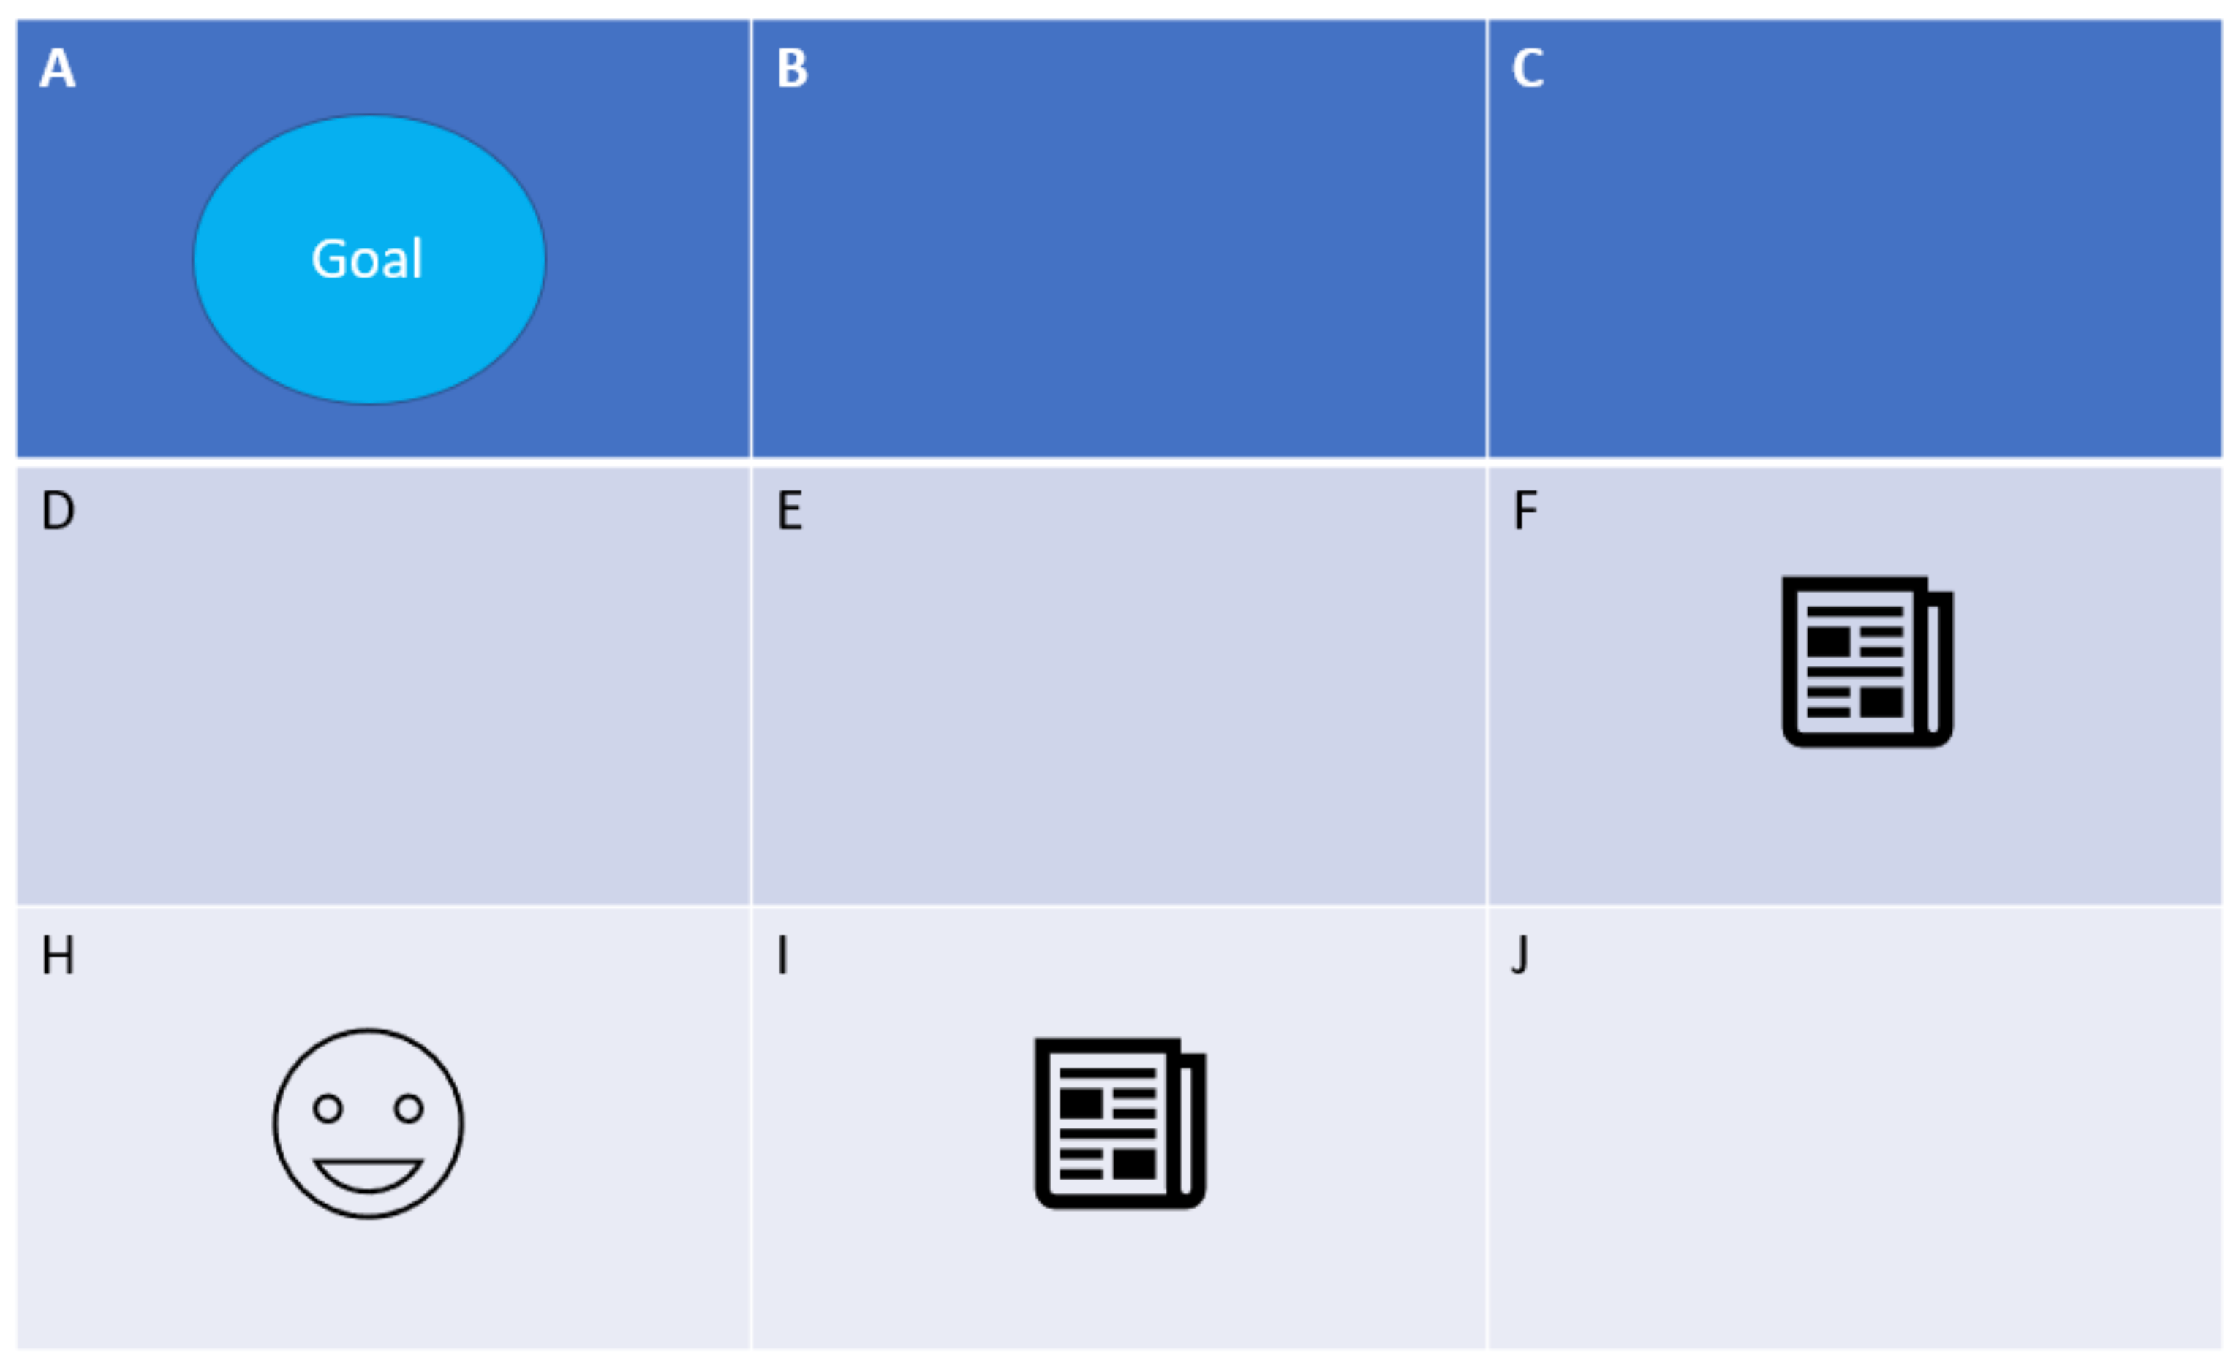
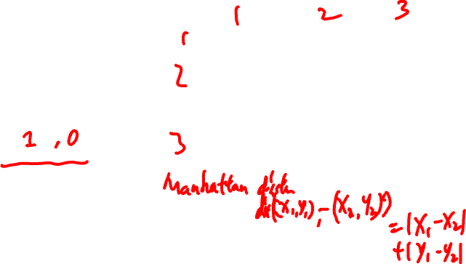
Exercise
Agent starts at cell H (moving Up, Down, Left, Right), aim to collect both newspapers (in I and F) and reach the goal cell A.
Reward:
pick up a newspaper +1,
arrive the goal +1.5,
in other cases -1
Two features:
f₁(s,a): pick up a newspaper or not
f₂(s,a): closer to the goal +1, o.w. -1
Feature weights w₁, w₂
Consider the trajectory (episode): H-I-J-F-C-B-A
Notes:
No extra action for picking up the newspaper
Manhattan distance to the goal
For simplicity, we remove the invalid actions hitting the wall
E.g., for cell H, invalid actions for down and left
|S| \leq 9*2^{#newspapers} = 36
(agent location, newspaper status)
each of the 2 newspapers is either present or collected
Stepsize alpha =0.1
Discount factor gamma = 0.9

Slide 20

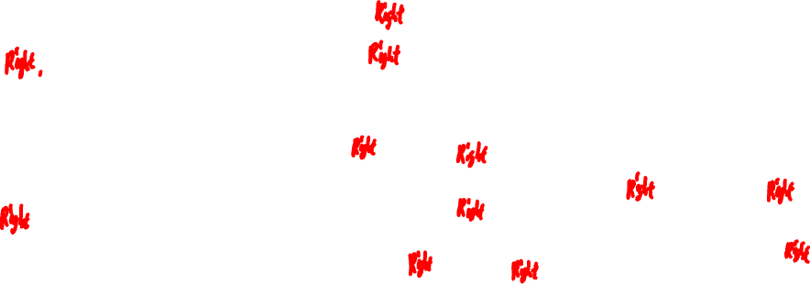

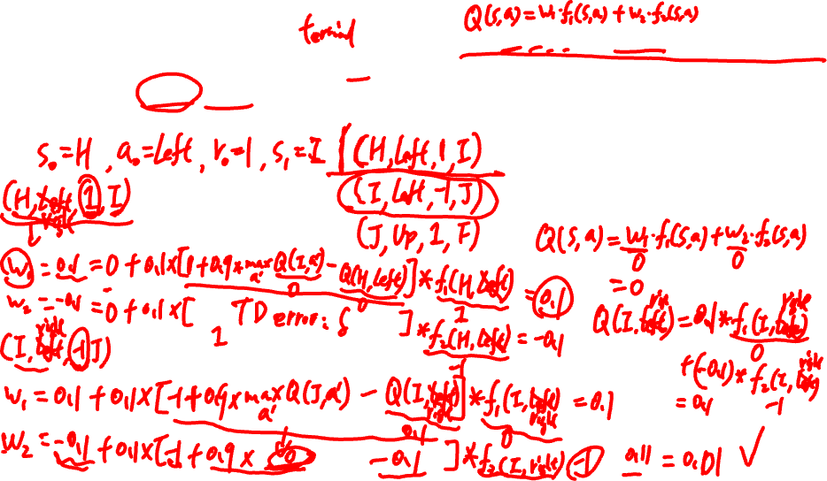
Trajectory (episode): H-I-J-F-C-B-A
Given stepsize $α=0.1,$ discount factor $γ=0.9$
Initialize weights $w_{1}=0,w_{2}=0$
Show the update of weights $w_{1},w_{2}$ for this training episode?
Notes:
pick up the newspaper +1, arrive the goal +1.5, in other cases -1
Manhattan distance to the goal
Stepsize alpha =0.1
Discount factor gamma = 0.9
|S| \leq 9*2^{#newspapers} = 36
(agent location, newspaper status)
each of the 2 newspapers is either present or collected
Experience 1: (s_0, Right, 1, I)
Q(s_0, Right) = w_1*f_1(s_0, Right) + w_2*f_2(s_0, Right) = 0
w_1 = 0 + 0.1*[1+0.9*max_a’ Q(s’, a’) - 0]*1 = 0.1
w_2 = 0 + 0.1*[1+0.9*0 - 0]*(-1)= -0.1
Experience 2: (I, Right, -1, J)
Q(I, Right) = 0.1*0 + (-0.1)*-1 = 0.1
Max_a Q(J, a)
Q(J, Up) = 0.1*1 – 0.1*1 = 0
Q(J, Left) = 0.1*0 – 0.1*1 = -0.1
Invalid actions for down and right
w_1 = 0.1 + 0.1*[-1+0.9*max_a’ Q(s’, a’) – 0.1]*0 = 0.1
w_2 = -0.1 + 0.1*[-1+0.9*0 - 0.1]*-1= 0.01
The updates for remaining experiences will be conducted in a similar manner.

Slide 21
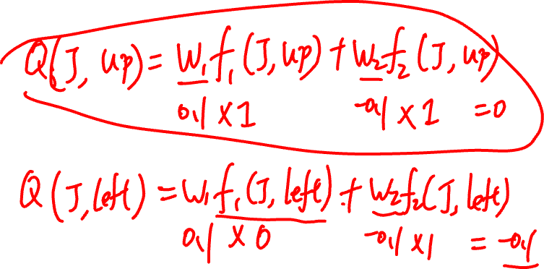
Notes:
pick up the newspaper +1, arrive the goal +1.5, in other cases -1
Manhattan distance to the goal
Stepsize alpha =0.1
Discount factor gamma = 0.9
|S| \leq 9*2^{#newspapers} = 36
(agent location, newspaper status)
each of the 2 newspapers is either present or collected
Experience 1: (s_0, Right, 1, I)
Q(s_0, Right) = w_1*f_1(s_0, Right) + w_2*f_2(s_0, Right) = 0
w_1 = 0 + 0.1*[1+0.9*max_a’ Q(s’, a’) - 0]*1 = 0.1
w_2 = 0 + 0.1*[1+0.9*0 - 0]*(-1)= -0.1
Experience 2: (I, Right, -1, J)
Q(I, Right) = 0.1*0 + (-0.1)*-1 = 0.1
Max_a Q(J, a)
Q(J, Up) = 0.1*1 – 0.1*1 = 0
Q(J, Left) = 0.1*0 – 0.1*1 = -0.1
Invalid actions for down and right
w_1 = 0.1 + 0.1*[-1+0.9*max_a’ Q(s’, a’) – 0.1]*0 = 0.1
w_2 = -0.1 + 0.1*[-1+0.9*0 - 0.1]*-1= 0.01
The updates for remaining experiences will be conducted in a similar manner.

Slide 22
Issues with Feature-based Representations
Who designs the features f(s,a)?
Typically domain experts, but it is not always feasible
Ex: Atari games – raw inputs (e.g., pixels) are too complex for manual feature design
Can we learn features automatically?
Yes, using Deep Learning
Leads to Deep Reinforcement Learning (Deep RL)
Key idea:
Input: state s (e.g., raw pixels)
Output: a vector of Q-values Q(s,a) for actions
Deep neural networks act as automatic feature extractors
Notes:
Input state a,
Output a vector Q(s,a) for all actions

Slide 23
Admin
No homework this week
Assignment 2 will release soon (apologies for the delay)
Deadline will be extended accordingly
Quiz 2 scores will be released later this week
Assignment 1 scores will be released next week
Solutions have already been released on eLearn
For the final exam, I will try to prepare a sample exam for you (expected release in next Week 13)

Slide 24
Next (Final) Session
Go through Quiz 2 solutions
Revision of the course
Open Q&A session

