Slide 1
Learn to Hack Hackathon
Group 1 – Matrix Not Found
Yeong Sir Chung
Matthew Roberto
Rohit Panda
https://roh00t.github.io/MatrixNotFound/
Notes:
0:00-0:15 (15 s). Hi, we're Group 1, Matrix Not Found: Yeong Sir Chung, Matthew Roberto and Rohit Panda. Our project is Retrofit Radar: predicting building energy use in MATLAB to find which buildings to retrofit first.

Slide 2


Problem Statement
z
Buildings are a major contributor to carbon emissions. We built an ML model that predicts a building's energy use intensity (site EUI) from known factors, such as:
Floor area and year built
Energy Star rating
Facility type and location
Climate: temperatures, degree days, precipitation and snow
Buildings that use far more energy than the model expects for similar buildings are the ones leaders should retrofit first.
Notes:
0:15-0:45 (30 s). Buildings are a big share of emissions. The challenge: predict site energy use intensity from building characteristics and weather. Our twist is to use the prediction as a benchmark: a building far above what similar buildings use is a retrofit candidate.

Slide 3
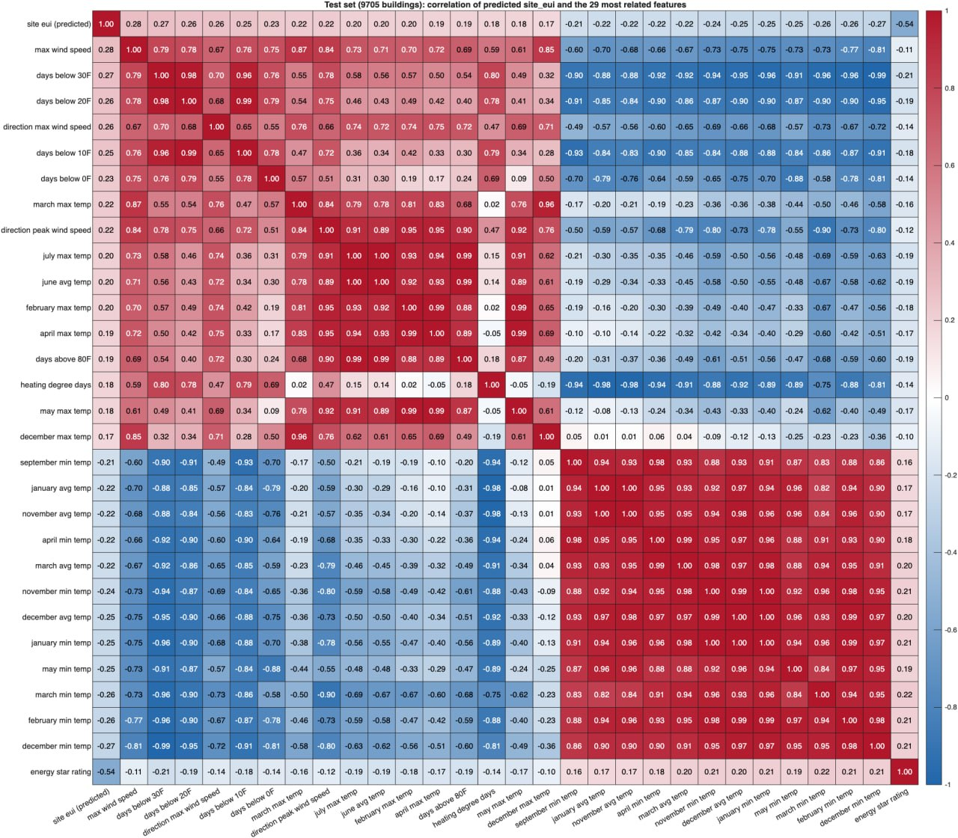
Exploratory Data Analysis
75,757 training building-years; 9,705 test buildings.
The test set is one unseen year (year 7) with no State 6 buildings, so we validate by holding out a whole year.
Energy Star rating is 35% missing: we filled gaps with training-only medians and added "was missing" flags (no rows dropped).
On the test set, Energy Star rating has the strongest correlation with site EUI (−0.54). Climate variables form tightly correlated blocks.
Notes:
0:45-1:20 (35 s). Two data findings drove everything. First, the test set is a single year the model never sees, and it has no State 6 buildings, so a random split would flatter us. Second, key fields are missing; we fill them using training data only and keep a flag, because missingness is informative. The heatmap shows Energy Star rating is the strongest single signal at minus 0.54, and the monthly temperatures are near-duplicates of each other.

Slide 4
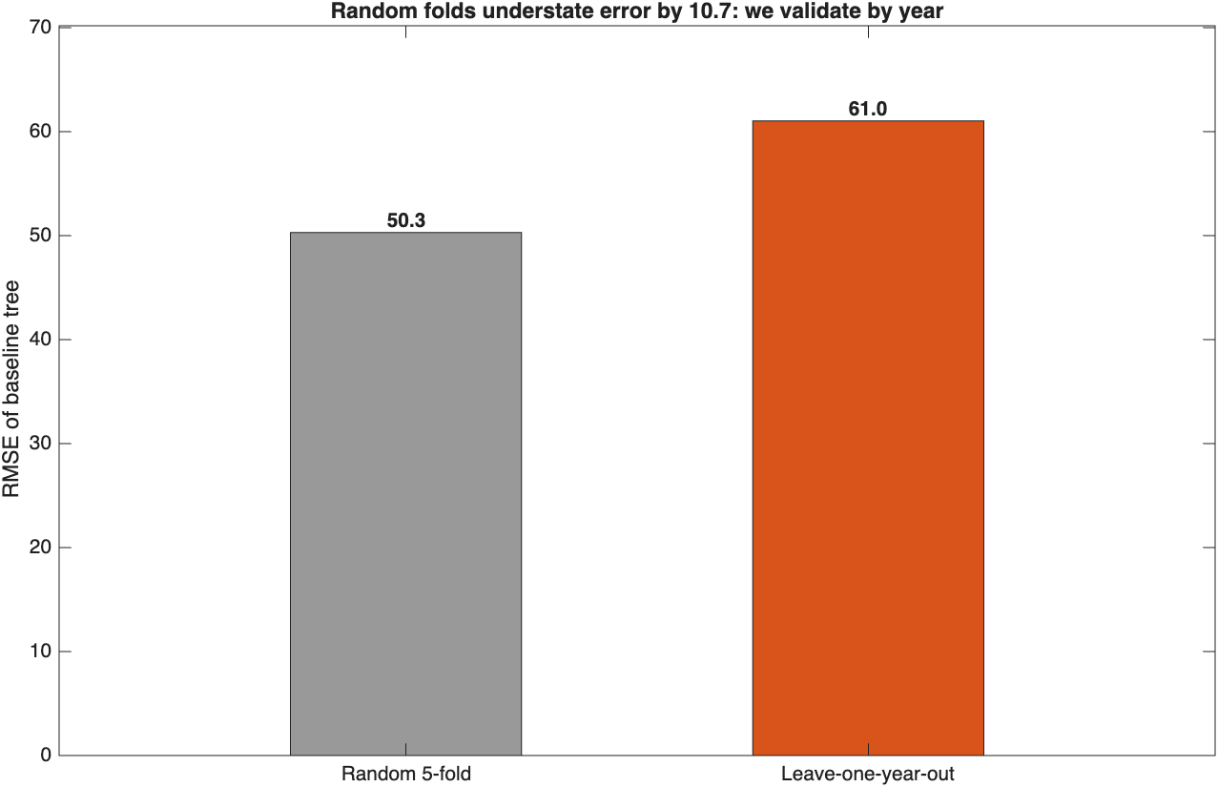
Model Architecture
Gradient-boosted regression trees (MATLAB LSBoost, the native XGBoost-family method): mixed numeric and categorical data, no scaling.
Tree baseline → LSBoost v1 (all features) → v2 (shrinkage) → v3 (feature selection: drop 36 monthly temperatures)
Engineered features: building age, floor area × heating/cooling degree days, Energy Star × floor area
Leave-one-year-out validation, with cleaning refit inside every fold (no leakage)
Notes:
1:20-2:00 (40 s). We use LSBoost, MATLAB's own gradient boosting, the same family as XGBoost. We iterated from a single tree to three boosted versions. Validation is the key design choice: we hold out one whole year at a time, six times. The chart shows why: on the same tree, random five-fold says 50, but holding out a year says 61. Random folds hide 10.7 points of error, because the same building appears in several years.

Slide 5
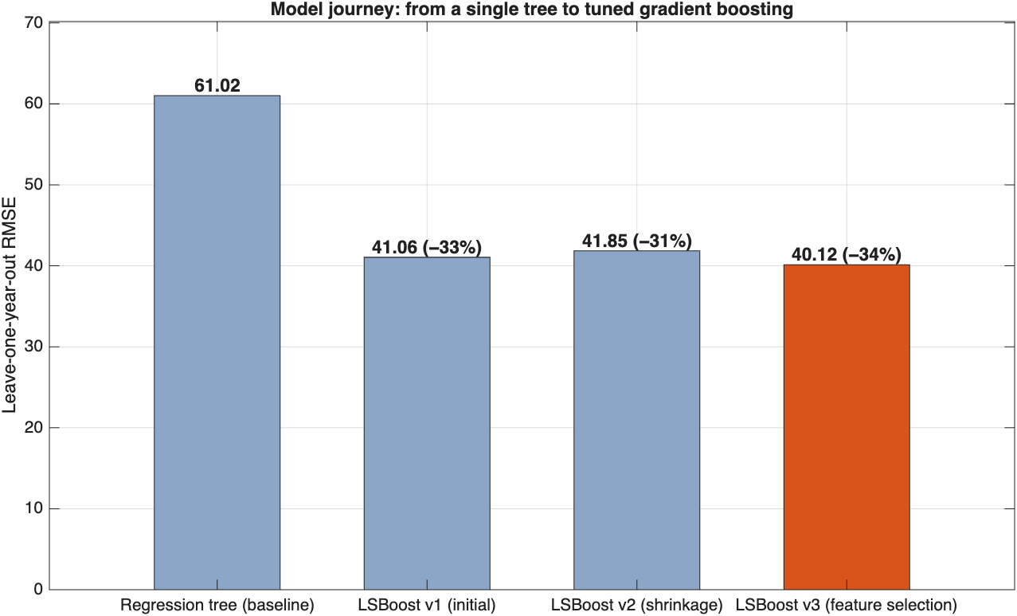
Results
Leave-one-year-out (official model)
Model | All years | Year 6 | vs. tree
Tree | 61.02 | 59.37 | –
LSBoost v1 | 41.06 | 41.08 | −33%
LSBoost v2 | 41.85 | 42.57 | −31%
LSBoost v3 | 40.12 | 41.31 | −34%
LSBoost v3 is our final model:
LOYO RMSE 40.1, 34% lower than a single tree
MAE 21.0 kBtu/ft²/yr and R² 0.53 on years it never saw
Best in 5 of 6 held-out years
Reproducible: a clean rerun gives a byte-identical submission
Notes:
2:00-2:35 (35 s). Results under leave-one-year-out. Boosting cuts the error by a third versus a single tree. Shrinkage, v2, did not help, and we kept that result to show the iteration honestly. Feature selection, v3, dropping the monthly temperatures, gave the best score: RMSE 40.1, MAE 21, R squared 0.53, best in five of six held-out years.

Slide 6
Model Comparison
Five-fold pooled out-of-fold
Metric | M1 | M2 | M3
MAE | 23.3941 | 23.3385 | 21.0390
MSE | 2044.3723 | 2024.7375 | 1695.0047
RMSE | 45.2147 | 44.9971 | 41.1704
R² | 0.3976 | 0.4034 | 0.5005
Controlled experiment: same data and folds, only the model changes.
M1: single regression tree, all cleaned factors
M2: single regression tree, 8 selected factors
M3: LSBoost (300 Trees), 8 selected factors
Boosting on selected features wins on every metric under both validations, consistent with the official result.
Latest-year holdout (train years 1–5, predict 6)
Metric | M1 | M2 | M3
MAE | 22.7927 | 22.7324 | 21.0440
MSE | 2023.2171 | 2003.8279 | 1842.3056
RMSE | 44.9802 | 44.7641 | 42.9221
R² | 0.3777 | 0.3836 | 0.4333
Notes:
2:35-3:00 (25 s). A second, controlled experiment by the team: same folds, only the model changes. Feature selection helps a little, boosting helps a lot: Model 3, LSBoost on eight selected factors, wins on every metric, both on five-fold and on the latest-year holdout. Two independent experiments agree.

Slide 7
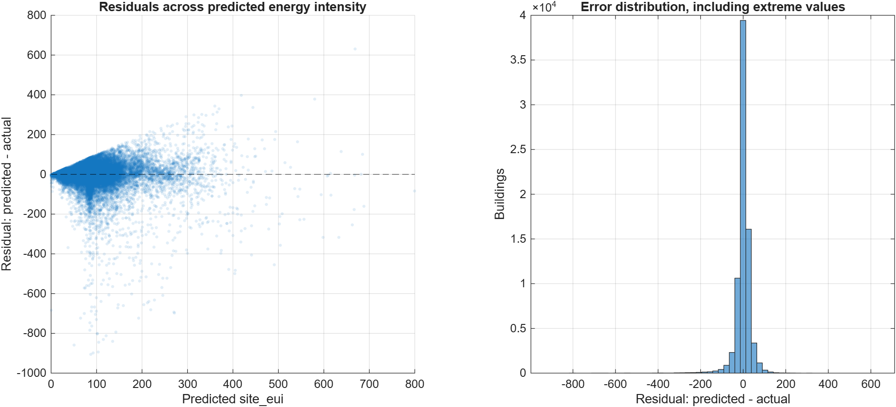
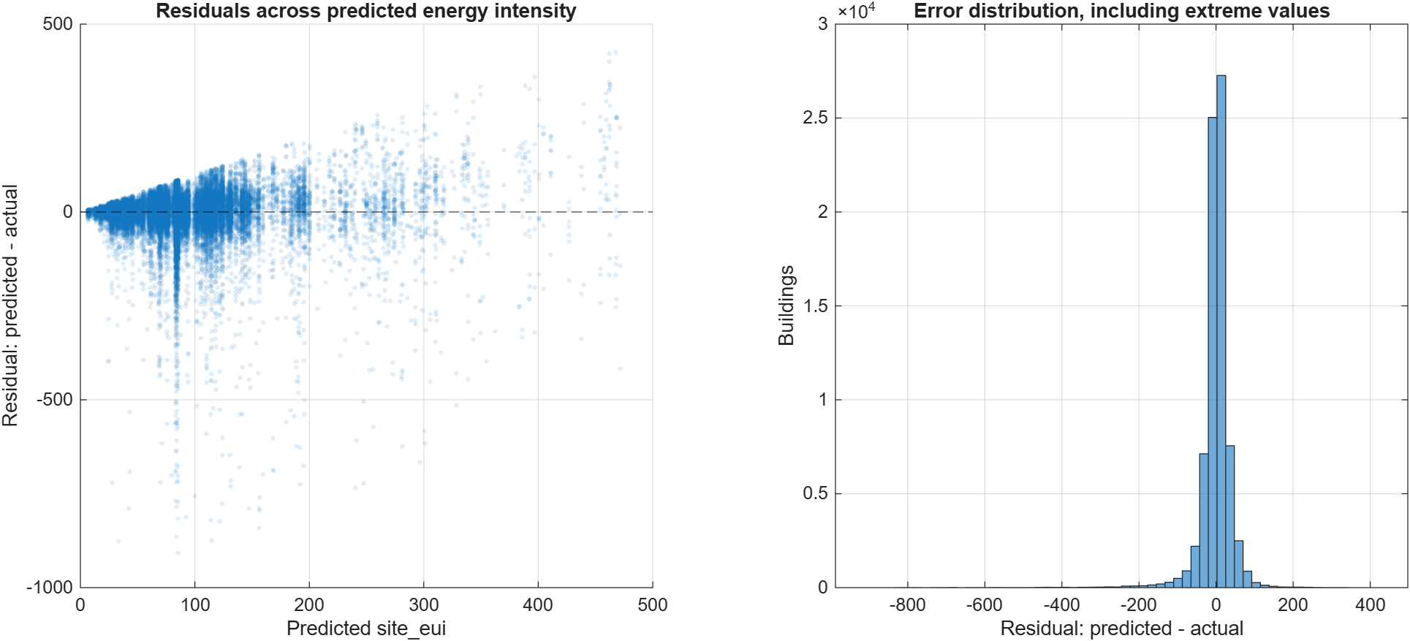

Results - Residual
Residuals (predicted − actual) for all three models, five-fold out-of-fold:
Centred on zero (M3 mean bias 0.03)
M3 has the tightest spread
Long negative tail: a few buildings use far more than predicted
Those outliers are exactly what Retrofit Radar flags.
M3: LSBoost, selected factors (best)
M1: tree, all factors
M2: tree, selected factors
Notes:
3:00-3:25 (25 s). Residuals for all three models. They are centred on zero, so the model is not biased, and Model 3 is the tightest. The long negative tail is the interesting part: a small number of buildings use far more energy than the model expects. That is exactly the signal we turn into a product.

Slide 8
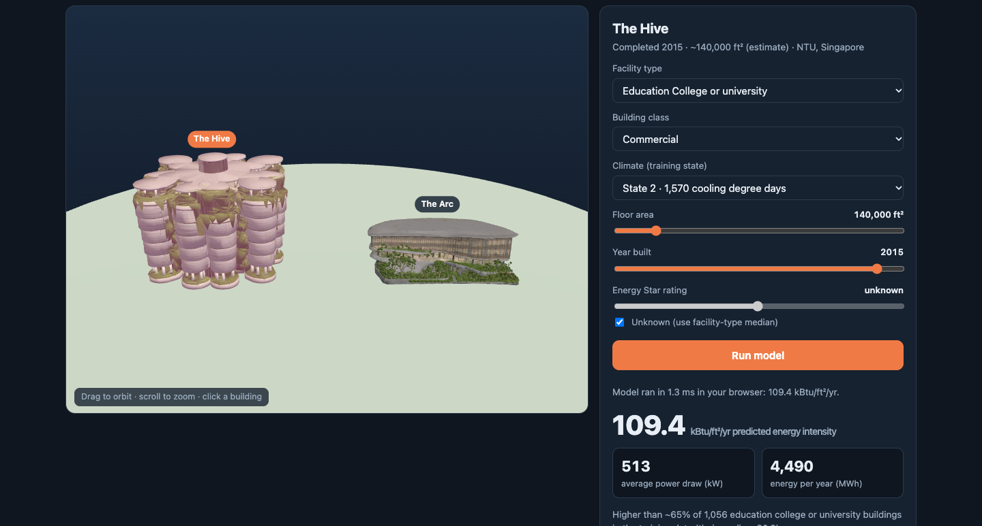
Live Demo
z
Retrofit Radar compares each building's actual energy use with what the model expects for similar buildings:
1,316 buildings use 50%+ more than expected
The top 50 account for 1,573 GWh/yr of excess energy
3D simulator: click NTU's The Hive or The Arc and our trained model runs in the browser, matching MATLAB exactly.
Open index.html in the repository for the dashboard, simulator and report.
https://roh00t.github.io/MatrixNotFound/
Notes:
3:25-4:40 (75 s). SWITCH TO THE BROWSER: open index.html. (1) Dashboard: model iteration chart, then the Retrofit Radar shortlist. 1,316 buildings use at least 50% more than expected. (2) Simulator: click The Hive, press Run model: about 109 kBtu per square foot, roughly 513 kW average. Drag floor area or Energy Star to show the curve update live. The 300-tree model was exported from MATLAB and matches it exactly. Then come back to the slides.

Slide 9
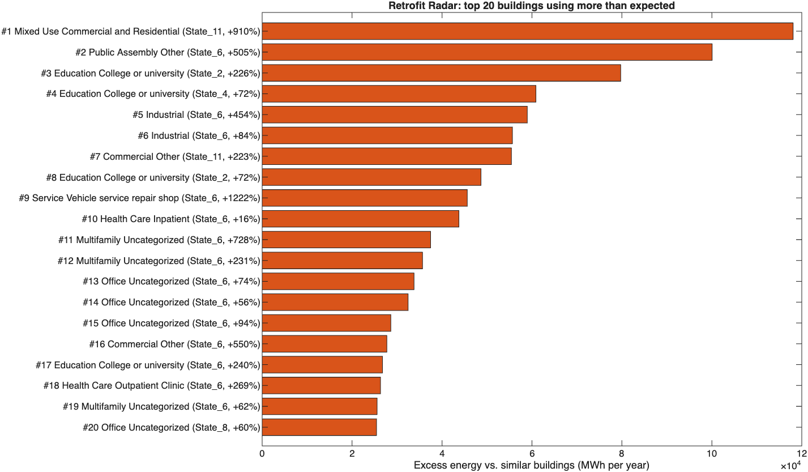
Conclusion
Our best model is LSBoost v3 (feature selection): LOYO RMSE 40.1, MAE 21.0, R² 0.53, with 34% lower error than a single tree.
In real-world use, Retrofit Radar turns predictions into a ranked audit list: the buildings using far more energy than their peers.
Repository link:
Roh00t/MatrixNotFound: LearnToHack
Notes:
4:40-5:00 (20 s). To wrap up: LSBoost v3 is our final model, validated the hard way on unseen years, and Retrofit Radar turns it into a list of buildings to audit first. Everything is in our repository. Thank you, happy to take questions.

