Slide 1
Bank Customer Churn Prediction
Rohit Umredkar
Student at Praxis Business School Bangalore

Slide 2
Problem Statement:
Marketing costs to acquire new customers are high. Therefore, it is important to retain customers so that the initial investment is not wasted.
Objective:
To reduce customer acquisition cost to bank by retaining current customers.
To predict whether customer will churn or not.

Slide 3
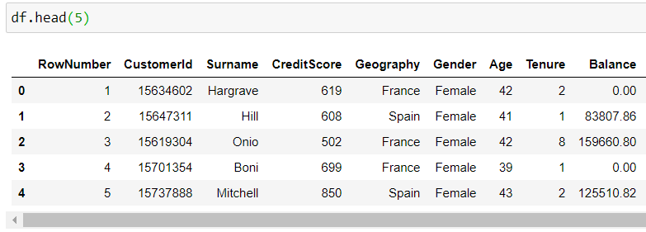
Dataset
The dataset consist 10,000 customer belongs to France, Germany and Spain.
There are total 14 Columns available
Label:
Existed – if customer exited then 1 else 0.
Features:
CreditScore -- Cont. Numerical
Geography -- Categorical(France, Germany, Spain)
Gender -- (Male, Female)
Age -- Cont. Numerical
Tenure -- Cont. Numerical
Balance -- Cont. Numerical
NumOfProducts -- Ordinal (1, 2, 3, 4)
HasCrCard -- Categorical( if yes then 1 else 0)
IsActiveMember -- Categorical( if yes then 1 else 0)
EstimatedSalary -- Cont. Numerical
Unwanted columns need to drop:
RowNumber
CustomerID
Surname

Slide 4
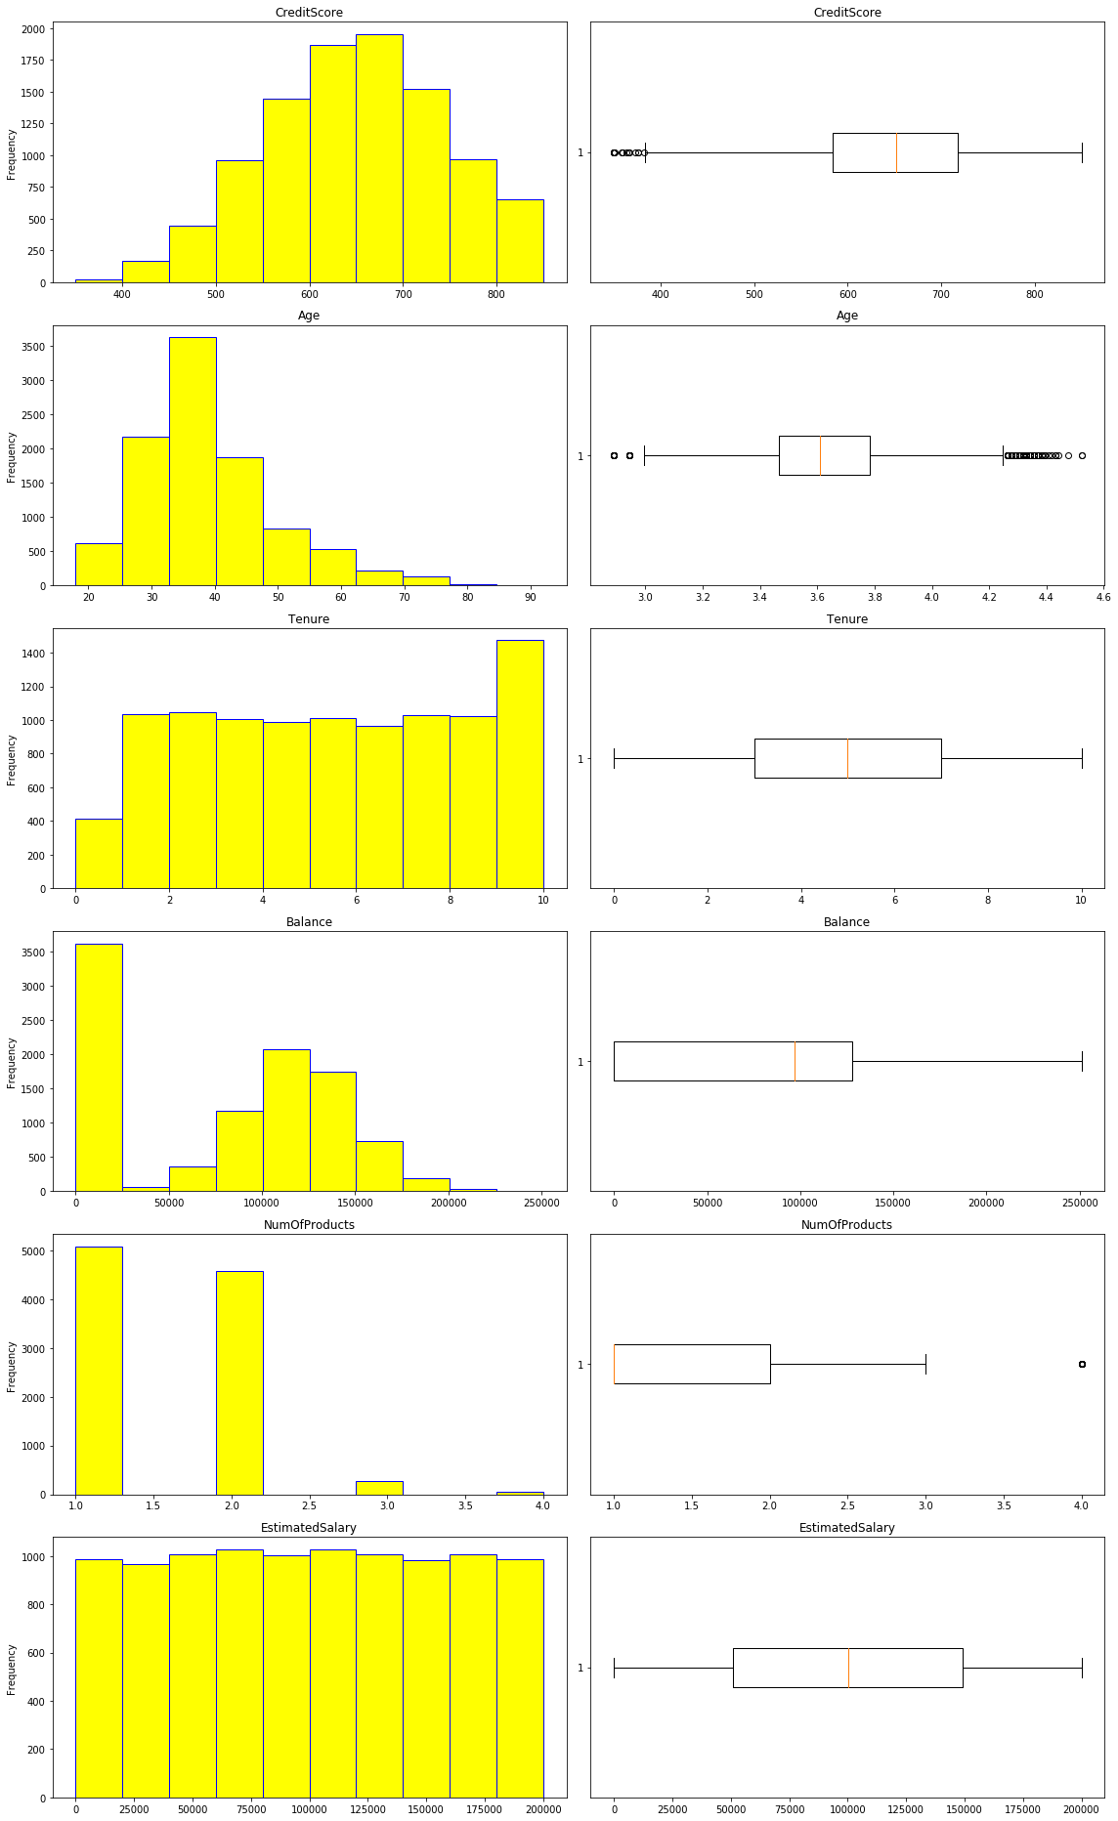
Exploratory Data Analysis(EDA)
Shape (10,000, 10)
No Null values found in dataset.
No Duplicates values found in dataset.
It is observed that No variable is redundant.
It is observed that No variable is Highly Imbalanced.
Univariate Analysis:
It is observed that ‘Age’ have skewed data.
It is observed that ‘Balance’, ‘EstimatedSalary’ are uniformly distributed.

Slide 5
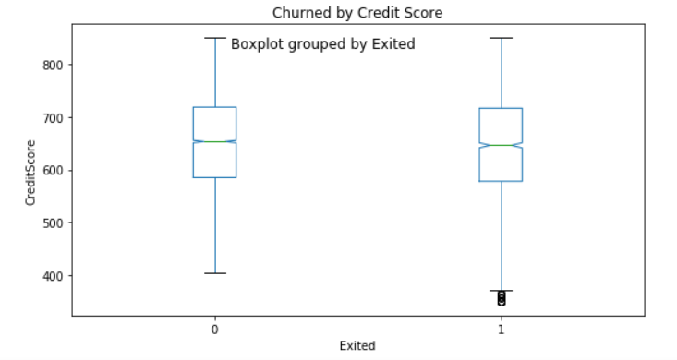
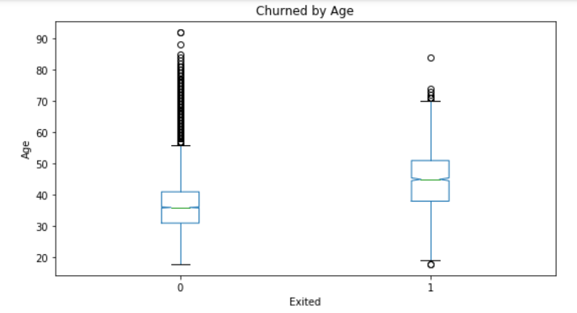
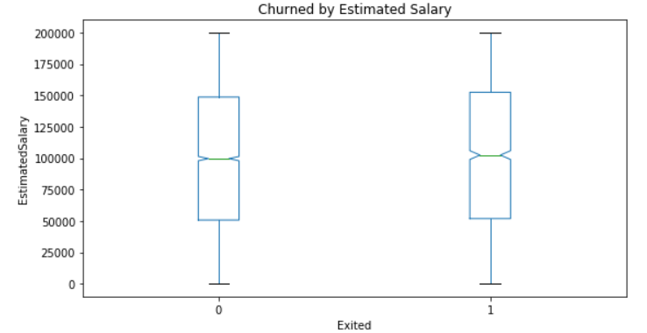
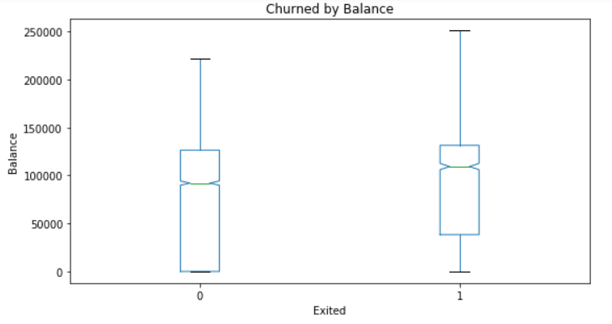
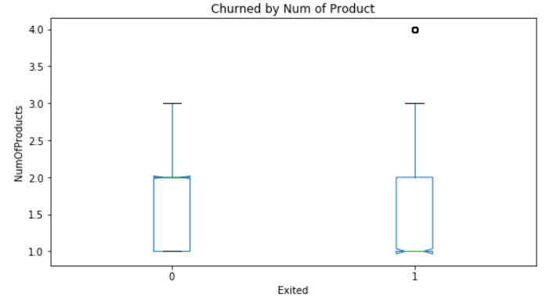
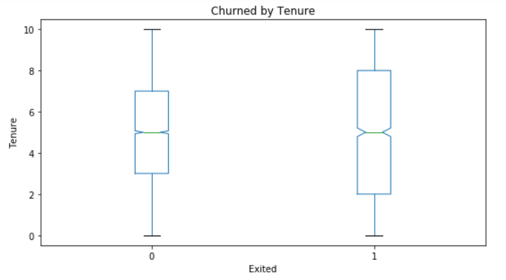
Exploratory Data Analysis(EDA)
Bivariate Analysis:
It is observed that ‘Age’ and ‘Number of Product’ are affecting Label more.

Slide 6
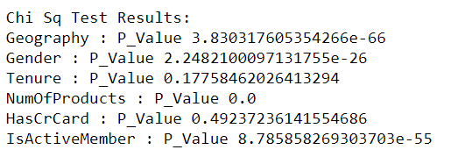
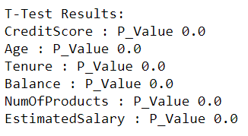
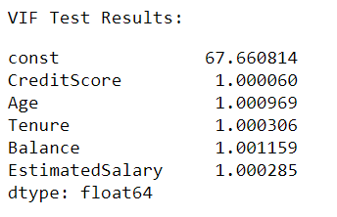
Exploratory Data Analysis(EDA) cont.
Tests:
Chi Sq Test:
It is observed that ‘HasCrCard’ is insignificant.
T-Test:
It is observed that No Numerical variable is insignificant.
VIF Test:
No Multicolinearity has been Observed

Slide 7
Model Building
Train Test Split:
80/20 ratio is used for model training & testing, respectively.
Model Performance
Model | Recall | Precision | f1-Score | Accuracy | AUROC
Logistic Regression | 0.04 | 0.35 | 0.07 | 0.79 | 0.68
Decision Tree Classifier | 0.45 | 0.70 | 0.58 | 0.85 | 0.80
Pruned Decision Tree | 0.50 | 0.71 | 0.59 | 0.85 | 0.81
Random Forest Classifier | 0.47 | 0.79 | 0.59 | 0.86 | 0.86

Slide 8
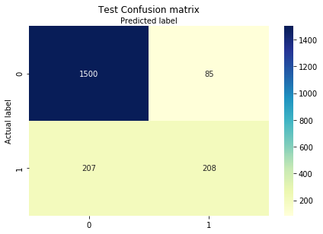
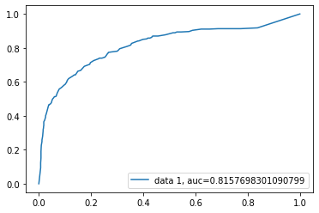
Conclusion
Best Model:
Pruned Decision Tree:
Actual Churner classified as Churner are 208.
Actual Churner classified as non-churner are 207.
Actual non-churner classified as non-churner are 1500.
Actual non-churner classified as churner are 85.
In conclusion, we have seen that predicting customer churn is a very challenging task due to its temporal characteristic, which increases the overall data analysis complexity. In fact, a standard procedure to model time events in classification tasks does not exists yet, making time varying problems widely discussed and studied in the literature. However, we have proved that data ML tools can help banks to understand their customers' behavior, conforming that further studies may be worth considering.

