Slide 1
Examining Median House Prices and School Ratings for Scarborough Canada
Applied Data Science Capstone - Final Project

Slide 2
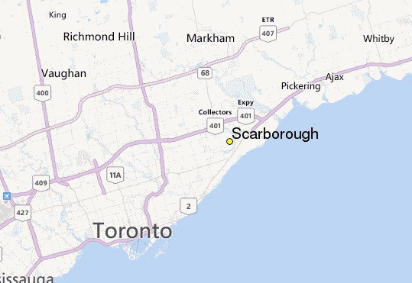

Slide 3
Data Requirements
Locational Coordinates
Geo-locational data will be required about the specific borough (Scarborough, Toronto) and the neighborhoods within.
Dataset containing latitudes and longitudes, and zipcodes is available through previous notebooks and Week 3 exercise.
https://github.com/Rohail-thedataguy/Week-3-Project-for-Applied-Data-Science-Capstone/blob/master/Segmenting%20and%20Clustering%20Neighborhoods%20in%20Toronto%20(Part%202).ipynb

Slide 4
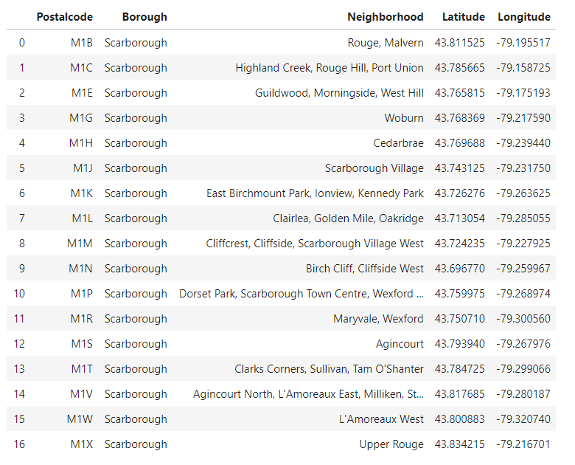
Scarborough data with locational coordinates

Slide 5
Foursquare API
Connecting to Foursquare and Retrieving Locational Data for Each Venue in Every Neighborhood
After subsetting the data and cleaning the data, connection to the Foursquare API is established to gather information about venues within each neighborhood. For each neighborhood, 2 km radius was chosen and limit was set to 100 venues.

Slide 6
Data Preprocessing
After having obtained the location data, the data were processed and a Data frame created for all the venues inside the Scarborough.
When the data is completely gathered, the raw data will be processed to find desirable features for each venue. The main feature is the category of that venue. After this stage, the column "Venue's Category" will be One-hot encoded and different venues will have different feature-columns.

Slide 7
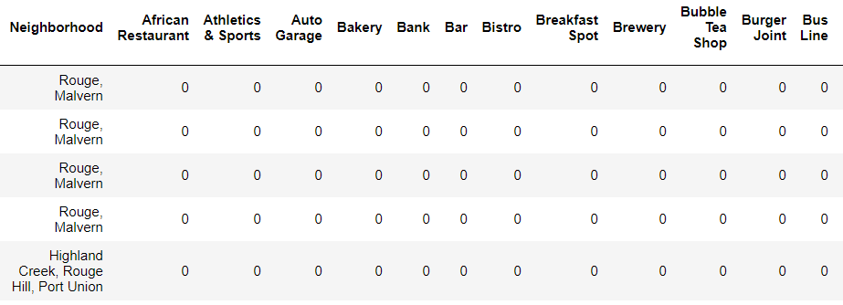
Creating a Data Frame
Processing the retrieved data and creating a data frame for all the venues inside the Scarborough

Slide 8
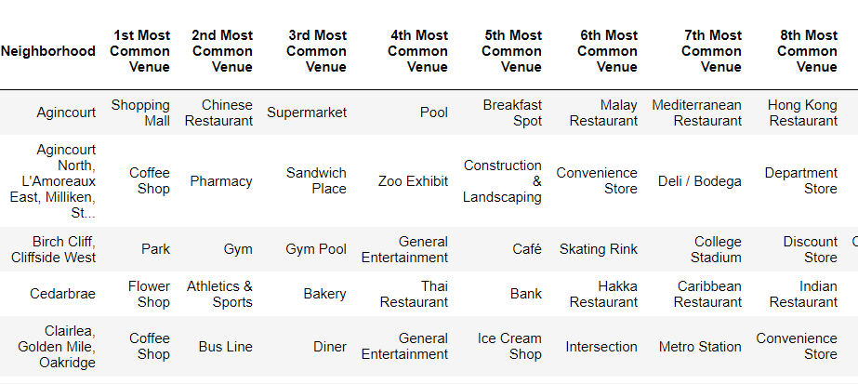
A bit of Exploratory Analysis
The most common Venues in each neighborhood in Scarborough, Toronto

Slide 9
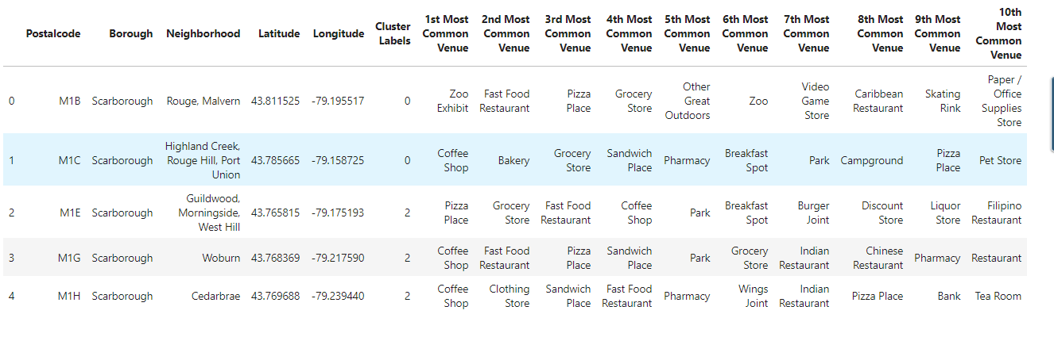
Applying Machine Learning Technique (K-Means Clustering)

Slide 10
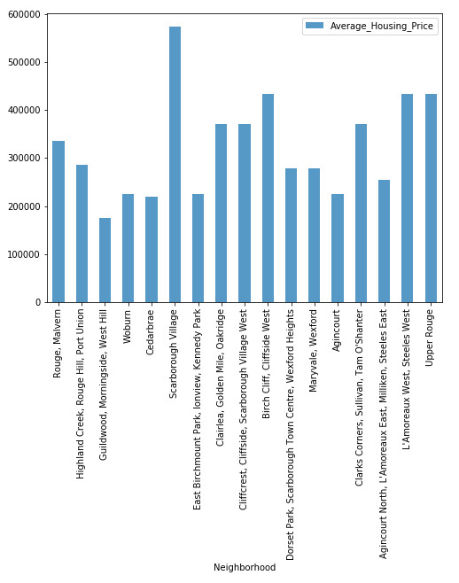
NEIGHBORHOOD MEDIAN HOUSING PRICES

Slide 11
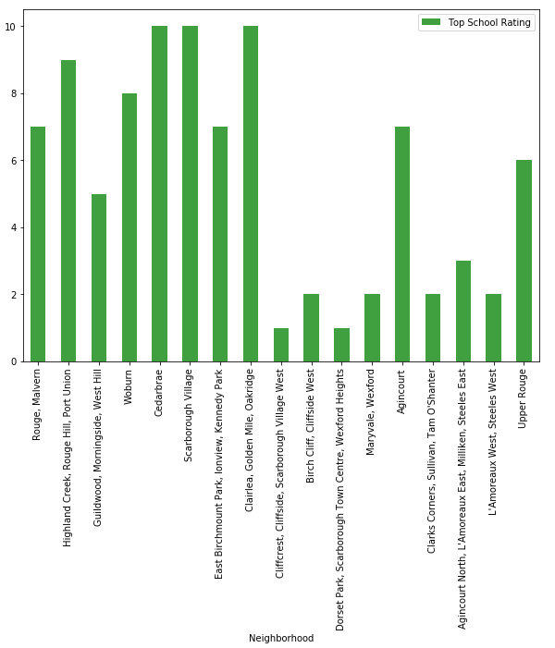
NEIGHBORHOOD SCHOOL RATINGS

Slide 12
Conclusion
In this project, through a k-means cluster algorithm we separate the neighborhood into 04 clusters, which have similar neighborhoods around them. Using the charts above decision leading to a neighborhood based on average house prices and school rating can be made.

