Slide 1
Task 1
UML State Machine

Slide 2
Activity Diagram
Red
Yellow
Green

Slide 3
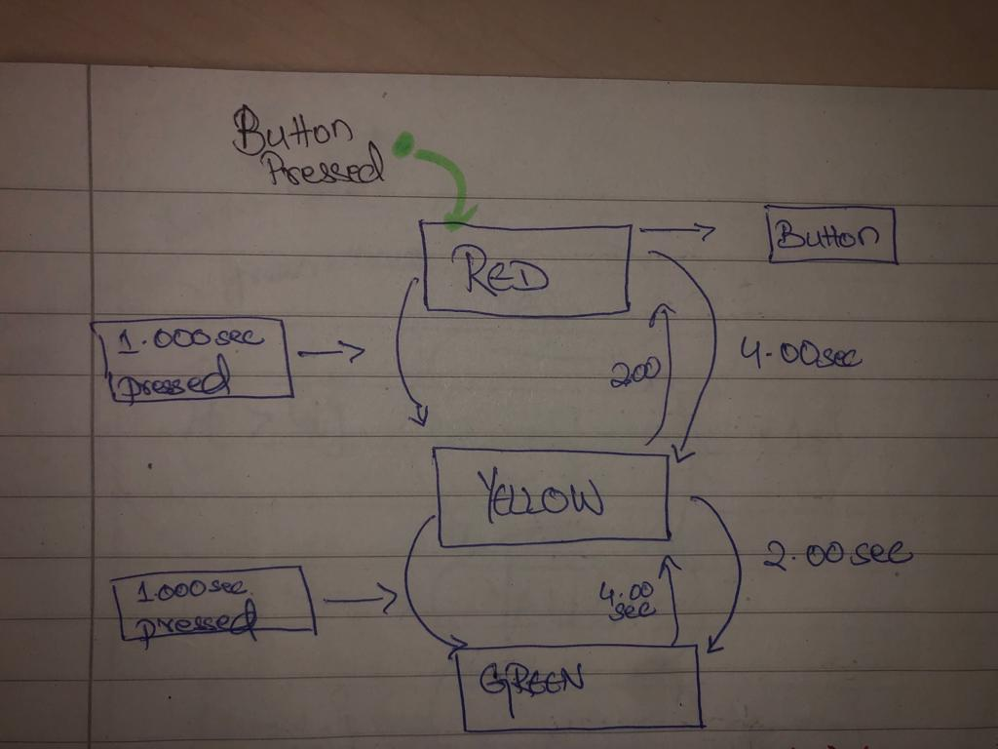

Slide 4
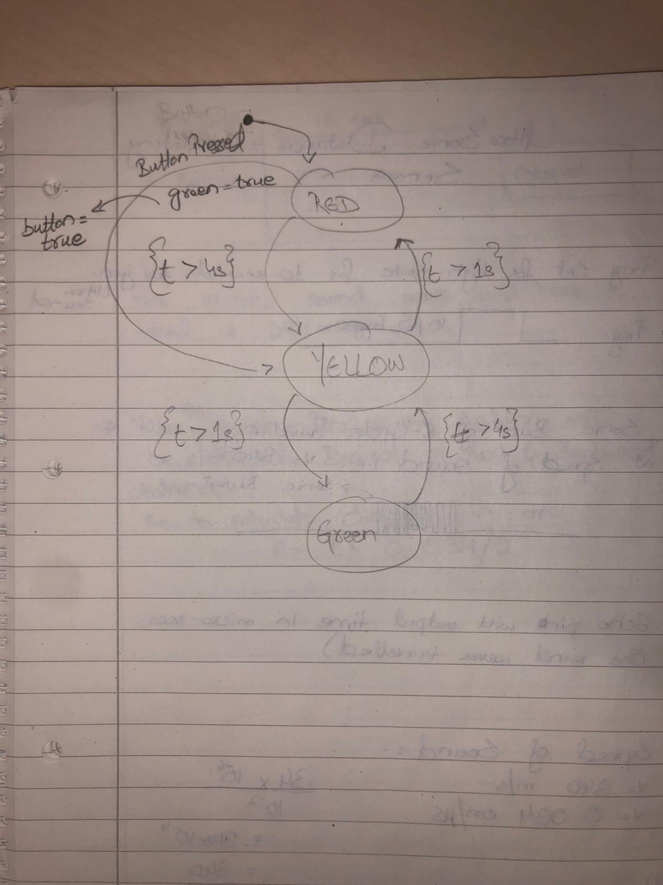

Slide 5
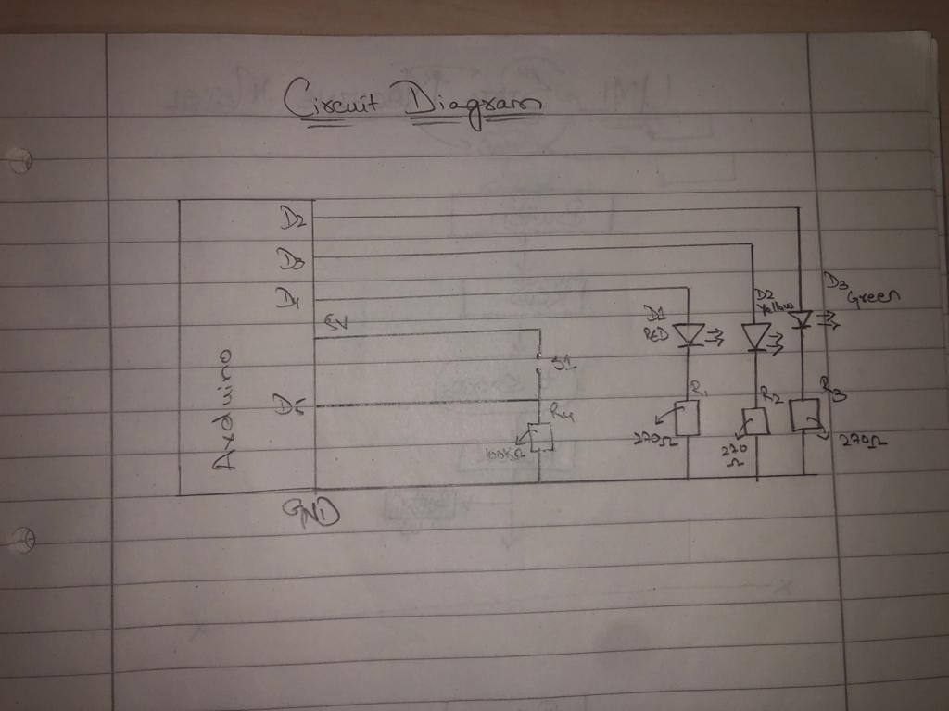
Circuitry

Slide 6

Source Code
https://github.com/Rohail999/Lab_Sprint_Task_1/blob/master/Source_code

