Slide 1
Lab_Sprint_4
ADDAC

Slide 2
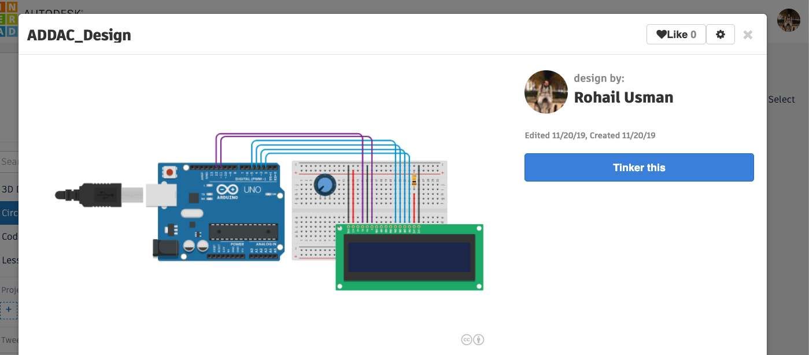
Circuit Diagram
https://www.tinkercad.com/things/879EUjuevds-addacdesign
Notes:
https://www.tinkercad.com/things/879EUjuevds-addacdesign

Slide 3
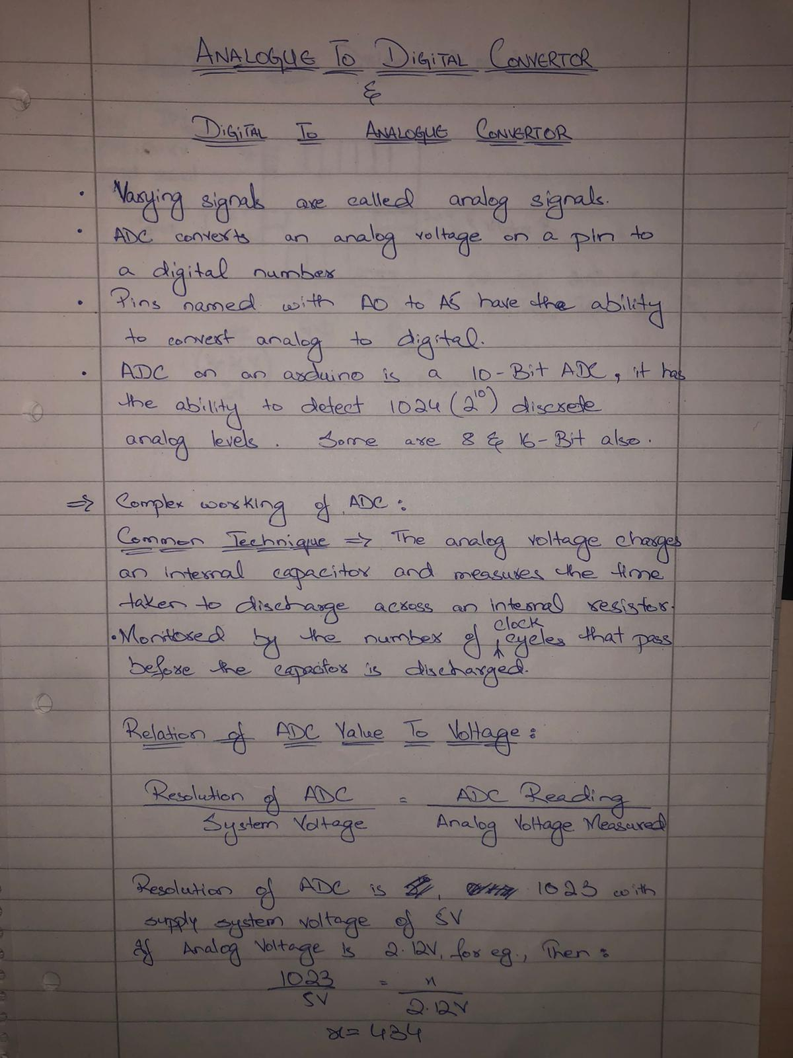
Research Material

Slide 4

Source Code
https://github.com/Rohail999/Lab_sprint_ADDAC/blob/master/ADDAC----Task_4.ino

