Slide 1
Lab_Sprint_3
UltraSonic Sensor

Slide 2
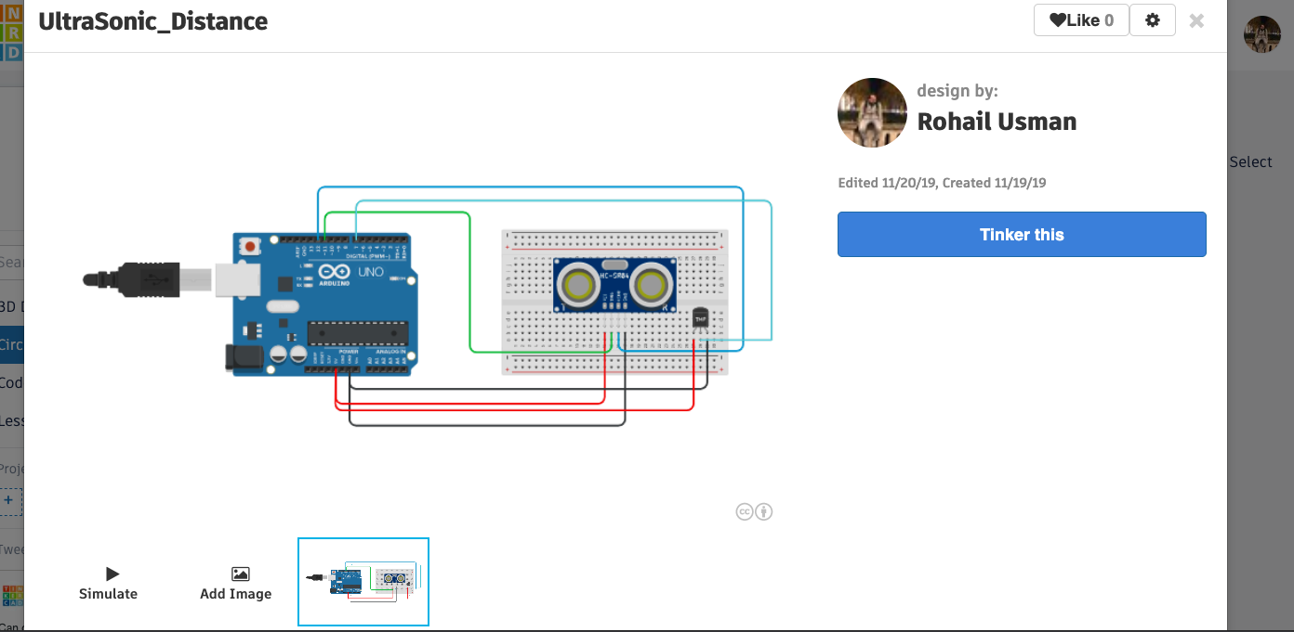
Circuit Diagram

Slide 3
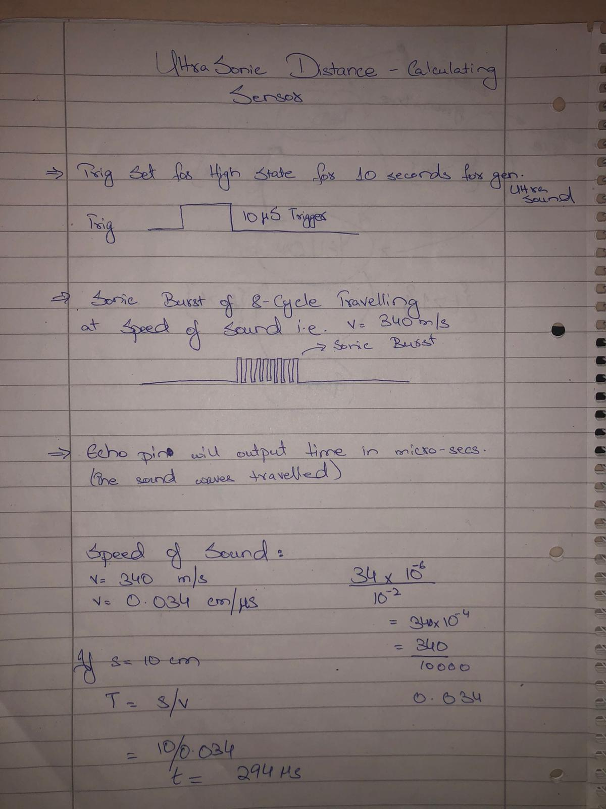
Research Material

Slide 4
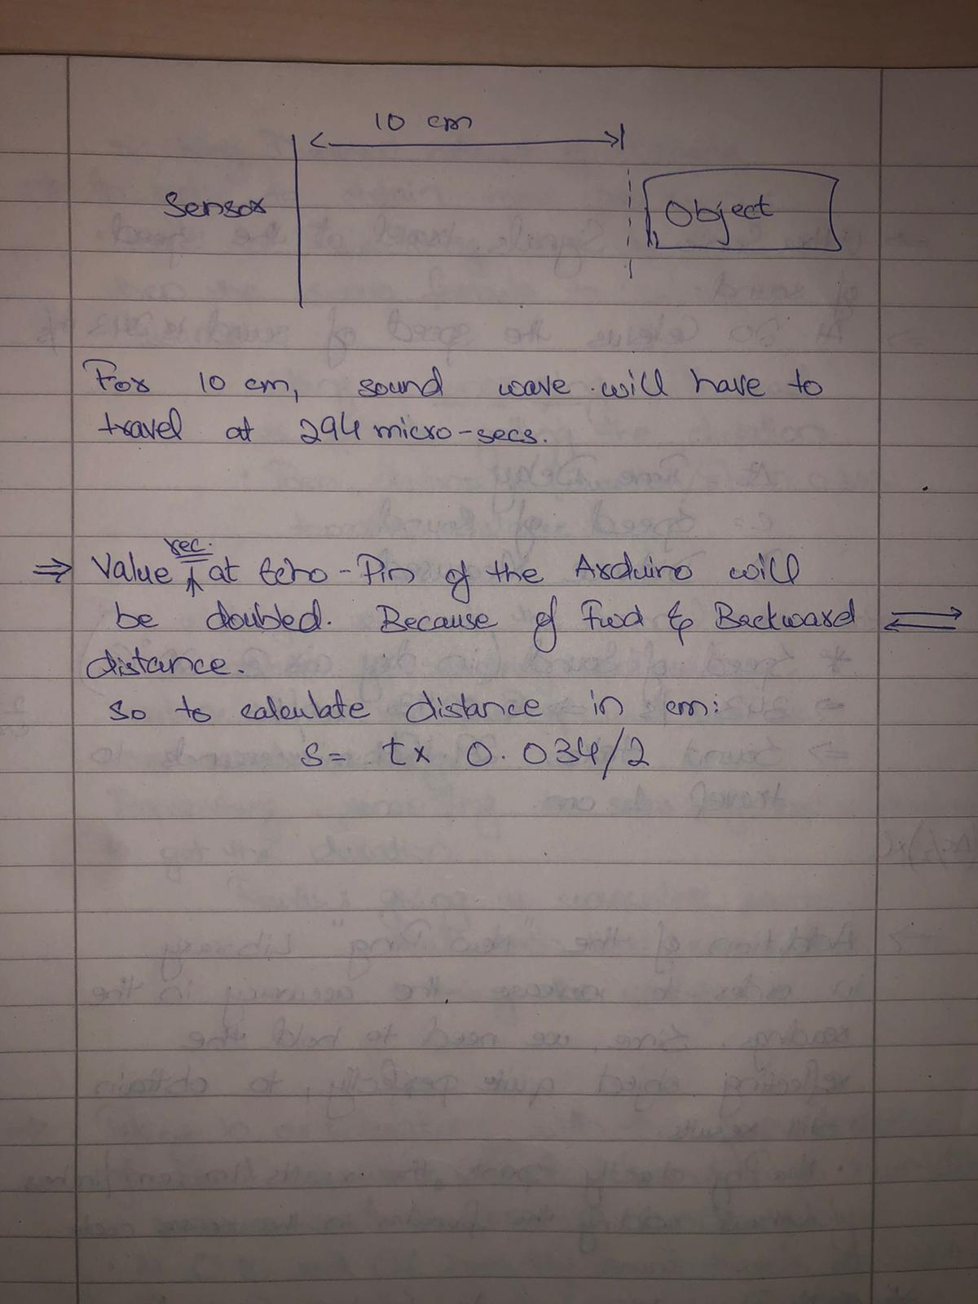

Slide 5
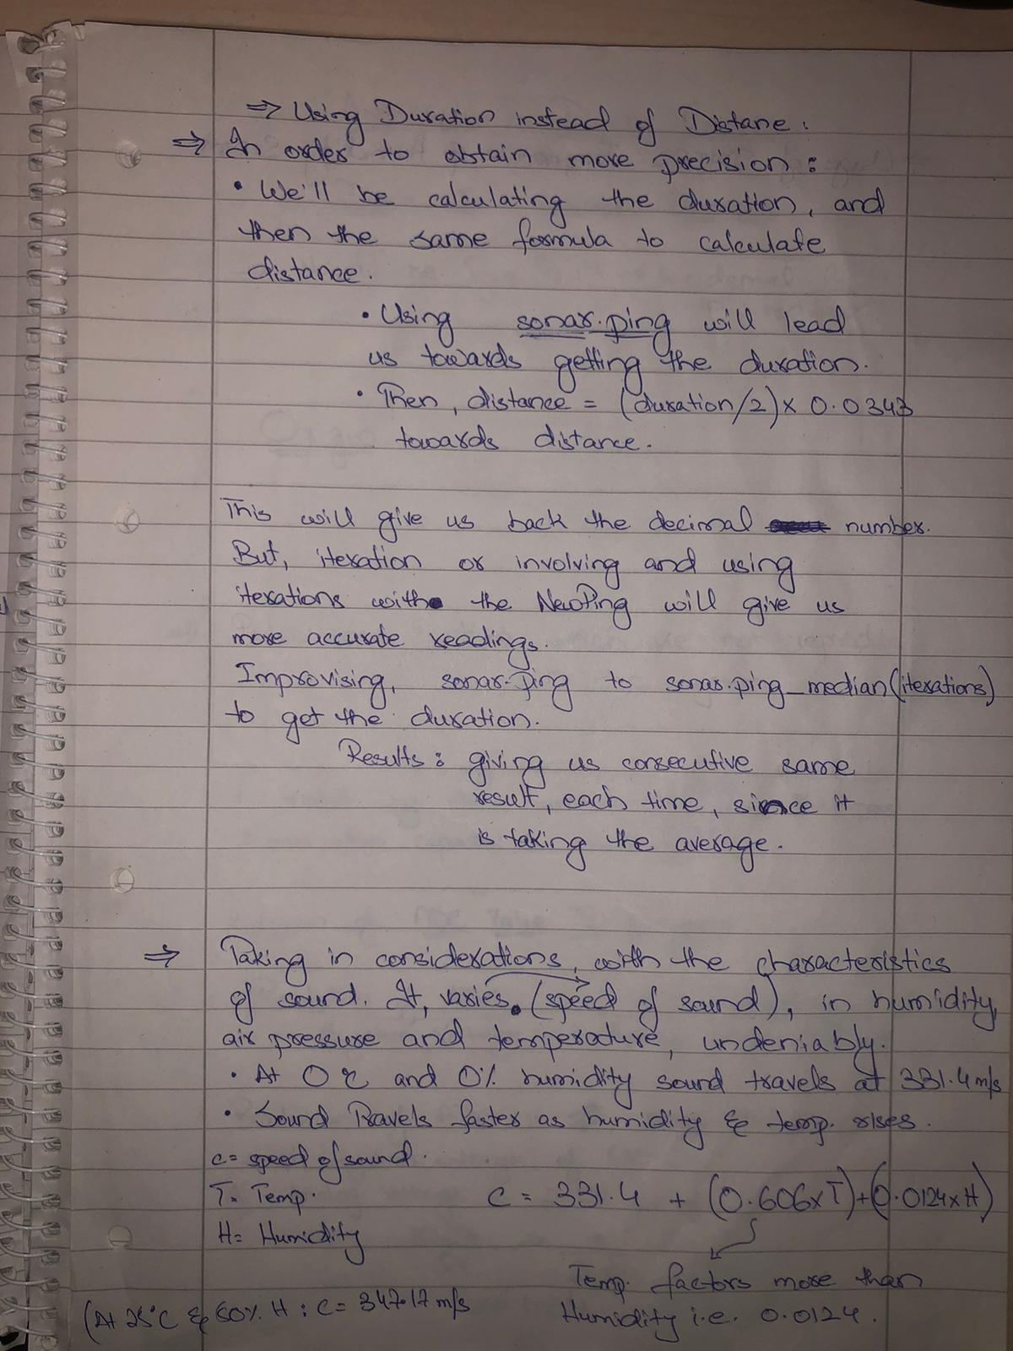

Slide 6
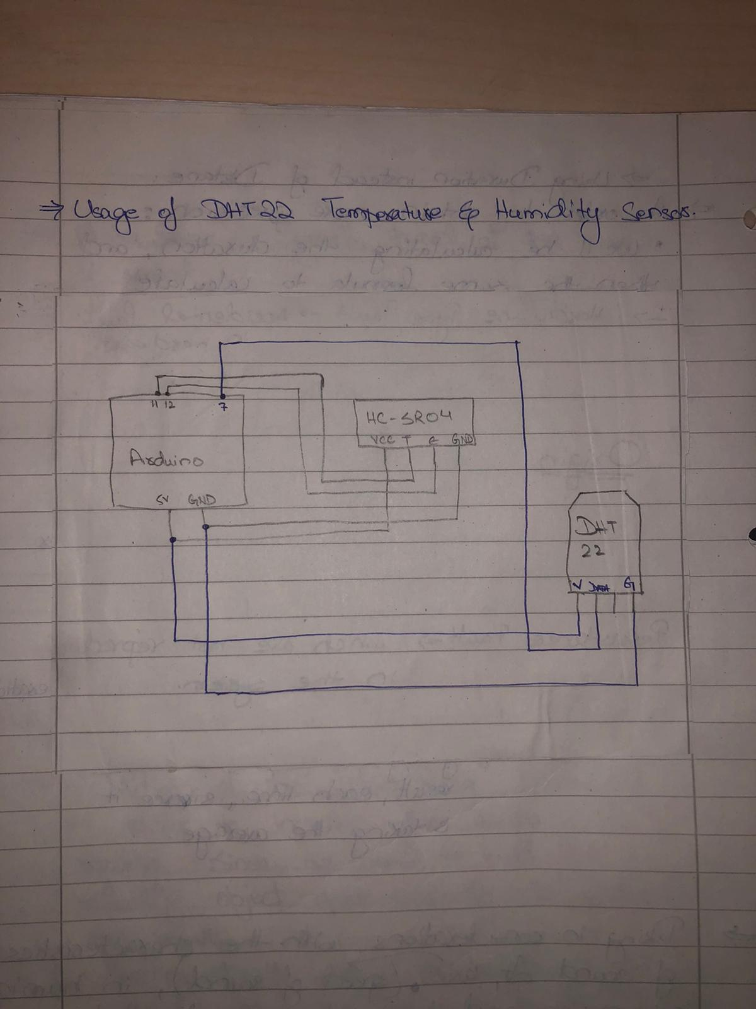

Slide 7
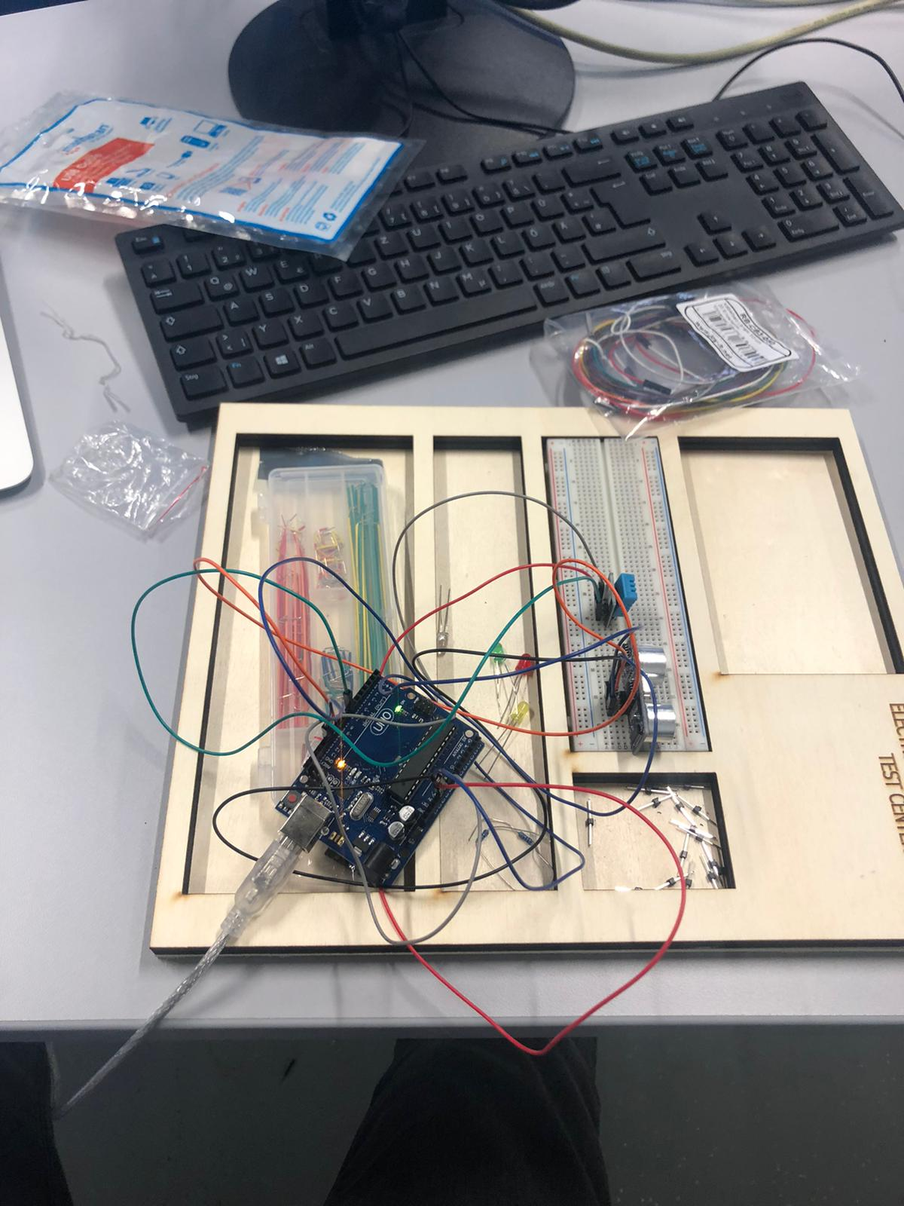
Practical Approach

Slide 8

Source Code
https://github.com/Rohail999/UltraSonic_Sensor/blob/master/UltraSonic_Sensor_Final.ino

