Slide 1
Data phishing using Instagram

Slide 2

Presentation outline
Introduction to data phishing
PT2: Data phishing using Instagram
Requirement
My project
My project architecture
User interface
Working
Data processing and saving
Avoiding Cybercriminals
Conclusion

Slide 3
Introduction to data phishing
Data phishing: malicious practice to obtain sensitive information.
Uses deceptive emails, messages, or websites impersonating trusted entities.
Targets personal details like passwords, credit card numbers.
Consequences include identity theft, financial loss, compromised privacy.
Vigilance and verification of communication authenticity crucial.
Security measures like two-factor authentication recommended to mitigate risks.

Slide 4

Pt2: Data phishing using Instagram
Phishing via Instagram involves creating fake profiles or messages impersonating legitimate accounts or entities.
Attackers may send direct messages or comments claiming to be from Instagram or a well-known brand, requesting sensitive information
Phishing links disguised as official Instagram pages prompt users to enter their credentials, leading to data theft.
Fraudulent posts may offer fake promotions or prizes, enticing users to click on malicious links or provide personal details.

Slide 5
My project
This project of mine shows how the data can be captured using from users anonymously.
This project show how a fake link or alternative similar website can be used to receive the data from the user.
This project is a easy explained working process of data phishing commonly done by cybercriminals from day to day life.
Disclaimer: This project is done for study purpose only, any misuse of the project the owner is not responsible for the acts of the guilty.

Slide 6
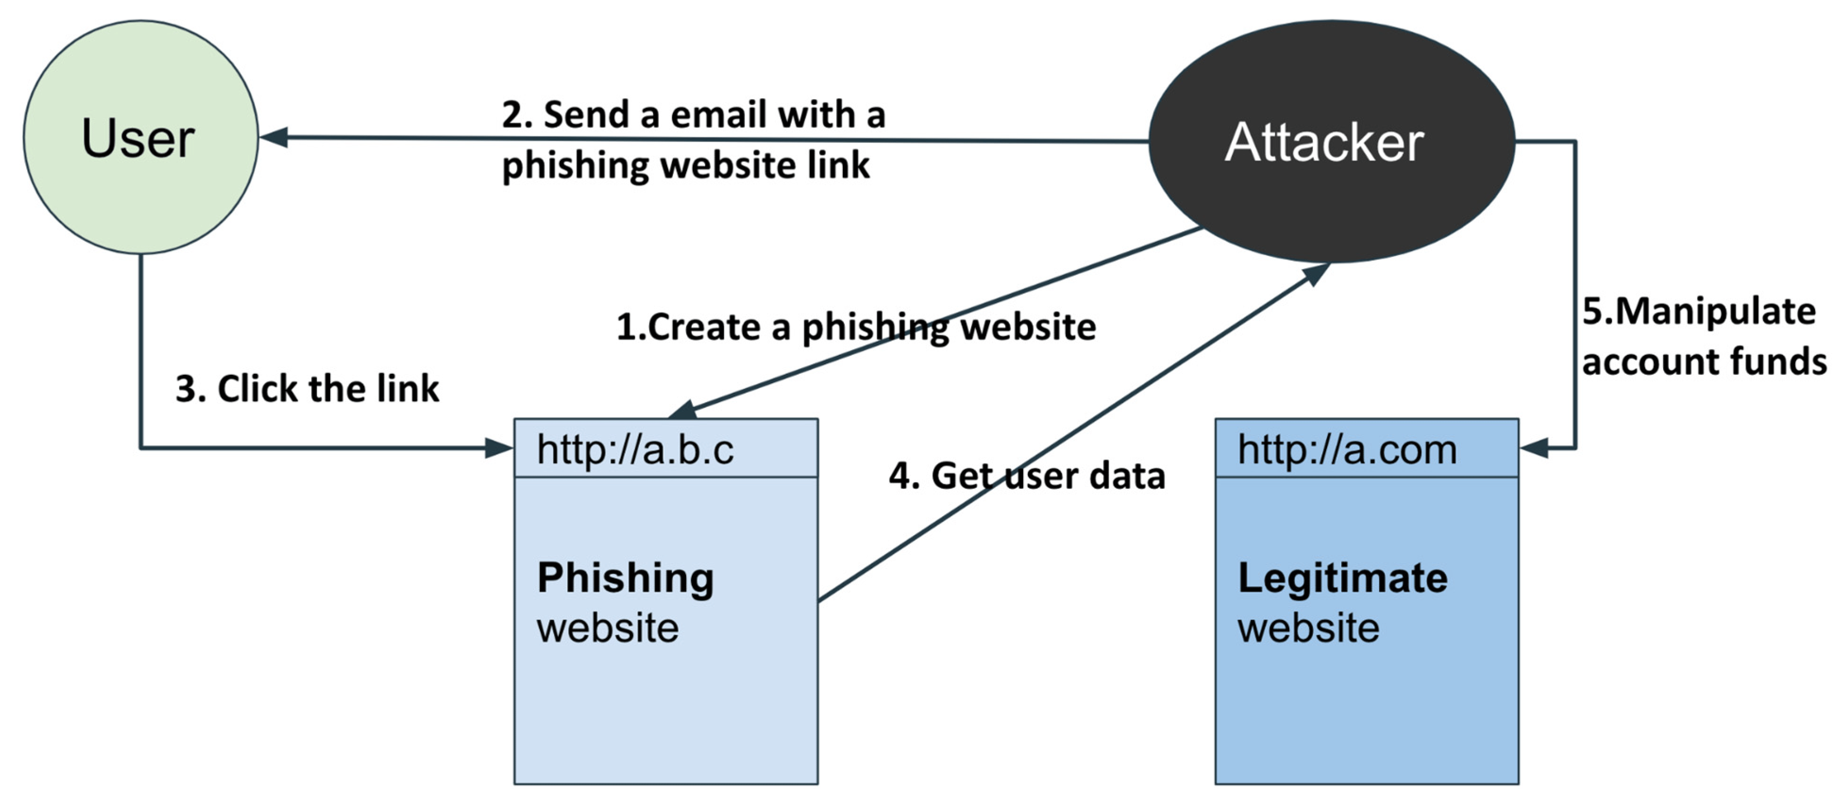
My project architecture
Instagram.org
Instagram.com

Slide 7

Requirement:
Front end
HTML
CSS bootstrap
Java script
Back end
PhP for original server
Database
CSV or excel

Slide 8
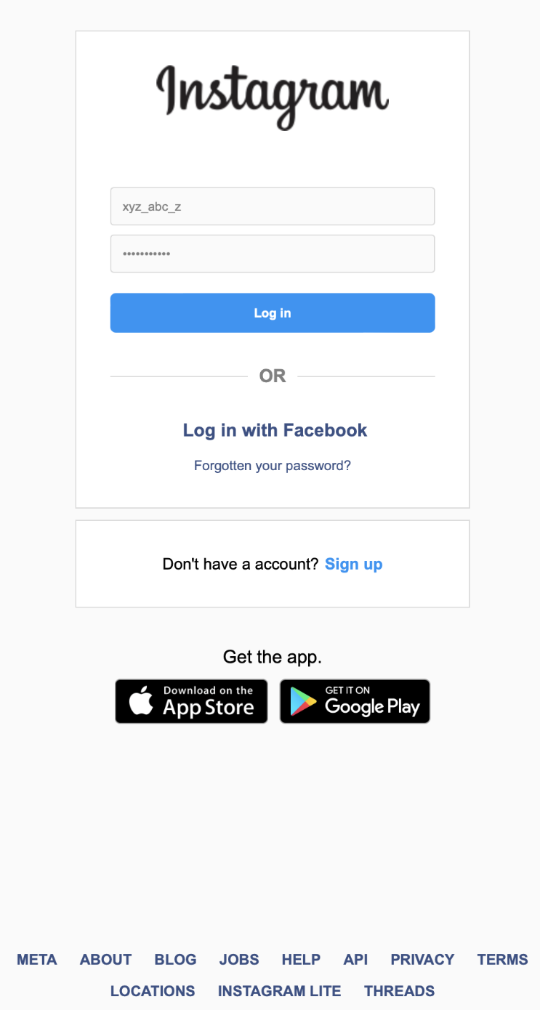
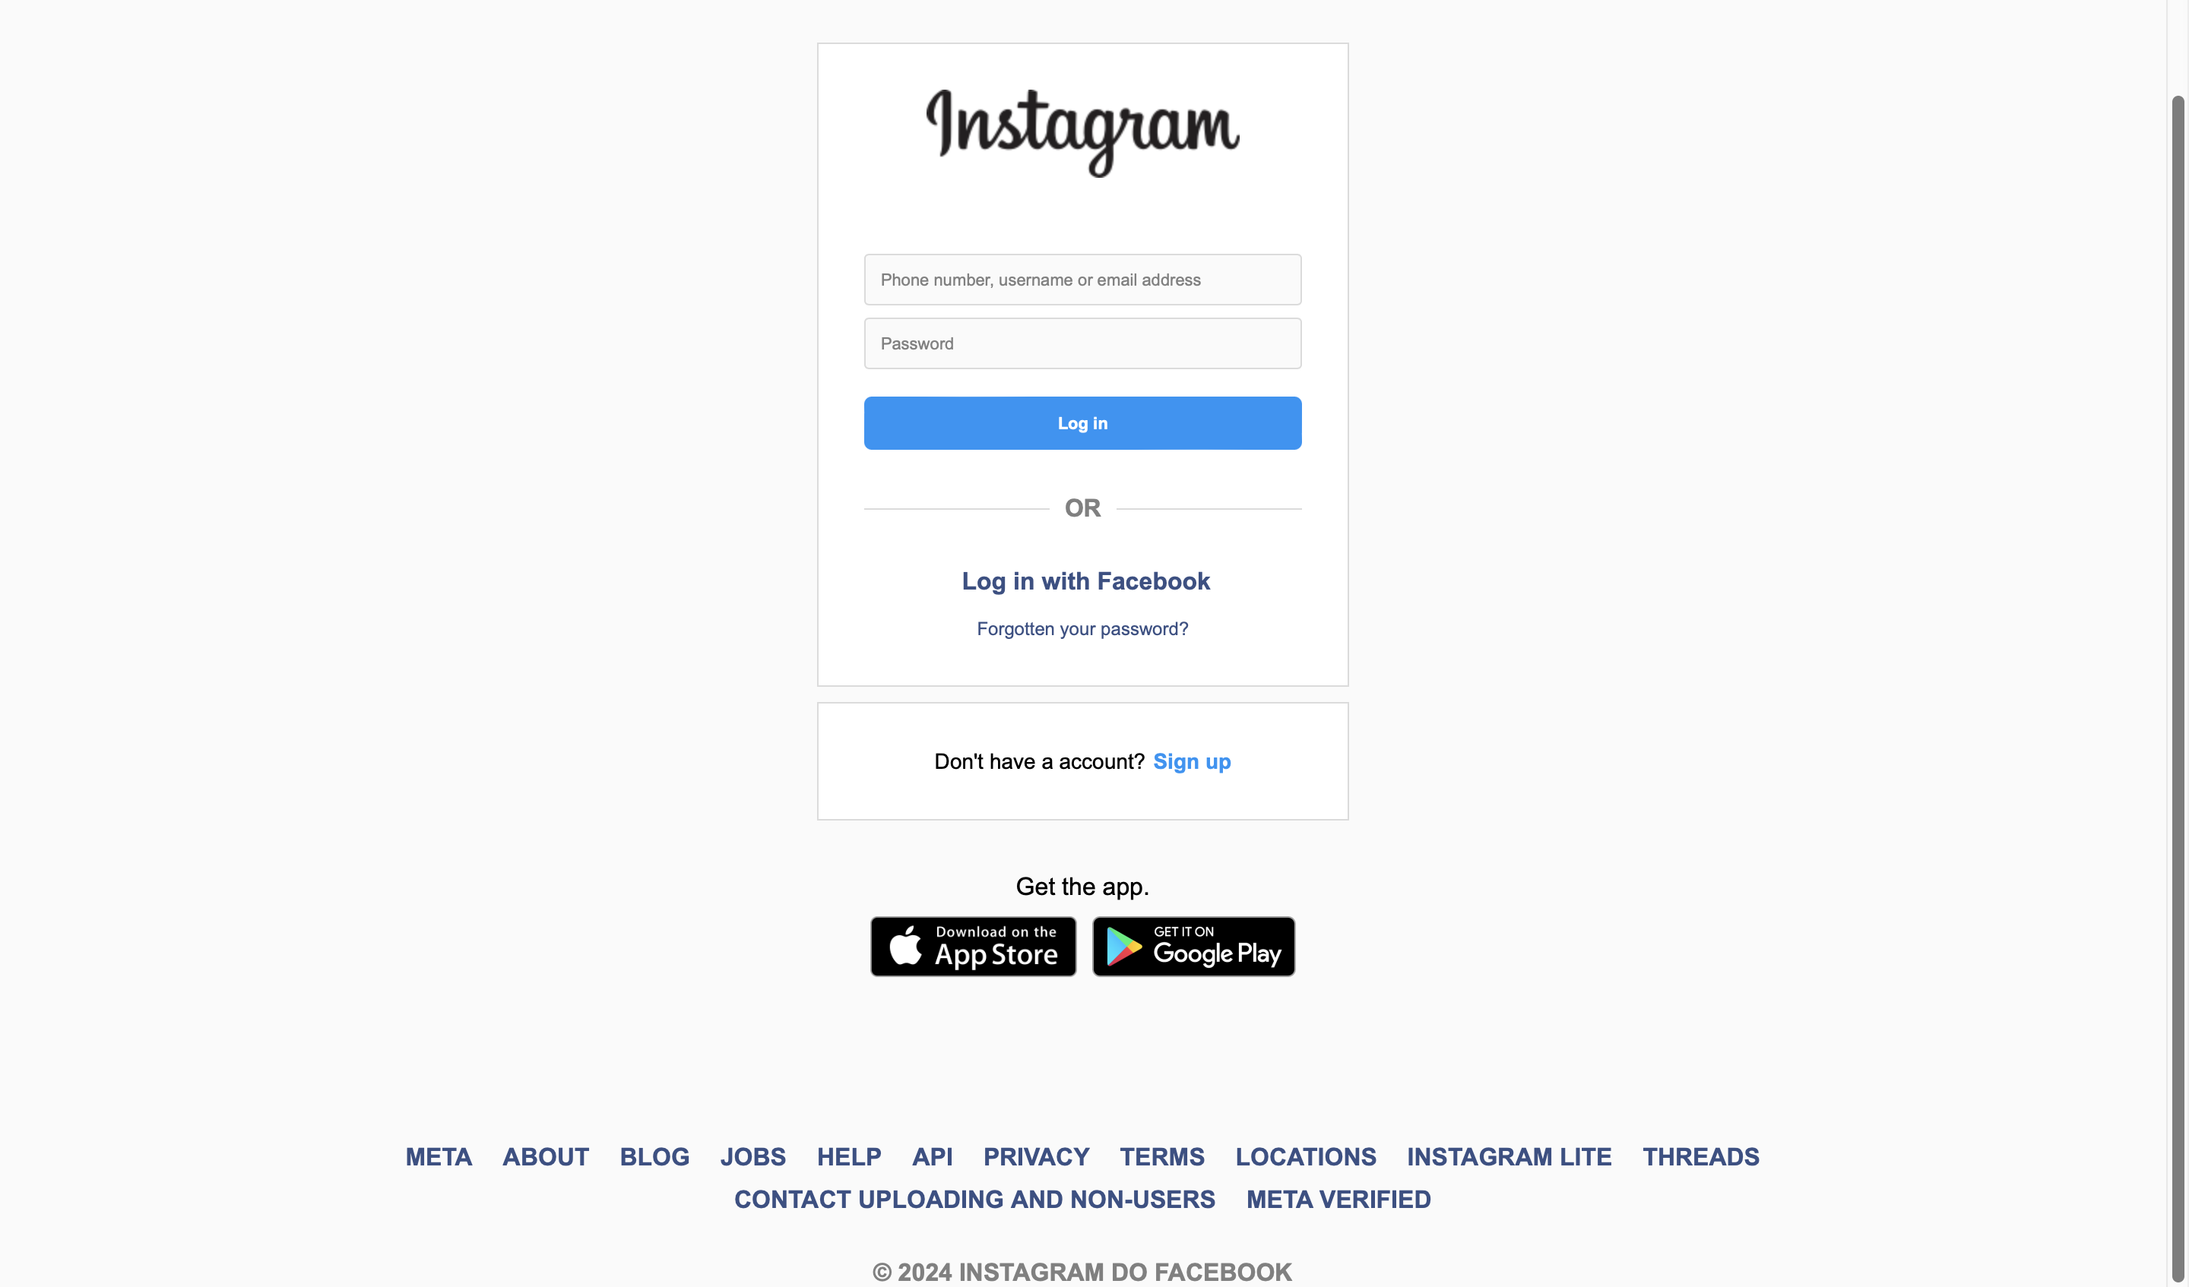
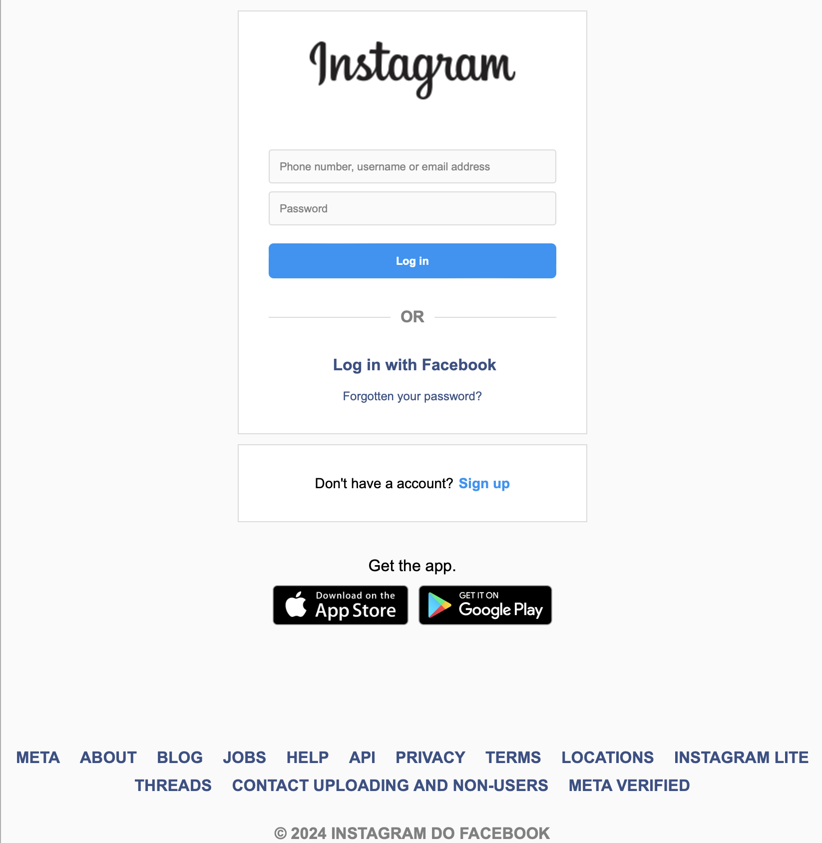
User interface
Tablet view
Mobile view
03/05/2024
03/05/2024
Desktop view
03/05/2024

Slide 9

Working
The website can be accessed using the common URL instaram.org
The user enters their username and password in this website
03/05/2024

Slide 10
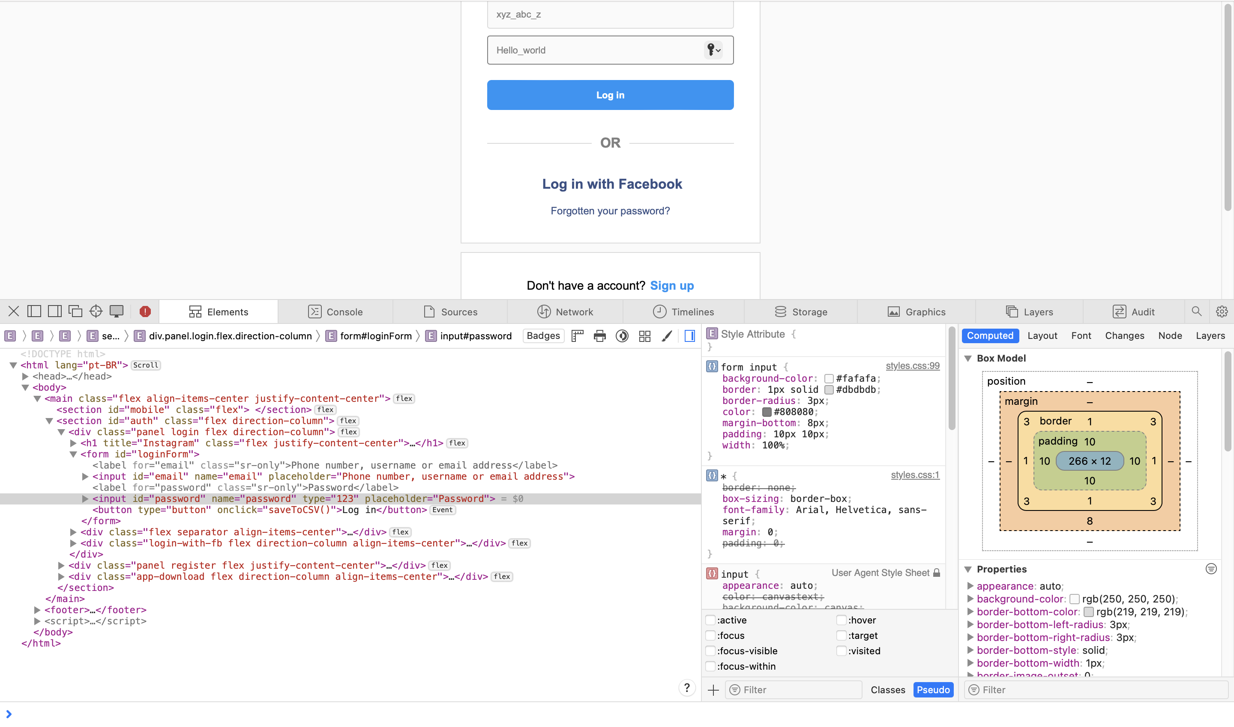
Data processing and saving
After the data is entered, when the user press the “log in” button it will redirect the user to original Instagram.com page but the data is captures and sent to hacker.
This is inspect option from the browser

Slide 11
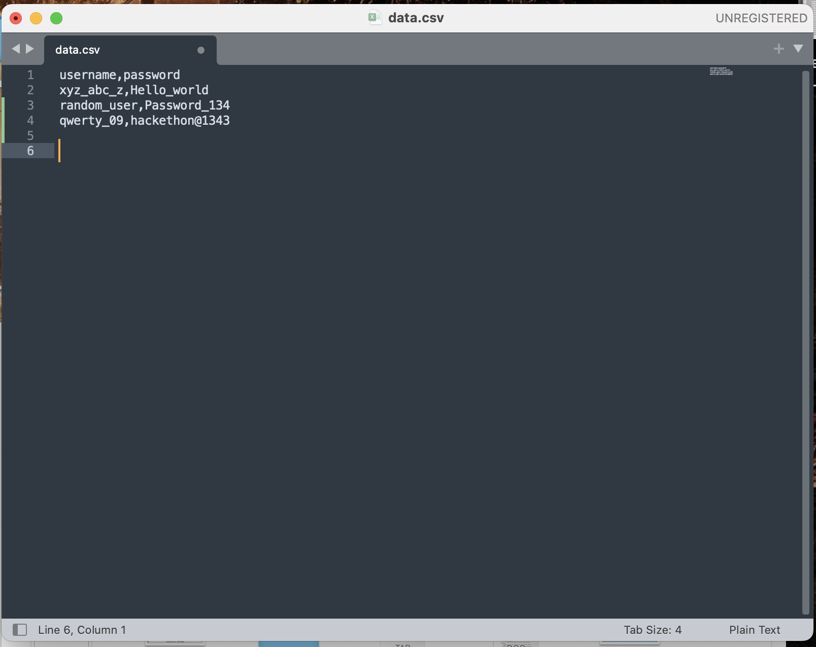
Final steps of success…
So the data entered by the users on the client side are saved in the form of CSV in the servers computer and the hacker can easily access these information.
Similar type of data phishing was once done by myntra.org by anonymous user and accessed users credentials and payment information

Slide 12
Avoiding Cybercriminals
Stay Vigilant: Continuously be on the lookout for suspicious emails, messages, and requests.
Verify: Always verify the authenticity of websites and communications before sharing personal information.
Use Strong Security Measures: Implement strong passwords and enable Two-Factor Authentication (2FA) wherever possible.
Limit Personal Information: Be cautious about sharing personal details online and adjust privacy settings accordingly.
Stay Informed: Regularly update yourself on emerging threats and best practices for online security.
Report Suspicious Activity: If you suspect phishing or encounter suspicious activity, report it to the appropriate authorities or IT support.

Slide 13
conclusion
Empowering users with the knowledge and tools to protect themselves against data phishing not only enhances their safety on Instagram but also contributes to building a more secure online community.
Exploring innovative technologies and strategies to detect and prevent data phishing on Instagram and other social media platforms can pave the way for a safer and more secure online environment in the future.
This conclusion summarizes the key findings and recommendations for the data phishing using Instagram project, emphasizing the importance of awareness, education, collaboration, and continuous improvement in combating phishing threats on the platform.

Slide 14

THANK YOU

