Slide 1
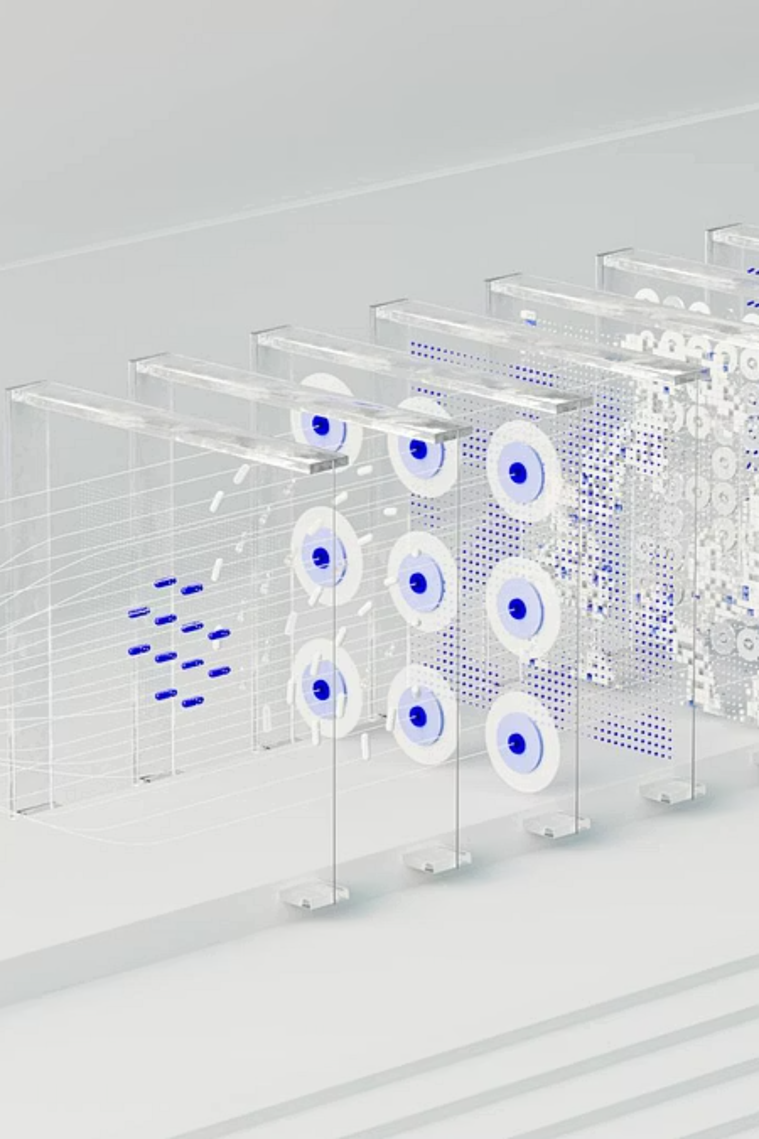

Lipschitz Momentum Optimization in Deep Learning for Pneumonia Detection
Advancing medical imaging through adaptive optimization techniques

Slide 2
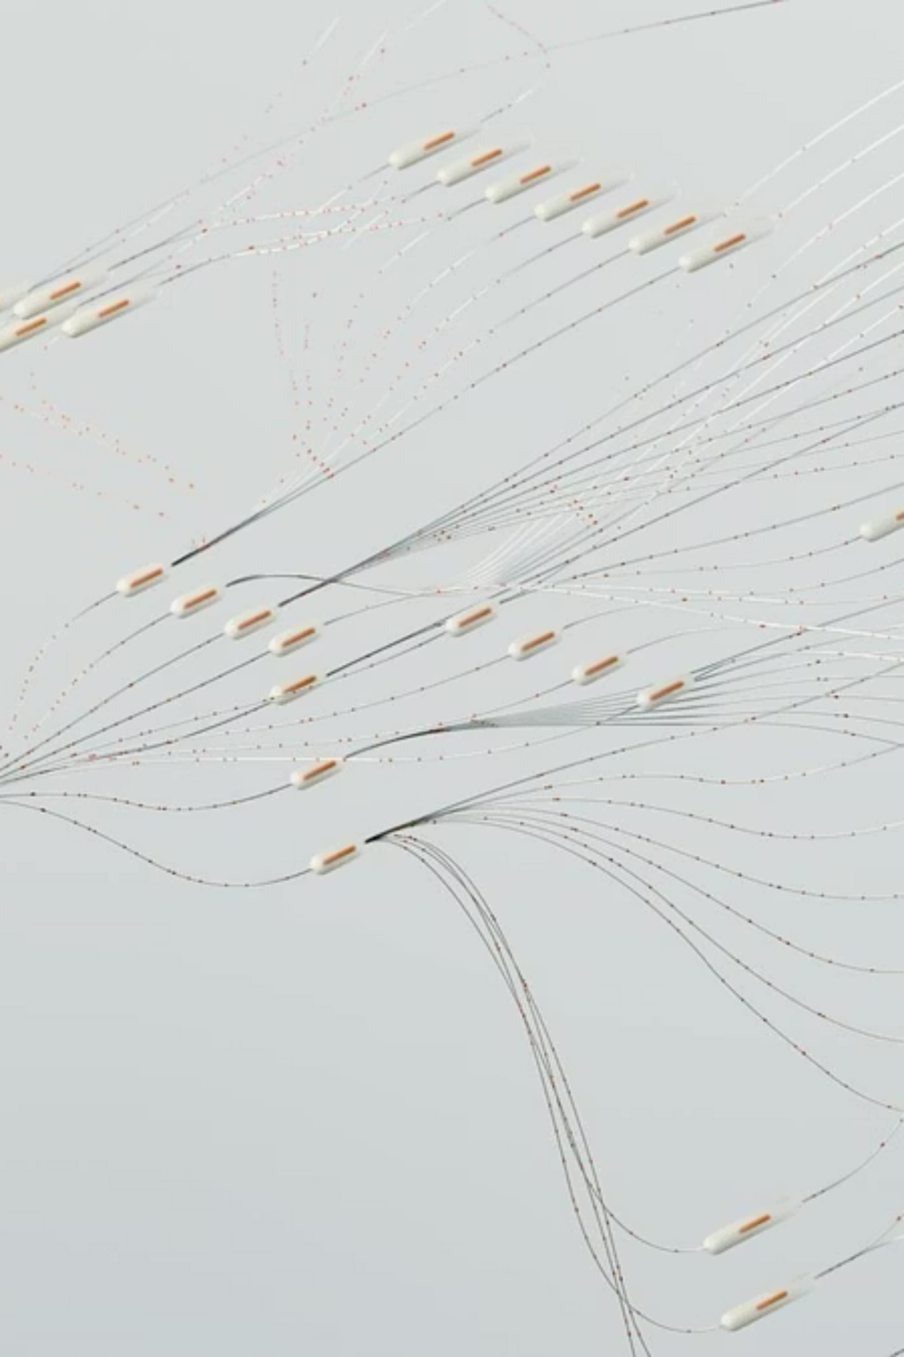

Optimization in Machine Learning
What is Optimization
Training Role
Finding optimal parameters that minimize loss function during model training
Enables neural networks to learn patterns from medical images efficiently
Why It Matters
Determines training speed, stability, and final model performance

Slide 3

Challenges with Traditional Optimizers
Slow Convergence
Standard gradient descent requires many iterations to reach minimum, consuming computational resources
Oscillations
Unstable updates cause the optimizer to bounce around optimal points without settling
Local Minima
Gets trapped in suboptimal solutions instead of finding global minimum
Learning Rate Sensitivity
Performance heavily depends on manually tuned hyperparameters

Slide 4




Understanding Momentum
Gradient Descent
Updates based only on current gradient direction
With Momentum
Incorporates previous update direction for smoother trajectory
Faster Convergence
Accelerates toward minimum while reducing oscillations

Slide 5


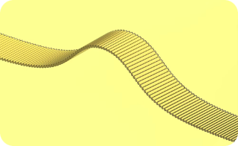
Lipschitz Continuity Explained
Definition
Bounded Gradients
Training Stability
Function with bounded gradients where the rate of change is limited by a constant
Prevents large, unstable updates during optimization process
Ensures controlled, predictable parameter updates throughout training

Slide 6
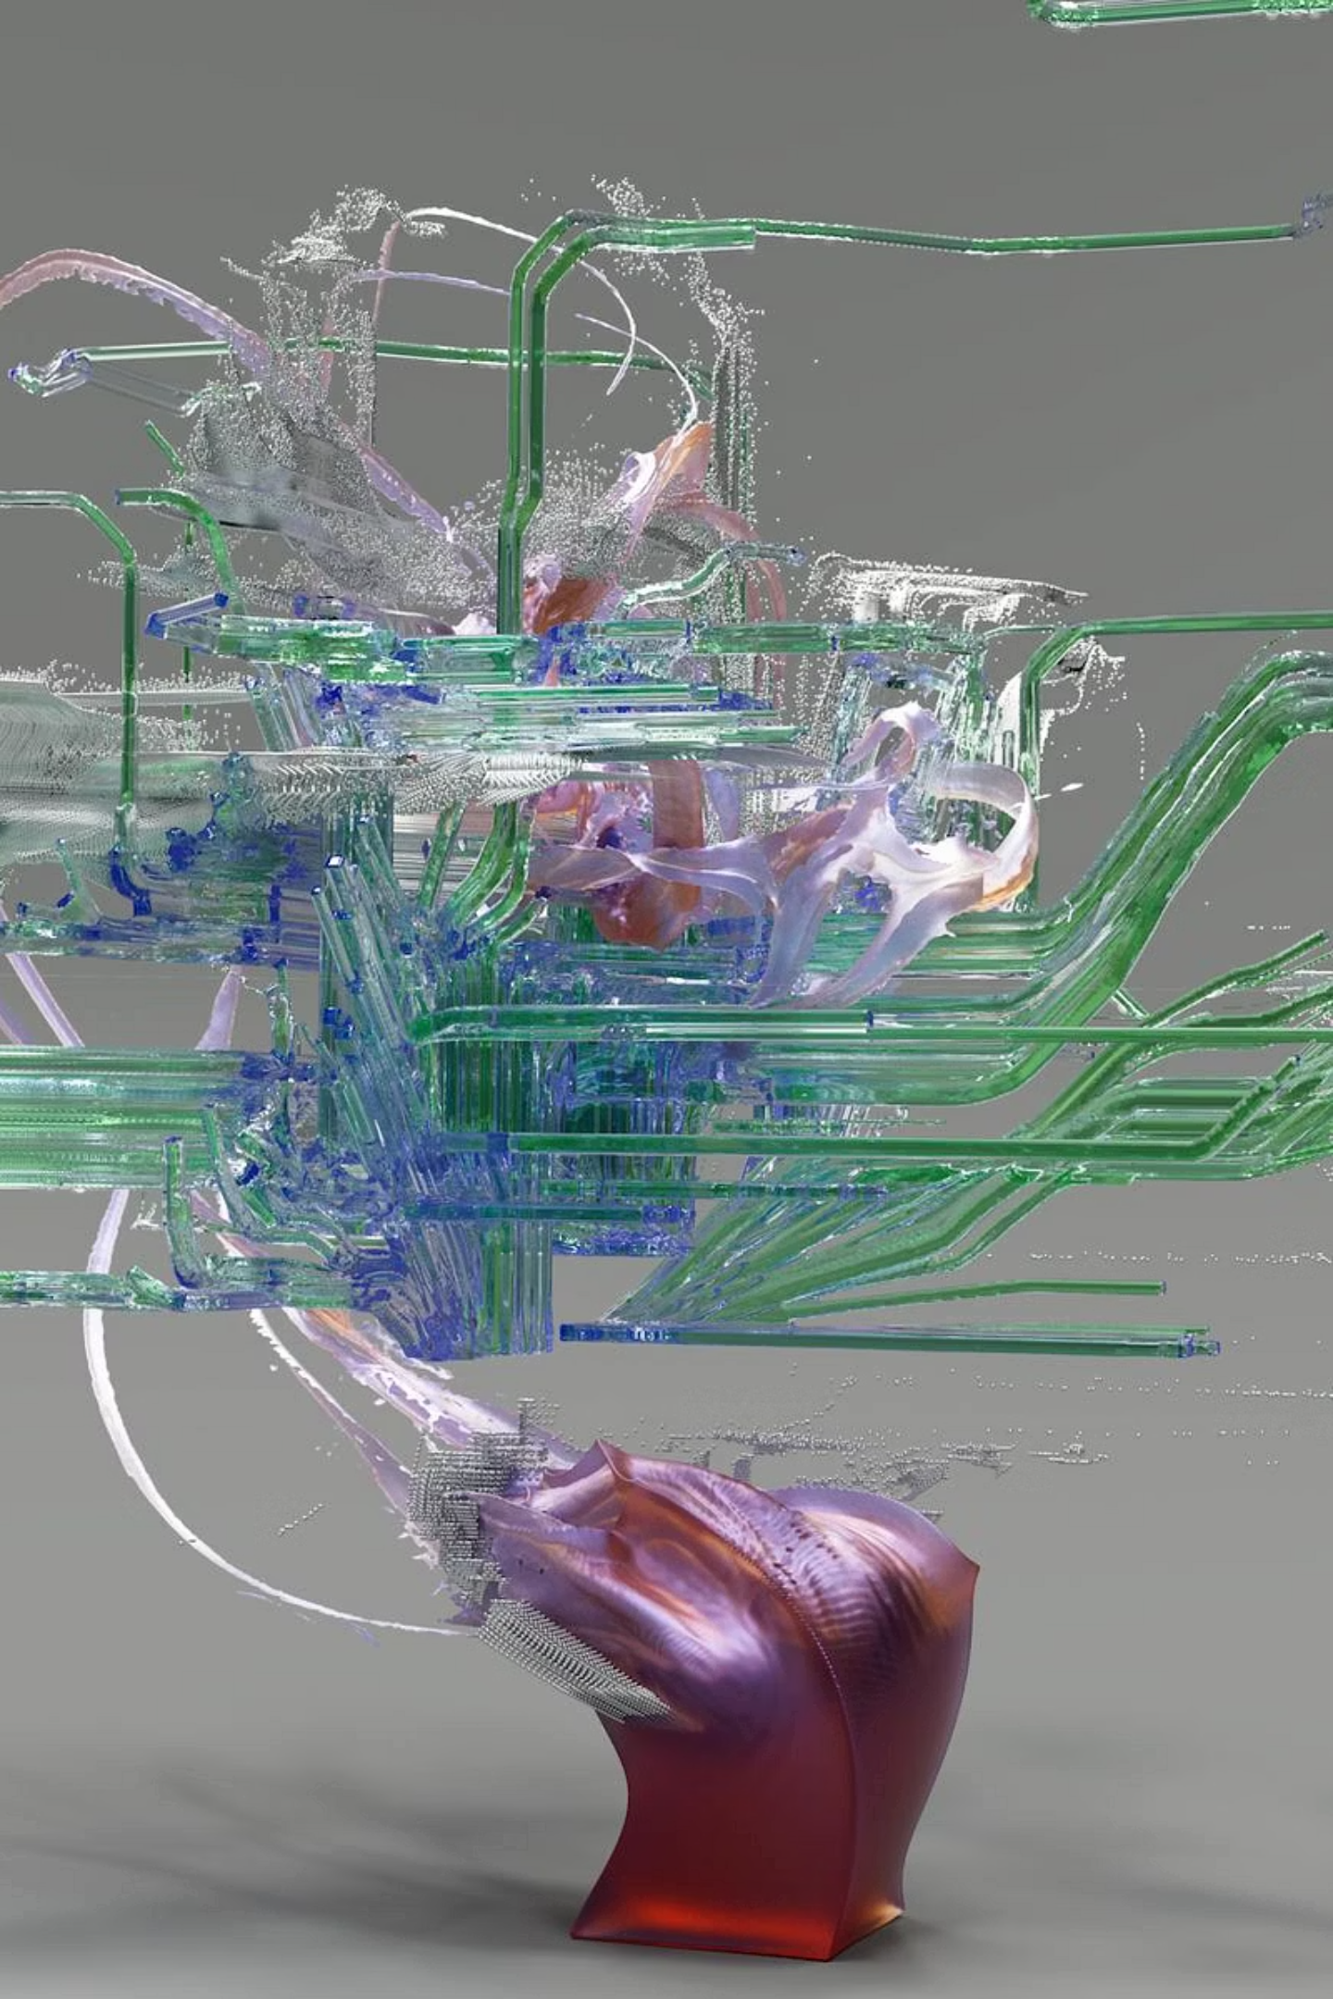
Lipschitz Momentum Optimization
01
Lipschitz Constraint
Applies bounded gradient condition to limit update magnitude
02
Momentum Integration
Combines historical gradient information for direction
03
Controlled Updates
Produces stable, adaptive parameter adjustments
04
Improved Convergence
Achieves faster, more reliable optimization

Slide 7
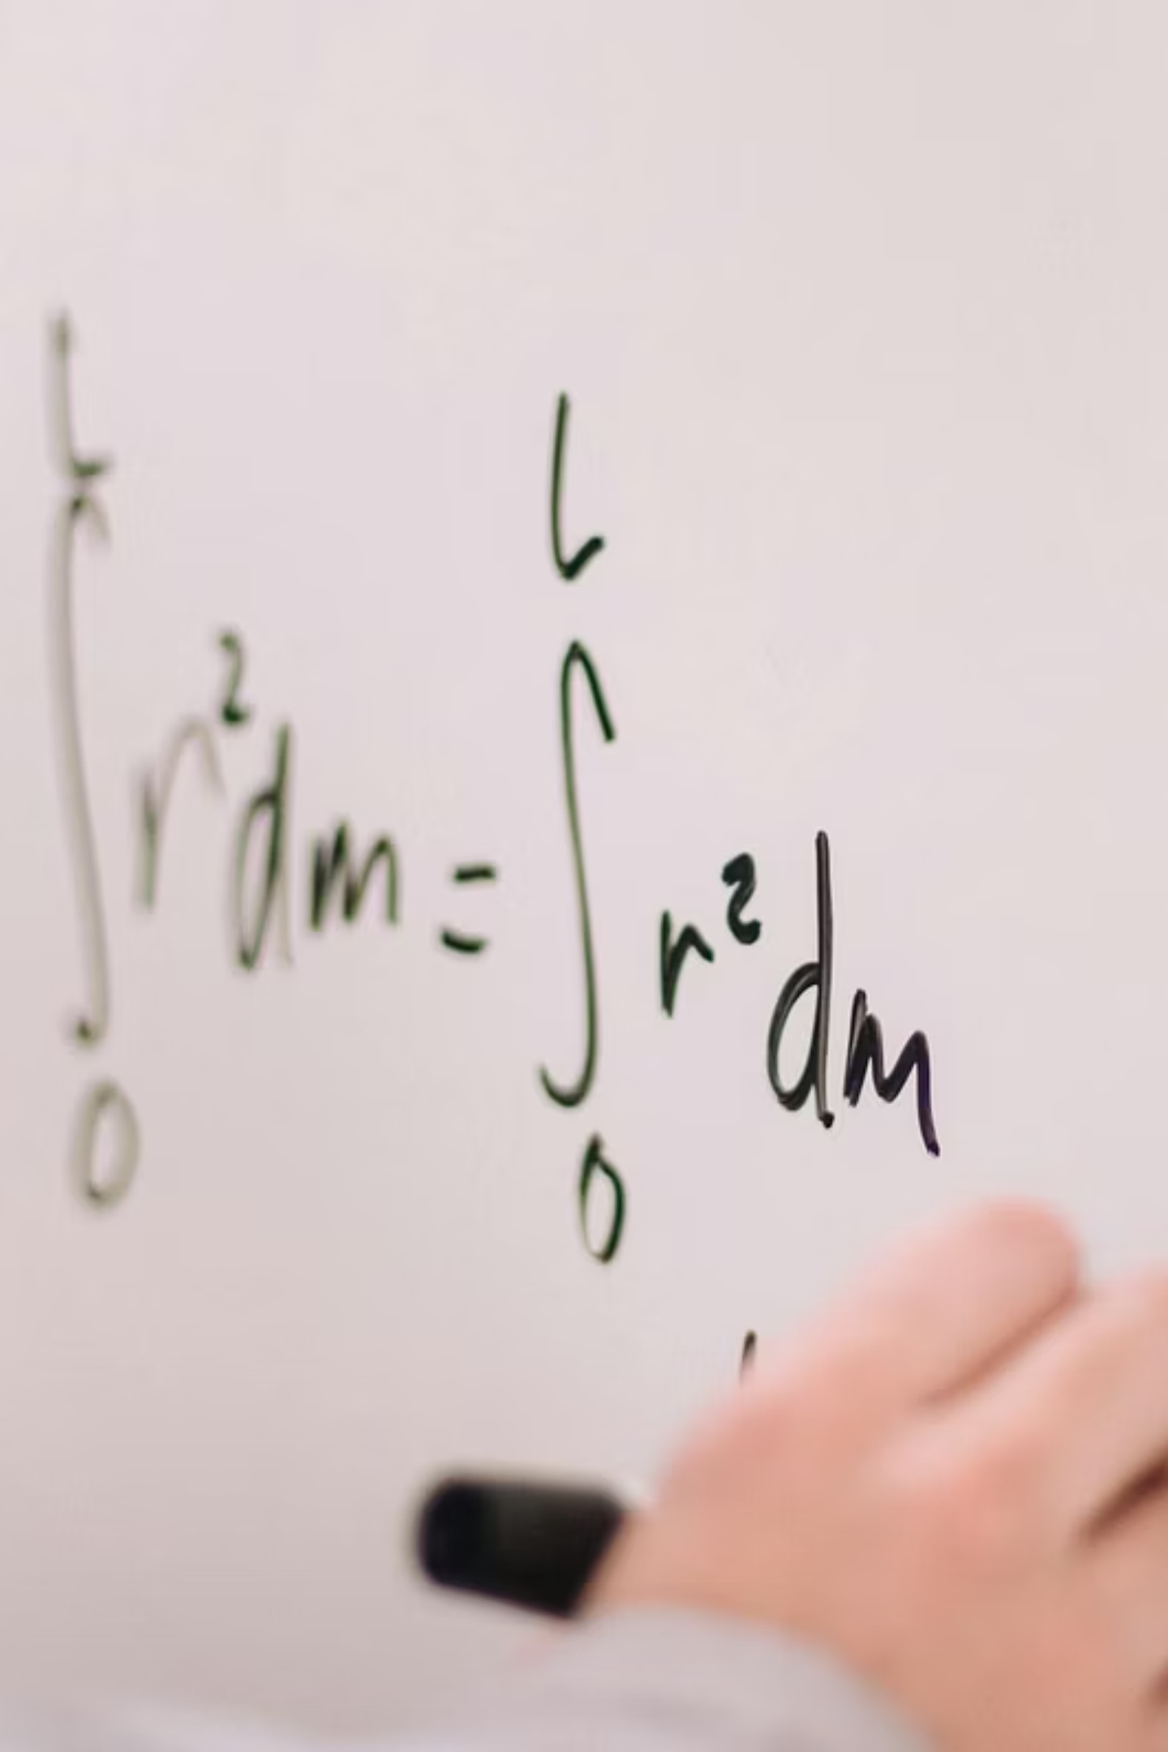
Mathematical Formulation
Update Rule
v_t
Momentum vector accumulating historical gradients
\beta
Momentum decay factor (typically 0.9-0.99)
\eta
Learning rate controlling step size
L
Lipschitz constant bounding gradient magnitude

Slide 8

Key Advantages
Faster Convergence
Reduces training epochs needed to reach optimal solution
Reduced Oscillations
Smooth update trajectory prevents bouncing around minimum
Stable Training
Lipschitz constraint prevents divergent behavior
Better Generalization
Controlled updates lead to improved test performance

Slide 9

Optimizer Comparison
Performance Comparison
1
2
SGD
Adam
Slow convergence, sensitive to learning rate, oscillates frequently
Adaptive learning rates, faster than SGD, but can overfit
3
Lipschitz Momentum
Controlled updates, stable convergence, reduced oscillations

Slide 10
Application in Pneumonia Detection
Implementation Details
Applied to CNN architecture for medical image classification
Trained on chest X-ray dataset with pneumonia labels
Achieved stable convergence within 50 epochs
Improved accuracy and recall compared to baseline
Training Behavior
Smooth loss curve with consistent decrease, no divergence or oscillations
Results Impact
Higher accuracy, improved recall, stable learning behavior throughout training

