Slide 1
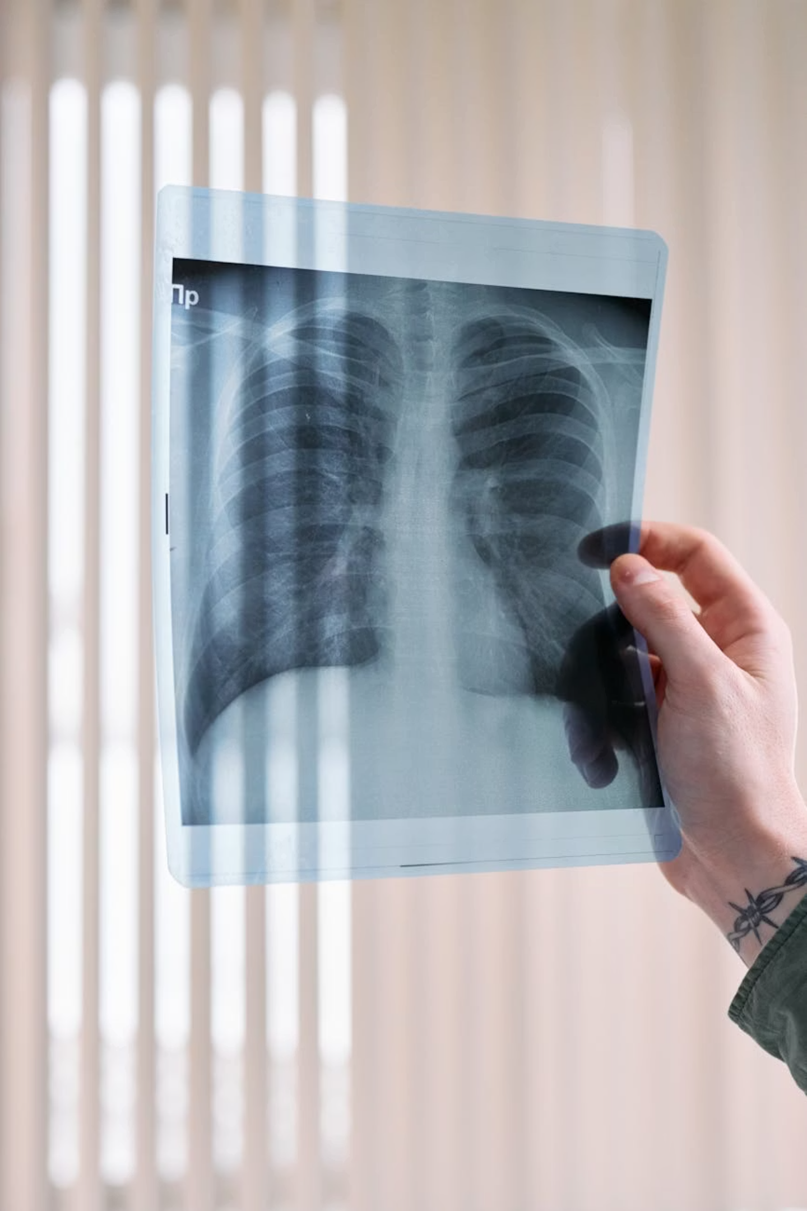

Pneumonia Detection via Deep Learning & Numerical Optimization
Advanced CNN architectures integrated with Lipschitz Momentum optimization for automated, high-sensitivity radiographic classification

Slide 2
Introduction & Problem Statement
Pneumonia Overview
Diagnostic Challenge
Bacterial/viral lung infection causing alveolar inflammation and pathological opacities visible on chest radiography
Subjective radiographic interpretation with inter-observer variability affecting sensitivity and specificity
Clinical Imperative
AI Solution Potential
High-volume screening requirements creating radiologist workload burden and diagnostic bottlenecks
Automated, consistent classification enabling triage support and early intervention protocols

Slide 3
Research Gap & Objectives
Existing Limitations
Project Goals
Training dataset bias toward specific patient demographics
Standard optimizers (SGD/Adam) exhibit slow convergence
Limited integration of advanced numerical methods
Insufficient focus on recall optimization
Develop robust CNN classifier for binary diagnosis
Implement Lipschitz Momentum optimization
Achieve 96% Recall to minimize false negatives
Validate on external test sets

Slide 4

Dataset & Preprocessing Pipeline
01
Image Acquisition
Paediatric chest X-rays: Normal (1,583) vs. Pneumonia (2,538) cases from NIH repository
02
Dimension Standardization
Resize to 224×224 pixels for consistent CNN input tensor dimensions
03
Intensity Normalization
Pixel value scaling (0–255) → (0–1) with channel-wise mean/std deviation standardization
04
Augmentation Pipeline
Random flips, rotations (±15°), and brightness/contrast perturbations for model robustness

Slide 5
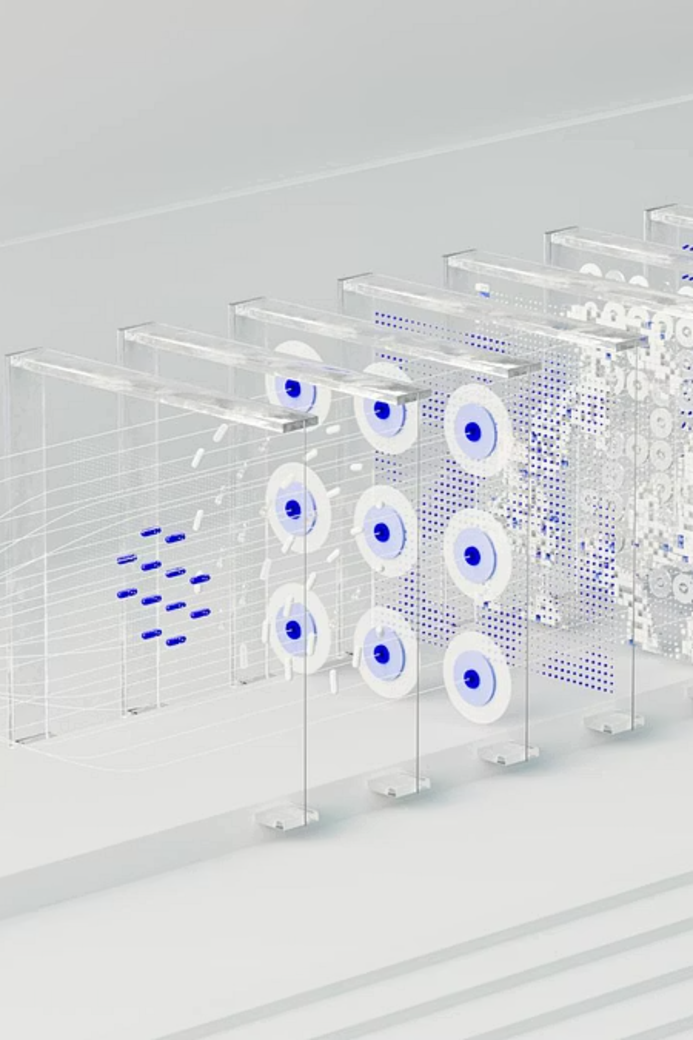




System Architecture & CNN Model
Input Layer
224×224×3 tensor from preprocessed radiograph
Convolutional Blocks
Conv → ReLU → MaxPooling layers extracting hierarchical features
Feature Extraction
Latent representations of pathological opacities and consolidation patterns
Classification Head
Fully-connected layer with sigmoid activation for binary probability

Slide 6
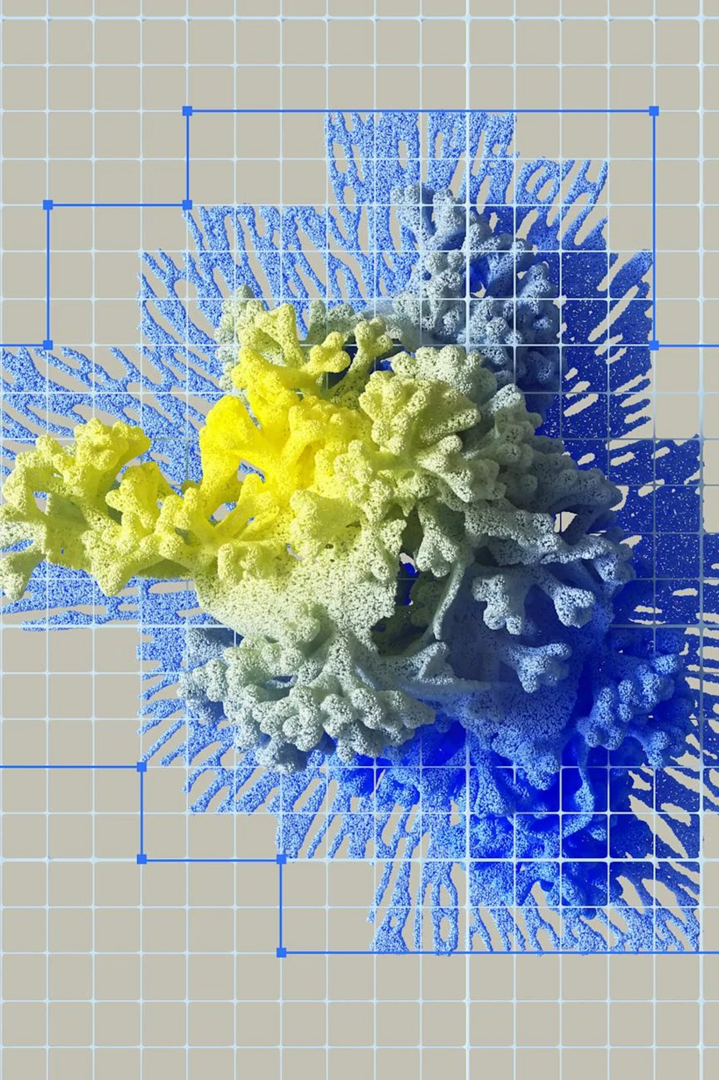
Key Innovation: Lipschitz Momentum Optimization
Theoretical Foundation
Convergence Advantage
Adaptive learning rates derived from Lipschitz continuity constraints on gradient mappings
Guaranteed stable descent with step sizes bounded by local smoothness parameters
Stability Properties
Reduced oscillations in stochastic gradients compared to SGD/Adam baselines

Slide 7
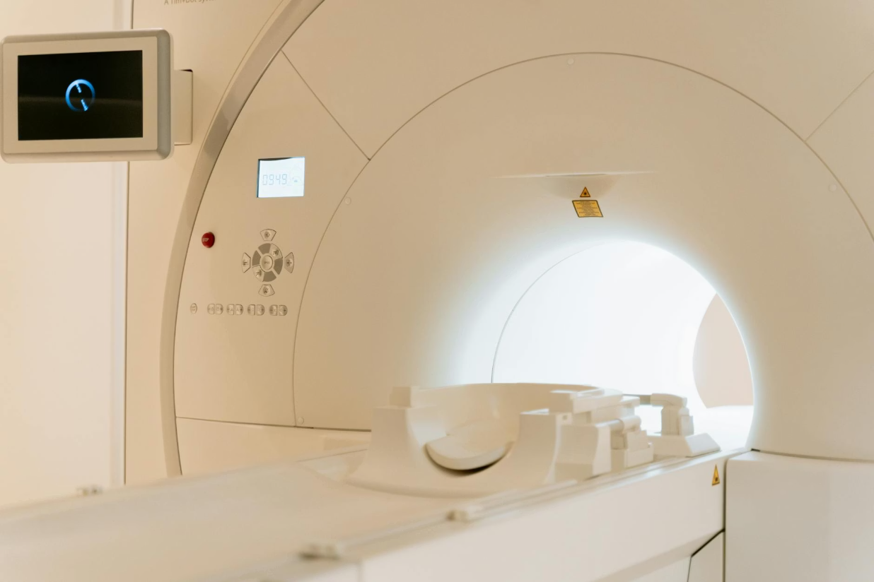
Training & Evaluation Metrics
1
Loss Function
Binary Cross-Entropy (BCE) with logits for probabilistic outputs
2
Checkpointing
Model persistence on validation accuracy improvement with early stopping (patience=10)
3
Accuracy
Overall correct classifications proportion
4
Precision
Proportion of positive predictions that are truly positive
5
Recall (Clinical Priority)
Proportion of actual positives identified—96% target to eliminate false negatives
6
F1 Score
Harmoic mean of precision and recall for balanced assessment

Slide 8


Results & Performance Analysis
95.03%
94%
96%
Accuracy
Precision
Recall
Overall diagnostic correctness across test set
Reliability of positive predictions
Sensitivity to pneumonia cases
95%
F1 Score
Balanced performance metric
Clinical Priority: 96% Recall ensures minimal false negatives, critical for avoiding missed diagnoses in acute care settings

Slide 9
Novelty & Web Deployment Pipeline
Model Training
Frontend Interface
CNN with Lipschitz Momentum on augmented dataset
Web application for radiographic screening
1
2
3
4
Flask API
Real-Time Inference
REST endpoint for image upload and prediction
Production deployment for clinical workflow integration

Slide 10
Conclusion, Future Scope & References
Key Achievements
References
Lipschitz Momentum integration achieved 96% Recall with 95% accuracy
Superior convergence over standard optimizers
Production-ready Flask API deployment
Addressed false-negative minimization for clinical safety
Kermany, D. S., et al. (2018). "Identifying Medical Diagnoses and Treatable Diseases by Image-Based Deep Learning." Cell, 172(5), 1122–1131.
Paszke, A., et al. (2019). "PyTorch: An Imperative Style, High-Performance Deep Learning Library." Advances in Neural Information Processing Systems, 32.
Rajpurkar, P., et al. (2017). "CheXNet: Radiologist-Level Pneumonia Detection on Chest X-Ray Images." arXiv:1711.05225.
Future Directions
ResNet/EfficientNet architectures for enhanced feature extraction
Multi-class pneumonia subtype classification
Prospective hospital validation studies
Integration with PACS systems

