Slide 1
Creating an Employee Performance Scorecard in Excel
Student Name: Rohanganapathy.B
Register Number :312211665
Department:BCOM General A
College:Thiruthangal nadhar college

Slide 2
AGENDA
1.problem statement 2.project overview 3.end users 4.our solution and proposition 5.data description 6.modelling approach 7.result and discussion 8.conclusion

Slide 3
Problem statement
Evaluating Employee Performance Effectively” Description: Explain the challenges of manual performance evaluation and the need for a data-driven approach.

Slide 4
Project overview
Employee Performance Scorecard Project” Description: Outline the project’s objectives, scope, and timeline

Slide 5
End users
Stakeholders and End Users” Description: Identify the stakeholders and end users of the scorecard, such as HR, management, and employees.

Slide 6
Our solution and proposition
Automated Performance Scorecard with Excel” Description: Explain how an Excel-based scorecard can streamline performance evaluation and provide actionable insights

Slide 7
Data description
:“Performance Data Overview” Description: Describe the data used for the scorecard, including: -Data sources (HR systems, performance reviews, etc.) Variables (employee ID, job title, performance metrics, etc.) Data quality and preprocessing steps

Slide 8
Modelling approach
Designing the Performance Scorecard” Description: Outline the modeling approach, including: Scorecard framework and structure - Metric selection and weighting – Data visualization and formatting

Slide 9
Result and discussion
First Name | LastName | StartDate | Supervisor | GenderCode | LocationCode | RaceDesc | MaritalDesc | Performance Score | Current Employee Rating
Park | 16-Jan-21 |  | Michelle Mitchell | Female | 5360 | Other | Married | Exceeds | 4
Dalton | 24-Aug-21 |  | Sydney French | Female | 16325 | White | Divorced | Exceeds | 2
Schultz | 26-May-20 | 18-Jun-23 | Michelle Evans MD | Female | 43481 | Asian | Widowed | Fully Meets | 3
Molina | 01-Oct-19 | 06-Nov-20 | Patricia Cook | Male | 50705 | Asian | Widowed | Fully Meets | 3
Preston | 10-May-23 | 27-May-23 | Ashley Reeves | Male | 5168 | Black | Single | Fully Meets | 5
Moyer | 01-Sep-20 | 04-Dec-22 | Stanley Harvey | Male | 11765 | Other | Single | Exceeds | 2
French | 18-Feb-21 | 11-Nov-22 | Michael Bradshaw | Male | 71071 | Other | Divorced | Exceeds | 3
Blackburn | 08-Nov-22 |  | Debbie Crosby | Male | 12122 | Black | Divorced | Fully Meets | 2
Carter | 13-Oct-22 |  | Elizabeth Taylor | Male | 87065 | White | Widowed | Fully Meets | 4
Beard | 11-Sep-22 |  | Brian Dunlap | Male | 10415 | Hispanic | Married | Needs Improvement | 4
Miranda | 29-Jun-21 | 05-Jul-22 | Daniel Rodriguez | Male | 3763 | Other | Widowed | Exceeds | 4

Slide 10
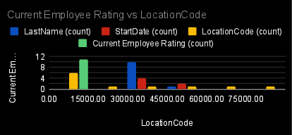
Par chart

Slide 11
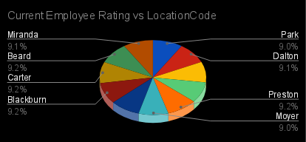
Pie chart

Slide 12
conclusion
"Conclusion and Recommendations"Description: Summarize key findings, implications, and recommendations for improving employee performance management practices.

