Slide 1
Aspect Based Sentiment Analysis for Hotel Reviews
Authors: Nikhilesh Venkat PES1UG23AM192
Prem M Thakur PES1UG23AM214
Rohan Suresh PES1UG23AM240
PES University, AIML 5th SEM D SECTION

Slide 2
Table of Contents
1. Introduction
2. Objectives
3. Related Work
4. Dataset & Features
5. Methodology and Approach
6. Project Directory Structure
7. Results and Analysis
8. Inference
9. Future Scope

Slide 3



1. Introduction
Aspect-Based Sentiment Analysis (ABSA) focuses on understanding sentiments expressed towards specific aspects of hotel services such as food, cleanliness, and staff. This project aims to perform fine-grained sentiment analysis on hotel reviews using NLP techniques.

Slide 4
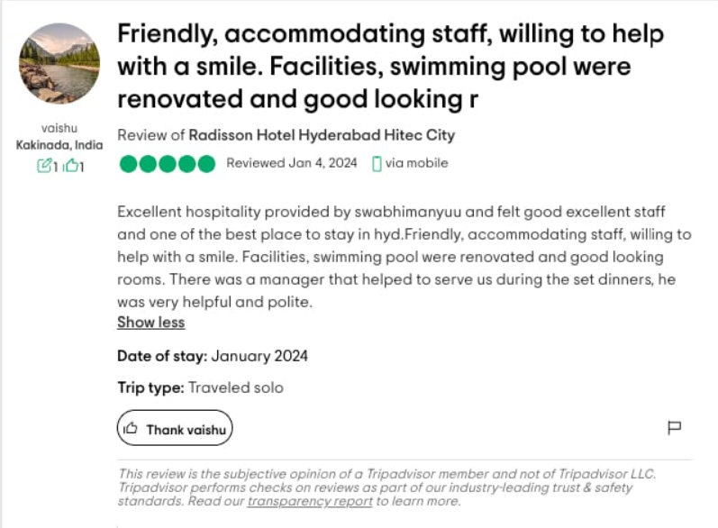
2. Objectives
• Extract aspects (e.g., service, room, food) from hotel reviews.
• Classify sentiment polarity (Positive, Negative, Neutral) for each aspect.
• Evaluate model performance using accuracy, precision, recall, and F1-score.
• Improve interpretability of customer feedback for hotel management.

Slide 5
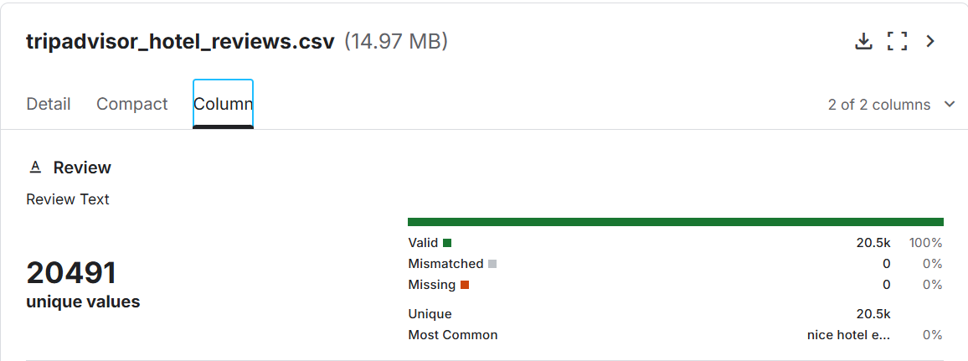
3. Dataset and its Features
Dataset Source: Kaggle
Total Reviews: 20,000+
Features:
1. Review Text
2. Aspect Label
3. Sentiment Label
Preprocessing Steps:
• Text cleaning
• Tokenization
• Stopword removal
• Lemmatization

Slide 6
4. Methodology and Approach
1. Data Preprocessing: Cleaning and preparing text data.
2. Aspect Extraction: Using rule-based or attention-based models to identify aspects.
3. Sentiment Classification: Applying Transformer based classification models such as SVM.
4. Evaluation: Metrics such as Accuracy, Precision, Recall, and F1-Score.

Slide 7
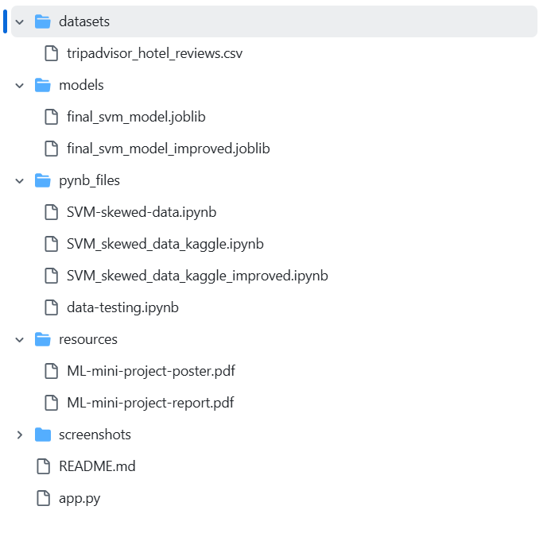
5. Project Directory Structure

Slide 8
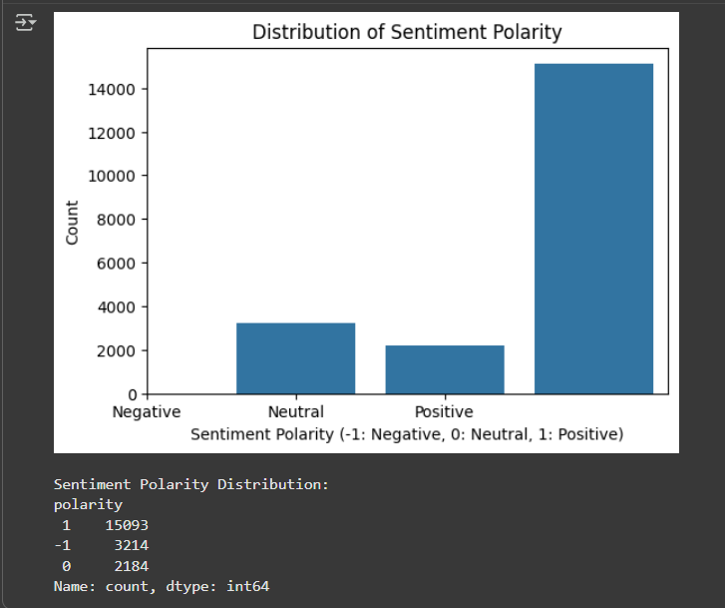
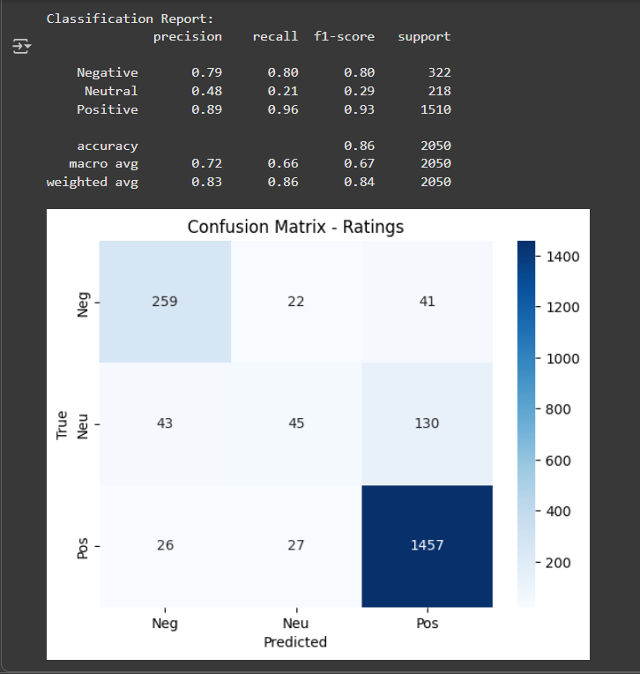
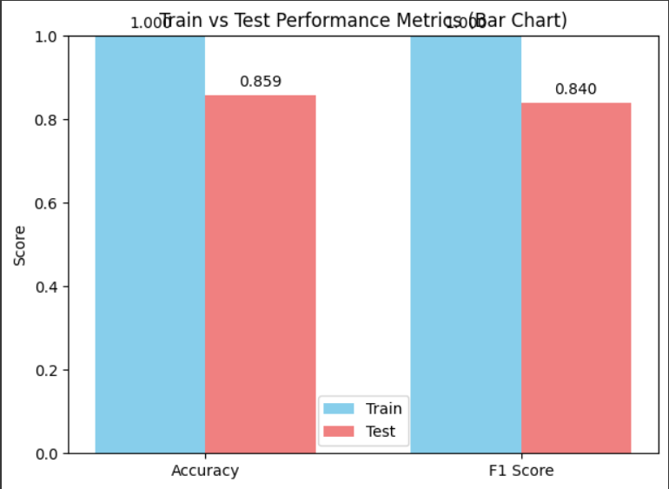
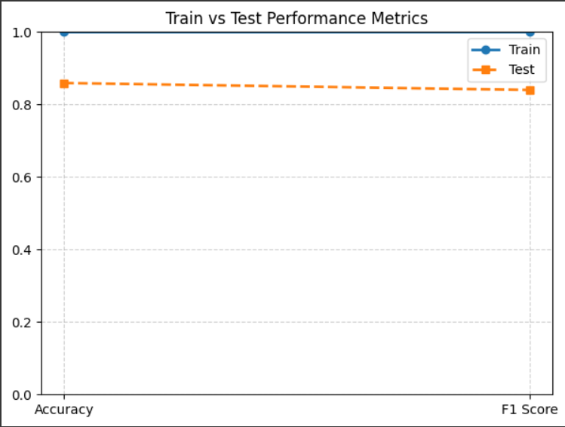
6. Results and Analysis
Training Accuracy: 100%
Testing Accuracy: 85.90%
F1-Score: 83.99%
Key Observations:
• Transformer-based models outperform traditional ML models.
• Certain aspects like 'location' and 'service' show clearer sentiment polarity.
• Mixed sentiment reviews remain challenging.

Slide 9
7. Inference
• ABSA provides fine-grained insights into customer opinions.
• Helps hotel management identify areas of improvement.
• Demonstrates the capability of transformer-based NLP models for sentiment analysis.

Slide 10
8. Future Scope
• Integrate real-time review analysis system.
• Expand dataset to include multilingual reviews.
• Implement visualization dashboard for aspect-wise sentiment trends.
• Fine-tune advanced models such as RoBERTa and DeBERTa.

Slide 11
Thank You

