Slide 1
Social Media Analysis for CK and TH

Slide 2
Social Media Account User Base
Brand | Facebook | Twitter | Instagram | YouTube | Customer Review section
Calvin Klein | 13.38M | 3.6M | 21M | 257K | Yes
Tommy Hilfiger | 13.38M | 1.5M | 13.6M | 82.5K
Notes
Both brands have a very active social media listening teams. They are prompt to reply to most of the customer queries either on Facebook or Twitter
Most of the UGC generated for both brands is in non English. While Tommy Hilfiger team replies in English to such comments, CK has localized responses
Facebook categorizes CK as “very responsive” to messages posted
CK being an innerwear brand as well, their social media handles is filled up with pictures of models/ real people wearing just their innerwear

Slide 3
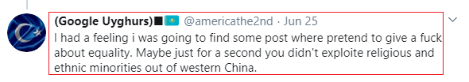

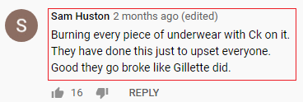
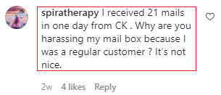


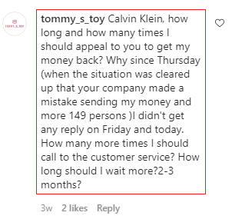
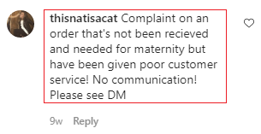


Examples of negative UGC - CK

Slide 4
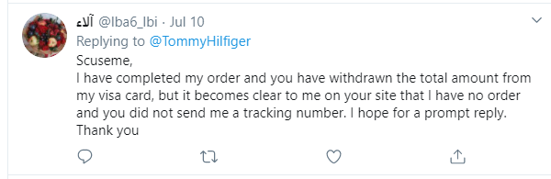
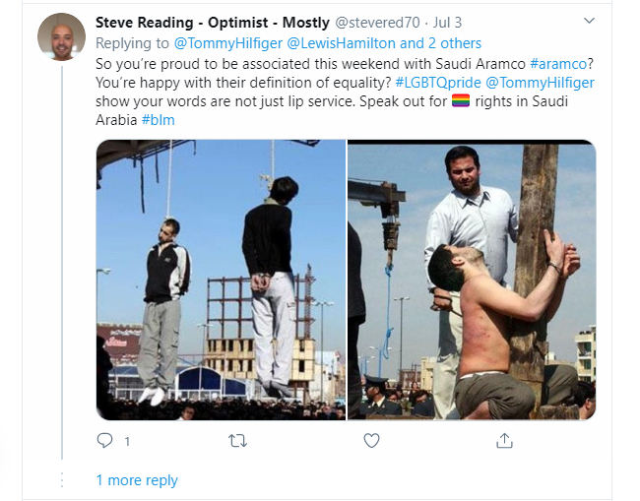
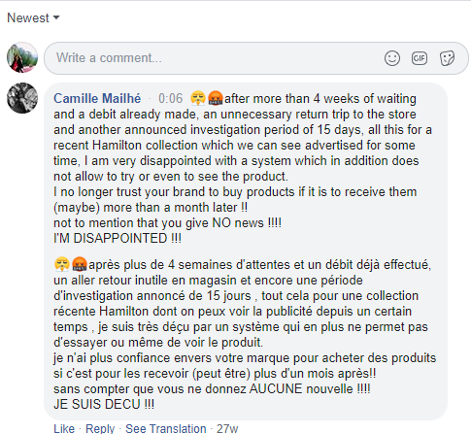
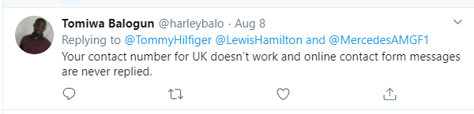
Examples of negative UGC - TH

Slide 5
Thank You

